Slide 1
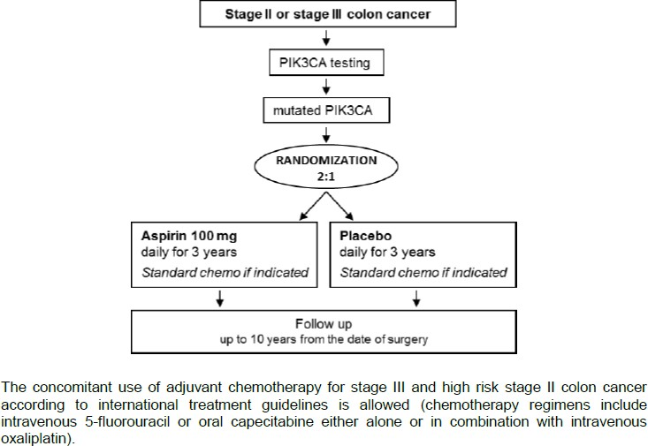
SAKK 41/13-Aspirin
Adjuvant aspirin treatment in PIK3CA mutated colon cancer patients. A randomized, double-blinded, placebo-controlled, phase III trial.
Inclusion criteria
To be eligible to enter this trial, patients must fulfill the following criteria.
Written informed consent according to ICH/GCP regulations before inclusion and prior to any trial-related investigations.
Histologically confirmed diagnosis of adenocarcinoma of the colon.
Stage II (pT3/T4 N0 cM0) or stage III (pTx pN+ cM0) colon cancer.
Availability of cancer tissue for central molecular testing.
Presence of predefined, activating PIK3CA mutation in exons 9 or 20
(centrally assessed, see section 17).
Complete resection of the primary tumor (R0) within 10 weeks maximum before registration.
WHO performance status 0-2 (see Appendix 3).
Age between 18–80 years.
Adequate hematological values:
Ergänzende Informationen sind unter ClinicalTrials.gov verfügbar
Beginn 08/2017
Ansprechpartner UKE: PI Marianne Sinn | 040 – 7410 70434 | ma.sinn@uke.de
SI Dr. Christian Frenzel | 040 – 7410 50880 | c.frenzel@uke.de
SK Inga Bitdinger | 040 – 7410 54354 | i.bitdinger@uke.de
Ansprechpartner SOH: SK Dorothea Zäch 040 – 35071 777 - 526 zaech@onkologie-hamburg.de

