Slide 1
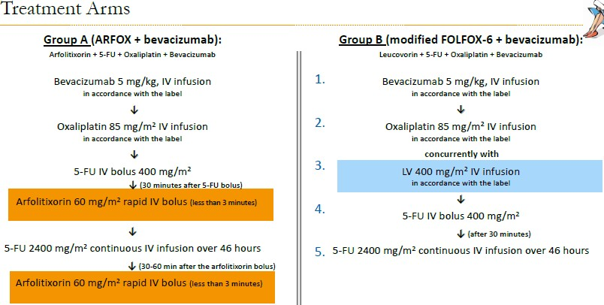
ISO-CC-007
A randomized, multicenter, parallel-group, Phase III study to compare the efficacy of arfolitixorin versus leucovorin in combination with 5-fluorouracil, oxaliplatin, and bevacizumab in patients with advanced colorectal cancer
Protocol Number: IS0-CC-007
Inclusion criteria (extract):
Colorectal adenocarcinoma verified by biopsy.
Availability of biopsy material, from the primary tumor or metastasis, allowing for analysis of tumor gene expression.
Non-resectable metastatic CRC planned for first line therapy with 5- FU, Leucovorin, oxaliplatin, and bevacizumab.
Evaluable disease with at least one measurable lesion of metastatic disease (≥10 mm in longest diameter on axial image on CT-scan or alternatively MRI with <5 mm reconstruction
Exclusion Criteria (extract):
Malignant tumors other than colorectal adenocarcinomas (current or within the previous five years), with the exception for curatively treated non-melanoma skin cancer or in situ carcinoma of the cervix.
Less than 6 months between randomization and completion of the last anti-cancer treatment (chemotherapy/radiotherapy/immunotherapy/surgery, etc.). (NB: Rectal cancer treatment shorter than 8 weeks of chemo/radiation therapy is allowed.)
Confirmation of progressive disease within 6 months after completion of prior anti-cancer treatment.
Indication for any metastatic Colo-rectal Cancer (mCRC) surgery or
anti-cancer treatment other than study treatment.
Ergänzende Informationen sind unter ClinicalTrials.gov verfügbar
Ansprechpartner:
PI | Marianne Sinn | 040 – 7410 70434 | ma.sinn@uke.de
SI | Christian Frenzel | 040 – 7410 50880 | c.frenzel@uke.de
SK | Inga Bitdinger | 040 – 7410 54354 | i.bitdinger@uke.de

