Slide 1

V-Disk
Automated Extracellular Vesicle Isolation
Dr. Jan Lüddecke
03.11.2025
ELBS general assembly
Madrid

Slide 2
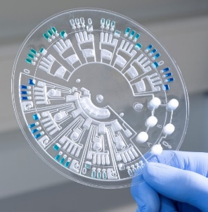
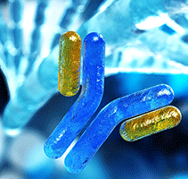
Hahn-Schickard – R&D in microsystems engineering
Microfluidic Platforms
Laboratory Automation
Bioanalytics
Notes:
https://www.youtube.com/watch?v=rYVTH61jNW8

Slide 3
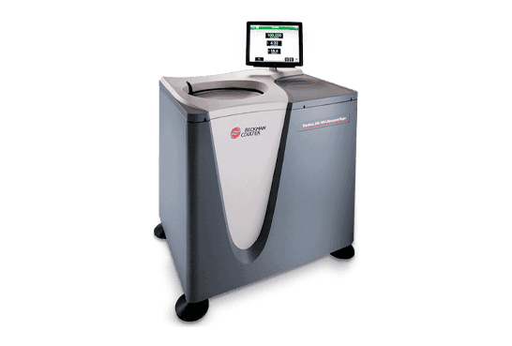
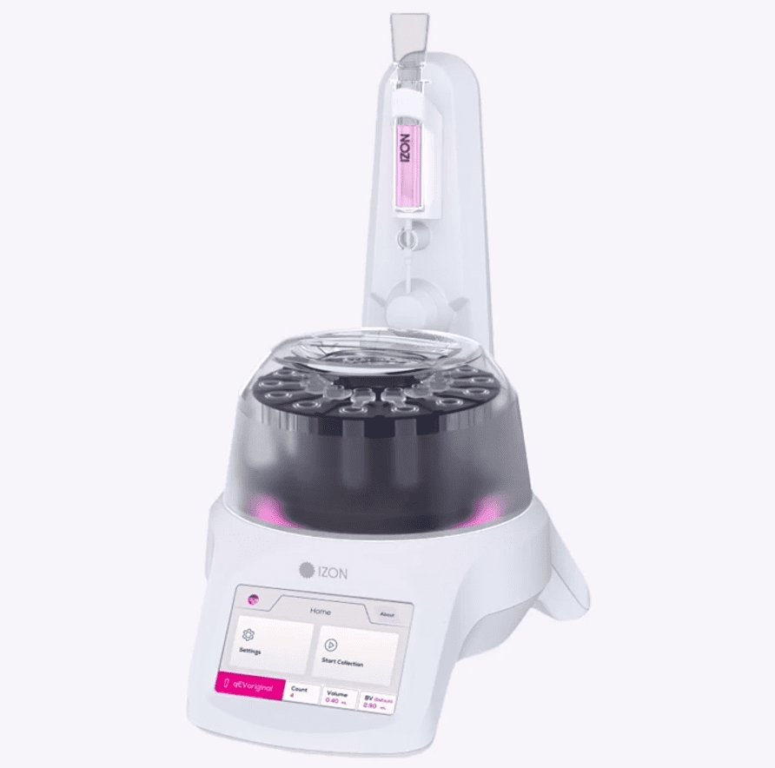
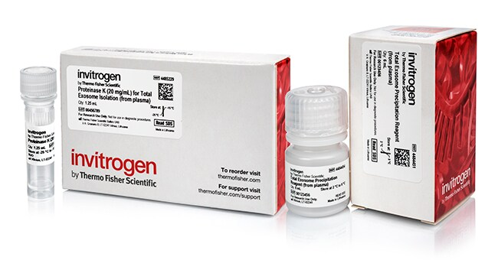
State of the art EV purification
Ultracentrifugation
SEC
Precipitation
EV purification needs to be standardized and automated for clinical application
Whole blood → purified EVs
+SEC
+UF
+TFF +UF
+DGUC
+UF
Time consuming, many manual steps, lots of different protocols
Single methods usually not sufficient

Slide 4
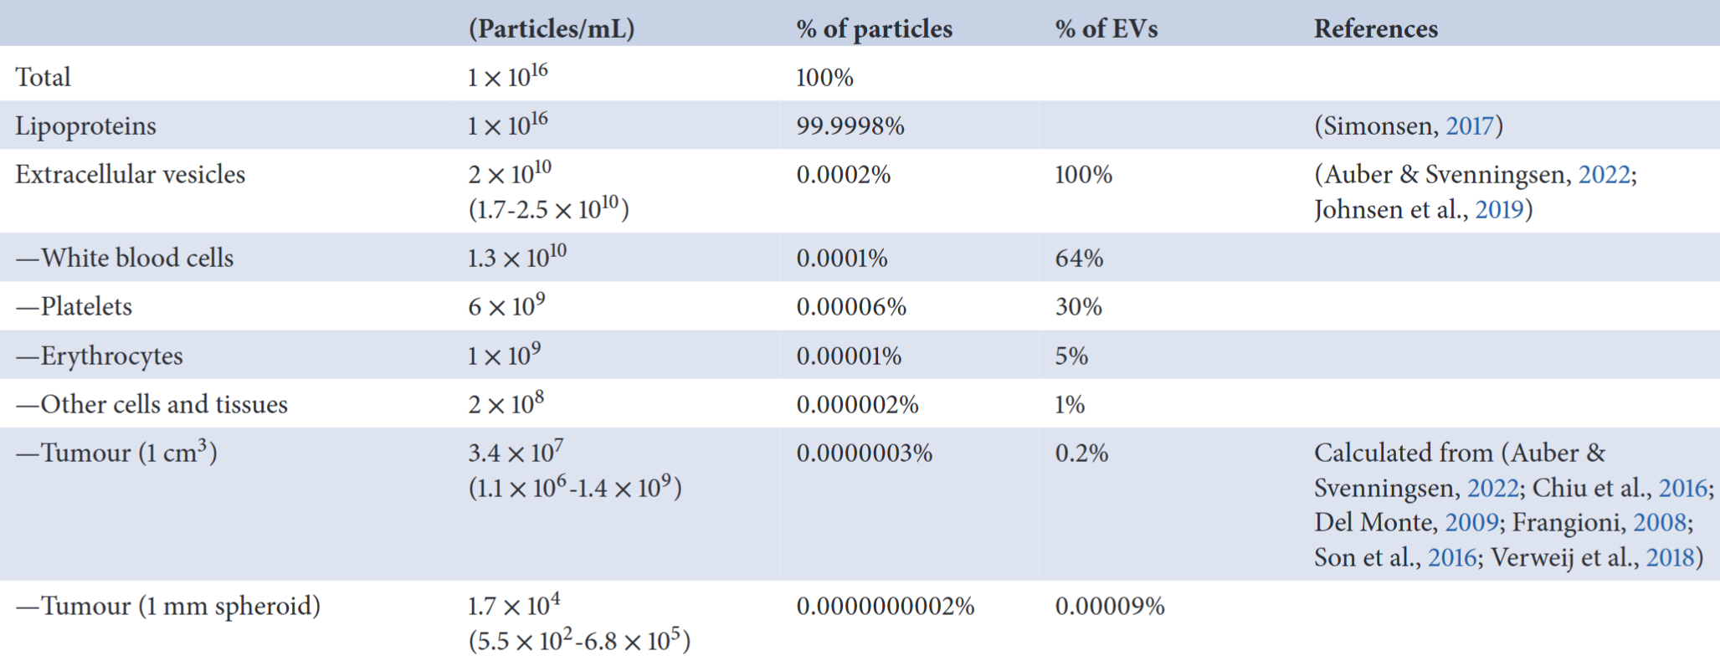
EVs – Needle in a haystack
Zarovni et al., J. Extracell. Vesicles, 2025
Notes:
According to the literature, on average, there are about 10¹⁶ particles in 1 mL of plasma.

Slide 5
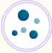
Label free EV purification
Size based purification
VLDL
LDL
Charge based purification
Positive
Diameter (nm)
Surface charge
0
10
20
40
60
80
500
Negative
HDL
Protein
EV
Adapted from Van Deun et al., 2020
Notes:
On the other hand, most label-free EV isolation techniques rely on either charge or size. However, as you can see, the mentioned contaminants overlap with EVs in at least one of these properties, that is why it’s often necessary to combine both to achieve a high-purity isolation. For example, if a method separates particles first by charge and then by size, the final isolate will be more or less free of contaminants.
40 seconds

Slide 6
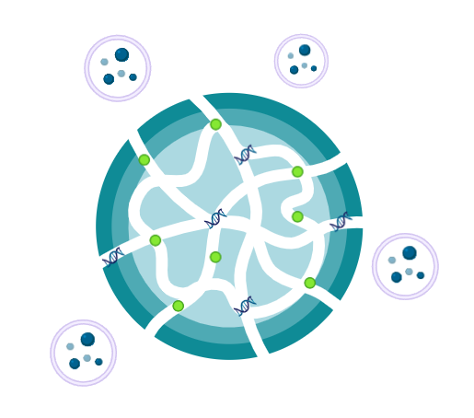
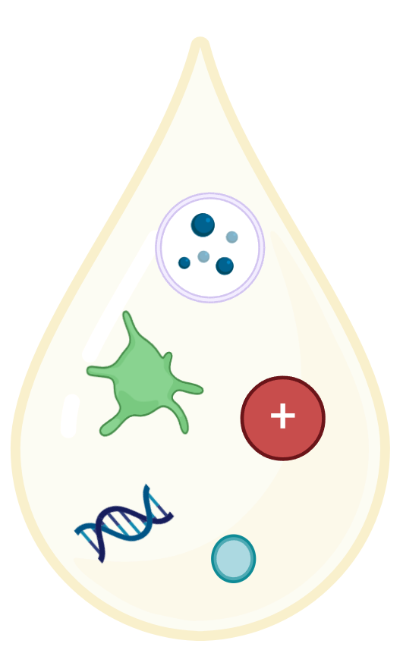
Multi-modal EV isolation protocol
Charge
Size
C+S
Cation-exchange Chromatography
(CEX)
1 µm filtration
20 nm filtration
Mixed-mode Chromatography
Platelets
EV
-
-
-
+
-
-
-
EV
EV
Proteins
CEX
HDL
-
-
VLDL
+
-
MMC resin
-
Proteins
-
-
-
-
CEX
+
LDL
-
+
-
-
+
  Removal of (+) charged particles
  Enhances filtration
  Removal of particles >1 µm, <20 nm
  EV concentration
  Removal of remaining small particles

Slide 7
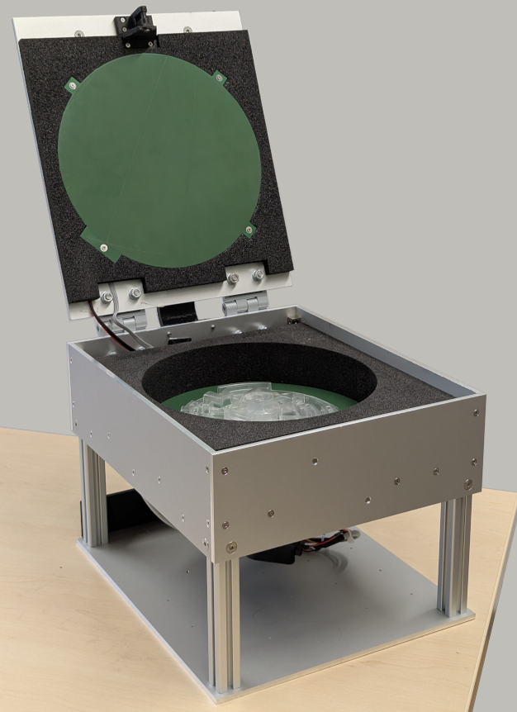
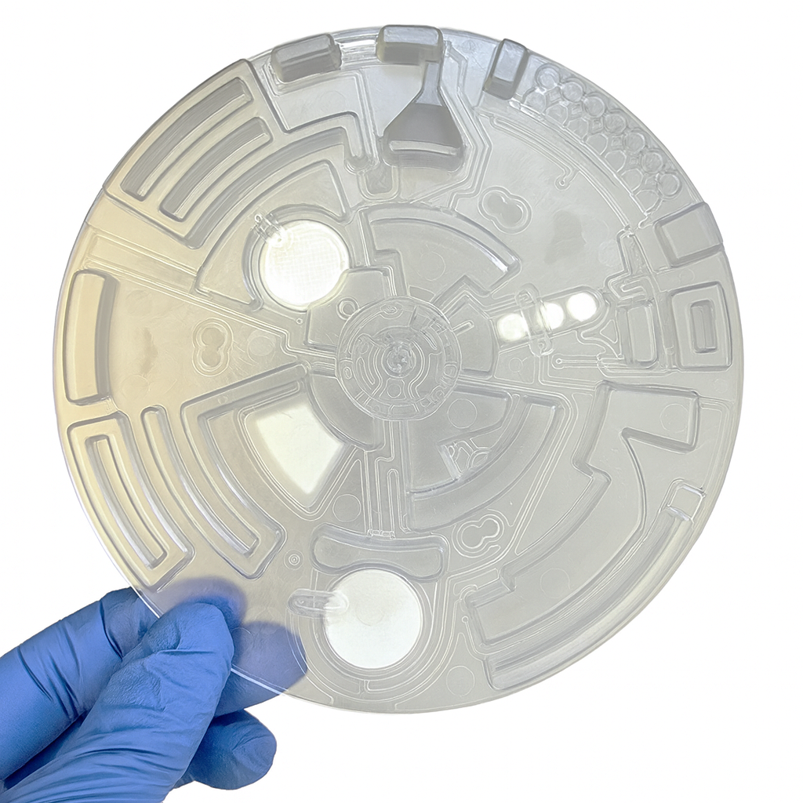
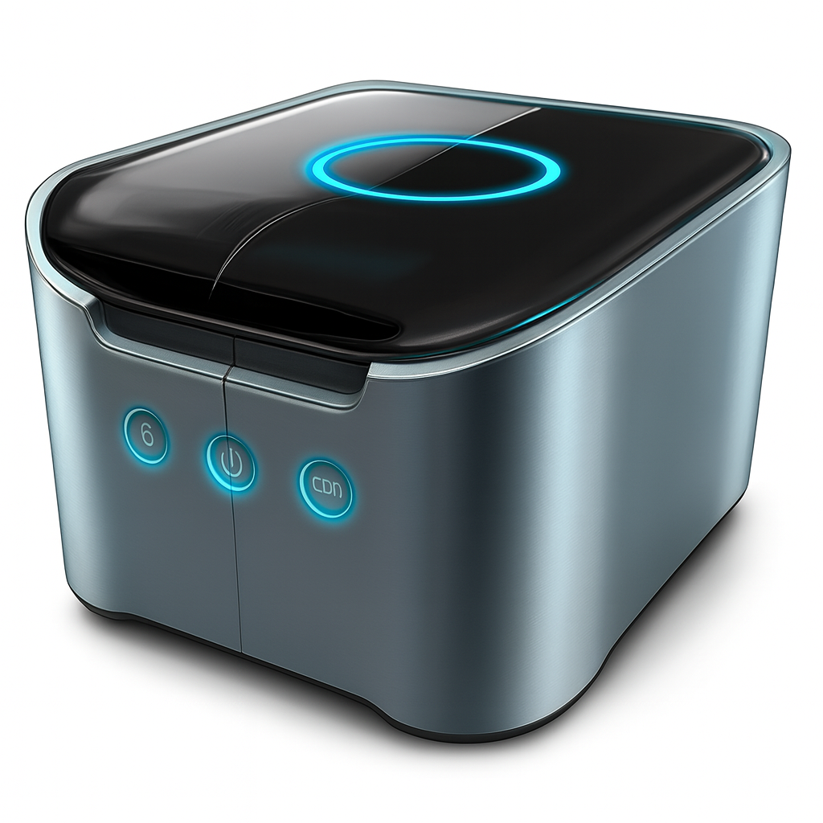
V-Disk + Disk-Player
Centrifugal microfluidics allows automation of complex biochemical assays
+

Slide 8
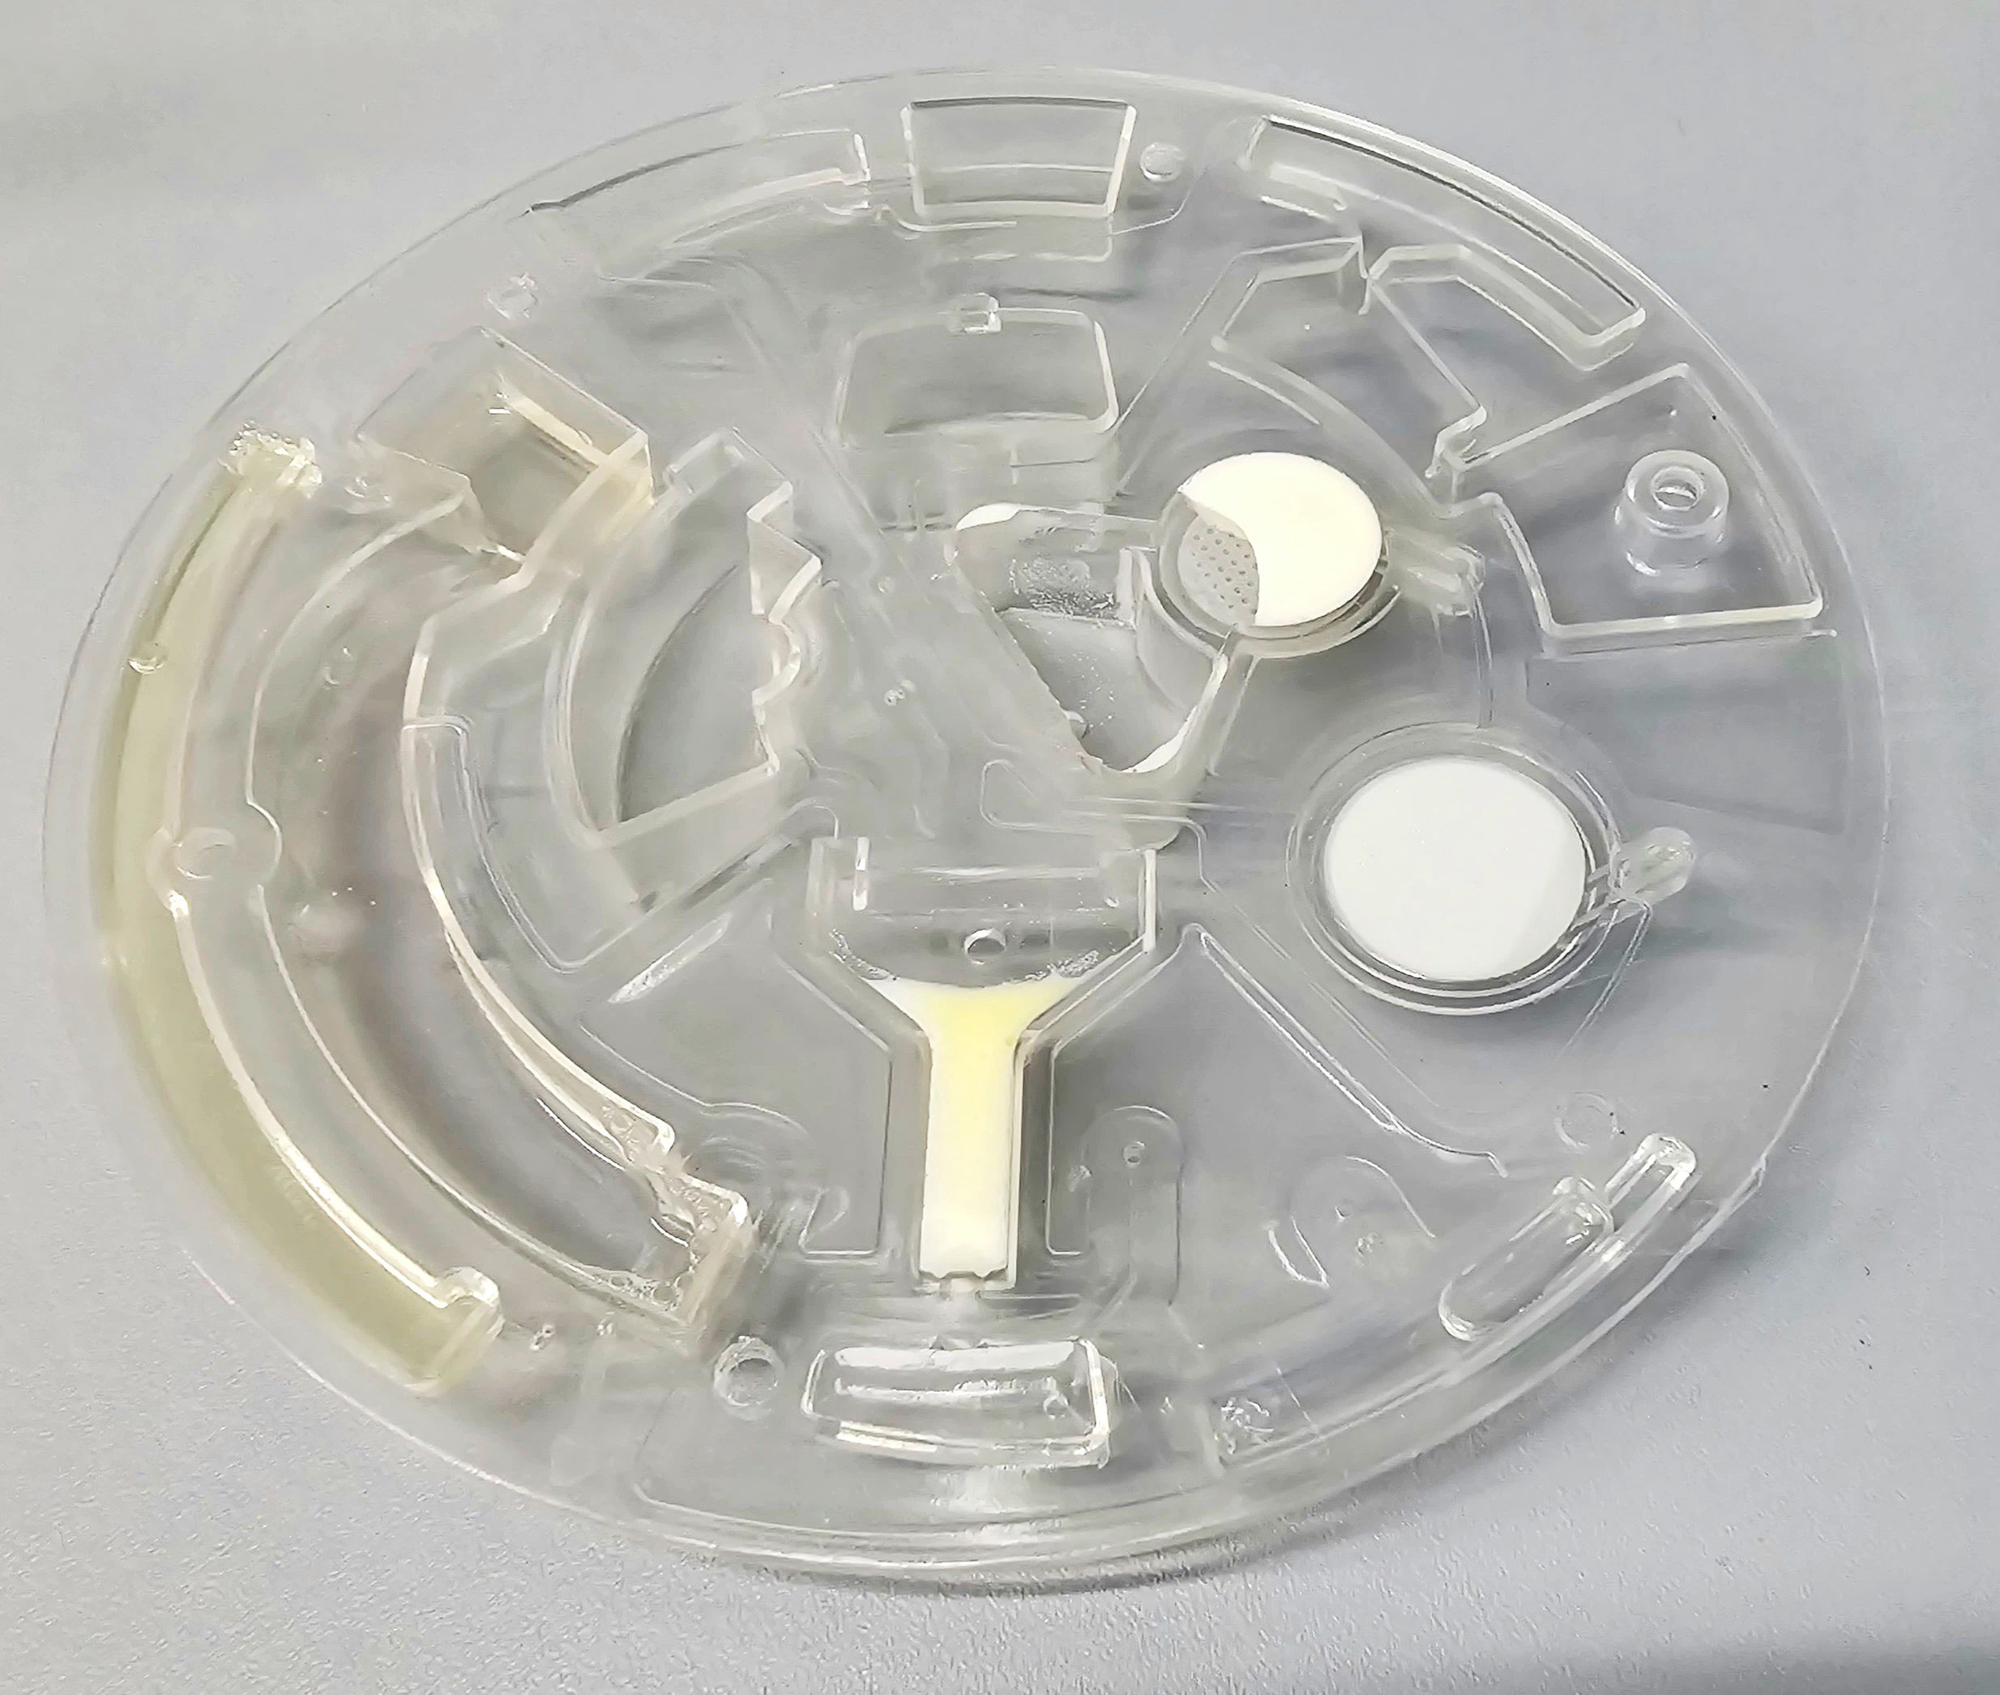
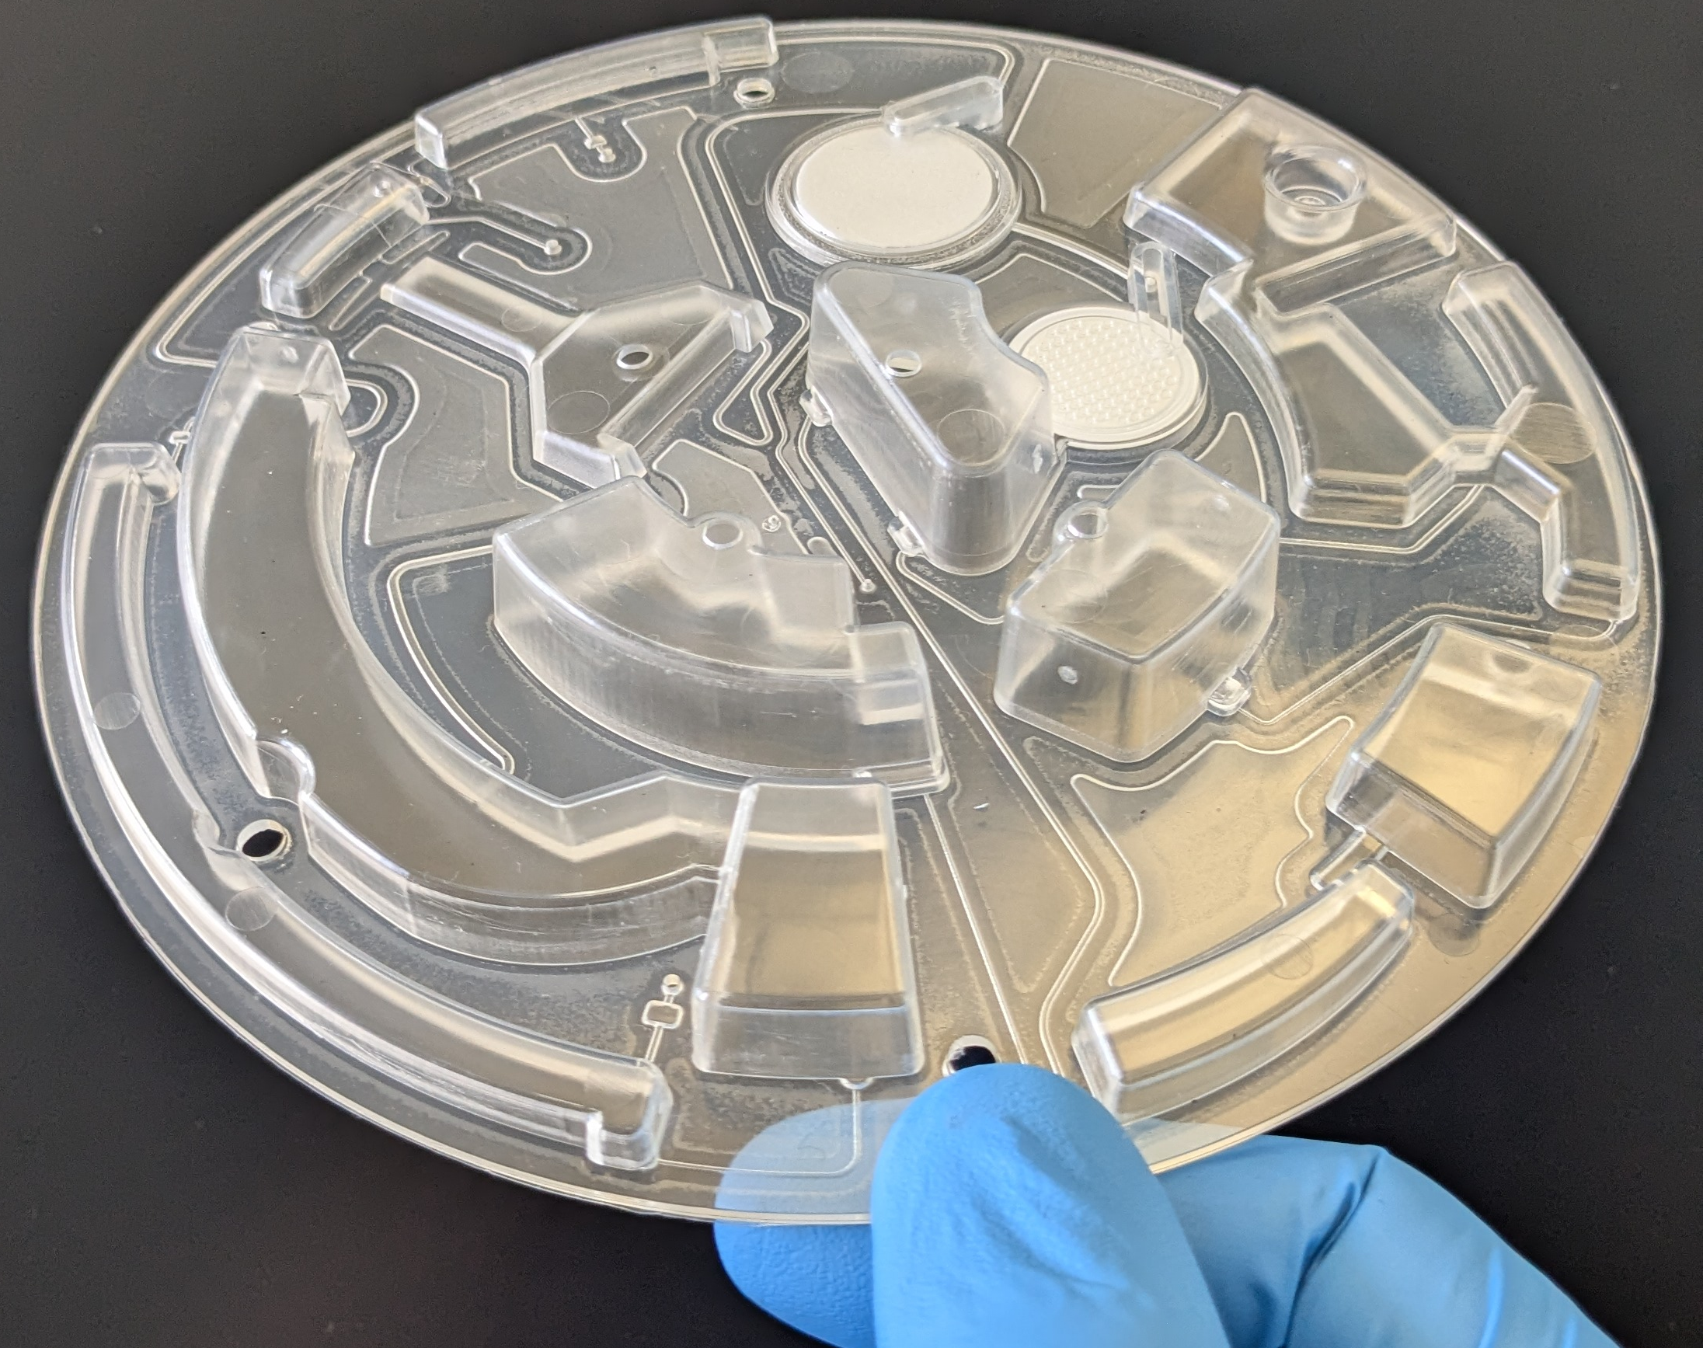
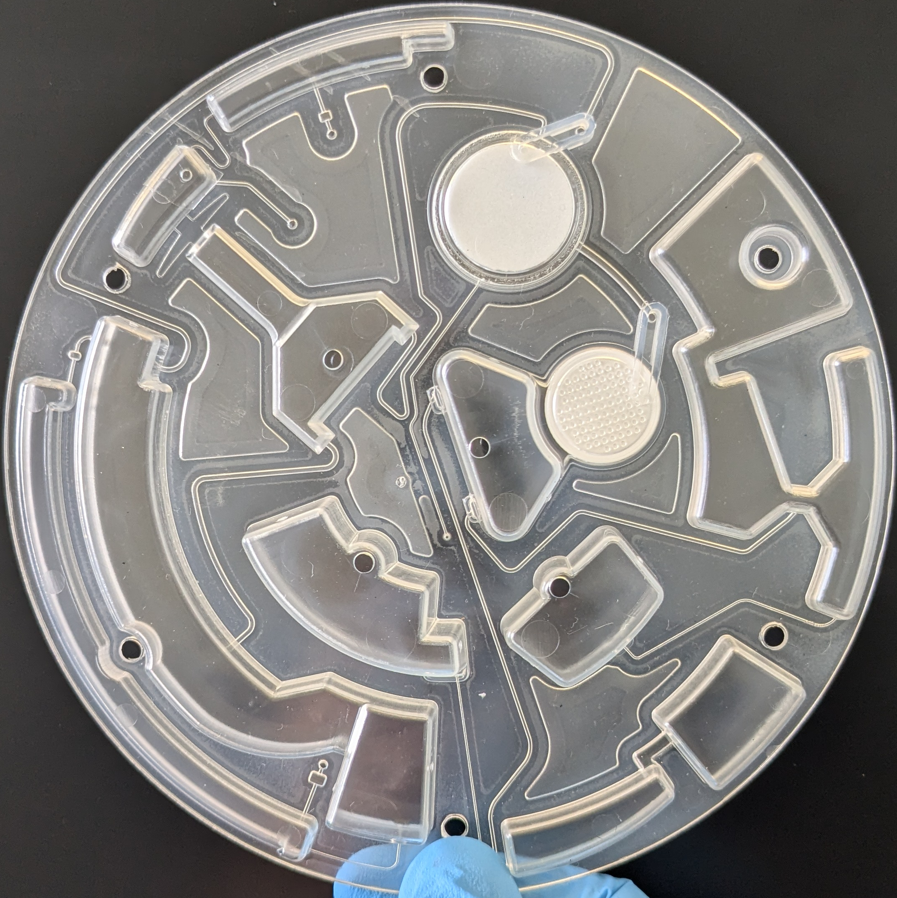
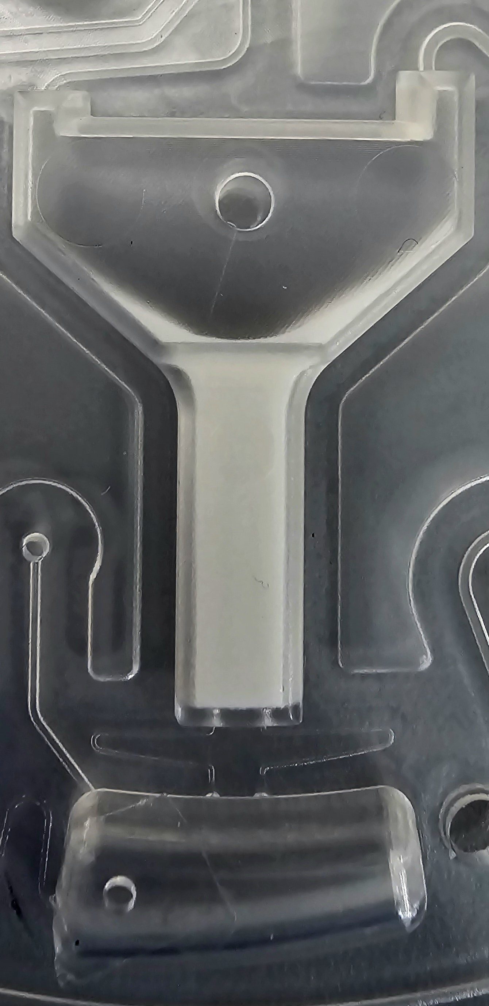
V-Disk
  Disposable cartridge
  0.1 – 1 ml Plasma → 700 µl purified EVs
  Thermal integration of filter membranes
  Dried storage chromatography resins
Filter-2 20 nm
Filter-1 1 µm
Dry resin
Reconstituted column
Notes:
Add scale

Slide 9
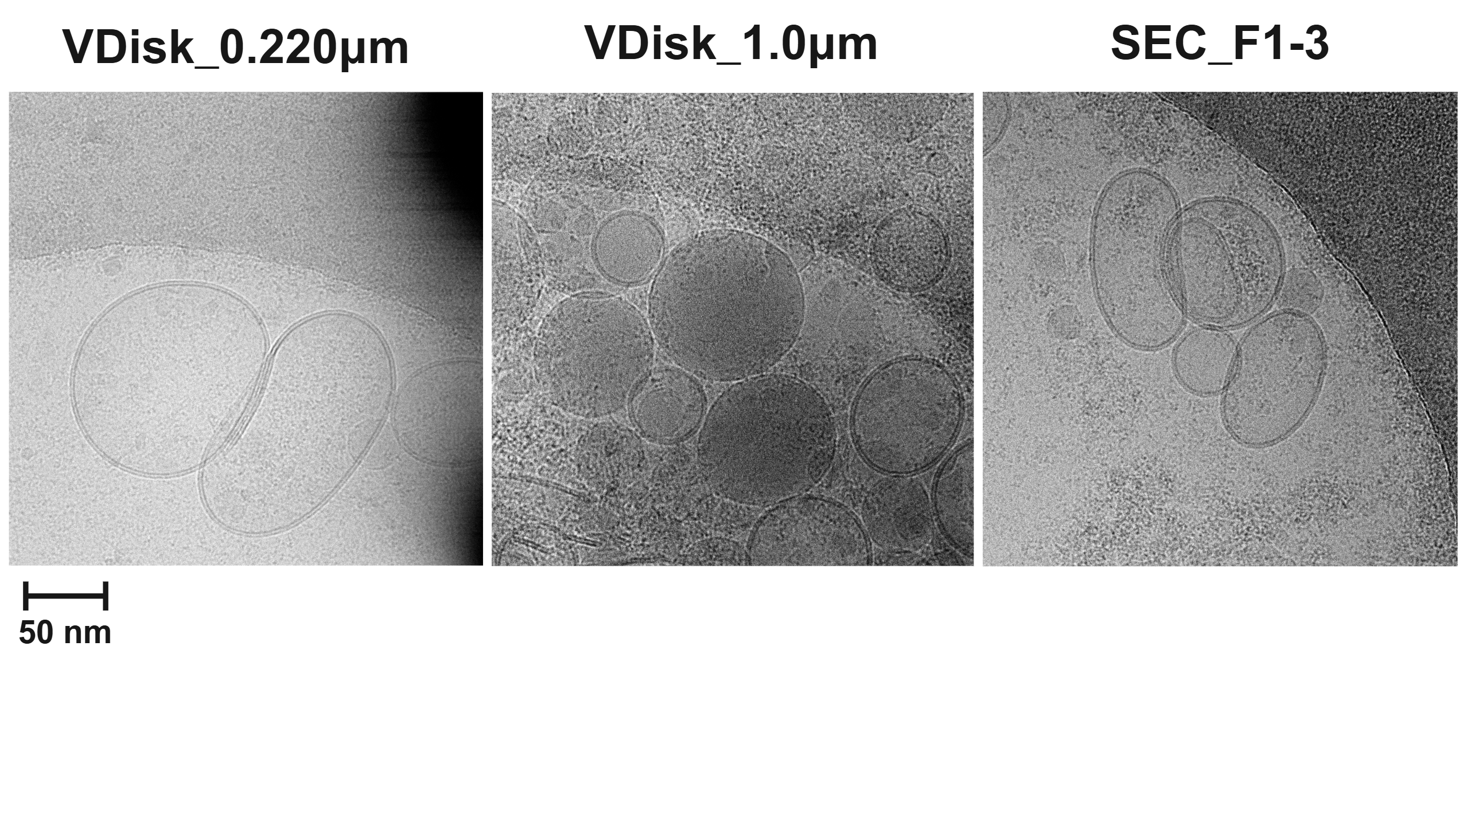
V-Disk – EV Morphology
  Cryo-EM analysis
  EVs are intact
V-Disk
SEC

Slide 10
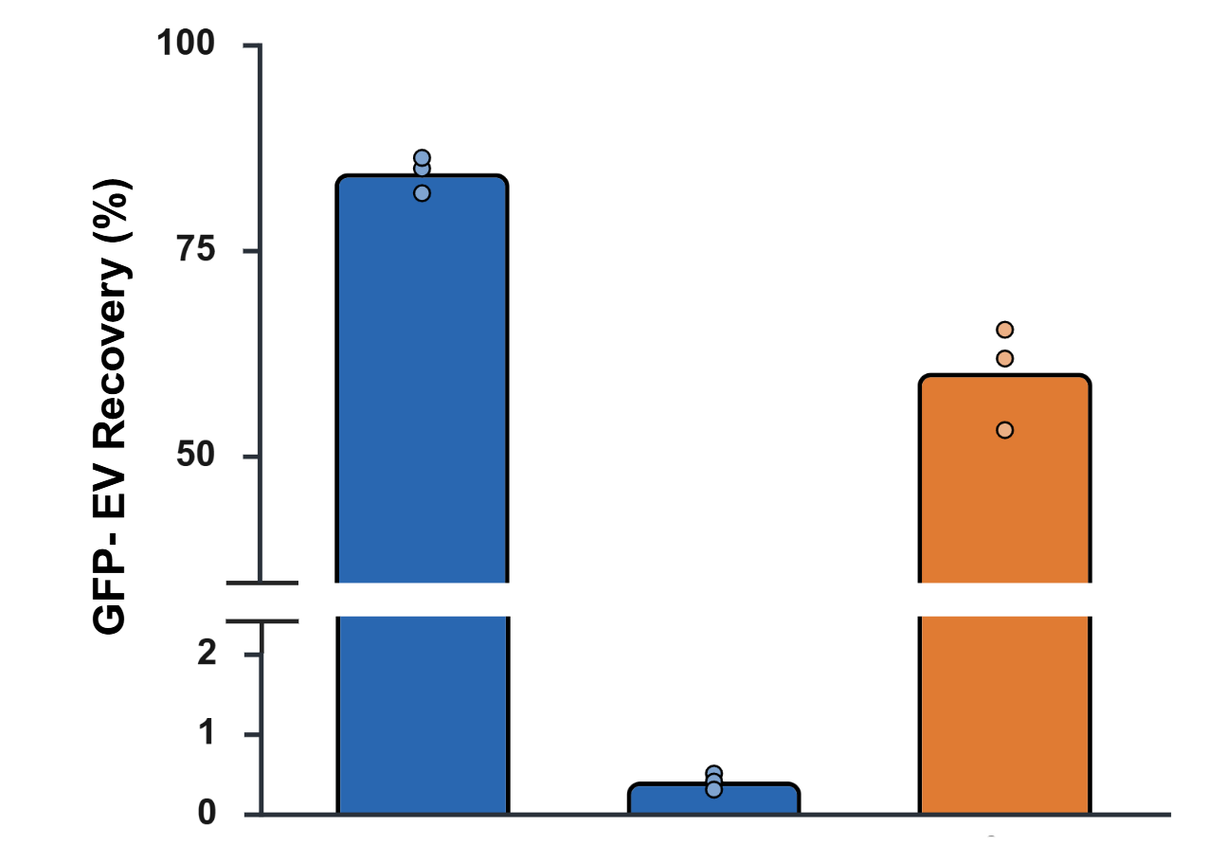
V-Disk vs SEC - Recovery
  GFP-EVs spiked into plasma
  80 % recovery
Isolate
Waste
SEC
V-Disk

Slide 11
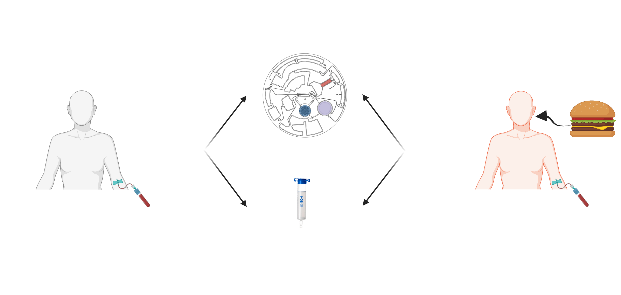
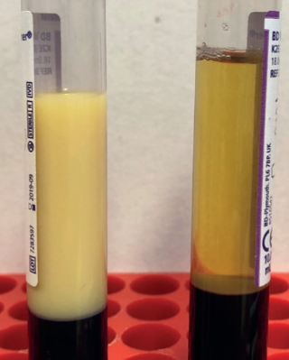
Reproducibility and Robustness
Non-lipemic
Lipemic
Reproducibility assessment
VDisk
Robustness assessment
Fasting
Postprandial
SEC
Healthy donor (n=3)
Healthy donor (n=3)
Created with BioRender.com
Notes:
To further investigate the reproducibility of the VDisk, we tested it using three different biological replicates from healthy donors. Additionally, to evaluate the robustness of our platform and its ability to handle lipemic samples, we collected blood from the same donors on the same day, a few hours after they had consumed fatty food.

Slide 12
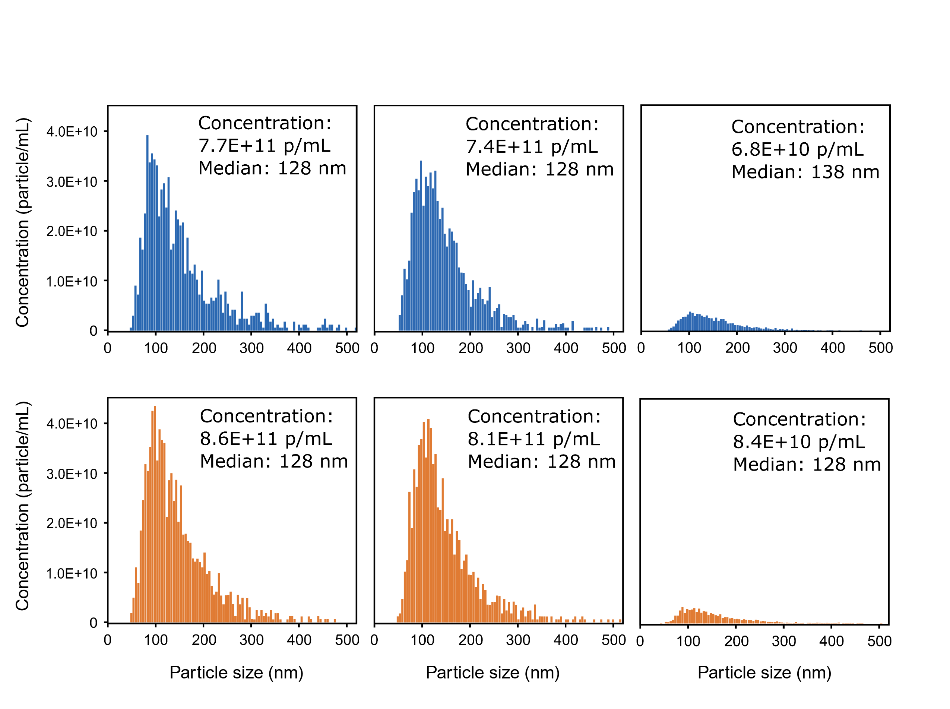
EV size distribution – NTA
  Particles in expected size range
  Size distribution unaffected by lipemic sample
V-Disk
SEC
Fasting
Postprandial
Notes:
Also the particle size distribution remained unchanged in VDisk isolates between fasting and postprandial plasma

Slide 13
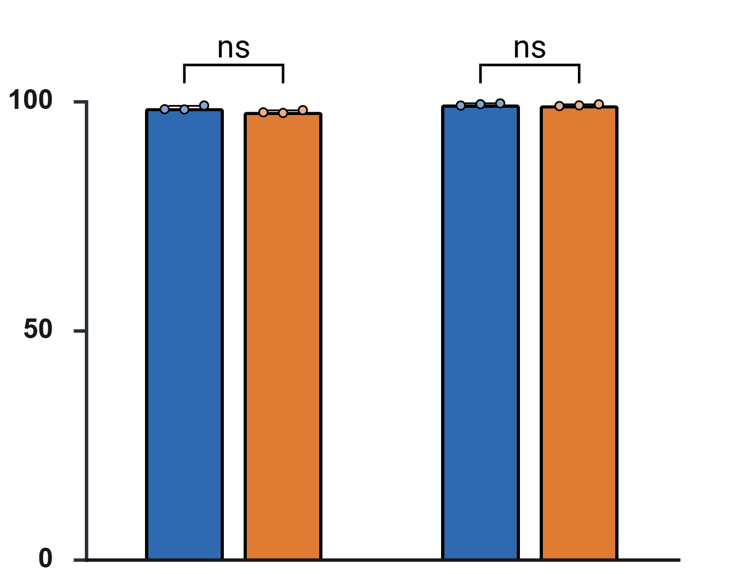
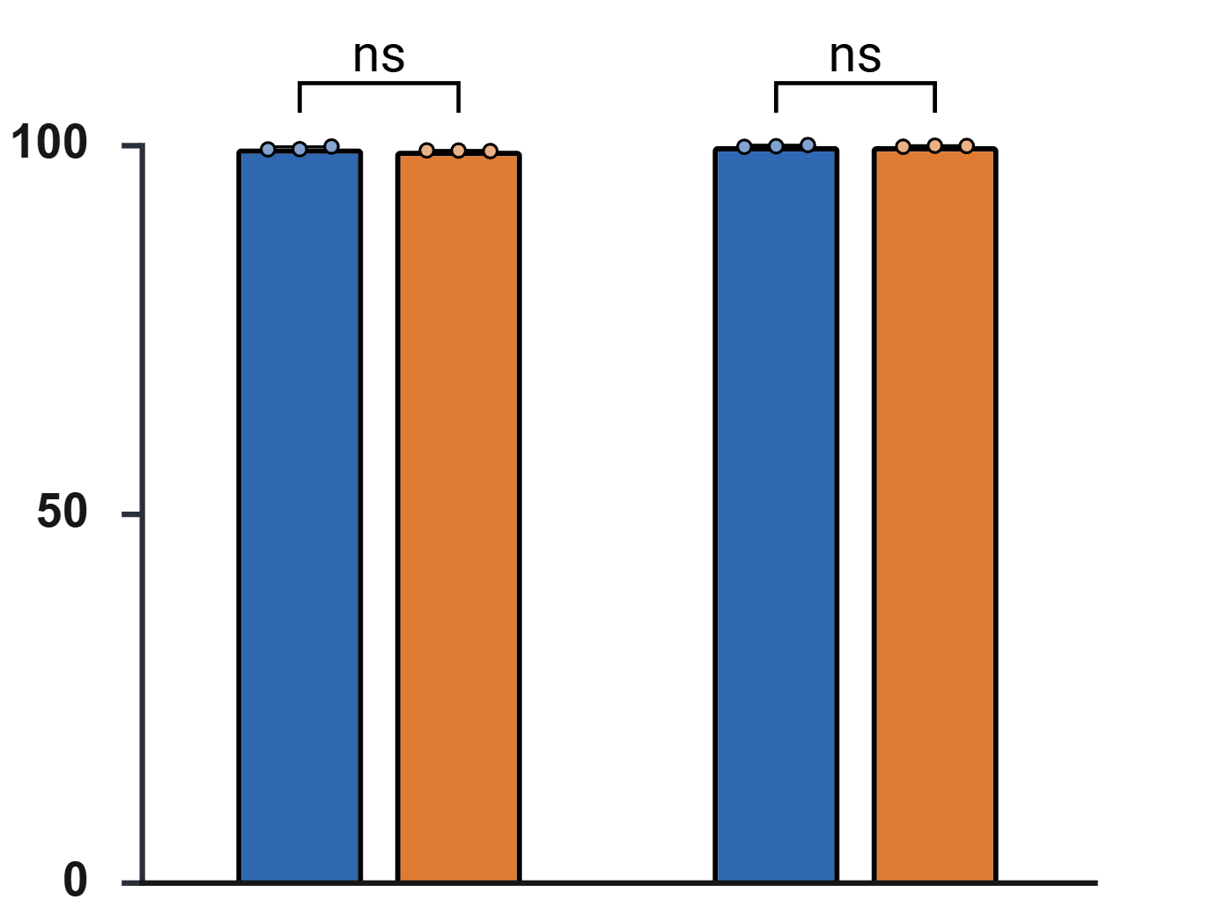
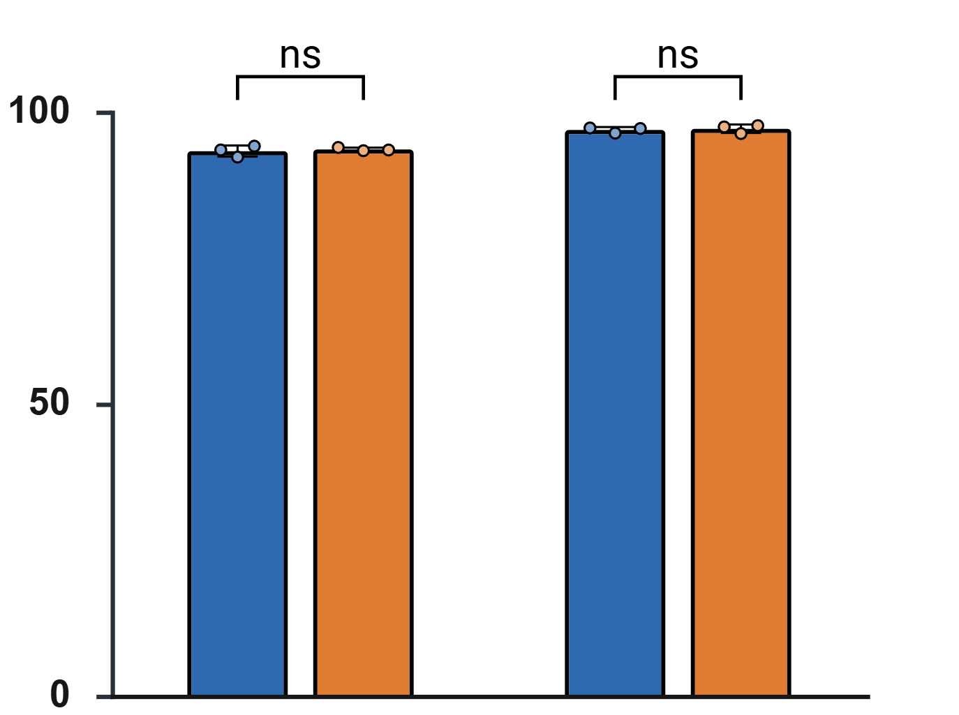
Contaminant removal
High-density lipoprotein (HDL)
Low- and very-low-density lipoprotein (V/LDL)
Total protein
Protein removal %
ApoA1 removal %
ApoB100 removal %
VDisk
SEC
VDisk
SEC
VDisk
SEC
Fasting
All methods removed contaminants with similar efficiency in both fasting and postprandial plasma.
Postprandial
Notes:
However, all three methods methods removed contaminants with similar efficiency in both fasting and postprandial plasma

Slide 14
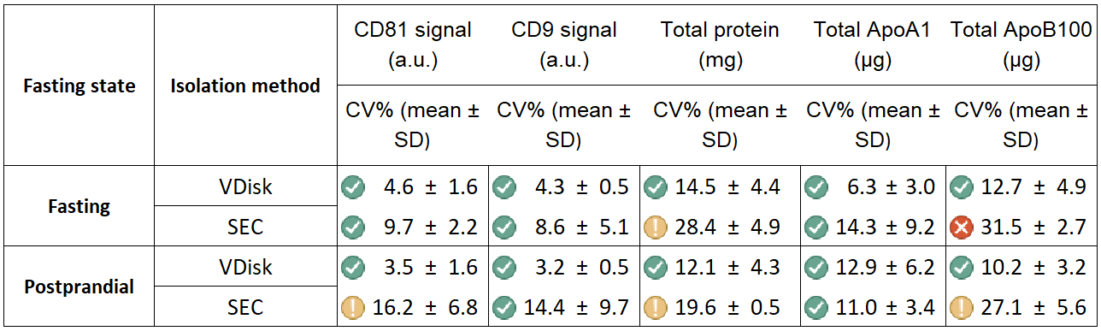



Reproducibility and Robustness
EV markers
Lipoprotein markers
CV≤15
15≤CV≤30
CV≥30
Notes:
We analyzed the EV isolates from each method using various biomarkers, including CD81, CD9, total protein, total ApoA, and total ApoB. Both VDisk configurations showed CV values below 15%, while SEC showed higher variability, reaching up to 30% in some cases.

Slide 15
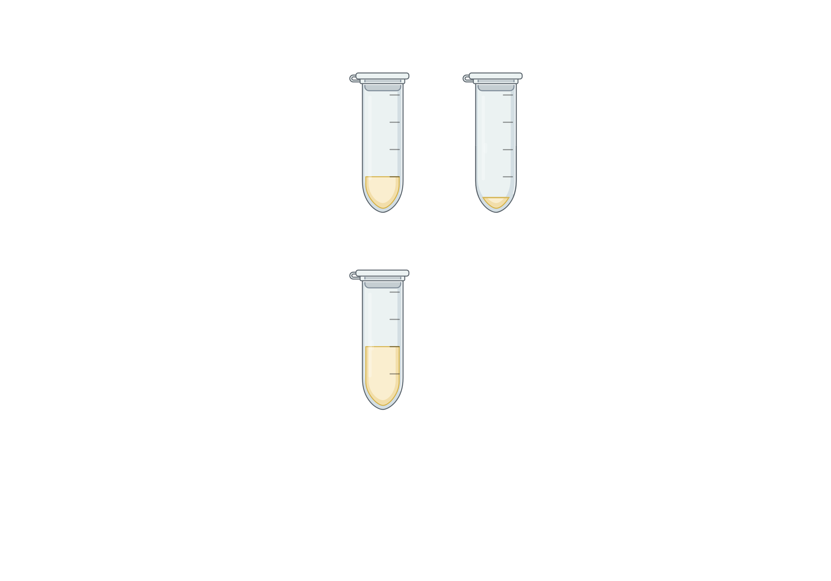
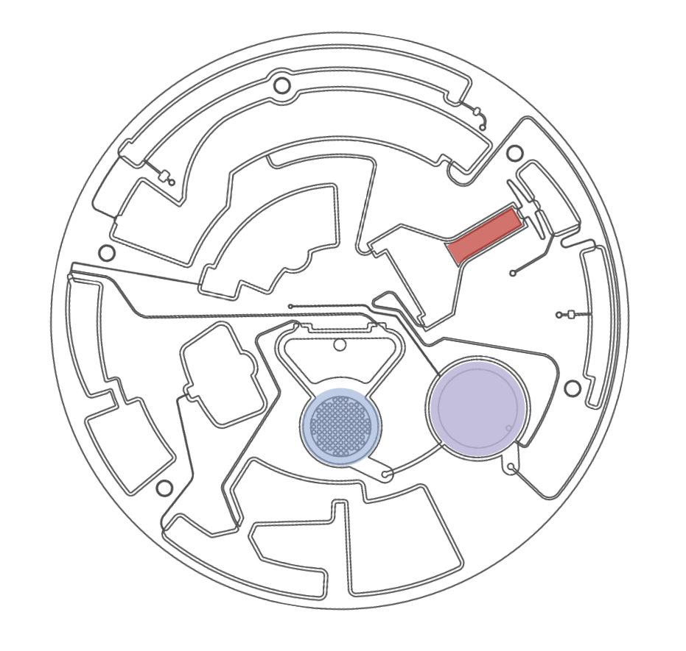
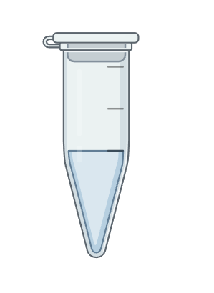
Impact of sample volume on V-Disk efficiency
Inlet plasma sample volume
VDisk
1 mL
EV isolate 700 µL
0.5 mL
0.1 mL
Notes:
Until now, we have always evaluated the VDisk using 1 mL of plasma. However, we thought that would be interesting to see how changing the initial plasma volume might affect the VDisk’s performance. Therefore, we tested three different input volumes — 1 mL, 0.5 mL, and 0.1 mL of plasma

Slide 16
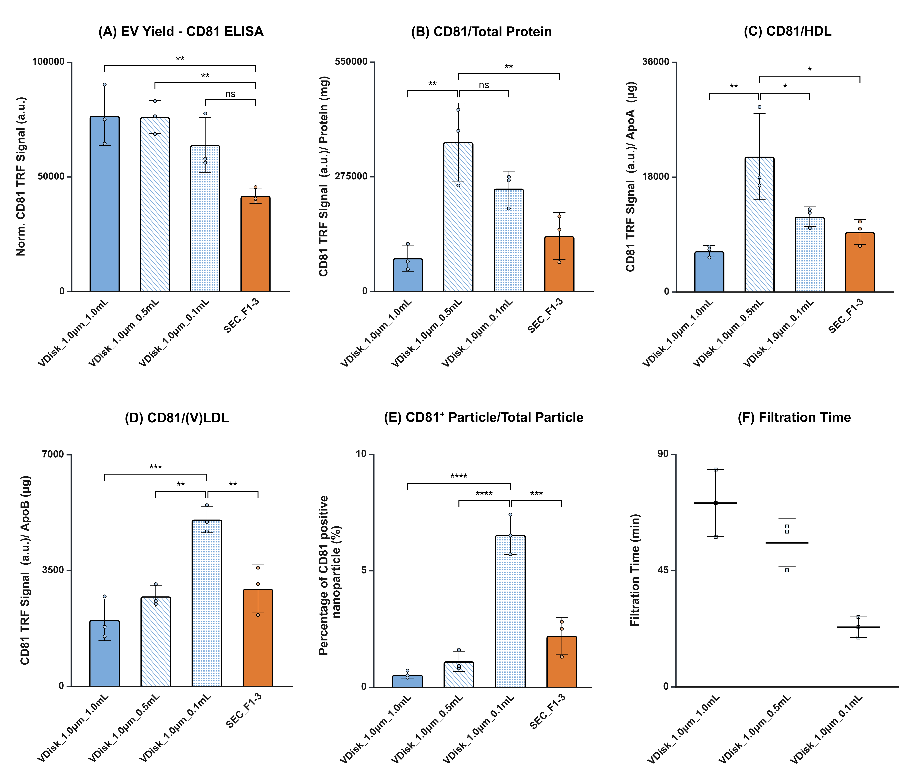
Impact of sample volume on V-Disk efficiency
Yield
(EV/ sample vol.)
Purity
(total EV/ total protein)
Purity
(total EV/ total HDL)
1.0 mL
0.5 mL
0.1 mL
SEC
1.0 mL
0.5 mL
0.1 mL
SEC
1.0 mL
0.5 mL
0.1 mL
SEC
VDisk
VDisk
VDisk
Notes:
Mention CD9 also gave us similar results
Signal to contaminant ratio
Membrane overloaded

Slide 17
Impact of sample volume on V-Disk Efficiency
Purity
(total EV/ (V/LDL)
Filtration time
1.0 mL
0.5 mL
0.1 mL
SEC
1.0 mL
0.5 mL
0.1 mL
VDisk
Notes:
Mention the result from other CD signals were similar

Slide 18
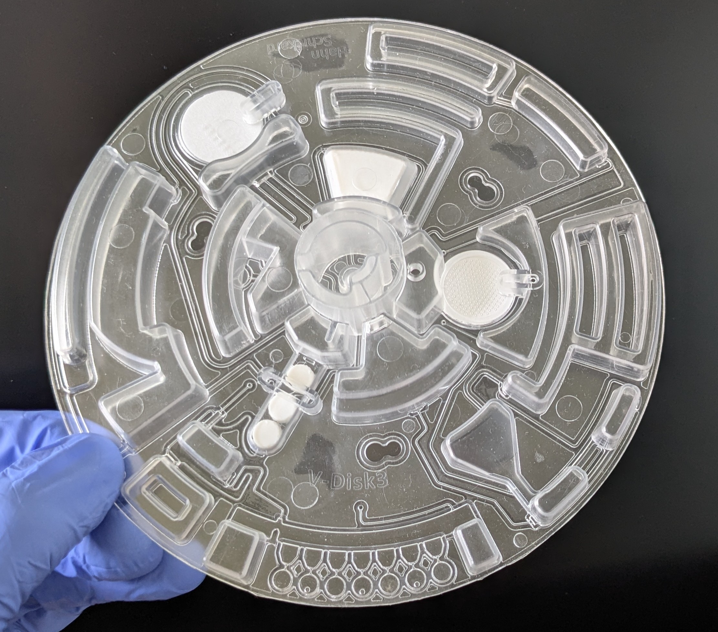
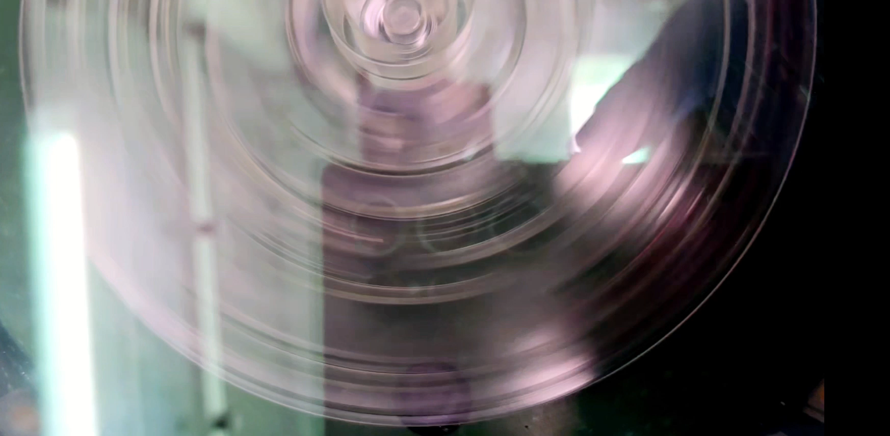
Outlook: V-Disk v3
  Sample: up to 3 ml of whole blood or 1 ml of plasma
  Plasma generation and platelet removal
  Improved workflow
  Detection module for QC or EV markers

Slide 19
Summary
  Automated EV purification from blood to concentrated EVs
  Robust, high recovery, high purity
  We are looking for:
  Feedback, user specification
  Project partners, interested in testing
  Commercialization partners

Slide 20

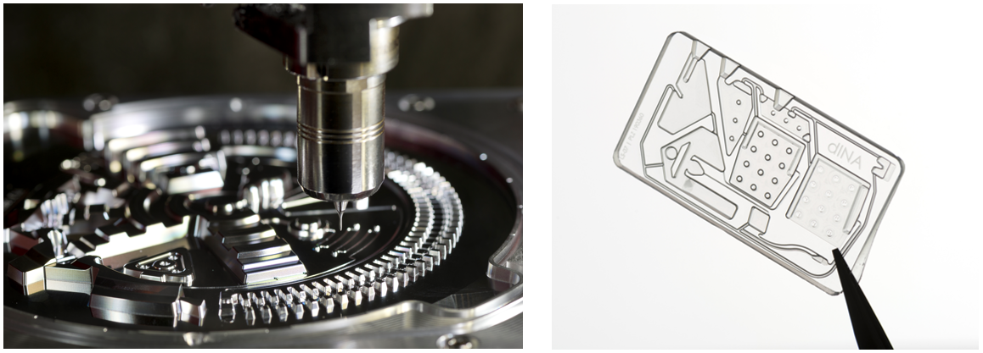

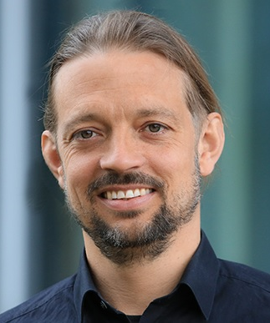





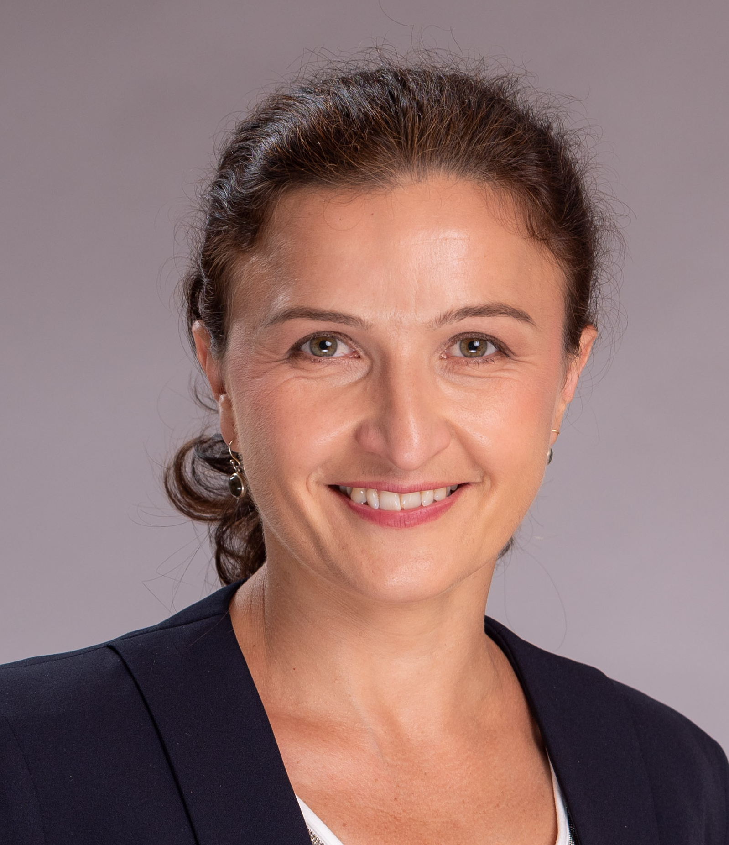

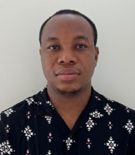


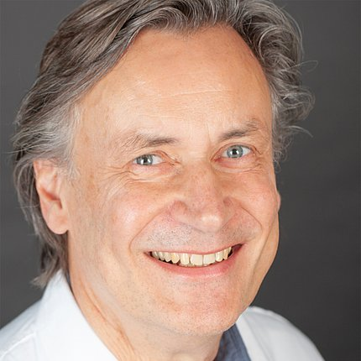

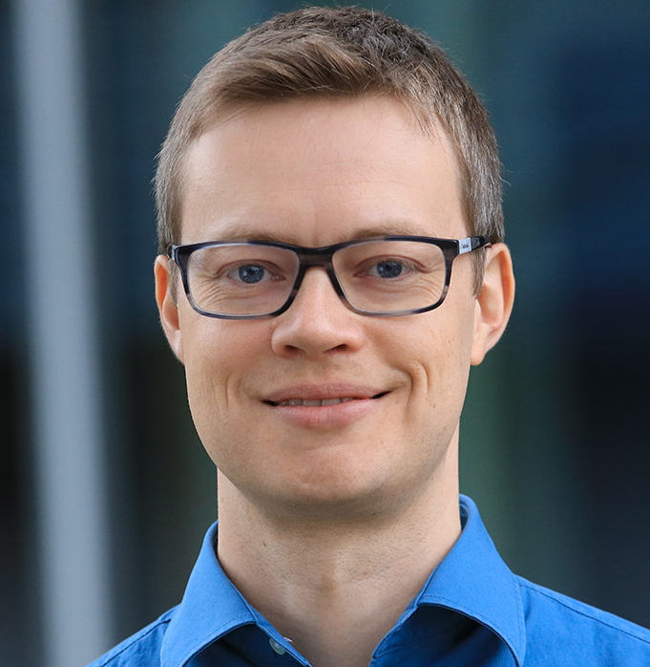

Acknowledgments
Precision milling
Hot embossing
Nils Paust
Gustav Grether
Ehsan Arjmand
Daniel Kainz
Prototyping @Hahn-Schickard
Irina Nazarenko
Gonzalo Bustos
John Atanga
Andreas Baur
Jan van Deun
Jan.Lueddecke
@Hahn-Schickard.de
Liquid Biopsy @Hahn-Schickard
Notes:
That brings me to the end of my presentation.
I’d like to thank my great team at Hahn-Schickard , as well as our project partners at the University Clinics in Freiburg and Erlangen. Also a big thanks to our prototyping team for their fantastic help.
If you’re interested in our work on liquid biopsy and extracellular vesicles, please check out our homepage.
And at the end thanks a lot for your attention.

