Slide 1
MRD’s Next Decade: Improving the Accuracy and Precision of Tumor-Informed MRD and Beyond
Krystyna Nahlik, PhD 04.11.2025

Slide 2
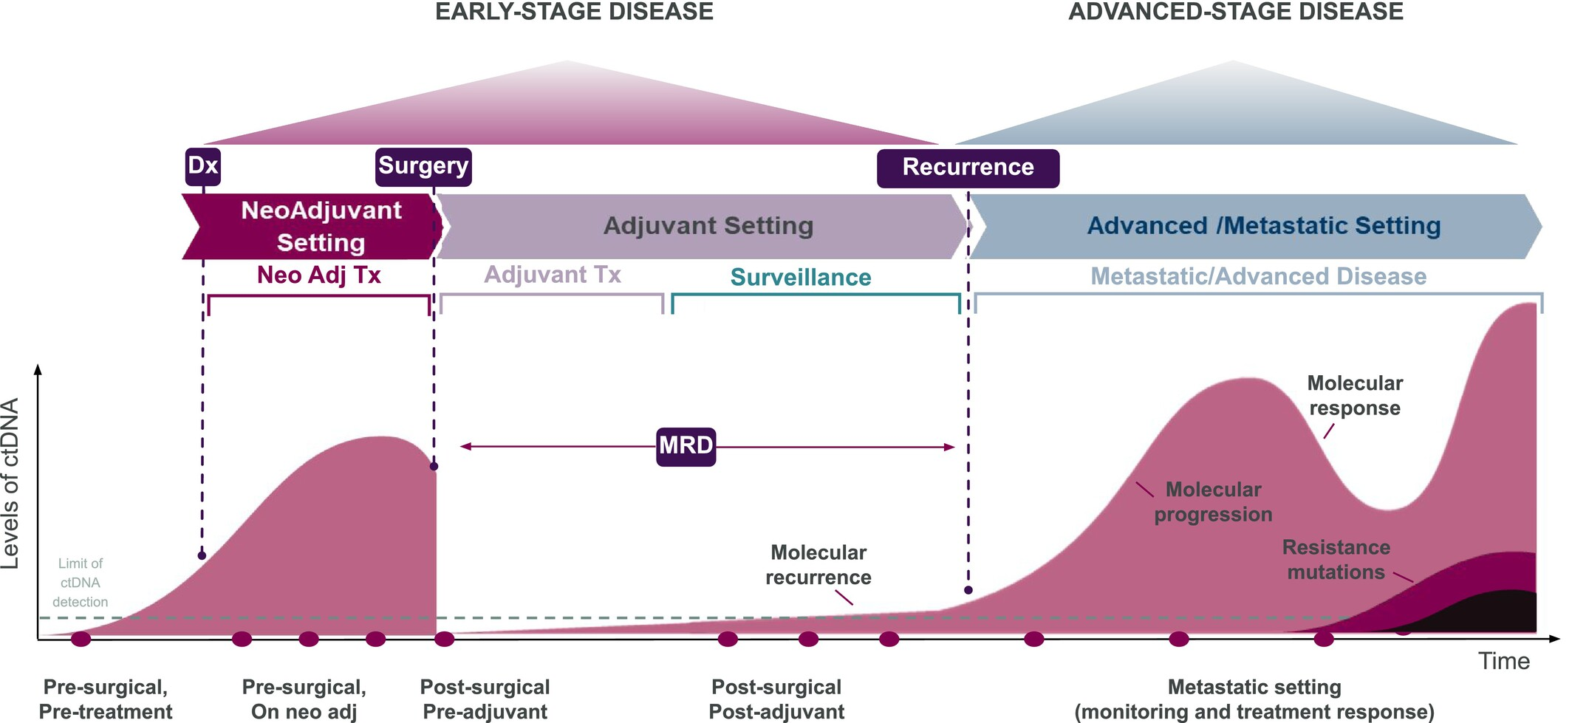
Molecular Residual Disease (MRD) Overview
Establishing a Common Lexicon for Circulating Tumor DNA Analysis and Molecular Residual Disease: Insights From the BLOODPAC Consortium
  Clinical and Translational Science, 2025; 18:e70185

Slide 3
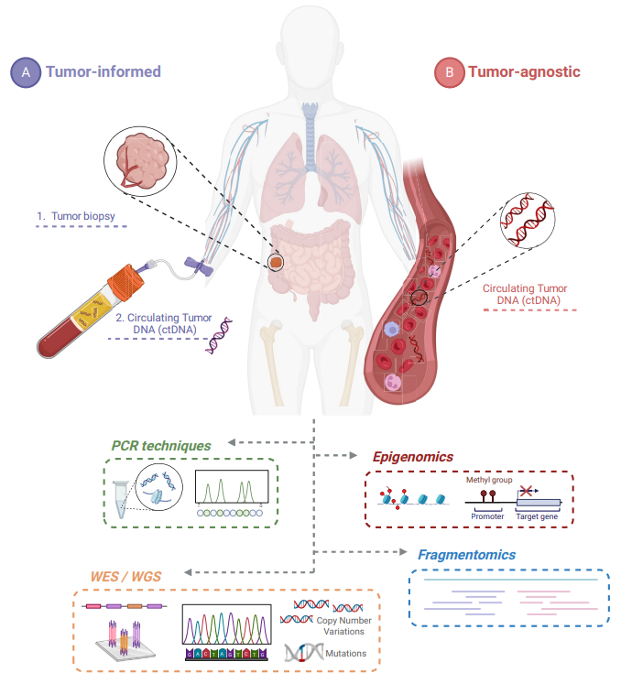
MRD testing: tumor-informed vs tumor-naïve
Detection of ctDNA based on tumor-specific, clonal somatic variants
Personal panel design for each patient (16 - >1000s of variants)
Uses NGS or dPCR for readout
Requires prior tumor sequencing (WGS or WES)
Many tests already on the market, require individualised assay design
Detection of ctDNA not only by base pair mutations
Including / focusing on other signals:
Epigenomics (methylation)
Fragmentomics
New approach to MRD, most tests still in development
Potential for a universal test not dependent on prior patient sequencing
B. Martínez-Castedo et al. 2024

Slide 4
Evolution of tumor-informed MRD assays…
PROVIDER | ASSAY | # VARIANTS TRACKED | REPORTED LoD
Natera | Signatera | 16 - 32 | 100 ppm
Predicine | BEACON | <50 | 50 ppm
C2i | MRDetect | >1000 (WGS) | 10 ppm
Inivata | RaDaR | <48 | 10 ppm
Personalis | NeXT Personal | 1800 | <5 ppm
Exact | MAESTRO | >1000 | <1 ppm
Foresight | Foresight | ~500 | <1 ppm
Haystack | Haystack | ~50 | <5 ppm
Natera | Signatera Genome | 48 | 1 ppm
First assays targeted 8 – 16 tumor variants based on tumor WES data with a limit of detection ~100 ppm (0.1% ctDNA tumor fraction)
More tracked tumor variants and improved deep-sequencing technologies led to a significant improvements in reported test LoD
Lower LoD should lead to earlier detection of residual disease
Evaluation of clinical utility versus increased cost of lower ppm testing is underway
Non-exhaustive list of selected assays including historical data.

Slide 5
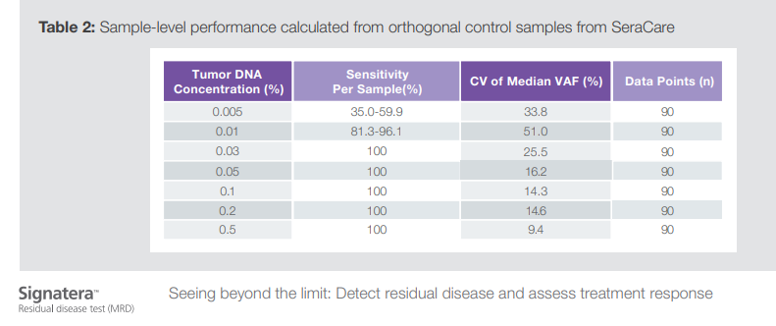
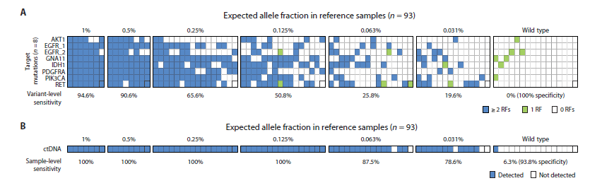
… and reference materials
Seraseq ctDNA v2 / Seraseq ctDNA Complete: designed for routine ctDNA profiling
validation of first version of Natera Signatera (dilutions down to 0.005% VAF / 5 ppm)
validation of the TARDIS platform (dilutions down to 0.031% VAF / 30 ppm)
McDonald et al (2019)
Notes:
TARDIS was later acquired by Exact Sciences

Slide 6

… and reference materials
Seraseq ctDNA v2 / Seraseq ctDNA Complete: designed for routine ctDNA profiling
validation of first version of Natera Signatera (dilutions down to 0.005% VAF / 5 ppm)
validation of the TARDIS platform (dilutions down to 0.031% VAF / 30 ppm)
new improved chemistry
lower background noise
Seraseq bTMB
Seraseq ctDNA MRD: designed with low background noise for use in sensitive applications
validation of Burning Rock PROPHET assay
validation of Personalis NeXT Personal assay (dilutions down to ~1 ppm)
The same chemistry is used in Seraseq ctDNA v4, myeloid, lymphoma etc.
Notes:
TARDIS was later acquired by Exact Sciences

Slide 7
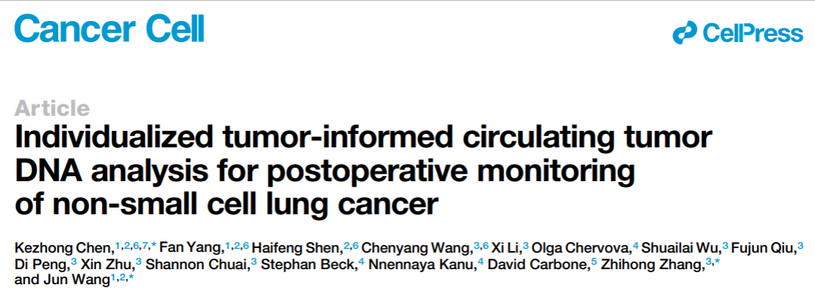
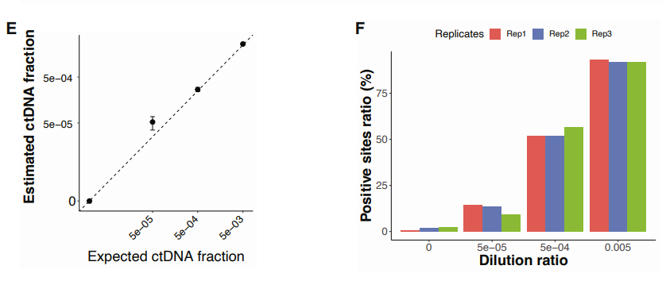
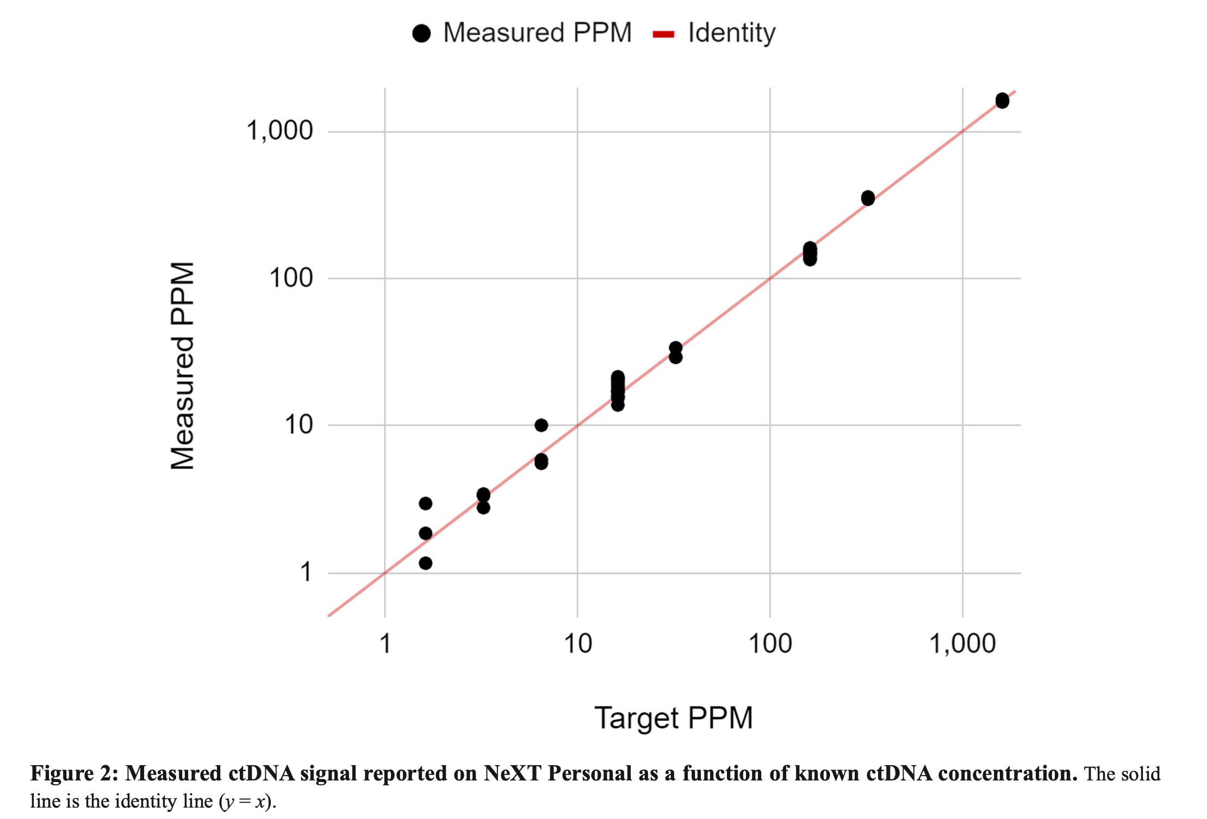
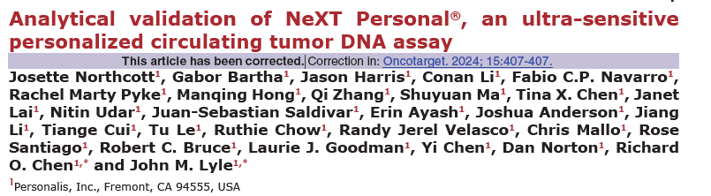
… and reference materials
Notes:
TARDIS was later acquired by Exact Sciences

Slide 8
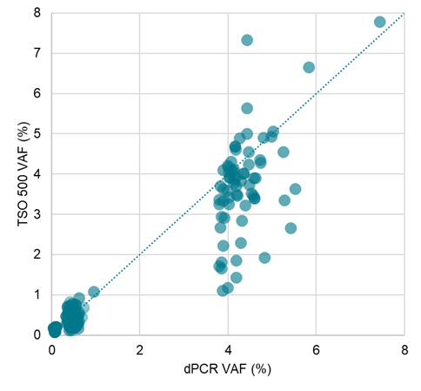
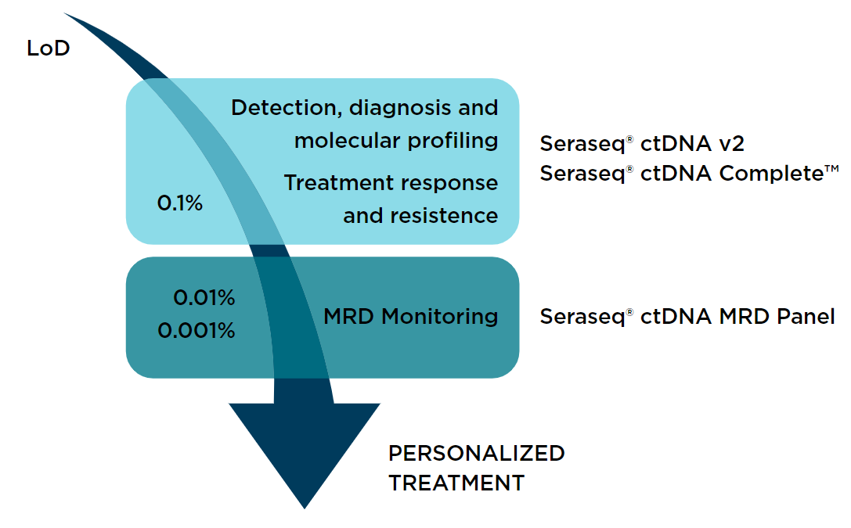

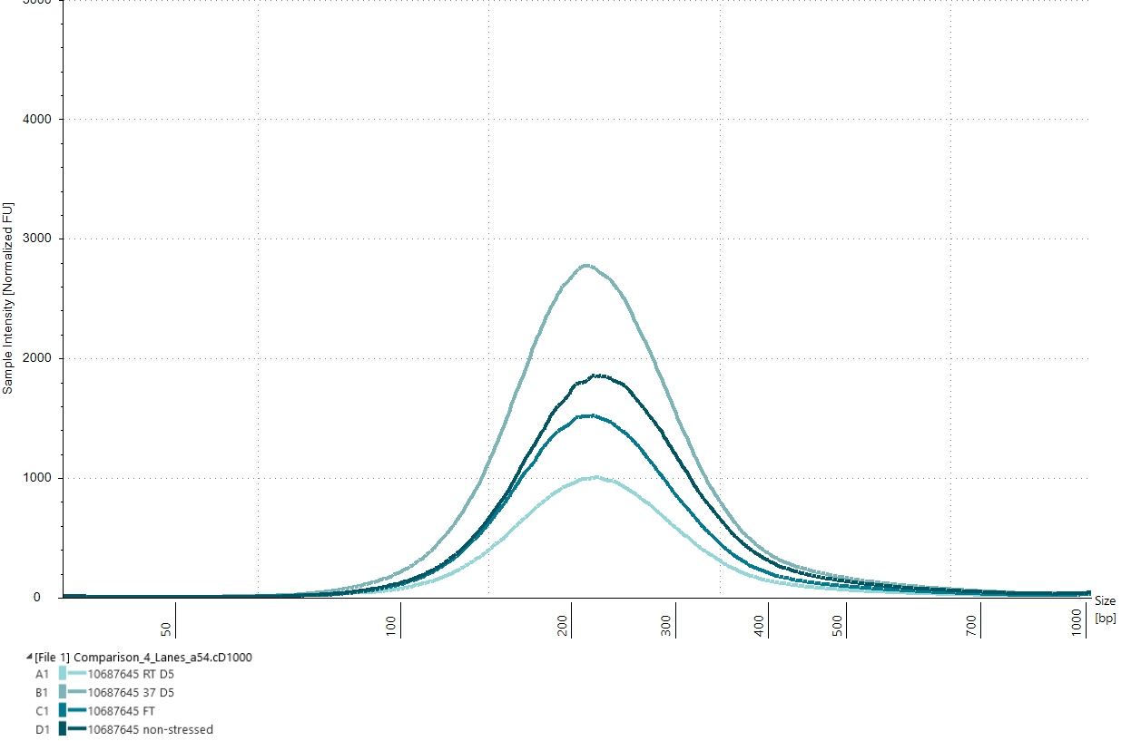
Seraseq® for Liquid Biopsy Applications
CNVs
gDNA
SNVs, INDELs
Fragmented to biologically relevant 150-210 bp
cfDNA extraction
Seraseq™ ctDNA v4
Seraseq™ ctDNA ESR1
Seraseq™ ctDNA Prostate
Seraseq™ Myeloid ctDNA
Seraseq™ Lymphoma ctDNA
PAN-CANCER, TUMOR SPECIFIC AND MRD ctDNA REFERENCE MATERIALS
Clinically actionable variant content, dPCR and NGS quantitation of all biosynthetic variants
Multiple VAFs to support a dynamic range of LoD needs down to 0.1% (100 ppm)
Dedicated MRD reference materials based on a tumor cell line with NGS QC down to 0.005% TF / 5 ppm
Diluted in buffer or embedded in synthetic plasma
Notes:
At LGC we co-develop the standards that reflect both the sample and the biomarker target

Slide 9
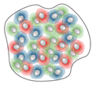

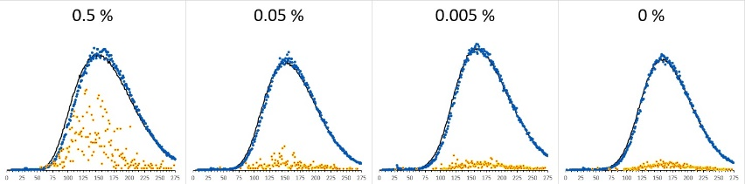
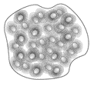
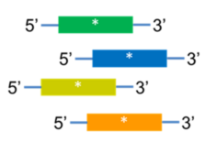
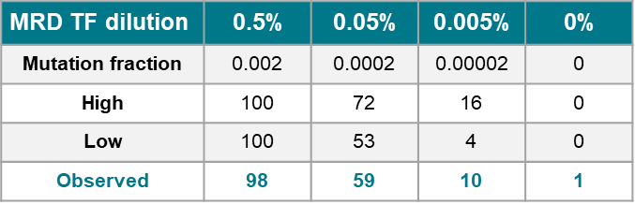
Seraseq® ctDNA MRD Panel Mix
Designed to help develop, validate & monitor the performance of tumor-informed MRD assays in cancer patients undergoing therapy.
0.5% (500 ppm) tumor blend is diluted to 0.05% (50 ppm) and 0.005% (5 ppm), all TF including 0% TF are fragmented & sized
WES
>600 variants
0.5% tumor fraction
TMB 26 tumor cell line (gDNA)
Targeted panel
Targeted panel for 100 tumor variants
+
22 variants
0.25% AF variants
Matched normal cell line (gDNA)
DNA constructs
MRD Assay validation possible using any subset of tumor & synthetic variants: mix & match
Individual TF% vials now also available
High and Low and are the bounds of the 95% CI

Slide 10


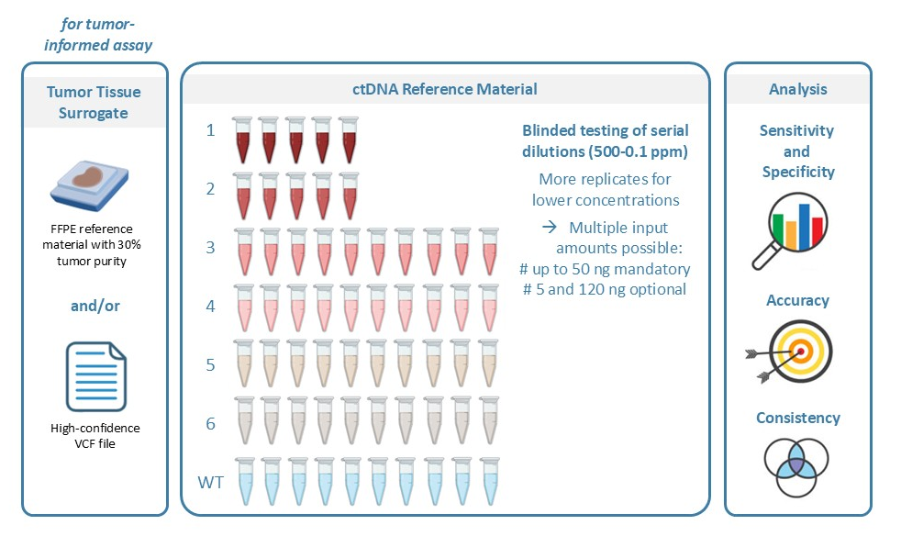
Guide.MRD tumor-informed assay benchmarking
A blinded set of cfDNA (with dilutions unknown) was distributed to companies participating in benchmarking
The dilutions are designed to challenge the claimed sensitivity of the latest generation of assays (down to 0.1 ppm)
A separate sample set used to evaluate dPCR-based approaches

Slide 11
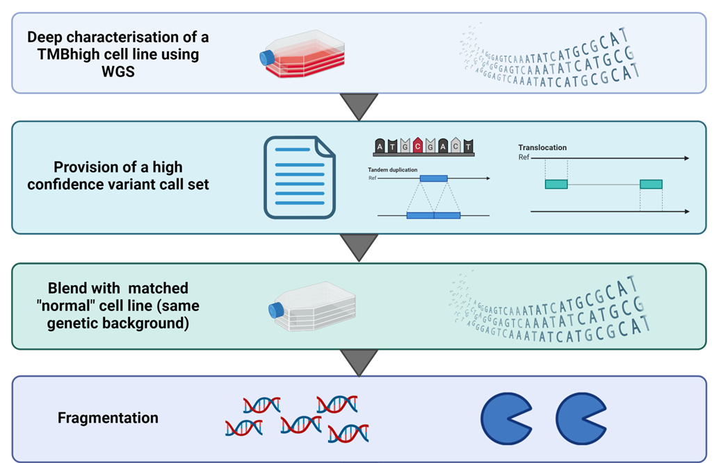
Guide.MRD reference material set
Features of the reference material:
Solid tumor cell line with high tumor mutational burden (TMB) blended with SNP-matched normal cell line
Representation of all major types of genetic alterations, including SNVs, indels, translocations and CNAs
Characterization of both cell lines by multiple sequencing platforms
Enzymatically fragmented to mimic the size of cfDNA (size range of 150-230 bp)
6 dilution levels suitable for high-sensitivity MRD testing (500 – 0.1 ppm) and a WT sample. 500 ppm dilution tested by ddPCR and dilutions down to 5 ppm validated by panel sequencing.
Provided as ready-to-use purified DNA mix in buffer.

Slide 12
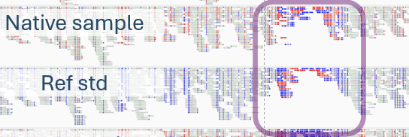
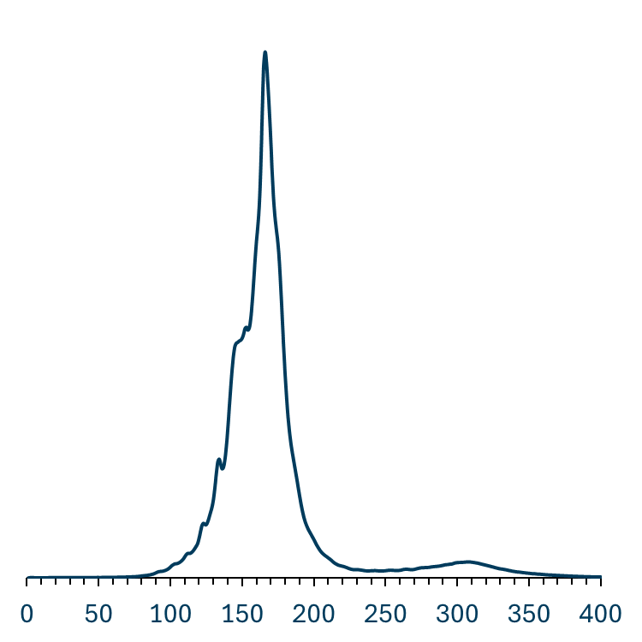
Beyond the DNA variants
To support the validation and benchmarking of tumor-naïve MRD assays, reference materials need to reproduce one or more tumor ctDNA features beyond the variant content:
Precise size profile and tumor-normal size differences
ctDNA end patterns
Epigenetic modification patterns
LGC is currently running limited testing of a patient-derived tumor naïve prototype reference material with a focus on methylation.
Promoter CpG region

Slide 13
Thank you!

Slide 14






Seraseq® Oncology Solutions
✓ | Biosynthetic spike-in technology Focusing on clinically relevant variants of all types
✓ | Highly multiplexed controls Provide a rich source of data in a single run at low cost, including rare and challenging alterations
✓ | Unparalleled quality Manufactured under ISO13485, backed by orthogonal data from a wide range of assays
✓ | Patient-like material Performance similar to clinical samples in FFPE, ctDNA and plasma process formats
✓ | Custom solutions available To support specific needs for assay development, validation, launch, QC and proficiency testing
SOLID TUMORS
HEME
DISORDERS
Somatic Cancer NGS Reference Materials
IMMUNO ONCOLOGY
LIQUID BIOPSY
CUSTOM SOLUTIONS

Slide 15

Quality Solutions for Clinical Oncology
SOLID TUMOR PROFILING
IMMUNO-ONCOLOGY
LIQUID BIOPSY
INHERITED CANCER
Tumor DNA v3 / FFPE
Fusion RNA v4 / FFPE
CNVs DNA / FFPE
HRD FFPE / DNA
BRCA1/2 LGR DNA / FFPE
NTRK RNA / FFPE
Sarcoma Fusion RNA
Tumor Mutational Burden
Tissue TMB DNA / FFPE
Blood TMB ctDNA
TMB Reference Panel
Microsatellite Instability
MSI Panel DNA
MSI-High DNA / FFPE
ctDNA Complete
ctDNA v4
Myeloid ctDNA
Prostate ctDNA
ESR1 ctDNA
Lymphoma ctDNA
ctDNA MRD Panel
Methylated ctDNA
ctDNA extraction
cfRNA
Inherited Cancer DNA v2
BRCA1/2 LGR DNA
BRCA1/2 Exon Deletions DNA
New!
New!
New!
PHARMACOGENOMICS
DPYD DNA
Pharmacogenomics DNA
BLOOD CANCER PROFILING
Myeloid DNA
Myeloid Fusion RNA
Lymphoma DNA / FFPE
New!
New!

