Slide 1
liquid biopsy
GENO1® TECHNOLOGIES
Unlocking the true potential
of NGS to empower
Simona Adamusová, sa@genomill.com
Jukka Laine, jukka@genomill.com
ELBS GA, Madrid

Slide 2
Sequencing is no longer the bottleneck
Liquid biopsy workflow in 2015
DNA EXTRACTION
LIBRARY PREPARATION
NEXT-GENERATION DNA SEQUENCING
Liquid biopsy workflow in 2025
DNA EXTRACTION
LIBRARY PREPARATION
NEXT-GENERATION DNA
SEQUENCING
Library preparation is the bottleneck of current liquid biopsies!
・High cost
・Slow TAT
・Poor data quality
・Dependency on centralized laboratories

Slide 3
Sequencing is no longer the bottleneck
Liquid biopsy workflow in 2015
DNA EXTRACTION
LIBRARY PREPARATION
NEXT-GENERATION DNA SEQUENCING
Liquid biopsy workflow in 2025
DNA EXTRACTION
LIBRARY PREPARATION
NEXT-GENERATION DNA
SEQUENCING
Liquid biopsy workflow with Geno1®
DNA EXTRACTION
Geno1®
NEXT-GENERATION DNA
SEQUENCING

Slide 4
Geno1® provides the fastest sample prep while maintaining accuracy and reducing costs
Geno1® circular library preparation protocol
2 STEPS; 2 H TAT
“This is by far the easiest workflow I have ever used”
User feedback from a clinical laboratory
HANDS-ON TIME:
25 MIN (MANUAL)
5 MIN (AUTOMATED)
Step 1
2
Geno1® linear library preparation protocol
4 STEPS; 3 H TAT
HANDS-ON TIME:
35 MIN (MANUAL)
5 MIN (AUTOMATED)
Step 1
2
3
4
AmpliSeq library preparation protocol
6 STEPS; 5 H TAT
HANDS-ON TIME:
1.5 HOURS (MANUAL)
Step 1
2
3
4
5
6
Roche Avenio library preparation protocol
8 STEPS; 44 H TAT
HANDS-ON TIME:
3.5 HOURS (MANUAL)
Step 1
2 (O/N)
3
4
5 (O/N)
6
7
8

Slide 5
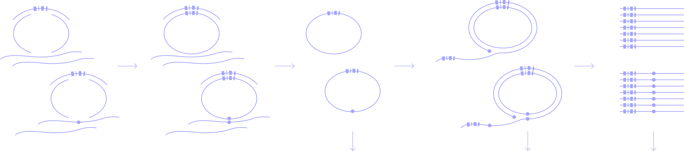
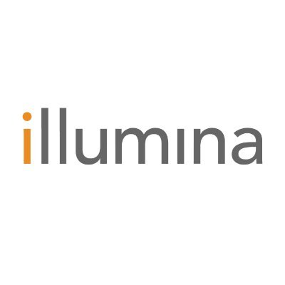



GENO1® TARGETED SEQUENCING WORKFLOW
Universally compatible, exceptionally fast
ANNEALING
GAP FILL
LINEAR DNA DEGRADATION
LINEAR CIRCLE AMPLIFICATION
COMPLETED IN:
2.0 HOURS
2.5 HOURS
3 HOURS
For additional detail, please see
Adamusova et al (2025) JMD; DOI: 10.1016/j.jmoldx.2025.09.006
Adamusova et al (2025) bioRxiv; DOI: 10.1101/2025.05.08.652165
Circular
platforms
Nanopore
platforms
Linear
platforms
SEQUENCING PLATFORMS:

Slide 6
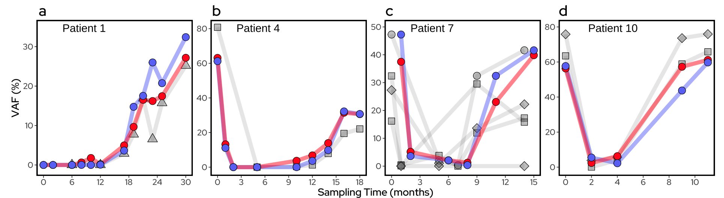
Clinical validation shows market-leading performance with game-changing improvements in ease-of-use and cost
Serial plasma samples from ten patients with KRAS variant in the primary tumor tissue (n = 80)
Scientific validation
Ganesan et al (2025) Sci Rep; DOI: 10.1038/s41598-025-04827-2
Adamusova et al (2025) JMD; DOI: 10.1016/j.jmoldx.2025.09.006
KRAS variant detected by Geno1 (violet) and matching KRAS variant detected by golden standard ddPCR (red). Geno1 also detected a priori known variants (grey).

Slide 7
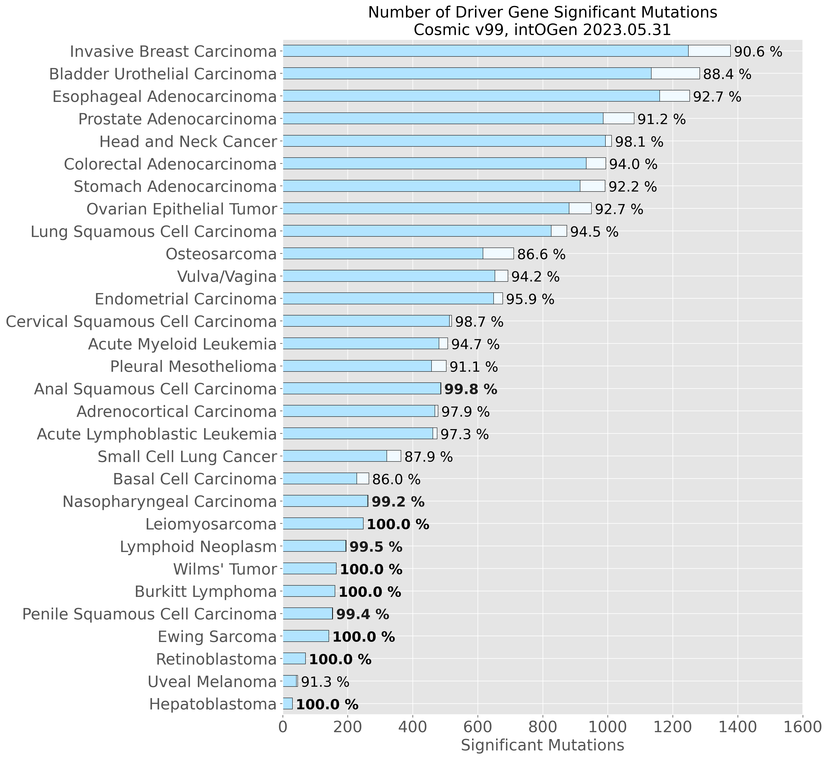
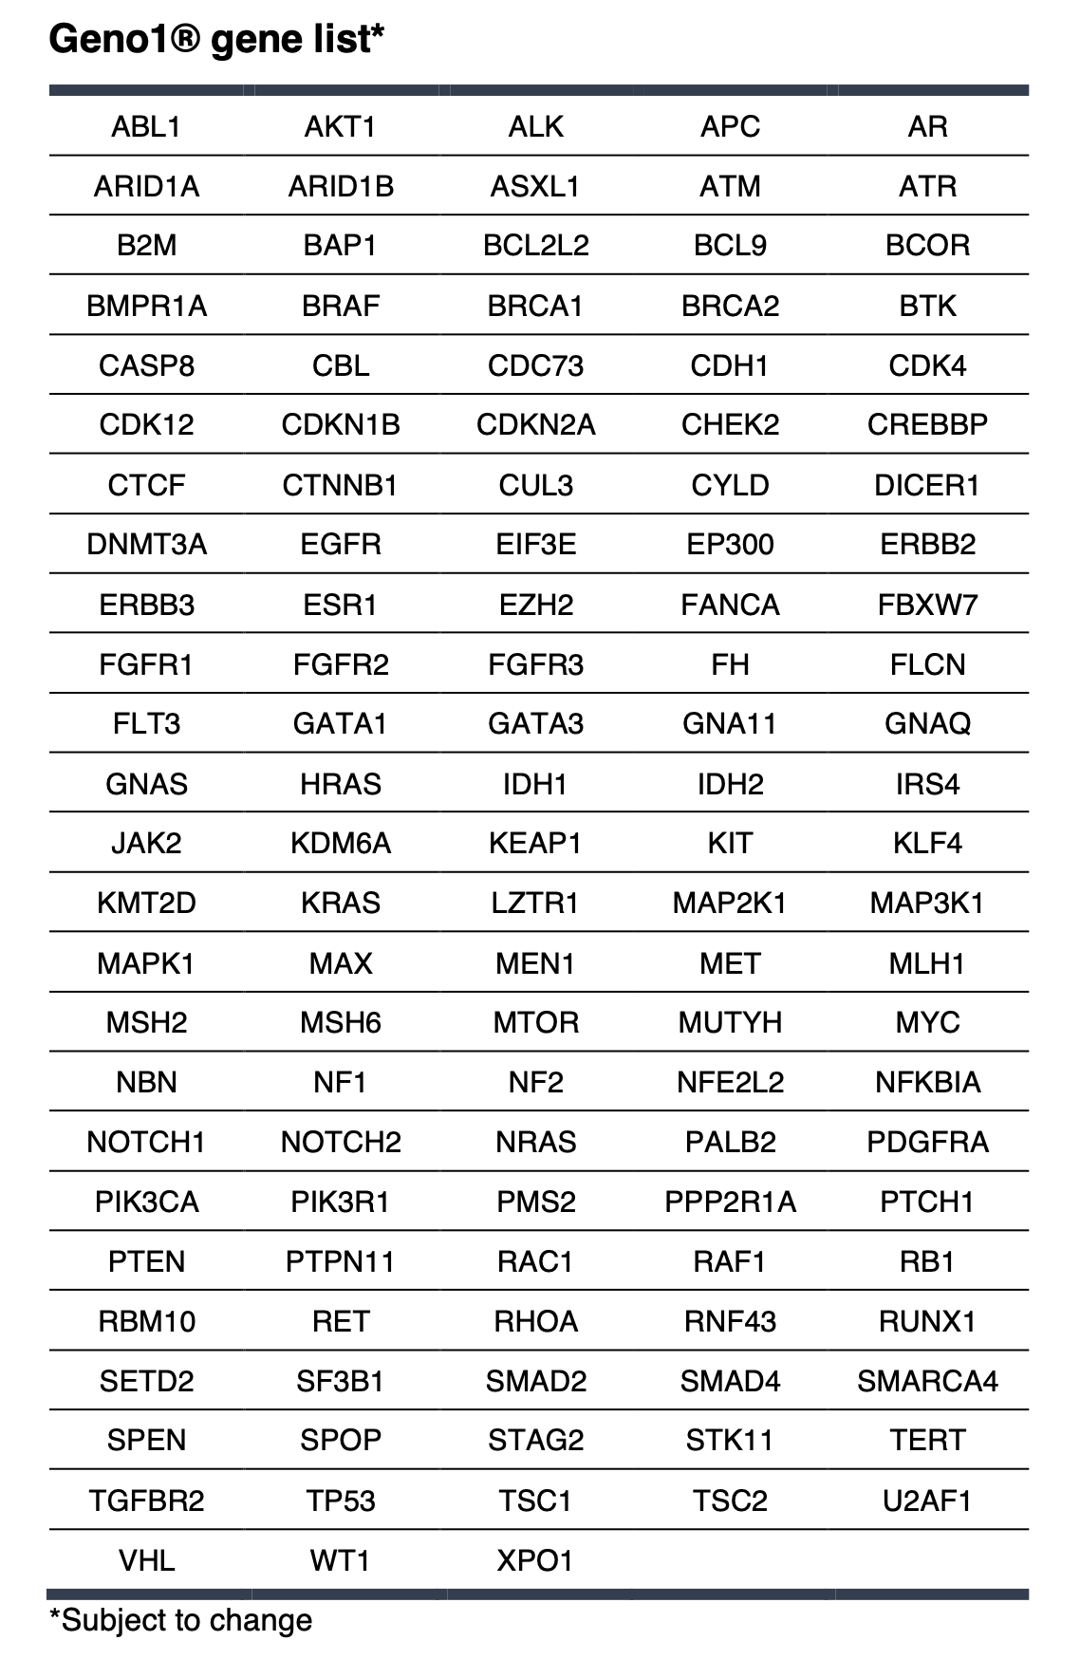
Unlimited panel scalability enabling pan-cancer diagnostics
Current panel of 805 probes covers a total of ~23,000 variants across 123 genes

Slide 8






Unlocking true potential of NGS applications for everyday healthcare
Rapid & simple
Streamlined for modern DNA sequencing, with minimal hands-on and fast turn-around
Extremely sensitive
Detects rare mutations, enabling early cancer detection and minimal residual disease monitoring
Cost-efficient
Reduces costs by over 50%, making NGS accessible and affordable for all
PCR-free & automated
Eliminates costly facility requirements, permitting easy distribution

Slide 9
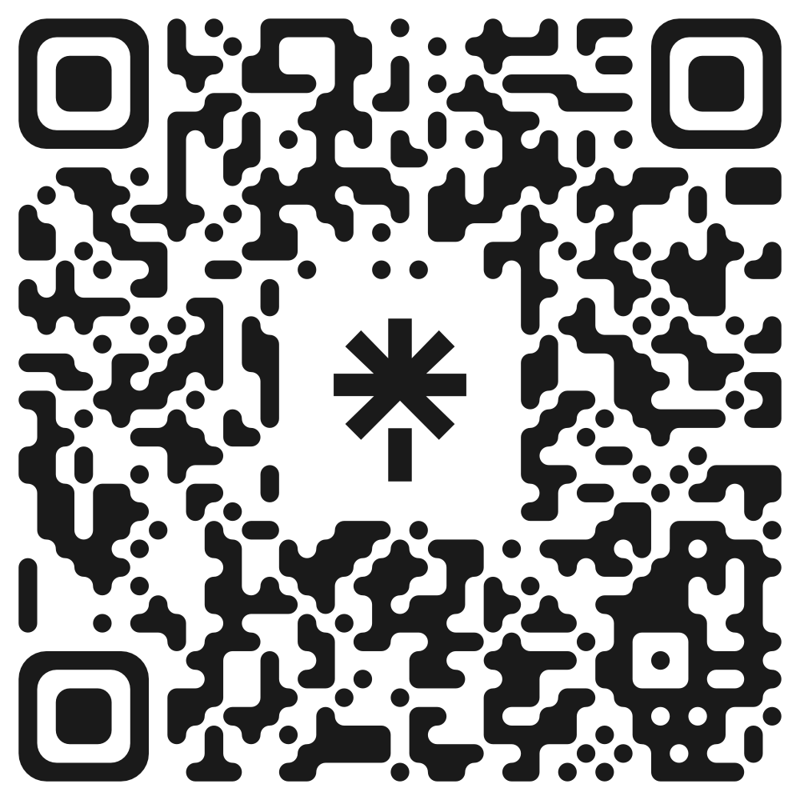
Explore Geno1®
Simona Adamusová
sa@genomill.com
Jukka Laine
jukka@genomill.com

