Slide 1
Comprehensive Cancer Center
Angers – Nantes
France
Christophe Passot (PharmD, PhD)
ELBS General Assembly
November 3, 2025

Slide 2
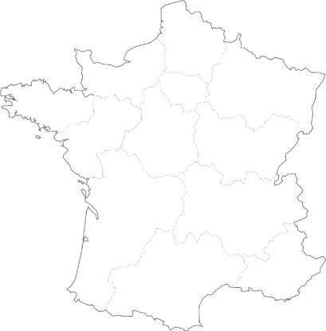

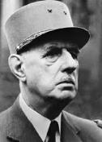
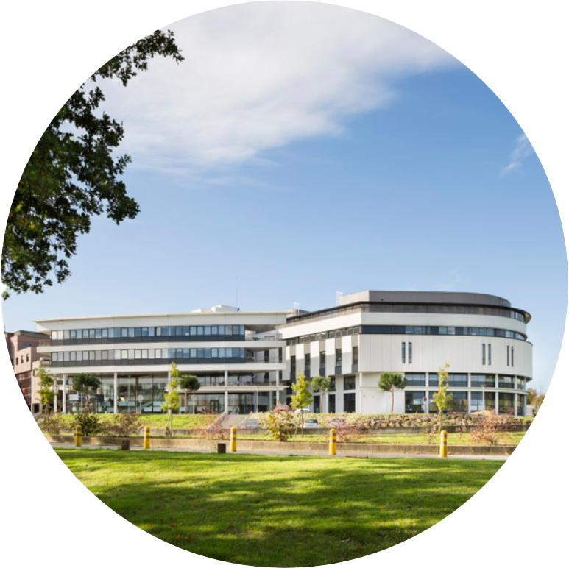
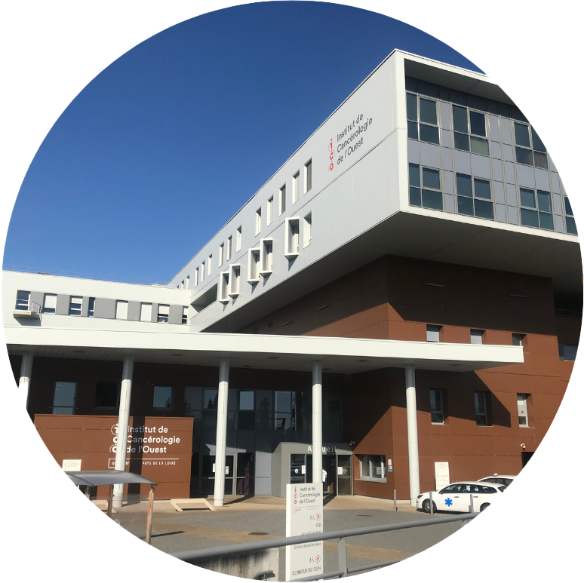
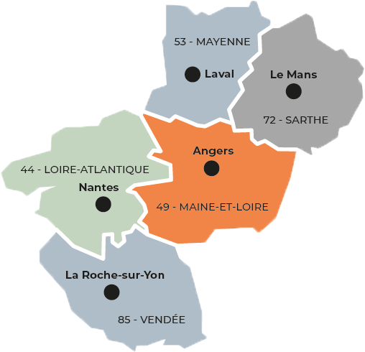
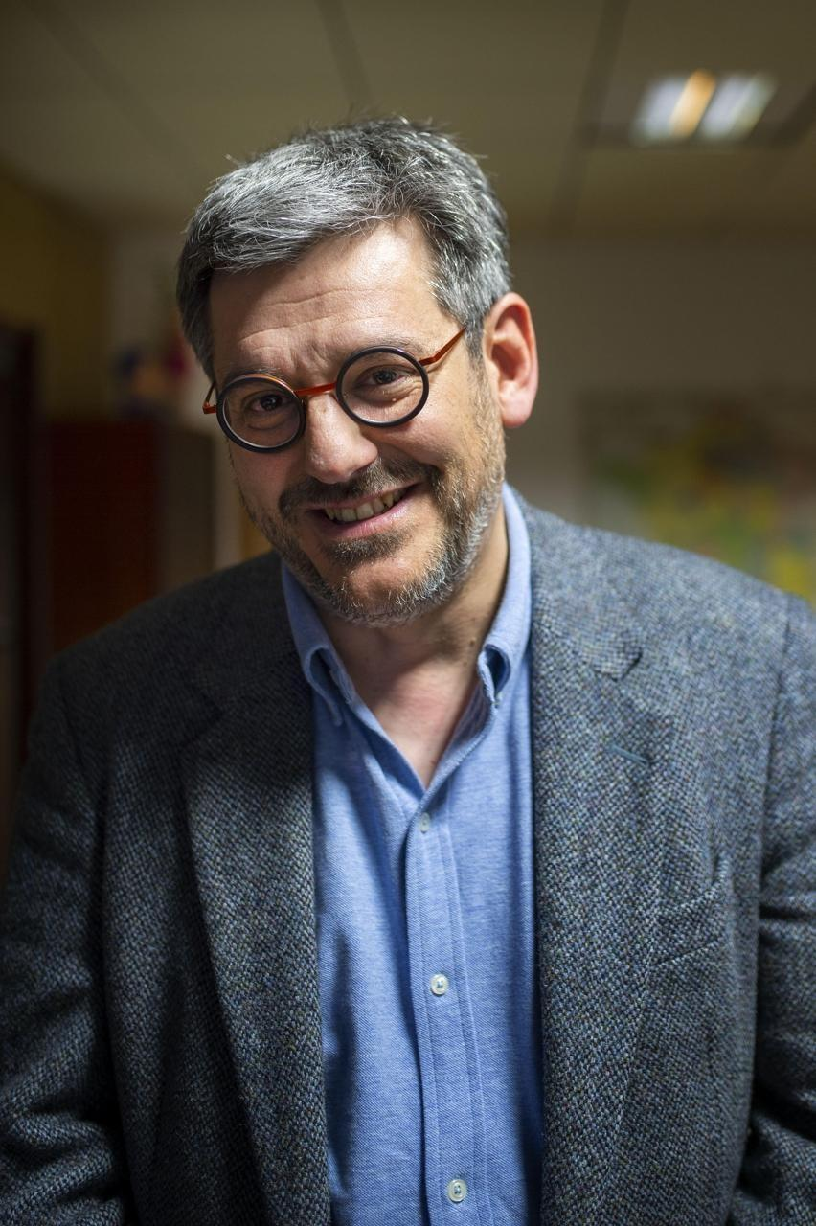


JANUARY 2011
Creation of the Institut de Cancérologie de l’Ouest
Creation of CLCCs by ordinance of 1st December 1945 which recognizes public utility of the FCCCs
1924 :
René GAUDUCHEAU
1925 :
Paul PAPIN
Head :
Pr Mario Campone
In the Pays de la Loire region, cancer affects more than 136,000 people, i.e. nearly 4% of residents:
1st cause of death, all ages combined;
40% of deaths before the age of 65, = 1st cause of premature death.
The excellence of our Institute is recognized at European level
2

Slide 3

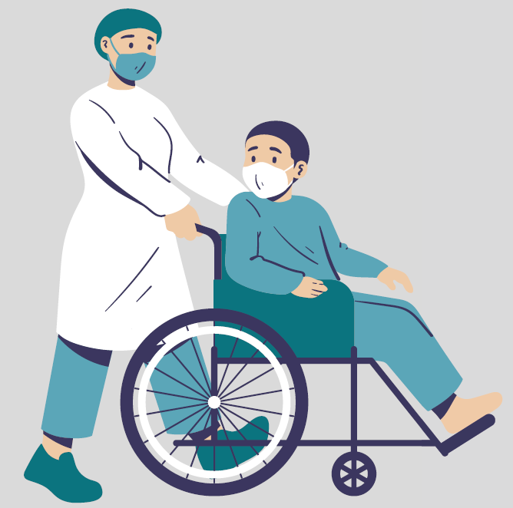



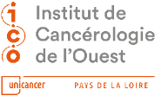
Key Figures
48 357
1st
patients admitted
provincial FCCC in number of patients admitted.
Clinical research
of the patients questioned are satisfied with their stay in hospital at the ICO.
1 390
97%
13 852
patients included
Incl.
new patients
270
trials open to inclusion
3

Slide 4
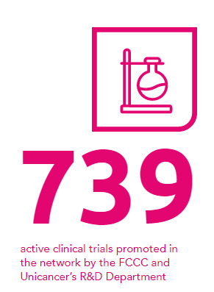
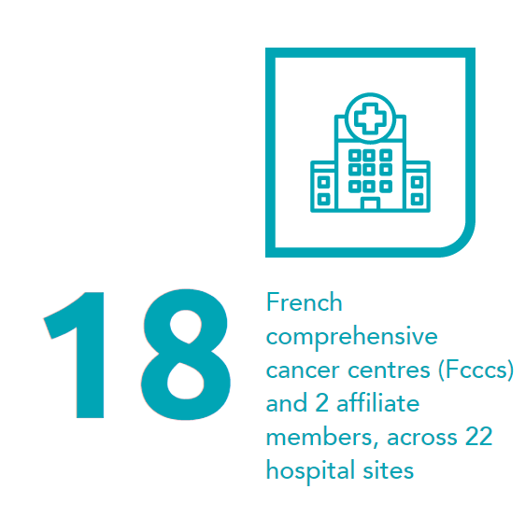
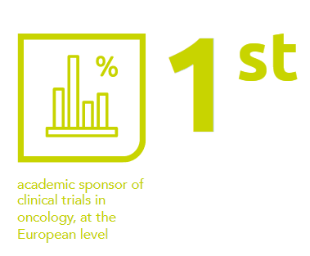
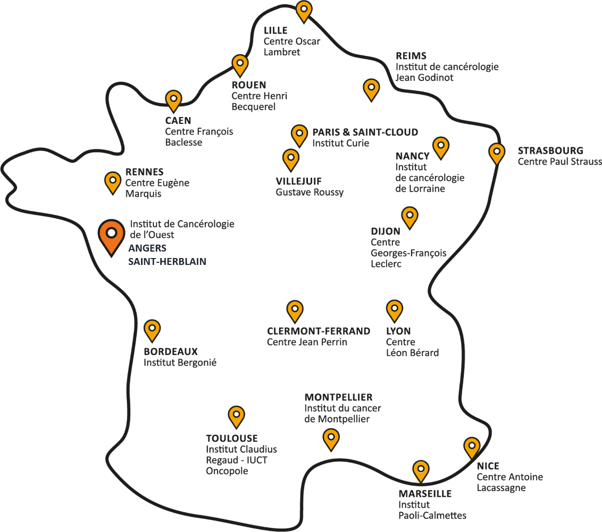
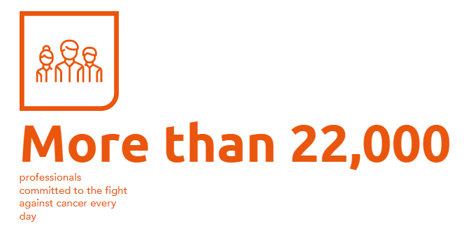
The UNICANCER Network
The Unicancer network represents the eighteen Cancer Centers (CLCC) in France, develops their organization model in oncology and pools their resources and expertise.
4

Slide 5
The UNICANCER Network
The UNICANCER network is based on a holistic, individualized and humanistic approach on the one hand, and on a care-research continuum on the other.
The Comprehensive Cancer Center model, guarantees the existence of centers of excellence with a European dimension: the majority of the Comprehensive Cancer Centers are committed to the highest level of European certification in oncology
5

Slide 6
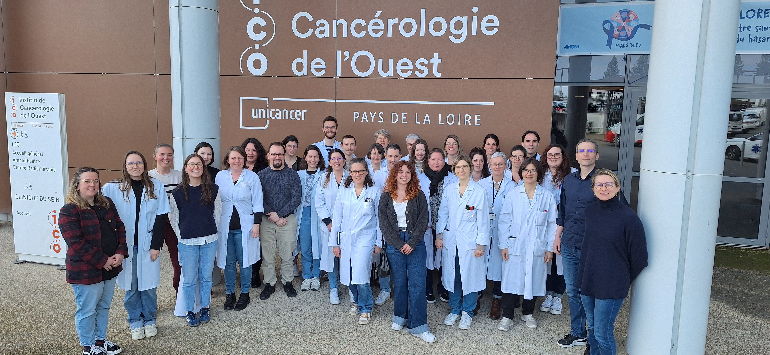
Department of Medical biology
5 medical biologists practitioners (MD or PharmD +/- PhD)
1 medical geneticist (40%)
1 resident
2 bioinformaticians
1 manager of lab technicians
15 lab technicians
2 administrative staff
6

Slide 7
Department of Medical biology
General diagnosis
Pharmacology
Molecular Genetics
Biochemistry
Tumor markers
Hematology
Hemostasis
Pharmacokinetics
Therapeutic drug monitoring
Pharmacogenetics
Somatic variants analysis
7

Slide 8



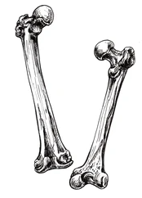



DNA and RNA analysis (mutations and fusions)
DNA analysis (mutations and MSI)
750 lung
100 sarcoma
450 colon-rectum
170 endometrium
DNA analysis
≈ 3500 NGS analysis / year
320 ctDNA
250 melanoma
DNA analysis
(BRCA1/2 +/- PALB2, RAD51C, RAD51D)
DNA analysis
(Homologous Recombination Deficiency status)
350 prostate
350 breast
200 ovary
8

Slide 9
Translational research
Research units:
  Functional genomics (Pr I. Tournier)
  Tumor heterogeneity (Pr D. Heymman, including expertise on circulating tumor cells)
  Genes & environment relationship (Pr S. Lelièvre)
  Genome integrity (Dr P.A. Vidi)
  Oncoproteomics (Dr F. Guillonneau)
  Data sciences (Dr P. Jezequel)
  Human & social sciences (Pr M. Bellanger)
A biological resource center:
  NF S 96 900 and NF EN ISO 20387 certification
  ≈ 7-10k new/year
9

Slide 10
Translational research
Translational research in collaboration with the hospital medical oncologists
Dynamic analysis of ctDNA:
→ Non small cell lung cancer
→ Tumor fraction estimation (technology determination and bioinformatic analysis)
→ Longitudinal modeling
Project of a PhD student (Keva Jussien, mathematician)
10

Slide 11

Conclusion
Liquid biopsy
Care
Translational research
11

Slide 12
12

