Slide 1


Comprehensive multi-omics technologies and solutions ready to be applied to your patients and clinical needs – Call for collaboration in 2026 EU calls
Molecular Diagnostics
AIT Austrian Institute of Technology
Christa Nöhammer, PhD
christa.noehammer@ait.ac.ac

Slide 2
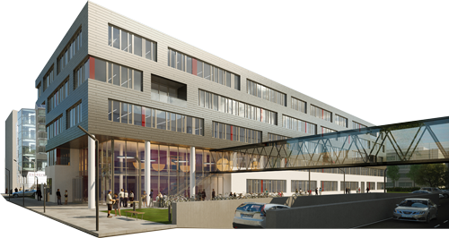
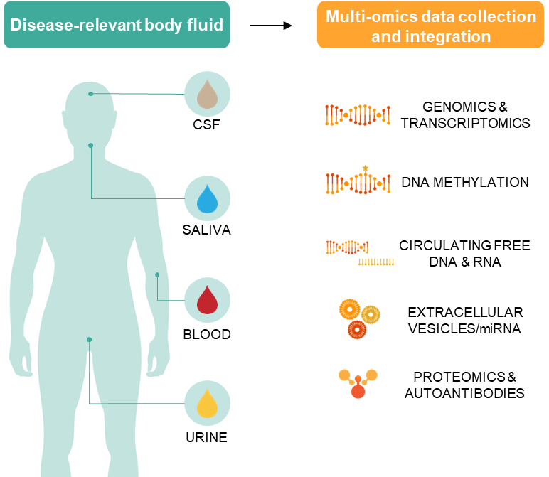
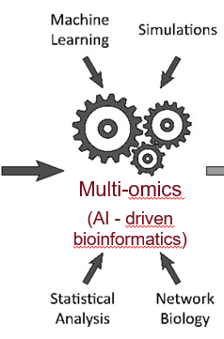

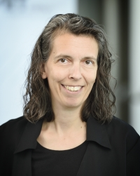
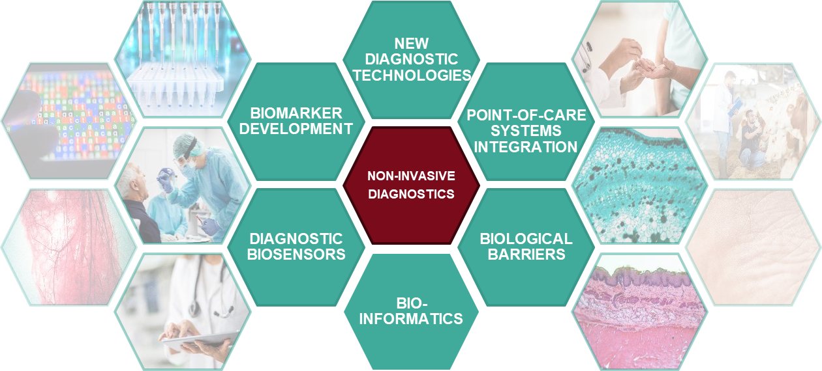
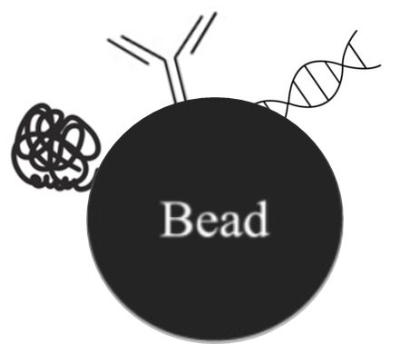
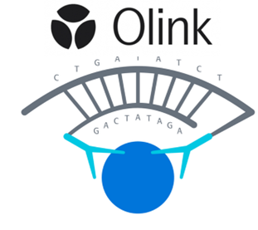



MOLECULAR DIAGNOSTICS UNIT
MINIMALLY INVASIVE BIOMARKERS
Austria‘s largest
RTO
over
employees
1,500
www.molecular-diagnostics.ait.ac.at
Christa Nöhammer
60
#employees
& students:

Slide 3
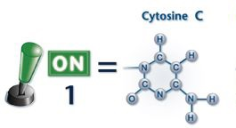
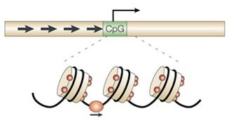
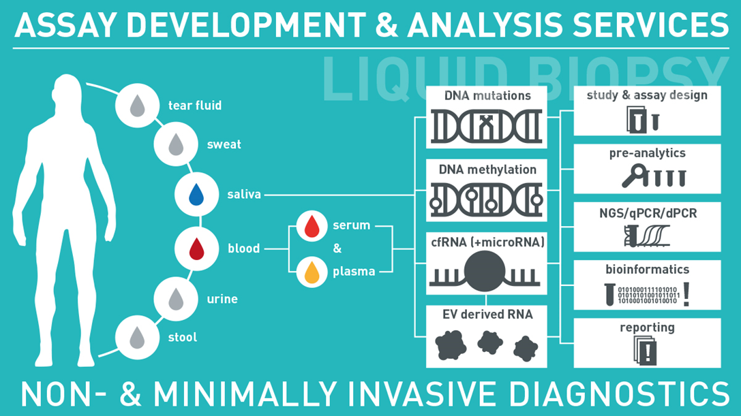
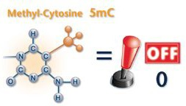
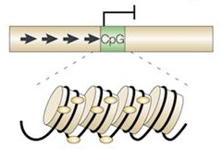

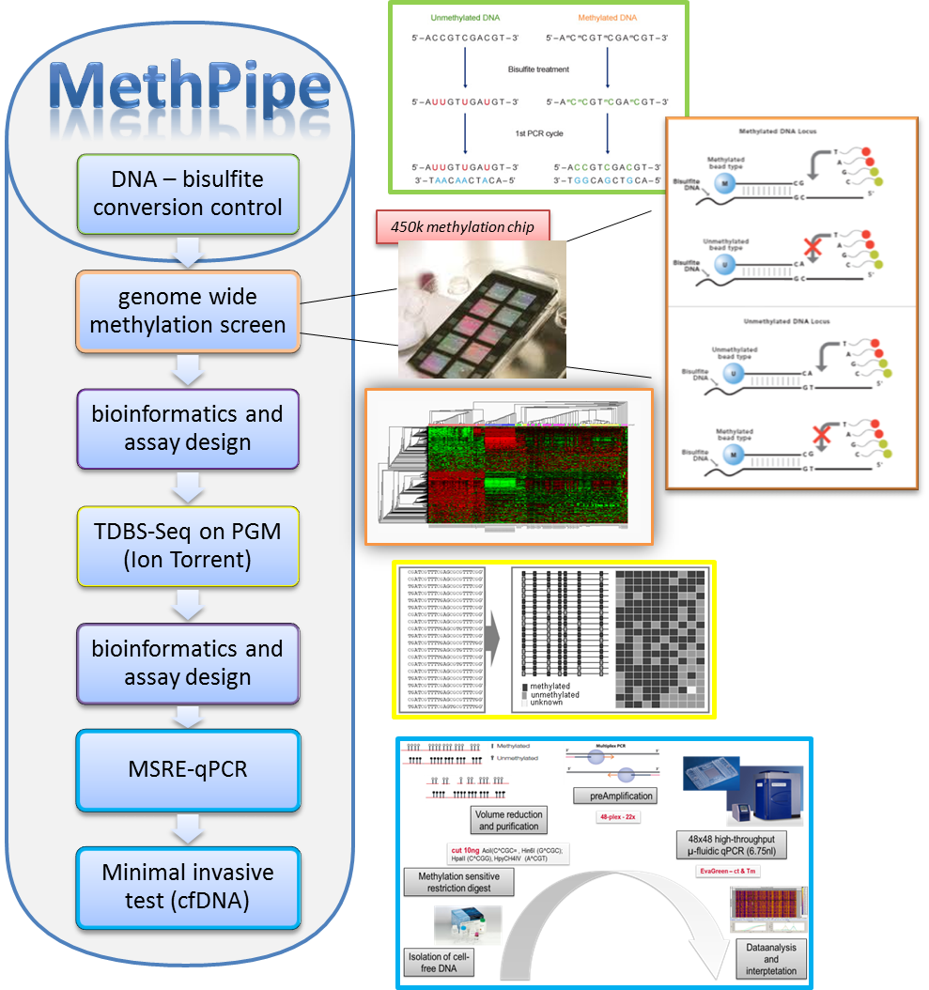
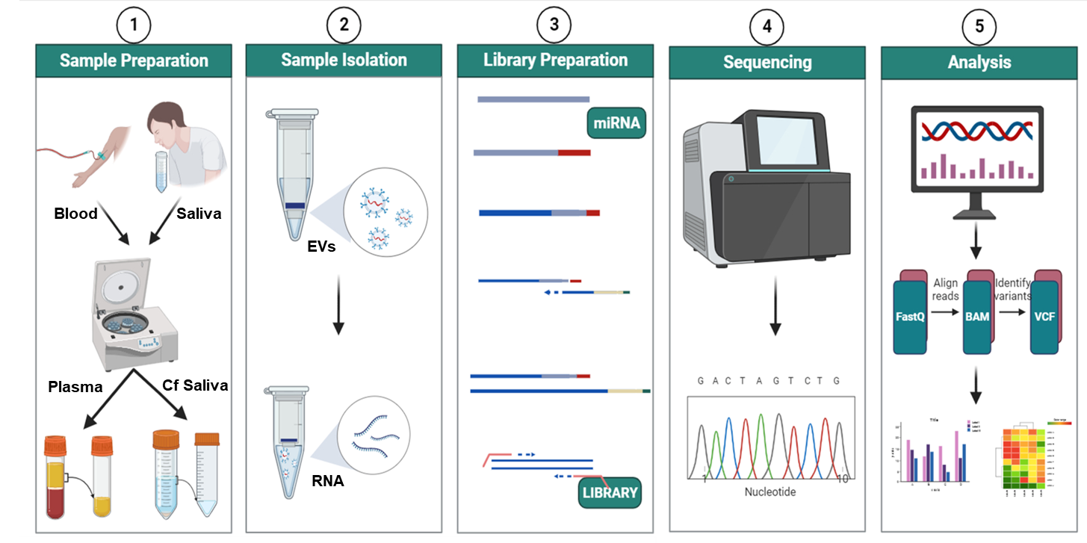
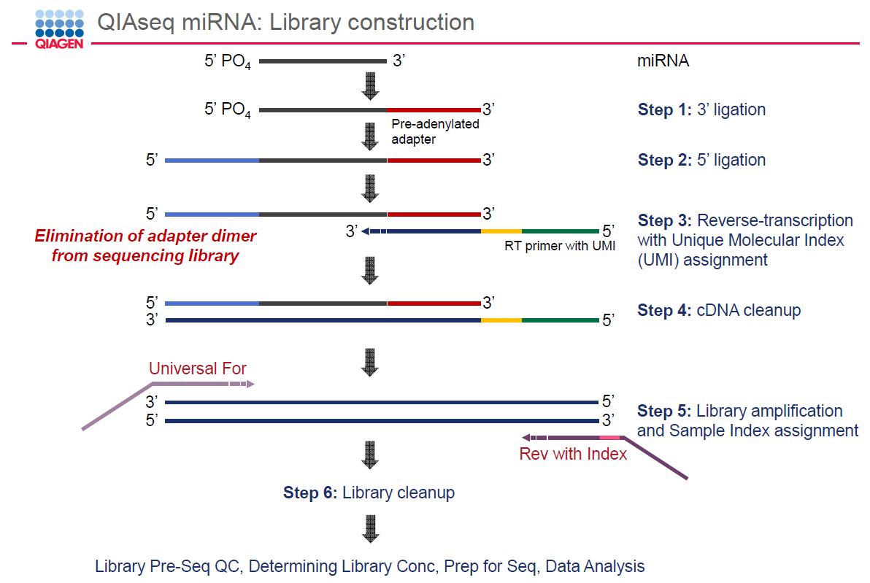
Nucleic ACID Technologies @ AIT

Slide 4
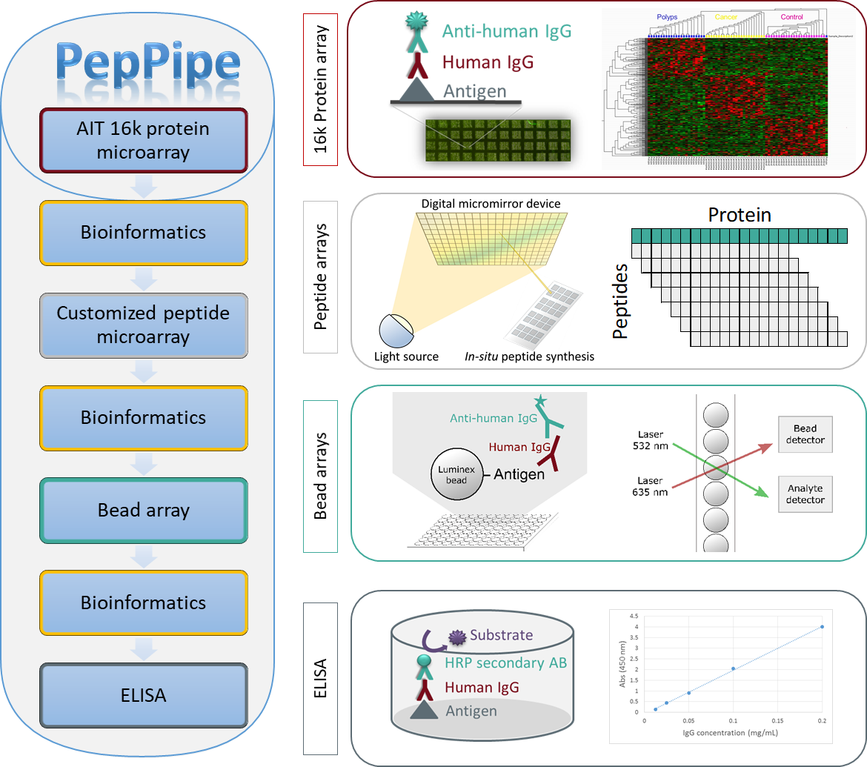
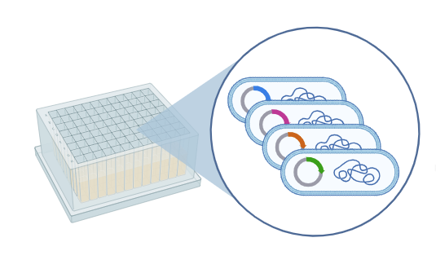
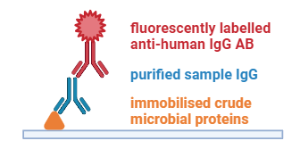
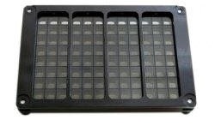
Protein Technologies @ AIT
(AUTO)-Antibodies
AIT’s 16k protein array:
His-tag / NiNTA-purified recombinant proteins
expressed in E.coli (15286 human cDNA-clones representing 6369 distinct human proteins)
Bacterial
lysate array
253 bacterial + 7 fungal lysates (mainly representing sepsis pathogens)
crude protein lysates spotted in duplicates (inkjet printing)
3x7 subarrays per slide

Slide 5
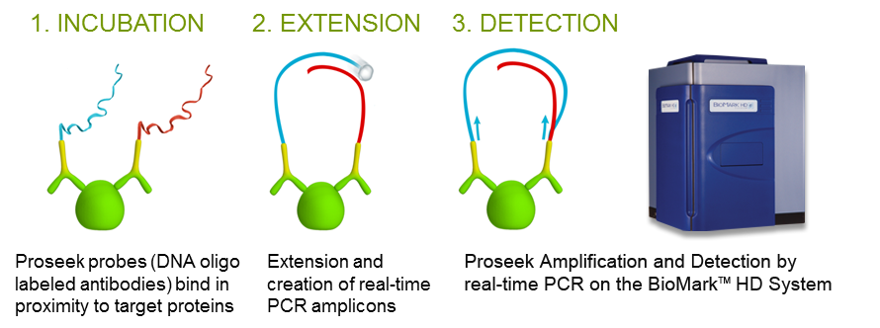

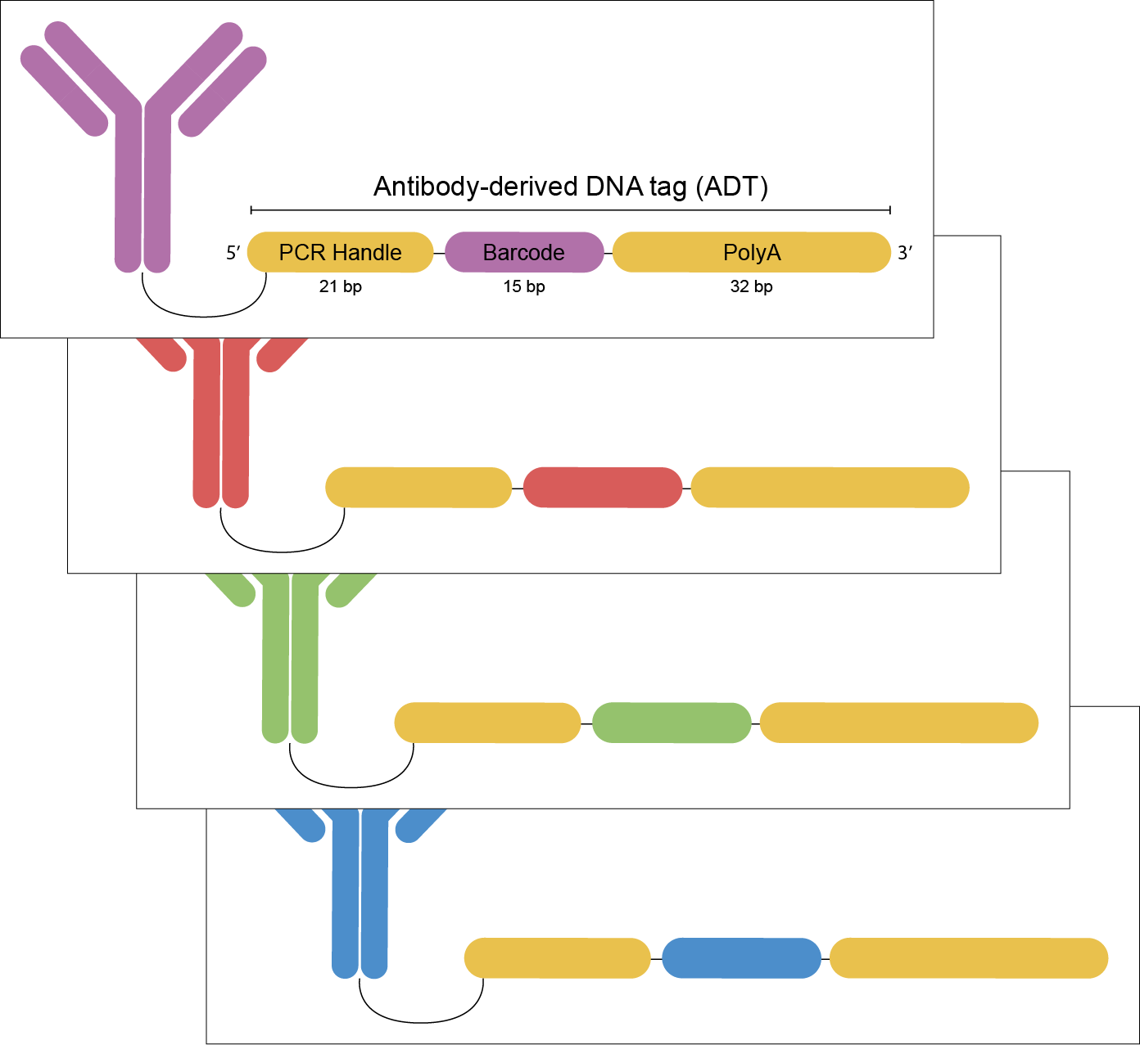
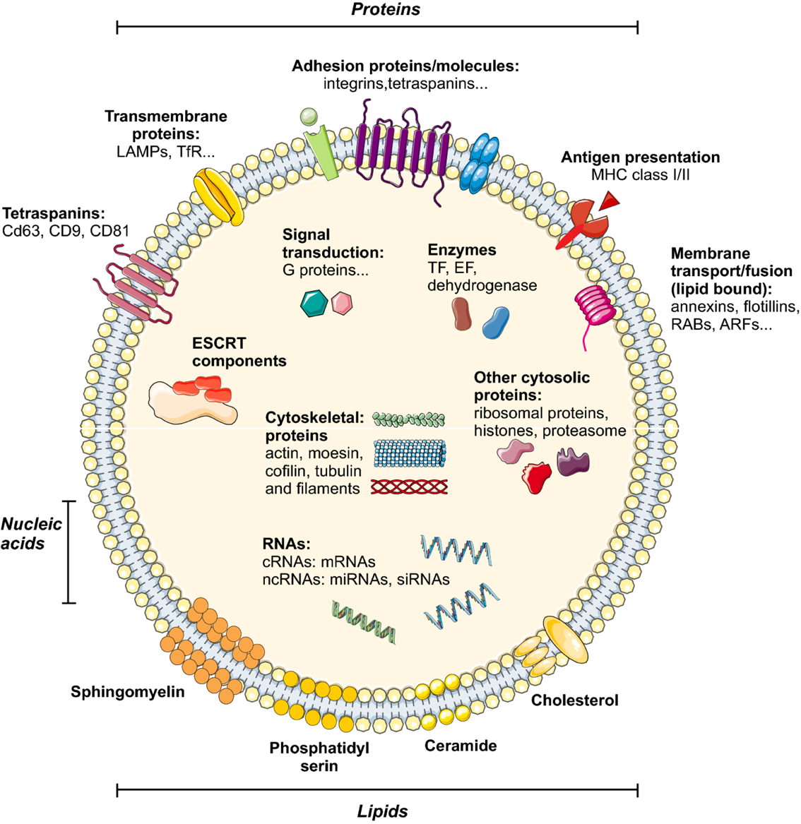
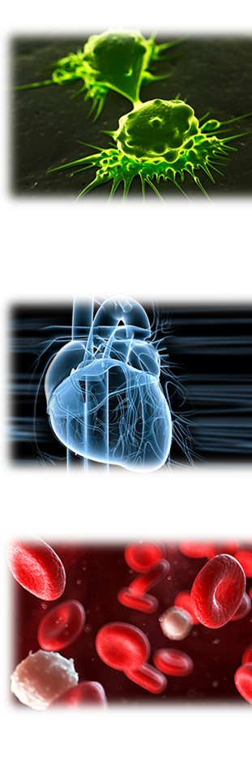

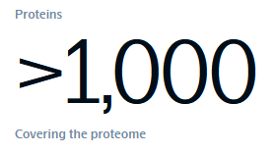
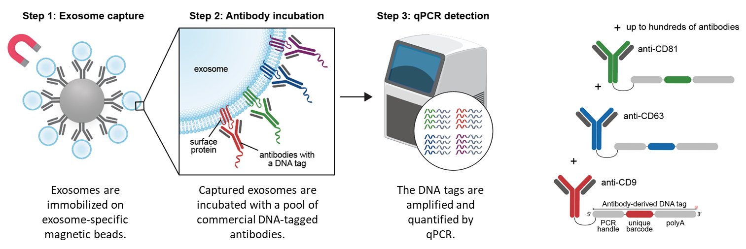


More Protein Technologies @ AIT
Olink‘s Targeted panel assays
EV / cell surface characterization
Via immuno qPCR
OLINK
analyse 92 markers
from 1µl of serum
ProteinS
Oncology
Cardio-Vascular / CVD
Inflammation
600+ antibodies available
5

Slide 6

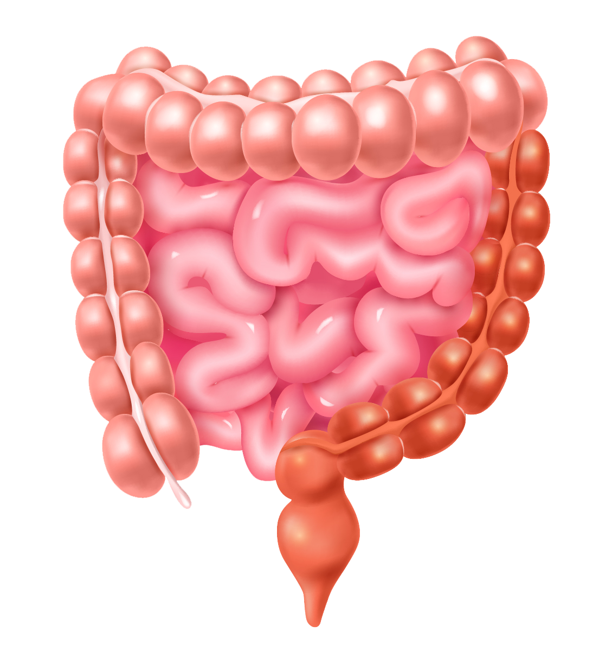
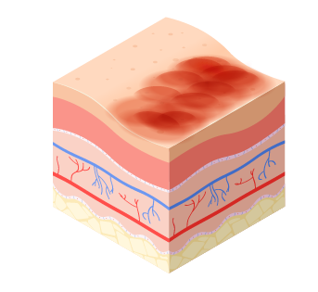
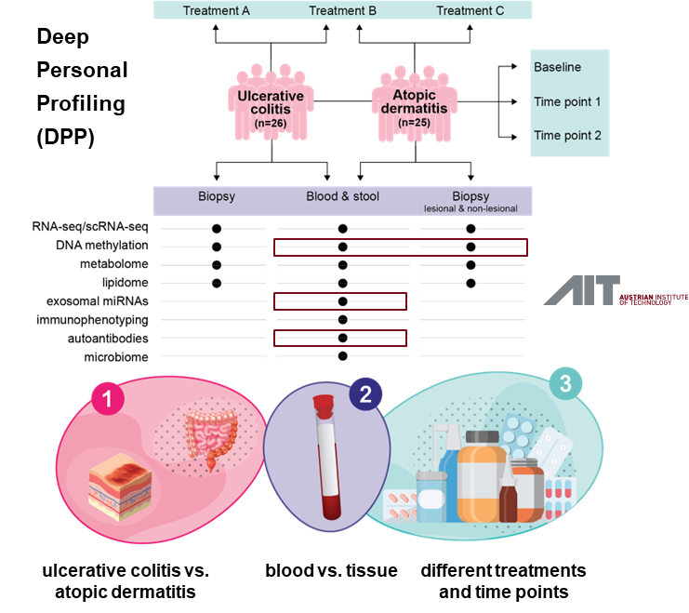
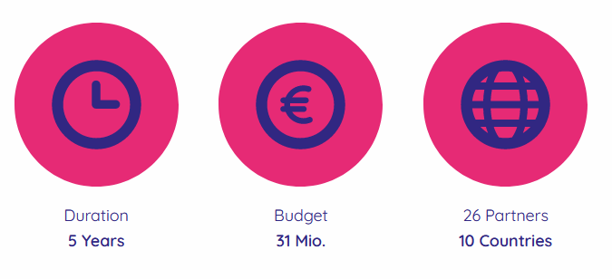
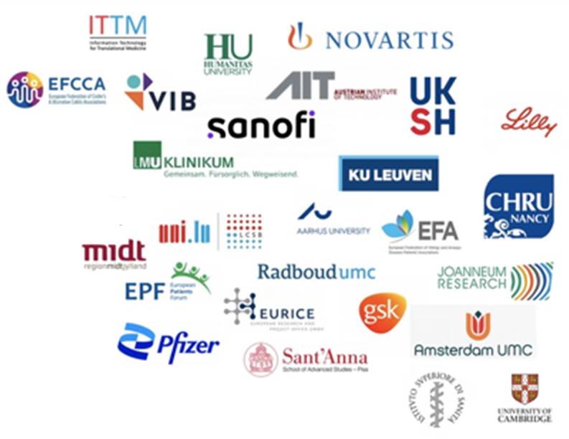
Immuniverse project (IHI)
Identification and validation of circulating biomarkers
for disease progression and treatment response
www.immuniverse.eu
Ulcerative
Colitis
Atopic
Dermatitis
02.11.2025

Slide 7
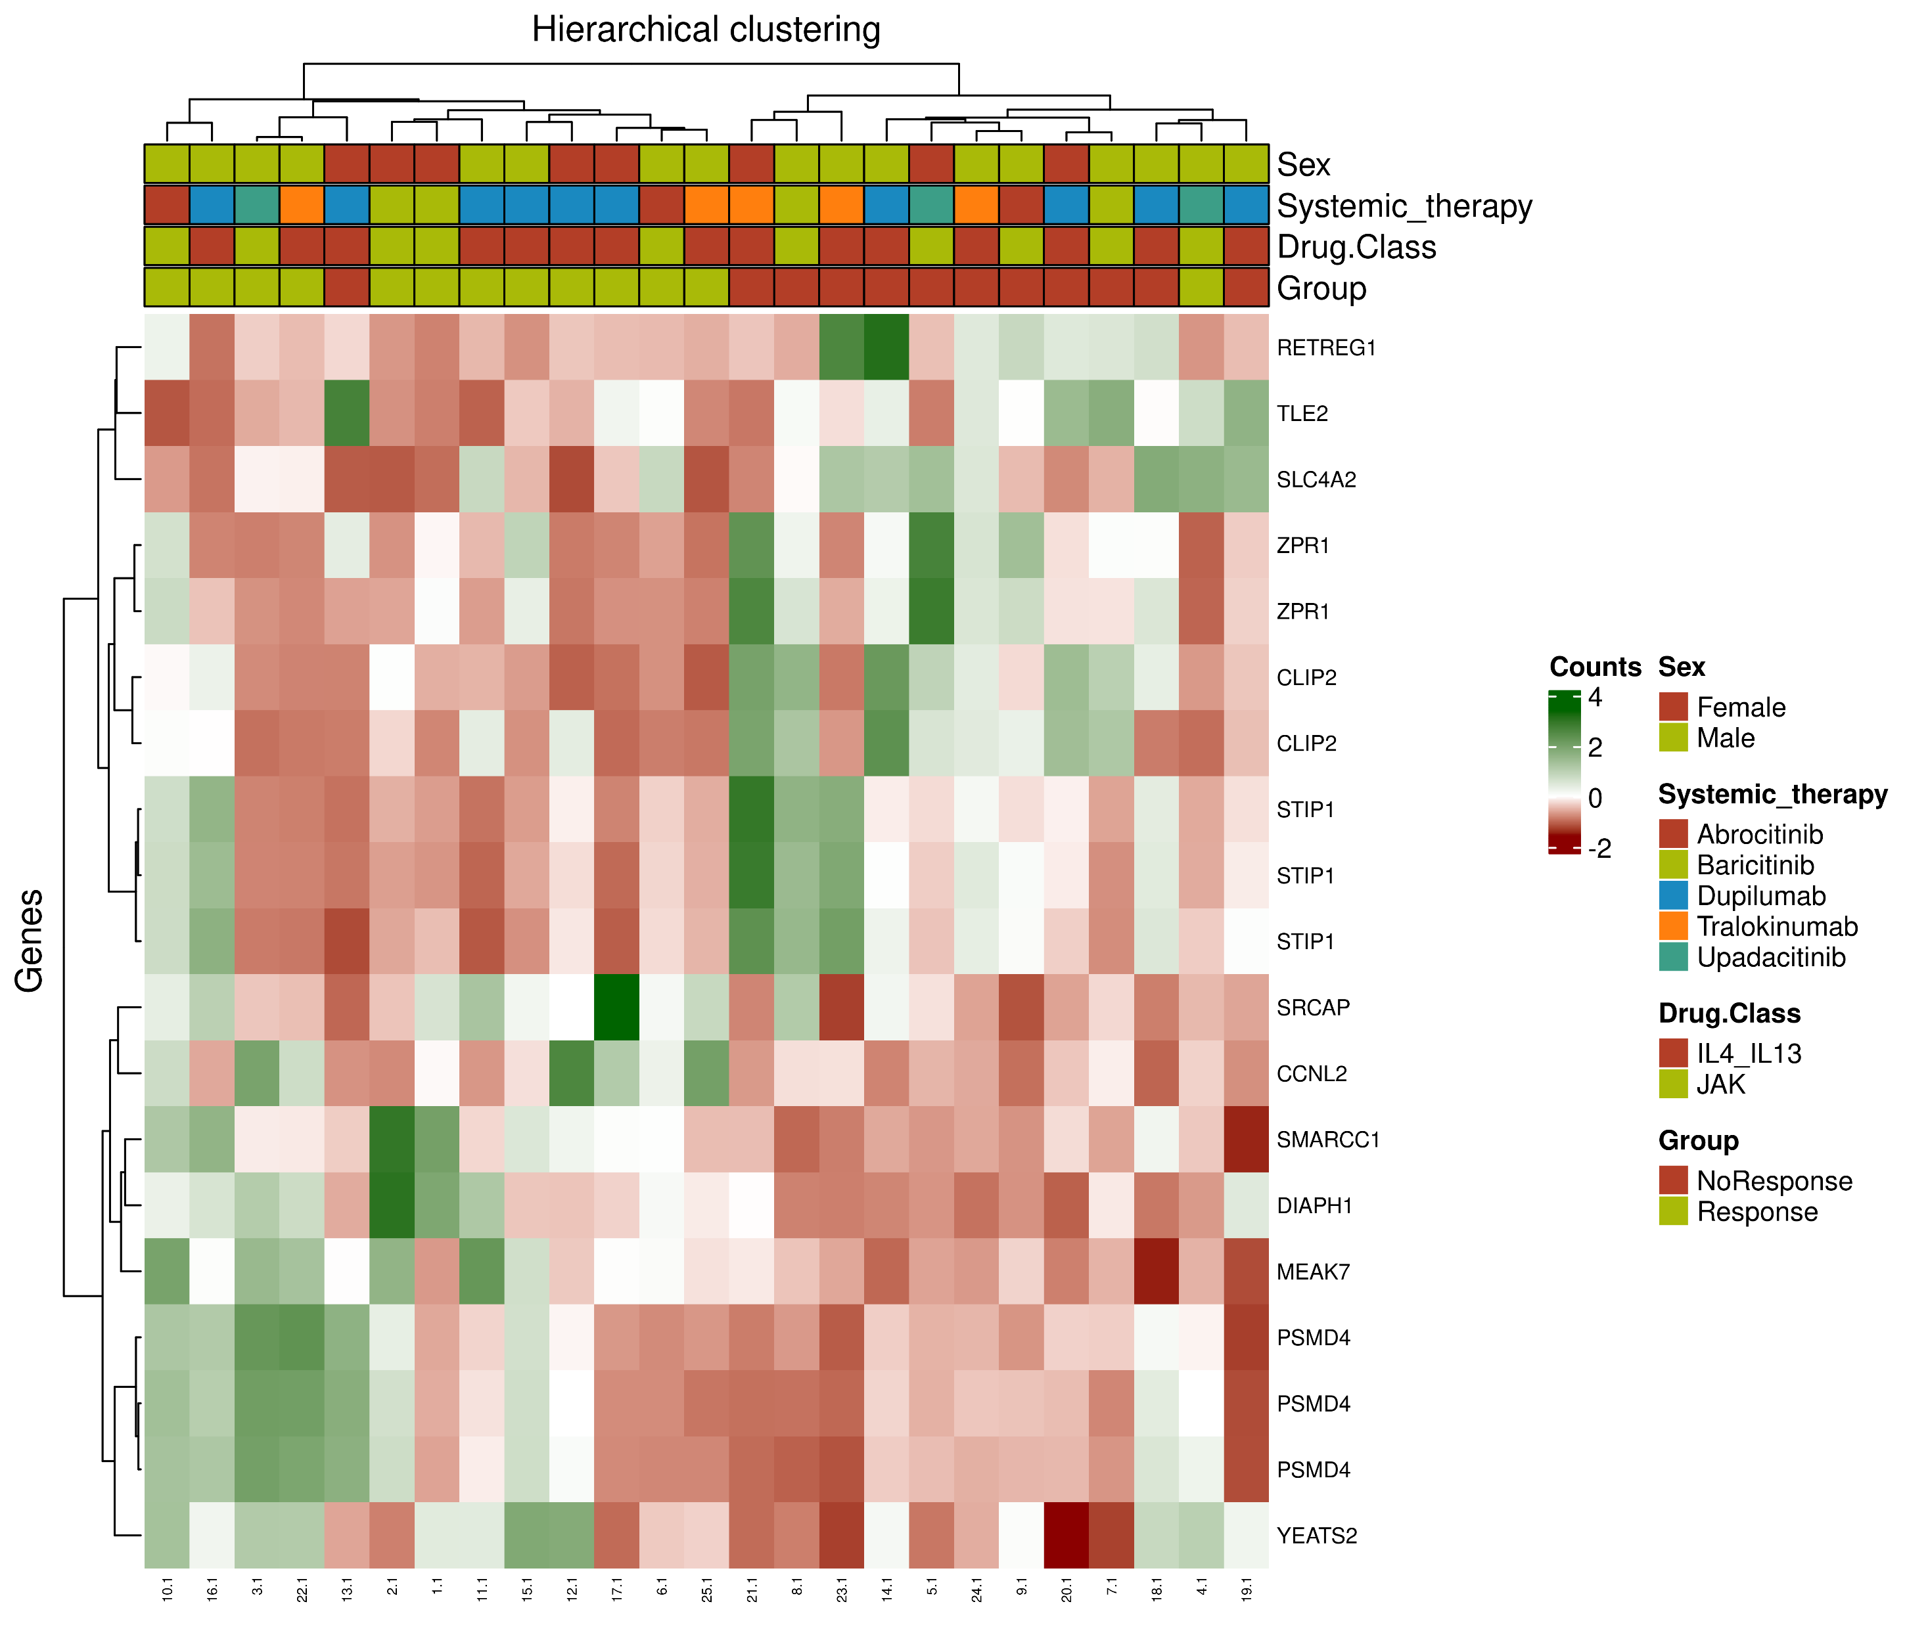
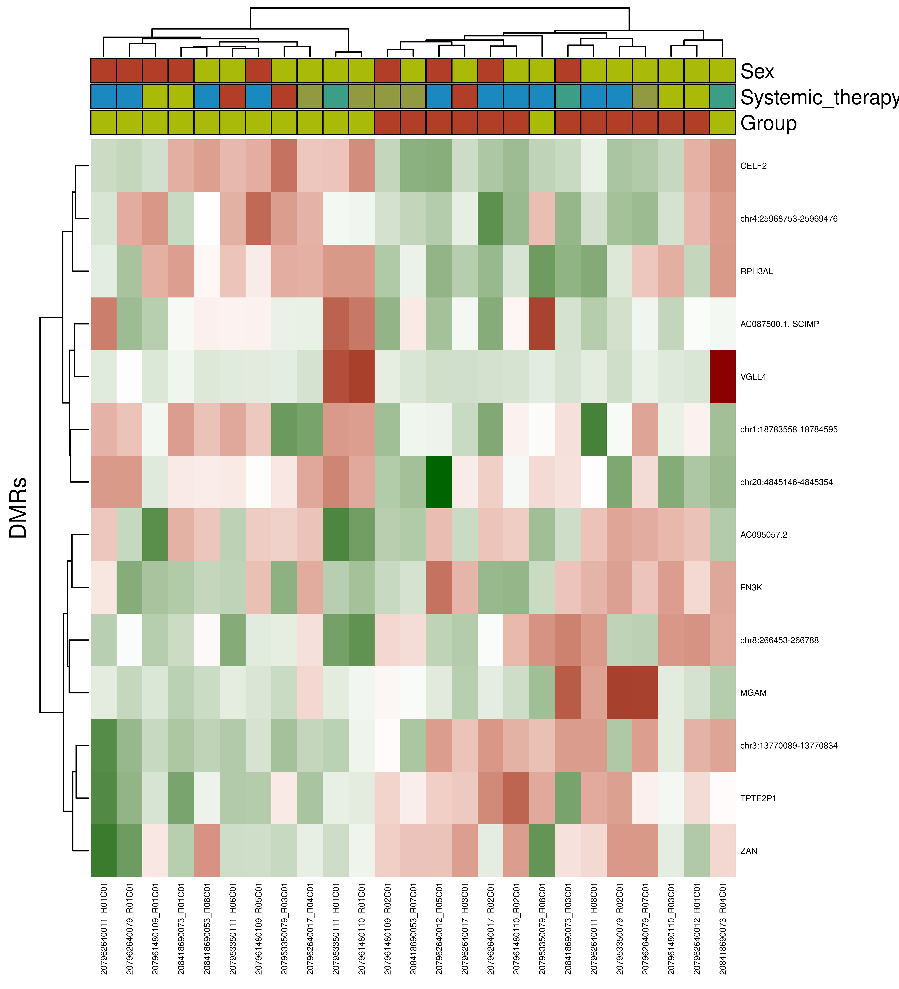
Therapy response Prediction in
Atopic Dermatitis
DNA-m
IL4_IL13 + JAK (Week 0, n=25)
(19 features ; log2FC > 1.5)
IL4_IL13 + JAK (Week 0)
14 DMRs (B diff > |0.1| & adjusted p-value < 0.05)
Auto-Ab

Slide 8

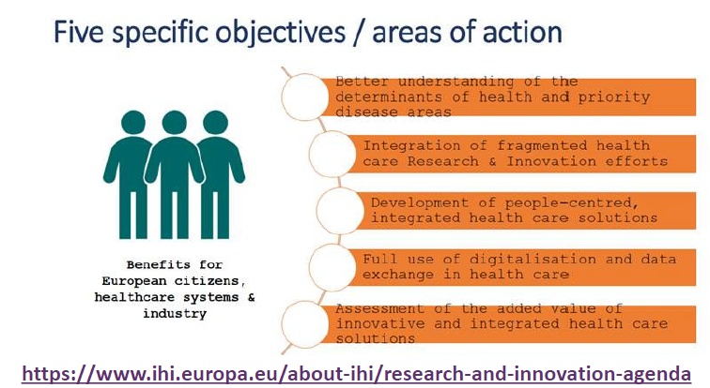
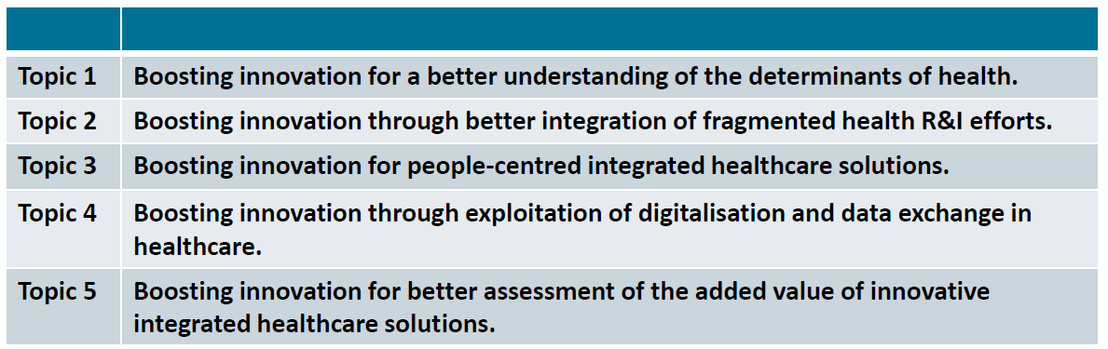

Innovative Health Initiative
Call 12 (single Stage)
https://www.ihi.europa.eu/sites/default/files/uploads/Documents/Calls/FutureTopics/Call_12_DraftText_Oct2025.pdf
Topic 1: Boosting innovation for a better understanding of the determinants of
health (RIA, < 8 000 000 EUR ) → 3 projects funded
Topic 2: Boosting innovation through better integration of fragmented health R&I
efforts (RIA, < 15 000 000 EUR) → 1 project funded
Topic 3: Boosting innovation for peopled centred integrated healthcare solutions
(RIA, < 8 000 000 EUR) → 2-3 projects funded
E.g. multi-omics therapy response prediction biomarkers from liquid biopsy & tissue
Integrative data analysis, key pathway identification
Multi-omics analysis from ex vivo organ cultures
Final Calltext: Jan 2026
Submission deadline: April 1, 2026
Industry funding: min. 45% (in kind and/or financial contribution) – EFPIA, MedTec, SMEs

Slide 9

Upcoming Mission Cancer Calls fitting our Multi-OMIcs Expertise
HORIZON-MISS-2026-02-CANCER-02: Microbiome for early cancer prediction before the onset of disease
RIA 15 Mio € → 1 project funded
Final Calltext: Feb 2026
Submission deadline: Sept 15, 2026
Development of microbiome tools for earlier, better and personalised prediction and prevention of cancer before the onset of the disease (up to 2 years before disease onset) Proposals should deal with several types of cancer if possible.
Assessments of predispositions, AI risk modelling approaches and organ/body simulations.
Collaboration with large cohorts/registries from different communities, usage of existing microbiome and clinical data in combination with and generation of new data (could include other predictive signs such fatigue, unusual pain, weight loss or other body changes)
Citizen engagement could be included with data/sample collections as well as educational programmes.
Comparison with other minimally invasive liquid biopsy tests concerning their predictive power, simplicity, cost-benefits and potential for commercialisation.
Validation of the tests in an independent cohort.
Development of guidelines that help to manage risk factors such as lifestyle or diet.
Outcome and expertise of ongoing EU and International initatives and the International Cancer Microbiome Consortium could be considered for test reliability
Analysis of microbial signatures from tissue and liquid biopsy
Check for prediagnostic antibody profiles against microbes (microbial lysate arrays)
Study of bacterial extracellular vesicles (BEVs)

Slide 10
Upcoming Mission Cancer Calls fitting our Multi-OMIcs Expertise
HORIZON-MISS-2026-02-CANCER-03: Pragmatic clinical trials to optimise immunotherapeutic interventions for patients with refractory cancers
RIA 7-8 Mio € → 3 projects funded
Final Calltext: Feb 2026
Submission deadline: Sept 15, 2026
Proposals should address all the following:
Conduct randomised or cluster-randomised academic investigator-initiated pragmatic clinical trials that benefit patients with refractory cancers (any disease stage, cancer subtype, age group or part of society) - to deliver effective, affordable and tailored immunotherapeutic interventions for implementation by healthcare systems
All data should be disaggregated by sex, gender, age, socio-economic status or ethnicity.
Translational research is limited to supporting biomarker-informed patient stratification and the conduct and analyses of the proposed clinical trial(s).
The primary and secondary endpoints of the pragmatic clinical trials should target overall survival, patient-reported outcomes and quality of life issues considered important by and for cancer patients and their caregivers/families. Such endpoints should be defined together with patients and their caregivers/families through research that stimulates social innovation and supports end-user engagement
Chosen treatment intervention(s) should be adapted to the particular needs of the target population and the specificities of the provision of care at regional, national level, Furthermore, affordability/accessibility should be taken into account.
Applicants should include an appropriate mix of stakeholders
Scope: Patients with refractory cancers across Europe need access to more effective, affordable and tailored cancer immunotherapeutic interventions which keep up with complex/fragmented healthcare landscape & spiralling costs.
Multi-omics therapy response prediction biomarkers from liquid biopsy (& tissue)
Data analysis, feature extraction
Multi-omics analysis from ex vivo organ cultures

Slide 11

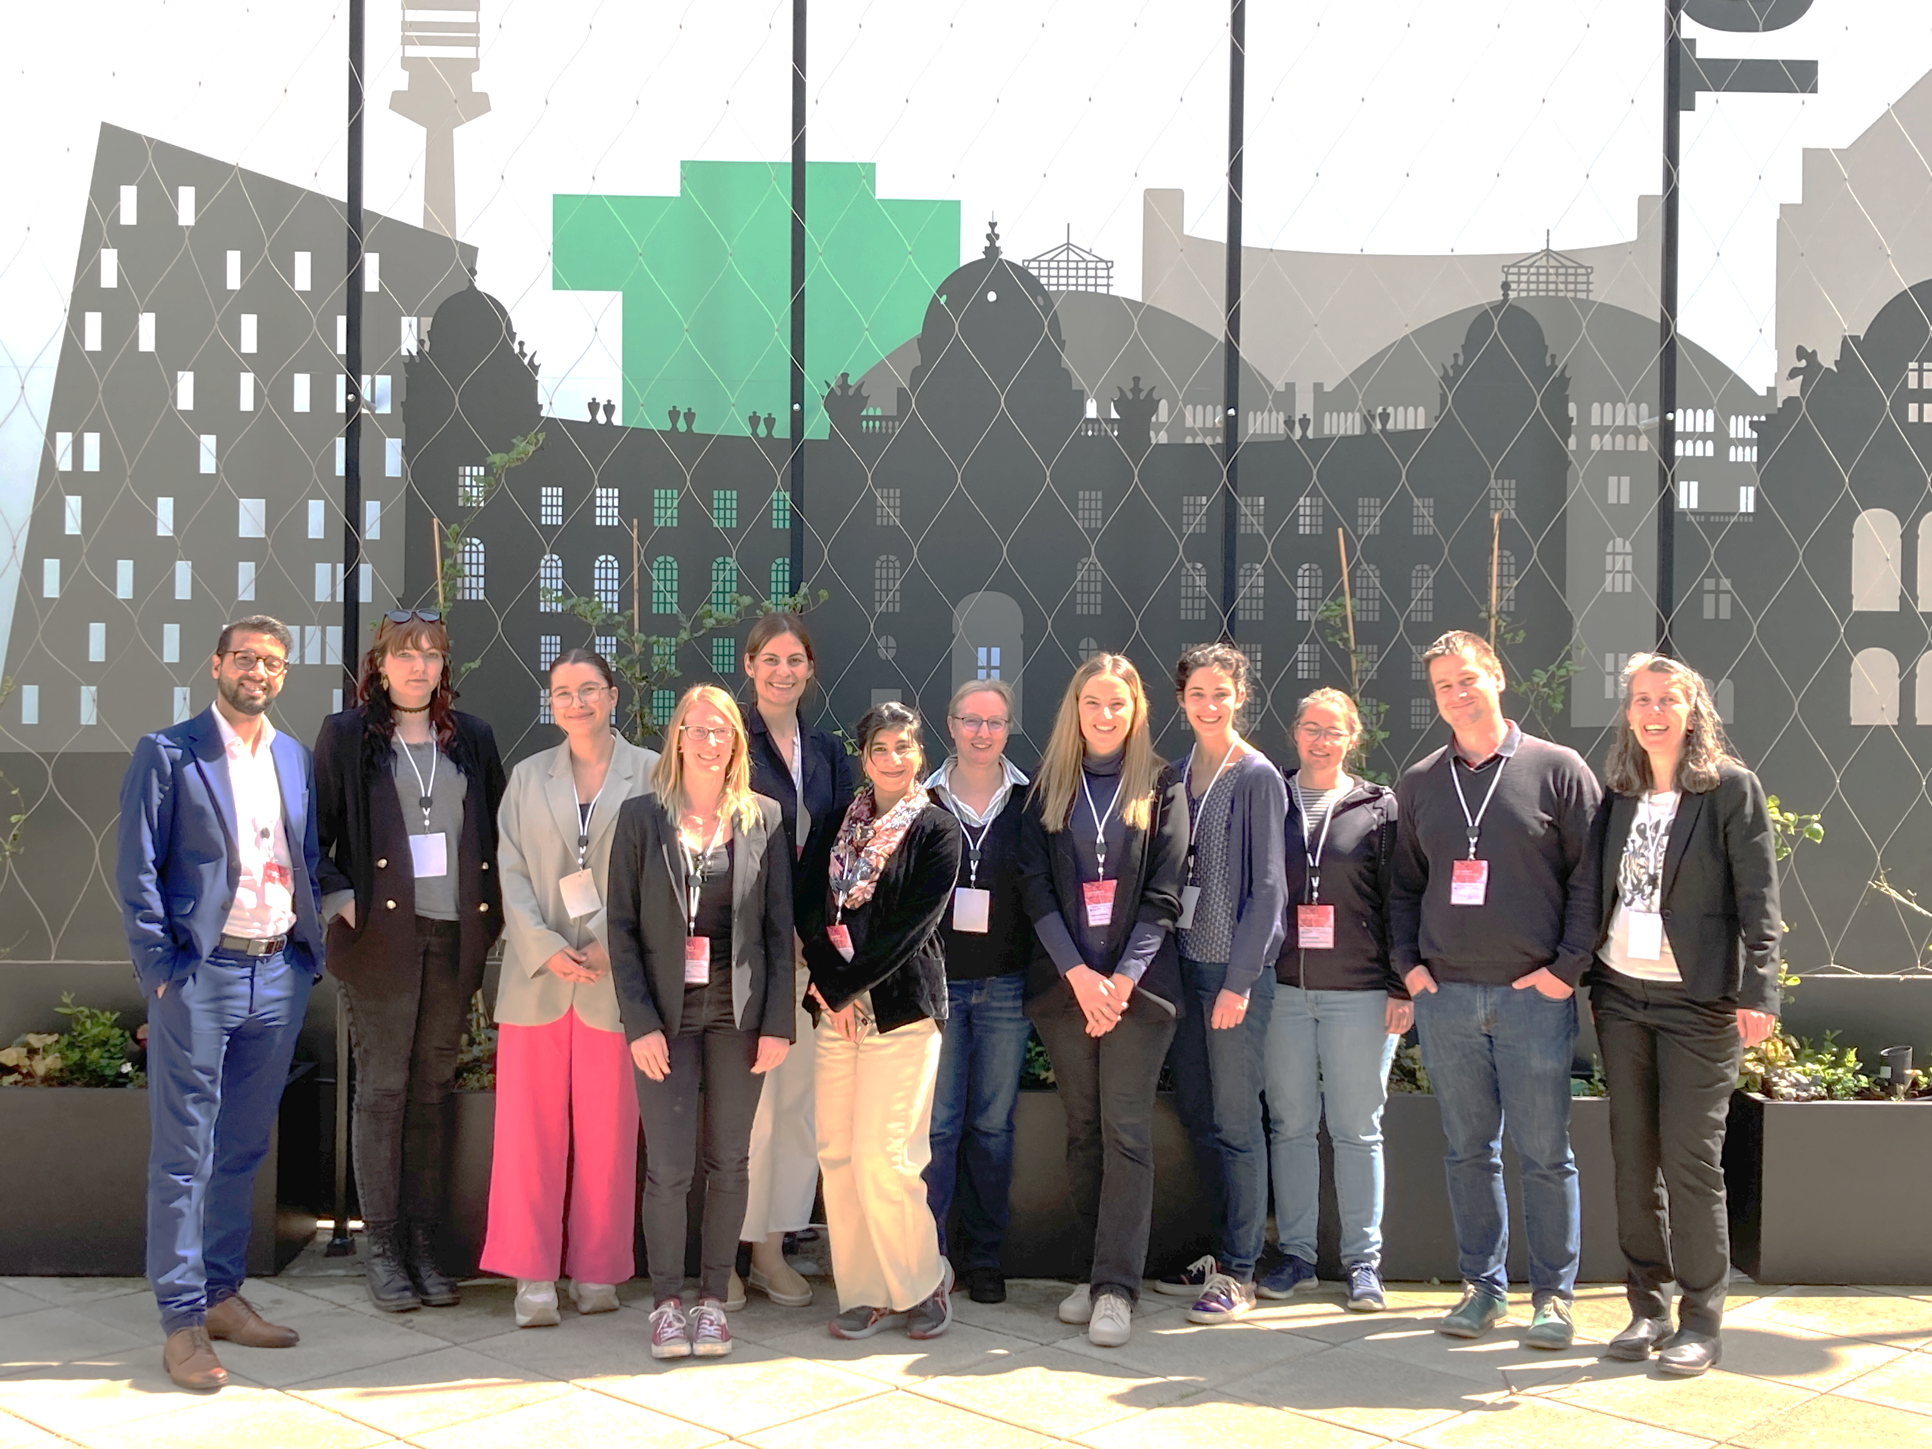

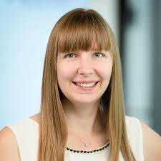


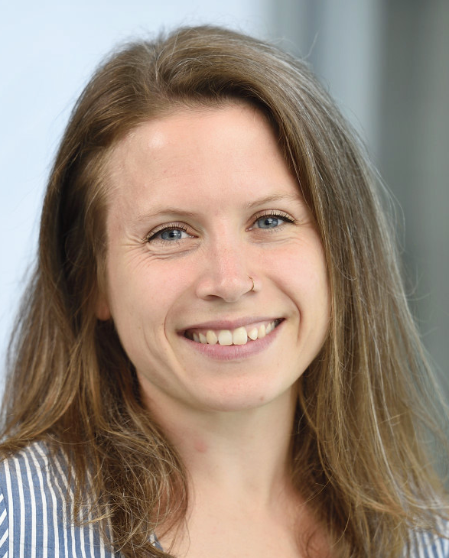
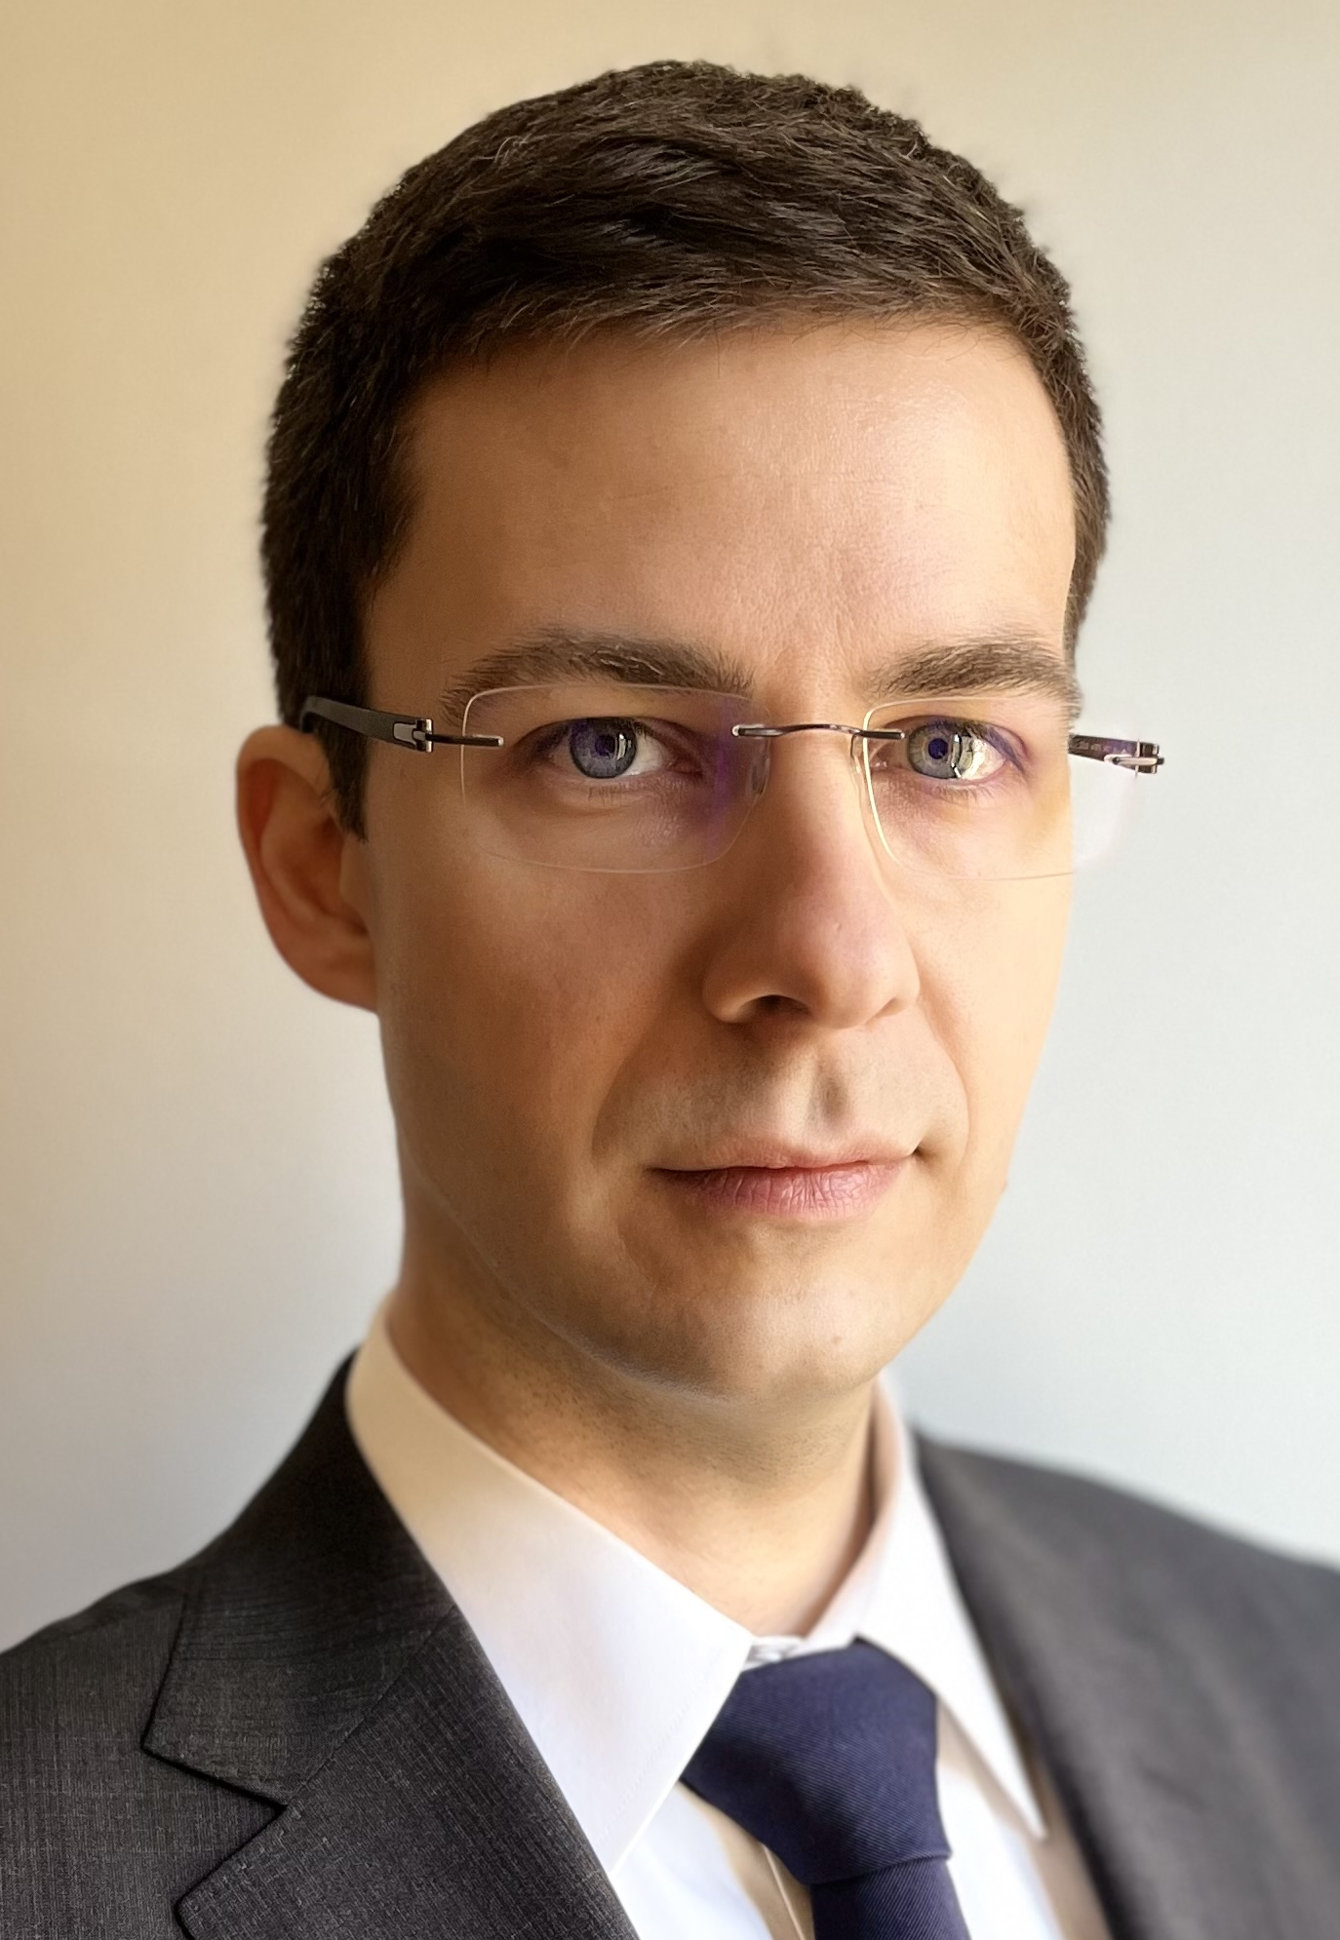
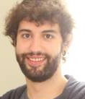





ACKnowledgments
BIOMARKER/
biOINFORMATICS
Jasmin Huber
Ulrike Kegler
Lucia Ciglar
Christa Nöhammer
Michaela Hendling
Gabriel Vignolle
Enrique Ozcariz
Klemens Vierlinger

