Slide 1


The power of Liquid Gold for Molecular Detection and Surveillance of Bladder Cancer using a combined urine and blood Liquid Biopsy assay
ELBS GA – Barcelona
26-27 November 2024
Maes, G.E.*, Parks, M., Feber A., Piechocki, K., Clokie S., Hastings R., Solanki, M., Sale C. and Silcock, L.
Notes:
Title:
The power of Liquid Gold for Molecular Detection and Surveillance of Bladder Cancer using a combined urine and blood Liquid Biopsy assay
Authors:
Maes, G.E.*, Parks, M., Feber A., Piechocki, K., Clokie S., Hastings R., Solanki, M., Sale C. and Silcock, L.
*Presenting author
Affiliation:
Nonacus Ltd
Quinton Business Park, Unit 5,
11 Ridgeway, Quinton, Birmingham,
B32 1AF, United Kingdom
Keywords:
urine biopsy, cfDNA, bladder cancer, haematuria, cancer surveillance, prognosis and diagnosis, patient stratification, precision medicine, next generation sequencing
Abstract
Conventional diagnostic and biopsy modalities for muscle invasive (MIBC) and non-muscle invasive (NMIBC) bladder cancer include cystoscopy, ureteroscopy (with or without biopsy), computed tomography (CT) scans with contrast; all procedures which are invasive, inadequate, and not without side effects. However, despite the omnipresence of urine, there are surprisingly few effective urine liquid biopsy approaches already widely used. Urine can prove to be “liquid gold” since it may be a more abundant source of tumor-derived material without the background noise; however, molecular detection of mutations in uDNA requires a sensitive and accurate method of analysis that allows a high depth of sequencing while minimizing artifacts. For MBIC, plasma or serum can add important information and increase sensitivity during on/post-treatment surveillance, using a paired urine-ctDNA analysis. Although many bladder cancer biorepositories contain serum samples (collected before the genomics era) that could be valuable for evaluation of ctDNA for MIBC patient management, blood serum is considered inferior to plasma because of contamination with white blood cell–derived genomic DNA.
Nonacus’ proprietary GALEAS Bladder genetic test offers a viable alternative to cystoscopy, ensuring a better patient experience, which delivers on the clinical sensitivity (92%; CI 85- 94%) and specificity (86%; CI 82-90%) expected for the detection of any bladder cancer stage or grade (comparable or higher than cystoscopy). Using GALEAS Bladder, as a non-invasive molecular triage in both the haematuria and surveillance pathways, has the potential to significantly reduce the number of cystoscopies by 80% (haematuria and surveillance combined).
Here, we provide an overview of recent clinical validation and study results using GALEAS Bladder in the haematuria and surveillance setting in NMIBC, and the detection of ctDNA in serum and urine-informed use of GALEAS Bladder, circumventing the need for patient-specific assays in MIBC.
Overall, GALEAS Bladder allows for the combination of urine and blood/serum-based analyses to increase the sensitivity of bladder cancer detection and in the future allow for earlier detection and treatment, (molecular) response assessment, patient stratification and further treatment guidance/(de)escalation.

Slide 2

Nonacus specialises in developing ultra-sensitive NGS panels that can detect key variants in both gDNA and cfDNA
Our Mission
Our Vision
Deploy advanced precision medicine platform, enabling decentralized and cutting-edge cancer genomics and democratize early disease detection and monitoring globally
Detecting cancer earlier and informing patient outcomes through the deployment of a truly innovative precision medicine, oncology & liquid biopsy testing platform
Notes:
We specialise in developing ultra-sensitive NGS panels that can detect key variants in both gDNA and cfDNA
In 2015, Nonacus established itself with a clear mission: to prioritize both the end-user and ultimately the patient, by providing high-quality, genetic testing solutions.
Our team consists of biotechnology experts, including those with a background in healthcare and international genome projects, all of whom have a deep understanding of the need for continued evolution and progression for genetic testing solution development.
Our mission is to deploy our precision oncology solutions to enable people access to accurate and cutting-edge cancer genomics solutions worldwide
Our vision is to contribute to creating a world where early cancer diagnosis, detection and management is simple and universally available

Slide 3

Outline
Urine: the liquid gold for molecular detection and surveillance of multiple diseases
Bladder cancer (BLCA) and its current care pathway
GALEAS Bladder: a comprehensive, genetic test for identifying ALL stages of bladder cancer
Overview of recent clinical validation and study results using GALEAS Bladder in the haematuria and surveillance setting in NMIBC
Detection of ctDNA in serum and urine-informed use of GALEAS Bladder, circumventing the need for patient-specific assays in MIBC

Slide 4
Urine:
The liquid gold for molecular detection and surveillance of multiple diseases
Notes:
Bladder cancer (BLCA) is a most common urological tumours with high rate of recurrence, which needs long-term of follow-up. To date, diagnosis and surveillance of BLCA still rely on cystoscopy, an invasive and expensive method that increases the difficulty for routine follow-up. However, they are invasive procedures that may cause pain and infectious complications. Considering the limitations of both procedures, and the recurrence and resistance to BC treatment, new non-invasive methodologies for early diagnosis and multiple evaluations in patients under follow-up for bladder cancer are highly welcomed. Blood/Serum liquid biopsies in the MRD setting detection of circulating tumour DNA (ctDNA) in patients with muscle-invasive bladder cancer (MIBC) pre-empts imaging-detected metastatic relapse, is associated with worse outcomes, and implies a response to adjuvant immune checkpoint inhibition. Blood serum is considered inferior to plasma because of contamination with white blood cell–derived genomic DNA. However, many bladder cancer biorepositories contain serum samples (collected before the genomics era) that could be valuable for evaluation of ctDNA for patient management
Figure 1. Overview of liquid samples and biomarkers in bladder cancer. Liquid biopsy is emerging
as a promising method. It involves using peripheral blood or urine samples for the collection and
examination of six tumor components: CTCs, ctDNA, ctRNA, exosomes, metabolomics, and proteomics.
Peripheral blood and urine samples are then used to extract and examine tumor components.

Slide 5

Bladder cancer causes >200K deaths globally each year
 | UK | Europe | APAC | USA
Hematuria cases* | 1,000,000 | 10,000,000 | 20,000,000 | 9,000,000
Cystoscopies* | 110,000 | 2,030,000 | 2,080,000 | 900,000
Bladder Cancer cases | 11,000 | 203,000 | 208,000 | 90,000
535,000
70%
30%
People living with bladder cancer in the USA (compared to 371,000 lung cancer)
Of bladder cancer cases are lower grade non-muscle invasive disease (NMIBC) and require active surveillance for 5 year to life. 70% will recur within two years.
Of cases are muscle invasive disease (MIBC) of which 50% progress/ die within 5 years.
BUT early detection can significantly impact survival!
Early diagnosis results in >80% survival at 5 years compared to <10% for late diagnosis.

Slide 6

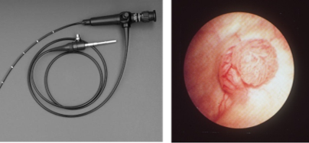
Why is the current standard of care failing patients?
“I have had bladder cancer 4 times. The cystoscopy is so invasive, uncomfortable and embarrassing I actually dread it for weeks before.”
NHS patient’s comment after hearing of GALEAS Bladder
It is at best uncomfortable, at worst painful and invasive
It is inconvenient as it requires a hospital visit
It costs the healthcare provider time and money (£88M* per year in the UK)
Is not without complications
Sensitivity and specificity is operator dependant.
AND 90% of patients referred don’t need it!
* Cost of cystoscopy only (NHS Tariff £330), plus staff time and ancillary costs for £470. Does not represent the full pathway.

Slide 7


Molecular Triage - Reducing the Burden of cystoscopy
Urine Test
Detection of bladder cancer from DNA in a urine sample
Hematuria
Surveillance
Molecular TRIAGE
1 000 000 PER YEAR
Cystoscopy
1 000 000 patients per year (EU)
CONFIRMED
BY CYSTOSCOPY
(420,000 patients
per year)
Positive
420,000
Negative
580,000
Ca. 580,000 Avoided Cystoscopies per year
Notes:
Triage moléculaire - Réduire le fardeau pour les hopitaux & patients
A gauche on voit la norme actuelle de soins de l’hematurie (dépistage + suivi) + avec donc 600 000 cystoscopies qui aurait pu etre evitées
A droite nous proposons une solution de triage moleculaire, composé d’un test de l’urine pour detecter l’ADN tumorale
Grâce à l'intervention moléculaire, 400 000 tests génétiques à partir d'un échantillon d'urine sont effectués au lieu de 400 000 cystoscopies.

Slide 8

Introducing GALEAS™ Bladder
  A comprehensive, laboratory developed, genetic test for identifying all stages of bladder cancer from a urine sample
  Allows patients to provide a sample in the comfort of their own home. No hospital visits,
  no painful procedure.
  Offers equivalent sensitivity and specificity to cystoscopy.
  Reduces the number of unnecessary cystoscopies, reducing costs and resource burden on clinics.
  Leverages targeted next generation sequencing chemistry to accurately detect somatic mutations from 23 genes in over 96% of bladder cancer cases.
  GALEAS Analytics is a sophisticated tool for analyzing biomarker panels that automate diagnosis and support patient monitoring

Slide 9
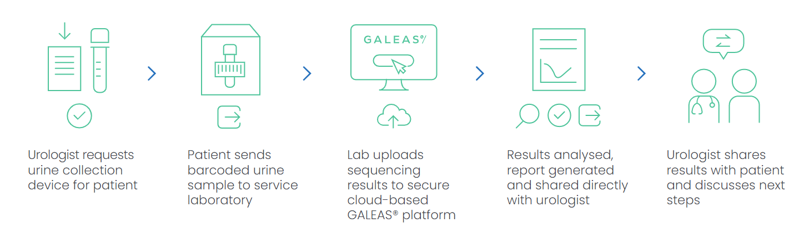



GALEAS™ Bladder workflow (for urologists)
Urologist requests urine collection device for patient
Patient sends barcoded urine sample to service laboratory
Lab uploads sequencing results to secure cloud-based GALEAS® platform
Results analysed, report generated and shared directly with urologist
Urologist shares results with patient and discusses next steps
Components of GALEAS™ Bladder
Urine collection device which allows patients to provide a sample in the comfort of their own home
High-throughput genomic DNA extraction kit extracts tumor-derived DNA from urinary cell-pellets using an easily automated magnetic bead-based protocol.
Comprehensive NGS panel interrogating somatic mutations across 23 genes found in over 96% of bladder cancers.
Reporting provided by the cloud-based GALEAS software

Slide 10
Comprehensive NGS panel
  Biomarkers were identified by Dr Rik Bryan and Dr Doug Ward at Birmingham University UK
  NGS sequencing panel that targets promoter and exonic regions of 23 of the most relevant genes associated with bladder cancer.
  Identified by a combination of publicly available data and deep
  exome sequencing
  -Exome studies were performed on Caucasian populations
  The panel have been shown to accurately detect somatic mutations in over 96% of bladder cancers in over 700 clinical samples.
  Compatible with all Illumina sequencers
  384 patient/sample indexes ensure that customer can use the
  GALEAS™ Bladder Cancer panel on the smallest to the largest output sequencers.
AKT1 | ERBB2 | NRAS
BRAF | ERBB3 | PIK3CA
C3orf70 | ERRC2 | RHOB
CDKN1A | FBXW7 | RXRA
CDKN2A | FGFR3 | SF3B1
CREBBP | HRAS | TERT (promoter)
CTNNB1 | KDM6A | TP53
ELF3 | KRAS
Equivalent sensitivity and specificity to cystoscopy across all grades and stages.
Reducing cystoscopies by ~90%
.

Slide 11
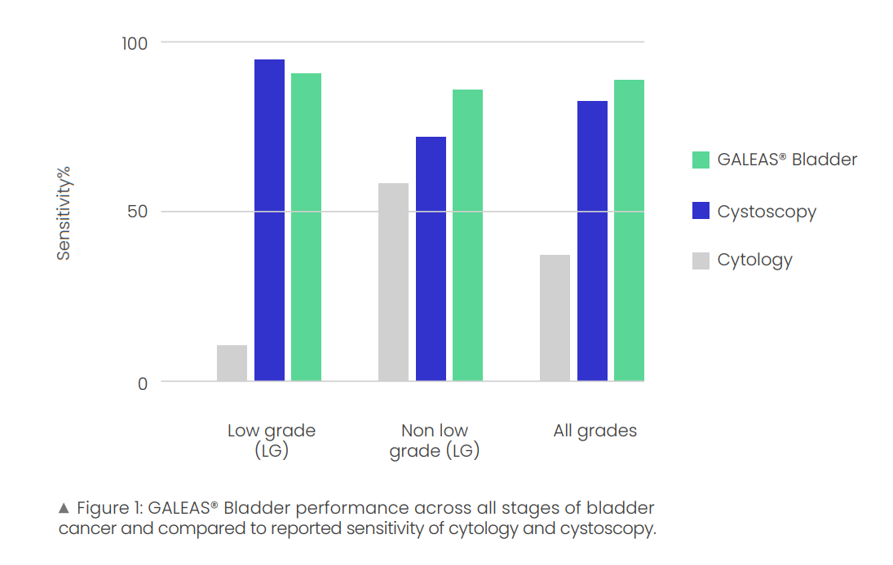
GALEAS™ Bladder Hematuria Clinical Sensitivity (NMIBC)
Validated in 710 urine samples from 3 UK clinical cohorts
  375 positive bladder cancer cases
  335 negative i.e. no cancer at the time of cystoscopy
 | Sensitivity | Specificity | NPV
pTa | 89% | 86% | 99%
T1 | 97% | 86% | 99%
T2+ | 92% | 86% | 99%
G1 | 78% | 86% | 99%
G2 | 93% | 86% | 99%
G3 | 96% | 86% | 99%
NMIBC | 92% | 86% | 99%
MIBC | 92% | 86% | 99%
Equivalent sensitivity and specificity to cystoscopy across all grades and stages.
Reducing cystoscopies by ~90%
.
References
Svatek RS, Hollenbeck BK, Holmäng S, Lee R, Kim SP, Stenzl A, Lotan Y. The economics of bladder cancer: costs and considerations of caring for this disease. Eur Urol. 2014 Aug;66(2):253-62. doi: 10.1016/j.eururo.2014.01.006. Epub 2014 Jan 21. PMID: 24472711.
Zheng C, Lv Y, Zhong Q, Wang R, Jiang Q. Narrow band imaging diagnosis of bladder cancer: systematic review and meta-analysis. BJU Int. 2012 Dec;110(11 Pt B):E680-7. doi: 10.1111/j.1464-410X.2012.11500.x. Epub 2012 Sep 18. PMID: 22985502.
Notes:
GALEAS™ Bladder Technical Performance
To demonstrate the analytical performance of GALEAS Bladder, two series of contrived reference standards were tested (cell line A and cell line B) and run in triplicate by two different operators, representing tumor cell fractions ranging from 100% to 0% in a wild-type normal DNA background. A total of 105 mutations were assessed across both cell lines and replicates. GALEAS Bladder demonstrated >99% sensitivity for the detection of variants. No false positives were identified, all wild type samples were defined as GALEAS Bladder negative (0/15). Across the 105 mutations assessed there was high concordance (R2 >0.99) between GALEAS Bladder and qPCR derived VAFs.
GALEAS™ Bladder Hematuria Clinical Sensitivity (NMIBC)
To validate GALEAS Bladder, urinary pellet DNA from a cohort of 710 hematuria patients was analysed. This included 335 samples confirmed cancer free hematuria patients and 375 confirmed cancer urines. The clinicopathological features of the included cystoscopy patients were recorded. The analysis yielded an overall sensitivity of 92% (CI 85- 94%) and specificity of 86% (CI 82-90%) for the detection of any bladder cancer stage or grade. The test exhibited high sensitivity across all grades of bladder cancer; when stratified by grade, the test sensitivity for the detection of Grade 3 disease was 96% (95% CI 92-98%), 93% (95% CI 86-97%) for Grade 2 disease and importantly the sensitivity for the detection of Grade 1 disease was 78% (95% CI 65-88%). When separated into non-muscle invasive (NMIBC) and muscle invasive (MIBC) disease, the sensitivity was 92% (CI 84-97) and 92% (CI 88-95%) respectfully (Table 2), whilst retaining a specificity of 86%. All cases of solitary carcinoma in situ (n=3) were GALEAS Bladder positive.
Overall, the prevalence corrected Negative Predictive Value (NPV) was 98.8%. When taking into account grade, the NPV remained >98% across all grades (Table 2). In logistic regression analysis, a positive GALEAS Bladder result predicted the presence of bladder cancer with an odds ratio (OR) of 52.6 (95% CI 34.4 - 82.2, p<0.001). In multivariate analysis, adjusting for stage, grade, age and gender, GALEAS Bladder was an independent predictor of bladder cancer presence (OR 38.2, 95% CI 24.7 - 60.6, p<0.001).

Slide 12
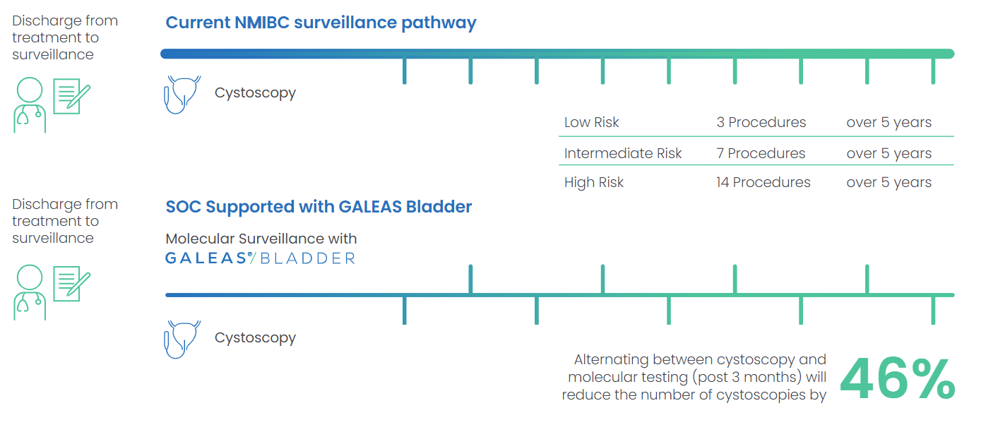
NMIBC Surveillance
GALEAS™ Bladder could be used to reduce the number of cystoscopies in the surveillance pathway by 46%

Slide 13
GALEAS™ Bladder Surveillance Clinical Sensitivity (NMIBC)
GALEAS Bladder has been validated using urine samples from a cohort of 289 patients undergoing surveillance cystoscopy for NMIBC disease recurrence.
  20 patients were confirmed to have cancer at the time of their surveillance cystoscopy
  19 were confirmed as positive by GALEAS Bladder
Of the 268 patients negative on the day of surveillance cystoscopy,
  23 were subsequently diagnosed with bladder cancer recurrence at a future cystoscopy (2-24 Months).
  13 of these were identified as GALEAS Bladder positive at the time of their negative surveillance cystoscopy.
 | Sensitivity | Specificity | NPV
NMIBC positive surveillance | 95% | 86% | 99.4%
This data demonstrates the potential for GALEAS Bladder to safely reduce the number of cystoscopies across the entire bladder cancer pathway, cancer patients from hematuria triage to disease recurrence
Notes:
Q1) What was the reason 1 positive sample was not detected?
A1) The undetected sample does not have mutations from the classifier to be deemed likely cancer. It should be noted that the current analytics pipeline used by GALEAS Bladder is tuned for the haematuria setting which is slightly different use case to surveillance.
GALEAS™ Bladder Surveillance Clinical Sensitivity (NMIBC)
GALEAS Bladder was also validated using a cohort of urine samples collected from patients undergoing surveillance cystoscopy for NMIBC disease recurrence. Of the 289 urine samples collected, 21 were confirmed to have cancer at the time of their surveillance cystoscopy. 20 passed GALEAS Bladder QC, of these, 19 were correctly identified as positive by GALEAS Bladder. This cohort of data indicates GALEAS Bladder has an overall sensitivity for the detection of bladder cancer recurrence of 95% (95% CI 76 – 100%), an NPV of 99.4% and an odds ratio of 3.63 (95% CI 1.71- 5.76, p<0.001). Of the 268 patients negative on the day of their surveillance cystoscopy, 23 were subsequently diagnosed with bladder cancer recurrence at a future cystoscopy (2–24 months). Of these, 13 were identified as GALEAS Bladder positive at the time of their negative surveillance cystoscopy.

Slide 14
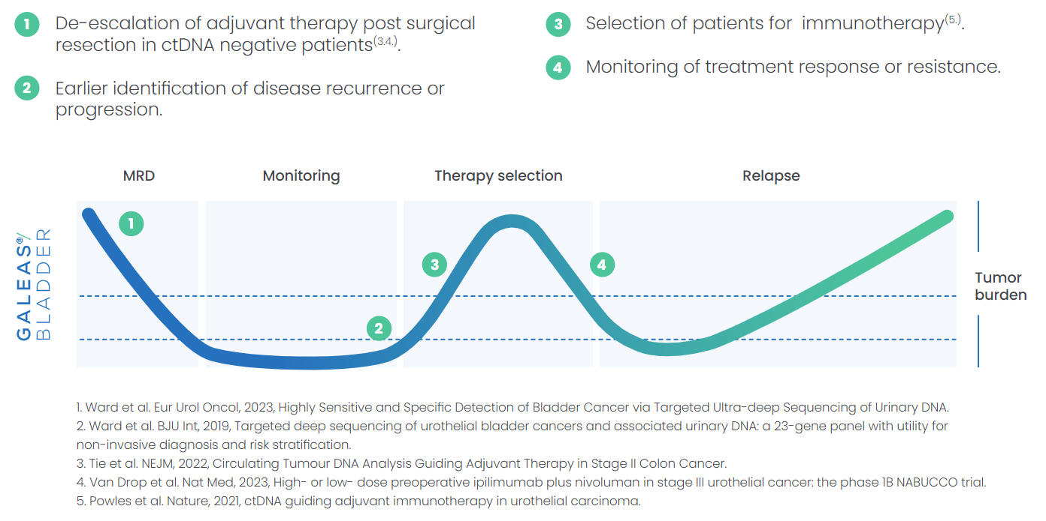
Circulating tumor DNA (ctDNA) guided monitoring for MIBC
The unique design of GALEAS® Bladder allows the test to be used as a blood-based test, post surgical resection to detect circulating tumor DNA and monitor treatment response and resistance in MIBC.

Slide 15
GALEAS™ Bladder MRD Clinical Sensitivity (MIBC)
GALEAS Bladder has been evaluated for the detection of ctDNA/utDNA in archived serum (more available than plasma) for its application in MIBC. Two ctDNA detection approaches were applied to samples from 40 patients with MIBC :
  The reliable use of small volumes of serum
  The urine-informed use of GALEAS Bladder, circumventing the need for patient-specific assays.
Urine samples from all 40 patients with MIBC harbored mutations
Most frequently mutated genes within the GALEAS Bladder panel were TERT (90%), ADGRG6 (57%), TP53 (45%), PLEKHS1 (35%), and PIK3CA (25%)
Each urine sample harbored five mutations, with a mean variant allele frequency (VAF) of 16%
Urine-informed cfDNA analysis requiring at least two consensus reads and VAF >0.04% for mutation detection identified at least one mutation in the sera of 24/40 patients (60%), and a mean of 2.8 mutations per sample (mean VAF 1.8%).
The ctDNA positivity rate was 56% for T2, 64% for T3, and 80% for T4 cases; 47% for N0 versus 71% for N+ cases; and 47% for M0 versus 67% for M+ cases
Notes:
Detection of circulating tumour DNA (ctDNA) in patients
with muscle-invasive bladder cancer (MIBC) pre-empts
imaging-detected metastatic relapse [1,2], is associated with
worse outcomes [1,2], and implies a response to adjuvant
immune checkpoint inhibition [3]. Typically, ctDNA detection
relies on sequencing of tumour tissue and the development
of patient-specific ctDNA assays [1–3]; such assays
may be challenging to implement in routine health care.
Blood serum is considered inferior to plasma because of
contamination with white blood cell–derived genomic DNA.
However, many bladder cancer biorepositories contain serum
samples (collected before the genomics era) that could be
valuable for evaluation of ctDNA for patient management.
Here we describe two novel approaches for detection of
ctDNA: (1) reliable use of small volumes of serum and (2)
urine-informed use of a bladder-cancer gene panel, circumventing
the need for patient-specific assays. The latter is relevant
since it is possible that tumour mutation data may
already be available consequential to urine DNA sequencing
during diagnostic workup [4,5].
GALEAS™ Bladder MRD Clinical Sensitivity (MIBC)
The urine samples from 40 patients with MIBC all harboured mutations; the most frequently mutated genes within the GALEAS Bladder panel were TERT (90%), ADGRG6 (57%), TP53 (45%), PLEKHS1 (35%), and PIK3CA (25%). On average, each urine sample harboured five mutations, with a mean variant allele frequency (VAF) of 16%. Urine-informed cfDNA analysis requiring at least two consensus reads and VAF >0.04% for mutation detection identified at least one mutation in the sera of 24/40 patients (60%), and a mean of 2.8 mutations per sample (mean VAF 1.8%).
The ctDNA positivity rate was 56% for T2, 64% for T3, and 80% for T4 cases; 47% for N0 versus 71% for N+ cases; and 47% for M0 versus 67% for M+ cases In ctDNA, the five most frequently mutated genes were TERT (45%), ADGRG6 (27%), TP53 (22%), PLEKHS1 (10%), and PIK3CA (7%; Fig. 1A). The presence of ctDNA was associated with worse overall survival (p = 0.017) and disease-specific survival (p = 0.012).
We performed GALEAS Bladder analysis of tumour tissue for ten urine-serum sample pairs. Tissue-informed analyses (using the same approach as for urine-informed analyses) also detected ctDNA in 60% of serum samples, with ctDNA positive/negative status unchanged from the urineinformed analyses.
The most common bladder cancer - non-muscle-invasive bladder cancer - will be staged as follows:
Carcinoma in situ (CIS): This appears as flat, red areas in your bladder. This type of bladder cancer is more likely to come back after treatment, often as another non-invasive cancer in the bladder. CIS is always classed as high grade. It can grow more quickly and can become invasive. This means it may need different treatment to other non-muscle-invasive bladder cancers.
Ta: Here the tumour is found as a mushroom-like growth (papillary cancer) growing only in the innermost lining of your bladder.
T1: The tumour has started to grow into the connective tissue just below the bladder lining.
The rarer muscle-invasive bladder cancer is staged as follows:
T2: The tumour has grown into the muscle layer in your bladder.
T3: The tumour has spread through the muscle layer to the outer fat layer around your bladder.
Advanced / metastatic bladder cancer
T4: The cancer has spread outside your bladder to other organs. For example, with locally advanced disease, the cancer may have spread into the pelvic wall, the prostate in men, or the womb or vagina in women. If there are distant metastases, it means the cancer has spread beyond the surrounding areas, to other parts of your body such as the liver, bones or lungs.
Nodes (N)
N0: No cancer is found in any of your lymph nodes.
N1: Cancer is found in one lymph node and is smaller than 2 cm.
N2: Cancer is found in one lymph node and is bigger than 2 cm but less than 5 cm OR the cancer has spread to more than one lymph node, but is smaller than 5 cm.
N3: Cancer is found in at least one lymph node and is 5 cm in size.
Metastasis (M)
M0: The cancer has not spread to other parts of your body.
M1: The cancer has spread to other parts of your body. This is also known as secondary, metastatic or advanced bladder cancer. The organs likely to be affected are your bones, liver or lungs.

Slide 16
GALEAS™ Bladder MRD Clinical Sensitivity (MIBC)
The presence of ctDNA was associated with worse overall survival (p = 0.017) and disease-specific survival (p = 0.012)
Mutated genes and VAFs in paired urine DNA and serum ctDNA from 40 MIBC patients
GALEAS Bladder analysis of tumour tissue for ten urine-serum sample pairs also detected ctDNA in 60% of serum samples, with ctDNA positive/negative status unchanged from the urine-informed analyses.
Notes:
Fig. 1 – (A) Mutated genes and VAFs in paired urine DNA and serum ctDNA from 40 MIBC patients; the top histogram summarises the number of mutated
genes in the serum and urine of each patient and the histogram on the right shows how frequently each gene is mutated across the samples. Kaplan-Meier
curves are shown for (B) overall survival and (C) disease-specific survival for ctDNA-positive and ctDNA-negative patients.

Slide 17
Ongoing RWE studies using GALEAS™ Bladder
Hematuria setting
BC-Recon a 3,000 samples multi-centre (10 hospitals) observational case control study for Bladder Cancer in the Hematuria setting
Real World Evidence study of Galeas Bladder implementation at 12 sites: 1,200 samples
Upper Tract Urothelial Carcinoma
Real World Evidence study UT-UC using Galeas Bladder: 2 sites enrolled
Surveillance setting
Real World Evidence study in NMIBC for surveillance setting using Urine: 1,200 Samples
We are actively seeking Urologists that we could work and collaborate with!!
Notes:
SUMMARY & PERSPECTIVES
GALEAS Bladder offers a highly promising non-invasive urinary biomarker test for ruling out the presence of bladder cancer in patients undergoing investigation for both hematuria and disease recurrence. The performance characteristics mean GALEAS Bladder has the potential to safely reduce the number of unnecessary cystoscopies across the entire bladder cancer pathway, reducing the cost of managing the disease and improving patients’ quality of life.
GALEAS Bladder also represents a promising and robust single assay for urine and serum/plasma, obviating the need for tumour (and germline) sequencing before liquid biopsy analyses for ctDNA detection in patients in whom utDNA has already been identified. Size selection improves ctDNA detection in serum, allowing analysis of historic biospecimens.
Overall, GALEAS Bladder allow for the combination of urine and blood analyses, as such increasing sensitivity and in the future allowing for early treatment, (molecular) response assessment, patient stratification and treatment guidance/(de)escalation.
BC-Recon a 3,000 sample a multi-centre (10 hospital) observational case control study for Bladder Cancer in the Hematuria setting
Real World Evidence study of Galeas Bladder (Hematuria setting) implementation at 12 sites 1,200 samples
Real World Evidence study of Galeas Bladder (Upper Tract Urothelial Carcinoma) 2 sites enrolled
Real World Evidence study in NMIBC for surveillance setting using Urine 1,200 Samples
We are actively seeking Urologists that we could work and collaborate with!!

Slide 18
Future Applications of GALEAS™ Bladder
Disease stratification
We are building the clinical evidence to demonstrate that GALEAS™ Bladder can stratify low- and high-grade bladder cancer which will be key in improving patient outcomes
Responders vs non-responders stratification to treatment as next step
Companion Diagnostics (CDx)
Many Pharma companies are using genetic signatures to target therapies E.g. FGFR3 inhibitors
Whole care pathway
Bladder cancer has one of the highest recurrence rates of any cancer. GALEAS™ Bladder has the potential to be used as an alternative to cystoscopies in monitoring patients for recurrence without changing workflows
Notes:
SUMMARY & PERSPECTIVES
GALEAS Bladder offers a highly promising non-invasive urinary biomarker test for ruling out the presence of bladder cancer in patients undergoing investigation for both hematuria and disease recurrence. The performance characteristics mean GALEAS Bladder has the potential to safely reduce the number of unnecessary cystoscopies across the entire bladder cancer pathway, reducing the cost of managing the disease and improving patients’ quality of life.
GALEAS Bladder also represents a promising and robust single assay for urine and serum/plasma, obviating the need for tumour (and germline) sequencing before liquid biopsy analyses for ctDNA detection in patients in whom utDNA has already been identified. Size selection improves ctDNA detection in serum, allowing analysis of historic biospecimens.
Overall, GALEAS Bladder allow for the combination of urine and blood analyses, as such increasing sensitivity and in the future allowing for early treatment, (molecular) response assessment, patient stratification and treatment guidance/(de)escalation.
BC-Recon a 3,000 sample a multi-centre (10 hospital) observational case control study for Bladder Cancer in the Hematuria setting
Real World Evidence study of Galeas Bladder (Hematuria setting) implementation at 12 sites 1,200 samples
Real World Evidence study of Galeas Bladder (Upper Tract Urothelial Carcinoma) 2 sites enrolled
Real World Evidence study in NMIBC for surveillance setting using Urine 1,200 Samples
We are actively seeking Urologists that we could work and collaborate with!!

Slide 19
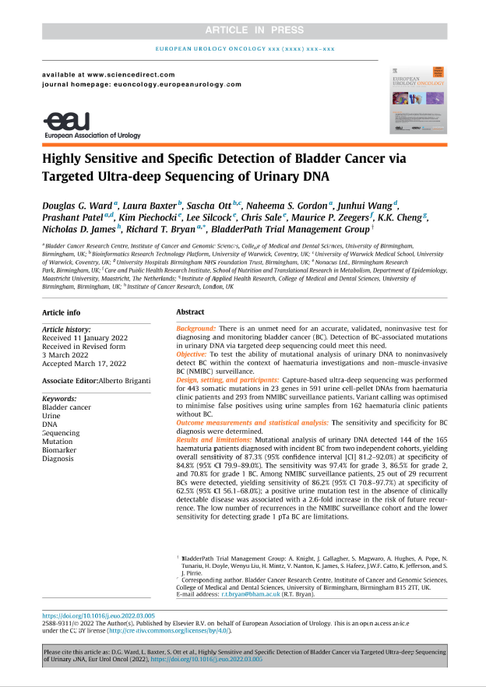

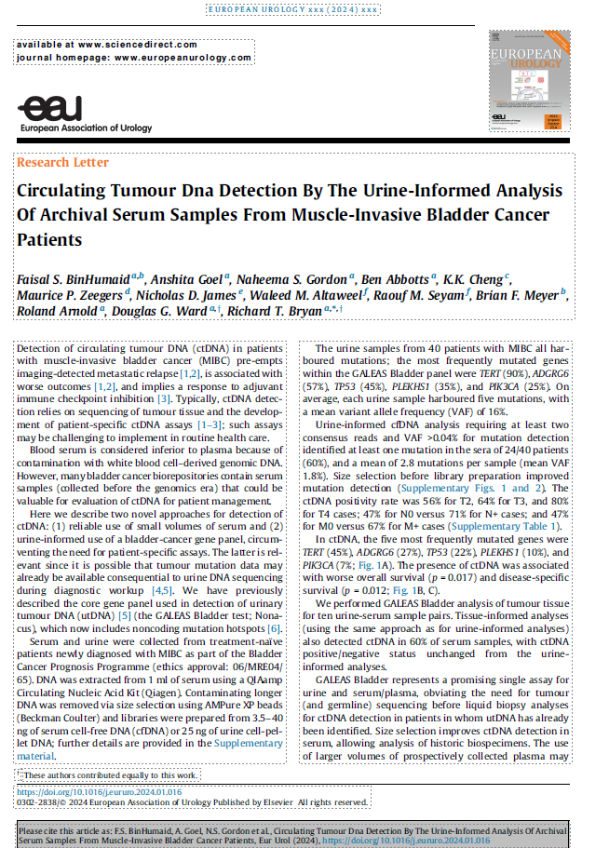
References
Douglas G. Ward, et al, Highly Sensitive and Specific Detection of Bladder Cancer via Targeted Ultra-deep Sequencing of Urinary DNA, European Urology Oncology, 2022, ISSN 2588-9311, https://doi.org/10.1016/j.euo.2022.03.005.
Ward DG, et al, Targeted deep sequencing of urothelial bladder cancers and associated urinary DNA: a 23-gene panel with utility for non-invasive diagnosis and risk stratification. BJU Int. 2019 Sep;124(3):532-544. https://doi.org/10.1111/bju.14808 Epub 2019 Jun 19. PMID: 31077629; PMCID: PMC6772022.
BinHumaid FS, Goel A, Gordon NS, Abbotts B, Cheng KK, Zeegers MP, James ND, Altaweel WM, Seyam RM, Meyer BF, Arnold R, Ward DG, Bryan RT. Circulating Tumour DNA Detection By The Urine-Informed Analysis Of Archival Serum Samples From Muscle-Invasive Bladder Cancer Patients. Eur Urol. 2024 May;85(5):508-509. https://doi:10.1016/j.eururo.2024.01.016 Epub 2024 Feb 1. PMID: 38302315.

Slide 20


Further information
Global Pharma and Strategic Alliances contact: gregory.maes@nonacus.com
For more information on our precision medicine solutions: https://nonacus.com/
For more information on our GALEAS® solutions: https://nonacus.com/oncology/
Or contact Nonacus directly: info@nonacus.com
Quinton Business Park, Unit 5, 11 Ridgeway,
Quinton, Birmingham, B32 1AF, United Kingdom
nonacus.com
Notes:
Pour plus d’infos, veuillez consulter notre sit web dedie à GALEAS (veuillez aussi checker les autres solution GALEAS qui y seront sous peu!)
Je redonne maintenant la parole à Elodie, qui va vous introduire aux panels customises de Nonacus avant de laisser la parole au prof Alex Harlé.
Merci!

Slide 21
Thank you for your time, any questions?

Slide 22
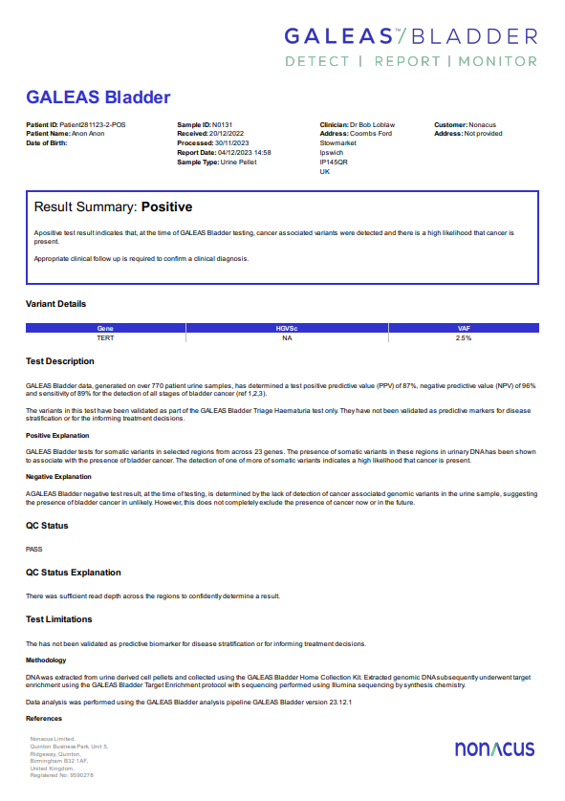
GALEAS™ Software – Cloud based, end to end solution for bioinformatics
Bulk upload of sequencing data (FASTQ files) via simple application; no minimum sample number
Automated ‘sample to report’ analysis pipeline, requiring no specialist training to interpret data
Simple report – ‘Yes’ or ‘No’ to likely presence of Bladder cancer
Detailed report of somatic variants identified
Report available as .pdf or .JSON and sent directly to service lab
Download batches of results
Reports on failed samples

