Slide 1
Exploring the dual analysis of circulating tumour cells and circulating tumour DNA
Anne-Sophie Pailhes-Jimenez
27 November 2024

Slide 2
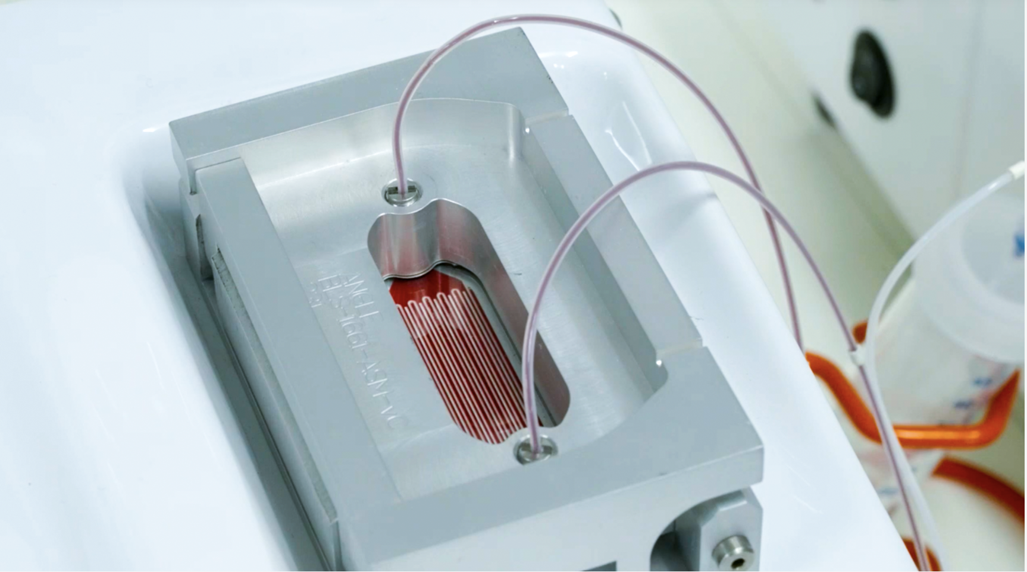
Parsortix® PC1 system
ANGLE’s CTC Solution:
First FDA cleared product for harvesting CTCs for subsequent downstream analysis*
Enables effective, affordable, repeat testing of intact cancer cells
Stepped, microscale cell separators for fluid flow and cell separation
26 granted patents worldwide
ANGLE believes it provides the best liquid biopsy sample of tumor material for downstream multiomic analysis
*FDA Clearance for use with metastatic breast cancer patients only
© ANGLE plc 2024 CONFIDENTIAL

Slide 3
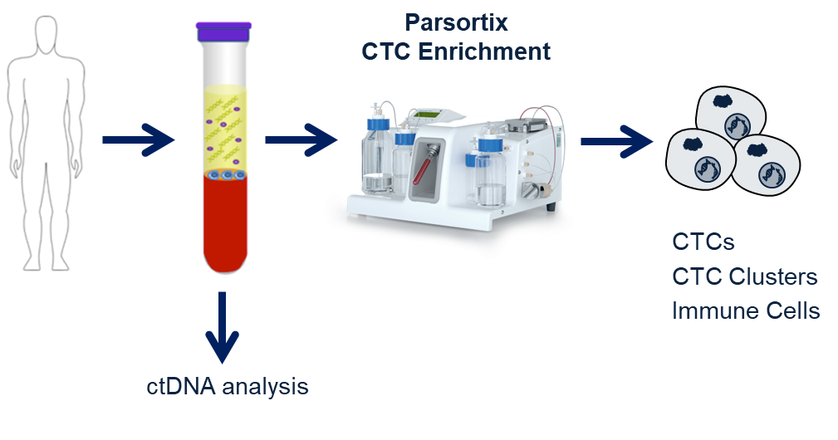
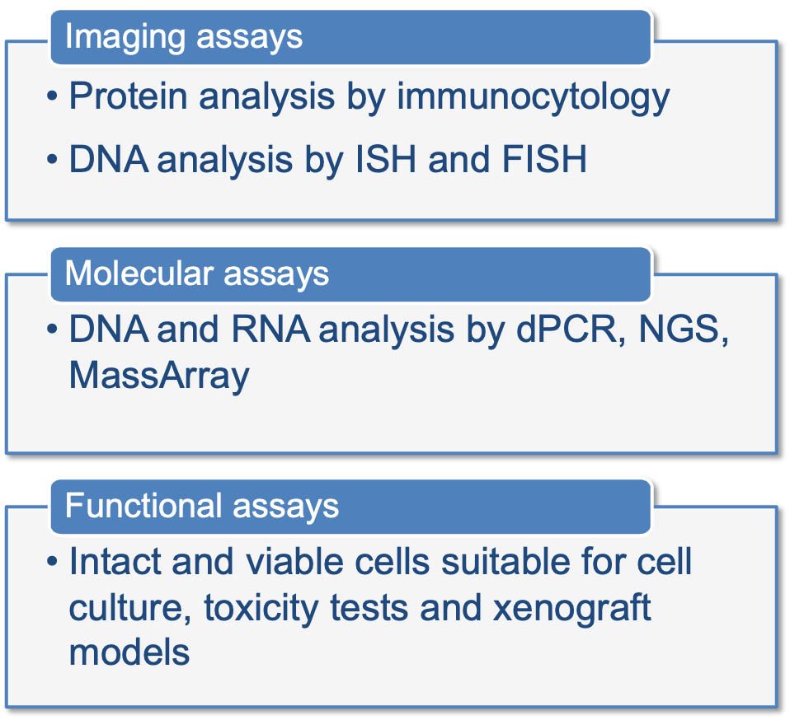
The Parsortix CTC Capture Process
3
Notes:
An estimated 40% of men and women will be diagnosed with cancer during their lifetime. - https://www.cancer.gov/about-cancer/understanding/statistics

Slide 4
DNA sequencing of CTCs (living) and ctDNA (dead)
Retrospective
ctDNA only
Patient immune system and / or therapies have successfully addressed these variants.
Active cancer
CTC-DNA and ctDNA
Active disease being addressed by current therapies but without complete response.
Prospective
CTC-DNA only
Clonal evolution, new variants. Immune system and therapies not a complete response.
CANCER PROGRESSION OVER TIME
Notes:
Critical new information is now available on how the cancer Is progressing and evolving and which therapies may be effective

Slide 5
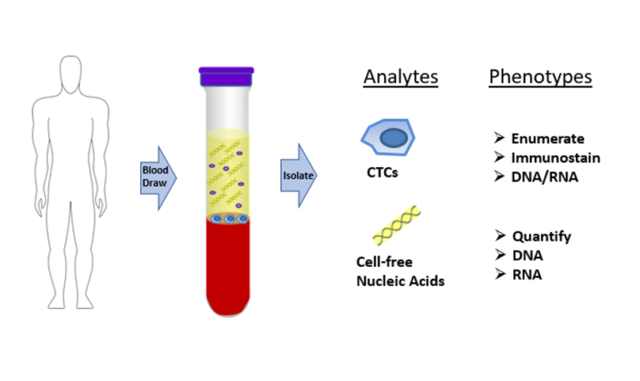
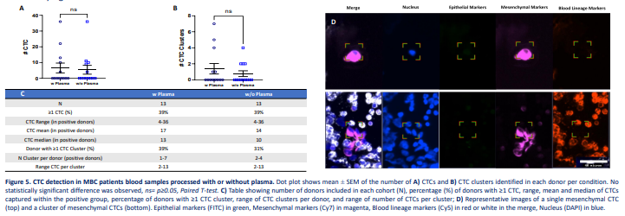
Parsortix Dual analysis strategy
Feasibility
Dual analysis of biomarkers present in plasma and cellular component
Proof Of Concept work:
No CTC loss following plasma removal, prior to Parsortix enrichment.
https://uscnorriscancer.usc.edu/liquid-biopsy-research-core/
https://angleplc.com/wp-content/uploads/2023/05/PTX-Poster-A-ISLB-2022-Bidetect-002.pdf
Detection of targets/variants for which FDA has recommended drugs, or new targets in development.

Slide 6
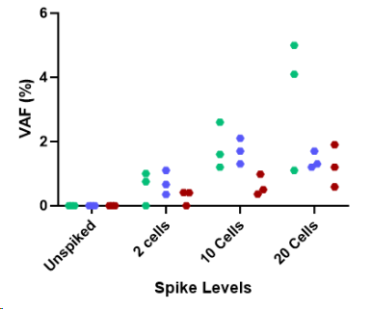

High-multiplexing assays using NGS
Pan-cancer NGS Panel – Analytical data
Landscape+ DNA NGS Assay
High-multiplexing DNA assays using NGS
Highly sensitive variant detection and quantitation (≥0.1% VAF) across hundreds of loci in 61 genes.
Using Illumina NextSeq2000 sequencing platform
Highly sensitive NGS assay compatible with Parsortix-enriched samples

Slide 7
High-multiplexing assays using NGS
Pan-cancer NGS Panel – Analytical data
Landscape+ DNA NGS Assay
High-multiplexing DNA assays using NGS
Highly sensitive variant detection and quantitation (≥0.1% VAF) across hundreds of loci in 61 genes.
Using Illumina NextSeq2000 sequencing platform
Processing on 47 patient samples (Breast, Lung, Ovarian and Prostate samples), CTC and ctDNA.
Good quality samples.
100% detection - All samples presented a signal, in both sample types.
Detection of signal in CTC only for most of the samples, showing the benefit in performing CTC-DNA testing alongside ctDNA analysis.

Slide 8
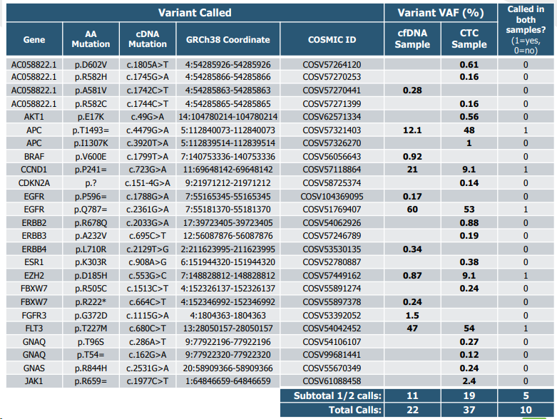
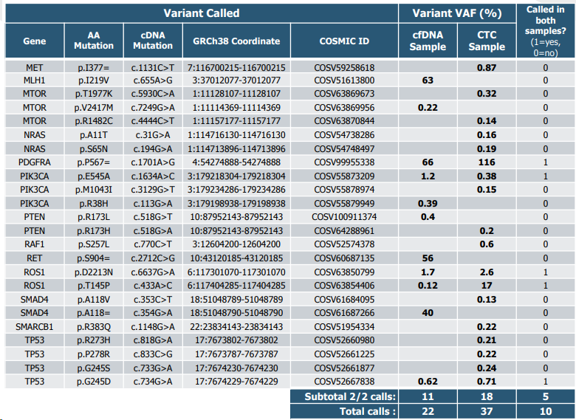
High-multiplexing assays using NGS
Pan-cancer NGS Panel – Breast Cancer, potential actionable targets
Example of a Breast cancer patient

Slide 9
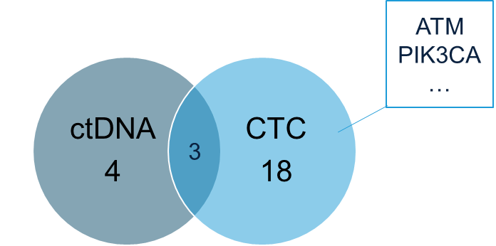
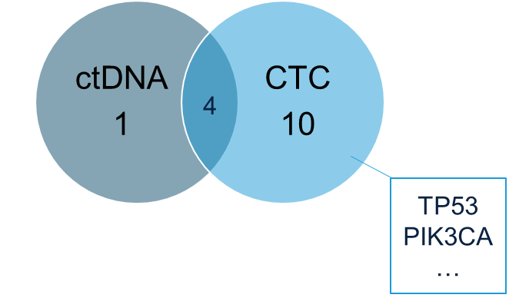
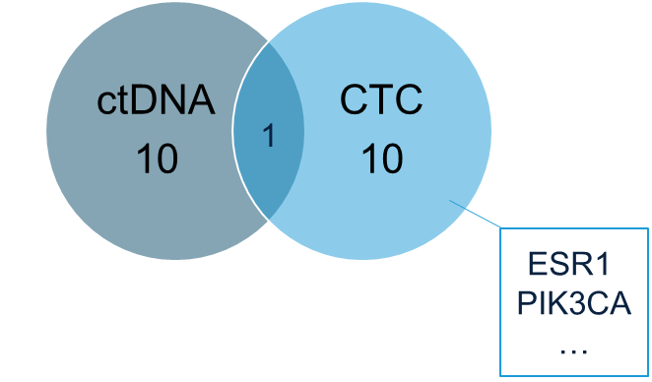
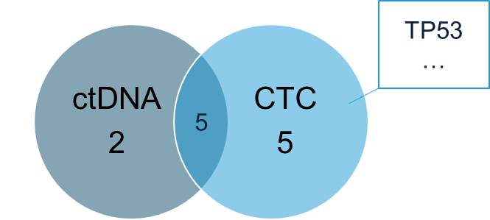
High-multiplexing assays using NGS
Pan-cancer NGS Panel – Patient sample data
Breast cancer patients (n=13):
70% of samples from breast cancer patients showed CTC-DNA only signal for one or more targets.
21 targets seem to be specifically detected in this cohort of 13 breast cancer patients:
- ctDNA only: 10 targets
- CTC-DNA only: 10 targets
- Both: 1 target
Lung Cancer (n=14): 70% of samples from lung cancer patients showed CTC-DNA only signal for one or more targets.
Ovarian Cancer (n=10): 60% of samples from ovarian cancer patients showed CTC-DNA only signal for one or more targets.
Prostate Cancer (n=10): 20% of samples from prostate cancer patients showed CTC-DNA only signal for one or more targets.

Slide 10
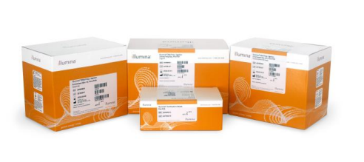
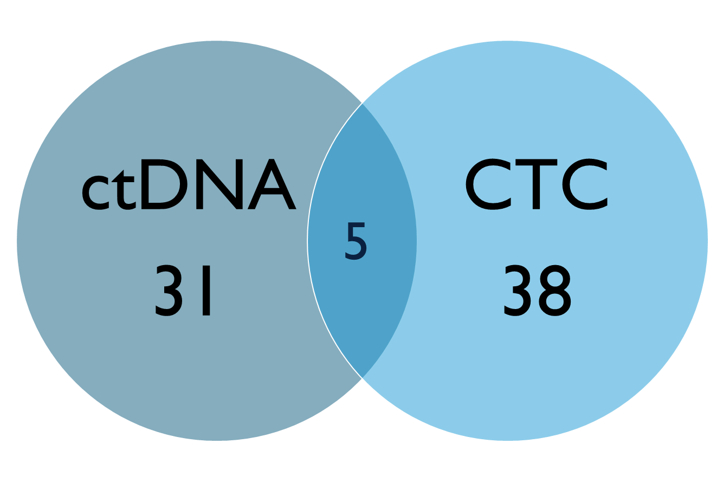
High-multiplexing assays using NGS
Pan-cancer NGS Panel – Illumina POC
Cell-free DNA prep with enrichment (Illumina)
Customised panel, covering 79 genes (mainly Lung Cancer)
Using Illumina NextSeq2000 sequencing platform
Lung cancer panel (n=8):
CTC(average)= 49 and CTC(median)= 20
All patients showed CTC-DNA only signal for one or more targets.
32 genes (74 variants) seem to be specifically detected in this cohort:
TP53
PTEN
CHECK1

Slide 11
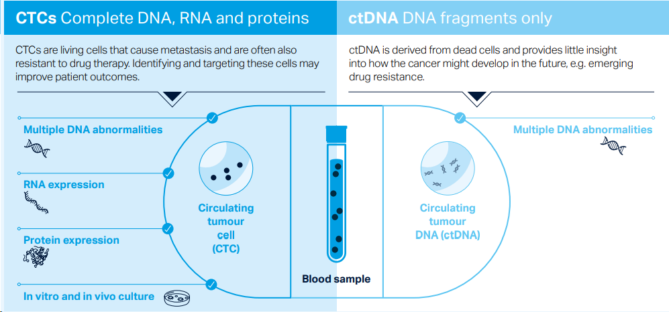
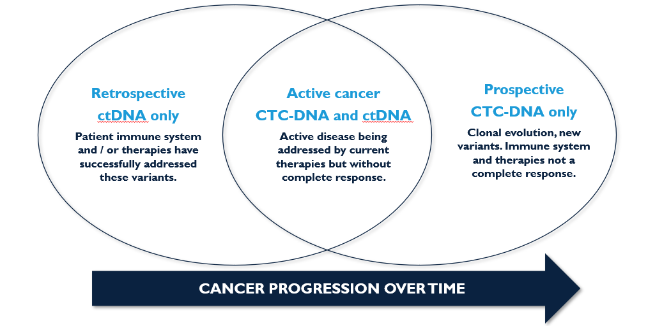
Parsortix Dual analysis strategy
CONCLUSION
Successful detection of actionable targets in ctDNA and CTC, from the same sample.
CTC samples provide a unique detection of actionable targets in most of the patient samples.
More data to come…
Parsortix system is allowing for CTC enrichment and DNA analysis from plasma and CTC, from the same blood sample, with high analytical sensitivity and specificity.
This has the potential to give access to (new) biomarkers, helping for patient decision.

Slide 12
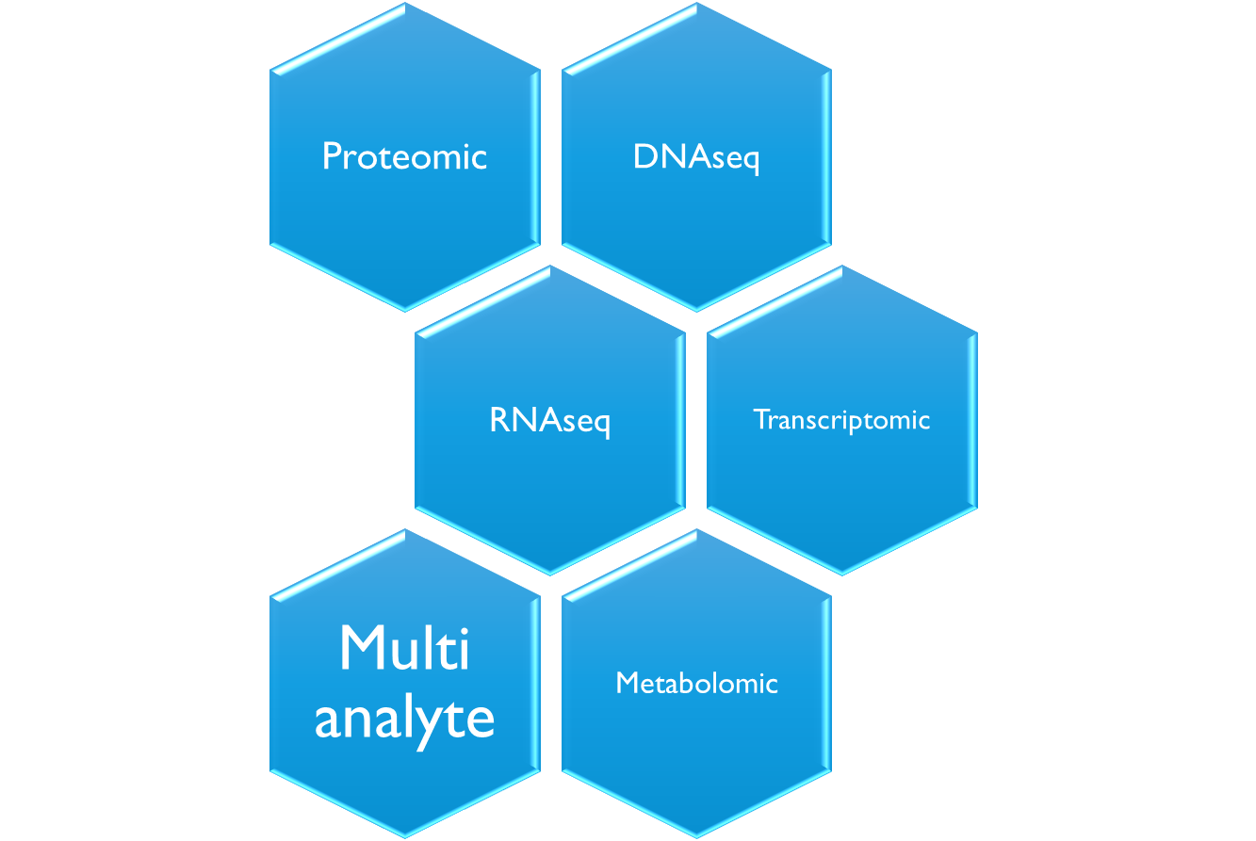
What’s next?
Multi-OMICS approach
Methylation
?
12
Notes:
An estimated 40% of men and women will be diagnosed with cancer during their lifetime. - https://www.cancer.gov/about-cancer/understanding/statistics

Slide 13
Thank you for your attention!
www.angleplc.com
a.pailhes-jimenez@angleplc.com

