Slide 1

ELBS General Assembly 2023
Dissemination &
Education Work Group
Catherine Alix-Panabières (Montpellier, Fr)
Paul Hofman (Nice, Fr)
November 26th – 27th
PRBB, Barcelona, Spain

Slide 2

New ELBS members in 2024
Congresses & Conferences where has been presented.
Special Issue : Journal of Experimental & Clinical Cancer Research
ELBS supported Symposium
Link to another Society
Working group leads
ELBS Meetings in 2024
Master Classes 2024

Slide 3
New ELBS members in 2024
Congresses & Conferences where has been presented.
Special Issue : Journal of Experimental & Clinical Cancer Research
ELBS supported Symposium
Link to another Society
Working group leads
ELBS Meetings in 2024
Master Classes 2024

Slide 4

14 New members in 2024
Academia: n=10
Fraunhofer IMM
Institute for Oncology and Radiology of Serbia (IORS)
Karolinska Institutet
Lillebaelt Hospital, Vejle
Leiden University Medical Center
Ludwig Maximilian University Clinic
McGill University Health Centre
University of Trento
Uniklinikum Köln
Yonsei University
From industry: n=7
ARCEDI Biotech
LMNTIC
Meridian Lifescience
Neomatrix Biotech
Quanterix
ScreenCell
SOPHiA Genetics
WELCOME
… 93 member institutions
(55 academics + 38 industries)

Slide 5
New ELBS members in 2024
Congresses & Conferences where has been presented.
Special Issue : Journal of Experimental & Clinical Cancer Research
ELBS supported Symposium
Link to another Society
Working group leads
ELBS Meetings in 2024
Master Classes 2024

Slide 6

Congresses highlighted via LinkedIn
AACR Liquid Biopsy Conference (San Diego, USA)
CCII 1st Symposium (Kyoto, Japan)
10th Thomas Ashworth Symposium (TAS) (Sydney, Australia)
7th FSEV (Strasbourg, France)
45th SFSPM Annual Breast Cancer Conference (Nantes, France)
GSEV 2024 (Hamburg, Germany)
Virtual Biomarkers Conference 2024 from CCRAN (virtual)
ESMO Breast Cancer (Berlin, Germany)
ASCO 2024 (Chicago, USA)
AACR 2024 (San Diego, USA)
10+1 Conference (Santorini Greece)
CRIS Contra el Cancer (Madrid, Spain)
CNAPS 2024 (Graz, Austria)
Precision Medicine in Oncology by DXRX (virtual)
8th Liquid Biopsy Research Conference (Tokyo, Japan)
4th Steering committee meeting of PANCAID (Stockholm, Sweden)
IX Symposium on Liquid Biopsy 2024 (Santiago de Compostela, Spain)
Presentation of
at Congresses

Slide 7
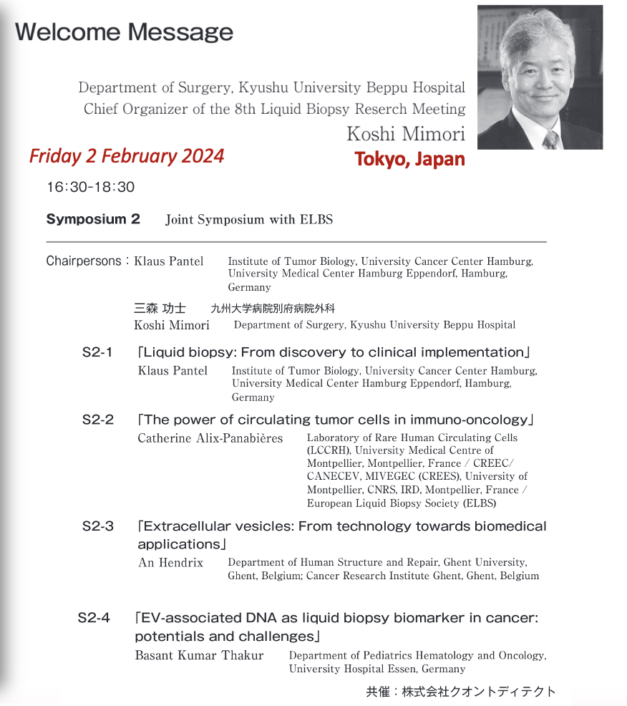

The 8th Liquid Biopsy Research Meeting in Tokyo
Designated ELBS Symposium
ELBS speakers:
Klaus Pantel
Catherine Alix-Panabières
An Hendrix
Basant Kumar Thakur

Slide 8
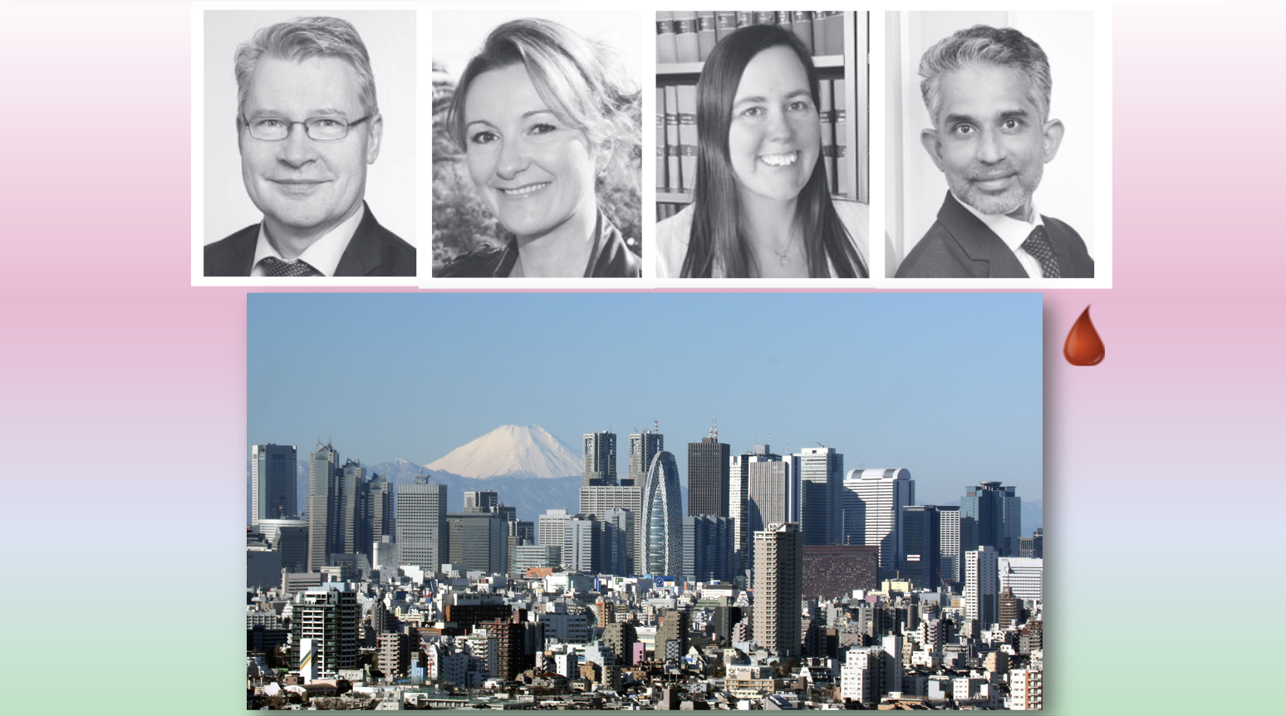
The 8th Liquid Biopsy Research Meeting in Tokyo

Slide 9

Co-hosted Symposium: NORD Workshop
Collaboration between University Cancer Centers of northern Germany.
Primarily, the University Cancer Center Hamburg (UCCH), together with the University Cancer Center Schleswig-Holstein (UCCSH), and northern university clinics (Hamburg, Kiel, Lübeck).
Topics:
Standardization and Harmonization of LB
Translation into clinical practice
Attendees: 59 Scientists and Clinicians

Slide 10

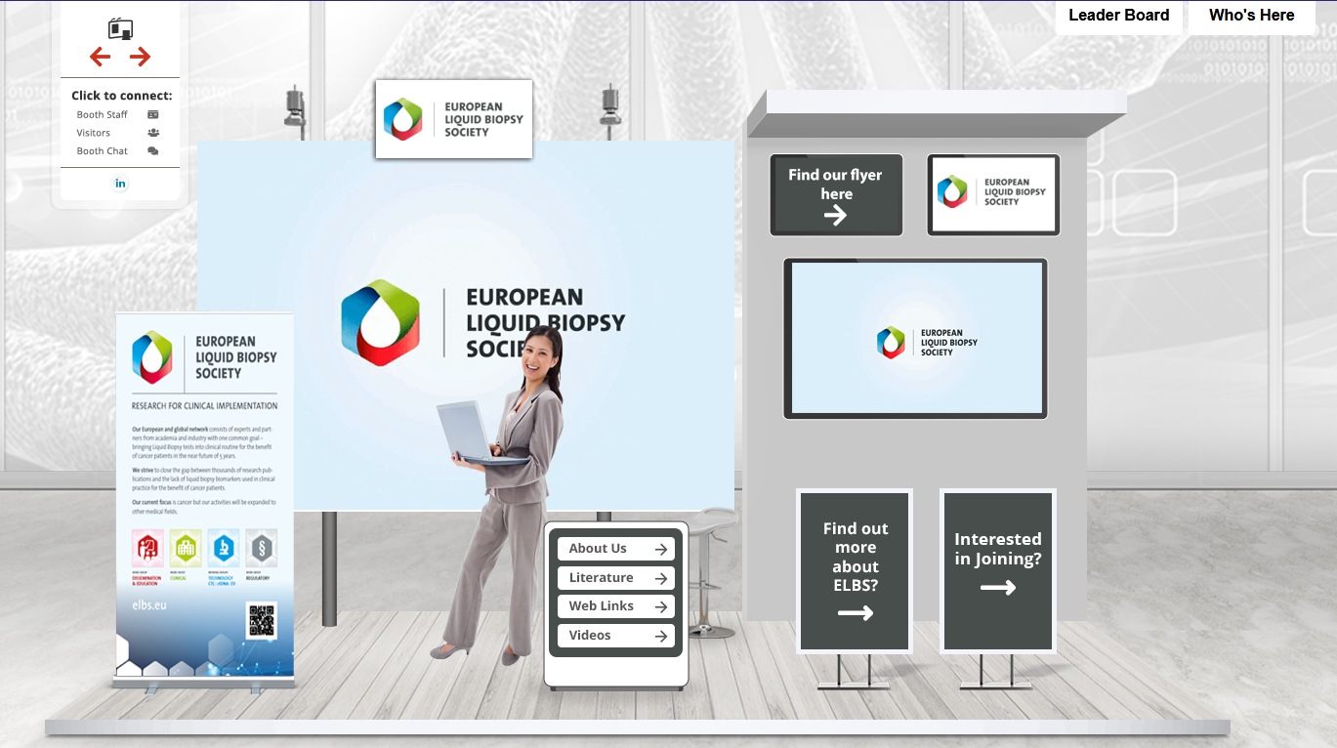
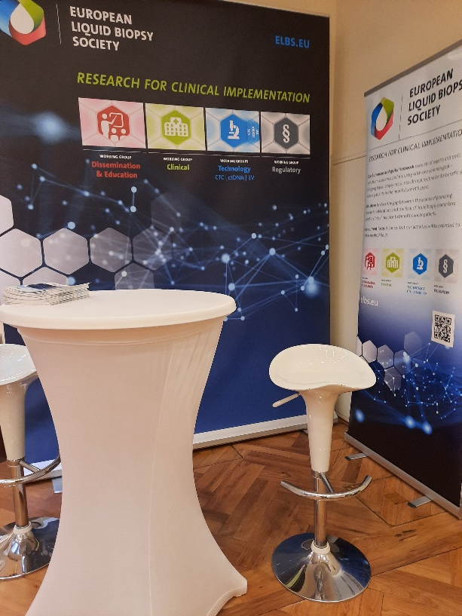
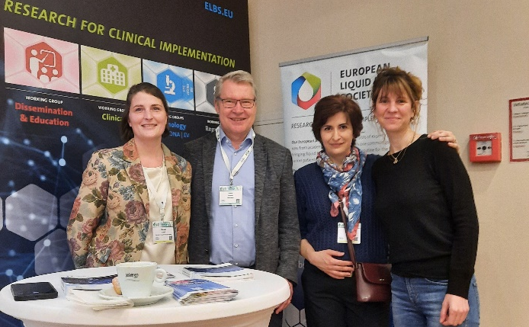
Representation at Congresses: ELBS booth
1st “Booth” at CNAPS 2024 hosted by Ellen Heitzer in Graz, Austria
Virtual congress on Precision Medicine in Oncology

Slide 11

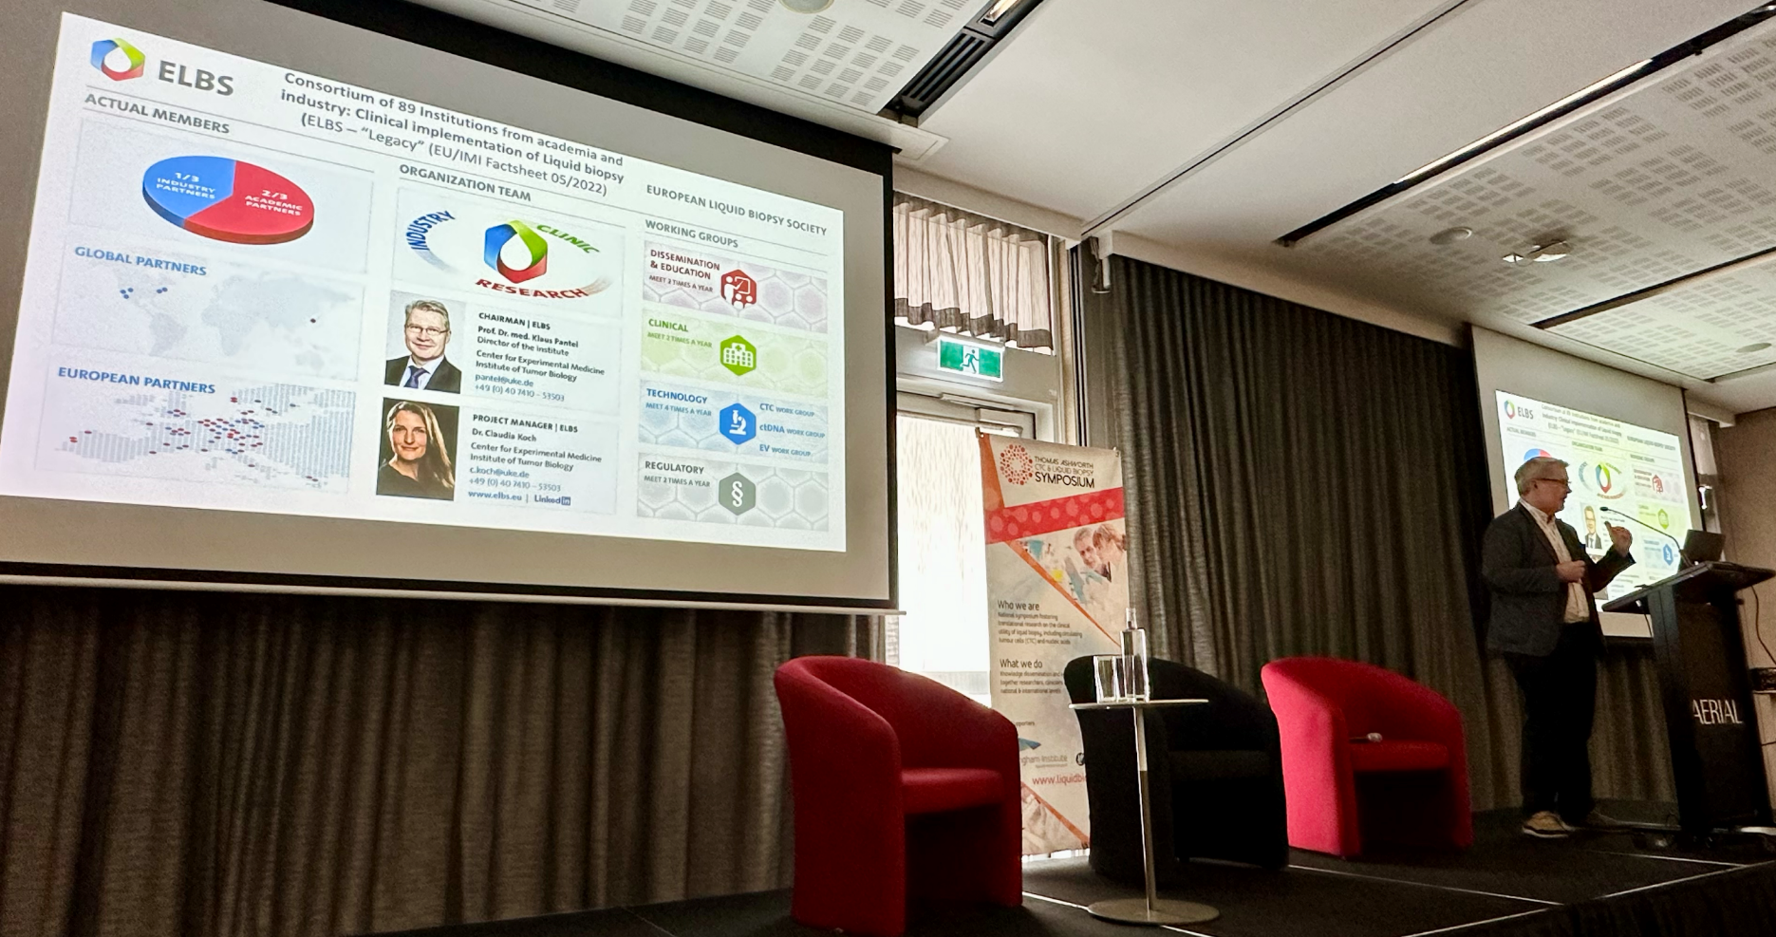
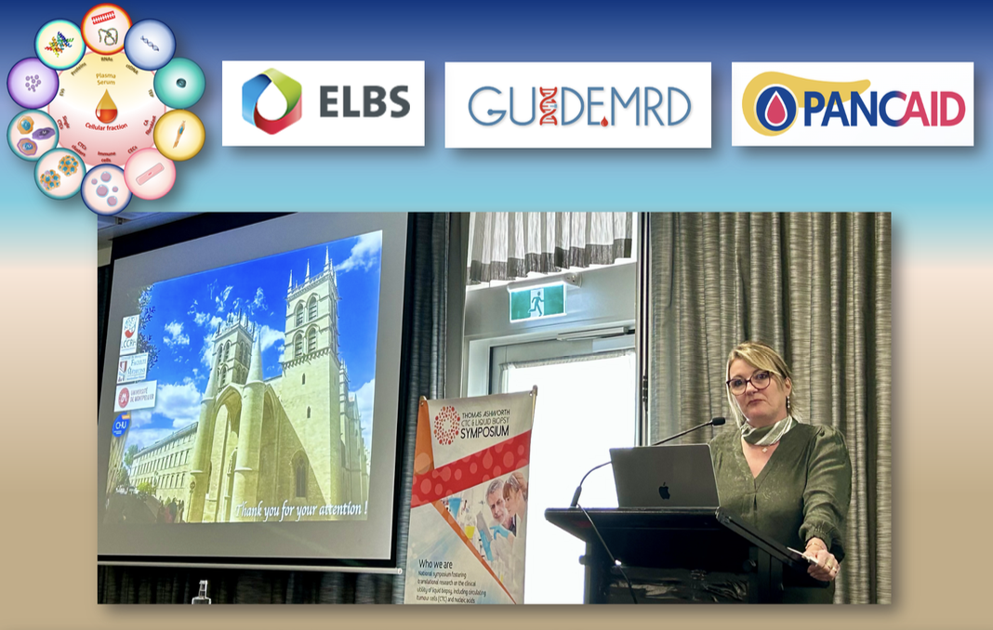
Representation at Congresses
10th Thomas Ashworth Symposium Sydney

Slide 12
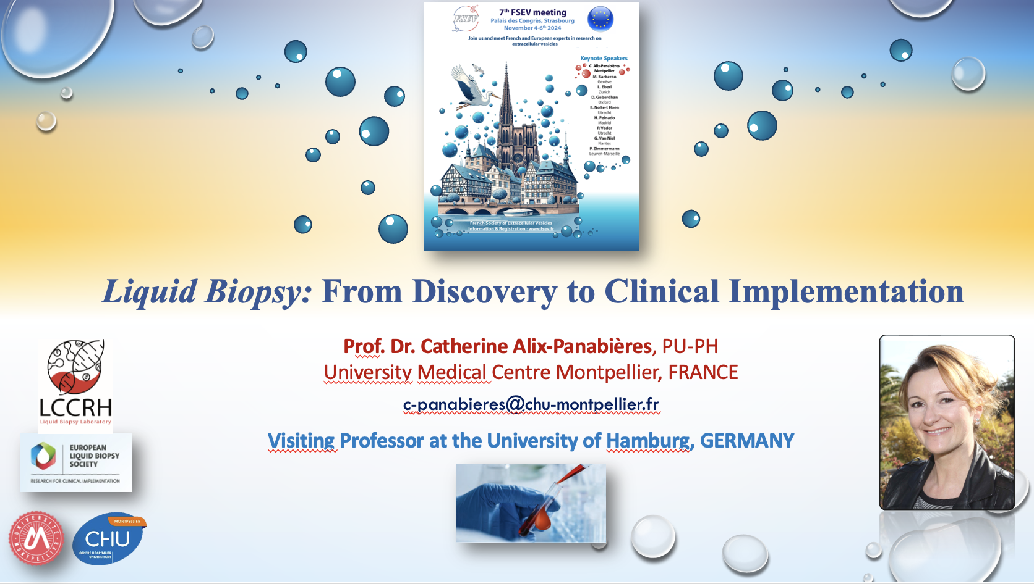
Representation at Congresses
EVs

Slide 13
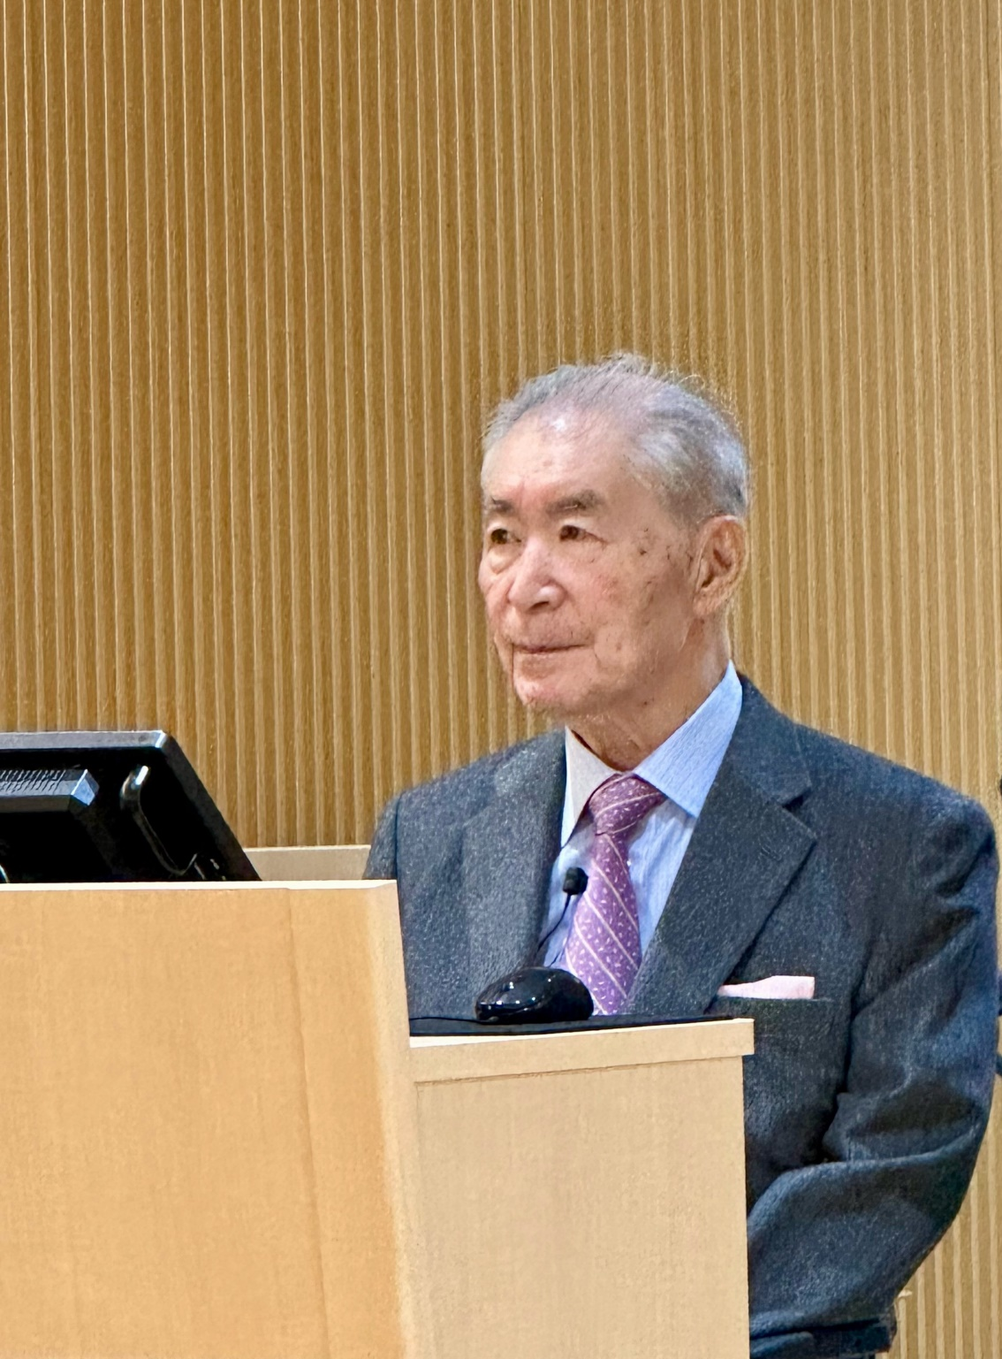
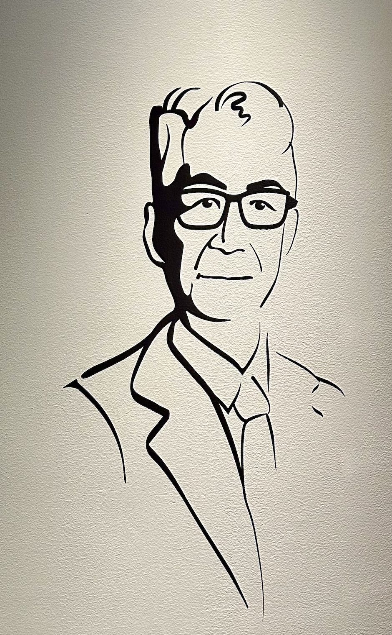
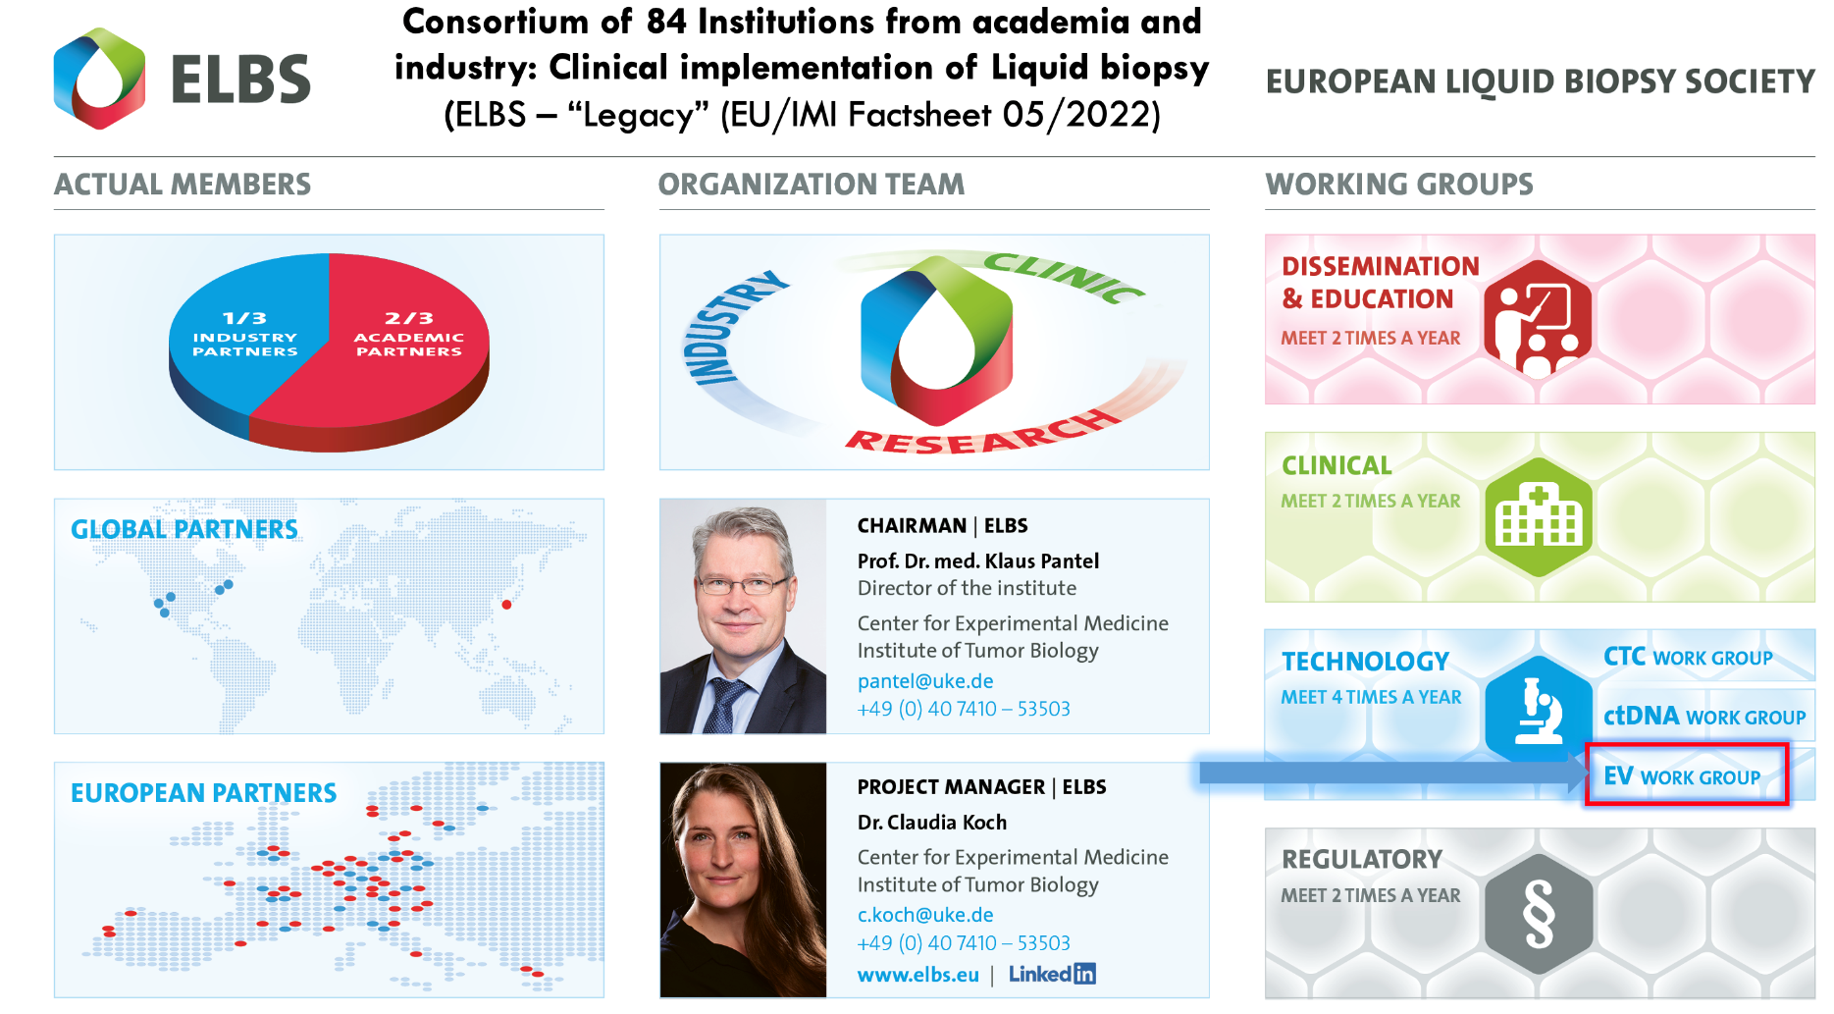
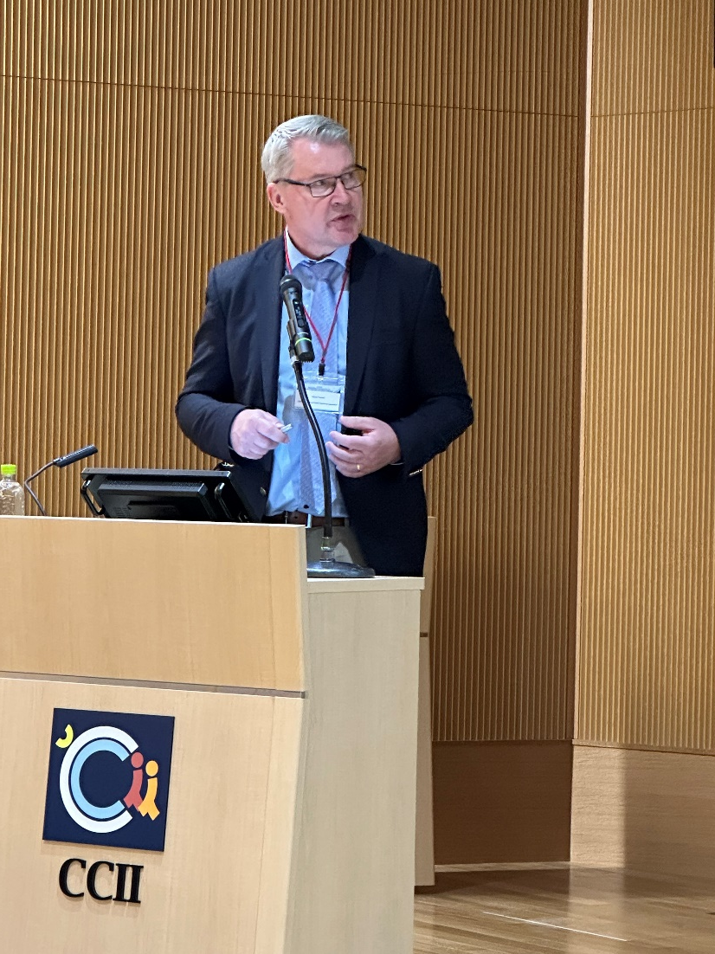
Representation at Congresses
1st CCII SYMPOSIUM KYOTO Japan
Nobel Laureate 2018
Prof Honjo Tasuku

Slide 14
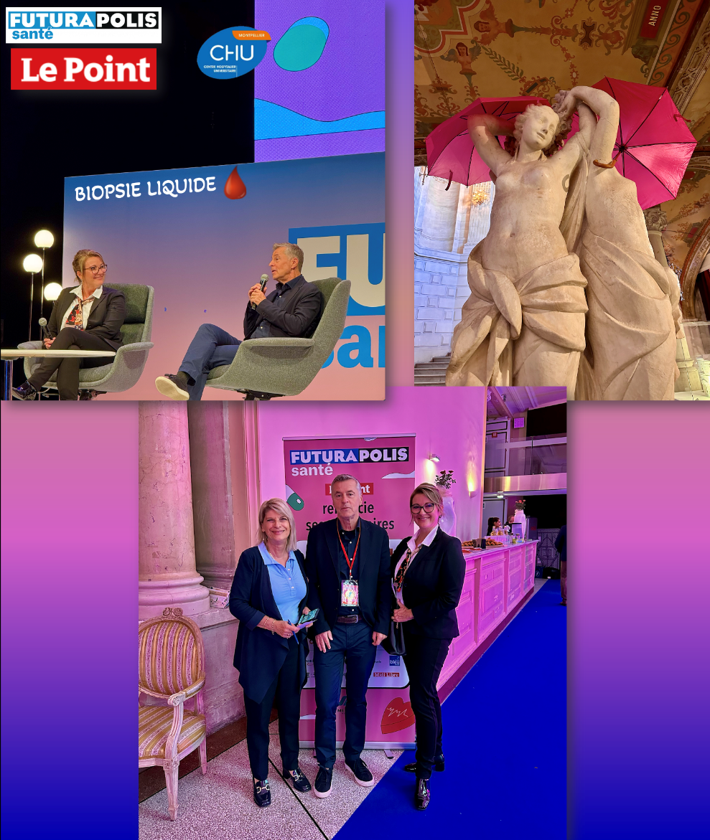
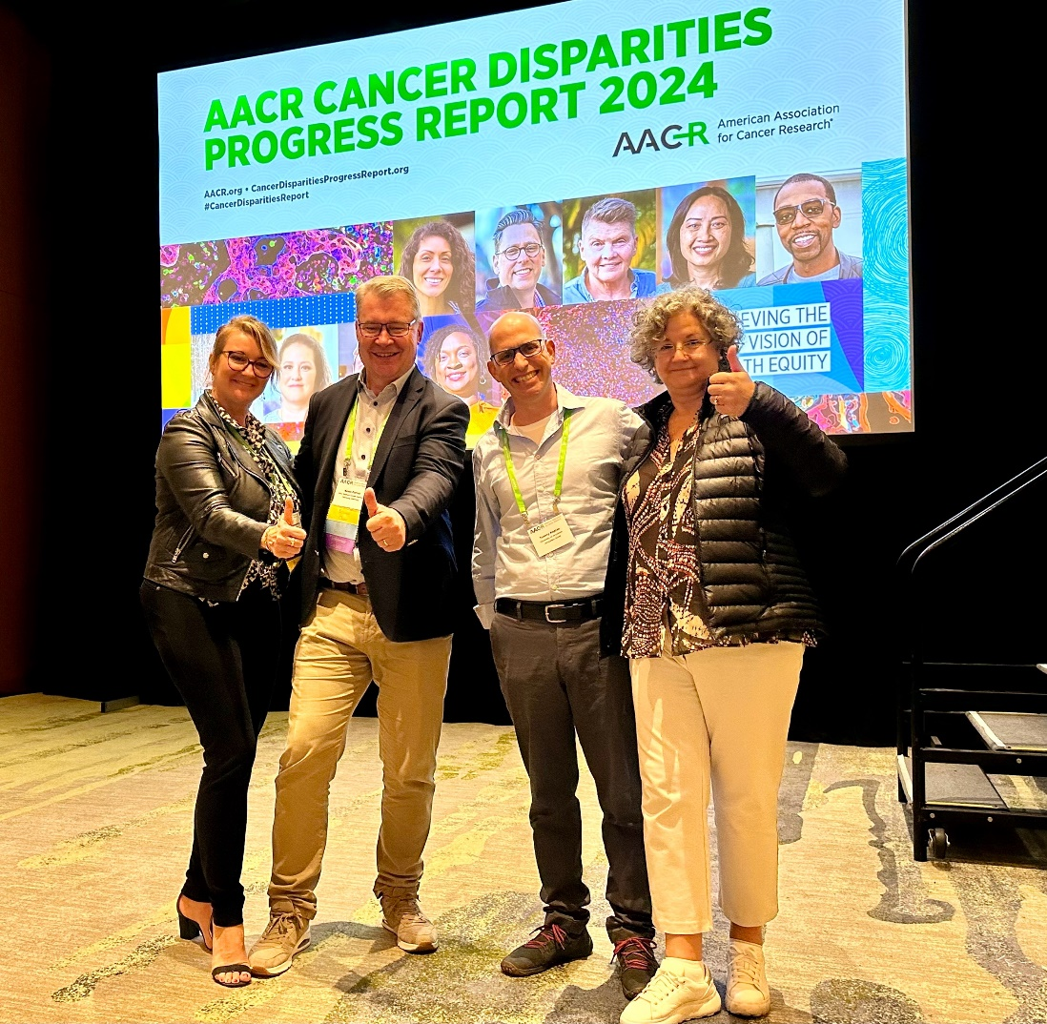

Representation at Congresses
AACR Liquid Biopsy Conference (San Diego, USA)
ELBS Members:
Catherine A-P
Paul Hofman
ELBS Members:
Catherine Alix-Panabières
Klaus Pantel
Tommy Kaplan
Nuria Malats
ELBS Members

Slide 15
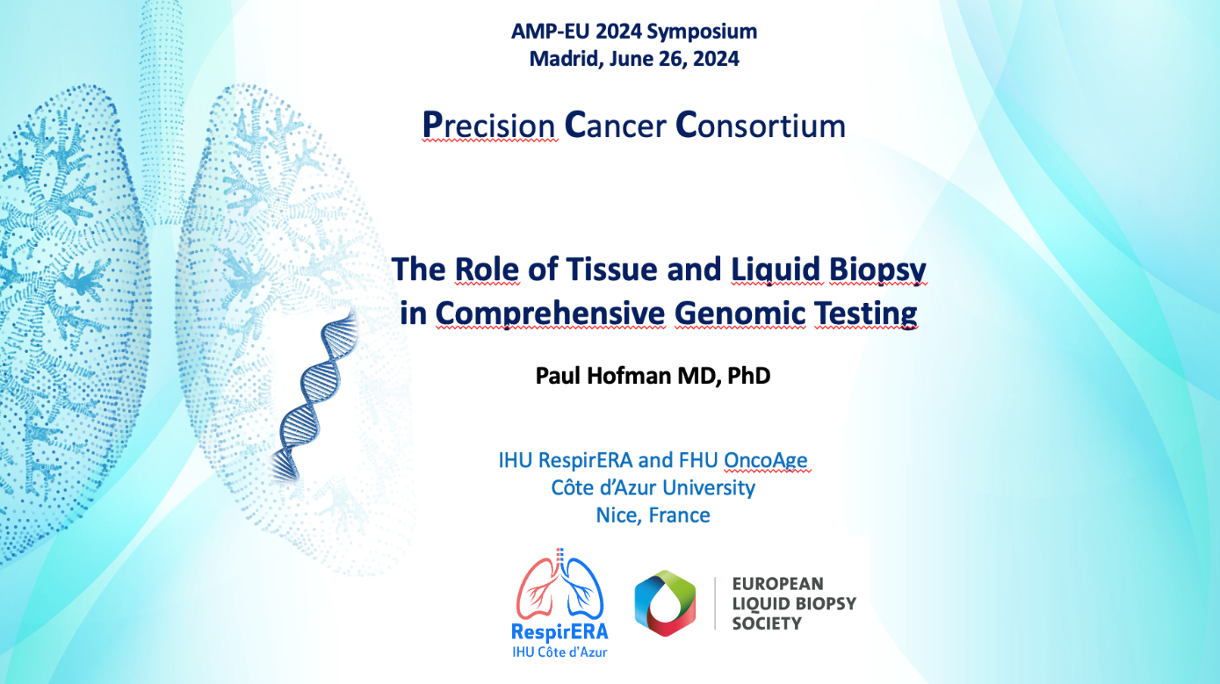
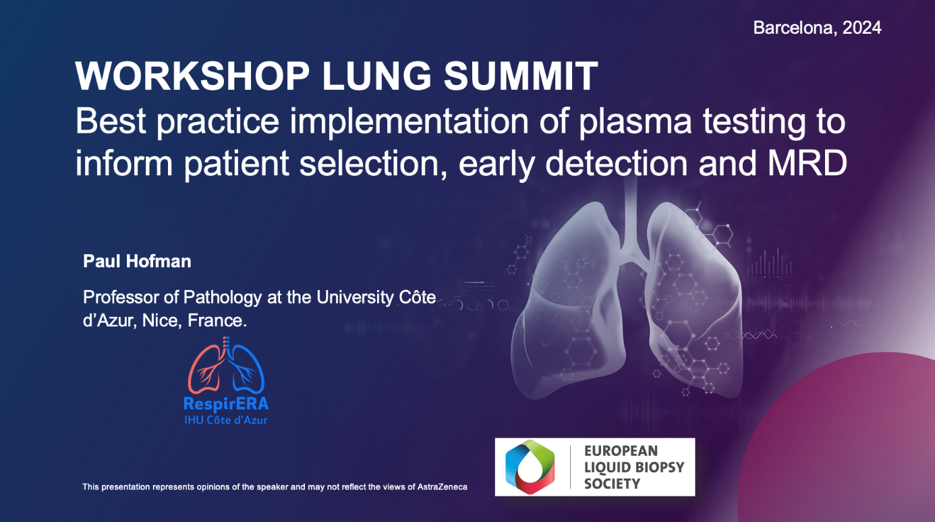
Representation at Congresses

Slide 16
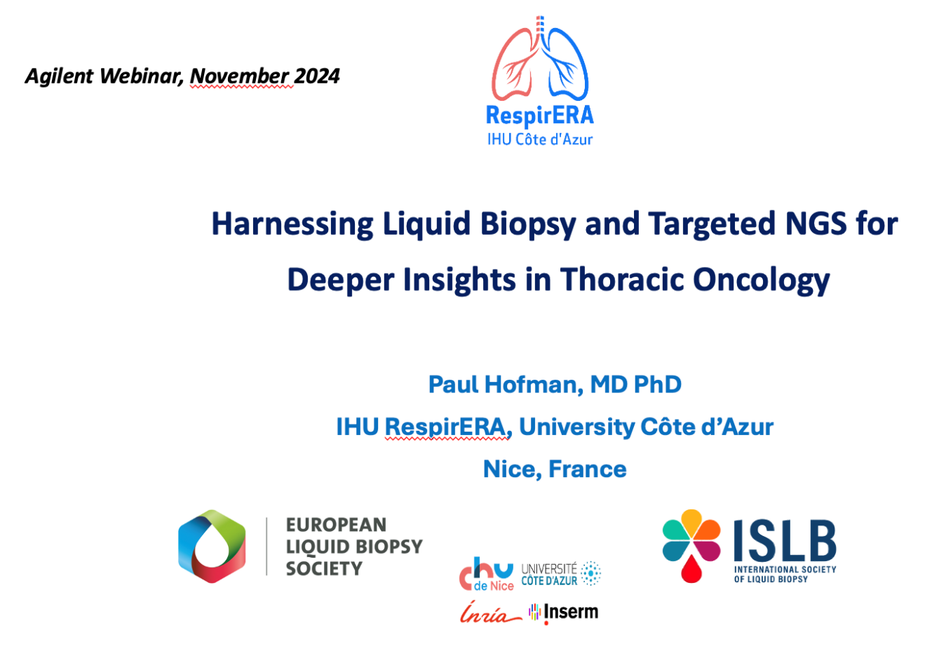

Representation at Congresses

Slide 17
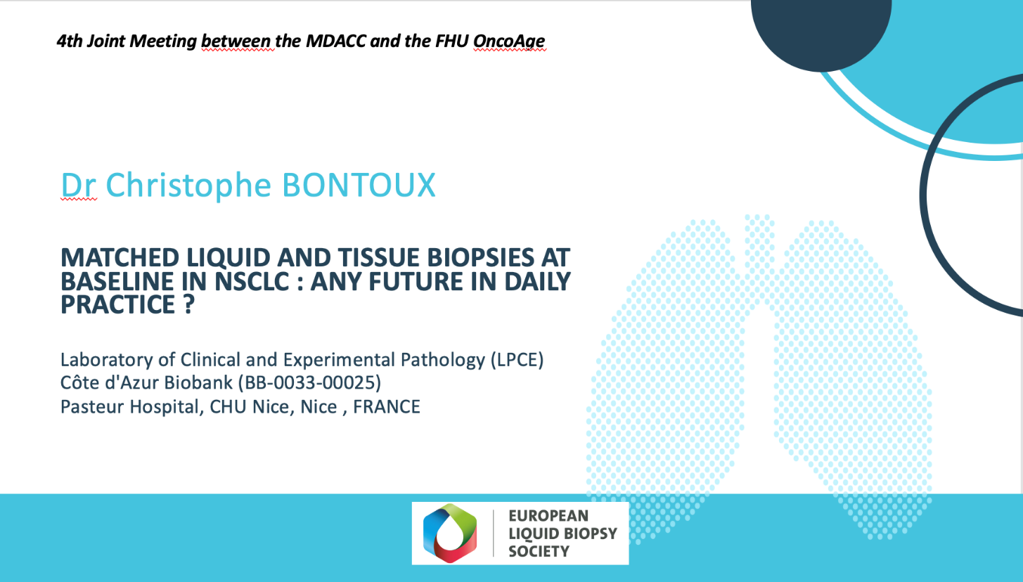
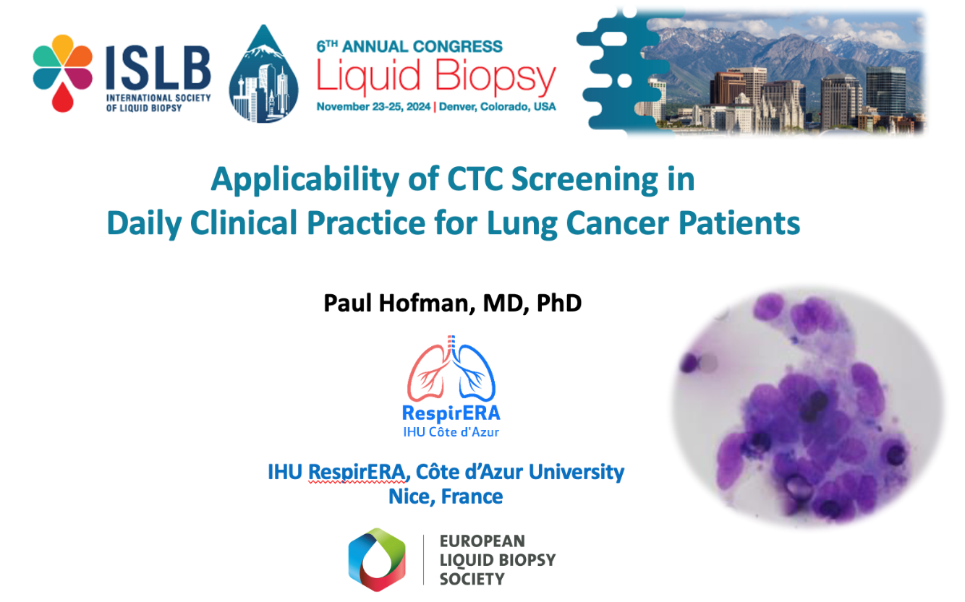
Representation at Congresses

Slide 18
New ELBS members in 2024
Congresses & Conferences where has been presented.
Special Issue : Journal of Experimental & Clinical Cancer Research
ELBS supported Symposium
Link to another Society
Working group leads
ELBS Meetings in 2024
Master Classes 2024

Slide 19
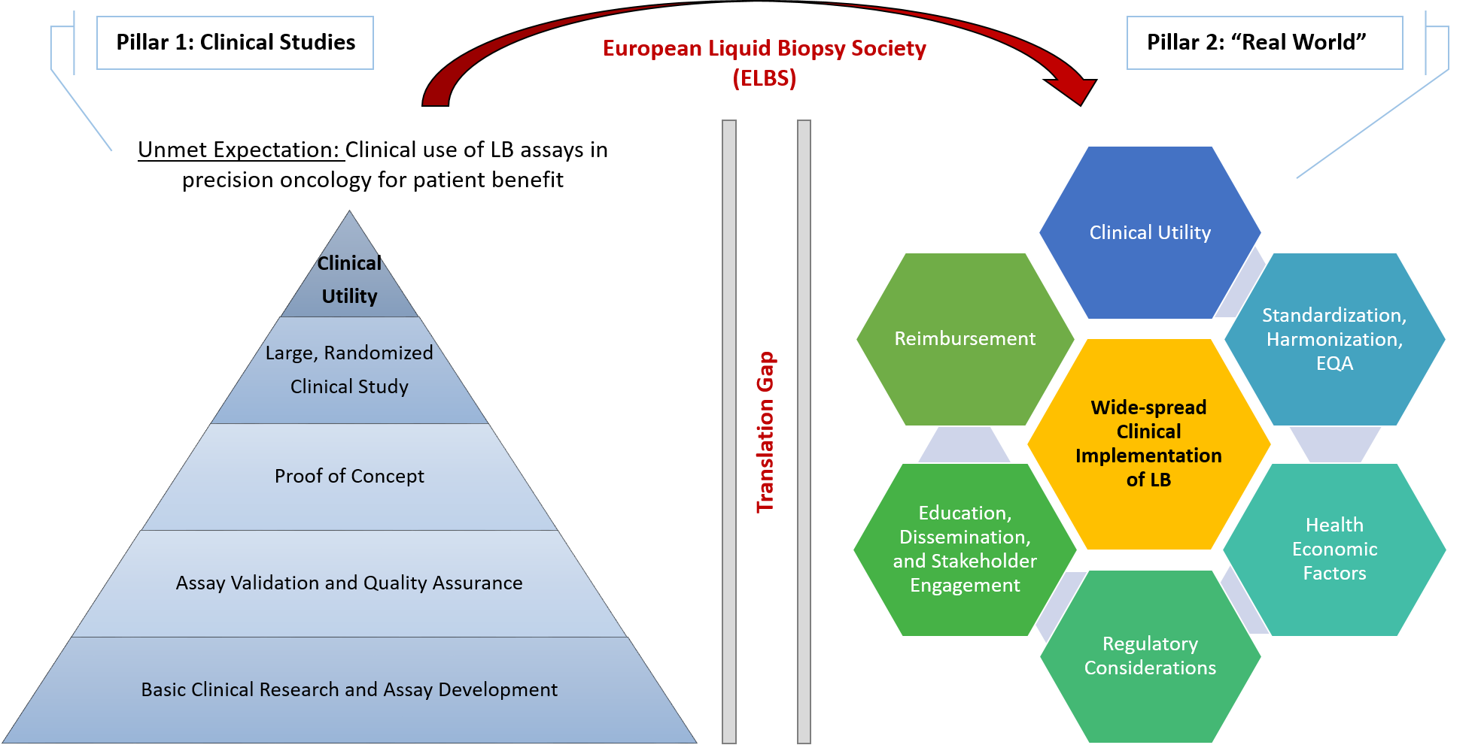
JECCR & ELBS: Special Issue
“Liquid Biopsy in Precision Oncology”
Journal of Experimental & Clinical Cancer Research (JECCR) – IF 12.658
“Liquid Biopsy in Precision Oncology”
The Special Issue will accept Research Articles and Reviews in this topic. Submit here.
Submission opens: 1st February 2024
Submission deadline: 31st January 2025
→ Time to submit your manuscript
Status: 16 manuscripts published,
1 accepted for publication, 3 under revision and 7 under peer review
Edited by:
Professor Klaus Pantel, MD, PhD, Department of Tumor Biology, University Medical Center Hamburg-Eppendorf, Germany; European Liquid Biopsy Society, University Medical Center Hamburg-Eppendorf, Germany
Claudia Koch, PhD, European Liquid Biopsy Society, University Medical Center Hamburg-Eppendorf, Germany
Professor Gennaro Ciliberto, MD, PhD, Scientific Director, IRCCS-Regina Elena National Cancer Institute, Italy
Alice Castelli, PhD, Managing Editor, Journal of Experimental & Clinical Cancer Research, IRCCS-Regina Elena National Cancer Institute, Italy

Slide 20

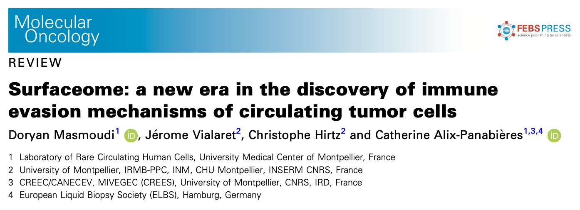
We need to think about affiliating ELBS …
as much as possible...

Slide 21
New ELBS members in 2024
Congresses & Conferences where has been presented.
Special Issue : Journal of Experimental & Clinical Cancer Research
ELBS supported Symposium
Link to another Society
Working group leads
ELBS Meetings in 2024
Master Classes 2024

Slide 22
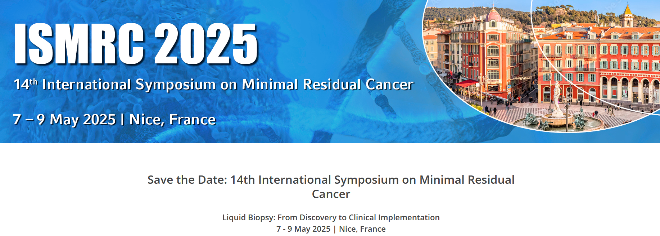
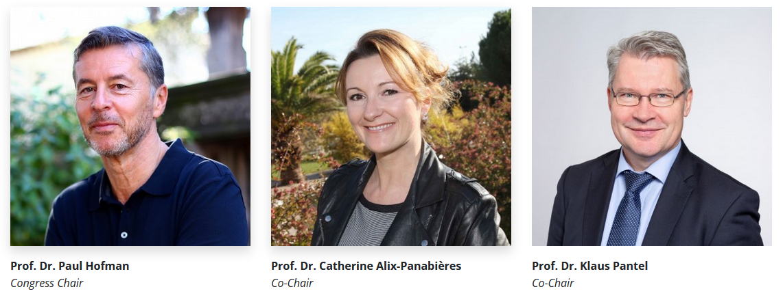
Upcoming ELBS supported Symposium
ISMRC 2025
https://ismrc-symposium.eu/

Slide 23
New ELBS members in 2024
Congresses & Conferences where has been presented.
Special Issue : Journal of Experimental & Clinical Cancer Research
ELBS supported Symposium
Link to another Society
Working group leads
ELBS Meetings in 2024
Master Classes 2024

Slide 24
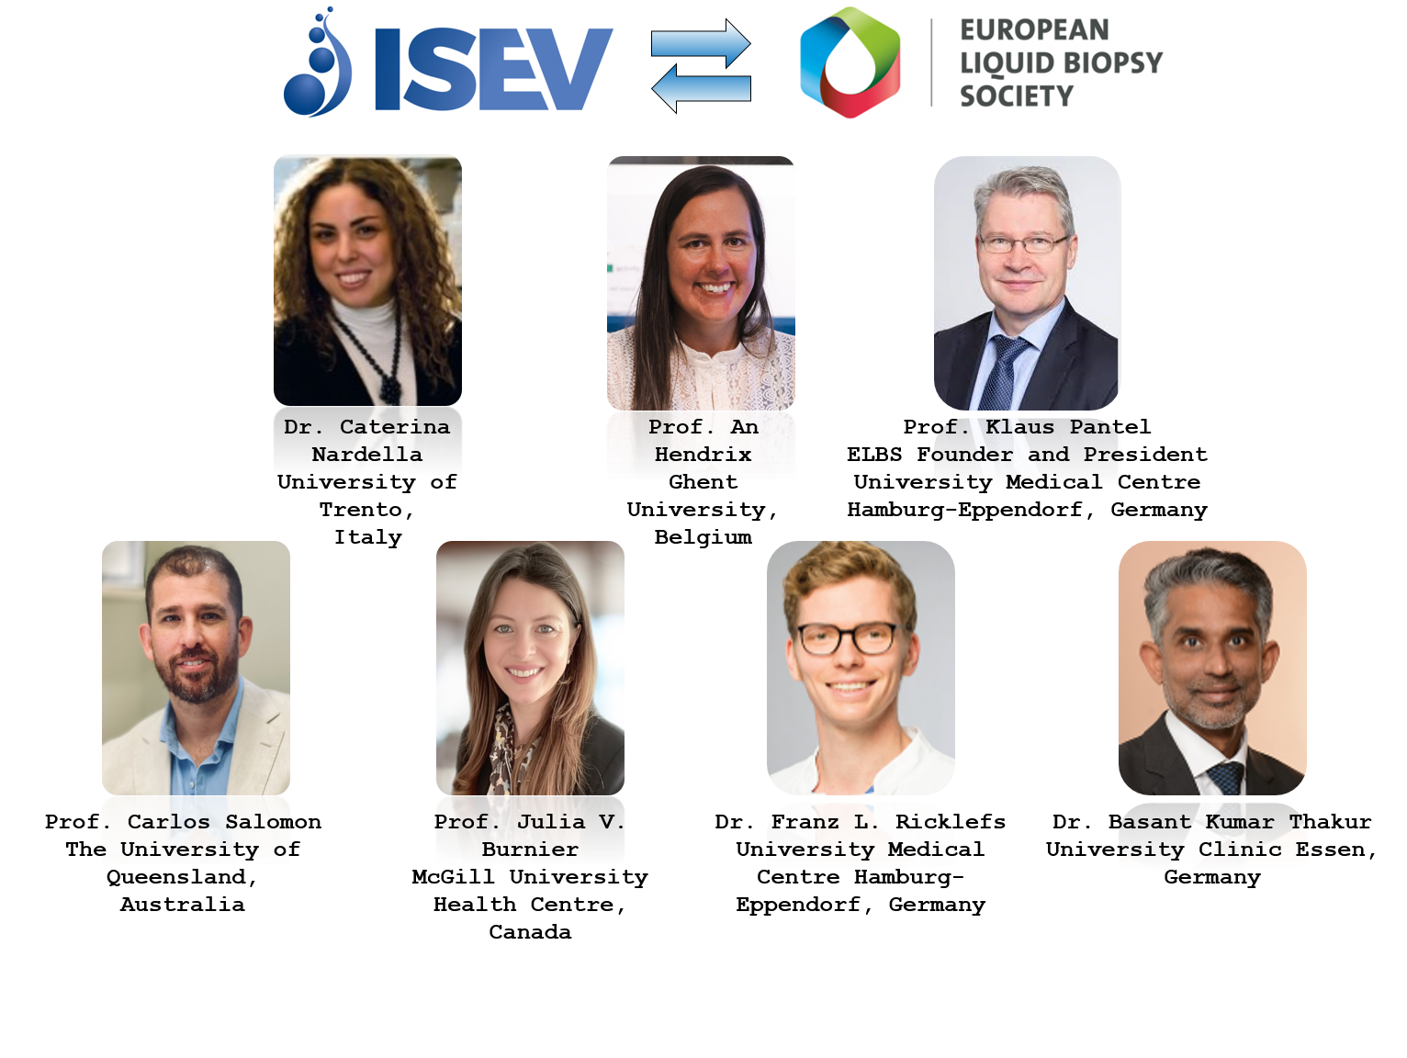
Link to another Society: ISEV and ELBS WG
04.40 p.m. | The ISEV and ELBS Intersociety WG Caterina Nardella, PhD, Department of Cellular, Computational and Integrative Biology, University of Trento, Trento, Italy 10 min presentation + 5 min discussion

Slide 25
New ELBS members in 2024
Congresses & Conferences where has been presented.
Special Issue : Journal of Experimental & Clinical Cancer Research
ELBS supported Symposium
Link to another Society
Working group leads
ELBS Meetings in 2024
Master Classes 2024

Slide 26
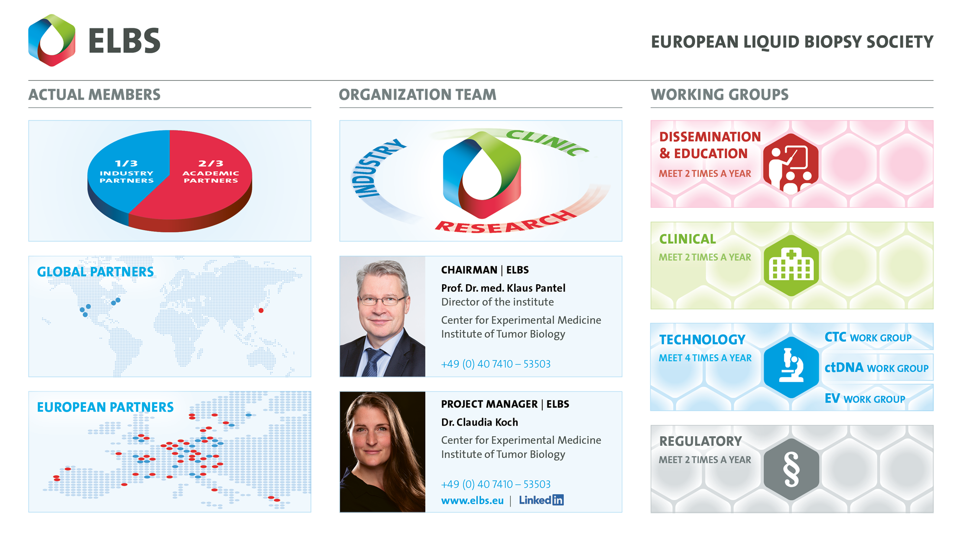
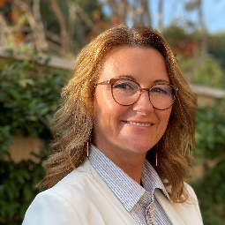
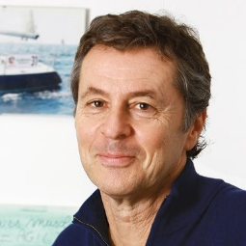
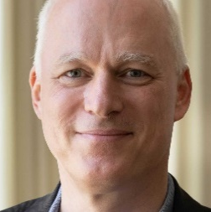
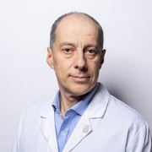
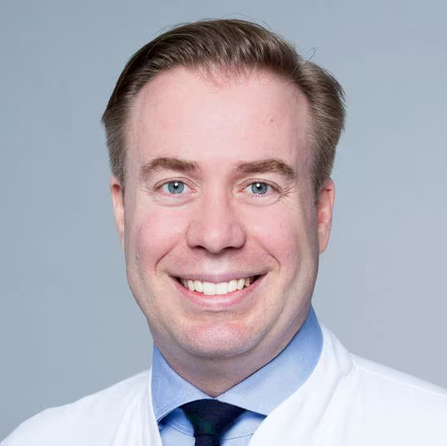
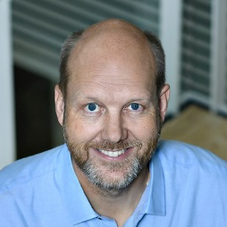
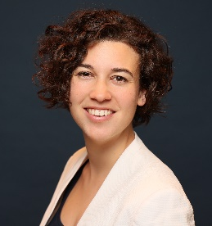
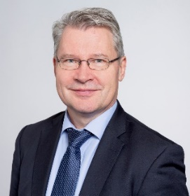
Working group leads
Prof. Catherine Alix-Panabières
University of Montpellier
Prof. Paul Hofman
University Côte d’Azur
Prof. Nikolas von Bubnoff
University Medical Center Schleswig-Holstein
Prof. Jean-Yves Pierga
Institut Curie
Prof. Christoffer Gebhardt
University Medical Center Hamburg-Eppendorf
Prof. Claus Lindbjerg Andersen
University oh Aarhus
Dr. Ariane Hallermayr
Medizinisch Genetisches Zentrum München (MGZ)
Prof. Klaus Pantel
University Medical Center Hamburg-Eppendorf

Slide 27
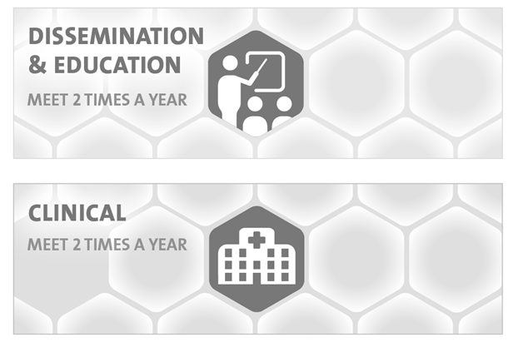
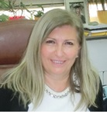
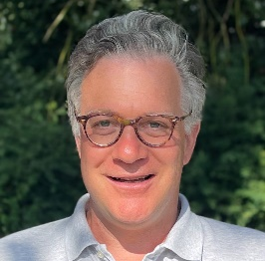
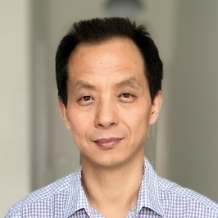

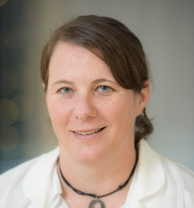
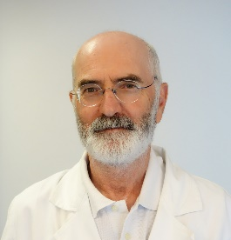
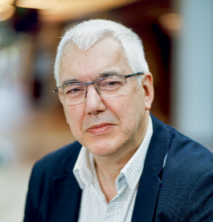

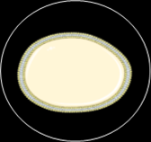
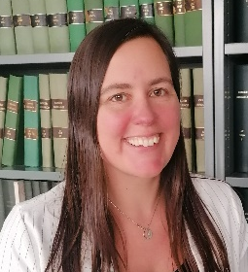
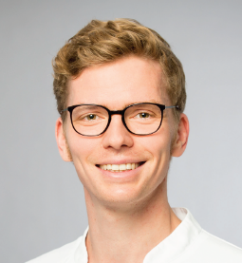
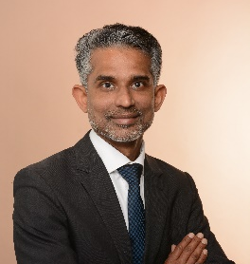
Leads of the Technology WGs
CTC
Prof. Evi Lianidou
University of Athens
Prof. Nikolas Stöcklein
University Clinic Düsseldorf
Prof. Yong-Jie Lu
Queen Mary University
ctDNA
Prof. Ellen Heitzer
University of Graz
Dr. Patrizio Giacomini
Policlinico Gemelli
Prof. Ed Schuuring
University of Groningen
EVs
Prof. An Hendrix
University of Ghent
Dr. Franz Ricklefs
UKE
PD Basant Thakur
University Clinic Essen

Slide 28



Proposal of a new Working Group on Bioinformatics and Artificial Intelligence
BIOINFORMATICS
AI
Nuria Malats
Discussions with

Slide 29
New ELBS members in 2024
Congresses & Conferences where has been presented.
Special Issue : Journal of Experimental & Clinical Cancer Research
ELBS supported Symposium
Link to another Society
Working group leads
ELBS Meetings in 2024
Master Classes 2024

Slide 30
ELBS WG meetings 2024
Clinical WG: 1 meeting – Topic; Rare neuroendocrine tumors
Technology WGs:
CTC: 2 WG meetings (1 more upcoming)
ctDNA: 1 WG meeting
EV: 2 WG meetings
Regulatory WG: 1 Workshop on ““IVDR & Reimbursement - The future of liquid biopsy adoption in Europe” (27th November 2 – 5 pm)

Slide 31
New ELBS members in 2024
Congresses & Conferences where has been presented.
Special Issue : Journal of Experimental & Clinical Cancer Research
ELBS supported Symposium
Link to another Society
Working group leads
ELBS Meetings in 2024
Master Classes 2024

Slide 32

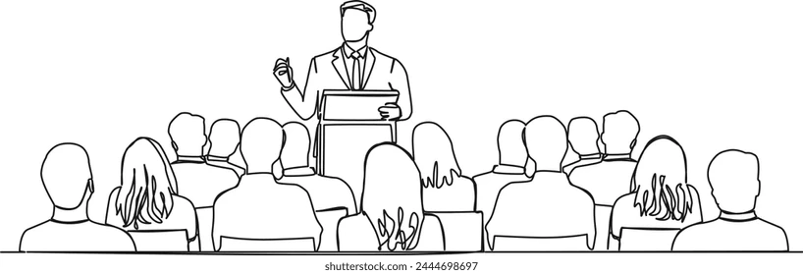
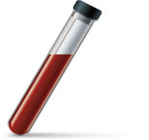
2024 Master Classes

Slide 33



New horizons of molecular testing for targeted therapy in lung cancer
PRESENTED BY
Paul Hofman, MD, PhD
IHU RespirERA, Louis Pasteur Hospital, Nice, France

Slide 34
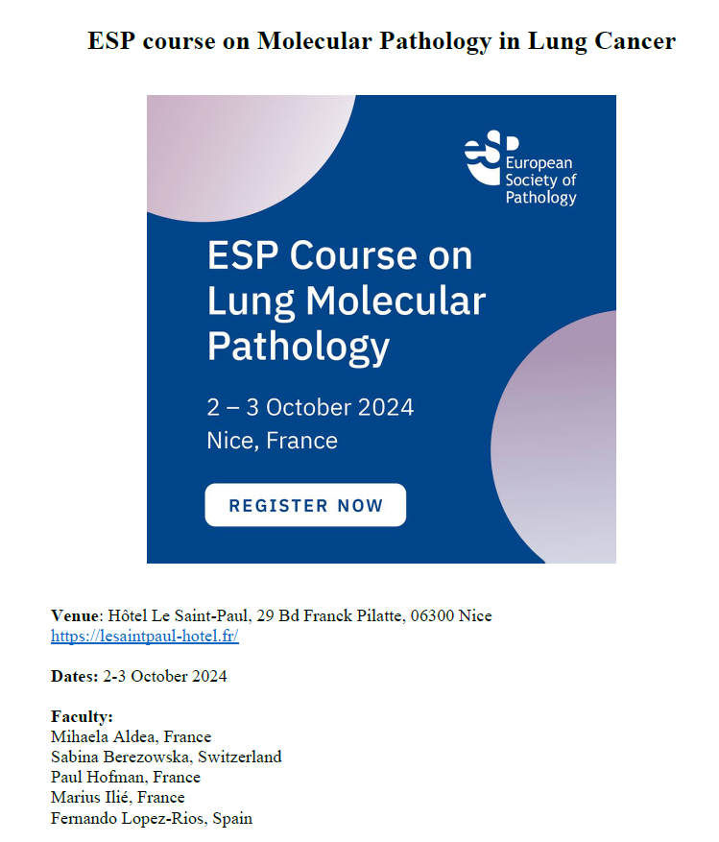
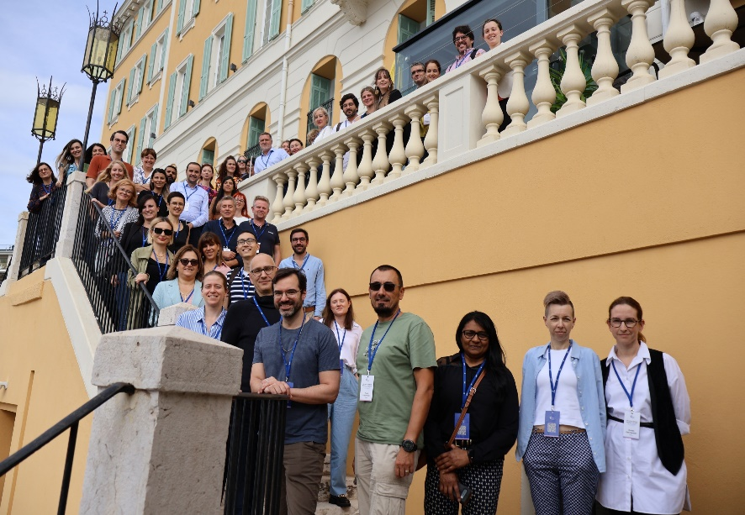
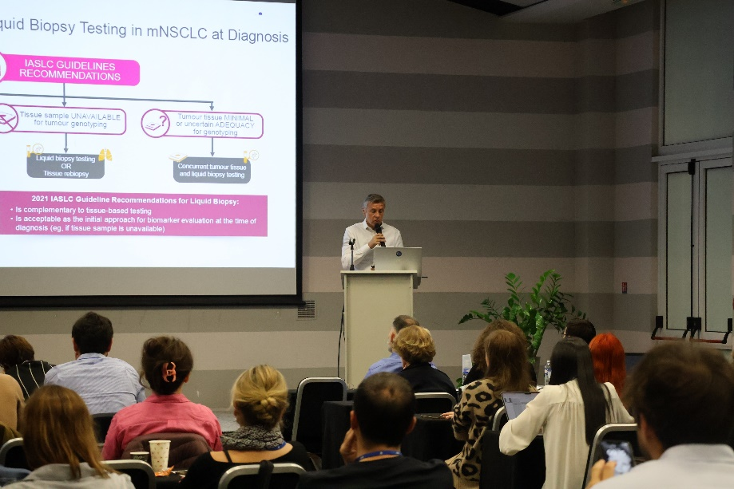

Slide 35
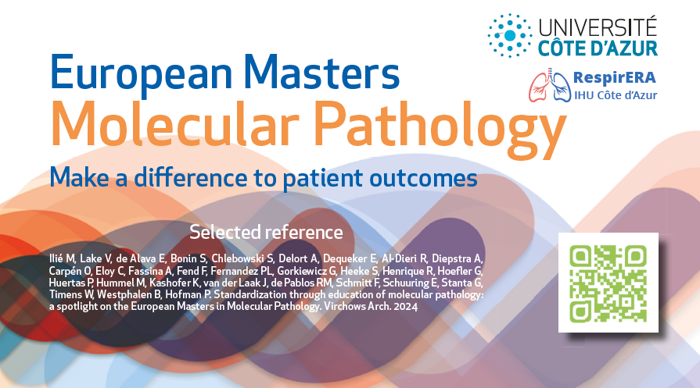

MODULE 12
LIQUID BIOPSY

Slide 36





Slide 37









Slide 38






Thank you for your attention !
… Any Questions ?

