Slide 1
The challenges and opportunities to bring circulating tumor DNA-based molecular testing to routine implementation: the conclusions from the COIN consortium
European Liquid Biopsy Society General Assembly
Paul van der Leest
Department of Laboratory Medicine
The Netherlands Cancer Institute
27-11-2024

Slide 2
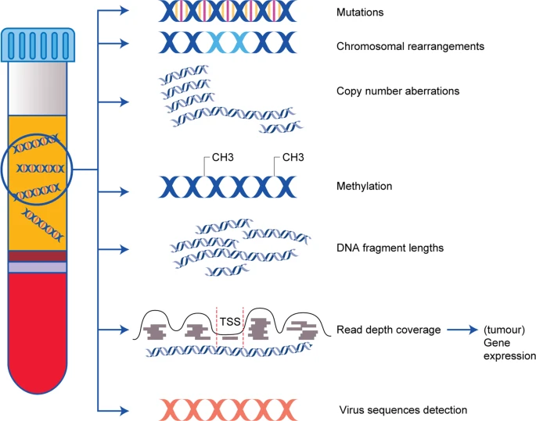
ctDNA is a valuable source of circulating biomarkers
Keller et al. Br J Cancer 2020

Slide 3
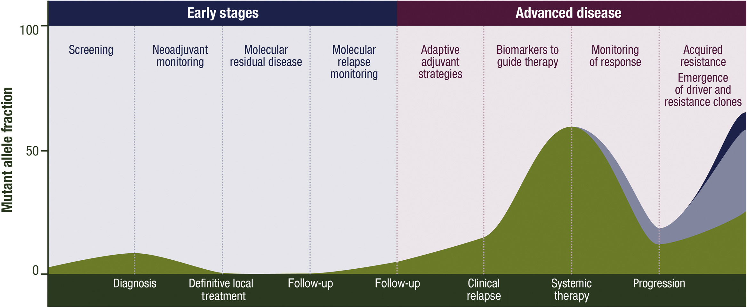
Several clinical applications for liquid biopsy testing in the patient’s journey
Pascual et al. Ann Oncol 2022

Slide 4
Several clinical applications for liquid biopsy testing in the patient’s journey
Potential applications
Screening
Early diagnosis
Neoadjuvant monitoring
Minimal residual disease detection
Recurrence surveillance
Treatment decision making
Response monitoring
Resistance mechanism identification
Currently implemented at NKI
NGS for advanced NSCLC (AVENIO)
BRAF V600 testing in Melanoma (ddPCR)
Predictive biomarker testing

Slide 5
Why are so few liquid biopsy applications implemented in the clinical routine?
Substantial clinical demand for liquid biomarker testing
Many academic and industrial assays show clinical applicability of liquid biopsies
BUT despite huge industrial investments and numerous publications
Uncertainty on the steps required to take a biomarker towards implementation
Absence of performance criteria resulting in wide divergences in (pre)analytical protocols
Ambiguity of institutions that should establish and monitor a biomarker implementation infrastructure

Slide 6

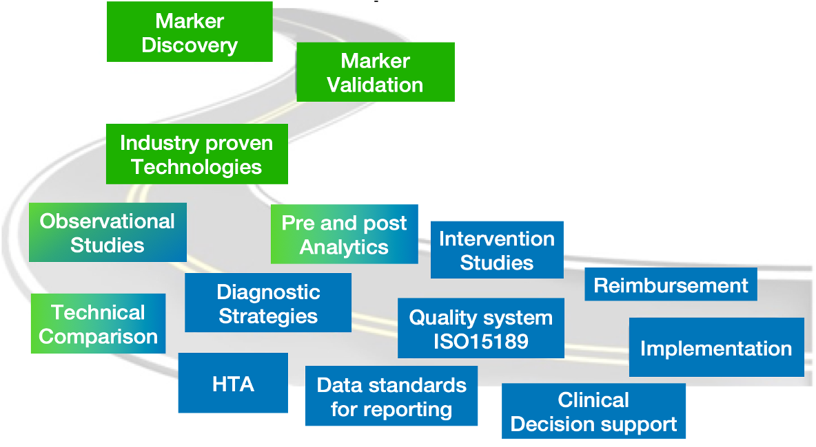

COIN project
ctDNA on the road to implementation in the Netherlands

Slide 7
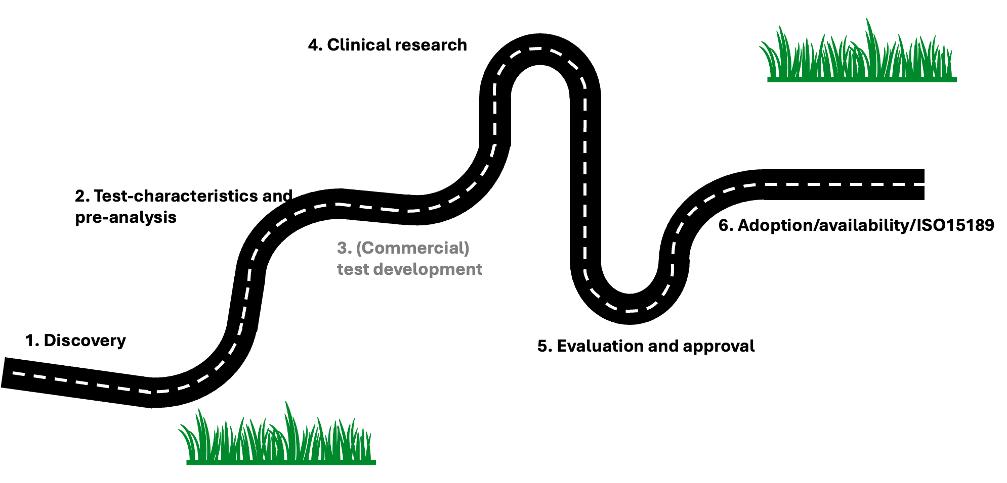
Implementation road in the Netherlands
Notes:
A roadmap mimicking drug evaluation and implementation

Slide 8
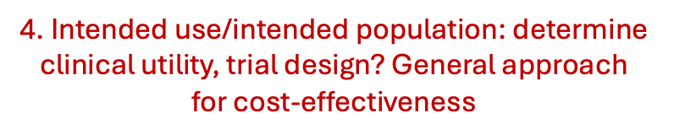
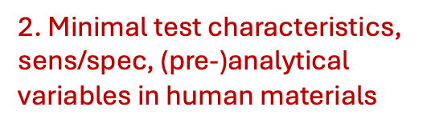
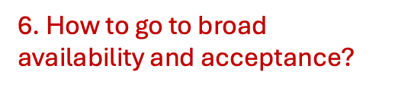

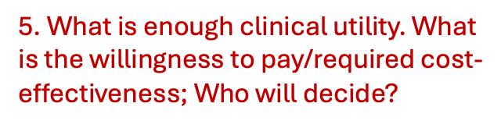
Implementation road in the Netherlands

Slide 9
Implementation road in the Netherlands
Notes:
A roadmap mimicking drug evaluation and implementation

Slide 10
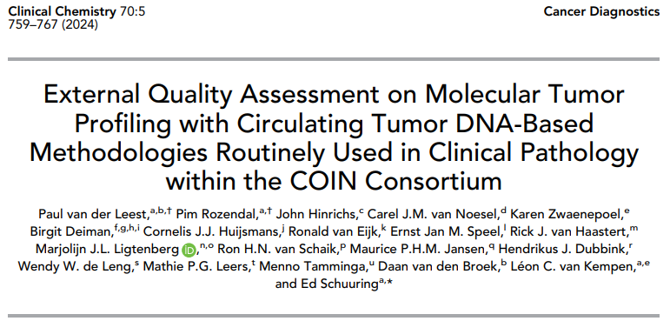

Slide 11
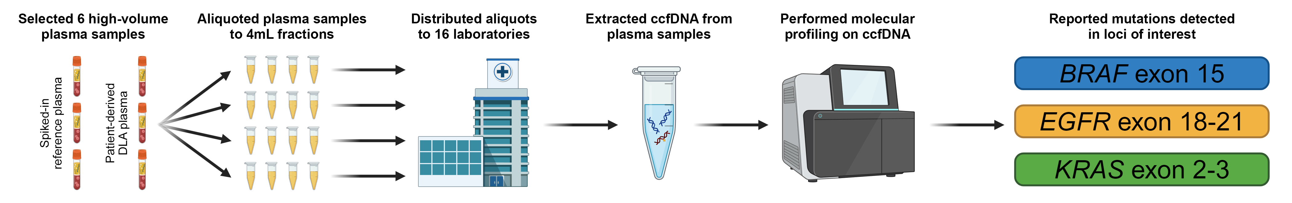
Assessed the genotyping of clinically relevant targets in BRAF, EGRF and KRAS
van der Leest et al. Clin Chem 2024

Slide 12
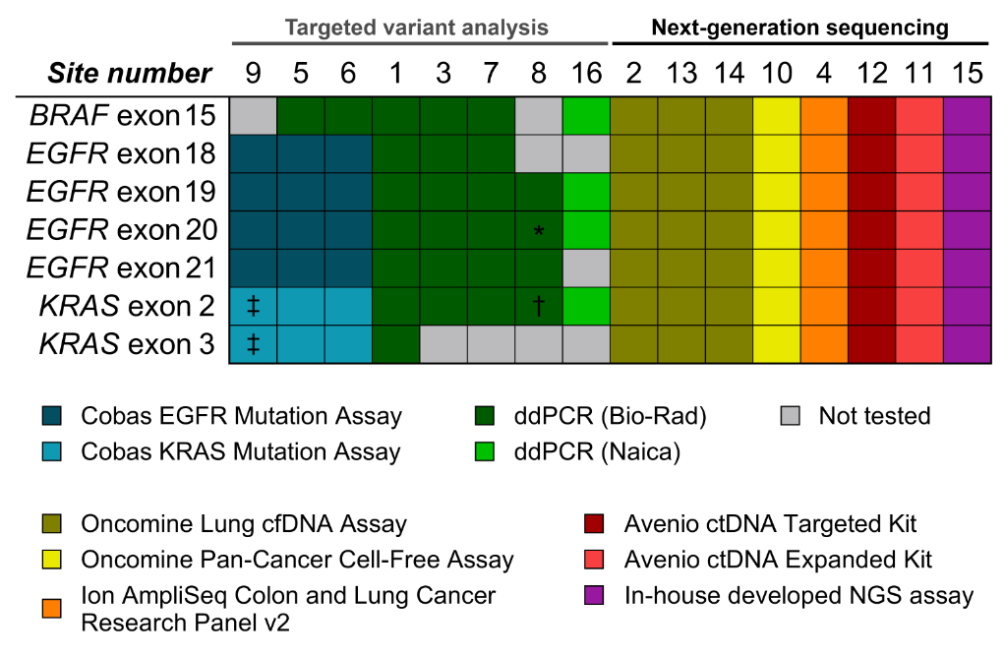
Broad range of assays used in routine practice
van der Leest et al. Clin Chem 2024

Slide 13
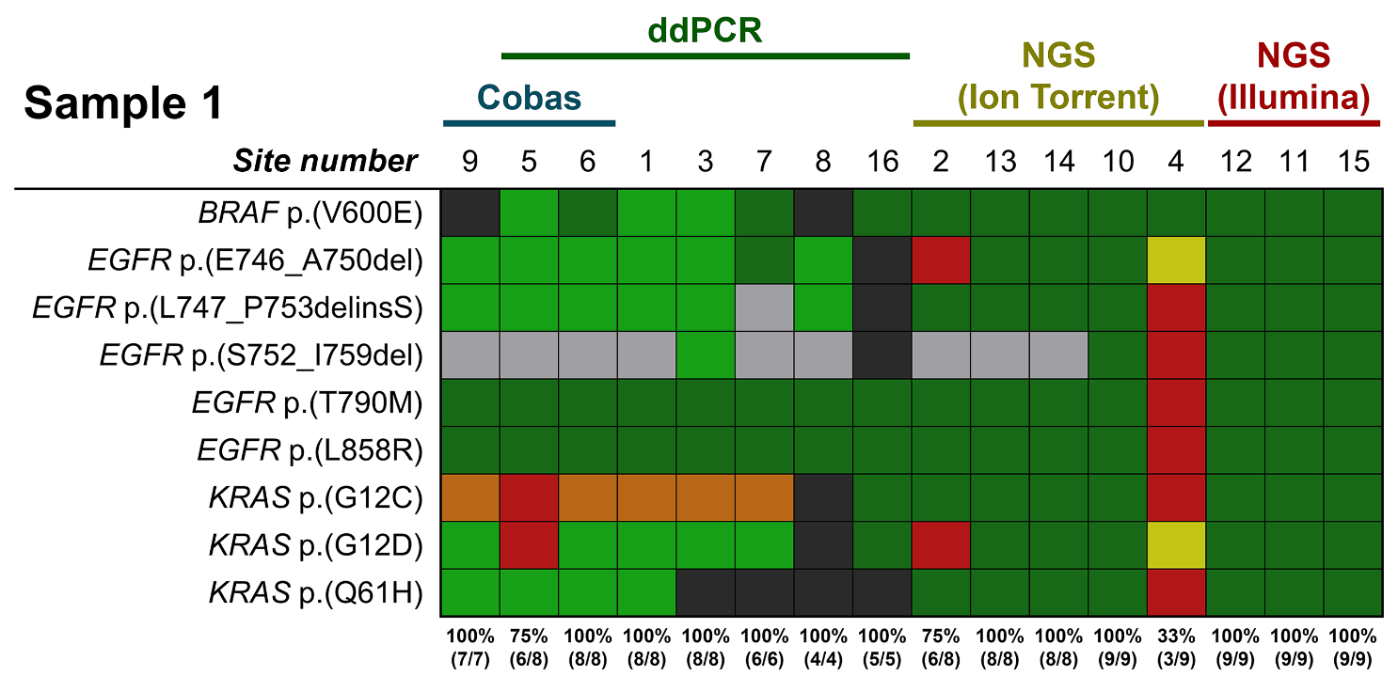
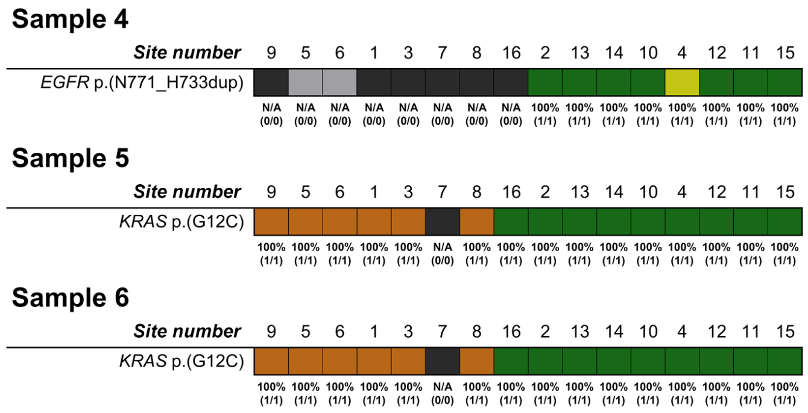
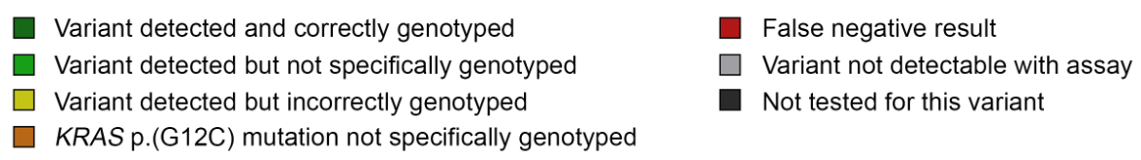
Inconsitencies in genotyping of actionable variants
Reference plasma sample
Patient-derived plasma samples
van der Leest et al. Clin Chem 2024

Slide 14
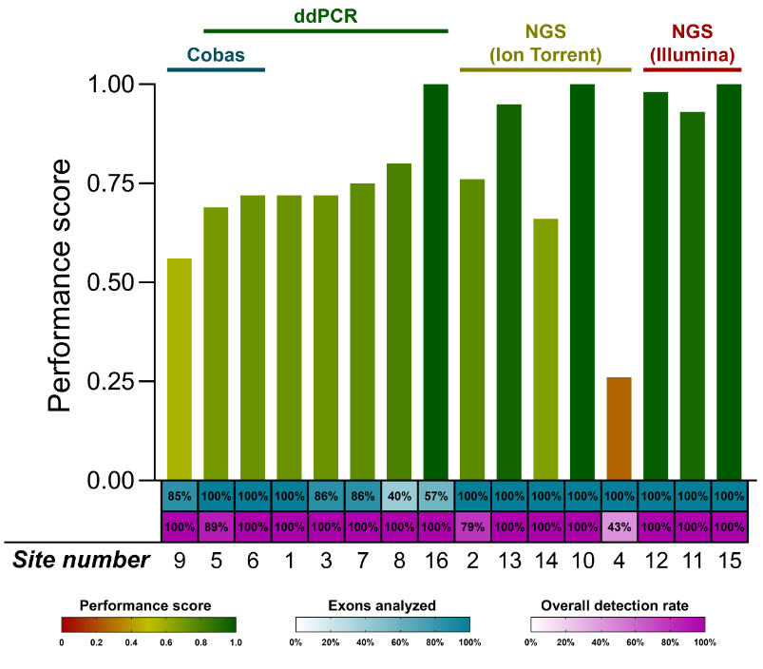
Great diversity in genotyping performance
The use of different ctDNA detection assays leads to inconsistencies in genotyping performance
  Different workflows
  Different outcomes
Standardization of liquid biopsy workflows should be pursued to secure accurate diagnostics across institutions
How can standardization be achieved when institutes use different analytical workflows?
van der Leest et al. Clin Chem 2024

Slide 15
Implementation road in the Netherlands
Notes:
A roadmap mimicking drug evaluation and implementation

Slide 16
Proposed implementation strategy based on COIN
Developed assay
Who is entitled to determine?
Determine ad hoc outcome criteria
Performance evaluation
Clinical research
EQA and HTA assessment
Approval and accreditation
Adoption
Who is entitled to regulate?
Reimbursement

Slide 17
Governance required for biomarker implementation
European Liquid Biopsy Society?
European Biomarker Agency?
Performance evaluation
Clinical research
EQA and HTA assessment
Approval and accreditation
Show adherence to ad hoc quality standards/ performance criteria
Show clinical validity for intended use and in intended population
Show transferable utility and cost-effectiveness of assay in clinical setting
Receive required approval and accreditation for application in clinical routine

Slide 18
Conclusions
Divergent (pre)analytical protocols result in inconsistent genotyping results
The absence of an implementation infrastructure hinders its progression to the clinical routine
Desperate need for a biomarker implementation framework → COIN2.0
  Further establish the road to implementation in the Netherlands
  Identify stakeholders to put biomarker implementation on the (inter)national agenda
    Predictive markers (easier)
    Other applications (challenging)
  Appoint institutions responsible for the assessment and approval of biomarker workflows
  Transfer implementation framework to other European countries
What role does ELBS envision in the biomarker implementation framework?

