Slide 1
ELBS General Assembly 2024
Regulatory working group
Klaus Pantel, Ariane Hallermayr
November 26th- 27th
PRBB, Barcelona, Spain

Slide 2
Focus of the Regulatory Working Group
Routine clinical practice
Regulatory terms and conditions
health care stakeholders
regulatory agencies
Approval + reimbursement

Slide 3
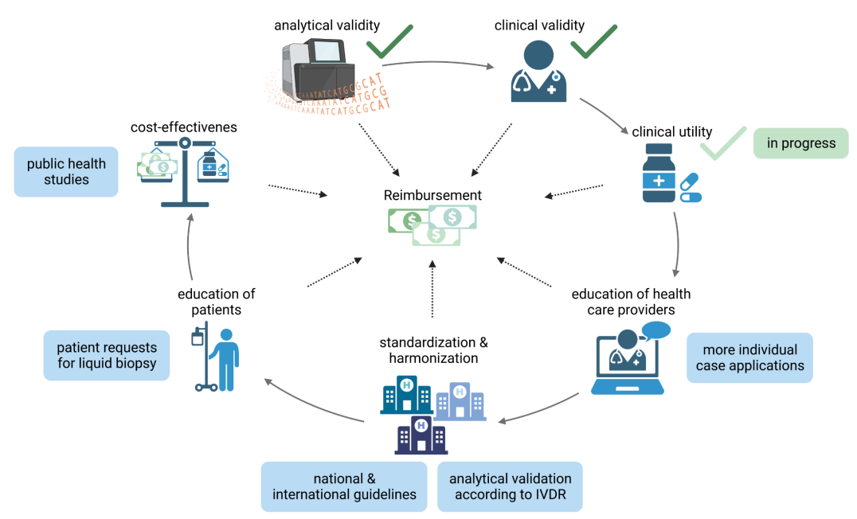
Challenges hindering reimbursement

Slide 4
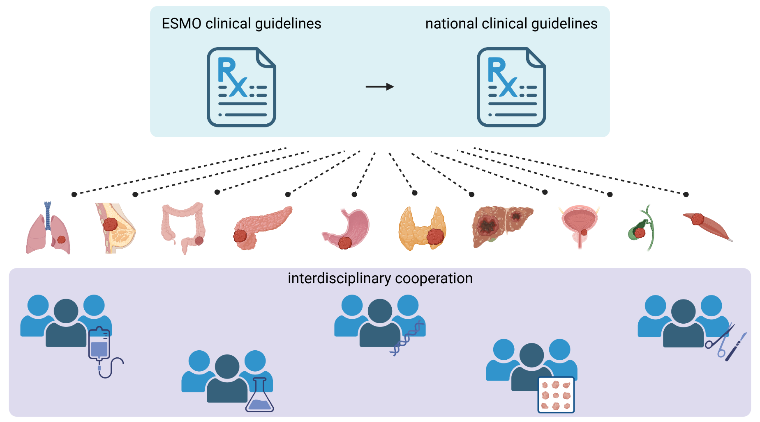

Requirements to overcome challenges
To-Do: Moderation of communication to specialists and professional societies

Slide 5
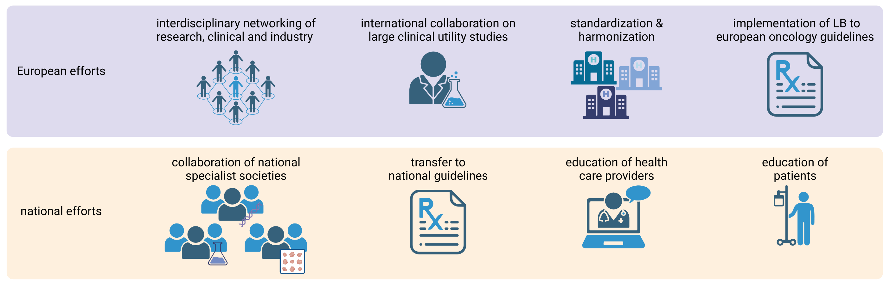
Ideas to improve reimbursement

Slide 6
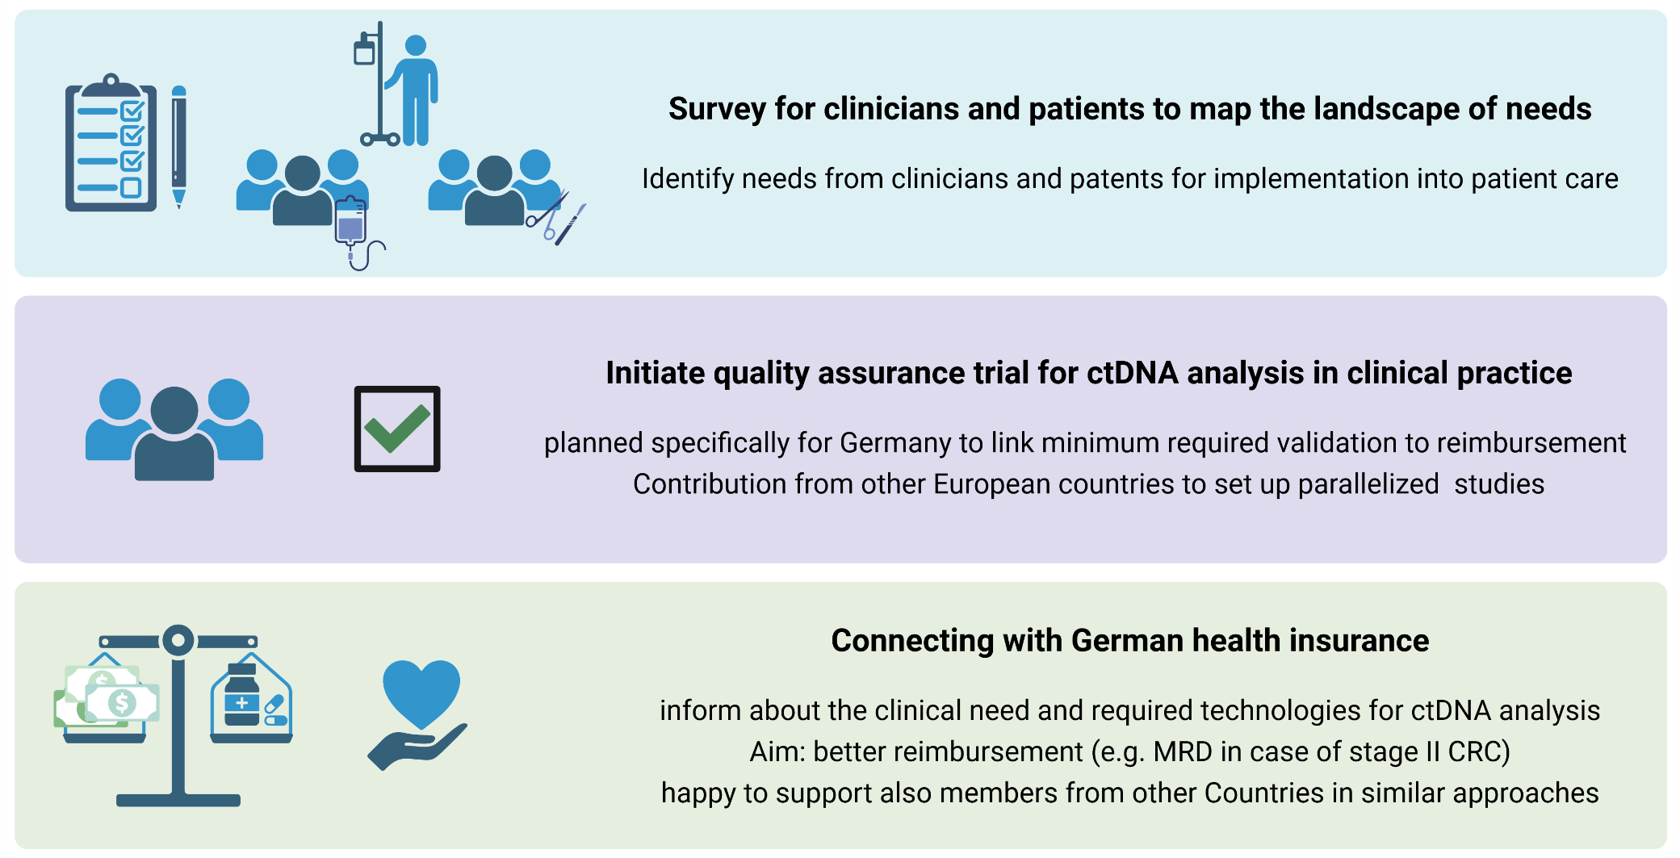
Future plans and initiatives
Please reach out for suggestions

Slide 7

Connecting with German health insurance
Communications with a large German health insurance company (Techniker)
Presentation at the VDEK (Verband der Ersatzkassen), representing 6 major health insurance companies with over 28 million Germans insured
Use-case discussed:
De-escalation: reimbursement of ctDNA based stratification of stage II CRC patients following operative tumor resection → treatment decision chemotherapy YES/NO
High interest, further meetings scheduled
Requirements by insurances:
Number of patients per year
Cost-calculation
Costs of the test
Quality assurance

Slide 8
ELBS Satellite Workshop:
IVDR and Reimbursement – The future of LB adoption in Europe
27th of November (2 – 5 pm)
Charles Darwin Room, Inner Square, PRBB

Slide 9
Thank you for your attention!

