Slide 1
Tumor-agnostic detection of ctDNA in patients with advanced pancreatic cancer using targeted DNA methylation sequencing and cfDNA fragmentomics
Oddmund Nordgård, PhD, Professor
Stavanger University Hospital
University of Stavanger
Department of Hematology and Oncology
Notes:
Thanks to the organizers for giving me this opportunity to present some of our latest results. I work as a researcher at Stavanger University Hospital and the University of Stavanger. And I am going to tell you about our most recent efforts to enhance ctDNA detection.

Slide 2
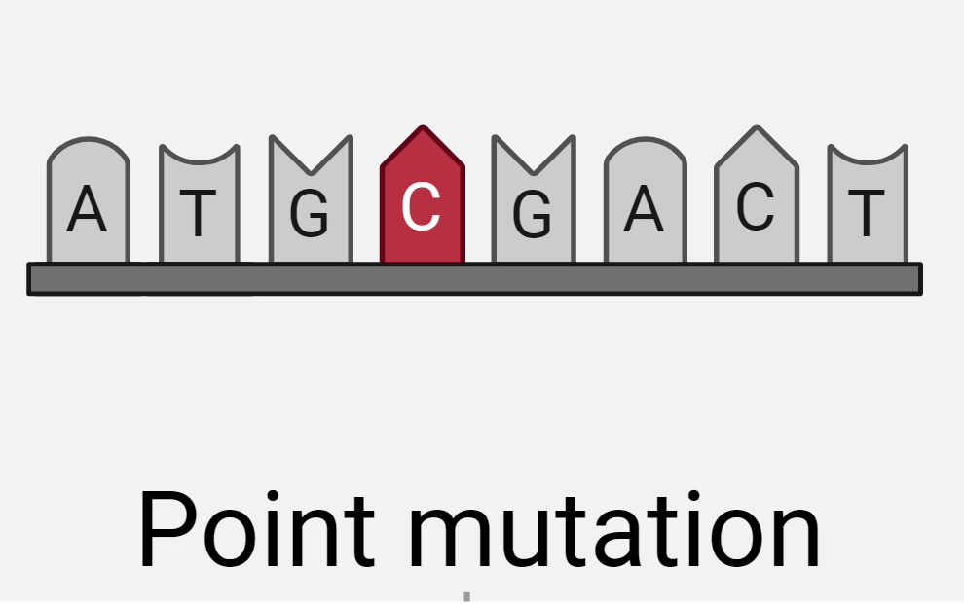
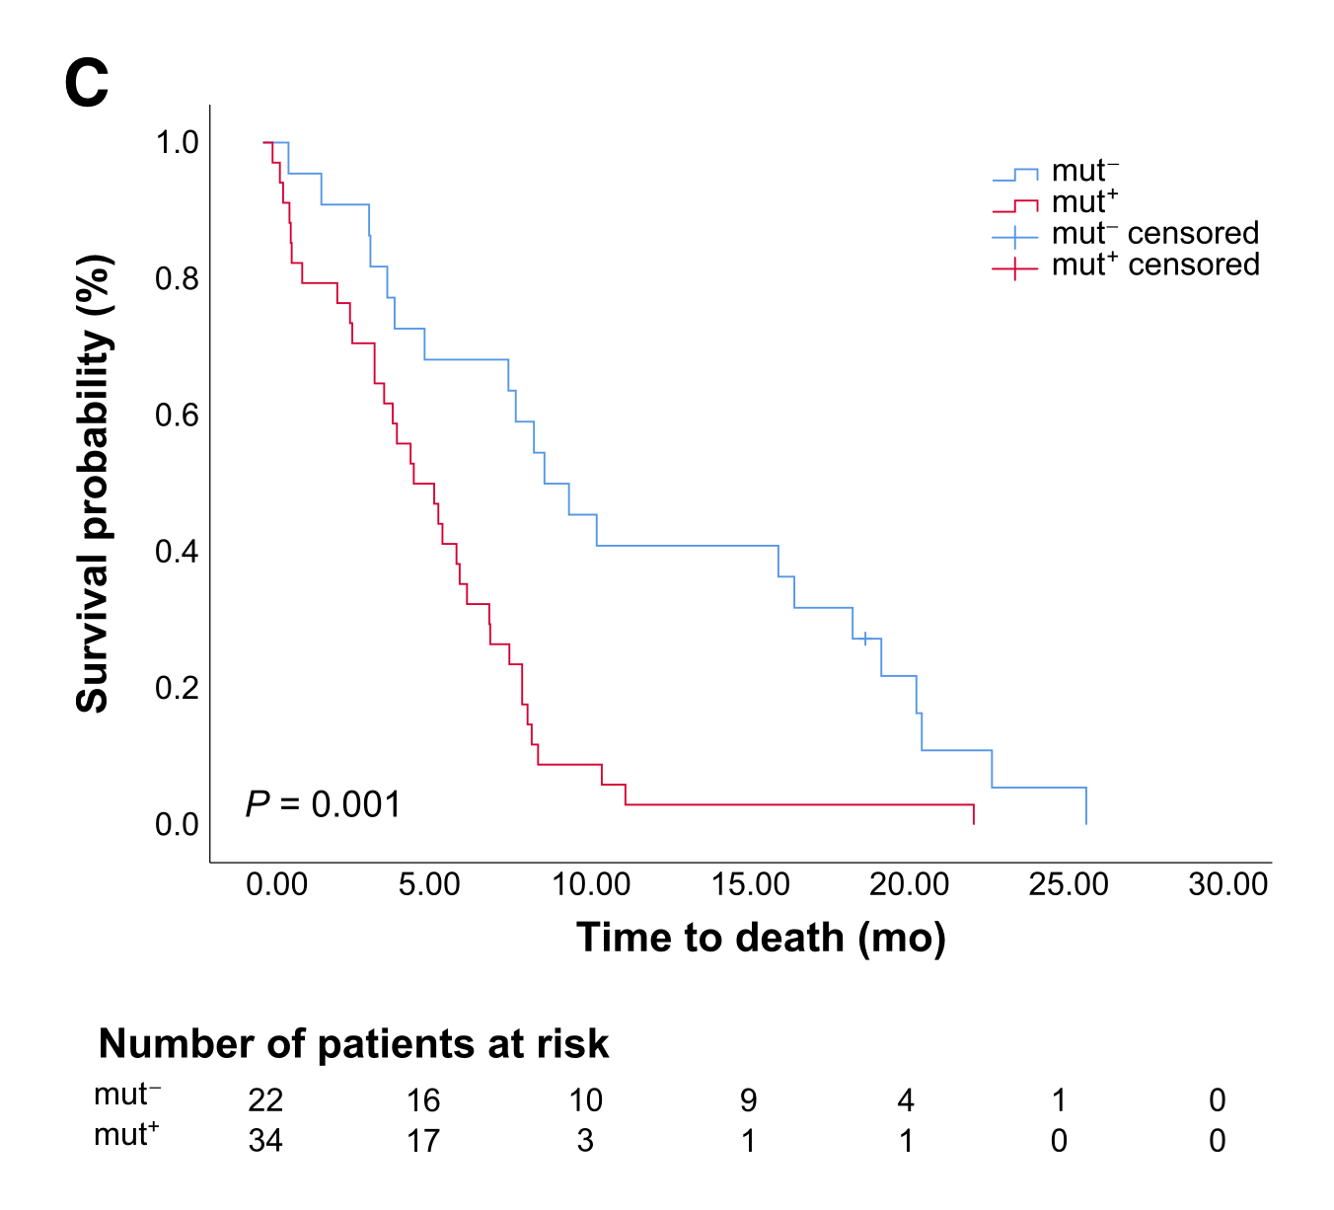
Background & Aim
Previous data show prognostic value and monitoring potential of ctDNA measurements by mutations in patients with advanced pancreatic cancer
~40% of patients are ctDNA-negative in this study, despite advanced disease
More sensitive methods needed?
Aim: Validate alternative ctDNA markers
Lapin et al. 2023, CCR
Edland et al. 2023, Mol Oncol
Notes:
First some background information. We have previously demonstrated prognostic value and a monitoring potential of ctDNA measurements in patients with advanced pancreatic cancer. Our previous publications was based on point mutations, both SNVs and small indels, using an 8-gene sequencing panel and advanced error correction. Selected survival curves are shown on the right.
Interestingly, around 40% of the patients were cDNA negative, despite having advanced, incurable disease. We speculated that at least some of these patients must have ctDNA, either because the dont have mutations in the 8 assessed genes, or perhaps at levels below the limit of detection.
Thus, we aimed to validate alternative and perhaps more numerous and thus more sensitive markers of ctDNA in the same patient group of pancreatic cancer.

Slide 3
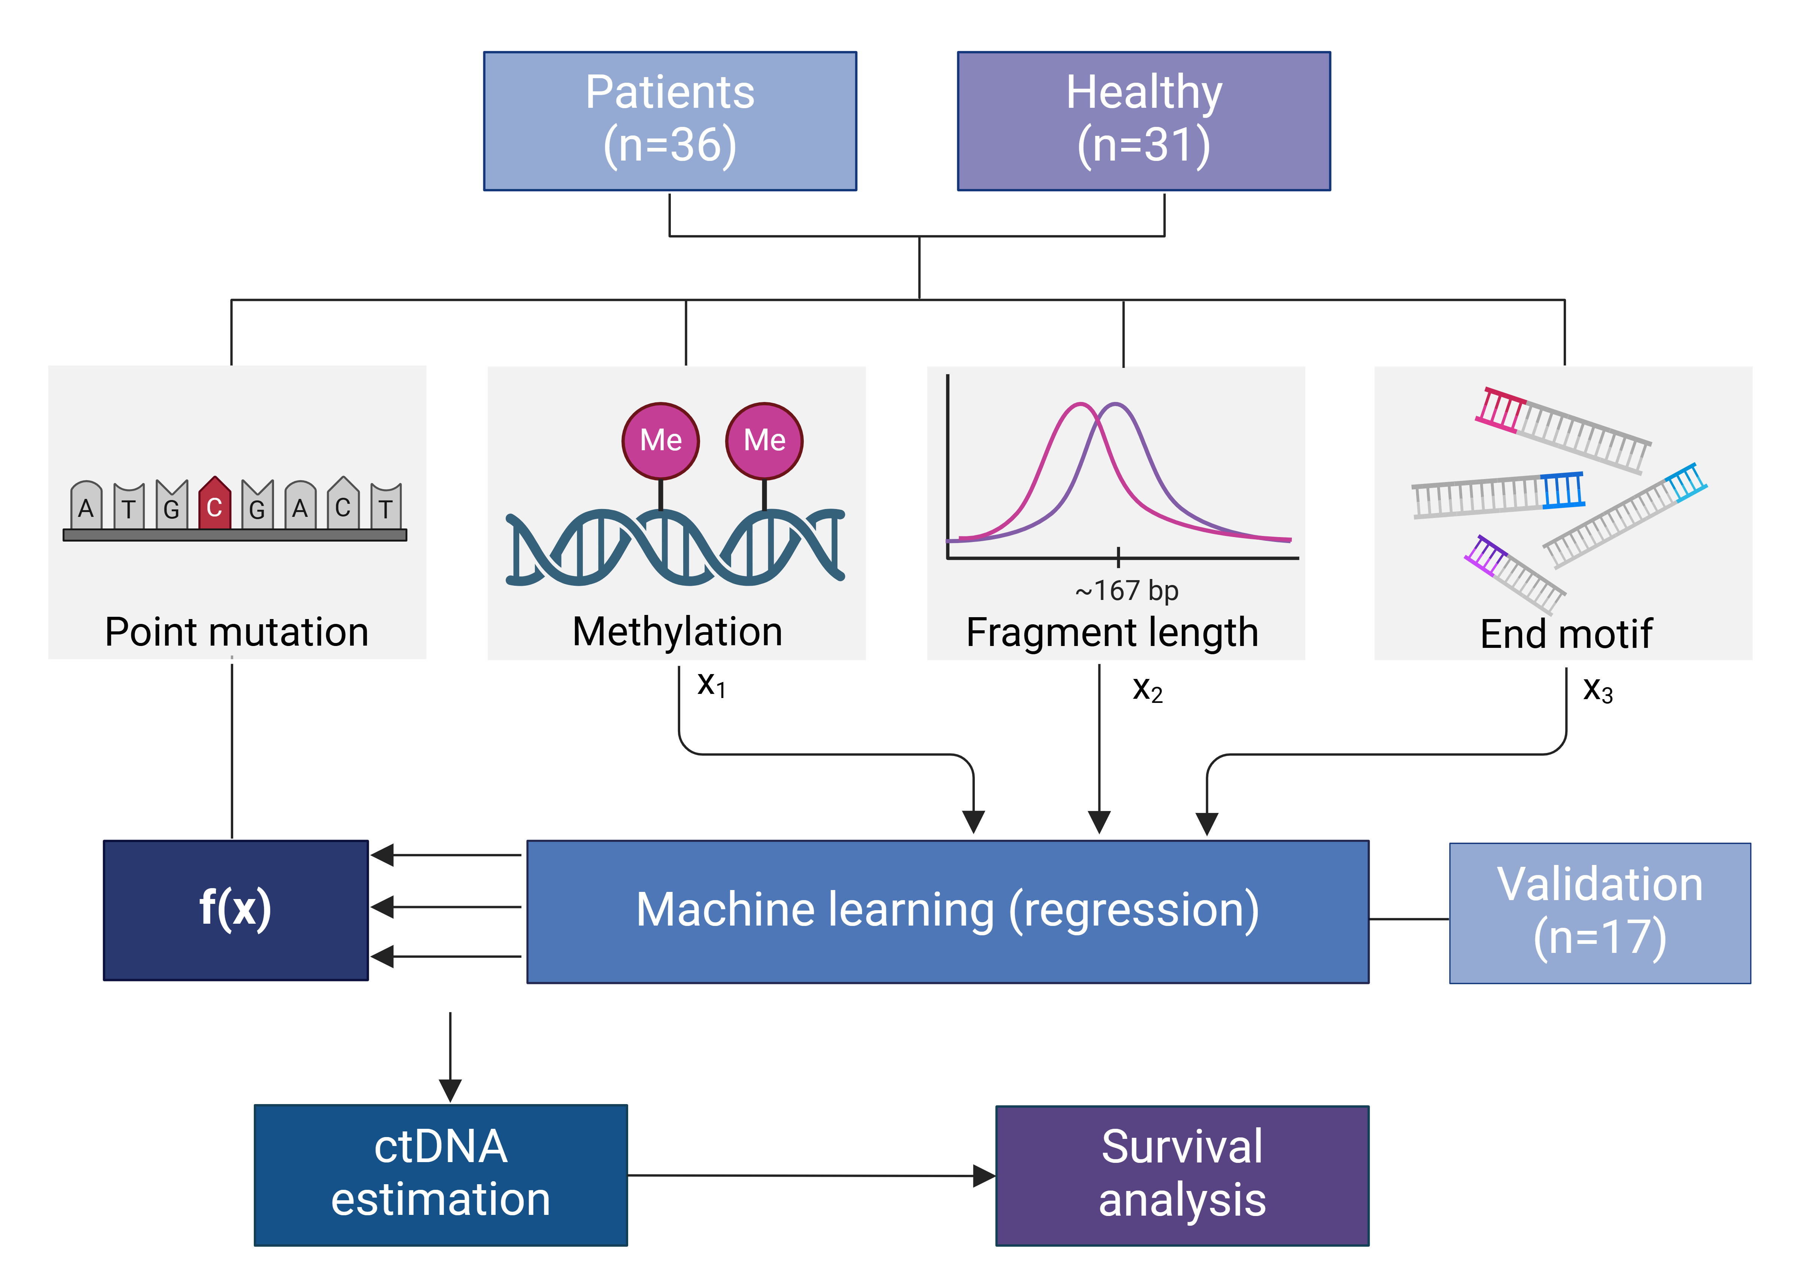
Created by S. Ekedal with biorender.com
Notes:
We investigated three alternative markers for ctDNA: targeted DNA methylation, cfDNA fragment length and cfDNA end motifs, in comparison with the already described mutation detection. These markers were measured in plasma samples from a cohort of 36 patients with advanced PDAC and 31 healthy volunteers. The data obtained were used to generate machine learning-based regression models, modeling known ctDNA concentration previously determined by targeted sequencing, using the leave-one-out cross validation method. The training cohort consisted of the 36 baseline patient samples and plasma from 10 randomly selected healthy controls. The models were validated in a separate set of plasma samples from the same patient cohort, obtained at later time points.
Finally, we validated the new ctDNA markers by survival analysis.

Slide 4
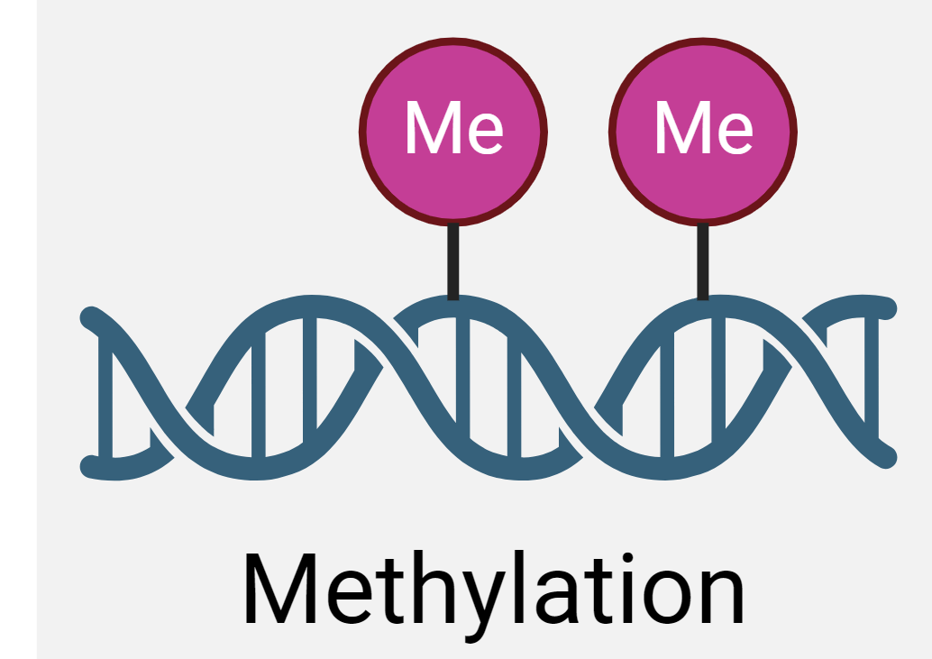
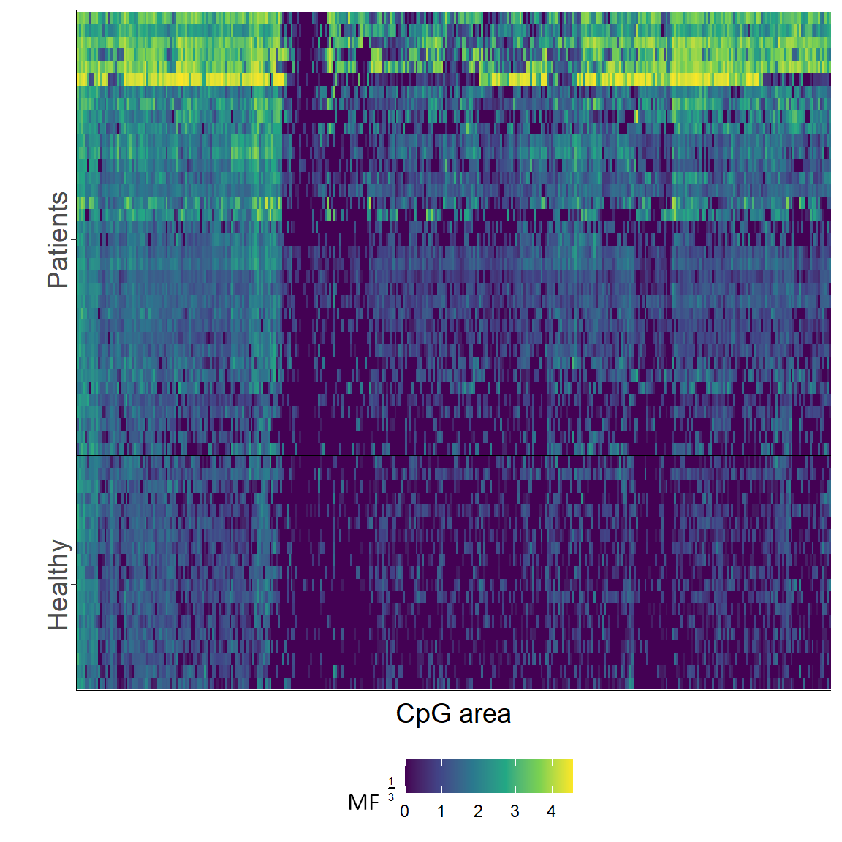
cfDNA methylation
Targeted DNA methylation sequencing (356 CpG areas)
MF = methylation fraction
Heatmap with unsupervised clustering indicates that many patients have high-methylation profile
Lapin et al. 2024, unpublished
Notes:
Then, I would like to show you some results. First from the targeted methylation sequencing. 356 CpG areas were selected based on TCGA data, selecting areas specifically methylated in pancreatic cancer. The heat plot here shows the methylation fraction (MF) of these 356 CpG areas, sorted according to unsupervised clustering of both CpG areas and samples. As you can se, a large group of patients had consistently elevated methylation fraction of many CpGs, indicated by the yellow and green colors in the upper rows.

Slide 5
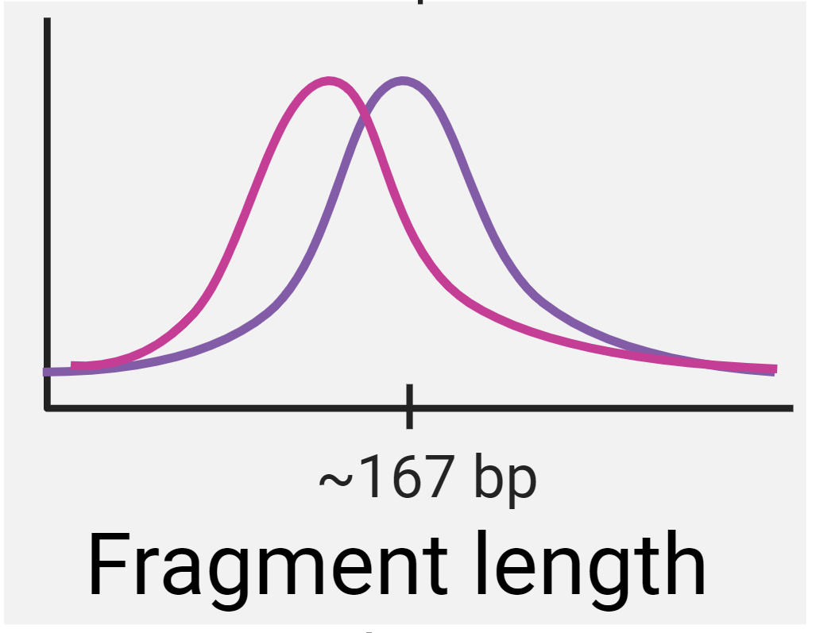
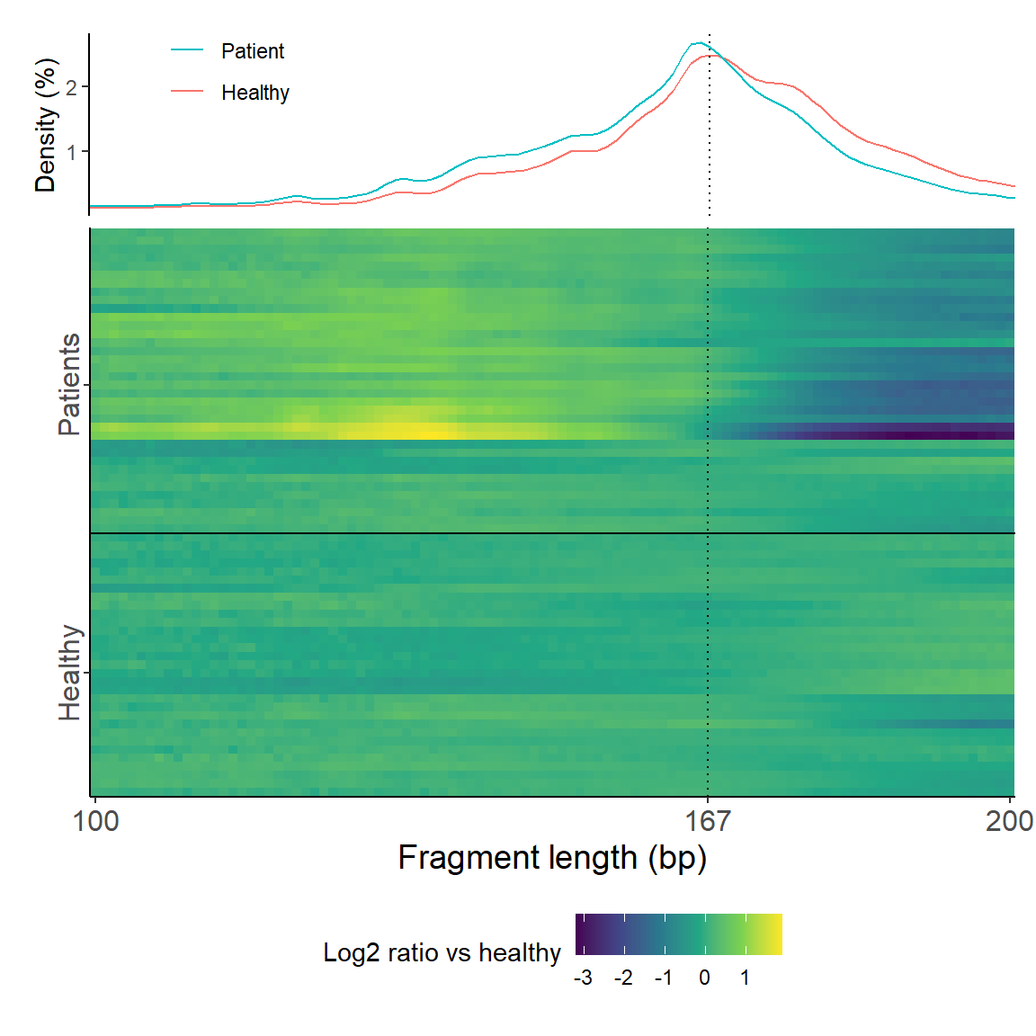
cfDNA fragment length
cfDNA fragment lengths (off-target) extracted from previous targeted sequencing
Density plot demonstrates shorter lengths in baseline samples from patients
Heatmap with unsupervised clustering show that many patients have shorter length profile
Lapin et al. 2024, unpublished
Notes:
Next, cfDNA fragment lengths. Length of off-target cfDNA moleculares were extracted from previous targeted sequencing of cfDNA. The denisty plot on top demonstrates that mean cfDNA fragment lengths were shorter in baseline samples from patients, compared with healthy plasma.
The heatmap below indicates that almost two thirds of the patients has a shortened length profile of cfDNA.

Slide 6
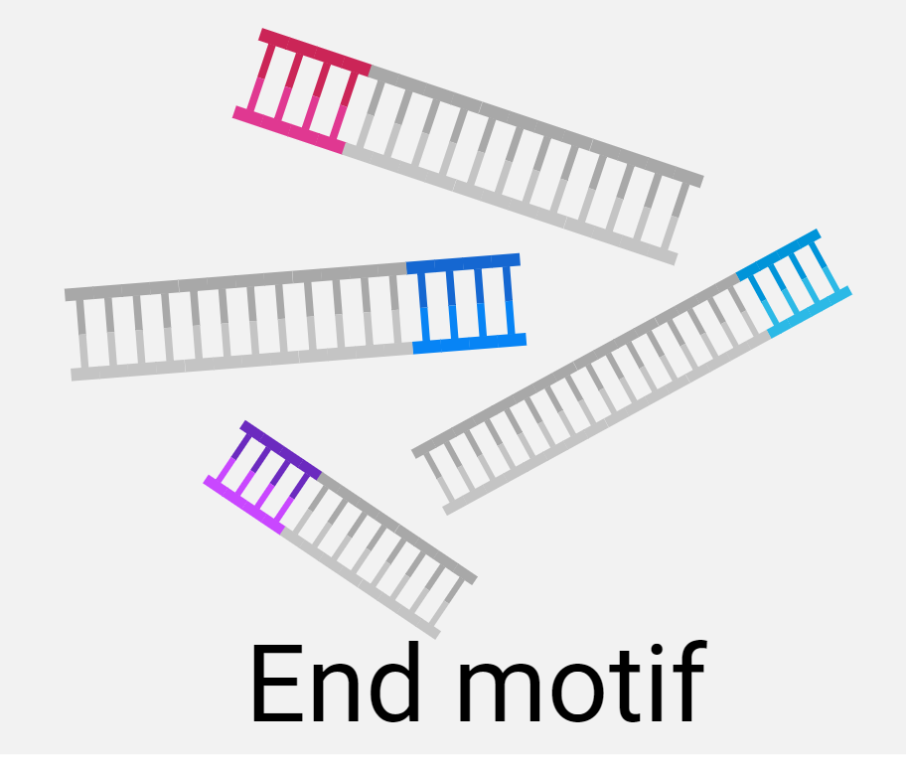
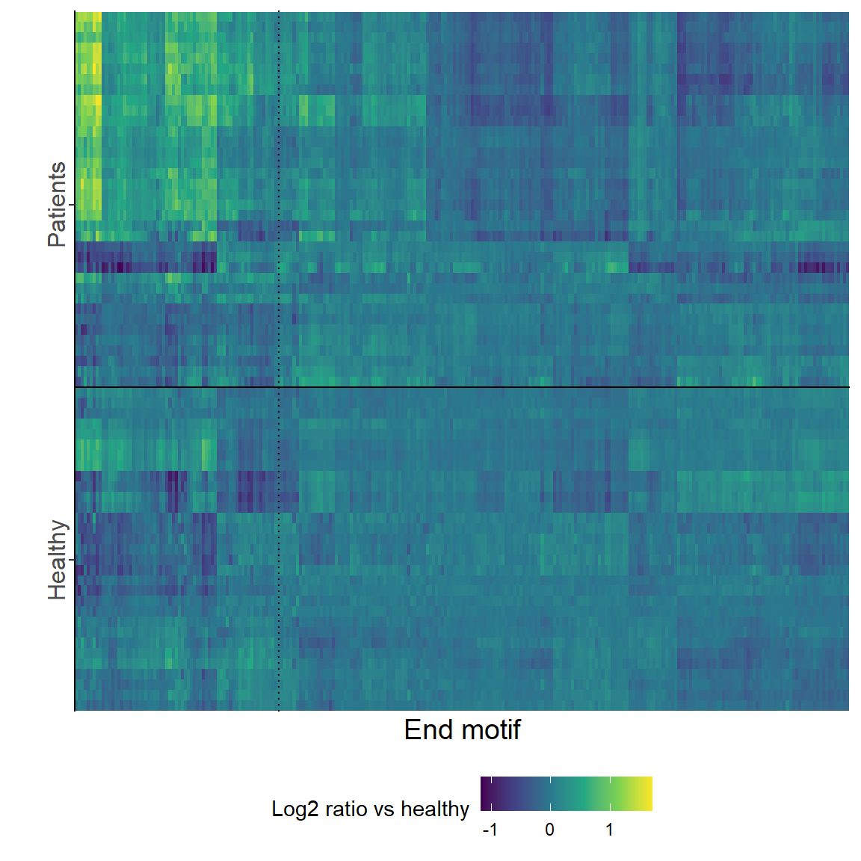
cfDNA end motifs
4-base 5’ end motifs (off-target) extracted from previous targeted sequencing
Heatmap with unsupervised clustering indicates that some patients have different end motif pattern
Lapin et al. 2024, unpublished
Notes:
Finally, cfDNA end motifs. 4-base 5’ end motifs from off-target sequences were extracted from previous targeted cfDNA sequencing. The heatmap shows the relative frequency of the 256 possible end motifs, ordered by unsupervised clustering . We can recgonize that somewhat more than half of the patient samples has a different end motif pattern, compared to healthy control samples.

Slide 7
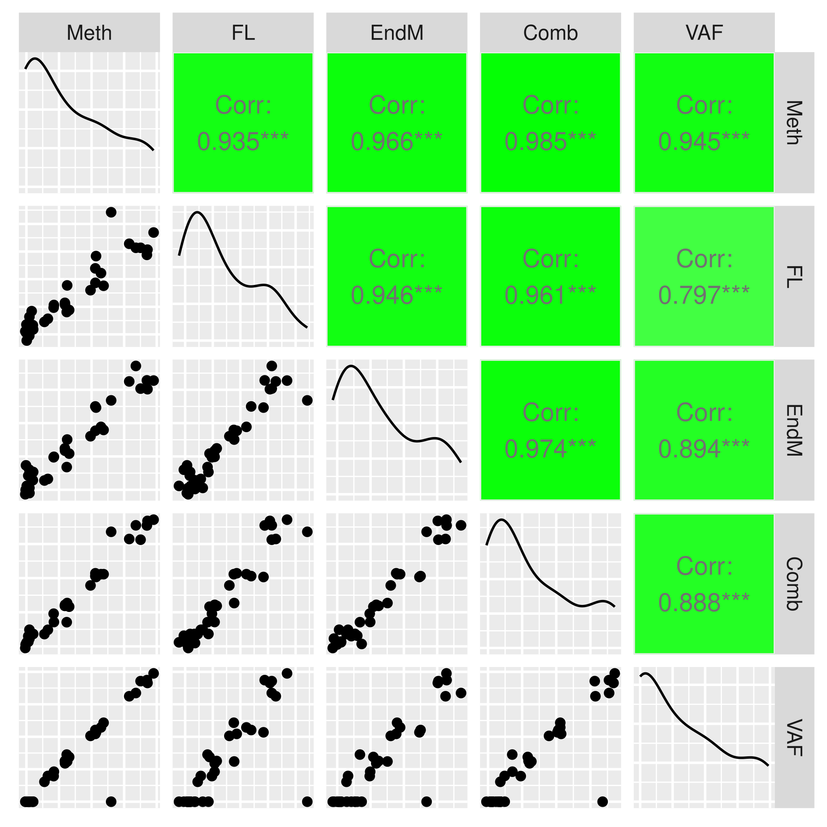
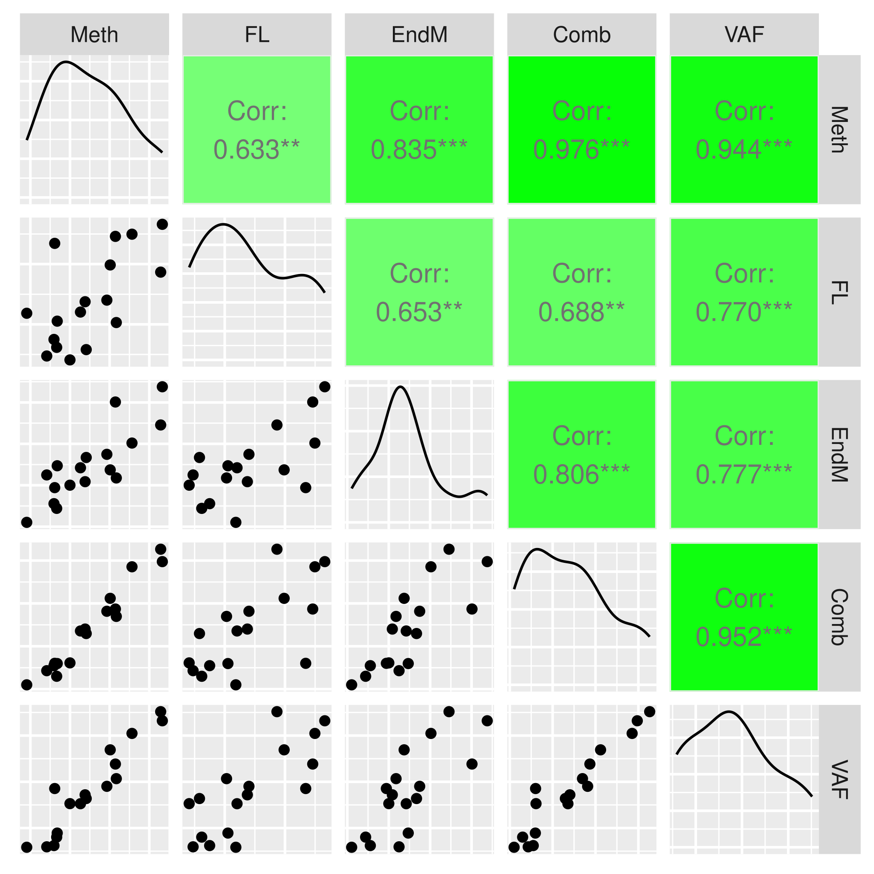
Training set
Validation set
Notes:
These three data sets were subjected to machine learning based regression, both individually and combined. All models presented here had known ctDNA concentration as the modeled variable, denoted VAF in the correlation plots shown here. Several different machine learning models were tested, both classification and regressions and with different sample sets for training. More or less the same results were obtained, as shown here. There were clear correlation beween all data models and known ctDNA concentration, both in training and validation set. Notice one sample that deviated from this in the training set, having high estimated ctDNA level despite negative for mutations.

Slide 8
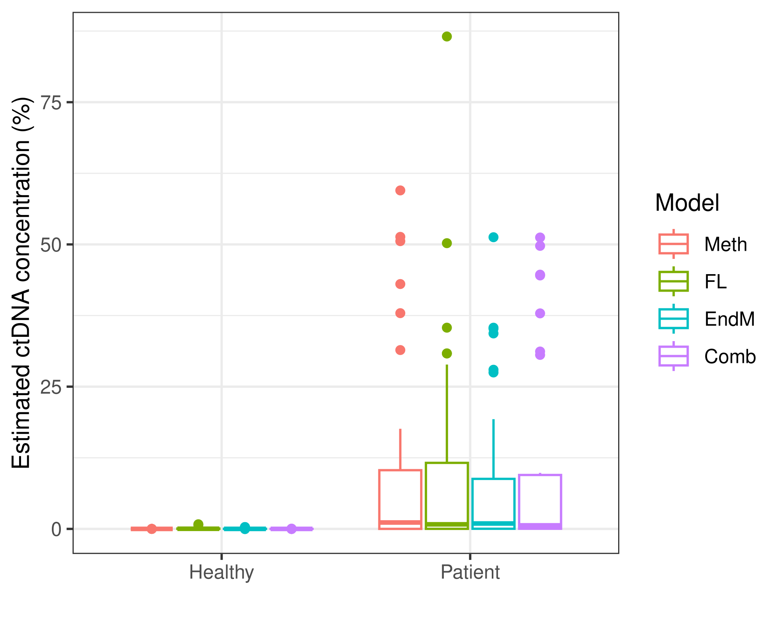
Estimated ctDNA levels
Using the highest healthy level as cutoff,
  25 (69%) had ctDNA detected by methylation
  18 (50%) by fragment length,
  20 (56%) by end motif
  25 (69%) by the combined data model.
  21 (58%) by mutations
Classification concordance with mutations: 30-32 of 36 patients
Lapin et al. 2024, unpublished
Notes:
This figures shows estimated ctDNA levels based on the individual regression models and on the combined data model. As expected, the estimated ctDNA levels in patient samples were much higher than in samples from healty controls.
We used the highest level in the healthy control group as cutoffs for ctDNA detection and found that from 50% to 69% of the patients had elevated estimated cDNA levels. As compared to 58% by mutation detection.
There was considerable classification concordance between the new models and mutation-based ctDNA detection, ranging from 30-32 of the 36 patients.

Slide 9
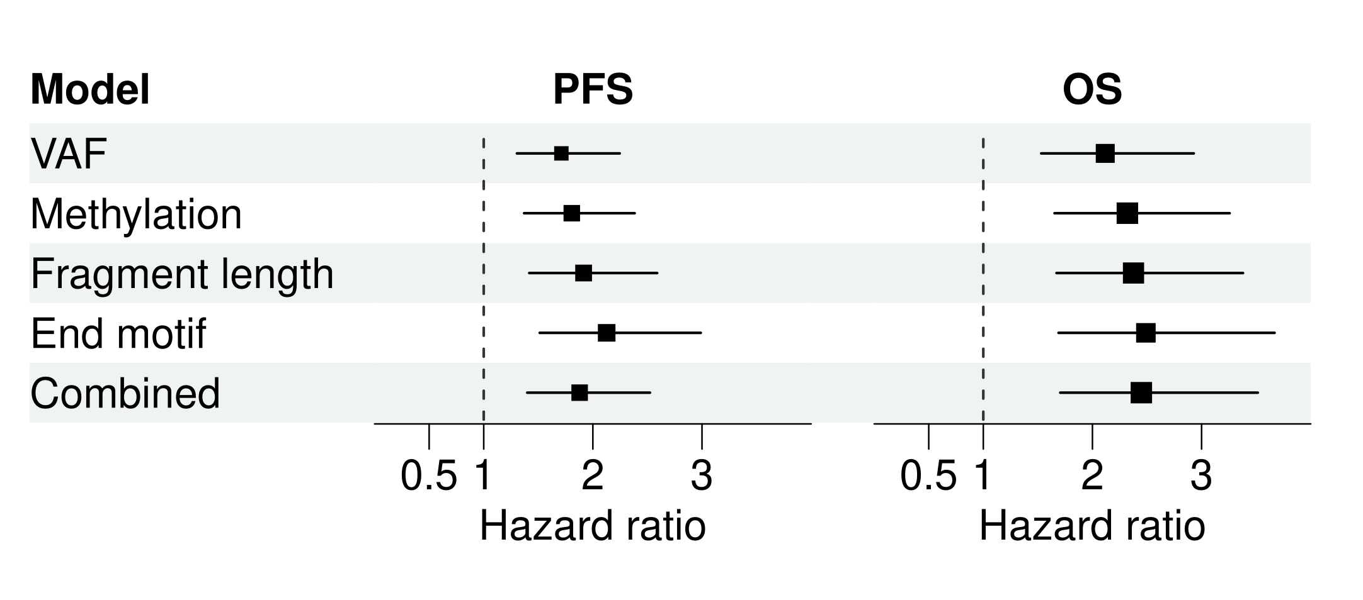
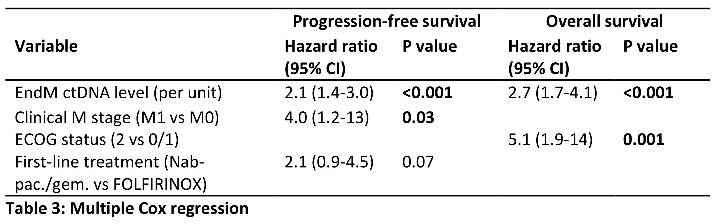
Cox regression
Lapin et al. 2024, unpublished
Notes:
We then evaluated the prognostic value of ctDNA estimates by the alternative markers, compared with mutation-based detection.
It came as no surprise that all individual and the combined model had strong prognostic value in univariable Cox regression, comparable to VAF.
Using multippel Cox regression, we also adjusted the model for known prognostic factors, including only the end motif based ctDNA estimates. As shown in the lower table, estimated ctDNA levels were an independend predictor of both PFS and OS.

Slide 10
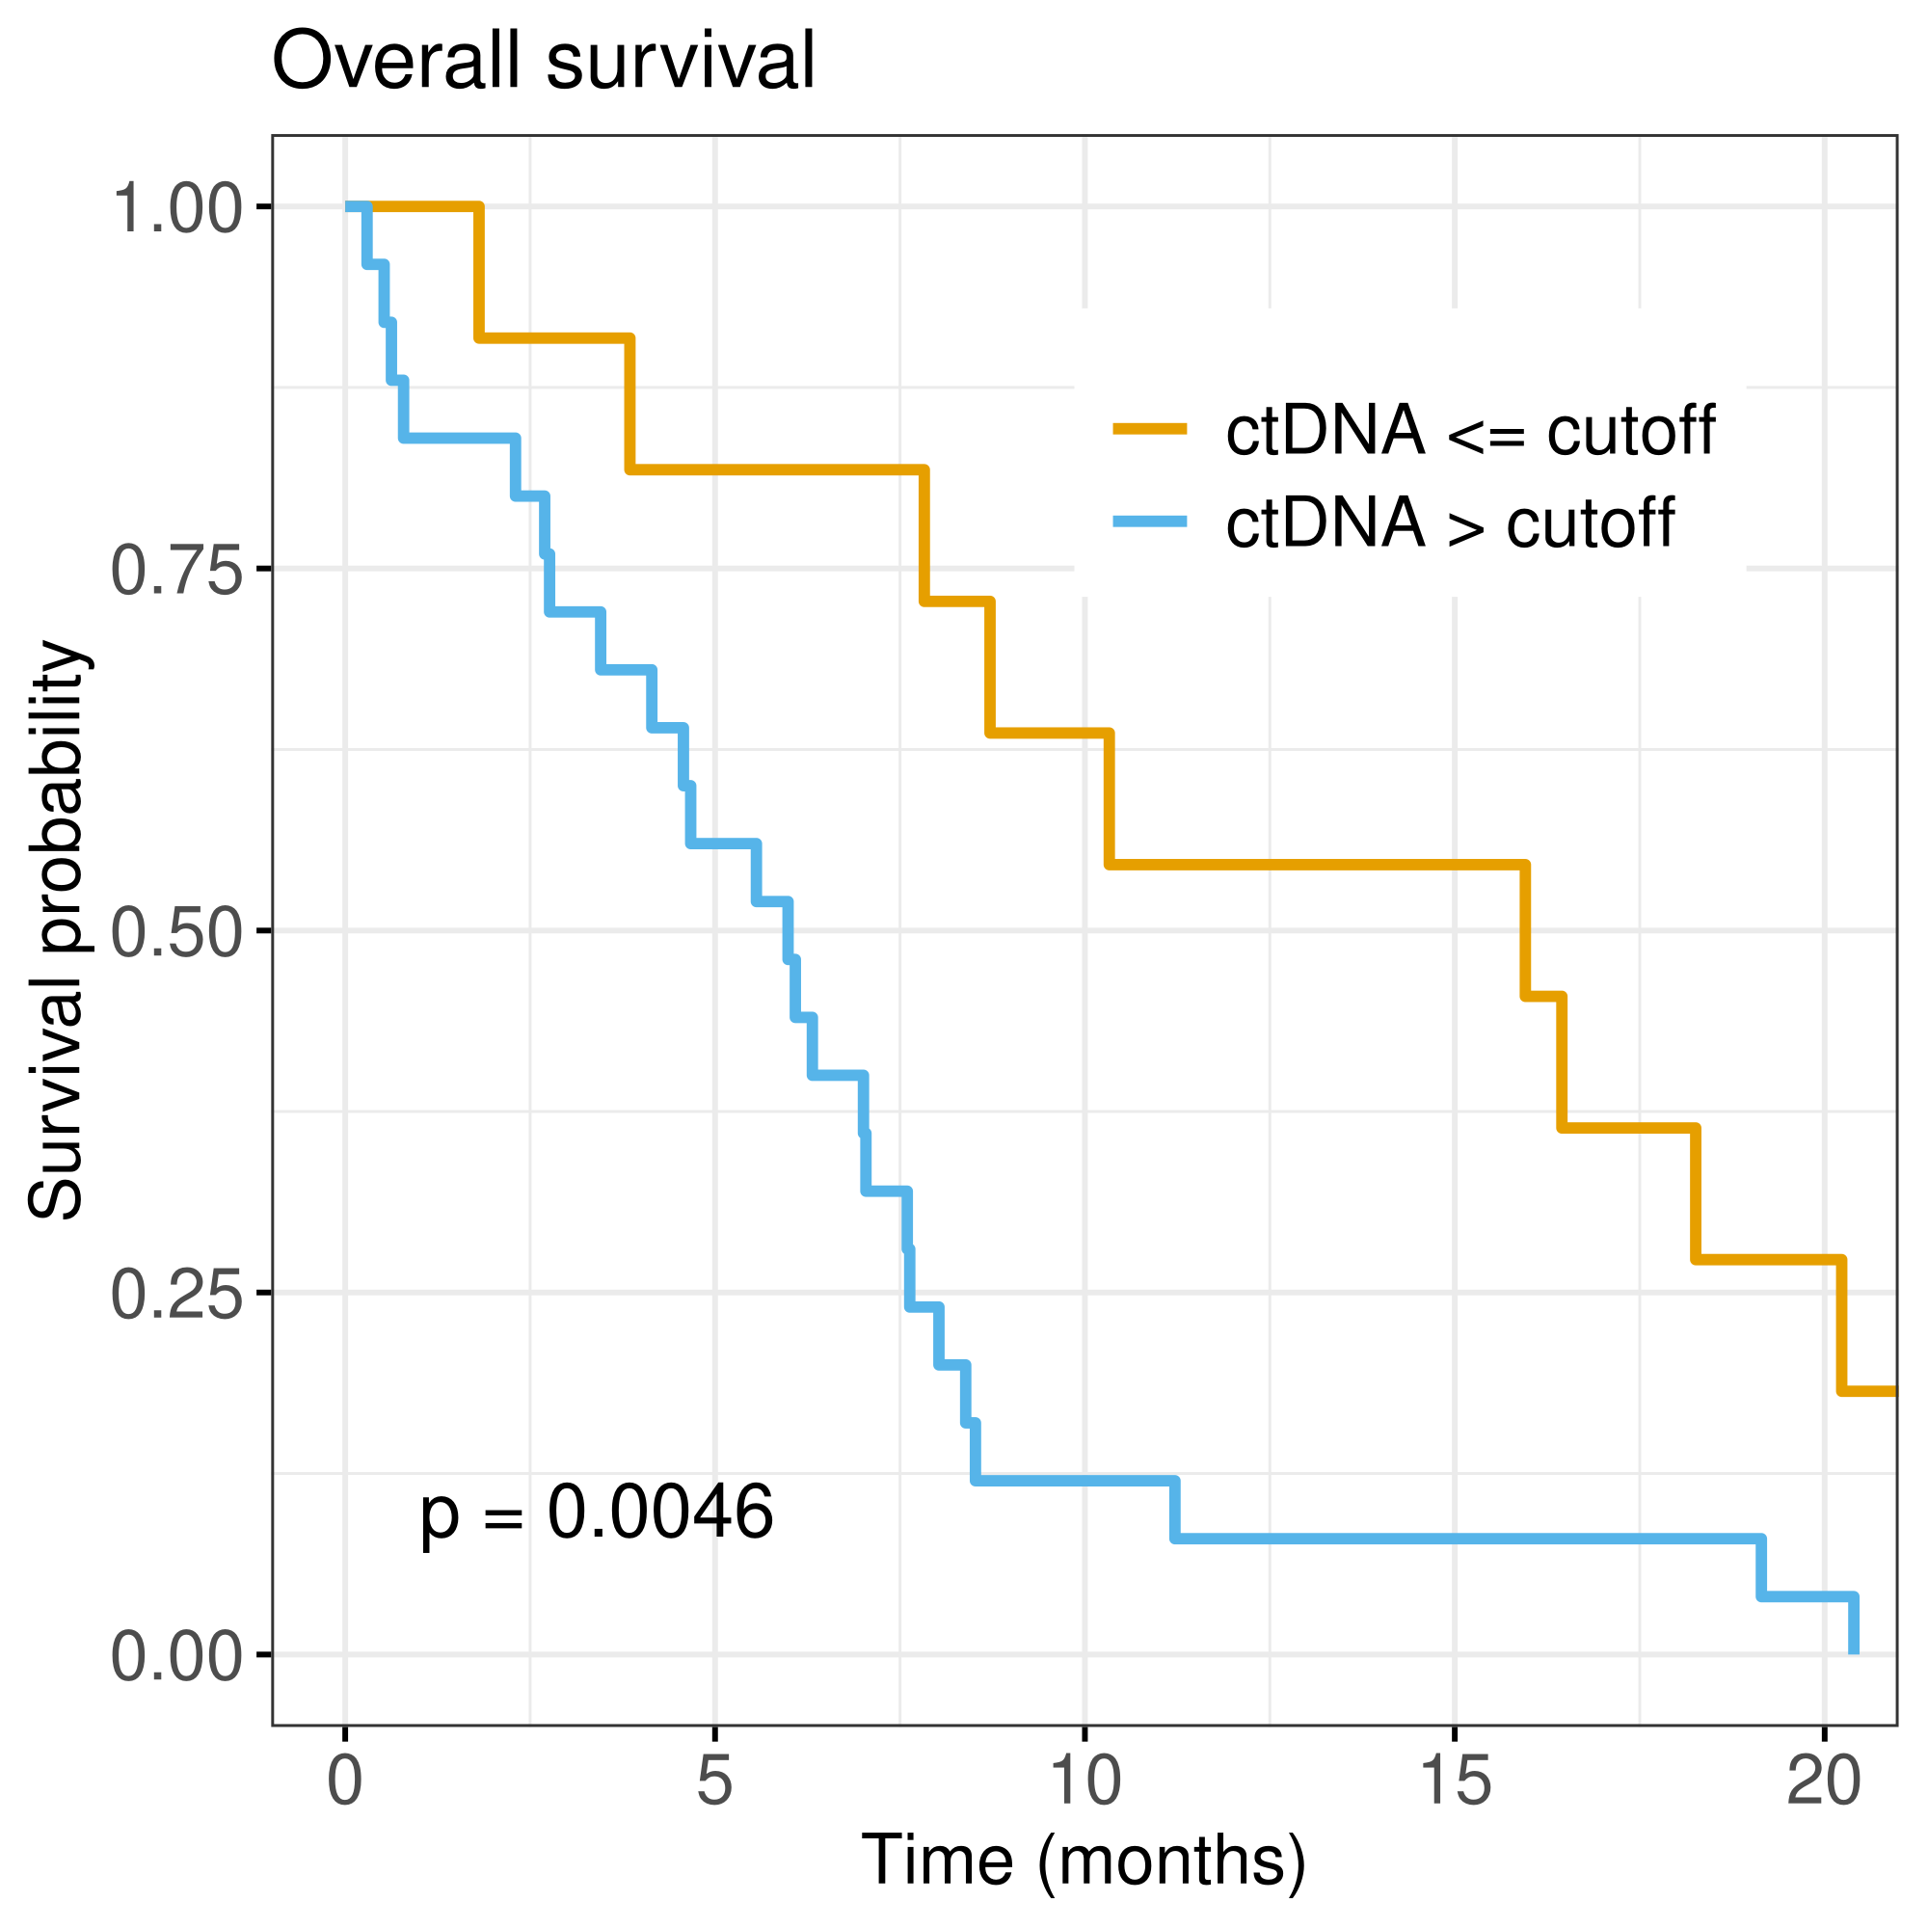
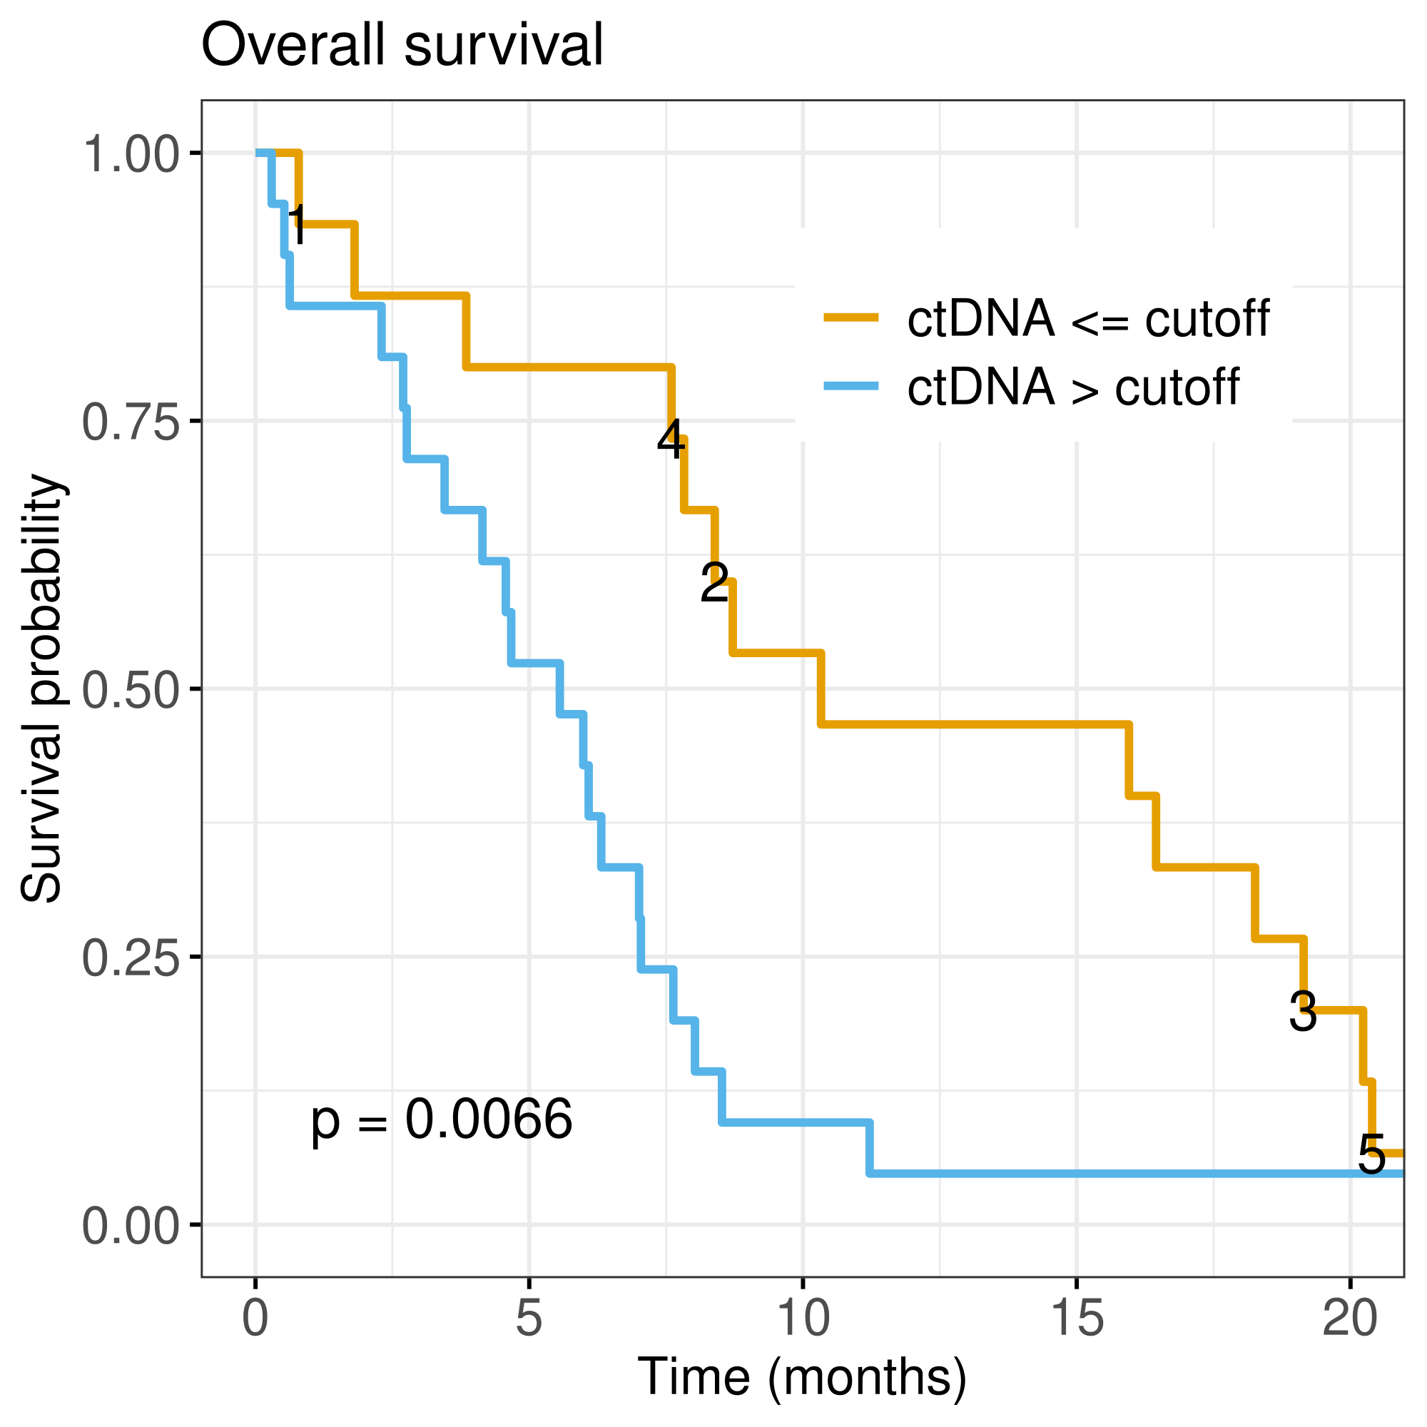
Combined data estimates
Mutation-based
Notes:
Finally, I will show you just one slide with Kaplan-Meier survival estimates, patients stratified according to ctDNA detection. The left plot is based on the combined data regression model and the right is based on mutation detection. As expected, the curves are rather similar and both confirms the prognostic value of baseline ctDNA levels.
Perhaps more interesting, in the right plot I have emphasized the 5 patients that were ctDNA positive by the combined data regression model, but not by mutation detection, with a number on the yellow curve, refering to the ordered level of estimated ctDNA level by the combined model. Only the patient with really high ctDNA level by the combined model, denoted by 1 here, had really short overall survival.

Slide 11
Conclusion & Discussion
Targeted methylation, cfDNA fragment length and end motifs can be successfully used for ctDNA measurements
  But add little information added vs point mutations
Explanation for 40% ctDNA negative patients:
  Low ctDNA level («low shedders»)
  Too low input DNA amount for this group
  Targeted panels/sequencing versus whole genome
Same results with other machine learning approaches
Notes:
In conclusion, we have shown that targeted methylation sequencing of cfDNA; cfDNA fragment length and end motifs extracted from targeted DNA sequencing can be successfully used for ctDNA measurements.
However, the alternative marker approaches added little to the information we obtained with the 8-gene DNA sequencing. Perhaps somewhat disappoinging, we think.
So, around 40% of the patients with advanced PC still are ctDNA negative at baseline. Possible explanations for this is that they might have really low ctDNA levels, below the detection limit for these methods with the input cfDNA amount we used. Ranged from 2-50 ng.
We anticipate that whole-genome approaches might lower the limit of detection, as well as increasing the amount of input cfDNA.
We explored many alternative machine learning based approaches, for example modeling of survival based on the input variables. However, more or less the same results were obtained.

Slide 12
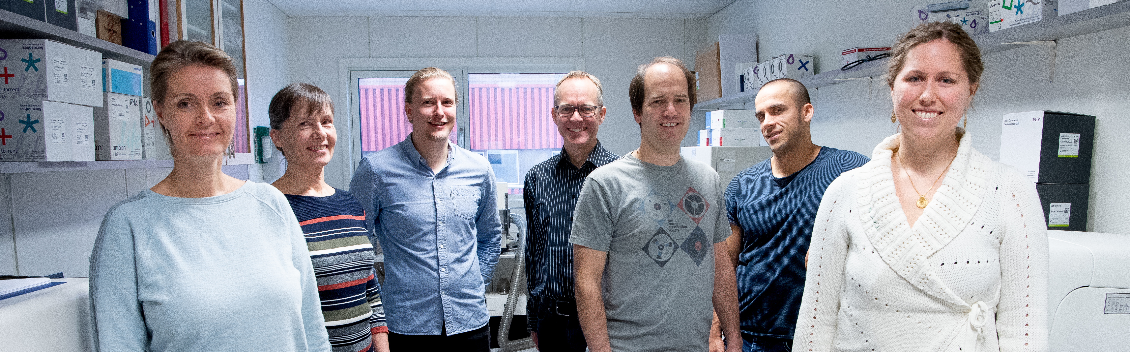




Acknowledgements
Department of Hematology and Oncology
Stavanger University Hospital:
  Morten Lapin
  Kjersti Tjensvoll
  Satu Oltedal
  Karin H. Edland
  Herish Garresori
  Marie Austdal
MDACC: F. Janku
Paris University: Y. Rozenholc
Haukeland University Hospital: Anders. Molven, Nils Glenjen
University of Stavanger: Trygve Eftestøl, Jan Terje Kvaløy.
  Saga Ekedal
  Bjørnar Gilje
Notes:
Finally, I would like to thank everyone that contributed to our study. Both in Stavanger, Bergen, and internationally.
Thanks for listening!

