Slide 1
ELBS General Assembly 2024
The clinical WG
Nikolas von Bubnoff
Rodrigo De Almeida Toledo
Christoffer Gebhardt
Jean-Yves Pierga
Claus Lindbjerg Andersen
November 26th – 27th
PRBB, Barcelona, Spain

Slide 2
Agenda
Status and upcoming activities
Follow-up of past clinical WG workshops
ctDNA in neuroendocrine tumor workshop (Rodrigo Toledo)
ctDNA EQA – the framework and network for ctDNA EQA within ELBS (Claus Lindbjerg Andersen)
ctDNA RECIST – reviews and planning of trials (Karen-Lise Garm Spindler)
LB-stratified trial in melanoma (Christoffer Gebhardt)

Slide 3
Clinical WG activities in 2024
Work Package Leads: Nikolas von Bubnoff, Christoffer Gebhardt, Jean-Yves Pierga, Claus Lindbjerg Andersen, Rodrigo De Almeida Toledo
Proposed setup of clinical Trials:
Uveal melanoma
  Planned: Diagnostic and identification of pts. with early dissemination/high risk of relapse
Melanoma
  Ongoing: MeLB identifying high risk stage IIB-III pts (Lübeck, Hamburg, Kiel, Freiburg; NGS/ddPCR)
  Planned: LB-stratified therapeutic trial in stage IV (C. Gebhardt)
GIST
  Ongoing: GISG-19 identifying MRD in resected GIST
  Planned: Trial on Trial on liquid biopsy-guided treatment stratification headed by S. Bauer (Essen)
New Neuroendocrine tumors
  Clinical WG workshop (Rodrigo Toledo)
Contribution welcome !

Slide 4
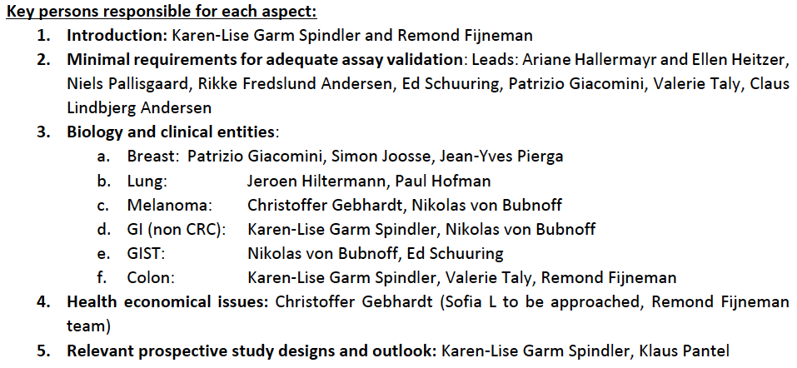
Clinical WG activities in 2024
Work Package Leads: Nikolas von Bubnoff, Christoffer Gebhardt, Jean-Yves Pierga, Claus Lindbjerg Andersen, Rodrigo De Almeida Toledo
ctDNA in RECIST Review: almost finished

Slide 5
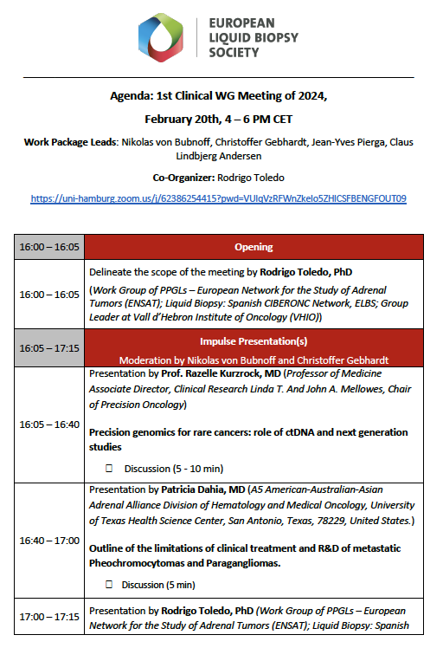
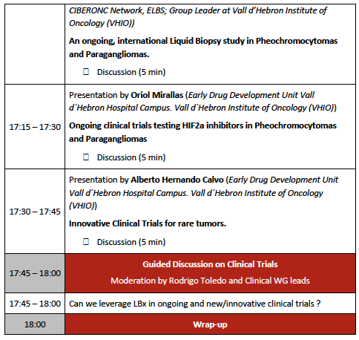
Clinical WG activities in 2024
ctDNA in neuroendocrine tumors workshop
Rodrigo Toledo
Feb 20th 2024

Slide 6



Plasma circulating DNA analyses in Neuroendocrine Tumors
Rodrigo Toledo, PhD
Biomarkers and Clonal Dynamics Lab
Vall d’Hebron Institute of Oncology (VHIO), Barcelona, Spain

Slide 7
Plasma circulating DNA analyses in Neuroendocrine Tumors
Pheochromocytoma / Paraganglioma
  Prognosis in advanced setting
  Diagnosis in the Hereditary setting
Gastroenteropancreatic and lung NE tumors
  Predictive biomarkers
Others
  TBD

Slide 8
Plasma circulating DNA analyses in Neuroendocrine Tumors
Rare tumors
Heterogenic
Lack of preclinical models
Hard to recruit clinical trials

Slide 9
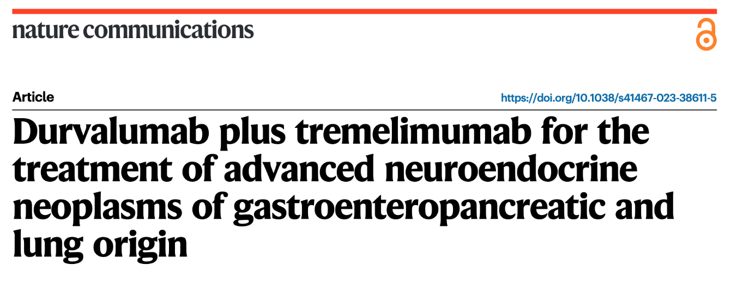
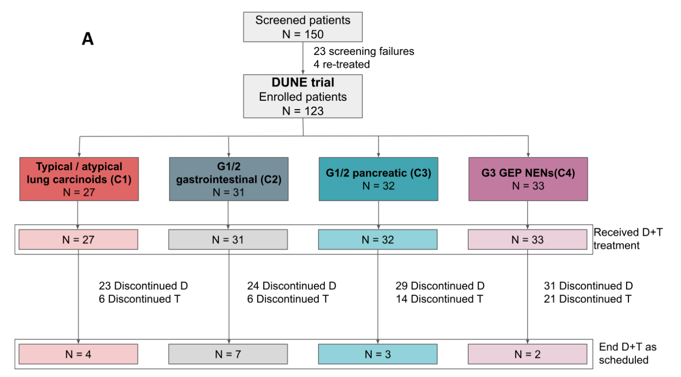
Plasma circulating DNA analyses in Neuroendocrine Tumors

Slide 10
Plasma circulating DNA analyses in Neuroendocrine Tumors
Pheochromocytoma / Paraganglioma
  Prognosis in advanced setting
  Diagnosis in the Hereditary setting
Gastroenteropancreatic and lung NE tumors
  Predictive biomarkers
Others
  TBD

Slide 11



RESULTS: PPGL Liquid Biopsy Cohort (recruiting is still ongoing…)
CENTER | CONTACT | COUNTRY | PATIENTS
1. National Institutes of Health | Dr. Pacak | Bethesda, MD (USA) | 64
2. Universitätsklinikum Würzburg | Dr. Faßnacht | Würzburg (Germany) | 26
3. University of Texas Health San Antonio | Dr. Dahia | San Antonio, TX (USA) | 24
4. Vall d’Hebron University Hospital | Dr. Capdevila | Barcelona (Spain) | 22
5. Barts Health NHS Trust | Dr. Lim, Akker, Drake | London (United Kingdom) | 13
6. Hospital Universitario La Fe | Dr. Del Olmo | Valencia (Spain) | 10
7. Ludwig-Maximilians-University of Munich | Dr. Kroiss | Munich (Germany) | 8
8. Universitätsklinikum Carl Gustav Carus | Dr. Bechmann, Pamporaki, Eisenhofer | Dresden (Germany) | 3
9. Istituto Oncologico Veneto | Dr. Opocher, Schiavi | Padova (Italy) | 7
10. University of Turin | Dr. Bioletto, Parasiliti | Torino (Italy) | 4
11. University of Florence | Dr. Rapizzi, Canu | Florence (Italy) | 3
12. Hospital Universitario Central de Asturias | Dr. Menéndez | Oviedo (Spain) | 3
13. Hospital Universitario Reina Sofia Córdoba | Dr. Herrera | Córdoba (Spain) | 2
14. Endocrinologie Campus Brugge, AZ Sint Jan | Dr. Van Caenegem | Brugge (Belgium) | 1
15. Centro Ambulatorio Beasain | Dr. Perez de Ciriza | Beasain (Spain) | 1
16. Hospital Universitario de Gran Canaria Dr. Negrín | Dr. Saura | Las Palmas de Gran Canaria (Spain) | 1
17. Hospital Universitario Virgen Rocío | Dr. Bernal | Sevilla (Spain) | 1
18. Hospital Universitari Clínic | Dr. Hanzu | Barcelona (Spain) | 1
18 centers and 6 countries participating
2
1
3
1
8
3
January 2020-May 2024, TOTAL = 194 patients

Slide 12
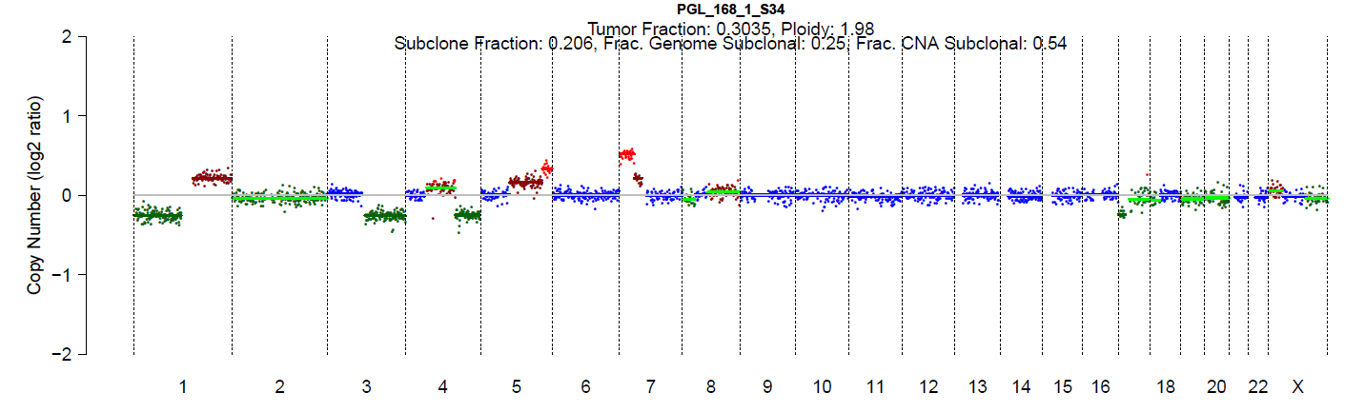
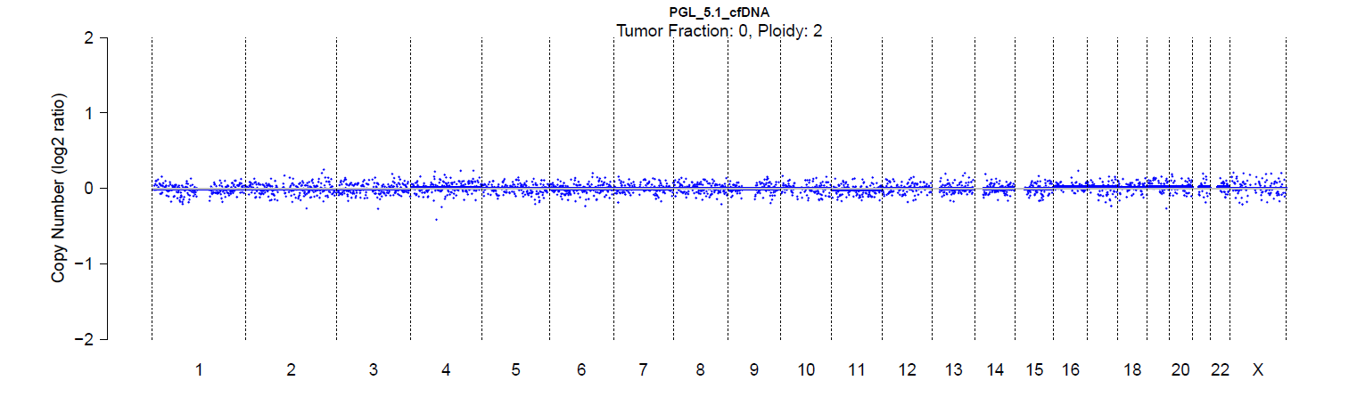
RESULTS
Detectable ctDNA in plasma from mPPGL patients
143 metastatic PPGL patients
18.8%
Detectable TF
(N=27)
81.1%
Undetectable TF
(N=116)
Confidential, unpublished

Slide 13
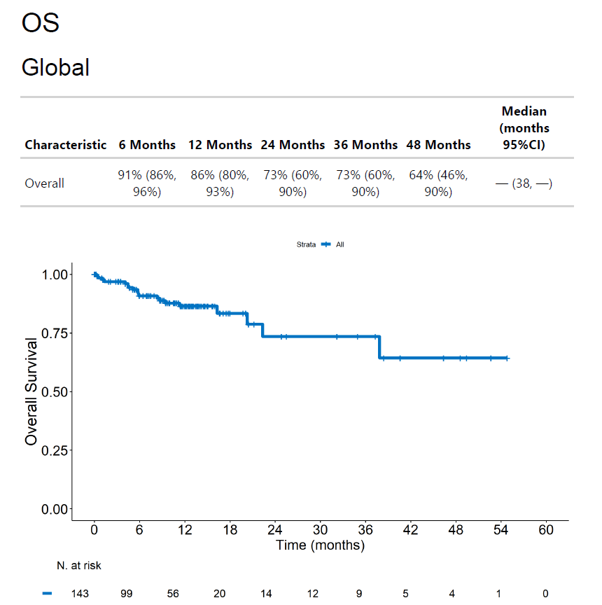
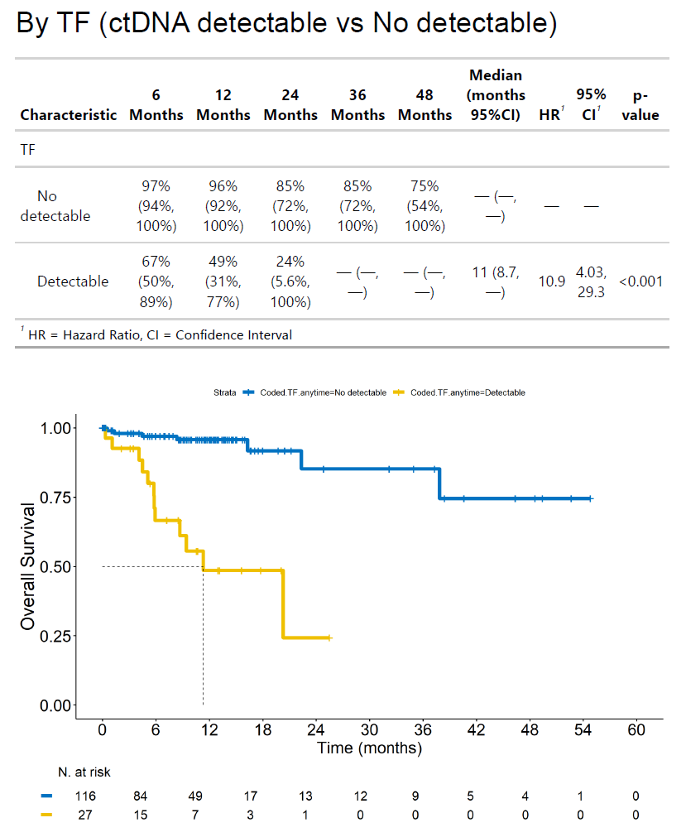
RESULTS
Prognostic value of detectable TF at baseline in mPPGL patients
Valor pronóstico TF. KM de pacientes clasificados en dos grupos: ctDNA detectable y ctDNA no detectable (0 y not enough cfDNA, dentro de la misma categoría), los cuales se encuentran en la columna F llamada Coded TF anytime.
KM diferenciando tres grupos utilizando los valores de la columna E (TF anytime):
    ctDNA-negative -> Incluyendo 0 o No
    ctDNA-positive (2-10) -> TF desde 2 a 10
    ctDNA-positive (>10) -> Valores mayores a 10
KM de overall survival con ctDNA detectable (Coded TF anytime, columna F) analizando si el tratamiento recibido desde el momento de la muestra de plasma contribuye a un mejor o peor pronóstico, ver columna N denominada Coded Treatments:
    Tratamiento clase 1 (codificada como 1)
    Tratamiento clase 2 (codificada como 2)
    NA (codificada como 3)
Análisis multivariado con las variables:
    Sex (columna G)
    SDHB mutation (yes/no) (columna H)
    Tumor Type (PHEO, PGL, PPGL (both PHEO/PGL), NA) (columna I)
    Metastasis location (liver, not liver) (columna J)
    TF: ctDNA detectable/non-detectable (0, not enough) at any time (columna F)
Tumor Fraction 24-months OS HR (95% CI) p-value
Non-detectable (n=116) 85% Ref
Detectable (n=27) 24% 10.9 (4.03-29.3) <0.001
Confidential, unpublished

Slide 14
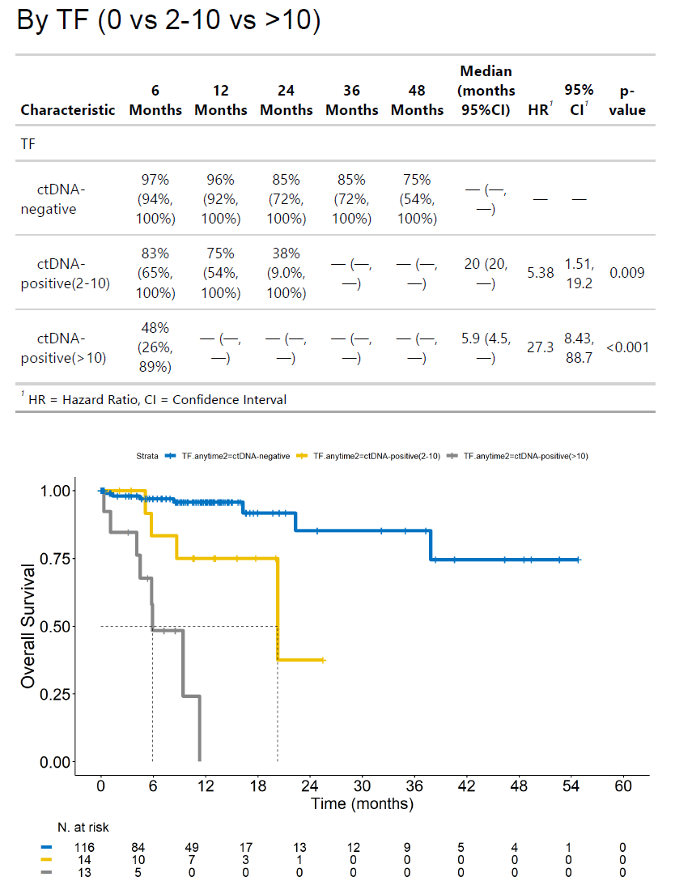
RESULTS
Detectable TF>10% at plasma baseline was indicative of a worse prognosis in mPPGL patients
Tumor Fraction 6-mo OS 12mo OS 24-mo OS HR (95% CI) p-value
ctDNA negative (n=116) 97% 96% 85% Ref
ctDNA positive (TF=2-10%) 83% 75% 38% 5.38 (1.51-19.2) 0.009
(n=14)
ctDNA positive (TF>10%) 48% - - 27.3 (8.43-88.7) <0.001
(n=13)
Confidential, unpublished

Slide 15
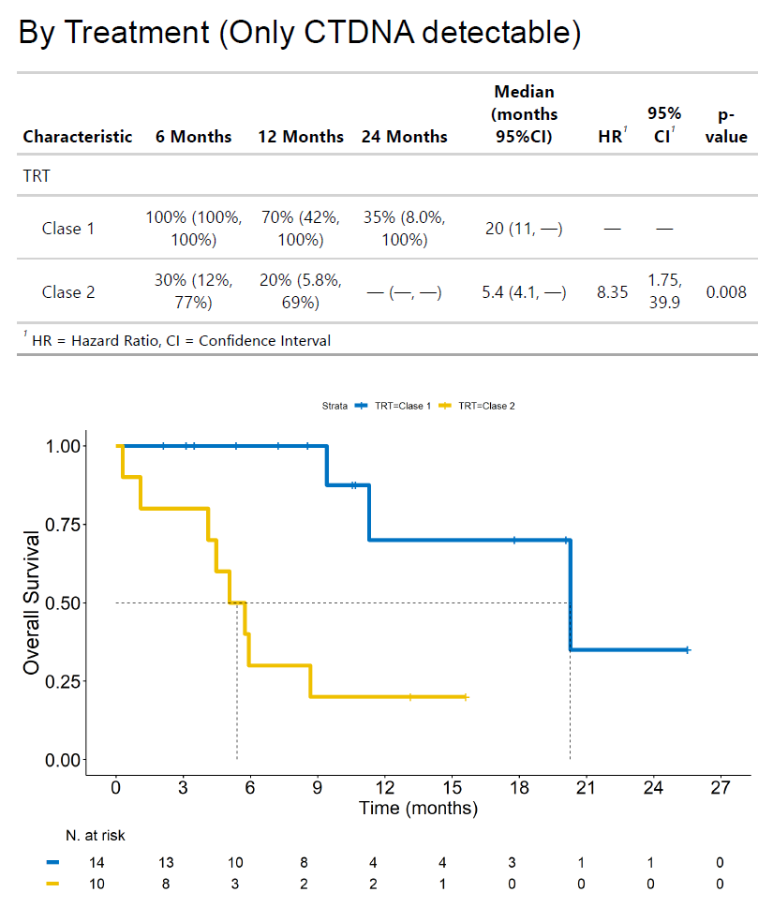
RESULTS
Tumor-targeted therapies improved survival outcomes
Treatment Class 1
(Evidence of therapeutic effectiveness in clinical studies)
Surgery
HIF2α and RET inhibitor
TK inhibitor (Sunitinib, Axitinib)
Molecular Targeted Radiotherapy (177-Lu
Therapy, Somatostatin analog)
Treatment Class 2
(Other systemic therapeutic therapies)
No anti-cancer treatment (wait and see)
Chemotherapy/Radiotherapy
Immune Checkpoint inhibitor
mTOR inhibitor
Treatment 6-mo OS 12mo OS 24-mo OS HR (95% CI) p-value
Treatment Class 1 (n=14) 100% 70% 35% Ref
Treatment Class 2 (n=10) 30% 20% - 8.35 (1.75-39.9) 0.008
Confidential, unpublished

Slide 16
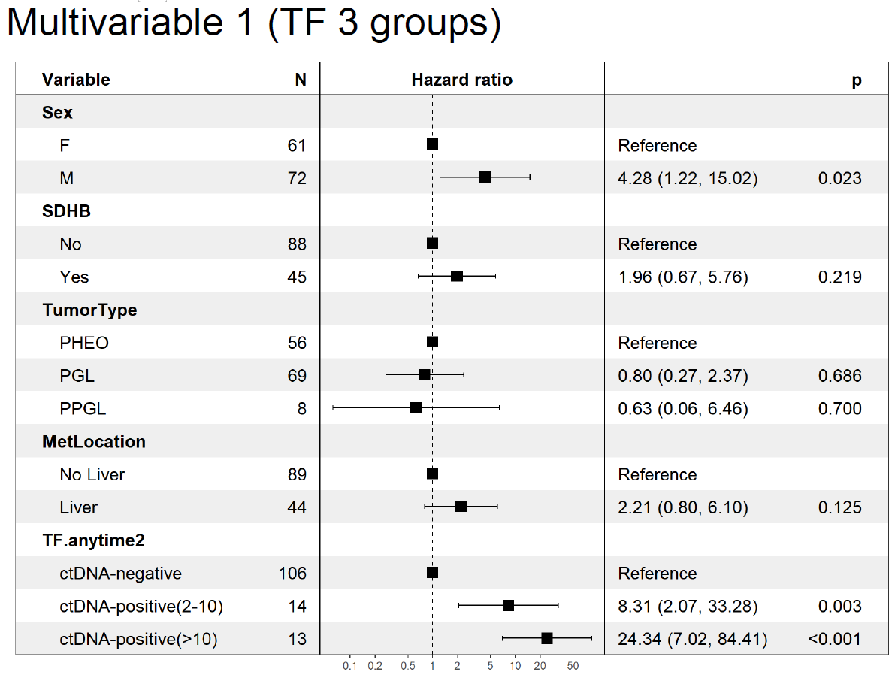
RESULTS
ctDNA as an independent biomarker of poor prognosis (death risk)
*
Hamidi et al. JCEM, 2017 (*).

Slide 17
Plasma circulating DNA analyses in Neuroendocrine Tumors
Pheochromocytoma / Paraganglioma
  Prognosis in advanced setting
  Diagnosis in the Hereditary setting
Gastroenteropancreatic and lung NE tumors
  Predictive biomarkers
Others
  TBD

Slide 18
Plasma circulating DNA analyses in Neuroendocrine Tumors

Slide 19
Plasma circulating DNA analyses in Neuroendocrine Tumors
Pheochromocytoma / Paraganglioma
  Prognosis in advanced setting
  Diagnosis in the Hereditary setting
Gastroenteropancreatic and lung NE tumors
  Predictive biomarkers
Others
  TBD

Slide 20
Plasma circulating DNA analyses in Neuroendocrine Tumors
Pheochromocytoma / Paraganglioma
  Prognosis in advanced setting
  Diagnosis in the Hereditary setting
Gastroenteropancreatic and lung NE tumors
  Predictive biomarkers
Others
  TBD

Slide 21
Plasma circulating DNA analyses in Neuroendocrine Tumors
Pheochromocytoma / Paraganglioma
  Prognosis in advanced setting
  Diagnosis in the Hereditary setting
Gastroenteropancreatic and lung NE tumors
  Predictive biomarkers
Others
  TBD

Slide 22
ctDNA analysis
External Quality Assurance (EQA)

Slide 23
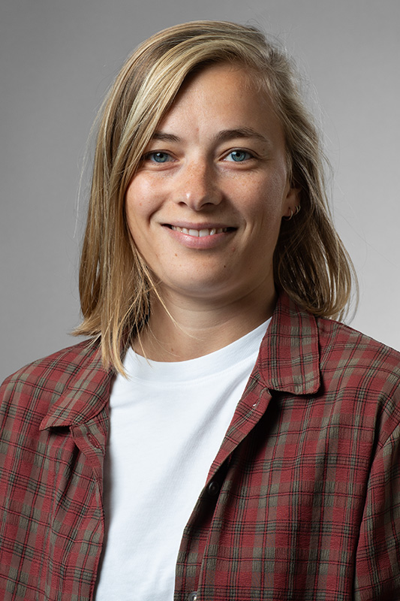

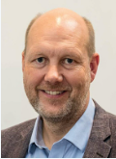



The Danish national DCCC ctDNA research center
CAN.HEAL and ELBS
Promote and facilitate implementation of ctDNA guided clinical decision making
  Aim to improve, standardize and harmonize the quality of ctDNA analyses
  External Quality Assurance (EQA) of ctDNA detection
  Establish best practices, disseminate these through EQAs and training
Maria Hønholt Jørgensen
PhD Student, MSc
Aarhus University
Aarhus University Hospital
mhj@clin.au.dk
Mads Heilskov Rasmussen
Assoc. Prof., PhD, MSc
Aarhus University
Aarhus University Hospital
mads.heilskov@clin.au.dk
Claus Lindbjerg Andersen
Professor, PhD, MSc,
Group leader,
ctDNA research center director
Aarhus University
Aarhus University Hospital

Slide 24
Why do we conduct an EQA?
Increase quality of ctDNA analyses for clinical practice
Comparison of ctDNA detection methods and laboratory workflows
Standardisation and harmonisation of ctDNA detection methods
Knowledge sharing of best practice ctDNA analysis

Slide 25
ctDNA EQA activities: Status and plans
RefMat
Pilot
Proof-of-concept
EQA
2023
2024
2025
Mutation selection
Protocol for RefMat
Protocol for QC
Small EQA DK
Establish questionnaires
Establish results DB
Larger EQA DK
Larger EQA DK + EU
Involving CANHEAL and ELBS
Recurrent EQAs
  Performance monitoring
    Improving performance
    Best practice
    Knowledge sharing
    Training
  Lab certification

Slide 26
Reference Material design

Slide 27
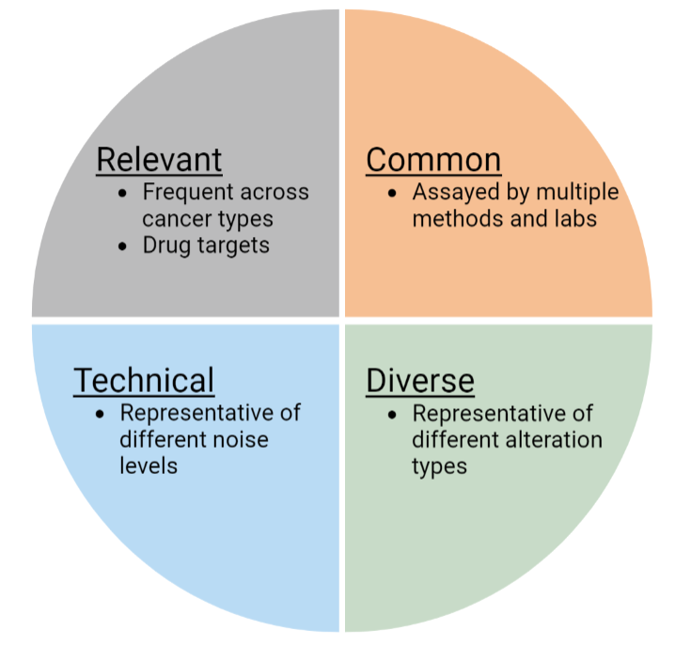
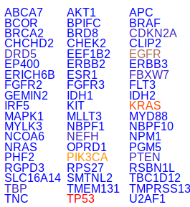
Mutations in the current RefMat
Mutation selection process
COSMIC database
Drug targets
ctDNA center members
10+ cancers
Diverse alteration types
Mutations with different noise levels
PubMed search
"Doctors choice"
Workshop
101 mutations
(easy to expand)

Slide 28
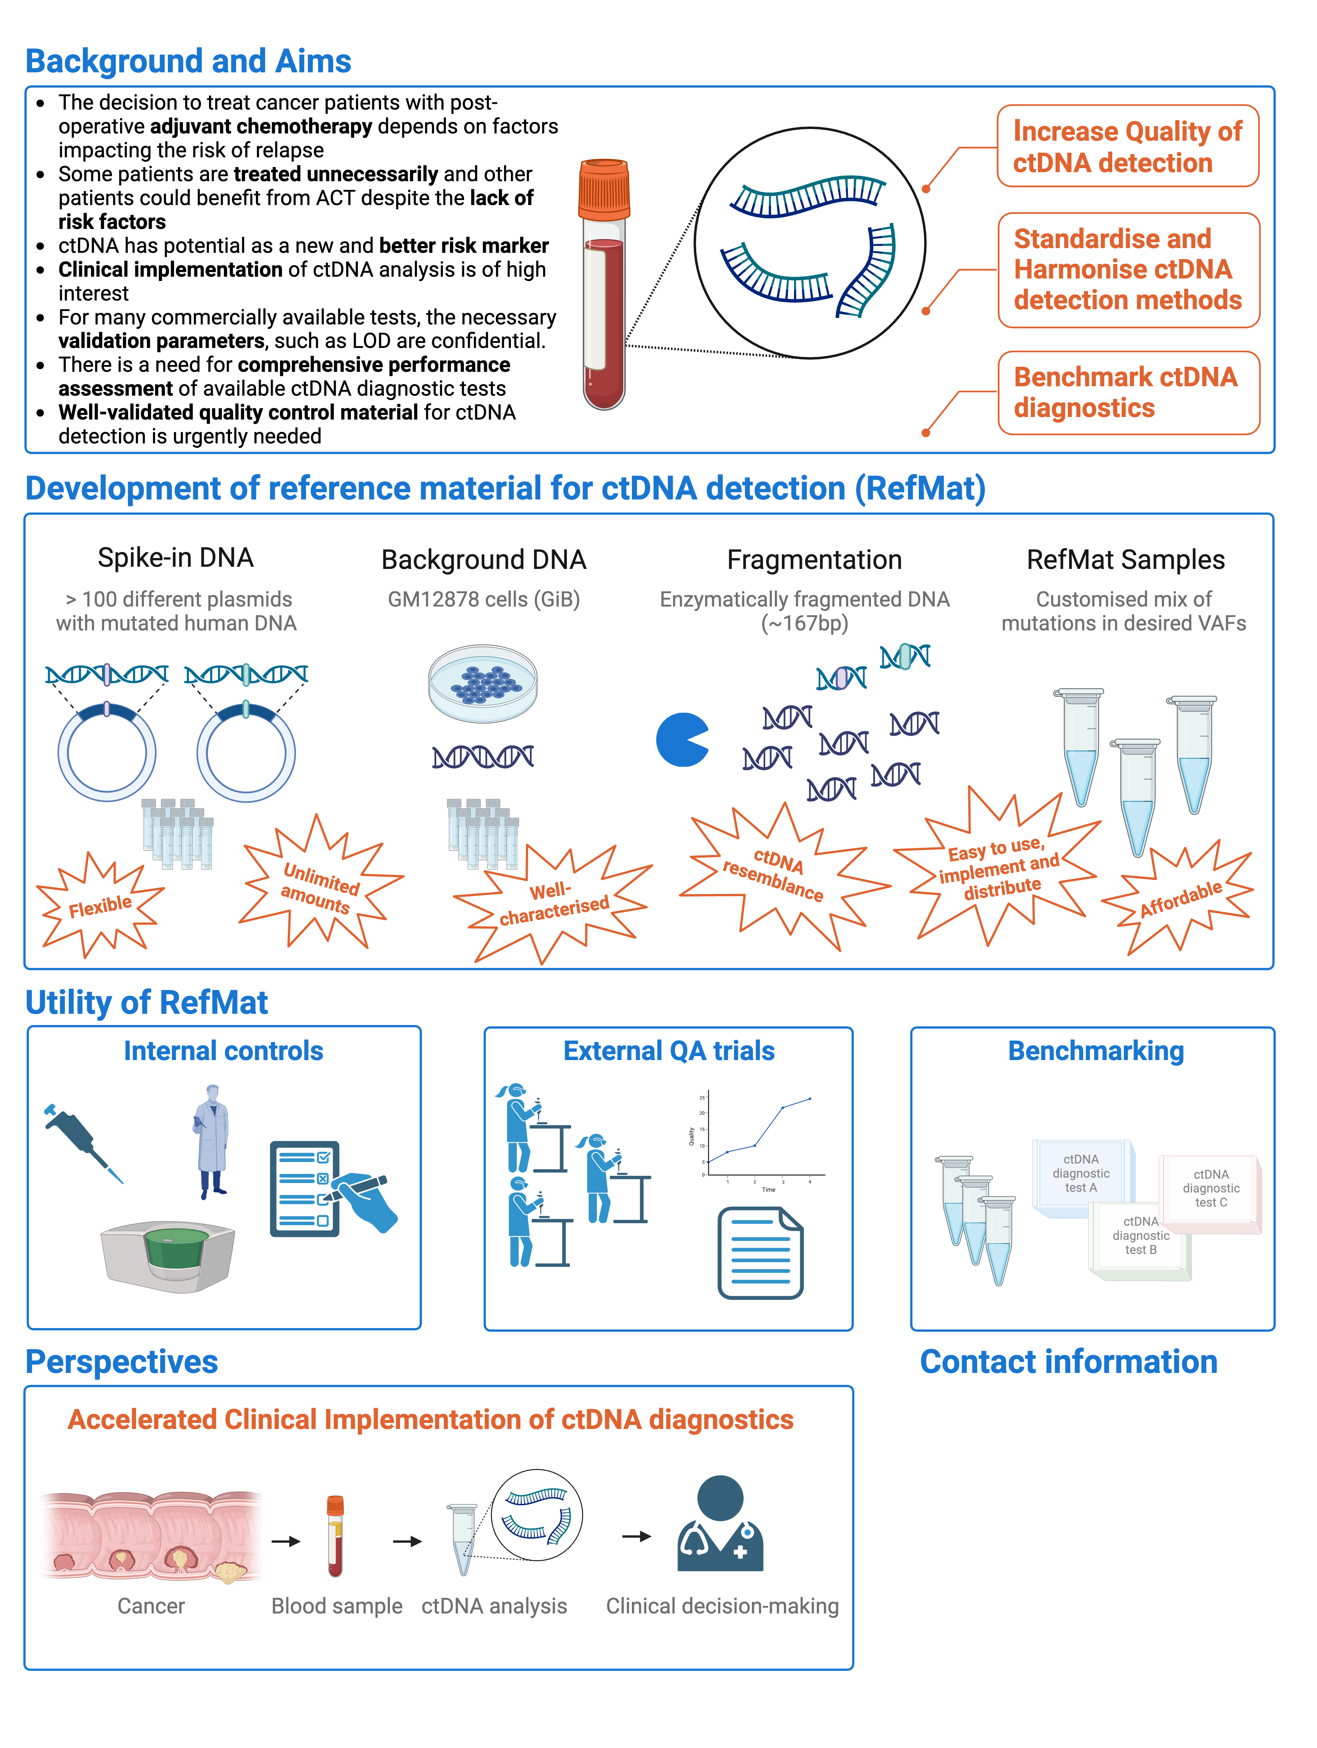
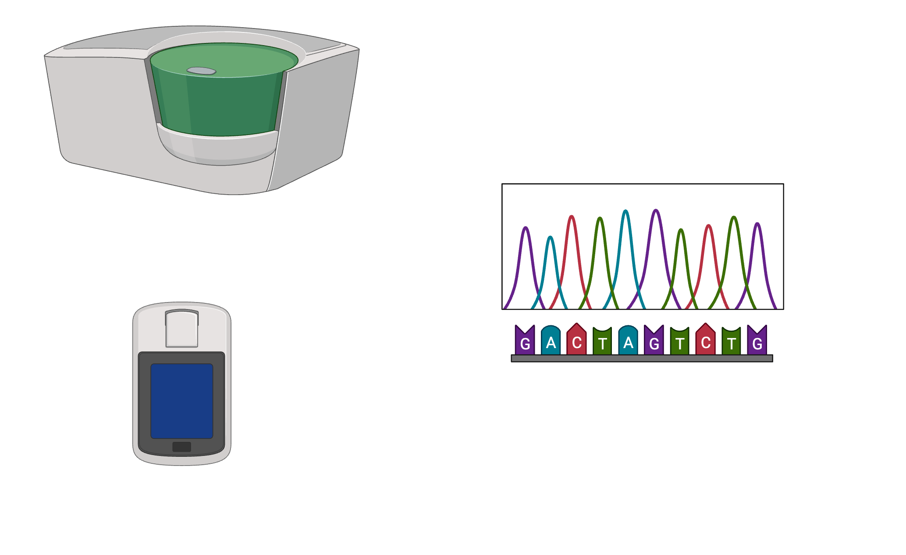
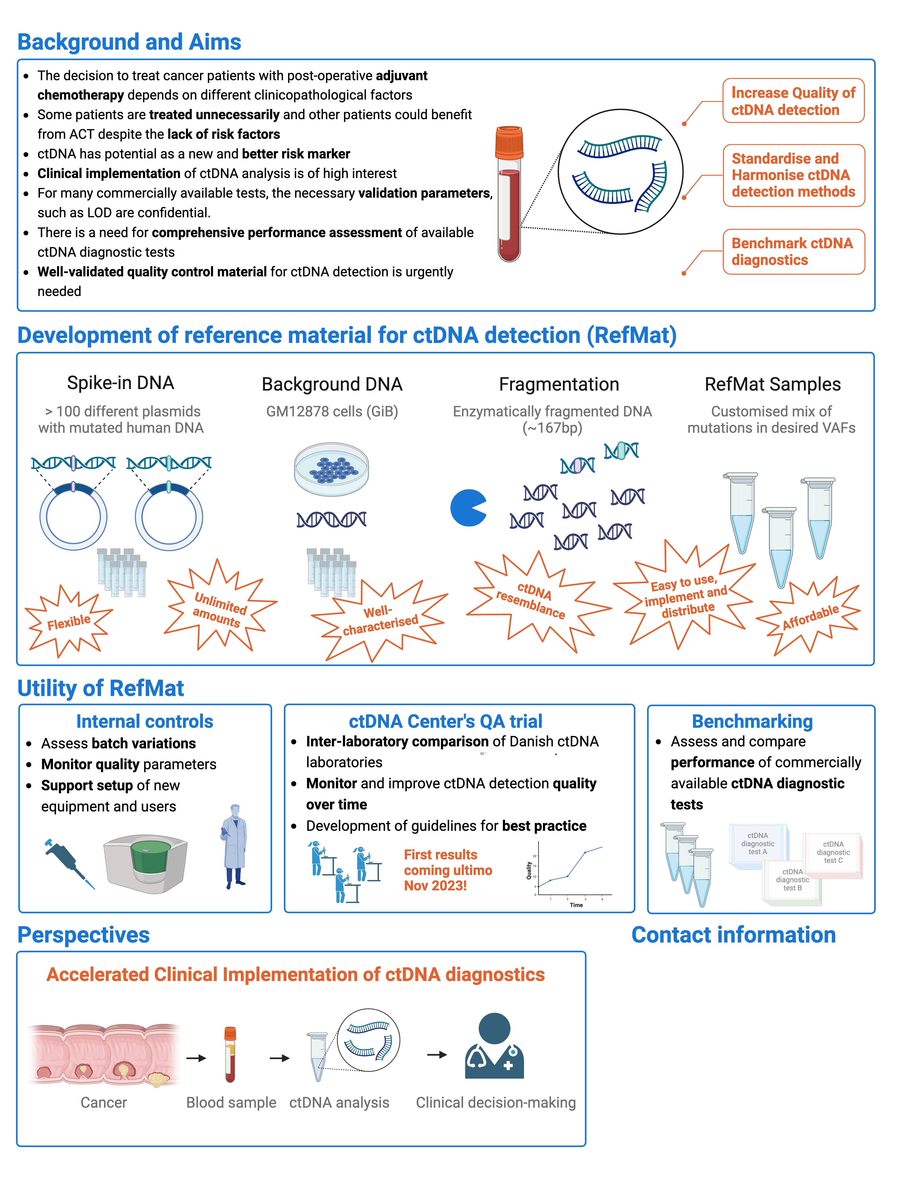

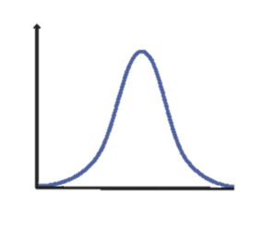
Reference Materials production
Foreground (FGR)
Enzymatic fragmentation
Quality control
1000 bp
1000 bp
Density
~167bp
101 different plasmids with mutated human DNA
(Long term storage as glycerol stocks)
Fragment length (bp)
Whole exome sequencing
Ultra deep panel sequencing
ddPCR
Aim
Confirm mutation presence
Confirm expected mutation VAF
Confirm Ref Mat
  Total DNA quantity in samples
  DNA fragment sizes
  processability/conversion rate
    Input to library
    Input to ddPCR droplets
Background (BGR)
DNA from GM12878 GiB human cell line
(Long term storage as low passage freeze stocks)
Density
~167bp
Fragment length (bp)

Slide 29




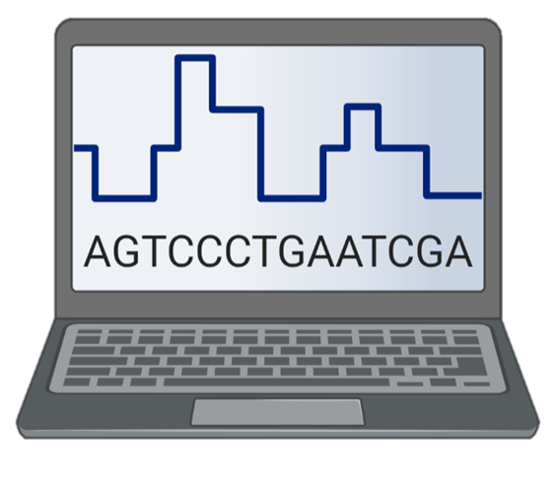
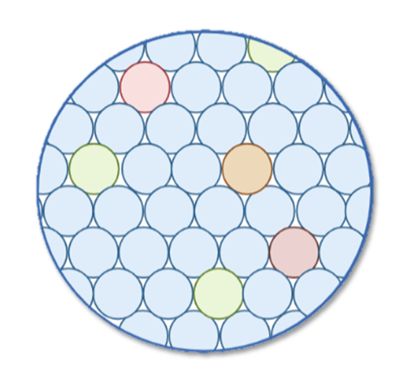
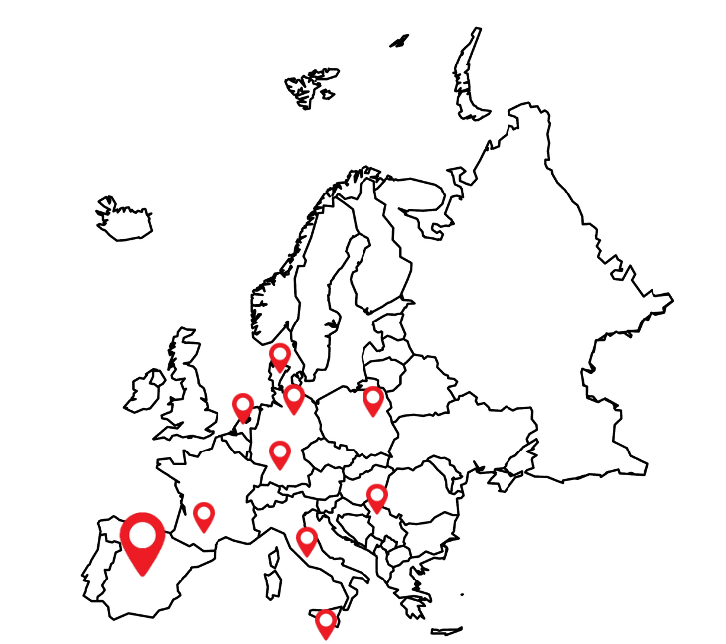

The EQA setup
Preliminary survey
shipment information
ctDNA methods (NGS/ddPCR/assay name)
Mutations targeted
Expected LOD etc
1
4
B
5
2
RefMat sample sets are distributed with VAFs blinded for the participants
EQA
START
3
RefMat samples are analysed by each lab using their normal workflow
3
@
4
Results are reported by the participants in the 2nd survey.
Survey to collect participant affiliation
5
Data is analysed centrally and the results are shared anonymously with participants
?
?
?
?
A
2
1
BE, DE, DK, ES, FR, MT, IT, PL

Slide 30
Some results from the proof of principle ctDNA EQA efforts

Slide 31
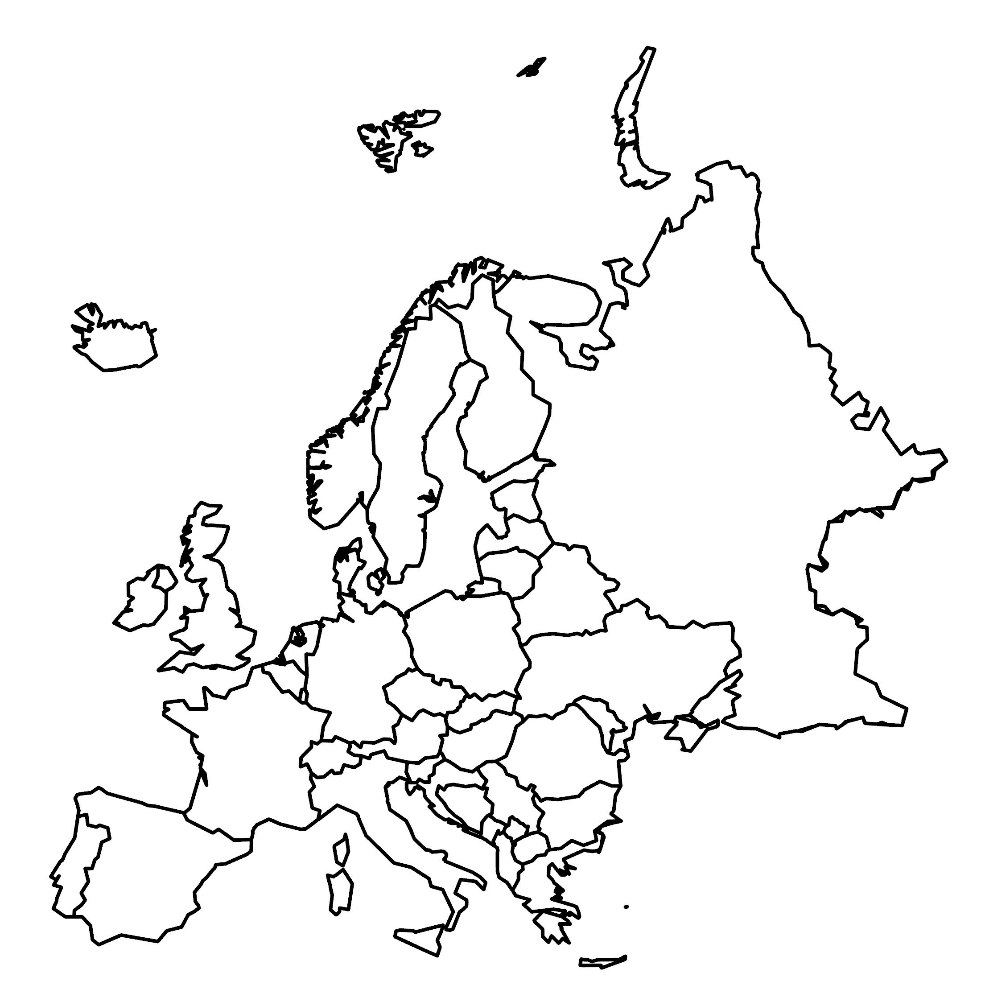



Participants, samples, assays
No. Participants | 21
No. Samples analysed | 295
--- by ddPCR | 276
--- by NGS | 19
No. distinct ddPCR targets | 16
No. distinct NGS assays | 10
7 Danish participants
14 international participants
  7 participants in Can.Heal / Dr Joosse, UKE
  10+ participants in ELBS
    IUCT
    UKE
    UKSH
    AU
    IFO
    SLB
    NKI
    And others

Slide 32
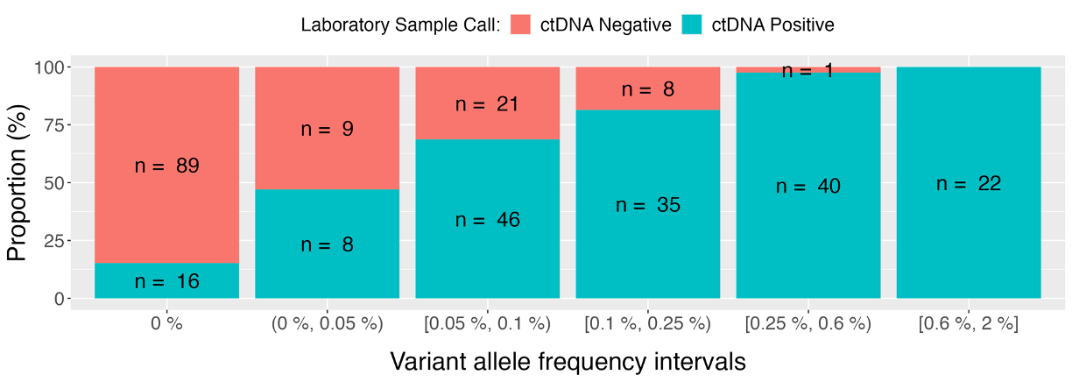
How sensitive are the ctDNA test used ?
Data based on
17 Participants
276 ddPCR samples
  102 VAF = 0
18 NGS samples
  3 VAF = 0
SPEC (%) | 87
SENS (%) |  | 38 | 67 | 81 | 97 | 100
Indsæt expected/observed plot

Slide 33
ctDNA EQA activities in 2025/2026
With proof-of-principle and ctDNA EQA network established
the next step is to design the ctDNA EQAs needed by ELBS
Suggestions
Performance monitoring ctDNA EQA
Purpose: Individual lab’s to know their own performance
compared to the ELBS average
Are their interest in expanding beyond mutations ?
  Methylation markers
  Fragmentomics
  Other markers
EQA for laboratory certification by ELBS
  Certificate level VAF to detect
  1000 ppm 1e-3
  100 ppm 1e-4
  10 ppm 1e-5
  1 ppm 1e-6
Framework:
Ref Mat: 10,000 GE (corresponding to 4-8 mL plasma)
Fixed number of mutations in RefMat
Fixed #samples
#participation frequency
Purpose: Lab and method certification

Slide 34
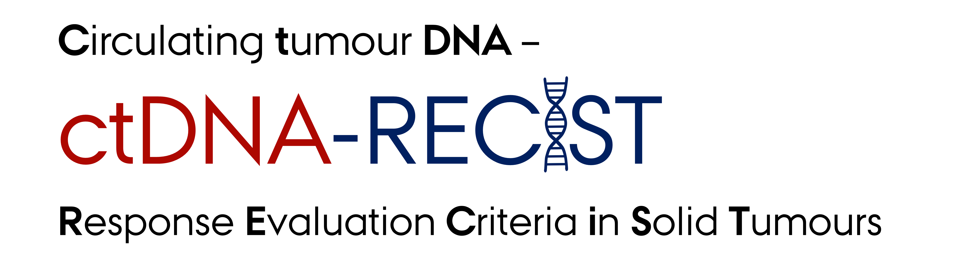

Karen-Lise Garm Spindler
Professor, Overlæge, PhD, Dr.Med
Department of Clinical Oncology, Aarhus University Hospital
Institute of Clinical Medicine, Aarhus University, Denmark
Can we ctDNA-RECIST?

Slide 35
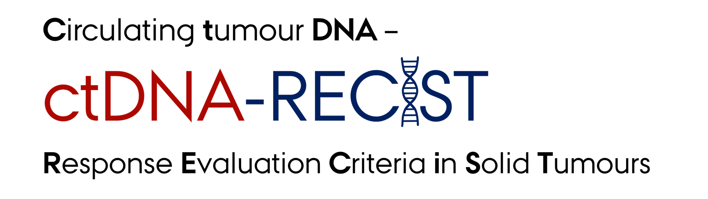
The Clinical ctDNA-RECIST Program
Reviews and prospective studies
Clinical trials
A international ctDNA-RECIST network
The first international ctDNA-RECIST symposium 2025
Can we ctDNA-RECIST?

Slide 36


Slide 37




LB-stratified trial designs in melanoma and uveal melanoma
Department of Dermatology and Venereology
University Skin Cancer Center
ELBS General Assembly 2024 - Barcelona
Christoffer Gebhardt | 27th November 2024

Slide 38
Detection of Minimal Residual Disease and Relapse
under (neo-)adjuvant treatment using ultra-sensitive ctDNA analysis
Detection of MRD and Relapse
Wan et al., 2017 Nat Rev Cancer

Slide 39
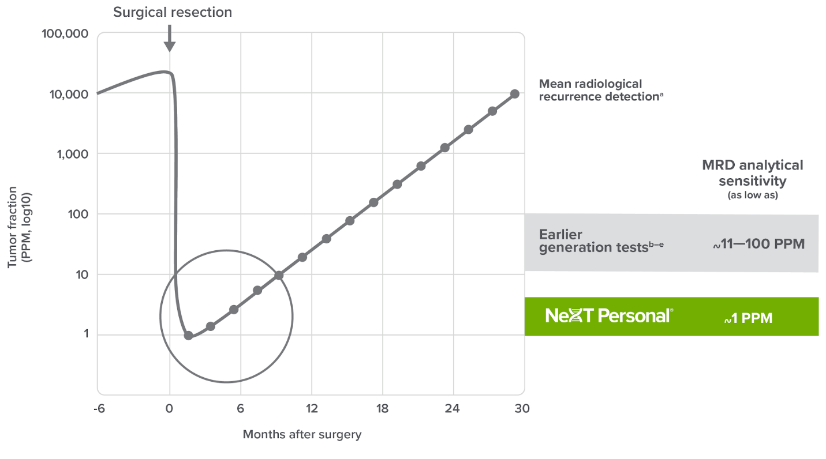
Ultra-sensitive ctDNA tests designed to see MRD
earlier and more accurately
Model of tumor fraction, PPM (part per million)
ultrasensitive tests ~1 PPM
Post-surgical model assumptions: Median breast tumor size detected by mammography: 1.3cm, Median shedding per NSCLC TracerX study^{e}; Residual tumor from surgery: 1%; Volume doubling time (actual VAF time): 2 months. Pre-surgical values are illustrative. PPM: Part Per Million
a. Adler et al., EJNMMI Physics, 2017 b. Sethi et al., AACR, 2018, Abstract 4542 c. Abbosh et al., Nature, 2023 d. Marsico et al., AACR 2020, Poster 309 e. Abbosh et al., Nature, 2017

Slide 40
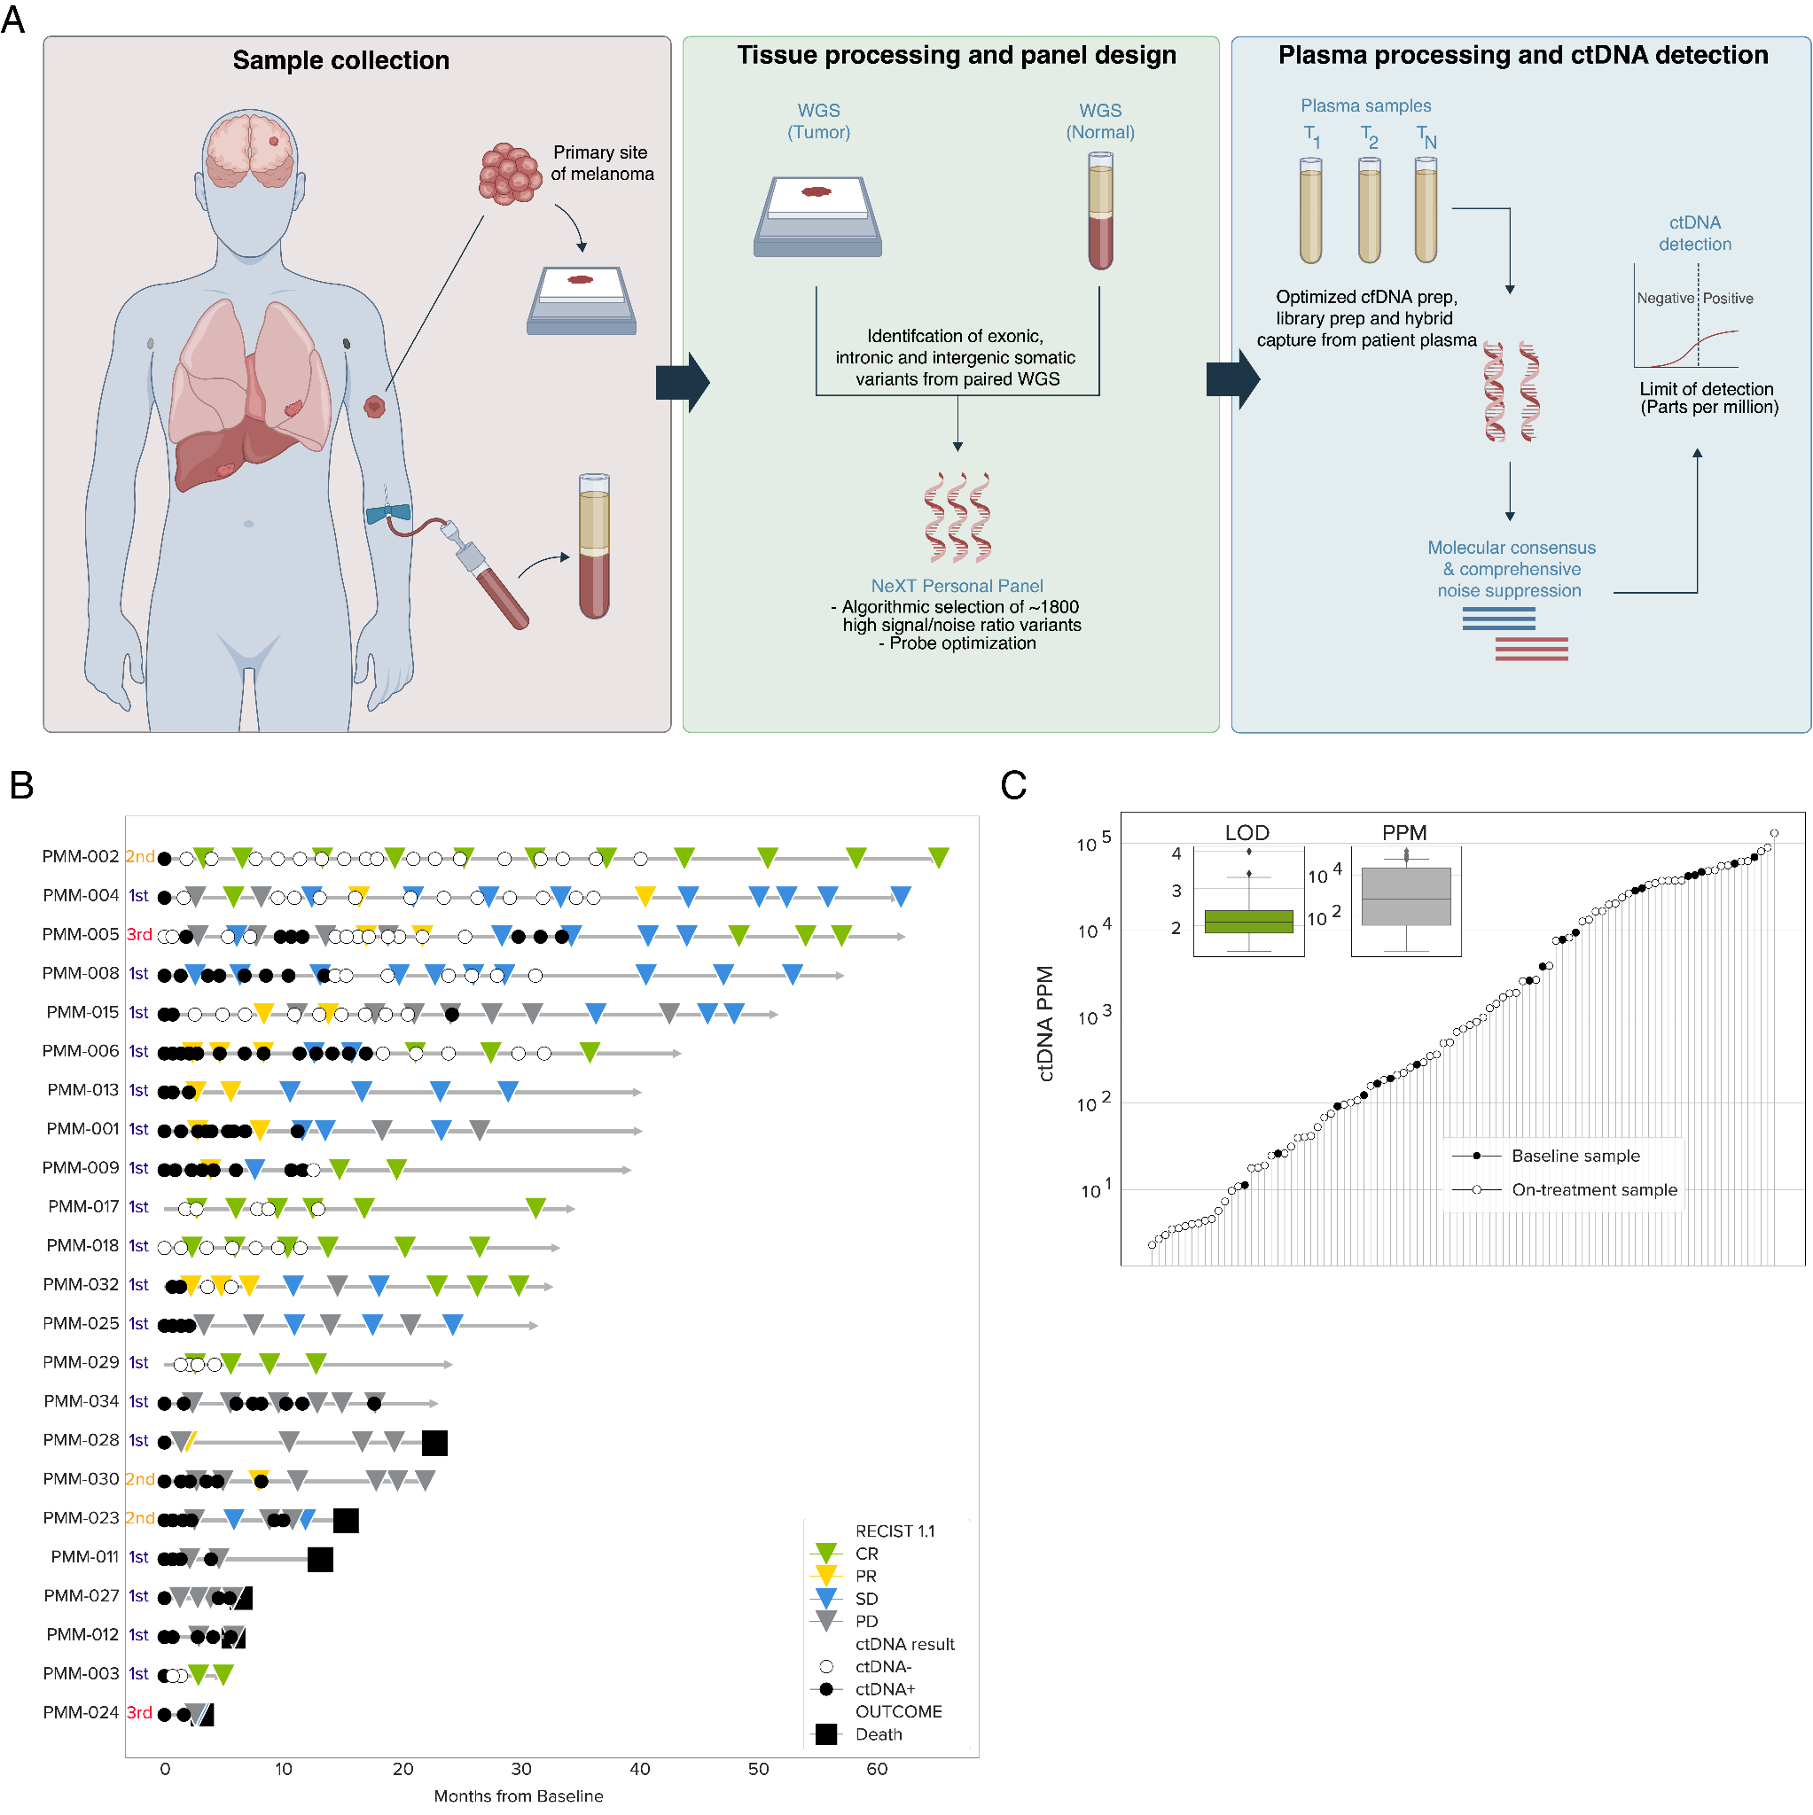
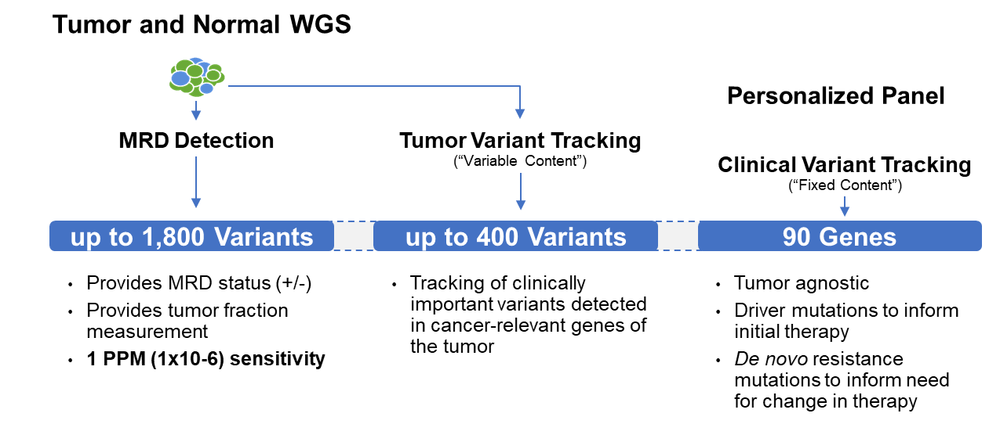
Advanced melanoma patient cohort receiving high frequent blood draws under immune checkpoint inhibition
n= 188 plasma samples
from n= 23 advanced 1L melanoma patients receiving ICI
Gebhardt et al. ASCO 2023
Gebhardt et al. AACR 2024
Keller et al. submitted

Slide 41
Majority of patient baseline samples detected
using an ultra-sensitive ctDNA assay
100 PPM
- ctDNA was detected with a sensitivity down to 2.3 PPM
- up to 28.6% of all positive detections fall below 100 PPM
standard ddPCR reaches sensitivity of up to 100 PPM
Keller et al. submitted

Slide 42
ctDNA-guided therapy for stage IIIB-IV melanoma after surgical resection (ADJUliquidSelect Proof-of-concept study)
ctDNA
tissue
ctDNA
tissue
pos.
Pembrolizumab 200 mg IV Q3W
x 18 cycles
relapse
mRNA-4157/V940 IM Q3W x 9 cycles + Pembrolizumab 400 mg IV Q6W x 8 cycles
+resection*
Key Eligibility Criteria
Fully resected stage IB-IIA cutaneous melanoma
No prior systemic therapy
ECOG PS 0 or 1
d0
ctDNA
Observation
N=40
neg.
Plasma sample used for:
baseline ctDNA
neoantigen identification
FFPE Tissue sample used for:
neoantigen identification
Preparation of V940
ctDNA
Diagnostics/Technology used:
ctDNA analysis and NGS for neoantigen identification by e.g. ultra-sensitive NeXT Personal assay (Personalis)
Plasma samples (pre-/post-surgery) used for:
pre-/post-surgery ctDNA
FFPE Tissue sample used for:
certification of R0 resection*
Primary End Point:
Secondary End Points:
RFS
DMFS (OS, safety, QoL)

Slide 43
ctDNA-guided therapy for stage IIIB-IV melanoma after surgical resection (NEOliquidSelect Proof-of-concept study)
Diagnostics/Technology used:
tissue
tissue
ctDNA analysis and NGS for neoantigen identification by e.g. ultra-sensitive NeXT Personal assay (Personalis)
Key Eligibility Criteria
Resectable stage IIIB-IV cutaneous melanoma
No prior systemic therapy
ECOG PS 0 or 1
d0
Pembrolizumab 200 mg IV Q3W
x 3 cycles
d63
d80
pos.
mRNA-4157/V940 IM Q3W x 9 cycles + Pembrolizumab 400 mg IV Q6W x 8 cycles
SURGERY
1:1
N=40
ctDNA
ctDNA
ctDNA
tissue
Observation
Plasma sample used for:
baseline ctDNA
neoantigen identification
FFPE Tissue sample used for:
neoantigen identification
Preparation of V940
Plasma samples (pre-/post-surgery) used for:
pre-/post-surgery ctDNA
FFPE Tissue sample used for:
pathological response
neg.
Primary End Point:
Secondary End Points:
EFS, PathResponse
DMFS (OS, safety, QoL)

Slide 44
ctDNA-guided therapy for stage IIIB-IV melanoma after surgical resection (liquidSurveillance Proof-of-concept study)
ctDNA
*
High-risk Observation
(surveillance imaging every 3 months in the first 10 years)
tissue
pos.
Key Eligibility Criteria
Primary non-metastatic UM, except iris melanoma, after definitive treatment either by surgery or radiotherapy
No prior systemic therapy
ECOG PS 0 or 1
d0
ctDNA
relapse
tissue
ctDNA
Low-risk Observation
(surveillance imaging every 12 months)
N=40
neg.
Diagnostics/Technology used:
ctDNA analysis using e.g. ultra-sensitive NeXT Personal assay (Personalis)
Plasma sample used for:
baseline ctDNA
FFPE Tissue sample used for:
certification of R0 resection*
Monosomy 3 or GEP class 2 (DecisionDx-UM)
Primary End Point:
Secondary End Points:
RFS
DMFS (OS, safety, QoL)

Slide 45
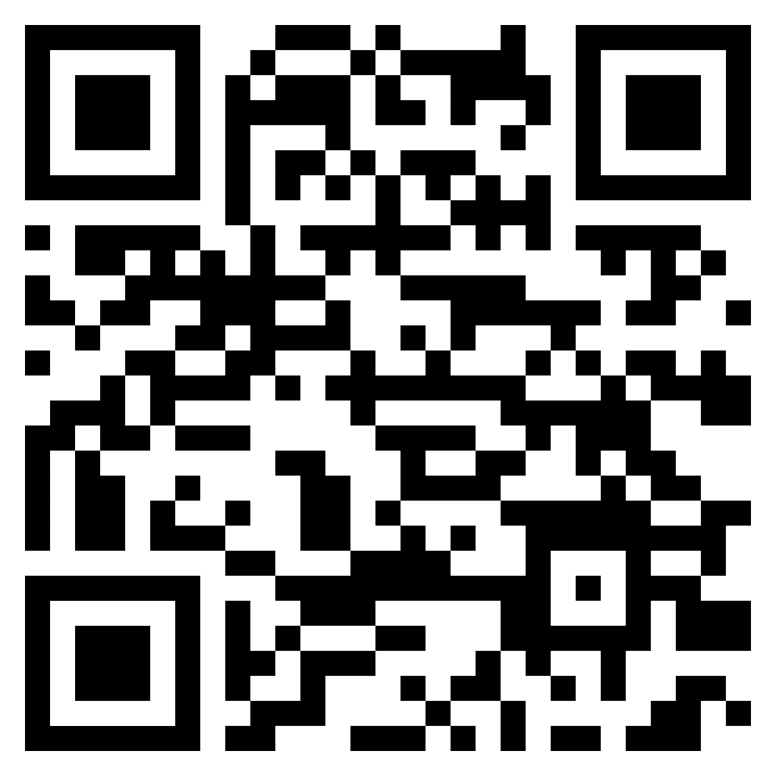
Clinical WG activities in 2025
Work Package Leads: Nikolas von Bubnoff, Christoffer Gebhardt, Jean-Yves Pierga, Claus Lindbjerg Andersen, Rodrigo De Almeida Toledo
Setup of 1-2 ELBS clinical trials (diagnostic/therapeutic)
Clinical WG communication platform
  Poll: Interest in LB-guided trial activity
Merge activities with tech WGs (CTC, ctDNA, EV)
  Acceleration of clinical implementation
  Setup of LB stratified clinical trials
Finish up ctDNA in RECIST review
Contributions welcome !

