Slide 1
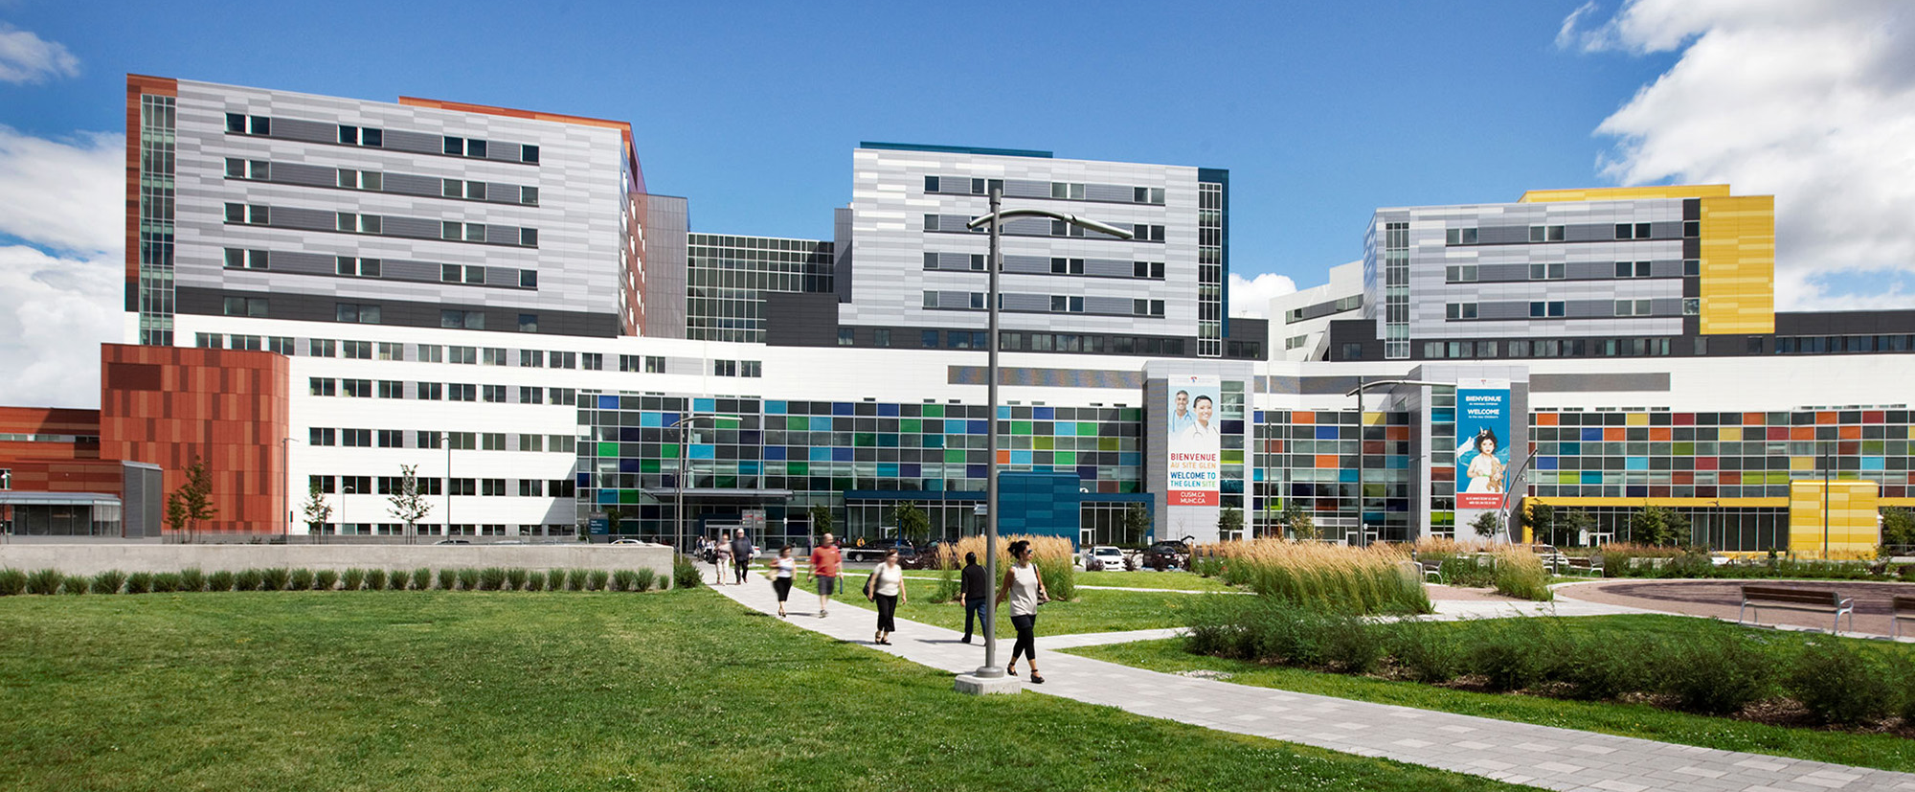


Research Institute of the
McGill University Health Centre
Julia V. Burnier, Ph.D.
William Dawson Scholar
Assistant Professor, Faculty of Medicine, McGill University
Department of Oncology & Department of Pathology
Scientist, Cancer Research Program,
Research Institute of the McGill University Health Centre
Associate member, Goodman Cancer Institute
Director of the Liquid Biopsy Lab
Lead of the Liquid Biopsy Unit
ELBS
November 2024

Slide 2
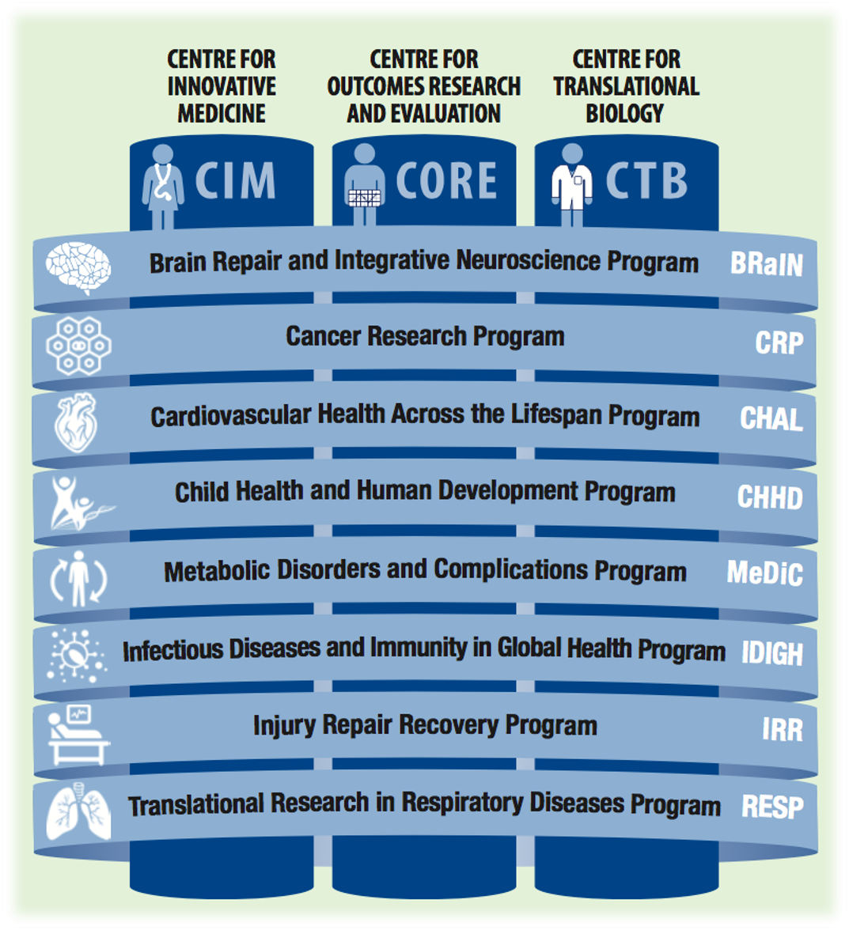

The RI-MUHC
Research arm of the McGill University Health Centre (MUHC)
Affiliated with McGill University
688 researchers
1600 research trainees
1300 research staff
Cancer Research Program
100 Members (PIs)
18 New early career investigators
>250 Trainees

Slide 3




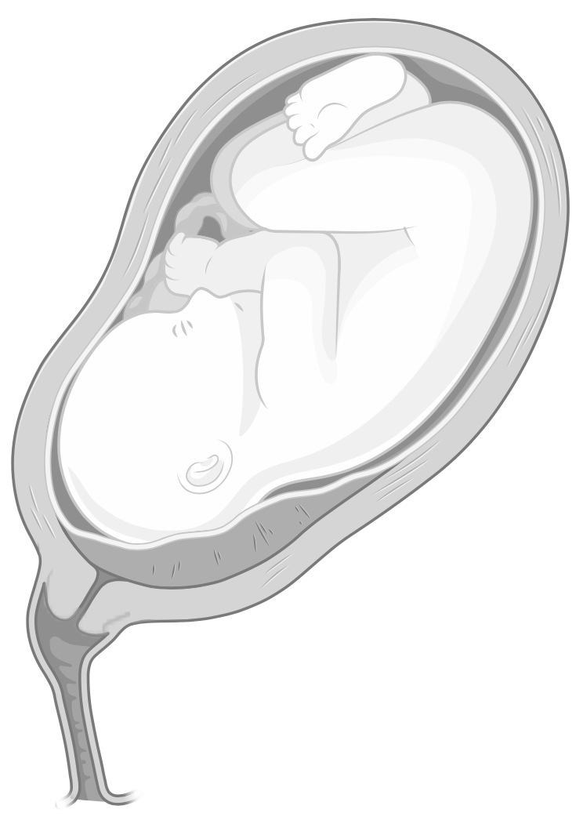

Linked to the major treating hospital in the province of Québec
Prenatal
Infant
Toddler
Adolescent
Adult
Old Age
700,000 patient visits per year at the McGill University Health Centre
4,500 new cancer patients with 4,500 cancer surgeries, 22,000 chemotherapies and 42,000 radiotherapies
>100 kidney transplantations alone
~3,000 babies born per year
>1000 open heart surgeries
And so much more….

Slide 4
Clinical liquid biopsy studies under the Burnier Lab (Cancer Research Program) since 2019 – ctDNA and EVs
~800 patients enrolled with ~3000 liquid biopsy samples
 | Head & neck cancer (n = 193 patients, 824 samples) | Melanomas (n = 110 patients, 232 samples) | Esophageal cancer (n = 49 patients, 214 samples) | Cervical cancer (n = 252 patients, 1146 samples) | Lung cancer (n = 25 patients, 59 samples) | Breast Cancer (n = 53 patients, 220 samples) | Colorectal cancer (N = 118 patients, 148 samples) | Thyroid cancer (REB approved)
Blood | ✓ | ✓ | ✓ | ✓ | ✓ | ✓ | ✓
Urine |  |  |  | ✓ |  |  | ✓
Saliva | ✓
Vaginal fluid |  |  |  | ✓
Aqueous/ vitreous |  | ✓

Slide 5
Two new Liquid Biopsy initiatives
Liquid Biopsy Unit (Cancer Research Program)
Circulating Biomarkers of Health and Disease Across the Lifecourse (cfDNA)

