Slide 1
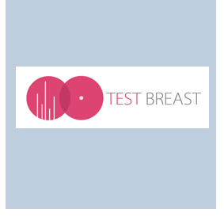
TESTBREAST study
Trial Early Serum Test BREASTcancer
Early detection of breast cancer in high-risk women using serum-based proteins
Layla Andour, PhD Candidate
Dr. W.E. Mesker, associate professor
Prof. dr. R.A.E.M. Tollenaar
Department of Surgery
Leiden University medical center

Slide 2





Can we predict breast cancer onset using blood?
Screening moments
Breast cancer diagnosis

Slide 3
High-risk women
    5-10% of all cases: due to high-risk
    Breast cancer susceptibility genes or family history of BC
    Increased lifetime risk of developing BC: up to 85%
    Adapted screening programs

Slide 4
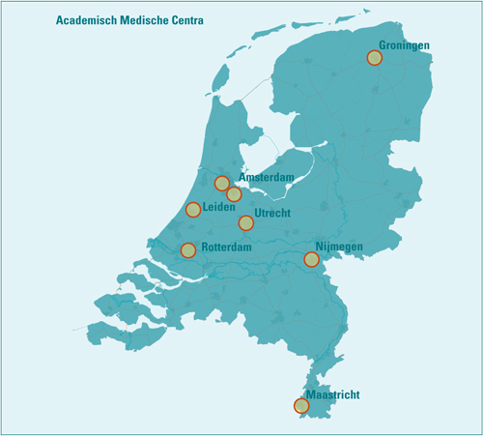

TESTBREAST study
Started in 2010
    National, multicenter study
    Based on previous data on protein profiles
    Unique study set-up
    Prospective, longitudinal follow-up
    Aim: blood test for early detection of breast cancer in high-risk women

Slide 5
Inclusion and exclusion criteria
Inclusion criteria
    Women between 25 – 75 years old
    Indication for frequent screening: high-risk of breast cancer
    Exclusion criteria
    Previous invasive breast cancer
    Other malignancies in the last 10 years, with the exception of basal cell carcinoma

Slide 6
TESTBREAST study: current status
    Large biobank with serum samples, stored at -80 degrees
    Longitudinally collected (last update January 2024)
    >3500 serum samples
    1108 women

Slide 7
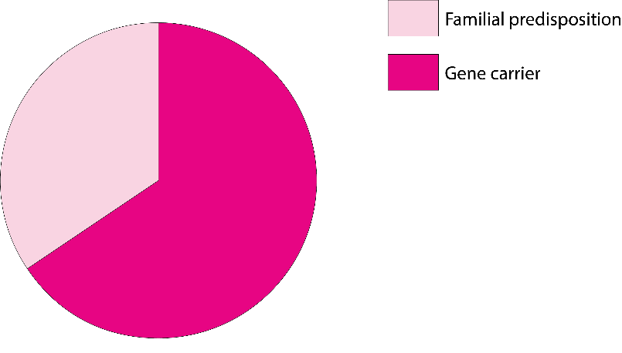
Characteristics cohort
Familial: 32.9%
Pathogenic variant: 65.7%
BRCA1: n = 337 (30.4%)
BRCA2: n = 335 (30.2%)
Median age [range] Age groups: <50 years 50-74 years ≥75 years | 51 [26-81] 512 (46.2%) 590 (53.2%) 6 (0.5%)

Slide 8
Characteristics cohort: breast cancer patients
    124 cases: 100 invasive, 24 in situ carcinoma
    Incidence breast cancer: 16.5%
    Median age all patients: 49 [26-68]
      General population: average 61-62 years
    Median age pathogenic variant: 48 [26-68]
    Median age familial predisposition: 52 [40-64]

Slide 9
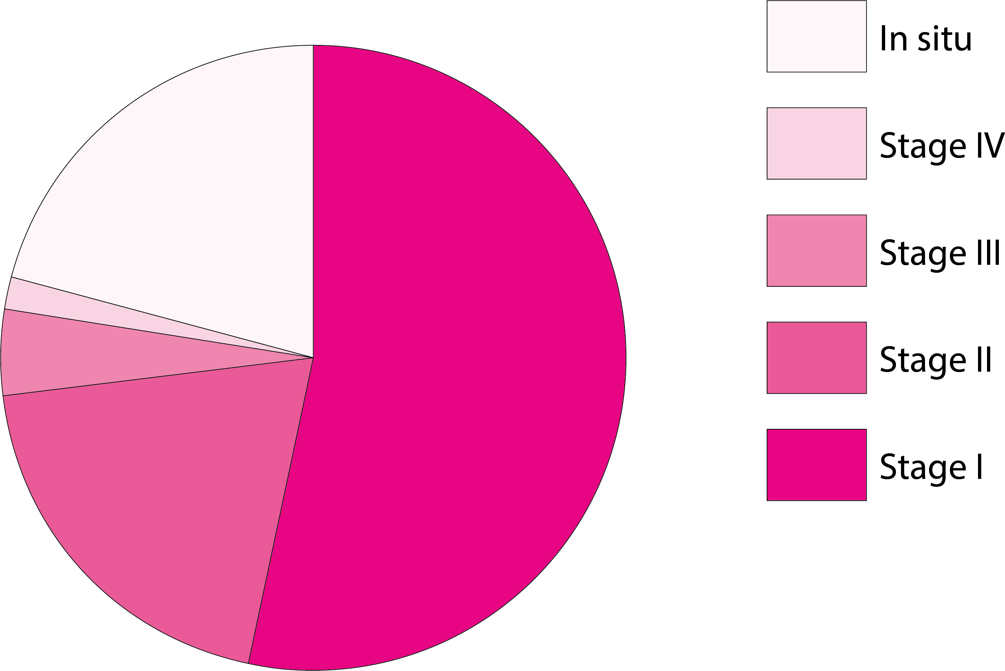
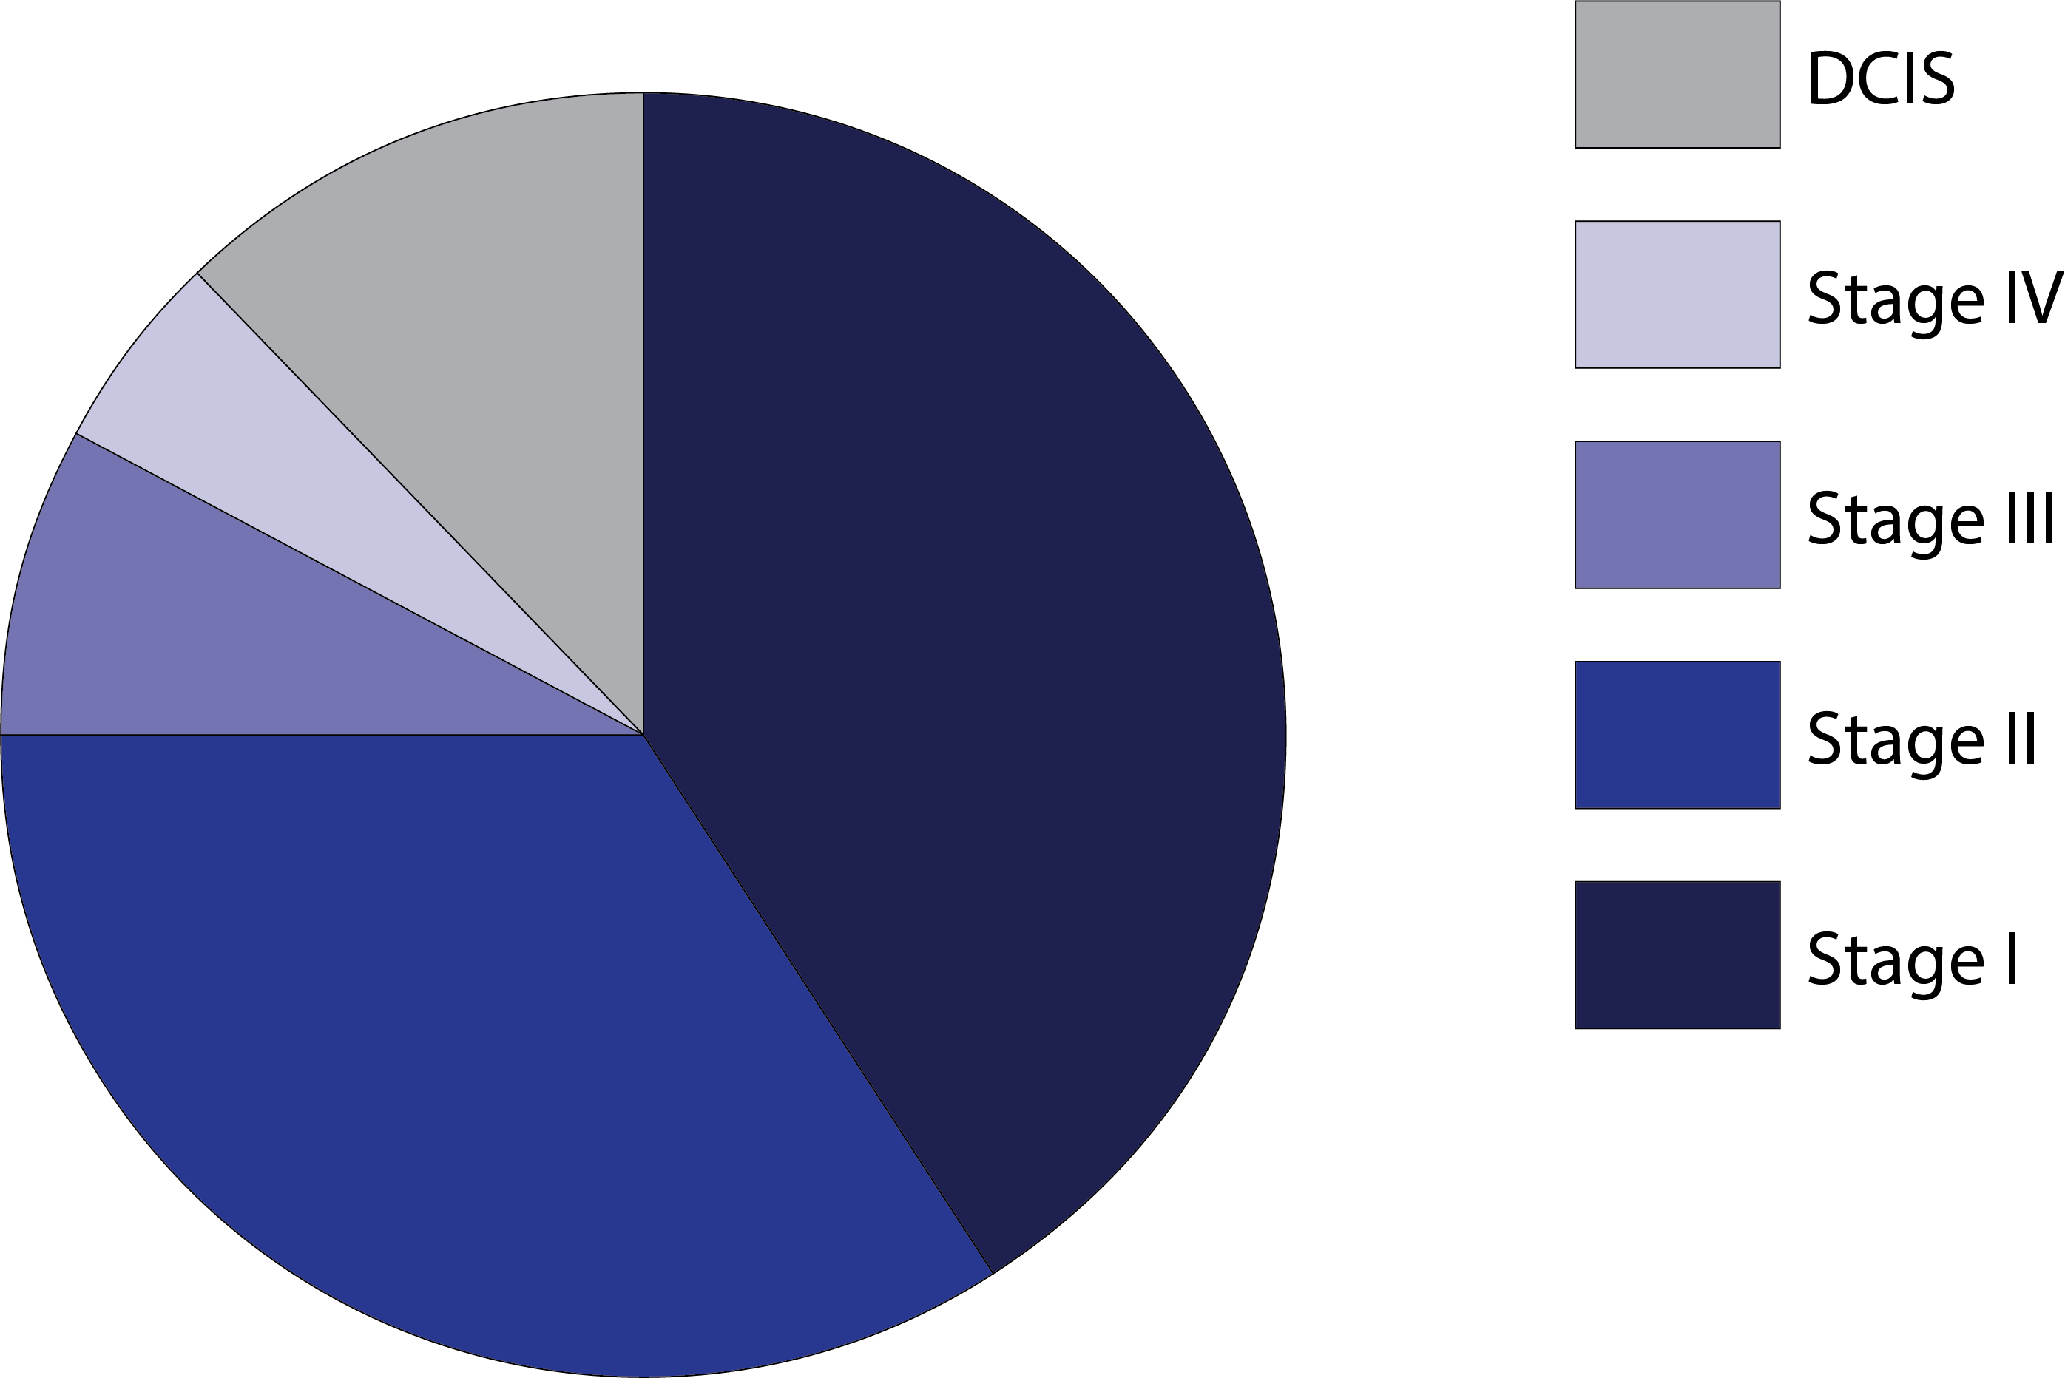
Characteristics cohort: breast cancer patients
TESTBREAST cohort (n = 124) National registry

Slide 10
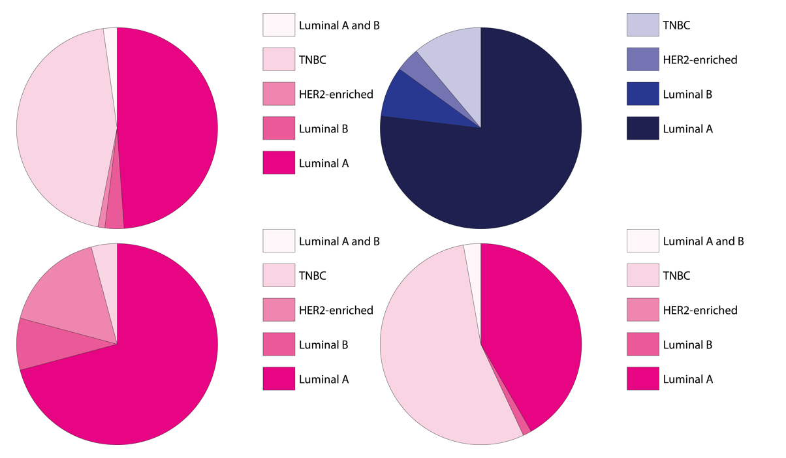
Characteristics cohort: breast cancer patients
TESTBREAST cohort (n = 100) National registry
Familial predisposition (n = 24) Pathogenic variant (n = 76)

Slide 11
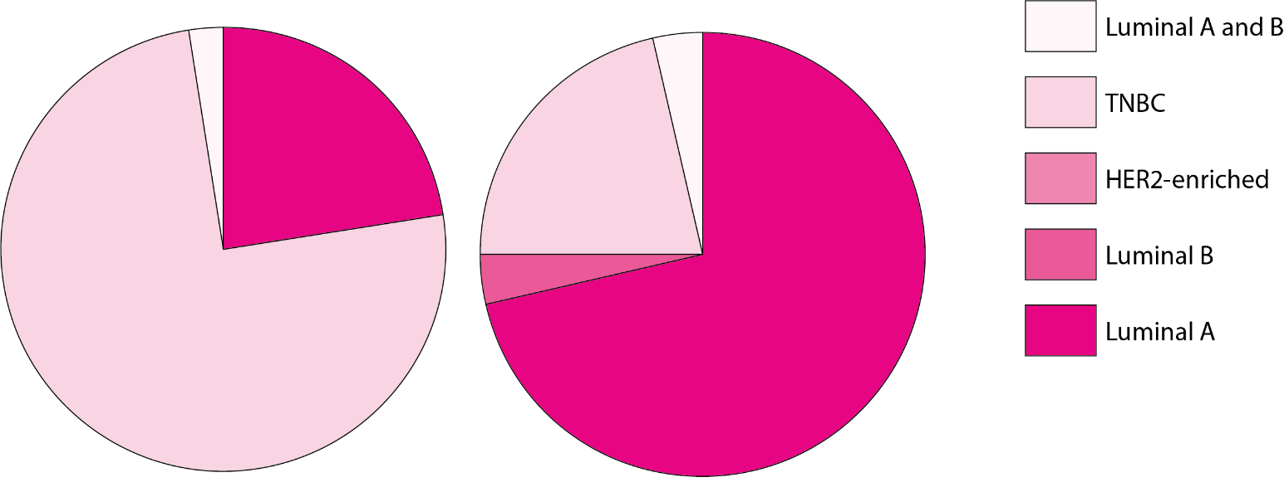
Characteristics cohort: BRCA patients
BRCA1 mutation (n = 47) BRCA2 mutation (n = 29)

Slide 12
TESTBREAST patients
Younger at moment of diagnosis
Aggressive subtype (TNBC)
Early stage
Emphasize the importance of early detection

Slide 13
Analyses
    First analyses finished
      Collaboration Erasmus MC (NL)
      Mass spectrometry
      Cluster analyses (ANOVA)
      Selection of distinctive proteins

Slide 14
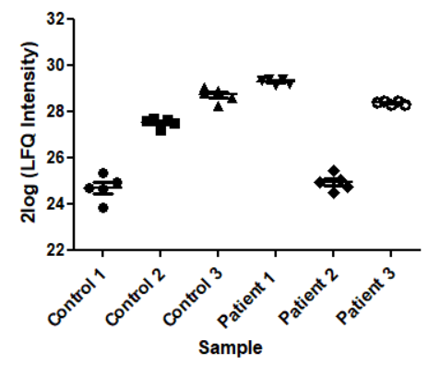
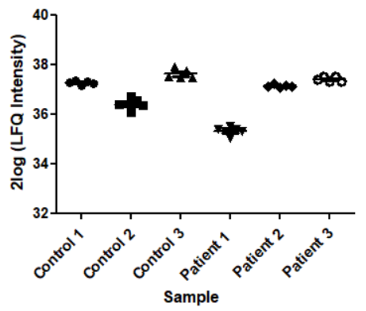
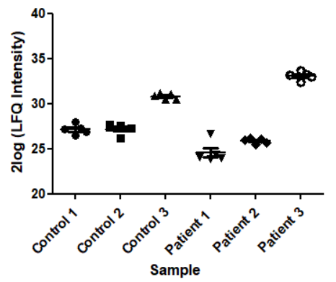
Hagenaars et al. - First results
Longitudinal analysis using mass spectrometry
    3 cases and 3 controls, each 5 samples per patient (n = 30)
    Different points in time
    Patients can serve as their own controls
Protein 1 Protein 2 Protein 3

Slide 15
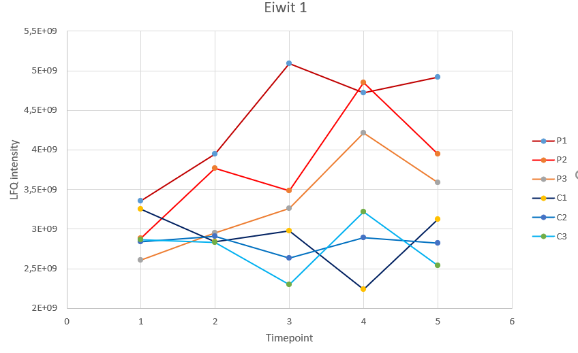
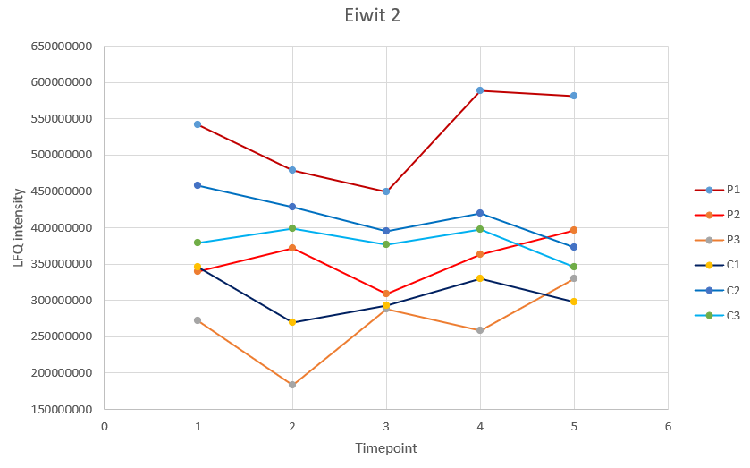
Hagenaars et al. - First results
Protein A
Protein B

Slide 16
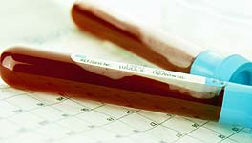
Summary
Strong points
    Longitudinal study set-up
    Identified highly discriminating proteins that change up to 2 years in advance
    Patients serve as own control
    Future
    Validation in TESTBREAST cohort and other high-risk cohorts
    Collaboration with other members of the ELBS?

Slide 17






LUMC
Surgery
J. Aalberts
T.M.A. Berends-van der Meer
M.G. Kallenberg-Lantrua
S.C. Hagenaars
L. Andour
Dr. W.E. Mesker
Prof. dr. R.A.E.M. Tollenaar
Datamanagement
L. Verhoeff
Ir. W.M. Meershoek-Klein Kranenbarg
Gynaecology
Dr. K.N. Gaarenstroom
Biobank Surgery
Ing. R.L.P. van Vlierberghe
LUMC
Robot
Dr. M.R. Bladergroen
Center for Proteomics
en Metabolomics
Prof. dr. M. Wuhrer
Clinical chemistry and
Laboratory medicine
F.P.H.T.M. Romijn
Dr. Y.E.M. van der Burgt
Dr. L.R. Ruhaak
Prof. dr. C.M. Cobbaert
Clinical and Cancer
Proteomics (Erasmus MC)
B. Ravesteijn
Dr. L.J.M. Dekker
Dr. T. Luider
Participating centers
MUMC
C.M.R. Haekens
Drs. K.B.M.I. Keymeulen
NKI
J. Remmelzwaal
Drs. M. Piek-den Hartog
Prof. dr. E.J.Th. Rutgers
Dr. C. Drukker
UMCG
C. Lemstra
A. Prozee
Dr. J. de Vries
MST
A. Stam
C. Bandel
I. Meijer
Dr. A.E. Dassen
Participating centers
UMCU
Drs. S. Makineli
Dr. A.J. Witkamp
Maxima MC
F. Scheffers
S. Silvis
Dr. K.E. Schenk
Albert Schweitzer
Hospital
W. van der Eijk
G. Themen-van der Oest
Dr. M. Foureaux
Dr. M.B.E. Menke-Pluijmers
Spaarne Gasthuis
J. De Droog-Laane
P. Dienaar
C. van den Anker
Dr. B.A. Kortmann

