Slide 1


Platelet-free plasma does not (yet) exist
Jillian W.P. Bracht, Mendel Engelaer, Mandy Los, Edwin van der Pol, Rienk Nieuwland

Slide 2
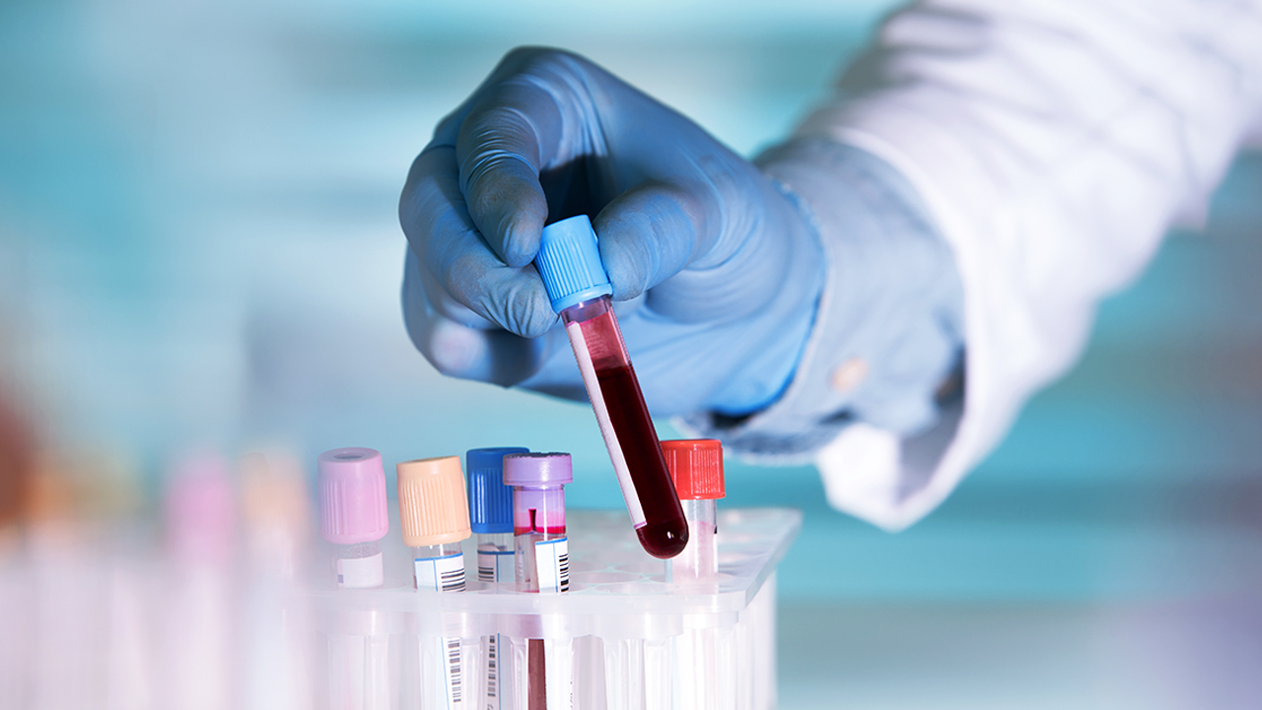
Potential of liquid biopsies
Expected global market value exceeding $18 billion by 2032

Slide 3
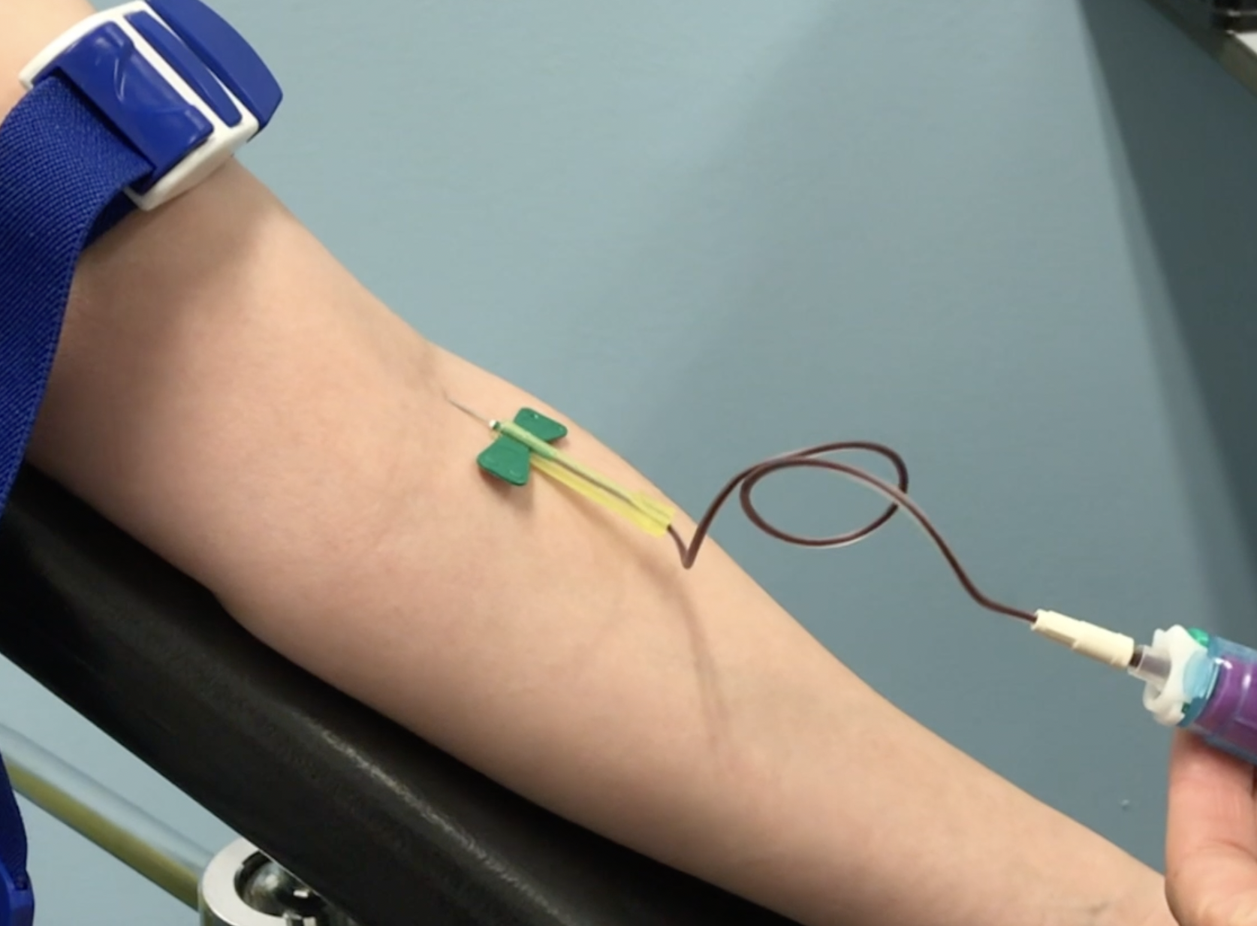
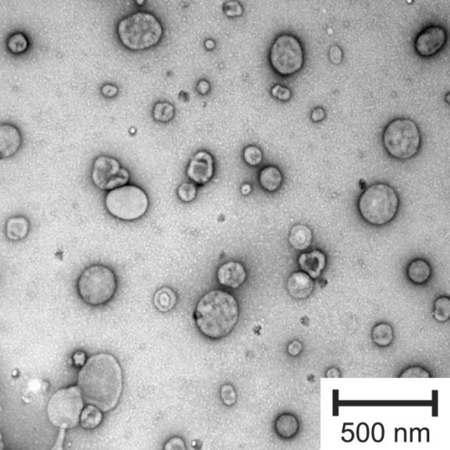
Extracellular Vesicles
Nanoparticles
Released by cells
Body fluids (plasma)
Potential biomarkers
  Concentration
  Disease-specific cargo

Slide 4
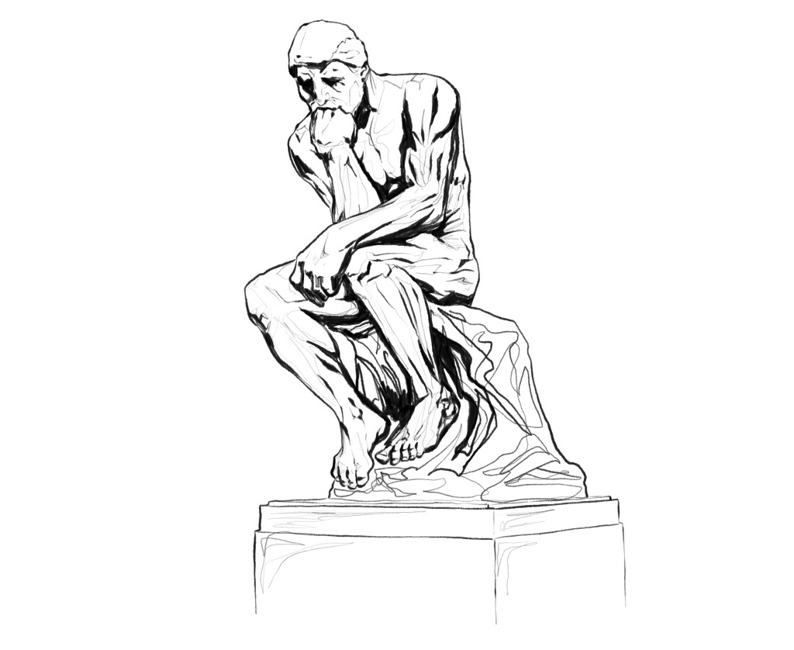
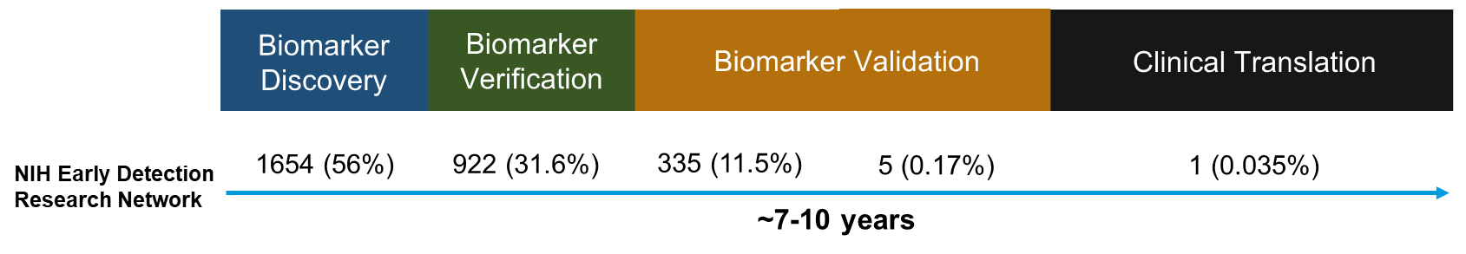
>99.9% of liquid biopsy biomarkers are irreproducible and fail to enter the clinic

Slide 5
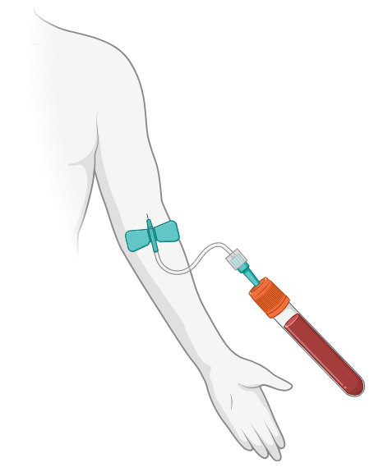

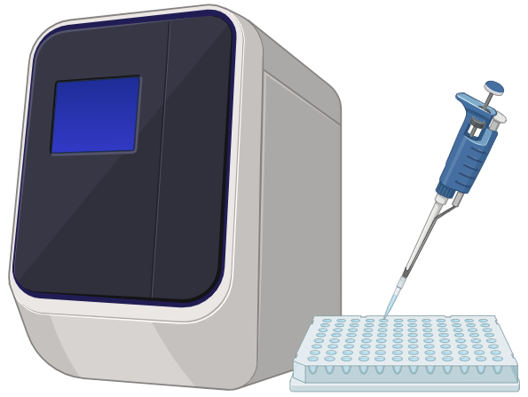
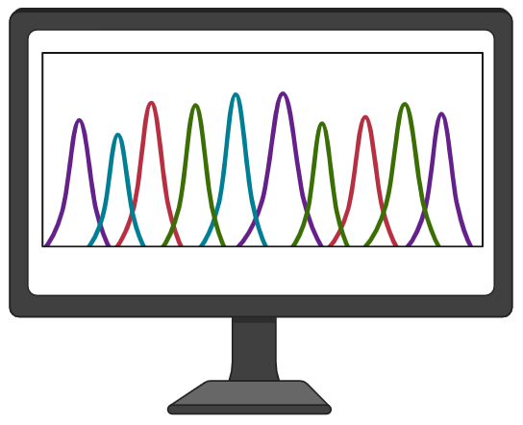

Sources of sample variability
Biospecimen
variables
Pre-analytical
variables
Analytical
variables
Post-analytical
variables

Slide 6
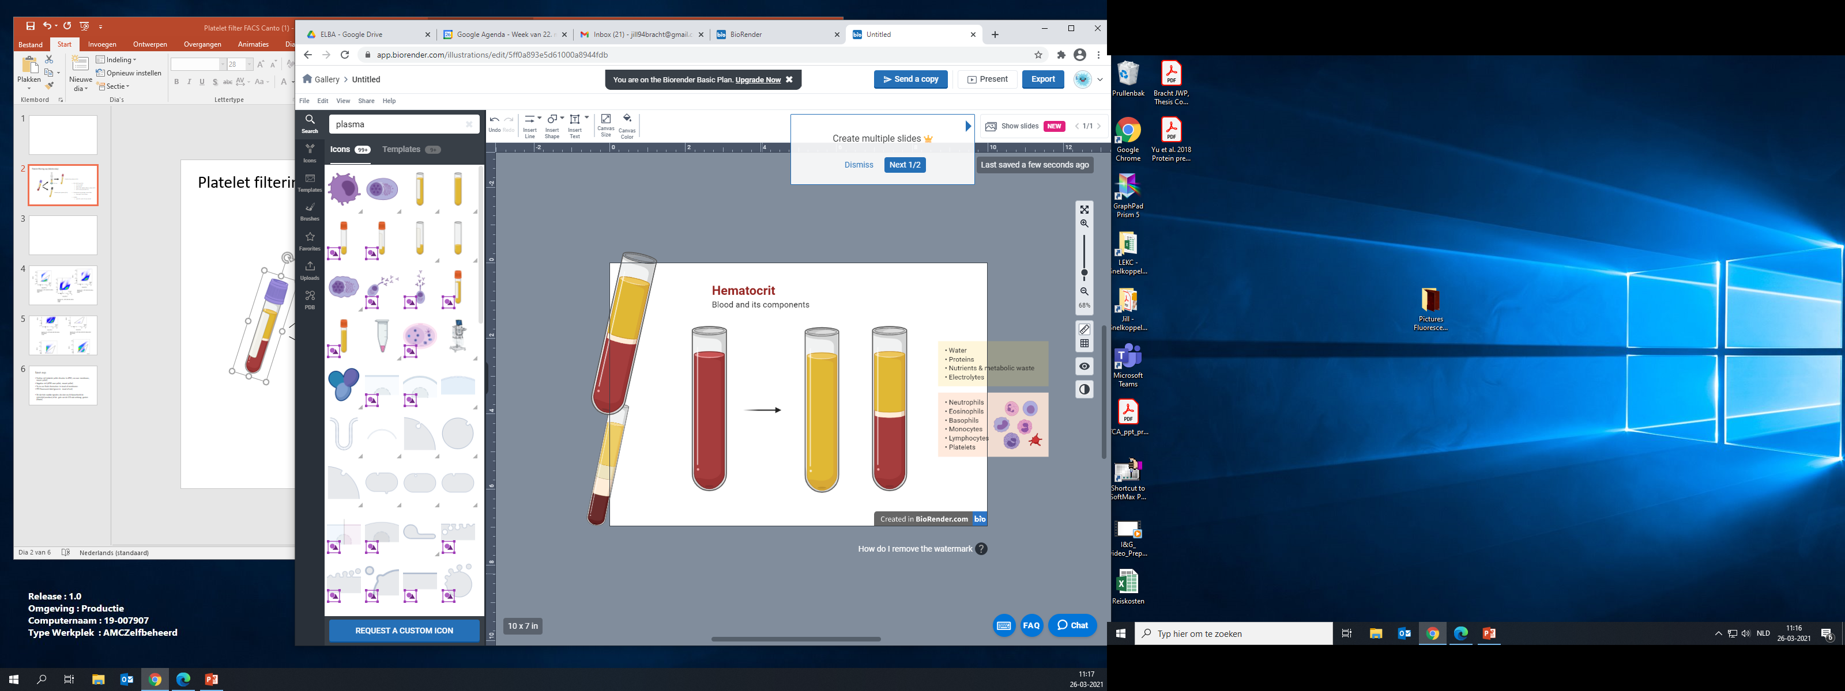



Double centrifuged blood plasma
10⁵-10⁸ platelets and erythrocyte ghosts per mL plasma!
Whole blood
Single centrifuged
plasma
Literature:
“Platelet-poor”
Double centrifuged
plasma
Literature:
“Platelet-free”

Slide 7
>200 different protocols
Notes:
Mention reviewed the protocols in studies that investigated EV-miRNA biomarkers in the plasma of cancer patients

Slide 8
Protocol affects sample composition
Notes:
The concentration of remaining platelets depends on the used blood processing protocol
As you can see from these graphs where the concentration of remaining platelets in plasma are depicted, after processing of blood using two different protocols, here called protocol A and B
ISTH protocol/protocol A: 2x 2500xg, 15 min, RT, no brake, exactly 10 mm from pellet (lego)
Non-ISTH protocol/protocol B: 1 x 900xg, 7 min, then 1x 2500xg, 10 min, RT, max brake, approx 10 mm from pellet (by eye)
FACS Canto, calibrated for scatter (size) and fluorescence (MESF = Molecules of Equivalent Soluble Fluorochrome)
Platelets:
MESF CD61-APC > 6000 + MESF CD41-PE > 3000
Detection range 1,000-8,000 nm

Slide 9

Recap
Centrifuged plasma contains variable concentration of remaining cells
Plasma composition within and between biobanks inconsistent & incomparable
Affect downstream analysis (EV-miRNA)

Slide 10
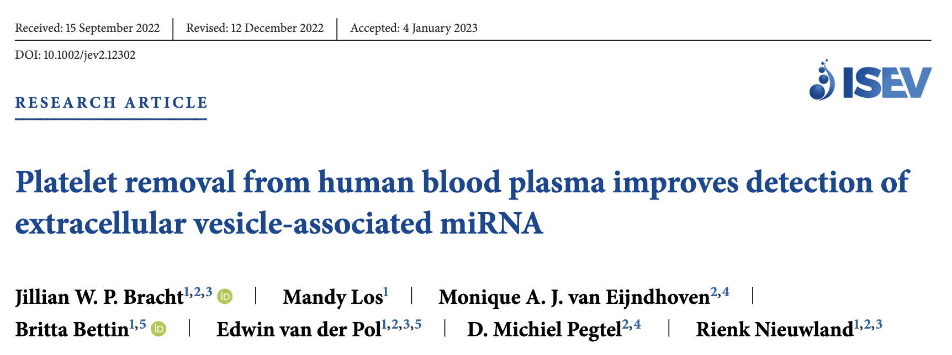
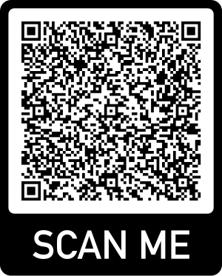

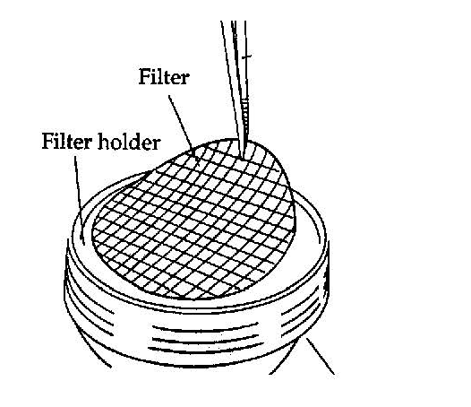
50-75% of miRNA derived from platelets
0.8 µm polycarbonate track-etched filters
>98% cells removed, EVs unaffected
Notes:
Track-etched: uniform pore size

Slide 11

Unrecognized problem

Slide 12
Unrecognized problem
“Only small percentage cells left”
  But huge volume!
“Are they really platelets/cells?”
  Seeing is believing
But concentration too low for visual confirmation..

Slide 13
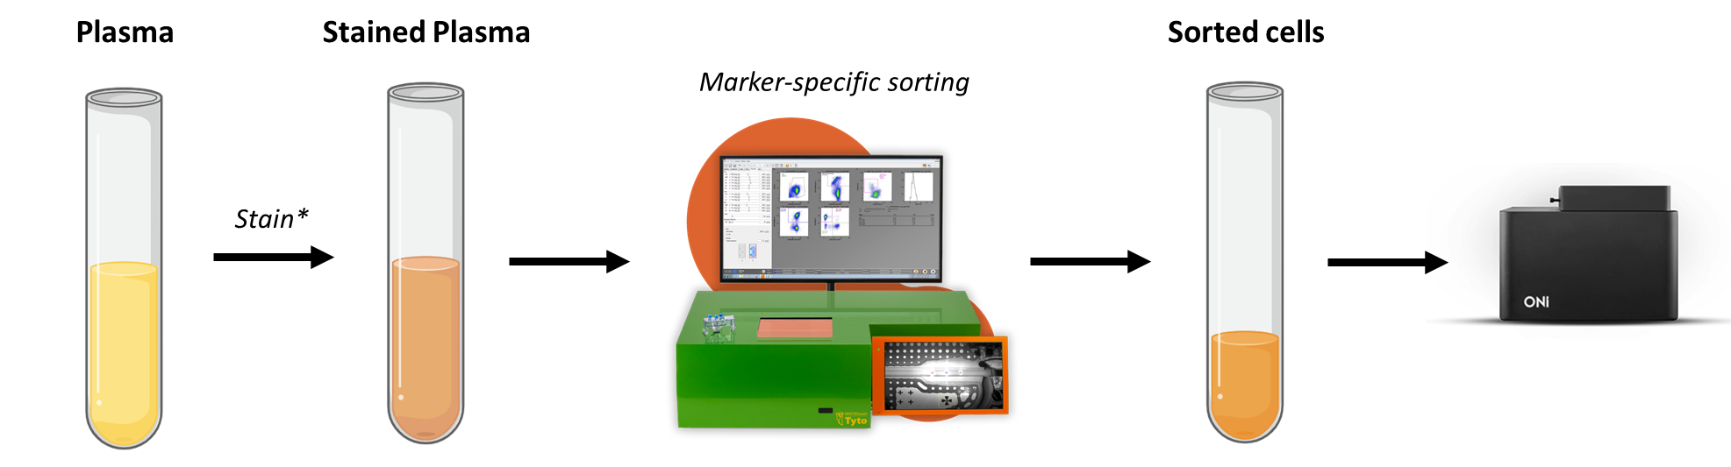
Goal
Sort and concentrate remaining cells from double centrifuged blood plasma
Visualize remaining cells by super resolution microscopy
Notes:
Platelets:
CD61-PE, CD62 p-BV421, CD235a-APC
Erys
CD235a-APC, CD61-PE

Slide 14
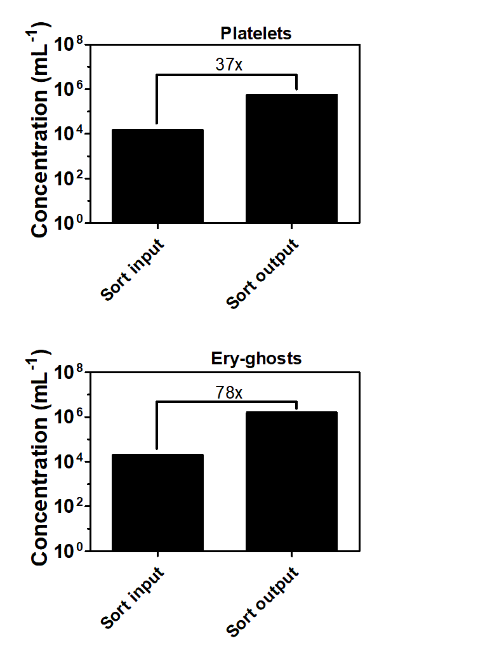
Sorting increases concentration
Platelets
Ery-ghosts
Notes:
The actual concentrations in plasma are 10-fold higher. Samples have been diluted prior to sorting due to the staining protocol.

Slide 15
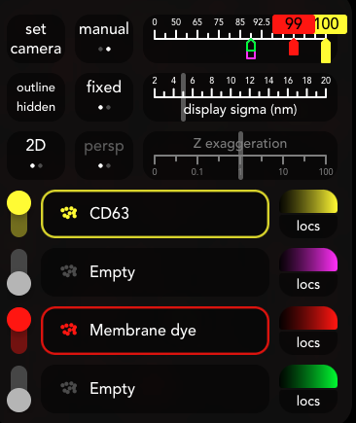
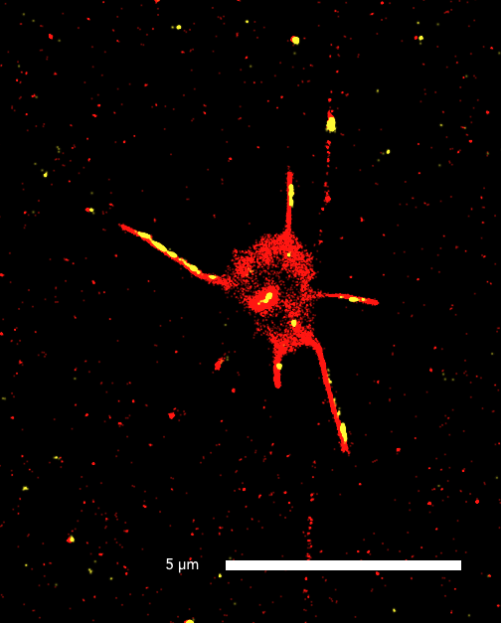
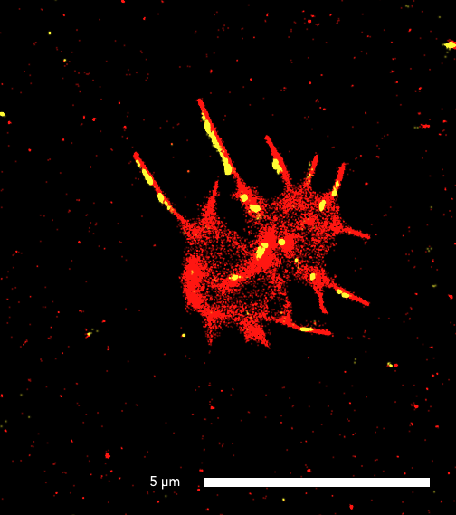
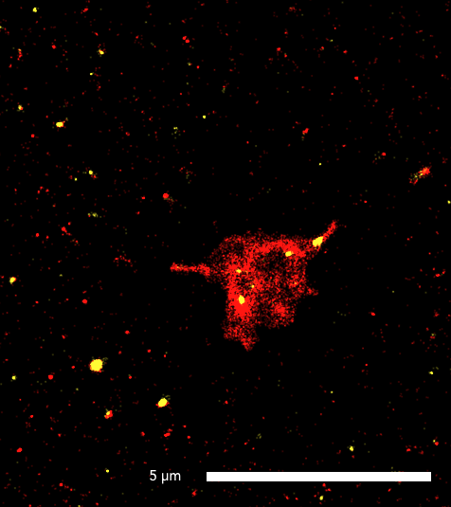
Platelets
5 µm
5 µm
5 µm
Notes:
EXP 20240627
CD63 capture, CD63 (561) and Membrane Dye (488) detection

Slide 16
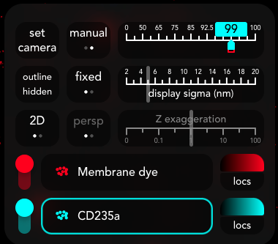
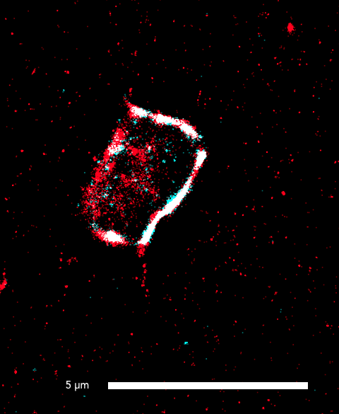
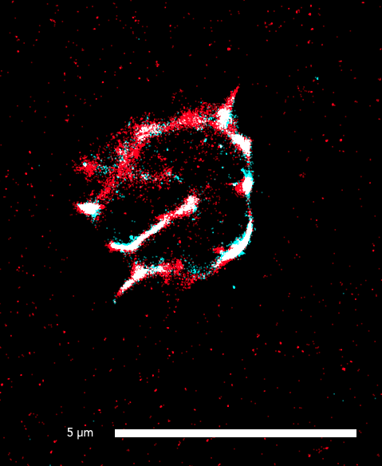
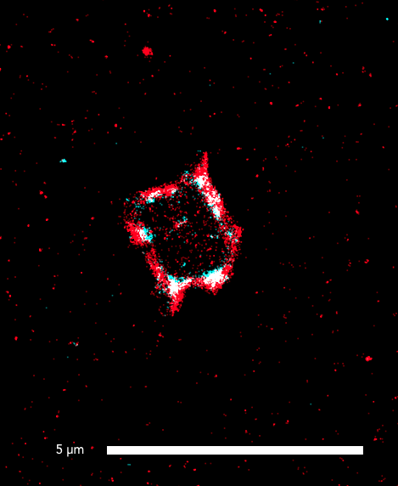
Ery-ghosts
5 µm
5 µm
5 µm
Notes:
EXP 20240730_2x2500g, sorted
CD235a capture, CD235a (640) and Membrane Dye (488) detection

Slide 17
Conclusions
What we measure as cells (FCM) are indeed cells
Novel workflow to
  Characterize cells, why do they remain?
  Quantify the effects of remaining cells on downstream analyses
Standardized plasma composition enhances biomarker development
  Truly cell-free plasma should be the start
  MIBlood EV
Notes:
Platelets:
CD61-PE, CD62 p-BV421, CD235a-APC
Erys
CD235a-APC, CD61-PE

Slide 18


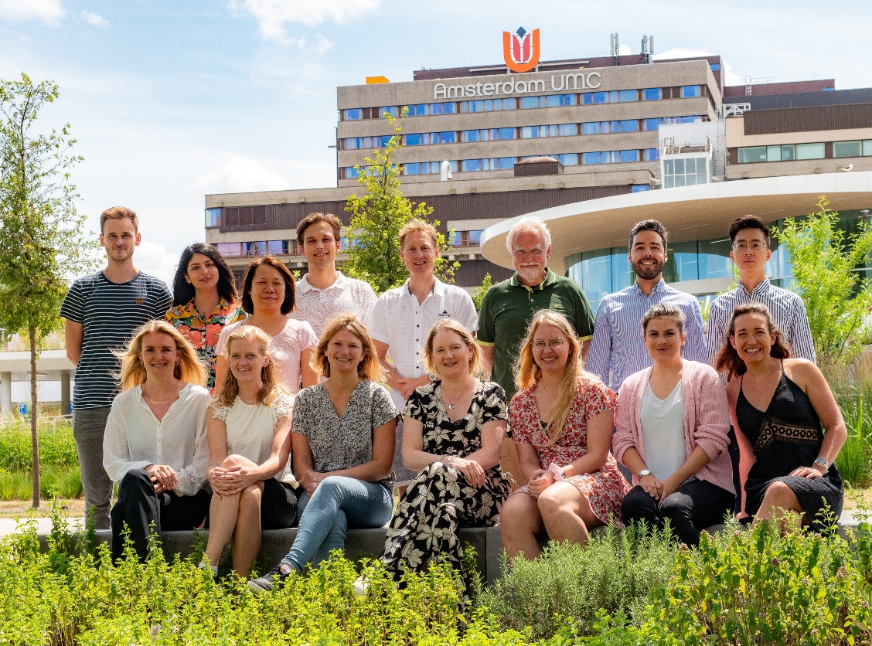

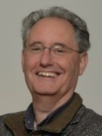

Acknowledgements
LEKC
BMEP
Mendel Engelaer
Rienk Nieuwland
Edwin van der Pol
Mandy Los
Figures were created in BioRender

Slide 20
Back-up

Slide 21
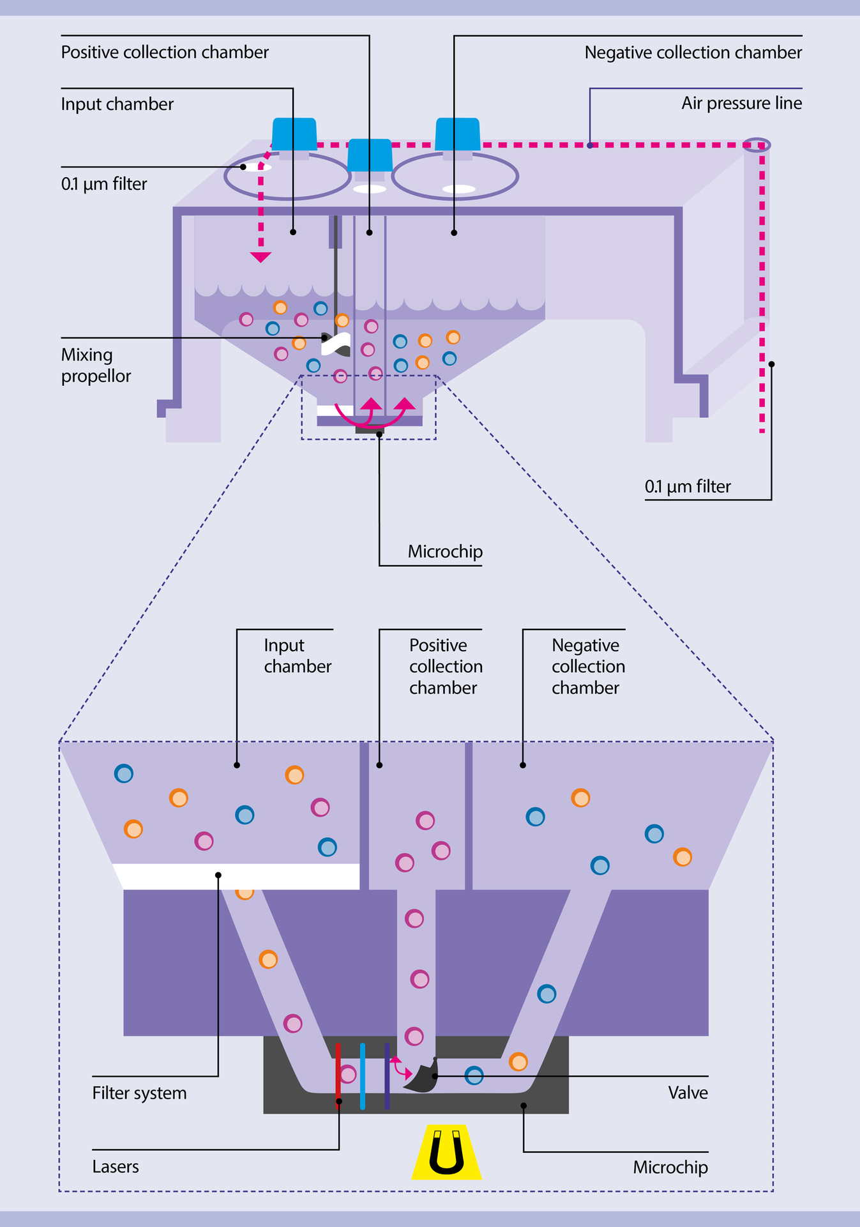
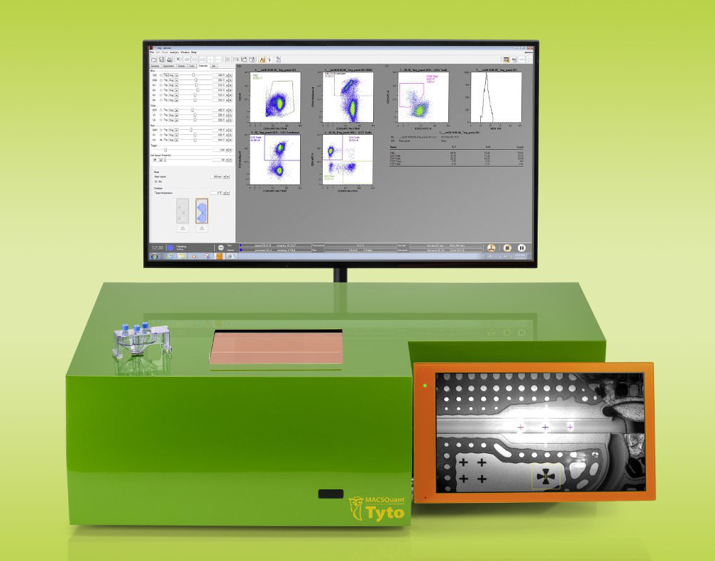
MACSQuant Tyto cell sorter
Notes:
Insert the cartridge, gate on cells, and sort.
Sort cells under low pressure without compromising cell viability or functionality. Cells are no longer exposed to high pressure, charge, or decompression.
No sheath fluid > no dilution

Slide 22







ONi
Membrane dye
Detection antibody
Capture antibody
Streptavidin
Assay chip
Notes:
Stochastic super-resolution: the chemical complexity of many molecular light sources gives them a complex temporal behavior, which can be used to make several nearby fluorophores emit light at separate times and thereby become resolvable in time.
Stochastic optical reconstruction microscopy > stoachastic activation of individual fluorophores with photoactivatable properties. STORM requires specific antibodies with photoswitchable fluorophores (+ very bright fluorophores + minimal photobleaching)

Slide 23
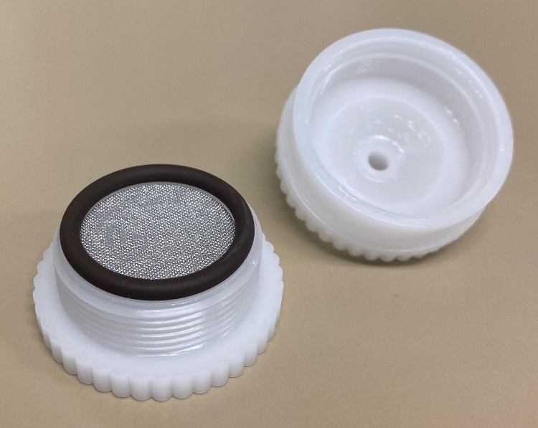
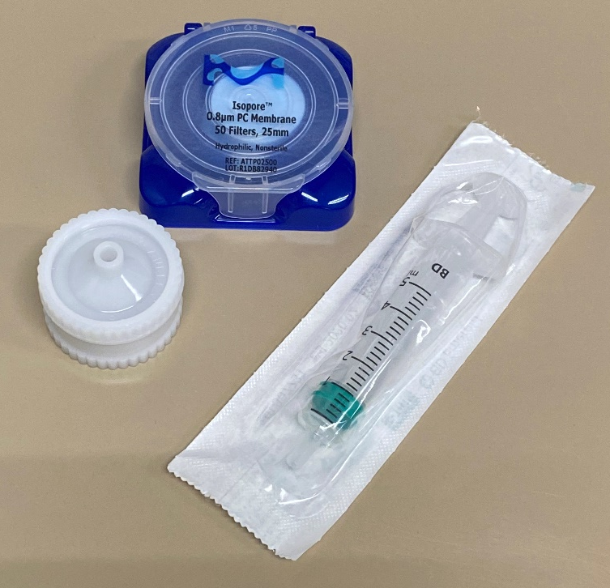
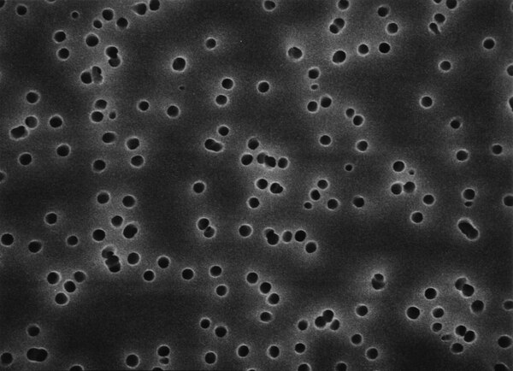
800 nm Polycarbonate track-etched filters
Notes:
To remove remaining platelets (1-3 um in size) from our plasma samples, we used 800 nm polycarbonate track etched filters
So on the left picture you can see some of the required materials, namely the filters, a filter holder and a syringe
We add one filter onto the holder, under this rubber ring to keep it in place and create a vacuum
We then add a syringe on top and push our plasma through
It is important to use track-etched filters, since they have a uniform pore size

Slide 24
Filtration removes platelets, EV concentration unaffected
*EVs were measured by flow cytometry (Apogee A60; detection range: 150-1,000 nm)
Notes:
>97% of platelets removed

Slide 25
50-75% of the detected miRNA originates from particles > 800 nm
EV-associated: let7a-5p, miR-21-5p
Platelet-associated: miR-223-3p
Notes:
We choose 3 different miRNAs, two of which have been previously associated with Evs, and one that has been previously associated with platelets
This graph shows the cycle treshold of the three miRNAs in the normal situation and after filtration of the EV-enriched SEC fractions
Y-axis is inverted, since a lower cycle treshold means a higher miRNA concentration
You can see here that filtration increases the cycle threshold 1-2, meaning there is a lower miRNA concentration
Assuming that the miRNA quantity doubles during each cycle (2^ct), this increase in ct indicates a 2-4 fold decrease in RNA quantity post filtration
And thus 50-75% of the measured miRNA is derived from particles > 800 nm, including platelets
5p means the microRNA is from the 5 prime arm of the hairpin and 3p means 3 prime end

Slide 26
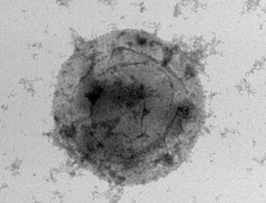
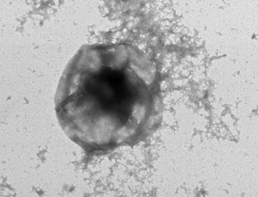
Transmission electron microscopy
1x2500g sort
2x2500g sort
1 um
1 um

Slide 27
Figure 1
Notes:
Figure 1. Overview of the sample nomenclature, centrifugation protocols (A) and downstream samples processing (B) in the current study. Approx: approximately; max: maximum; min: minutes; RT: room temperature; SEC2B: size-exclusion chromatography CL-2B. This figure was created with BioRender.com.

Slide 28
Filtration produces EVs beyond a critical concentration of platelets

Slide 29
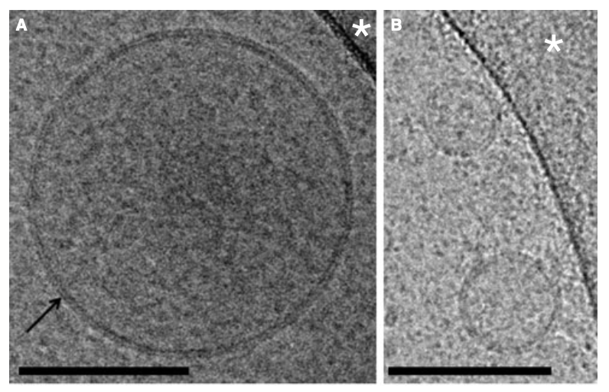
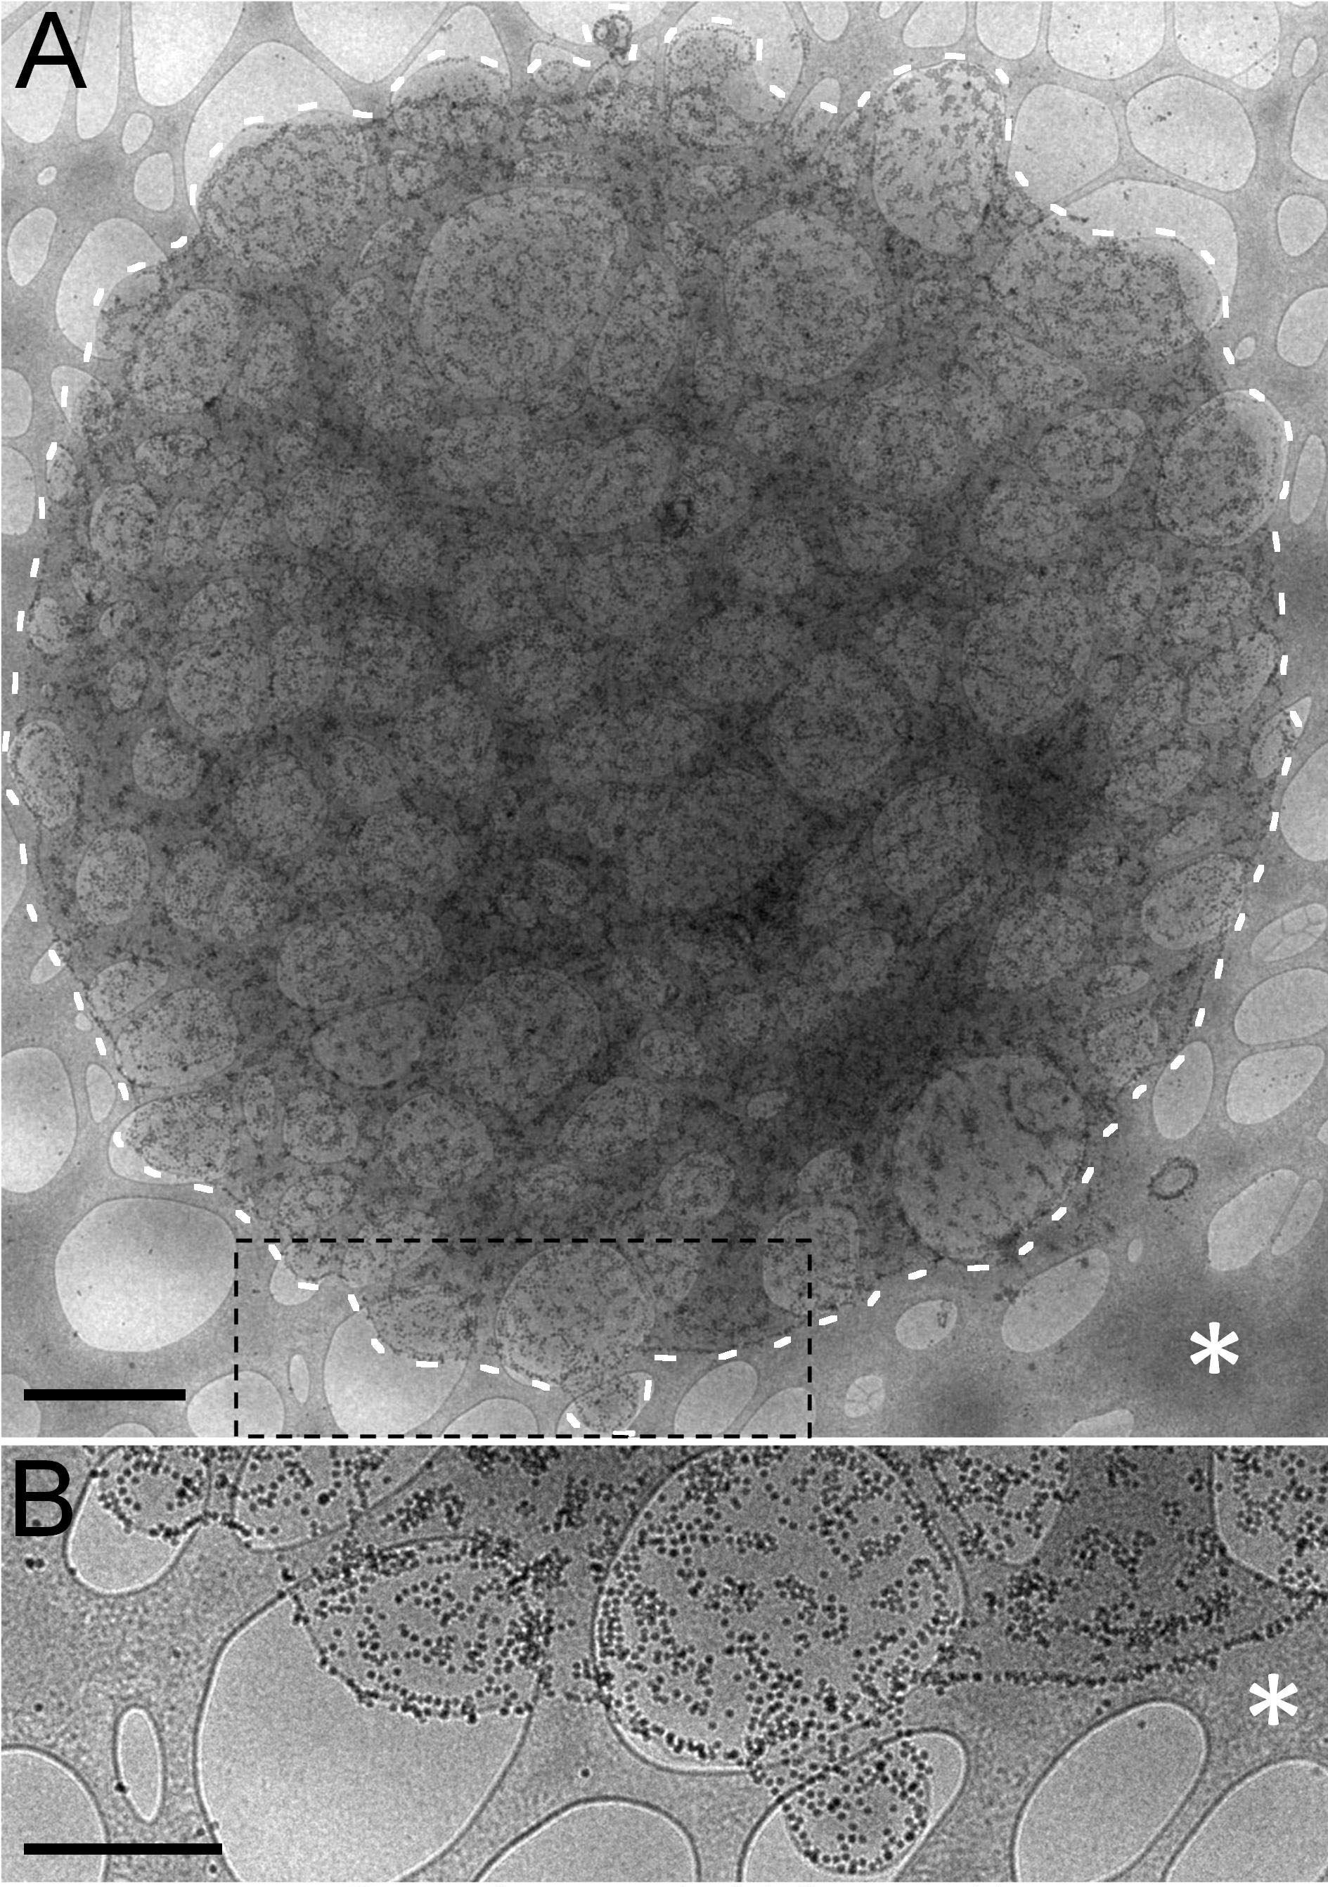
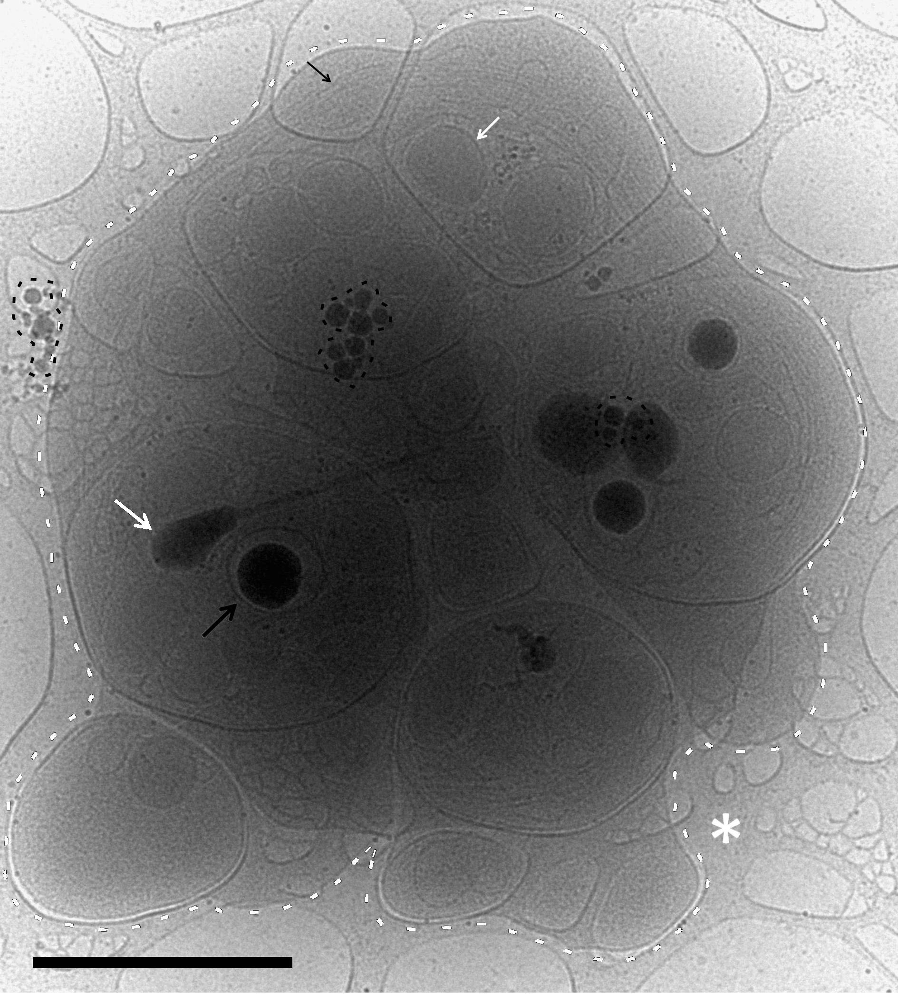
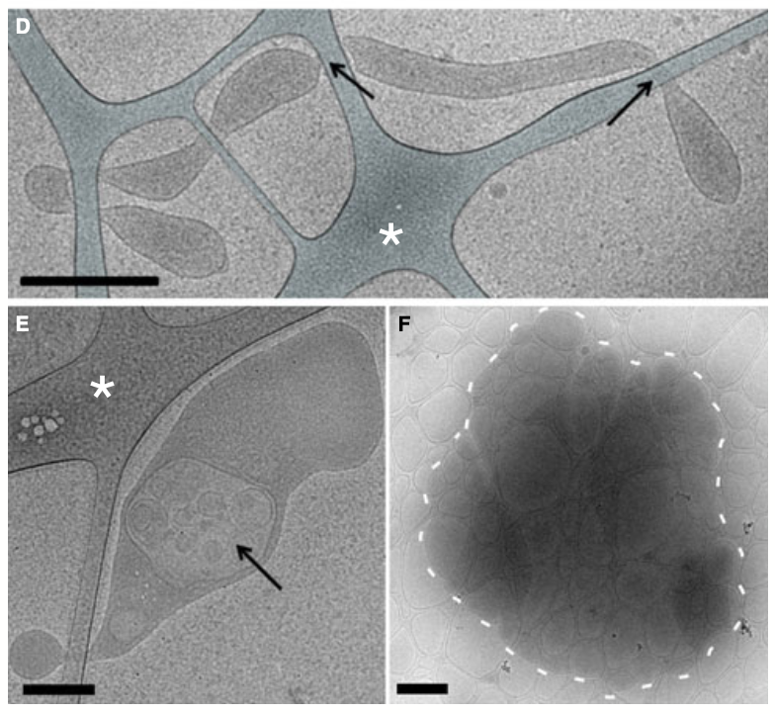
Platelet-free plasma:
Spherical EVs (> 95%) 30 nm – 1 um
Tubular EVs (< 5%) 600 nm – 5 um
Membrane fragments (< 0.5%) 1 um – 8 um
Lipoproteins
Ery-ghosts (empty erythrocytes, 145 per uL PFP)
Platelets (< 1 per uL PFP)
Scale bar: 100 nm
Scale bar: 100 nm
Scale bar: 0.5 um
Scale bar: 1 um
Scale bar: 1 um
Scale bar: 200 nm
Scale bar: 1 um
Arraud et al. JTH 2014
Notes:
PFP: 2 x 2500g 15 min, brake setting: 2
Staining used: CD235a (erythrocytes), CD41 (platelets), Anx5 (PS, phosphattidylserine)
(cryo-EM)

