Slide 1



miRquad: first-in-class RUO dPCR
multiplex assay for microRNA detection in head and neck cancers
Giulia Urbani
PhD student
Translational Oncology Research Unit
giulia.urbani@ifo.it
Young Investigator Session
26th November 2024

Slide 2

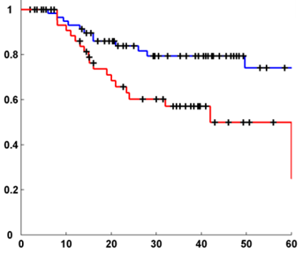

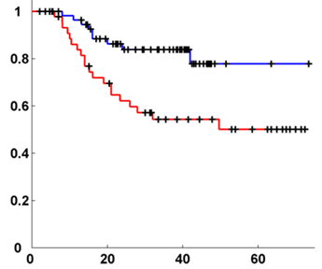

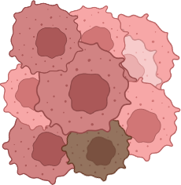
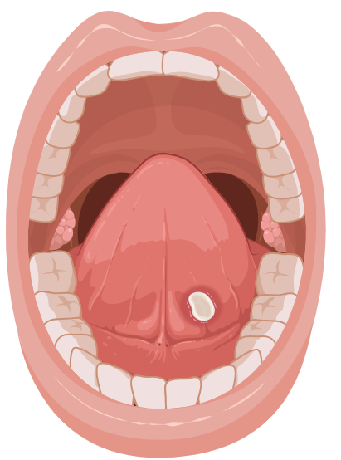

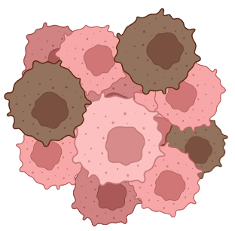
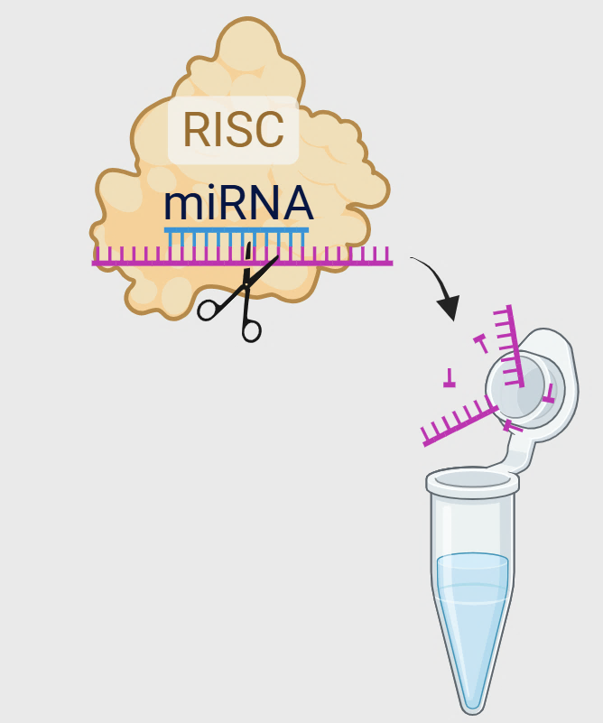






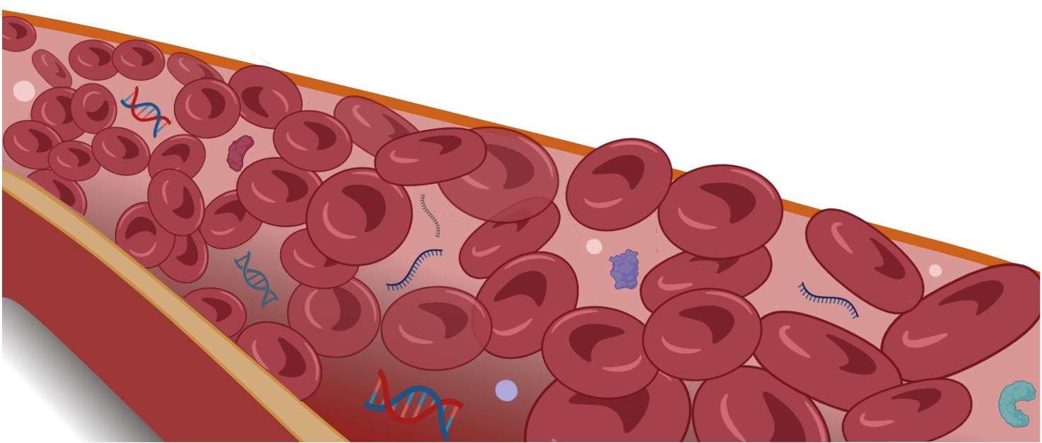


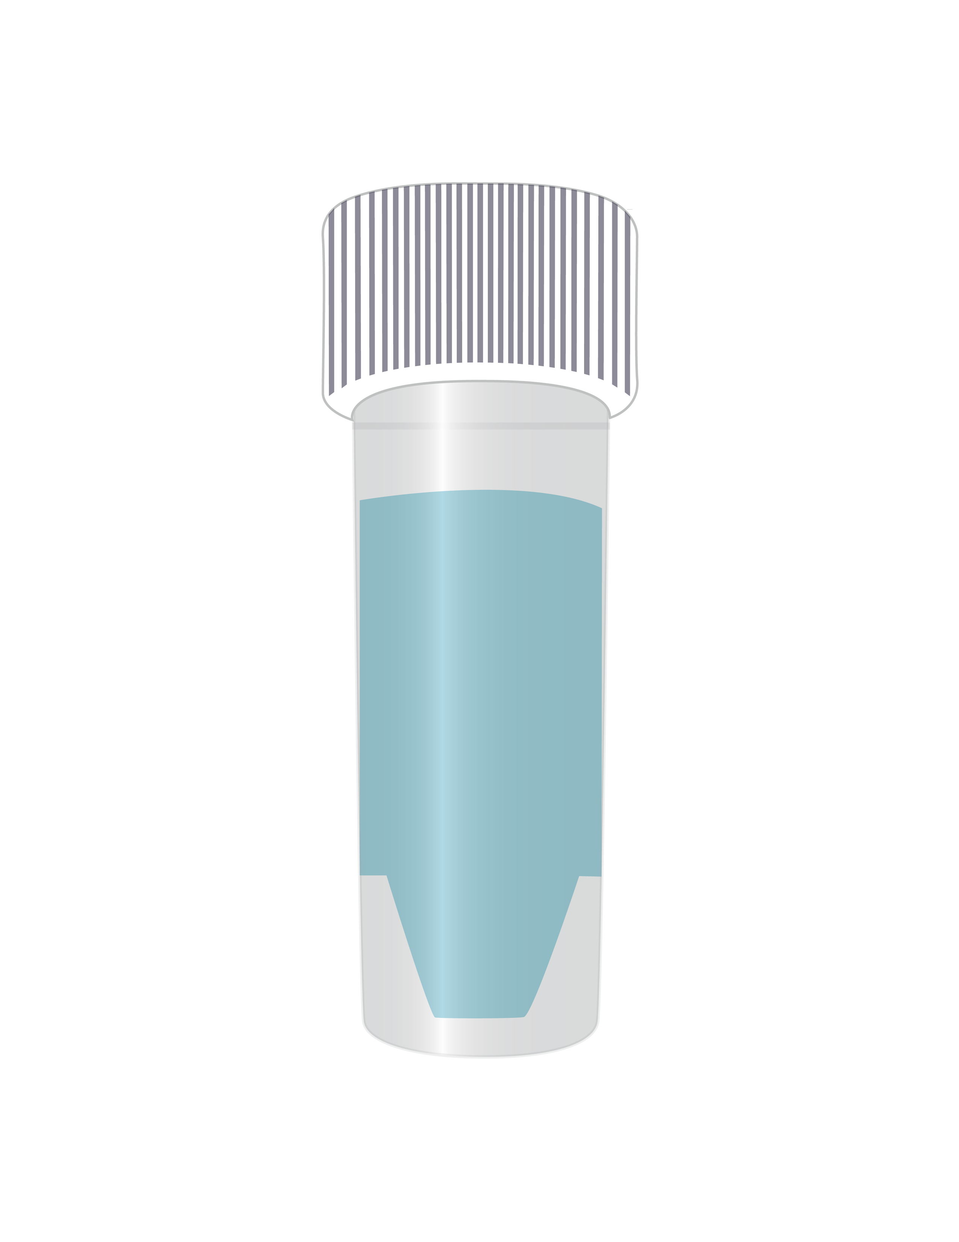




Background
Accurate monitoring
Tumors
Peritumor
miRNA
RNA
DNA
Peritumor
(<1 cm from the tumor)
miR 21-5p
miR 21-3p
miR 96-5p
miR 429
Key features
RFS
signature high
Primitives
or relapse
signature low
found into the circulation, actively released
generally abundant in plasma/serum samples
increased stability over ctDNAs
specificity for tissue/cell types (site of origin)
Prognostic prediction
p = 0.003
p = 0.007
Targeted approaches
Ganci et al, 2013
miRNAs
Ganci et al, 2017
Follow up (months)
Follow up (months)
Prospective single-center study
Does the circulating miRNAs signature reflect tumor behaviour?
Can we use these miRNAs as potential biomarkers for predicting recurrence in HNCs?
Early
diagnosis
Promising surrogate biomarkers mirroring disease status
Surgery
before
surgery
(T₀)
after
surgery
(T₁)
15 days
later
(T₂)
at follow-up visits
(T_{n})
Relapse
2

Slide 3












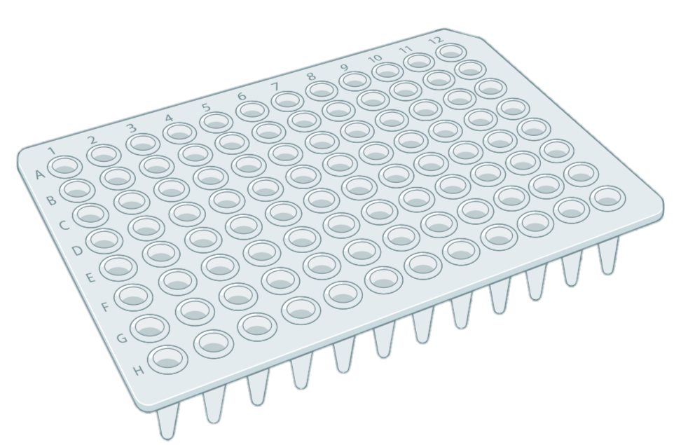















Pros and cons: single vs multiplex assays
miR 21-5p
miR 96-5p
miR 21-3p
miR 429
when using commercial single assays….
Taqman™ 4-plex
dPCR assay (RUO)
miRquad
miR 21-5p (FAM)
miR 96-5p (VIC)
miR 21-3p (ABY)
miR 429 (Cy5)
Study items
assay
#3
assay
#4
assay
#2
assay
#1
pt#001
miRquad
pt#002
at the end of the story…
Time
consuming
Error
prone
pt#001
Faster TAT
(4-time less)
Higher accuracy
(less pipetting)
Multiple miRNAs
pt#002
Different types of samples
Cost ineffective
Cost&sample
saving
Increased productivity
Multiple timepoints
RCA
Translational Oncology Research Unit
3

Slide 4
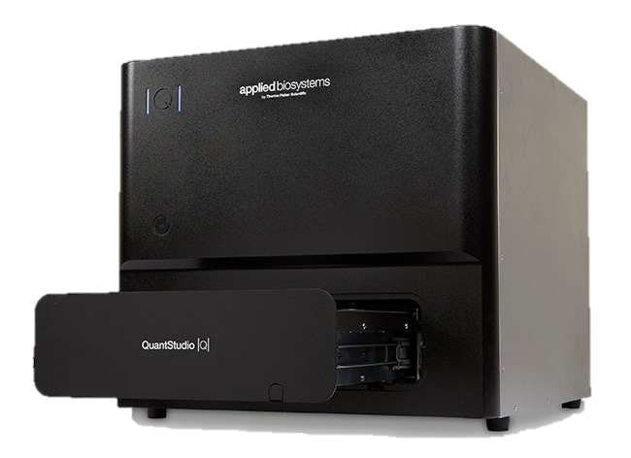


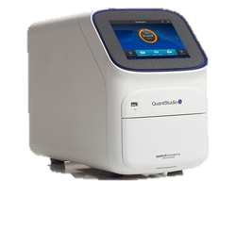
Our journey
Step 2
Preliminary assessment
of assay performance
Extended,
multicenter testing
Testing on different biological matrices
Step 1
Step 3
4

Slide 5

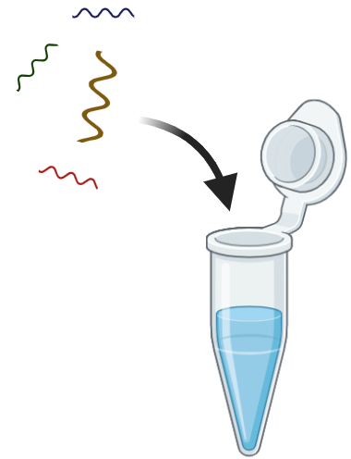
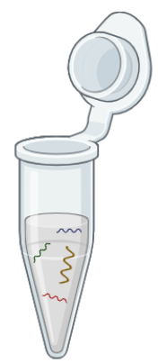
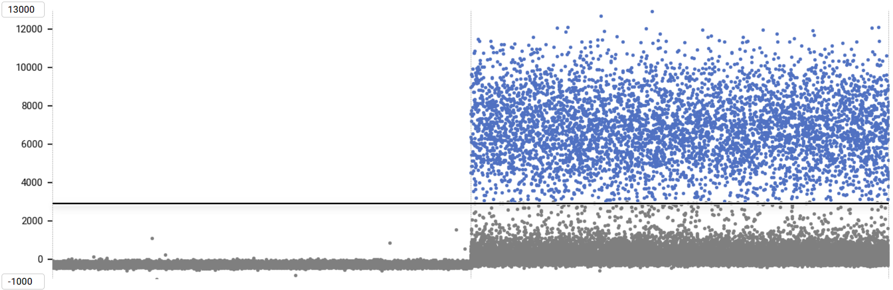
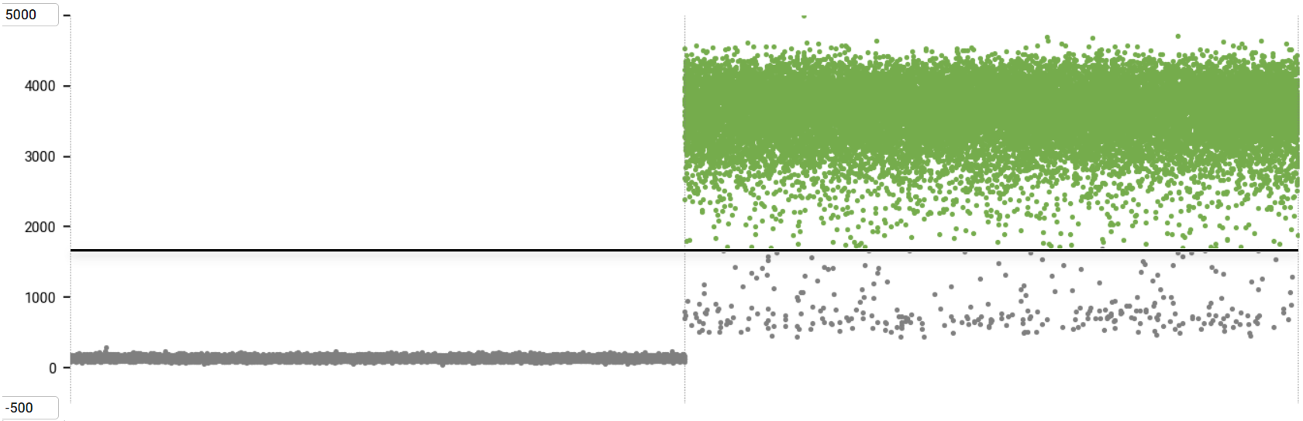
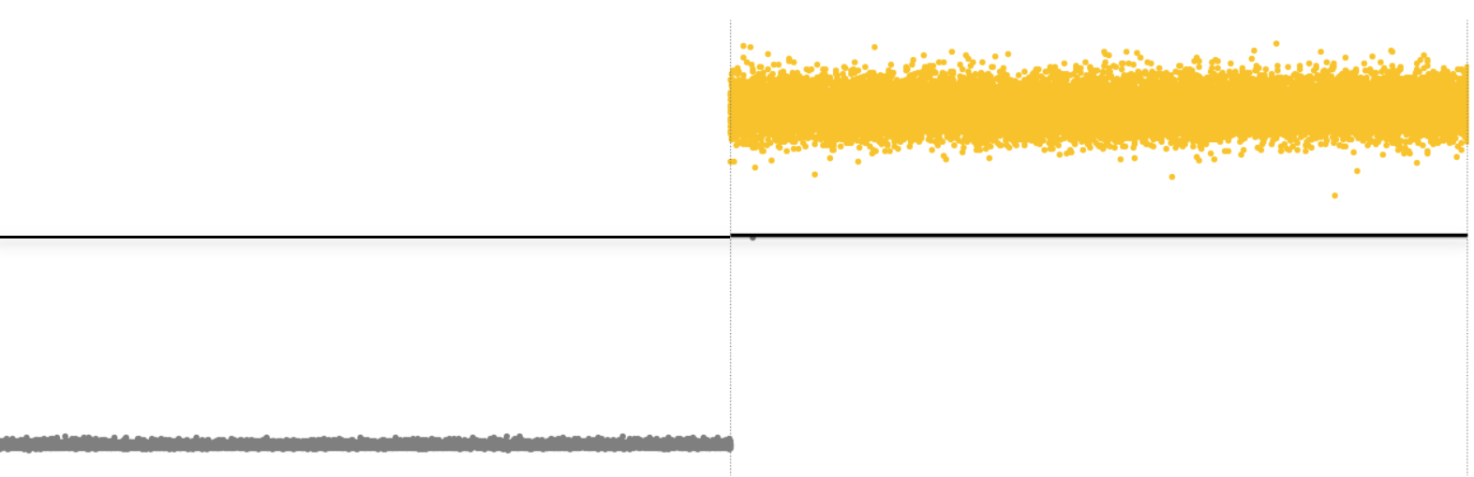
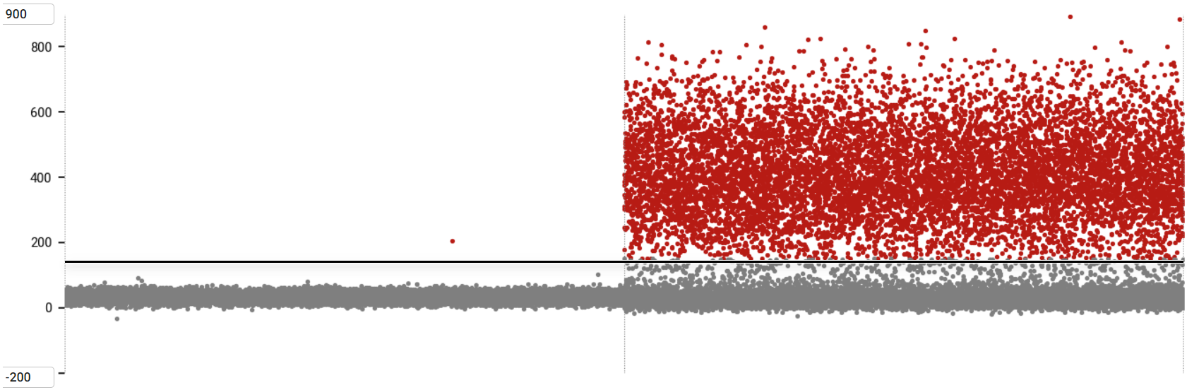
Preliminary assessment of assay performance
Step 1
detection with
commercial (single) assays
detection
with miRquad
single spike ins
specific for each miRNA,
different dilutions
qPCR Ct
miR 21-3p
miR 96-5p
miR 21-5p
Input
single spike ins
miR 429
miR 21-5p
spike
miR 21-3p
spike
miR 96-5p
spike
miR 429
spike
miR 21-5p
spike
miR 21-3p
spike
miR 96-5p
spike
miR 429
spike
BLOCK-IT™ custom RNA spike ins
detection with miRquad
dH₂0
miR 21-5p
miR 96-5p
multiple spike in
containing all miRNAs at
different concentrations
Input
multiple spike in
miR 21-3p
miR 429
NTC
multiple spike
NTC
multiple spike
5

Slide 6

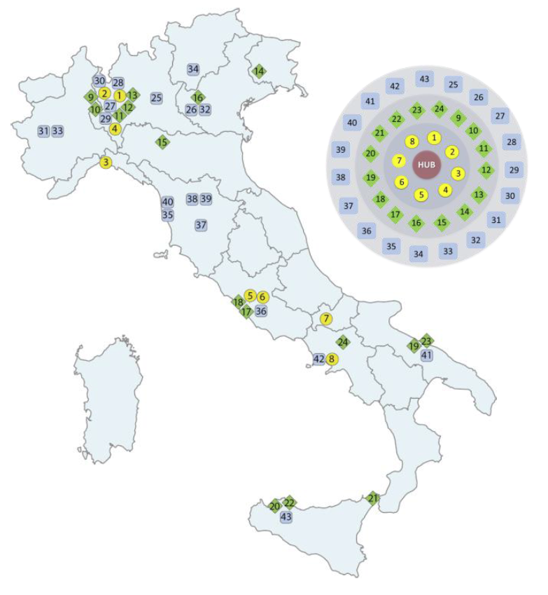
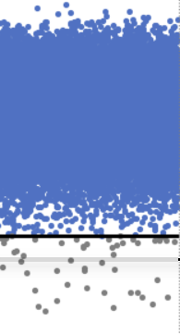



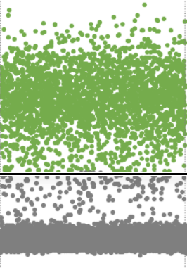
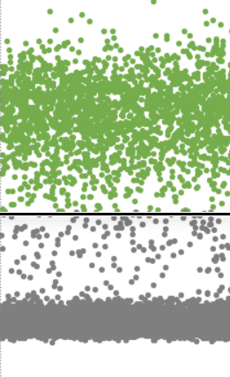



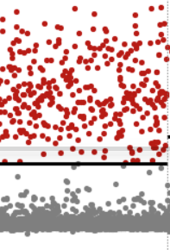
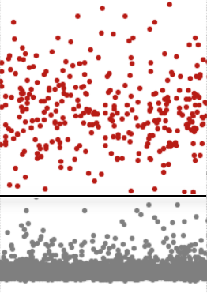
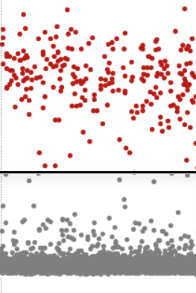




Extended, multicenter testing
Step 2
The INNOVA Consortium
A multidisciplinary diagnostic platform operating within NHS and translational research which promotes the development and dissemination of novel, standardized, advanced diagnostic tools throughout Italy in the field of wet lab and imaging
WP4 – Liquid biopsy & biomarkers
Involved Centers
miRquad
commercial assays
IRE-IFO
IRE-IFO
MultiMedica
MultiMedica
HSM
OSM-PV
Input
multiple spike in
Copies/ul
OSM-PV
Pascale
Gemelli
Mondino
IRE-IFO
IRE-IFO
Neuromed
CRO Aviano
Pascale
Pascale
Pascale
critical mass of more than 765 clinicians & researchers
CRO Aviano
ITGPII
CRO Aviano
Mondino
miR 21-5p
miR 21-3p
miR 96-5p
miR 429
miR 21-5p
miR 21-3p
miR 96-5p
miR 429
CRO Aviano
UniVer
research and innovation actions for major human diseases
ITGPII
minimal variations among Centers, particularly on dPCR data
wide applicability across multiple platforms (qPCRs/dPCRs)
almost complete overlap with Taqman commercial singleplexes
CERICT
miR 21-5p
miR 96-5p
IRCCS FBF
IRCCS SDC
Input
multiple spike in
catalize interactions with stakeholders and tech providers
AOU TO
miRquad
UNIFI
qPCR
ISPRO
dPCR
miR 21-3p
miR 429
Dr. Giovanni Blandino
WP4 coordinator
6

Slide 7

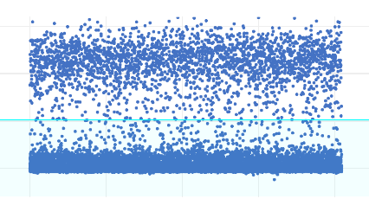
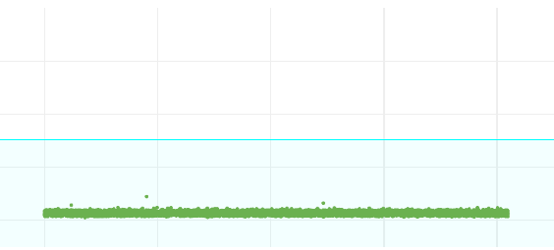
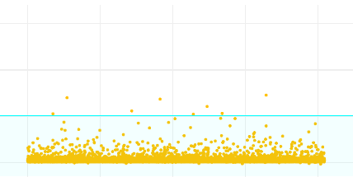
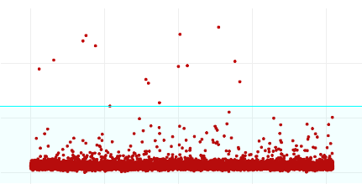
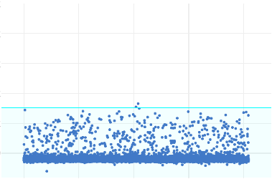
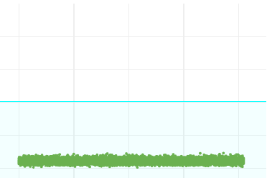
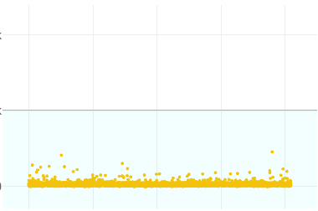
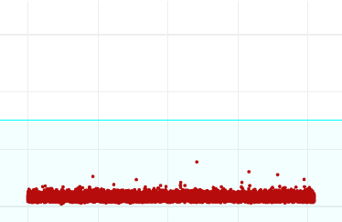
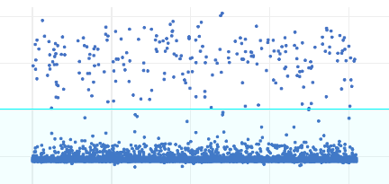
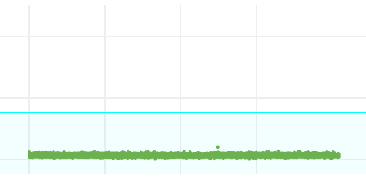
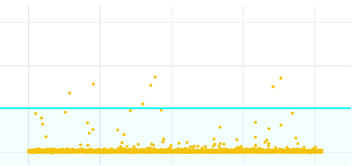
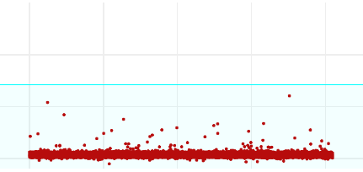
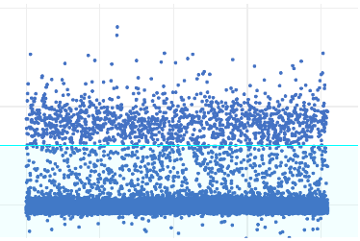
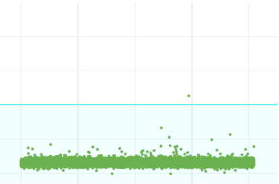
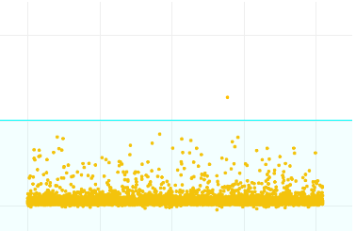
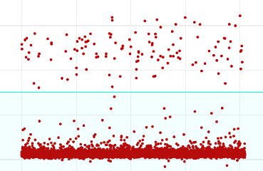
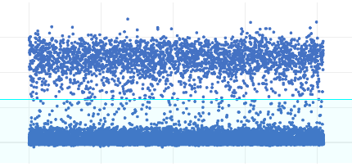
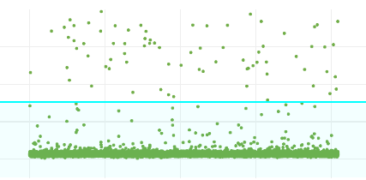
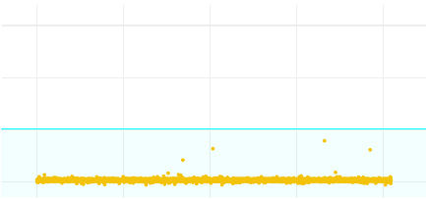
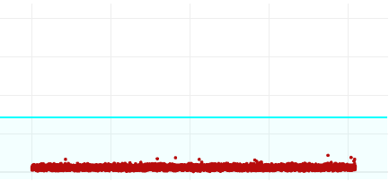
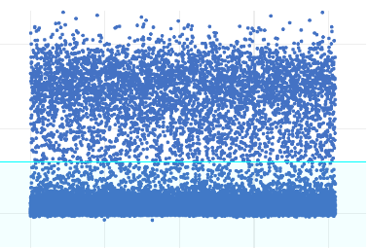
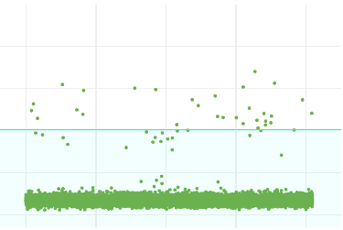
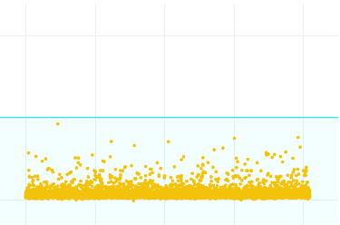
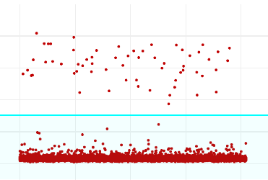
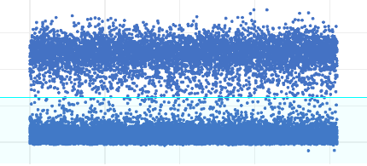
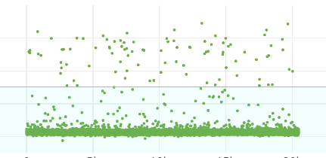






Testing on different biological matrices
Step 3
Serum samples (n=48)
Saliva samples (n=24)
single
assays
miRquad
single
assays
miRquad
miR 21-5p
miR 96-5p
miR 21-3p
miR 429
miR 21-5p
miR 96-5p
miR 21-3p
miR 429
baseline
baseline
Good
outcome
Good
outcome
miR 21-5p
miR 21-3p
Copies/ul
+15 days
+15 days
#61
#121
baseline
miR 96-5p
miR 429
baseline
Poor
outcome
Poor
outcome
Copies/ul
+15 days
+15 days
#153
#220
non recurrent
recurrent
For Research use only. Not for use in diagnostic procedures
7

Slide 8


Summary
miRNA multiplexing (Taqman™ chemistry) is a feasible and promising approach, particularly for dPCR
miRquad outperforms commercial single assays being faster, operator-friendly, reliable, and cost-effective
In HNCs, its potential application may refine clinical management predicting recurrence risk in the next future
Mucositis
Glioma diagnosis and prognosis
Common (up to 90%) adverse effect of chemo/radiotherapy
Alternative methods to surgery identifying gliomas are needed
Ongoing
projects
Patient discomfort and declined quality of life
Mutations in IDH1 gene shape patient prognosis but evolve upon therapy
Can lead to interruption or de-escalation of treatments
8

Slide 9





















Acknowledgements
Translational Oncology Research Unit
Otolaryngology-HNC Surgery
Thermo Fisher Scientific
qPCR/dPCR
patient
sampling
assay
development
Valentina
De Pascale
Federica
Ganci
Alina
Palcau
Raul
Pellini
Valentina Manciocco
Junko Stevens
David J.
Joun
Gianluca
Fascioli
Unit Director
Ongoing projects
project lead
mucositis
glioma
Giovanni
Blandino
Matteo Allegretti
Sabrina
Strano
Claudio
Pulito
Renata
Brandi
Ana Belen
Diaz
Giulia
Regazzo
9

