Slide 1


27th November 2024
ctDNA Response Evaluation Criteria for Solid Tumors (cRECIST)
and the GIM21 study (Gruppo Italiano Mammella)
Elena Giordani, PhD
Translational Oncology Research Unit
IRCCS National Cancer Institute Regina Elena
e-mail: elena.giordani@ifo.it

Slide 2
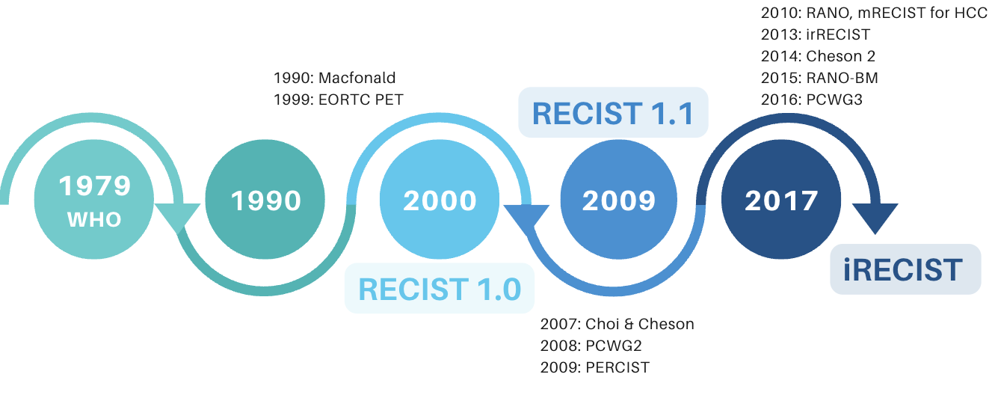

Implementing ctDNA in RECIST 1.1 scale remain an unmet medical need
EORTC RECIST working group (https://recist.eortc.org)
European Liquid Biopsy Society (www.ELBS.eu)
Friends of cancer research (https://friendsofcancerresearch.org)
ctDNA RECIST
RECIST 1.1
ctDNA RECIST (cRECIST)
ctDNA measurement
Size of individual tumor lesions averaged and turned into a discontinuous metric
ctDNA measurements turned into a discontinuous scale
mirror RECIST 1.1 into cRECIST
assign patient-specific outcomes by ctDNA
unlike RECIST 1.1 ctDNA is measured by most researchers on continuous scales
(copies/mL, VAF etc)
responders and non-responders differ in:
  baseline ctDNA
  on-treatment dynamic changes (𝚫VAF_{ot})
  Lead Time (LD): time between ctDNA increase and PD

Slide 3
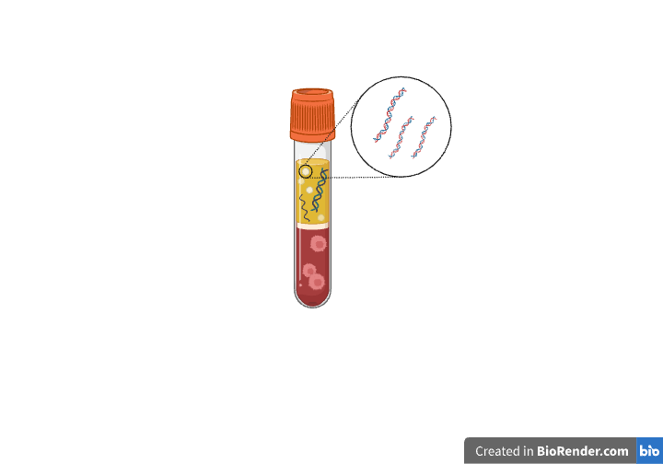
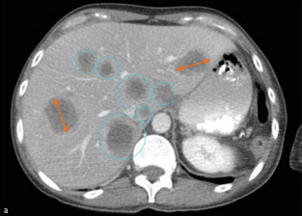
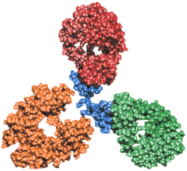

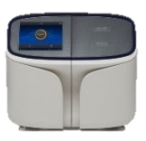
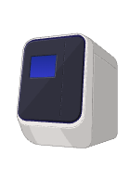
GIM21(NCT05735392 )
Imaging
RECIST 1.1
cRECIST
2018-2022
ctDNA
sum of all target lesions (diameters)
5 target lesions, max 2 per organ
non-target lesions noted
monitoring stops at PD
sum of all ctDNAs (VAF/CNV)
any ctDNA number
all ctDNAs are targets and noted
monitoring continues beyond cPD
Primary aim
to assess relationships between ctDNA changes and medical imaging (RECIST 1.1)
new lesion
size increase ≥ 20%
unequivocal non-target progression
ctDNA-informed
RECIST (cRECIST) metrics
PD
cPD
new ctDNA
Δ_{ctDNA} ≥ 20%
+20%
size 20% > < -30%
SD
-30%
cSD
Δ_{ctDNA} +20%> < -30%
size decrease ≥ -30%
PR
cPR
Δ_{ctDNA} ≥ -30%
index lesion = index ctDNA
all target and non-target lesions undetectable
CR
LoD
cCR
all ctDNAs undetectable
w₃
w₉
w₁
w₉
w₁₂
w₁₈
w₂₄
w₂₇
w₃₆
W_{n}
T-DM1 administration
(d21 cycles)
T₀
T₁
T₂
T₃
T₄
T₅
T₆
T_{n}
T_{p}
blood drawing
∑[VAF(T_{n}) + CN(T_{n})] - ∑[VAF(T_{ref}) + CN(T_{ref})]
CT scan
Δ_{ctDNA} =
x 100
∑[VAF(T_{ref}) + CN(T_{ref})]
targeted NGS
dPCR

Slide 4
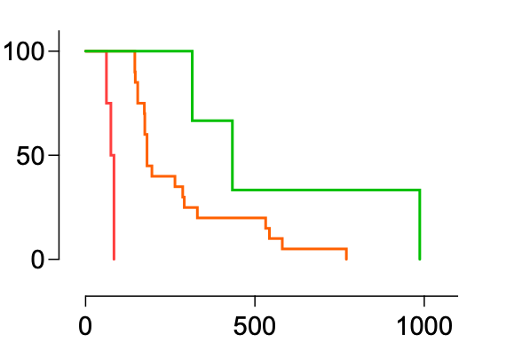
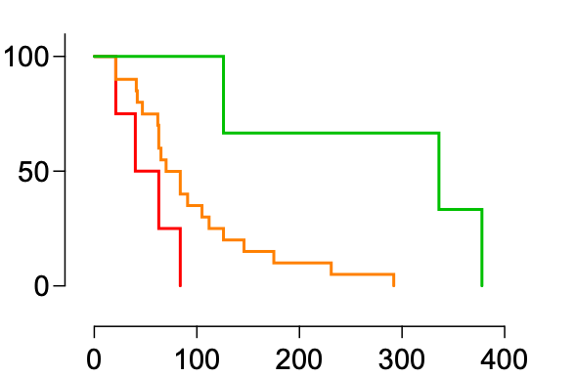
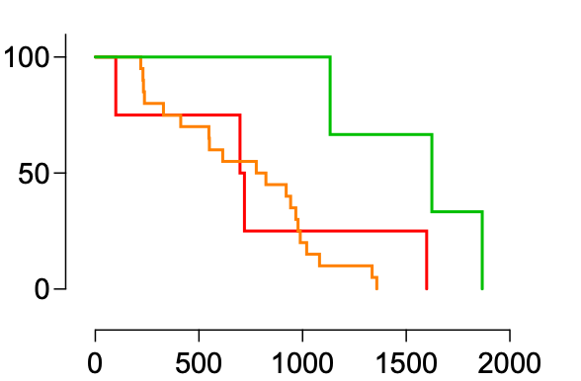
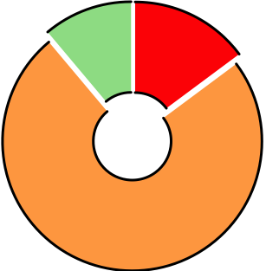
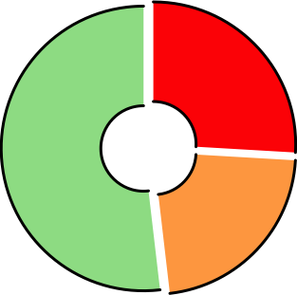
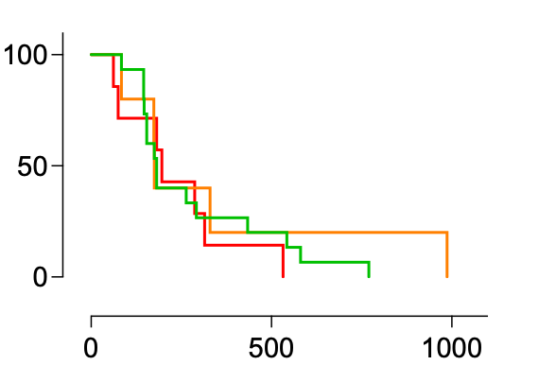
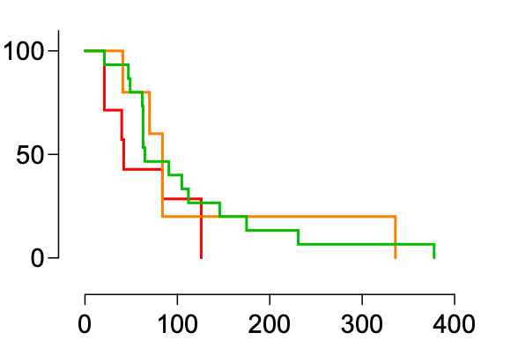
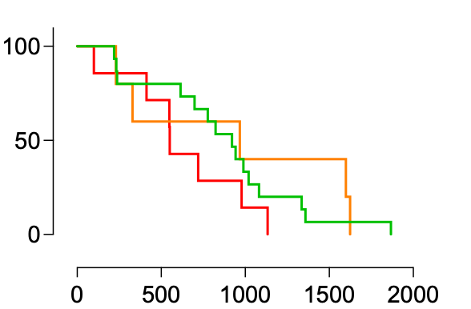
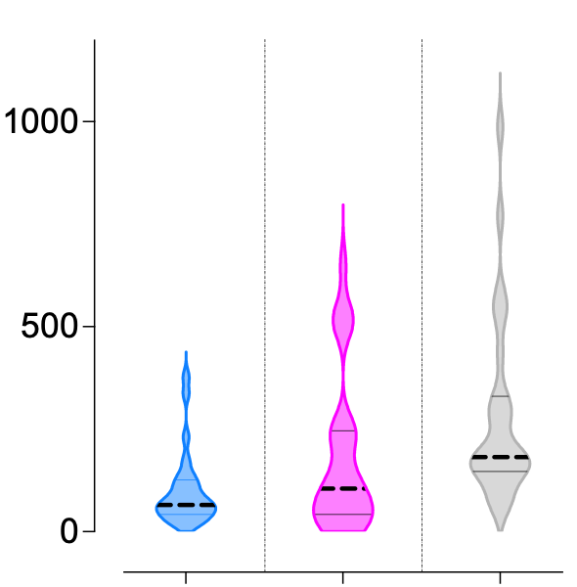
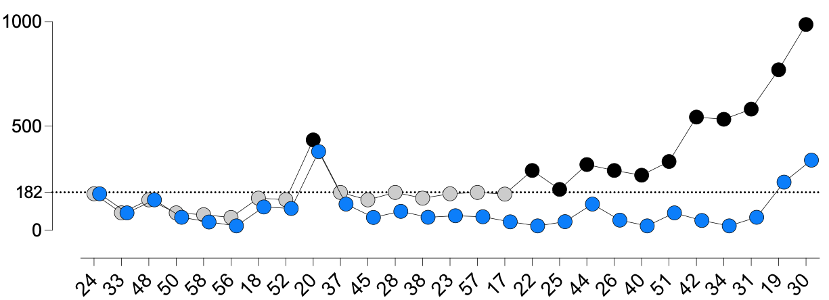
Beyond cRECIST
11%
p <0.0001
p = 0.0070
p = 0.0285
15%
best OR
patients (%)
74%
PD/cPD
SD/cSD
26%
PR/cPR - CR/cCR
best cOR
52%
patients (%)
p = 0.7090
p = 0.4388
p = 0.3141
22%
PFS (days)
cPFS (days)
OS (days)
PFS < 182 days
PFS > 182 days
cPFS
time to event (days)
105
182
median PFS
65
cPFS
(T₀ to cPD)
LT
(cPD to PD)
PFS
(T₀ to PD)

Slide 5
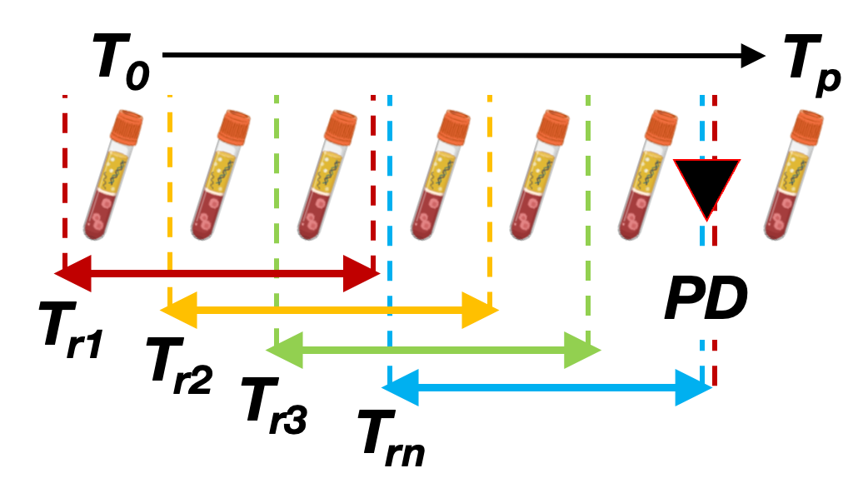
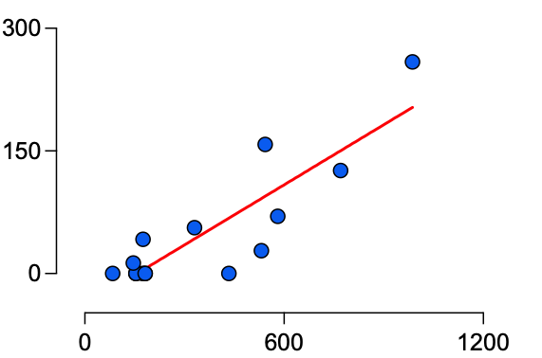
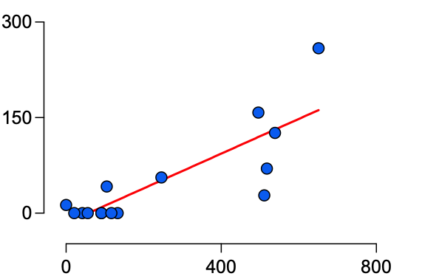

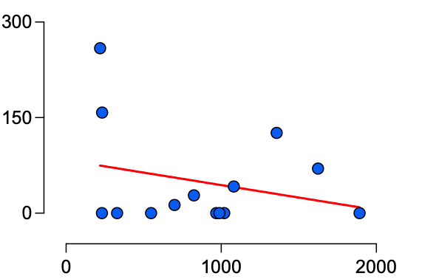
Combining cRECIST with ctDNA
to predict individual patient outcome
b
a
c
R² 0.76
R² 0.68
1st post-cPD decrease (days)
PFS (days)
LT (days)
PFS
no trend evaluable
de novo appereance
T_{nadir}
cPD
𝚫_{ctDNA} (T_{r}) decrease
𝚫_{ctDNA} (T_{r}) increase
first post-cPD 𝚫_{ctDNA} decrease
R² 0.08
no 𝚫_{ctDNA} decrease
OS (days)
Days of treatment

Slide 6
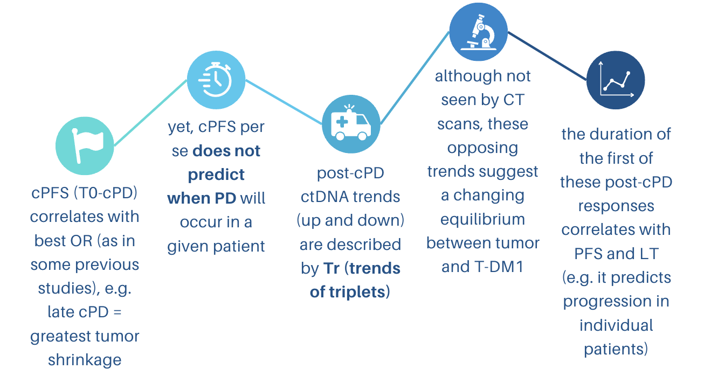
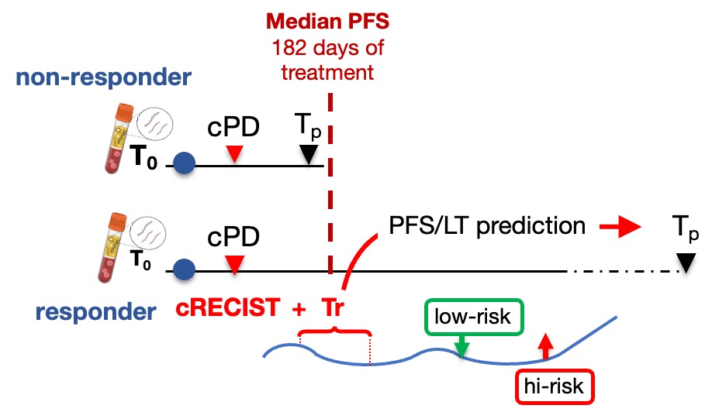
Conclusions
Implications
  clinical routine: Tr may help to evaluate patients for the risk of imminent PD
  drug registration: cPFS is an early surrogate for OR, much less for PFS, not at all for OS
  clinical trials: Tr may help randomizing responders for treatment discontinuation/switch/de-escalation
Limitations and perspectives
the GIM21 setting may not be generalized
low numerosity
target ctDNAs to be expanded in future studies

Slide 7
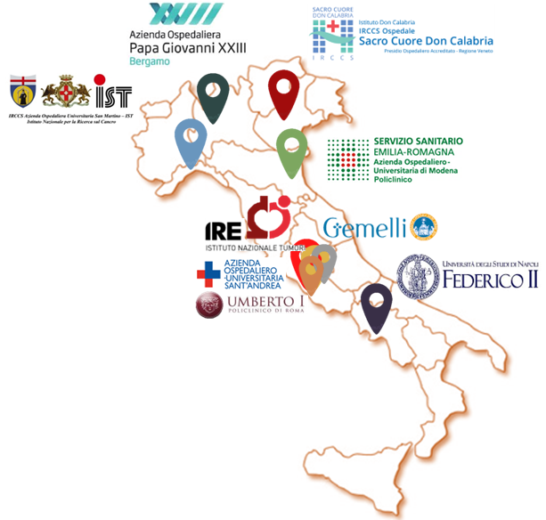



Acknowlwdgements
Main contributors
Elena Ricciardi
Translational Oncology Research Unit
elena.ricciardi@ifo.it
Patrizio Giacomini,MD
Precision Medicine Unit in Senology, patrizio.giacomini@guest.policlinicogemelli.it
Alessandra Fabi, MD (Principal Investigator)
Head of Precision Medicine Unit in Senology
alessandra.fabi@policlinicogemelli.it
Clinical Researchers
Gianluigi Ferretti, MD
Grazia Arpino, MD
Alberto Zambelli, MD
Claudia Omarini, MD
Ida Paris, MD
Andrea Botticelli, MD
Emilio Bria, MD
Antonella Palazzo, MD
Stefania Gori, MD
Special thanks to the ELBS ctDNA RECIST group for inspiration and great discussions
https://www.oncotech.org/gim21

