Slide 1



Nucleosome Positioning as a Prognostic Biomarker for Immune Checkpoint Inhibitor Response in Colorectal Cancer:
Insights from Shallow Whole Genome Sequencing.
Ana Belén Moreno Cárdenas, PhD student
Biomarkers and Clonal Dynamics Group
Notes:
Good afternoon everyone. The title of my talk is Nucleosome Positioning as a Prognostic Biomarker for Immune Checkpoint Inhibitor response in colorectal cancer: Insights from shallow whole genome sequencing.
1
1
1
1
1
1
1
1
1
1
1
1
1
1
1
1
1
1

Slide 2
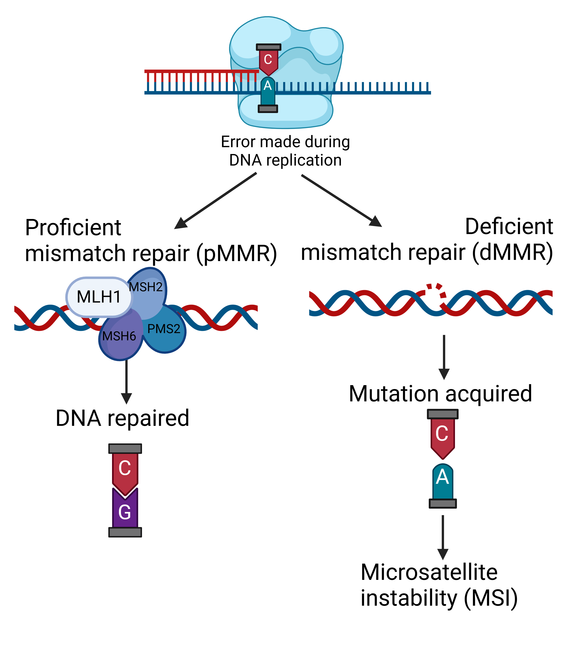
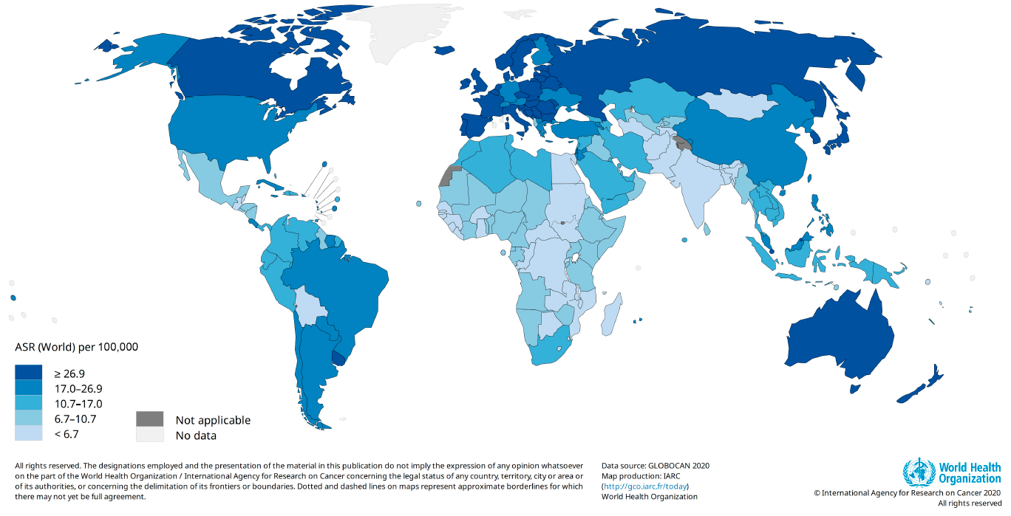
Introduction: Epidemiology and Molecular Classification of CRC
Colorectal cancer (CRC) is one of the most common solid cancers in developed countries, with approximatelly 1.8 million incident cases and 900.000 deaths every year worldwide.
Colorectal Cancer (CRC) can be categorized into:
Tumors that have high levels of microsatellite instability (dMMR-MSI-H; ~15%)
Tumors that have low levels of microsatellite instability (pMMR-MSI-L/MSS; ~85%)
A small percentage are POLE- mutated (~1-2%) and usually have low levels of microsatellite instability.
© Vall d'Hebron Institute of Oncology (VHIO)
Notes:
I will start with an introduction about epidemiology and molecular classification of colorectal cancer. Colorectal cancer is one of the most common solid cancers in developed countries, with 1.8 million of cases and nine hundred thousand deaths every year worldwide.
Colorectal cancer can be classified into tumors that are mismatch-repair-deficient and tumors that are mismatch-repair-proficient. POLE-mutated tumors are usually mismatch repair proficient.
2
2
2
2
2
2
2
2
2
2
2
2

Slide 3
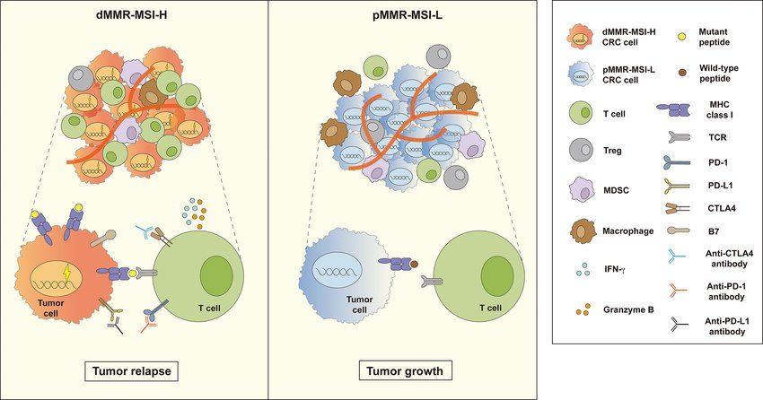
Introduction: Clinical Management of mCRC
The FDA has approved immunotherapy for metastatic colorectal cancer (mCRC) in patients with microsatellite instability-high (MSI)
This patients experience better tumor reduction after treatment with immune checkpoint inhibitors (ICIs) because are rich in tumor infiltrating lymphocytes (TILs) that release a large number of cytokines in the Tumor Microenvironment
However, the TME of MSS mCRC contains less functional TILs and more immunosuppressive cells.
POLE-mutated CRCs show potential for immune checkpoint inhibitor therapy because of their huge quantity of mutations
Shan J, Han D, Shen C, Lei Q, Zhang Y. Mechanism and strategies of immunotherapy resistance in colorectal cancer. Front Immunol. 2022 Sep 27;13:1016646. doi: 10.3389/fimmu.2022.1016646. PMID: 36238278; PMCID: PMC9550896.
Notes:
In terms of clinical management, the FDA has approved immunotherapy for metastatic colorectal cancer in mismatch repair deficient.
These patients experience better tumor reduction after treatment with immune checkpoint inhibitors, because are rich in tumor infiltrating lymphocytes that release cytokines in the tumor microenvironment.
However, the tumor microenvironment of mismatch repair proficient contains less functional TILS and more immunosuppresive cells. POLE-mutated tumors show potential for immune chekpoint inhibitor therapy.
Current research focuses on evaluating ICIs in various treatment settings, combining them with other therapies, and developing better biomarkers and strategies for patients with proficient mismatch repair.
3
3
3
3
3
3
3
3
3
3
3
3

Slide 4
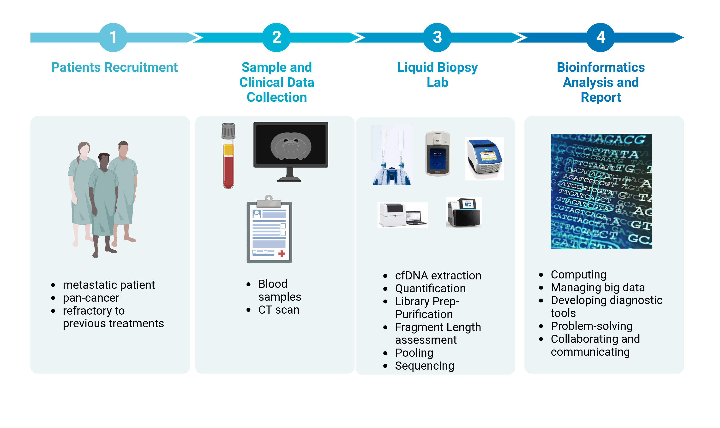

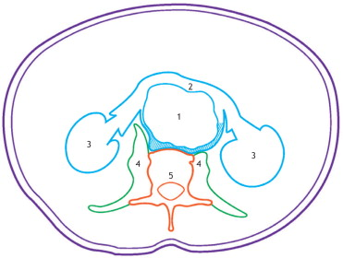

Methods: Sample/Data Collection and Processing
Baseline
PreC2
PreC3
TAC 1
PreC4
TAC 2
BEST RESPONSE
PD
TAC 3
PROGRESSION
IO
Cycle 1
IO Cycle 2
IO Cycle 3
IO Cycle 4
© Vall d'Hebron Institute of Oncology (VHIO)
Notes:
For our proyect, we collaborate with the VHIO's Research Unit for Molecular therapy. They recruit metastatic colorectal patients refractory to previous treatments for immunotherapy clinical trials in Phase 1. They also collect longitudinal samples and data.
We process the samples and perform the cfDNA extraction, quantification, library prep and ultra low pass whole genome sequencing. Then, we perform bioinformatics analyses.
4
4
4
4
4
4
4
4
4
4
4
4

Slide 5
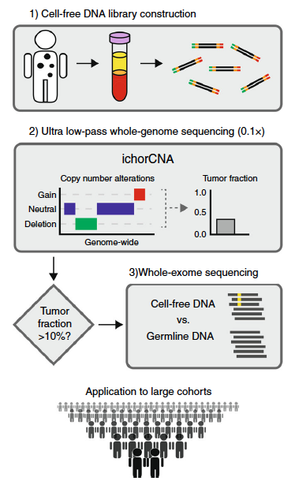
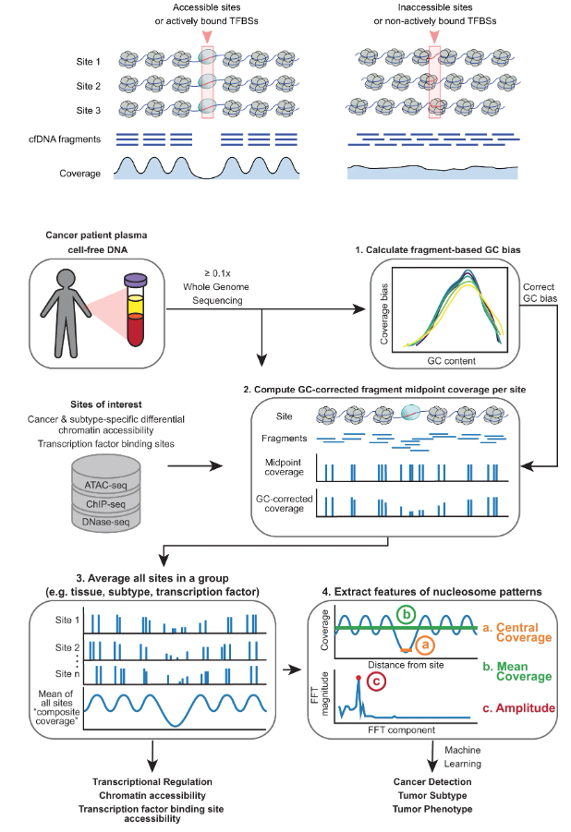
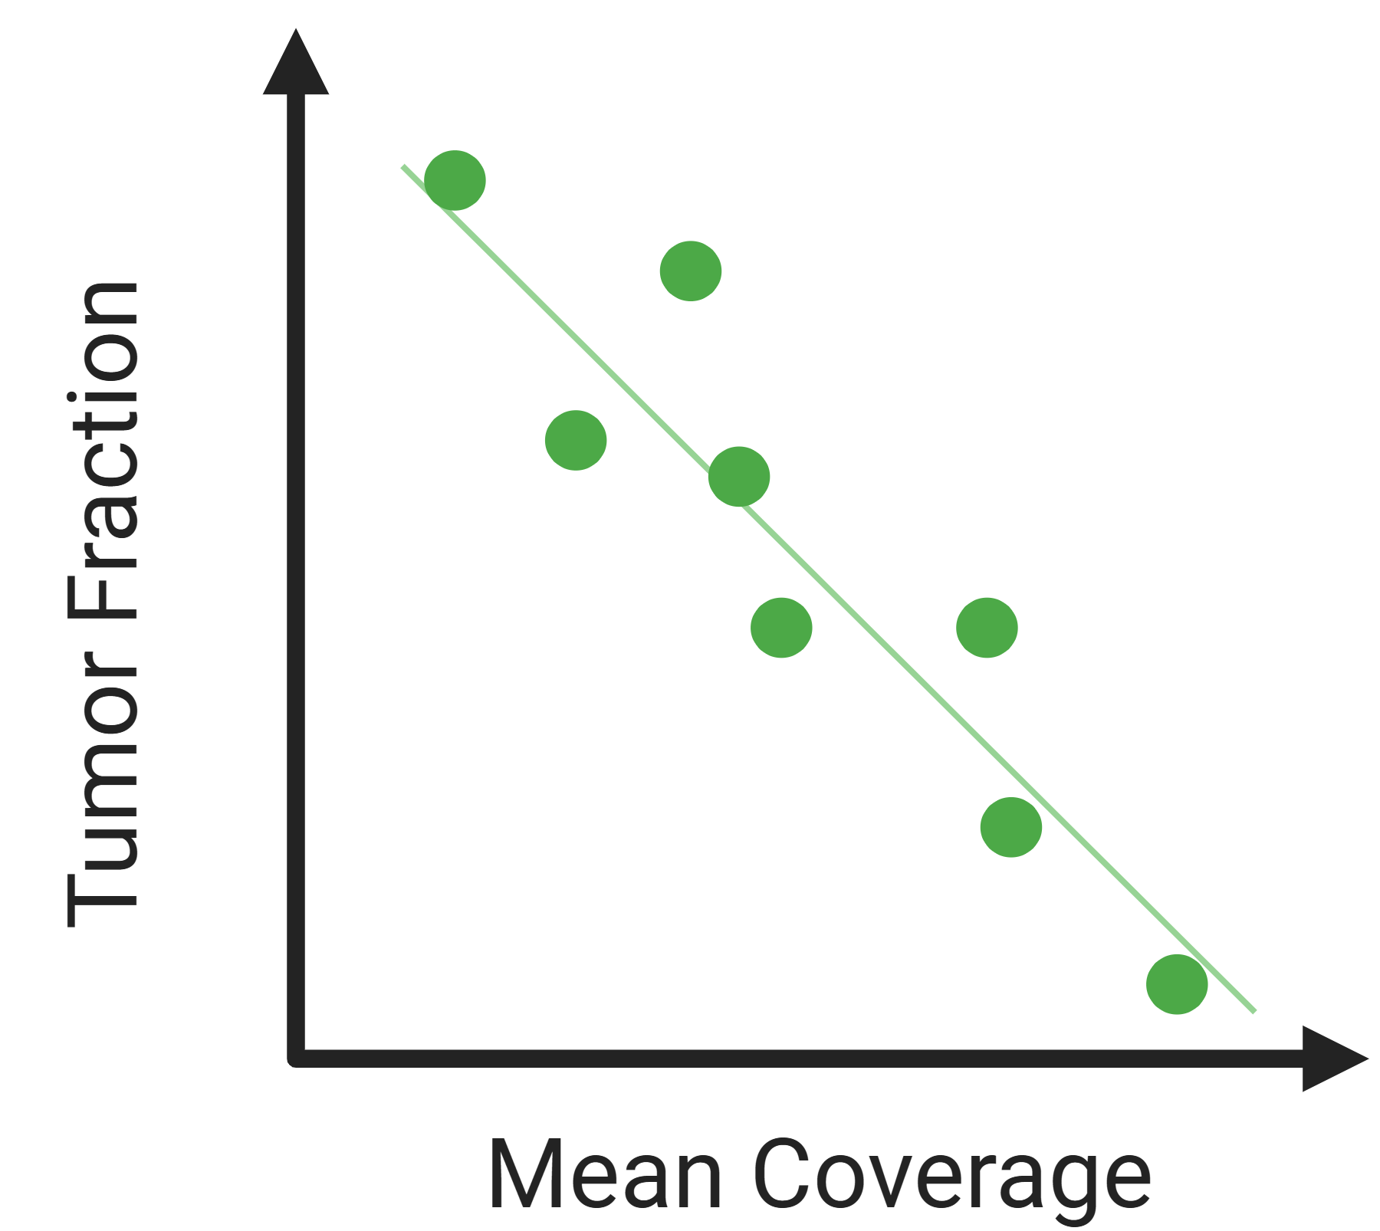
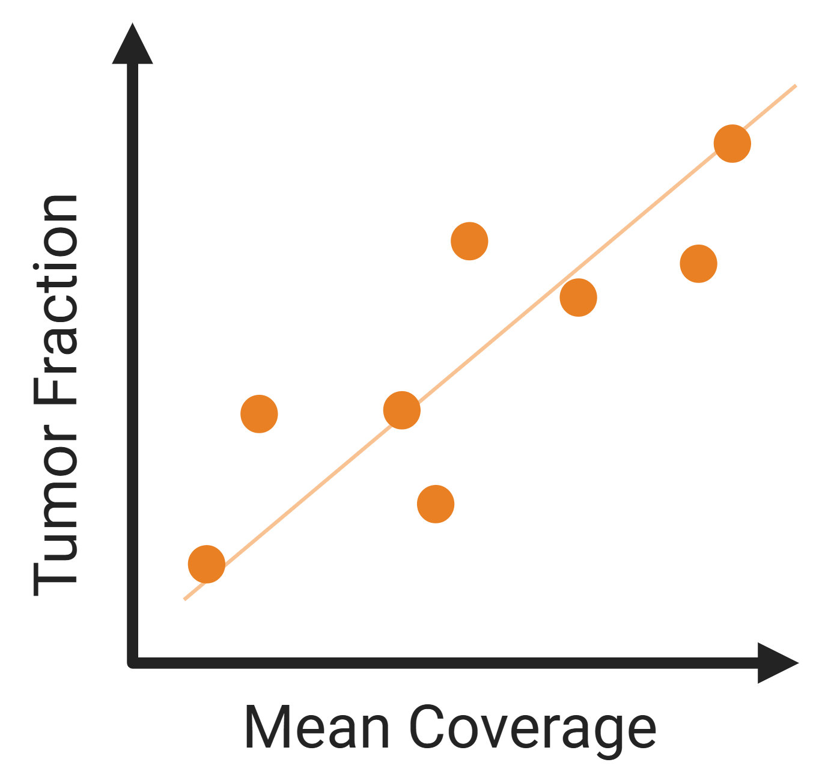
Methods: Bioinformatics Analysis
IchorCNA for Tumor Fraction calculation
2) Griffin for Mean Coverage calculation
3) Selection of 23 Transcription Factor Binding Sites (TFBS)
N = 21 TFBS
Adalsteinsson, V.A., Ha, G., Freeman, S.S. et al. Scalable whole-exome sequencing of cell-free DNA reveals high concordance with metastatic tumors. Nat Commun 8, 1324 (2017). https://doi.org/10.1038/s41467-017-00965-y
Doebley, AL., Ko, M., Liao, H. et al. A framework for clinical cancer subtyping from nucleosome profiling of cell-free DNA. Nat Commun 13, 7475 (2022). https://doi.org/10.1038/s41467-022-35076-w
N = 2 TFBS
© Vall d'Hebron Institute of Oncology (VHIO)
Notes:
The first step of the analysis is calculating the tumor fraction with IchorCNA pipeline. Then, we extract the features of the nucleosome positioning with Griffin pipeline. Transcription factor binding sites can be accesible or not, depending if the machinary of transcription is active. If the sites are accesible, the coverage in these sites are lower than in the sites that are not accesible due to DNase degradation activity. Finally, we selected 21 transcription factor binding sites with a strong negative correlation between tumor fraction and mean coverage, and 2 transcription factor binding sites with a strong positive correlation between tumor fraction and mean coverage. Note that in the negative correlation, more tumor fraction means less mean coverage.
5
5
5
5
5
5
5
5
5
5
5
5

Slide 6
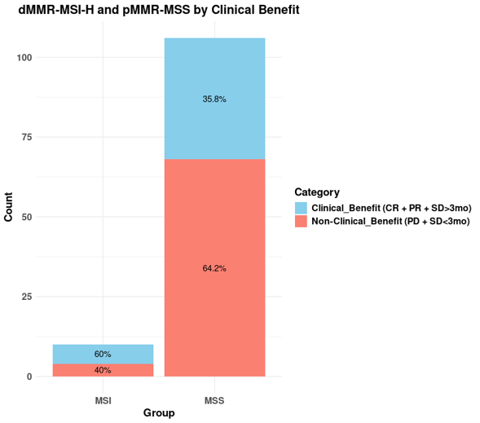
Results: Clinical Benefit in dMMR-MSI-H and pMMR-MSS CRC patients
In our cohort, patients with MSI mCRC shown significant benefits. 60% of patients had clinical benefit vs 40% of patient that did not.
Patients with MSS mCRC remained largely unresponsive (35.8% CB vs 64.2% nonCB).
© Vall d'Hebron Institute of Oncology (VHIO)
Notes:
In our cohort, mismatch repair deficient tumors shown significant benefits. 60% of patients had clinical benefit vs 40% of patient that did not.
Mismatch repair proficient tumors remained unresponsive (35.8% had CB vs 64.2% with nonCB).
6
6
6
6
6
6
6
6
6
6
6
6

Slide 7
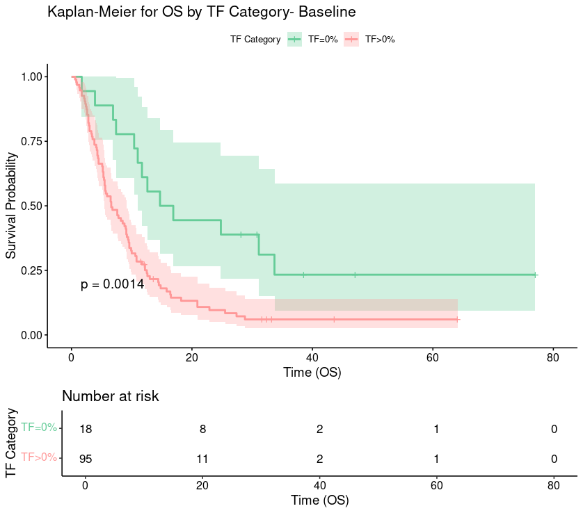
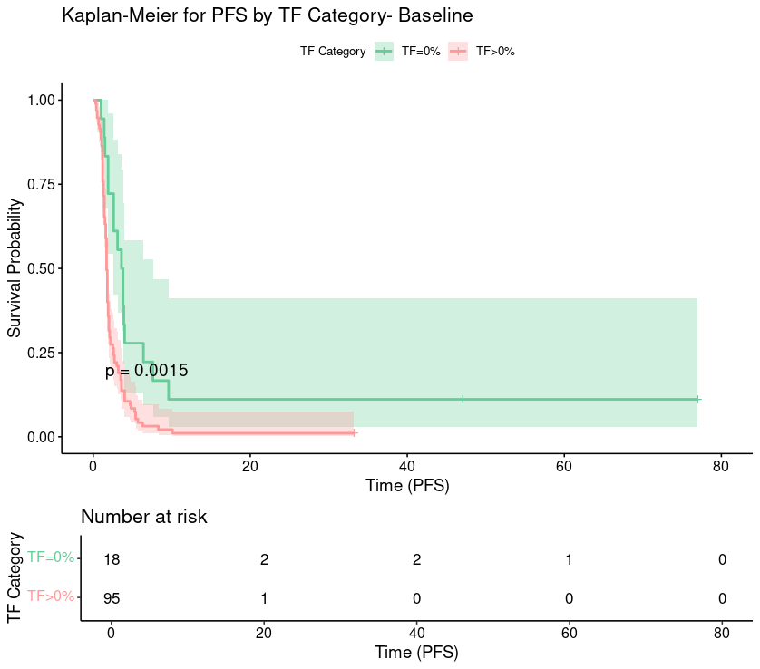
Results: Tumor Fraction positive correlates with decreased PFS and OS in mCRC treated with immunotherapy
HR = 2.56
HR = 2.55
Median OS:
TF = 0% -> 14.7 months (proportional 95% CI: 0.315-0.794).
TF > 0% -> 6.6 months (proportional 95% CI: 0.4038-0.606).
Median PFS:
TF = 0% -> 3.6months (proportional 95% CI: 0.32-0.79).
TF > 0% -> 1.7 months (proportional 95% CI: 0.4-0.6).
© Vall d'Hebron Institute of Oncology (VHIO)
Notes:
28/1/25
7
7
The detection of ctDNA before immunotherapy demonstrated significant prognostic value. The median overall survival (OS) in the group with TF = 0 was 14.7 months compared to 6.6 months in the TF > 0% group. Differences in OS were statistically significant, with an HR of 2.56.
Patients with TF = 0 also showed longer progression-free survival (PFS) compared to patients with TF > 0%, with a median PFS of 3.6 months versus 1.7 months. These differences were statistically significant, with an HR of 2.55.

Slide 8
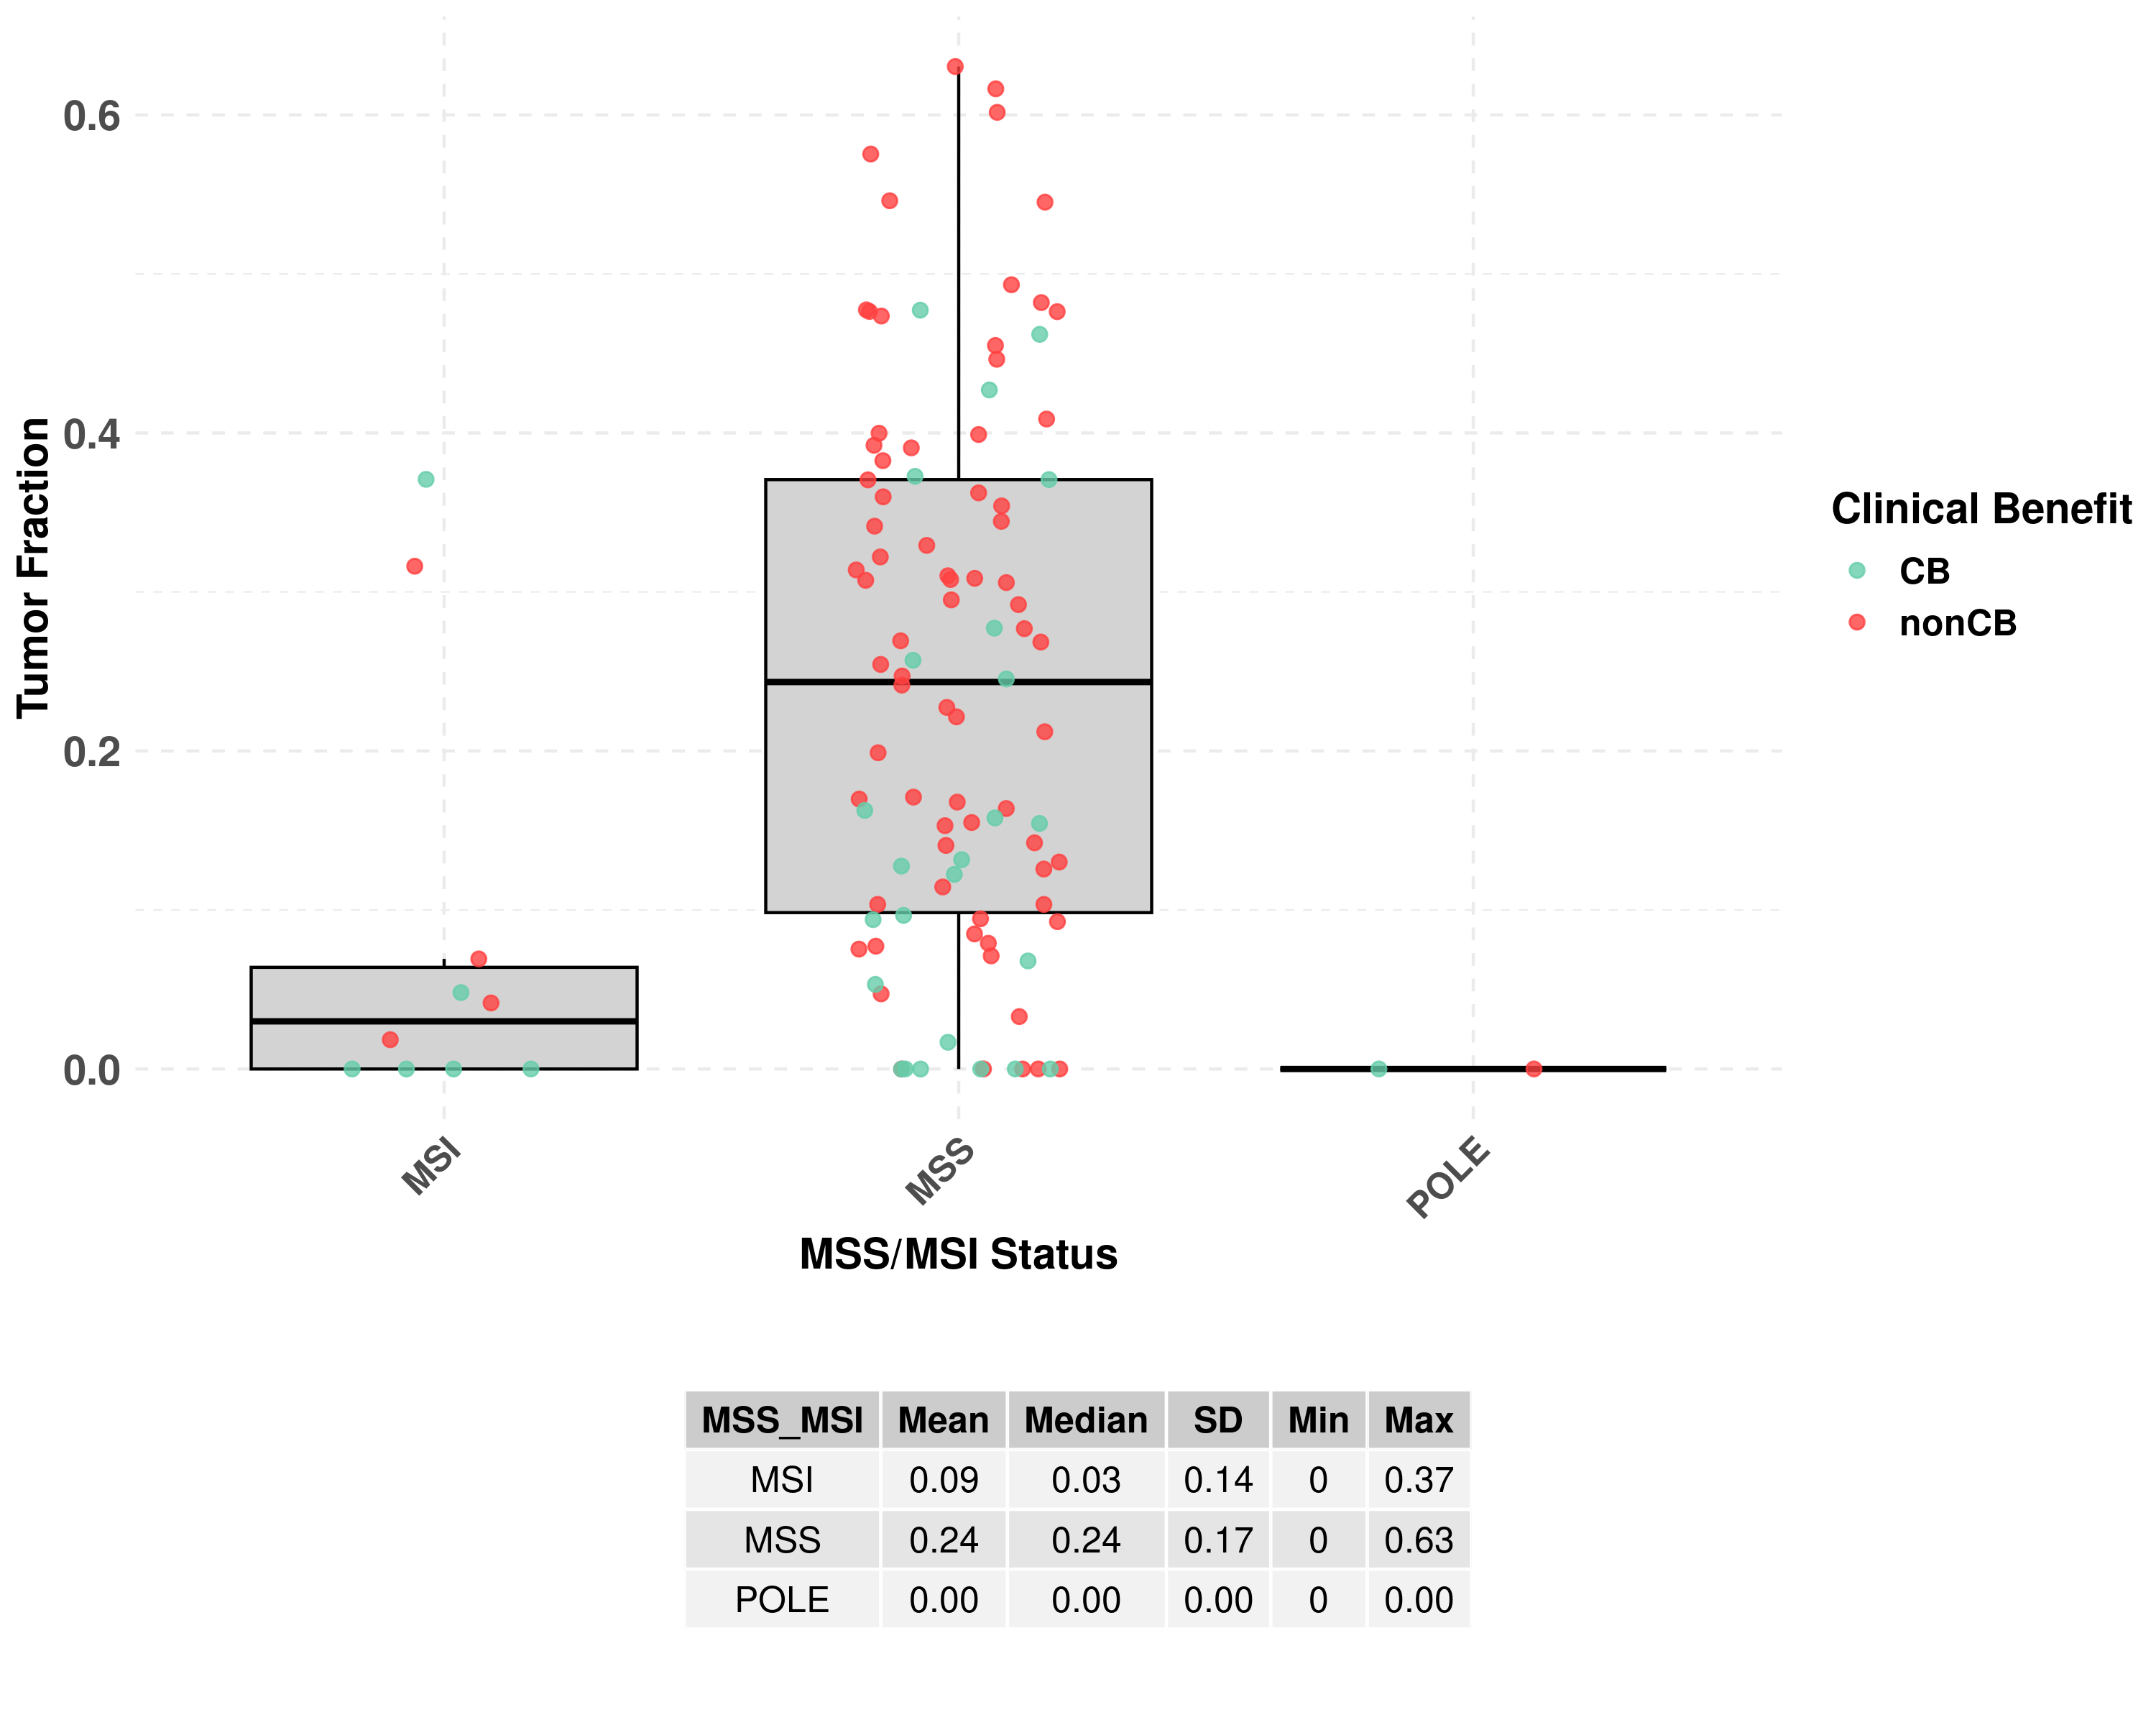
Results: Detection of Tumor Fraction at Baseline correlates with Clinical Benefit in MSI patients but don't correlate with Clinical Benefit in MSS mCRC patients
 | MSS |  | MSI
 | Clinical Benefit (CB) | Non-Clinical Benefit (nonCB) | Clinical Benefit (CB) | Non-Clinical Benefit (nonCB)
TF = 0% | 25% | 8,30% | 80% | 0%
TF > 0% | 75% | 91,70% | 20% | 100%
 | 100% MSS Clinical Benefit (CB) | 100% MSS Non-Clinical Benefit (nonCB) | 100 % MSI Clinical Benefit (CB) | 100% MSI Non-Clinical Benefit (nonCB)
2 patients presented mutations in POLE , both with TF= 0% at Pre-treatment. 1 patient had Clinical Benefit (50%) and the other one did not experience Clinical Benefit (50%).
© Vall d'Hebron Institute of Oncology (VHIO)
Notes:
28/1/25
8
8
If we take a look at the data, in the Mismatch repair deficient group: the tumor fraction is notably low, with most values close to 0.
Mismatch repair proficient group exhibits the highest variation in Tumor Fraction. The data points for Clinical benefit and non clinical benefit don't show an obvious pattern.
If we analyze the data we can see that in the Group of mismatch repair proficient
From patients who experienced clinical benefit, 25% were TF = 0 and 75% of patients were TF>0
From Patients without clinical benefit, 8.3% were TF = 0 and 91.7% were TF>0
In the Group of mismatch repair deficient
From patients who experienced clinical benefit, 80% were TF = 0 and 20% of patients were TF>0.
From patients without clinical benefit, 100% were TF>0
2 patients had mutations in POLE, both with TF= 0 at Pre-treatment. 1 patient had Clinical Benefit (50%) and the other one did not experience Clinical Benefit (50%).

Slide 9
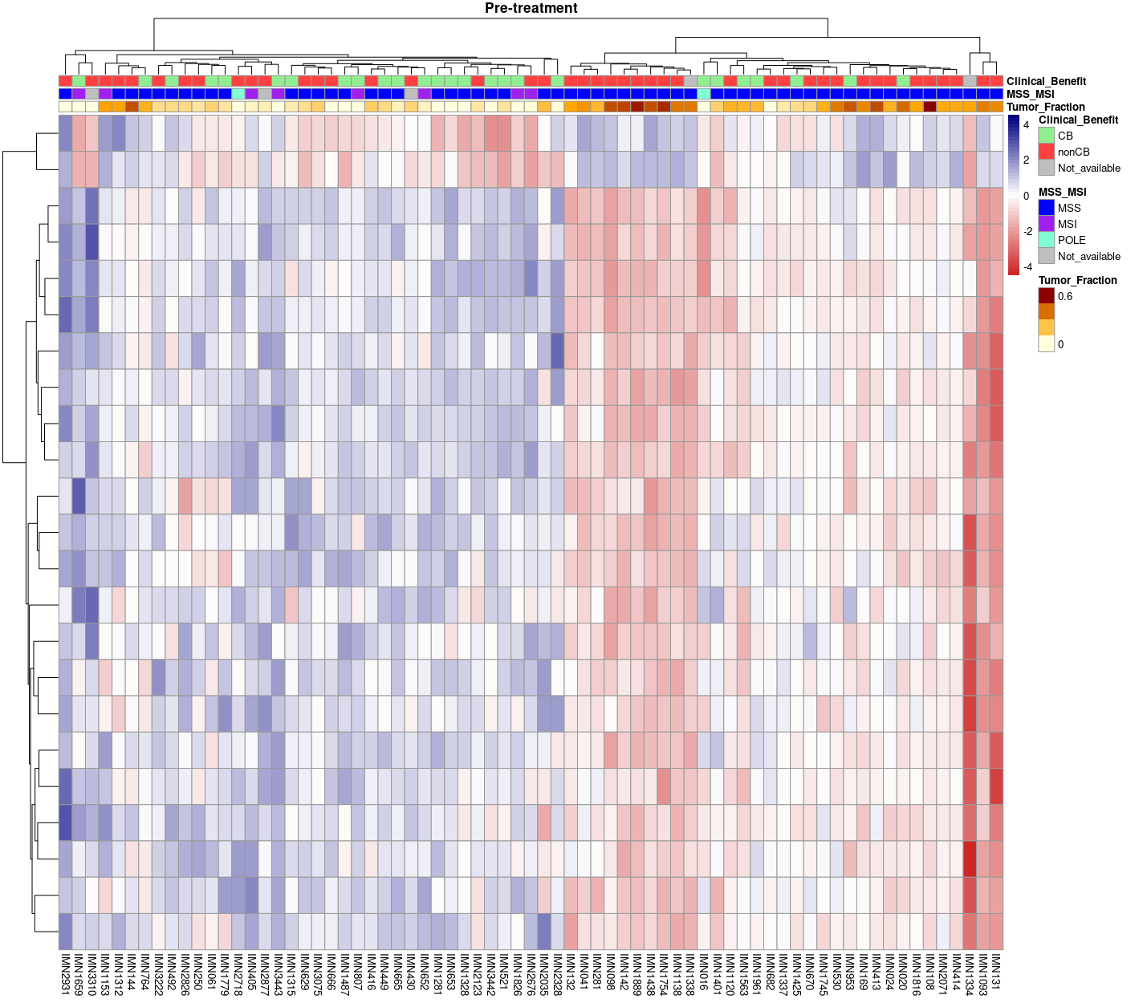
Results: Nucleosome Tumor Signal Profile could be associated with Clinical Benefit
In the Heatmap, we can distinguish between 2 clusters:
Low Tumor Signal Profile
High Tumor Signal Profile
Among patients with Clinical Benefit (CB):
73% of patients showed a "Low Tumor Signal " Profile
27% of patients showed a "High Tumor Signal" Profile
Among patients without Clinical Benefit (non-CB):
44.2% of patients showed a "Low Tumor Signal" Profile
55.8% of patients showed a "High Tumor Signal" Profile
Patients with Low Tumor Signal Profile show a higher proportion of Clinical Benefit.
In patients with High Tumor Signal Profile, we can not distinguish patterns of clinical benefit at Baseline.
Low Tumor Signal
High Tumor Signal
© Vall d'Hebron Institute of Oncology (VHIO)
Notes:
28/1/25
9
9
Here I show a Heatmap of Mean Coverage from the griffin pipeline
In the Heatmap, we can distinguish between 2 clusters:
Low Tumor Signal Profile
High Tumor Signal Profile
Among patients with Clinical Benefit (CB):
73% of patients showed a "Low Tumor Signal " Profile vs 27% of patients that showed a "High Tumor Signal" Profile at Baseline.
Among patients without Clinical Benefit (non-CB):
44.2% of patients showed a "Low Tumor Signal" vs 55.8% of patients that showed a "High Tumor Signal" Profile.

Slide 10
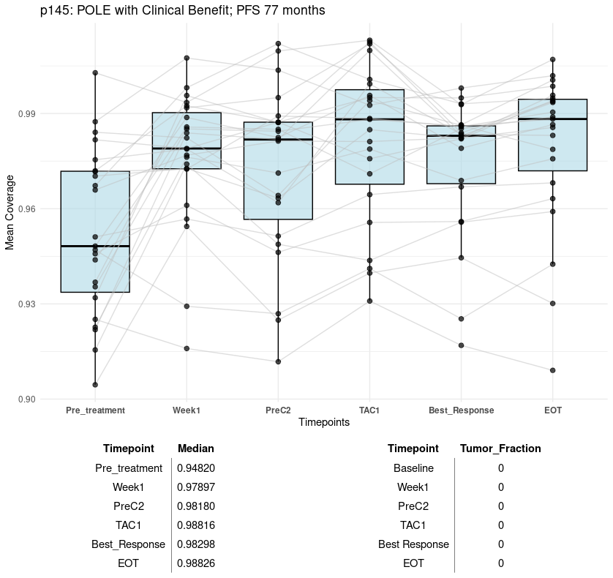
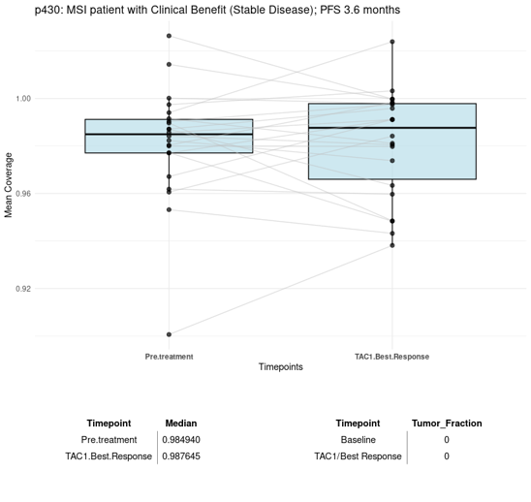
Results: Dynamics of Nucleosome-based signatures in longitudinal samples from Patients with Clinical Benefit
TF =0%
TF =0%
TF =0%
TF =0%
TF =0%
TF =0%
TF =0%
TF =0%
BOTH PATIENTS HAD CLINICAL BENEFIT: INCREASE OF THE MEAN COVERAGE MEANS LESS ACCESSIBILITY TO THE SITES ASSOCIATED WITH TUMOR SIGNAL
Notes:
28/1/25
10
10
We can use tumor fraction and mean coverage for monitorization of treatment.
On the left we can see a longitudinal analysis of mean coverage over multiple timepoints of immunotherapy treatment. This patient had a POLE mutation, with a prolonged PFS of 77 months.
The graph shows a progressive increasing of mean coverage from pre-treatment to subsequent timepoints, reaching the peak around TAC1 and maintaining the stability. (remember that the mean coverage have a negative correlation with site accessibility ). The tumor fraction remains zero along the treatment.
On the right we can see another POLE-mutated patient, in this case, without clinical benefit. The second timepoint shows a decrease of mean coverage and a increase of tumor fraction.

Slide 11
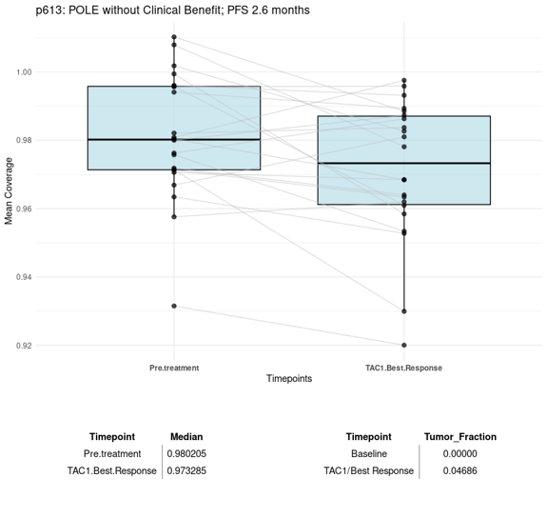
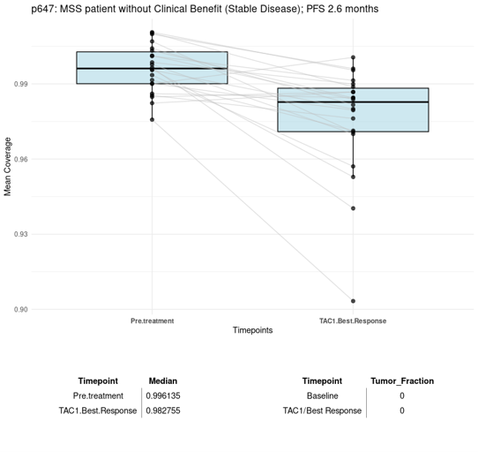
Results: Dynamics of Nucleosome-based signatures in longitudinal samples from Patients with Non- Clinical Benefit
TF =0%
TF =0%
TF =0%
TF =4%
BOTH PATIENTS HAD NON CLINICAL BENEFIT: DECREASE OF THE MEAN COVERAGE MEANS MORE ACCESSIBILITY TO THE SITES ASSOCIATED WITH TUMOR SIGNAL
© Vall d'Hebron Institute of Oncology (VHIO)
Notes:
28/1/25
11
11
So, mean coverage could be useful when tumor fraction is undetectable.
We have here another 2 examples. On the left, we have a mismatch repair deficient patient with clinical benefit. We can see here that the mean coverage in the second timepoint is increasing.
On the right, we have a mismatch repair proficient patient without clinical benefit. In the second timepoint we can see that the mean coverage is decreasing.

Slide 12
Conclusions
MSI and MSS classification have prognostic value for clinical benefit to immunotherapy in patients with Metastatic Colorectal cancer (mCRC).
~85% of patients are MSS and currently, there is a lack of prognostic/predictive biomarkers to immunotherapy for this molecular sub-group.
Tumor Fraction determination is a cost-effective approach with prognostic value for mCRC patients treated with immunotherapy, but in some cases, the sensibility of this approach is not enough.
Nucleosome positioning features from transcription factor binding sites, (i.e. Mean Coverage) could be useful in a cuantitative and qualitative way for immunotherapy treatment monitoring.
© Vall d'Hebron Institute of Oncology (VHIO)
Notes:
Mismatch repair classification have limited prognostic value for clinical benefit to immunotherapy in patients with Metastatic Colorectal cancer (mCRC). Moreover, ~85% of patients are mismatch repair proficient and currently, there is a lack of prognostic/predictive biomarkers to immunotherapy for this molecular sub-group.
Tumor Fraction determination is a cost-effective approach with prognostic value for metastatic colorectal patients treated with immunotherapy, but in some cases, the sensibility of this approach is not enough.
Nucleosome positioning features from transcription factor binding sites, (i.e. Mean Coverage) could be useful in a cuantitative and qualitative way for immunotherapy treatment monitoring.
12
12
12
12
12
12
12
12
12
12
12
12
12
12

Slide 13


Thank you!
Rodrigo Toledo, MBA PhD
Elena Garralda, MD PhD
Alma Calahorro, Lab Technician
Aya Louhamane, Lab Technician
Debayan Datta, Senior Bioinformatician
Alessandra Bonilla, Junior Bioinformatician
Carlota Arenillas, PhD Student
Armando Mel, Research Support Technician

