Slide 1
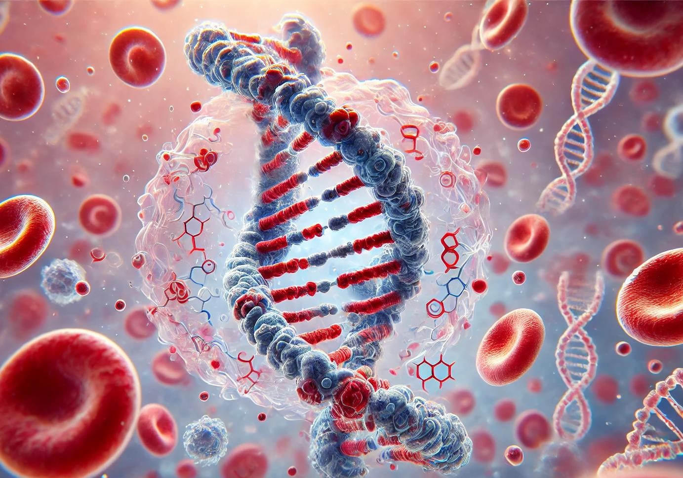

Evaluating the ctDNA ultrasensitive analysis detection and dynamics across solid tumors treated with immunotherapy
Alma M Calahorro
Biomarkers and clonal dynamics Group

Slide 2
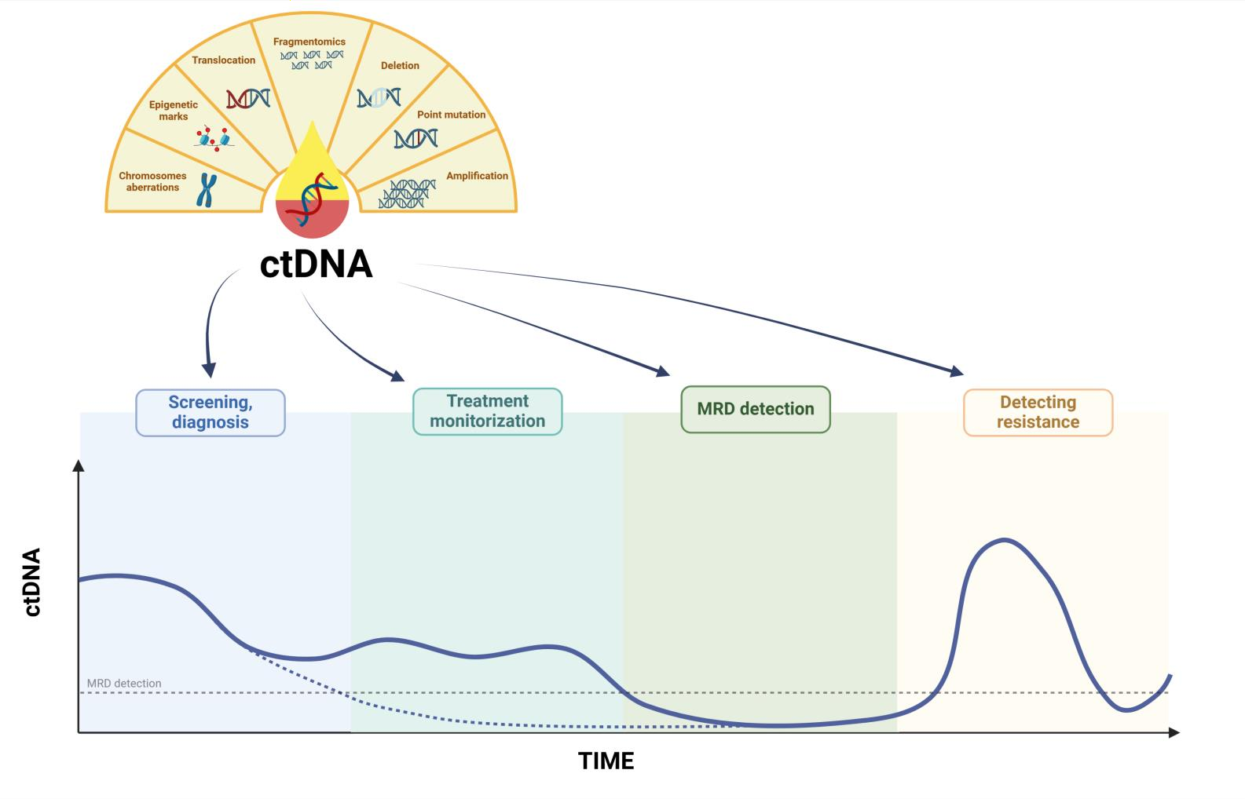
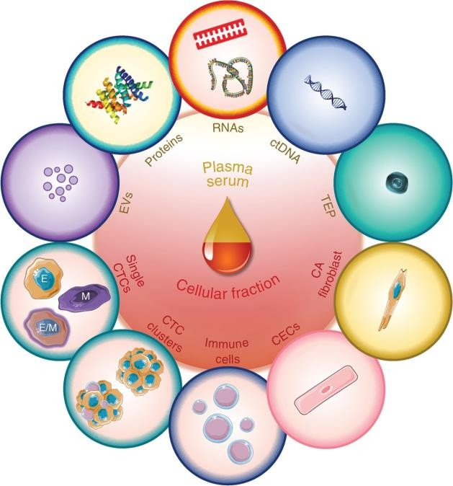
ctDNA as a biomarker in liquid biopsy of cancer research and its limitations
Cancer Discov. 2021;11(4):858-873. doi:10.1158/2159-8290.CD-20-1311
Limitations
X
-Challenging method’s standardization for clinical utility
X - Can provide false positives
X - Lack of sensitivity in ctDNA detection
Advantages
-Noninvasive
-Multi-analyte testing/combination of biomarkers
-High concordance with tissue biopsy
-Easily repeatable at various time points during
treatment
This is a modified figure from: García-Pardo, M., Makarem, M., Li, J.J.N. et al. Integrating circulating-free DNA (cfDNA) analysis into clinical practice: opportunities and challenges. Br J Cancer 127, 592–602 (2022). https://doi.org/10.1038/s41416-022-01776-9

Slide 3

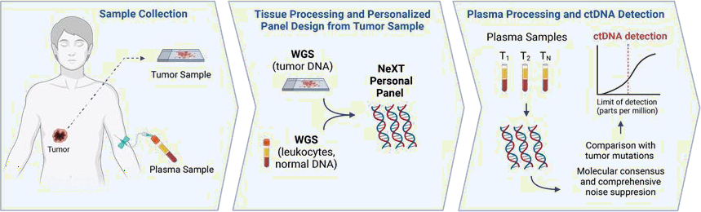

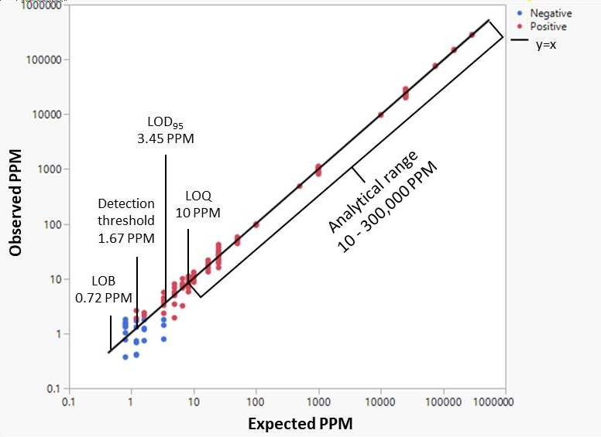
Patient panel creation and longitudinal plasma timepoints sequencing
Each patient get a personalized mutation panel.
Panels have a median of 1830 variants.
Mutation reads are quantified in Parts Per Million (PPM-ctDNA).
LODG5 (The concentration at which 95% of reading would be positively detected) for each patient.
If cuantification is less than LOD its determined that timepoint had no PPM- ctDNA detected.

Slide 4
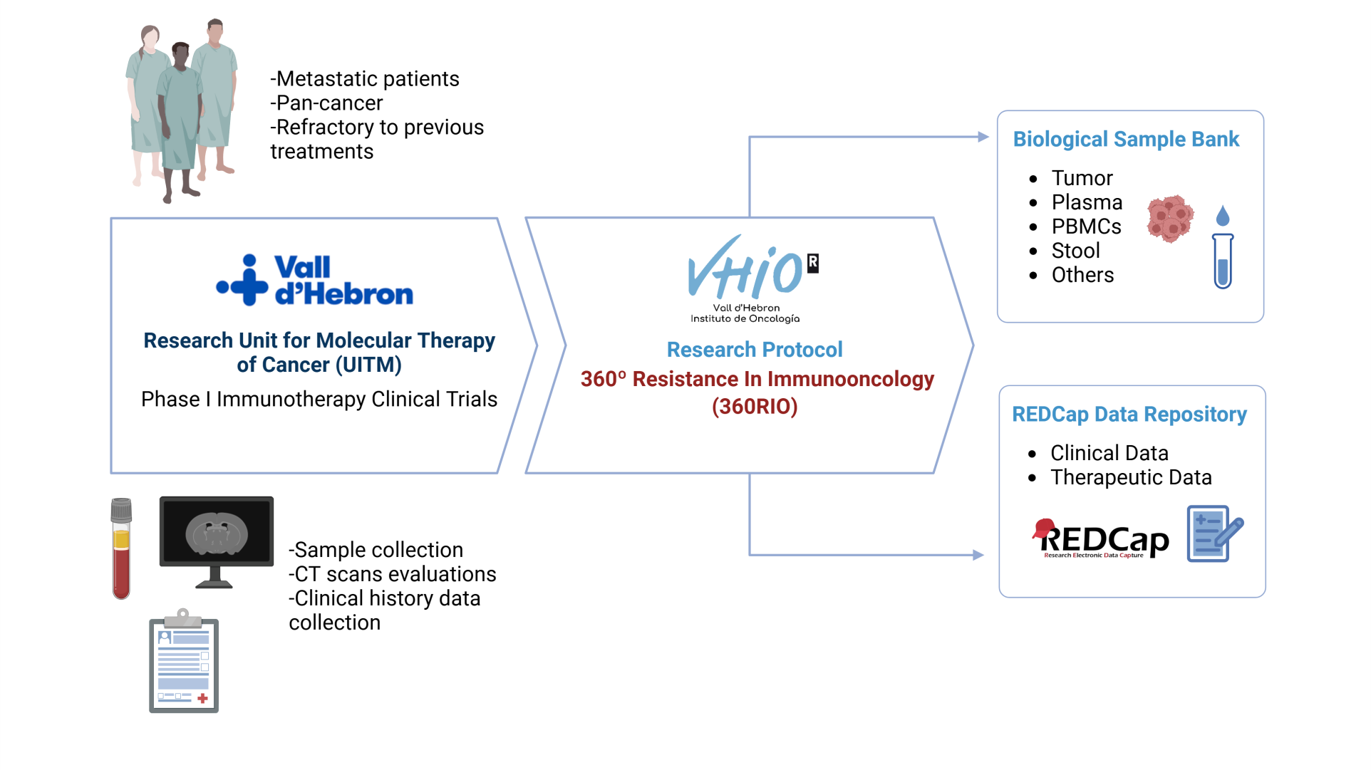
Patient recruitment and clinical data collection
HOMOGENEITY
Clinical data collection Clinical data evaluation Sample collection
Sample processing
Sample storage

Slide 5
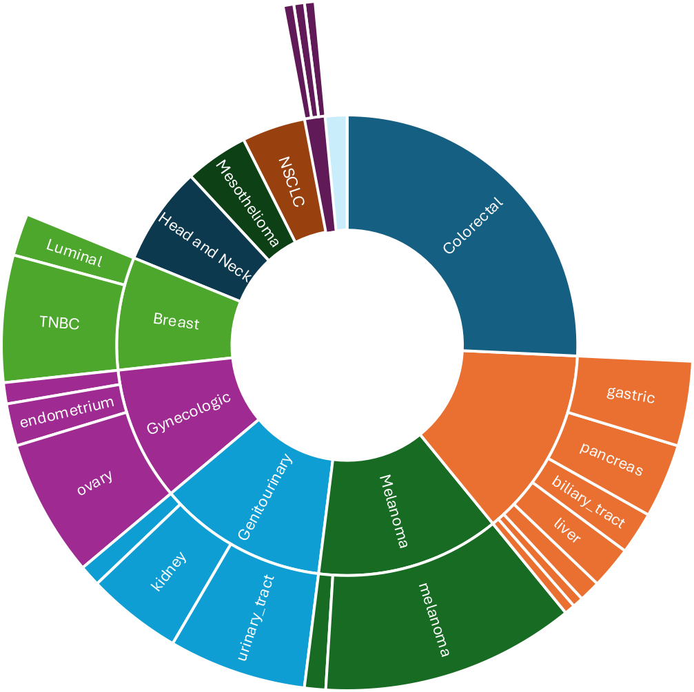
Cohort description
 |  | Overall | Primary | Validation | P-value
 |  | N=202 | N=136 | N=66
 |  | Patients (%) | Patients (%) | Patients (%)
Age (years ) median (IQR) |  | 63.0 (54.0 to 70.0) | 61.5 (53.0 to 69.2) | 64.5 (55.5 to 72.0) | 0,207
Previous antineoplastic lines |  | 198 (98.0) | 134 (98.5) | 64 (97.0) | 0,835
Previous immunotherapy |  | 99 (49.0) | 64 (47.1) | 35 (53.0) | 0,518
Cancer group | BC | 16 (7.9) | 13 (9.6) | 3 (4.5) | 0,047
 | CRC | 52 (25.7) | 40 (29.4) | 12 (18.2)
 | GI | 27 (13.4) | 15 (11.0) | 12 (18.2)
 | GU | 24 (11.9) | 13 (9.6) | 11 (16.7)
 | GYN | 19 (9.4) | 12 (8.8) | 7 (10.6)
 | ME | 9 (4.5) | 7 (5.1) | 2 (3.0)
 | MN | 26 (12.9) | 16 (11.8) | 10 (15.2)
 | NE | 3 (1.5) | 3 (2.2)
 | NSCLC | 9 (4.5) | 5 (3.7) | 4 (6.1)
 | SCCHN | 14 (6.9) | 12 (8.8) | 2 (3.0)
 | O | 3 (1.5) |  | 3 (4.5)
Gender | Female | 94 (46.5) | 61 (44.9) | 33 (50.0) | 0,591
 | Male | 108 (53.5) | 75 (55.1) | 33 (50.0)
ECOG | 0 | 102 (53.4) | 72 (56.7) | 30 (46.9) | 0,258
 | 1 | 89 (46.6) | 55 (43.3) | 34 (53.1)
Hepatic metastases at Baselin e | No | 90 (44.6) | 64 (47.1) | 26 (39.4) | 0,38
 | Yes | 112 (55.4) | 72 (52.9) | 40 (60.6)
Leukocytes (10^G/L) (Baselin emedian, IQR) |  | 6.9 (5.7 to 8.8) | 6.8 (5.7 to 8.6) | 7.3 (5.6 to 8.9) | 0,561
Neutrophils (10^G/L) (Baseline med ian, IQR) |  | 4.5 (3.6 to 5.9) | 4.5 (3.6 to 5.8) | 4.4 (3.6 to 6.1) | 0,636
Lymphocytes (10^G/L) (Baselin e median, IQR) |  | 1.4 (1.0 to 1.8) | 1.4 (1.1 to 1.8) | 1.4 (1.0 to 1.9) | 0,657
NL ratio (Baseline median , IQR) |  | 3.3 (2.4 to 4.6) | 3.3 (2.4 to 4.5) | 3.5 (2.5 to 4.7) | 0,467
dNLR (Baselin emedian, IQR) |  | 2.0 (1.5 to 2.6) | 1.9 (1.5 to 2.6) | 2.0 (1.5 to 2.7) | 0,68
LDH (UI/L) (Baselin e median, IQR) |  | 283.0 (213.5 to 463.0) | 295.0 (218.0 to 481.0) | 245.0 (208.0 to 366.0) | 0,069
Albumin (mg/L) (Baseline med ian, IQR) |  | 4.0 (3.8 to 4.2) | 4.0 (3.8 to 4.2) | 4.1 (3.9 to 4.3) | 0,06
Target lesions sum (Baselin emedian, IQR) |  | 105.0 (67.0 to 146.8) | 106.5 (64.2 to 146.2) | 101.5 (69.5 to 146.5) | 0,776
 |  | N (%) | N (%) | N (%)
BOR | CR | 3 (1.5) | 3 (2.2) |  | 0,117
 | PD | 112 (55.4) | 68 (50.0) | 44 (66.7)
 | PR | G (4.5) | 7 (5.1) | 2 (3.0)
 | SD | 78 (38.6) | 58 (42.6) | 20 (30.3)
Colorectal | 52
Gastrointestinal | 27
gastric | 8
pancreas | 7
liver | 4
biliary_tract | 4
anal | 2
vater_ampoule | 1
jejunum | 1
Melanoma | 26
melanoma | 24
uveal melanoma | 2
Genitourinary | 24
urinary_tract | 13
kidney | 9
prostate | 2
Gynecologic | 1G
ovary | 13
endometrium | 4
cervix | 2
Breast | 16
TNBC | 12
Luminal | 4
Head and Neck | 14
NSCLC | G
Melanoma | G
Neuroendocrine | 3
Others | 3
Chordoma | 1
unknown_primary | 1
Sarcoma | 1
202
patients

Slide 6
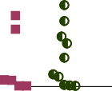





Evaluating PPM-ctDNA detection at Baseline in overall pan-cancer cohort
PPM by Tumor Group
20000
400000
15000
PPM
10000
PPM
5000
200000
0
NSCLC BC
CRC GU
NE
GI
GYN SCCHN O
MN
ME
Tumor Group
1000
800
600
400
200
0
NSCLC BC CRC GU NE GI GYN SCCHN O MN ME
Tumor Group
0
NSCLC BC
CRC GU
NE
GI GYN SCCHN O
MN
ME
Tumor Group
PPM
 | NSCLC | BC | CRC | GU | NE | GI | GYN | SCCHN | O | MN | ME
Number of values | 9 | 15 | 52 | 24 | 3 | 26 | 19 | 14 | 4 | 25 | 9
Minimum | 290.7 | 1337 | 0.000 | 0.000 | 2028 | 58.53 | 1539 | 51.94 | 2615 | 0.000 | 1.573
Maximum | 337899 | 517460 | 303631 | 225083 | 134325 | 291544 | 173853 | 172319 | 124994 | 153808 | 48991
Range | 337608 | 516123 | 303631 | 225083 | 132297 | 291486 | 172314 | 172267 | 122379 | 153808 | 48989
Mean | 141941 | 97683 | 95216 | 69576 | 60137 | 56470 | 48973 | 43048 | 42676 | 31260 | 8429
Std. Deviation | 133322 | 131597 | 79976 | 85022 | 67598 | 67591 | 51232 | 51159 | 57230 | 39870 | 17078
Std. Error of Mean | 44441 | 33978 | 11091 | 17355 | 39028 | 13256 | 11753 | 13673 | 28615 | 7974 | 5693

Slide 7
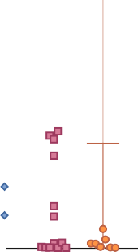





PPM at Baseline detection in a pan-cancer cohort
PPM by Tumor Gr
PPM by Tumor Group 20000
15000
10000
5000
0
NSCLC BC CRC GU NE GI GY
Tumor Group
CRC GU NE GI GYN SCCHN O MN ME
Tumor Group
GI GU GYN ME MN NE NSCLC O SCCHN
26 24 19 9 25 3 9 4 14
58.53 0.000 1539 1.573 0.000 2028 290.7 2615 51.94
31 291544 225083 173853 48991 153808 134325 337899 124994 172319
31 291486 225083 172314 48989 153808 132297 337608 122379 172267
6 56470 69576 48973 8429 31260 60137 141941 42676 43048
6 67591 85022 51232 17078 39870 67598 133322 57230 51159
oup
ctDNA dection at Baseline
400000
PPM
ctDNA Not detected ctDNA Detected
PPM
200000
N SCCHN O
MN
ME
PPM by Tumor
1000
800
600
400
200
0
NSCLC BC CRC GU NE GI G
Tumor Group
Group
0
98%
NSCLC BC
PPM
Number of values 15
BC
CRC
52
Minimum Maximum
1337
517460 3036
516123 3036
0.000
YN SCCHN O
MN
ME
Range
Mean
Std. Deviation
97683 9521
131597 7997
Std. Error of Mean
33978 11091 13256 17355 11753 5693 7974
39028 44441 28615 13673

Slide 8
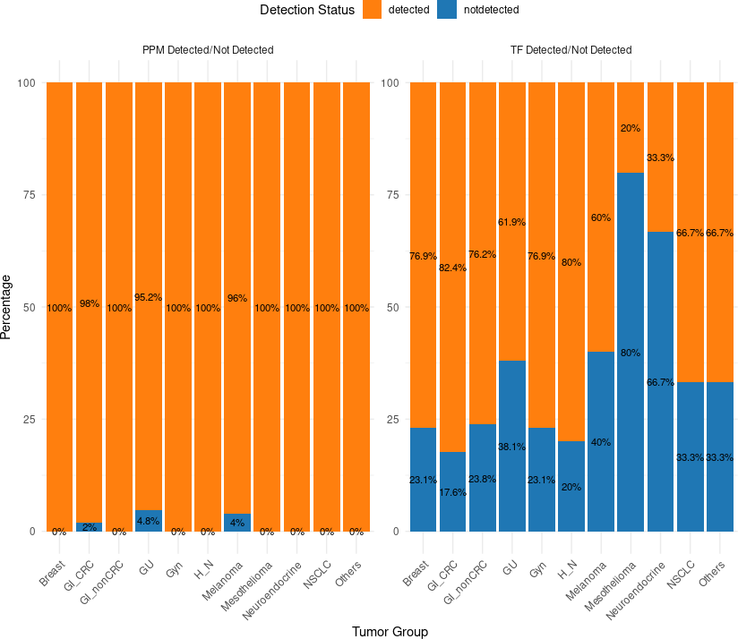
Comparative of TF and PPM detection at Baseline
 | PPM-ctDNA |  | Tumor Fraction
 | Not detected | Detected | Not detected | Detected | Total
GI_CRC | 1 (2%) | 50 (98%) | 9 (17,6%) | 42 (82,4%) | 51
Melanoma | 1 (4%) | 24 (96%) | 10 (40%) | 15 (60%) | 25
GU | 1 (4,8%) | 20 (95,2%) | 8 (38,1%) | 13 (61,9%) | 21
GI_nonCRC | (0%) | 21 (100%) | 5 (23,8%) | 16 (76,2%) | 21
H&N | (0%) | 15 (100%) | 3 (20%) | 12 (80%) | 15
Breast | (0%) | 13 (100%) | 3 (23,1%) | 10 (76,9%) | 13
Gyn | (0%) | 13 (100%) | 3 (23,1%) | 10 (76,9%) | 13
NSCLC | (0%) | 9 (100%) | 3 (33,3%) | 6 (66,7%) | 9
Mesothelioma | (0%) | 5 (100%) | 4 (80%) | 1 (20%) | 5
Others | (0%) | 3 (100%) | 1 (33,3%) | 2 (66,7%) | 3
Neuroendocrine | (0%) | 3 (100%) | 2 (66,7%) | 1 (33,3%) | 3
Total | 3 (1,7%) | 176 (G8,3%) | 51 (28,5%) | 128 (71,5%) | 17G

Slide 9


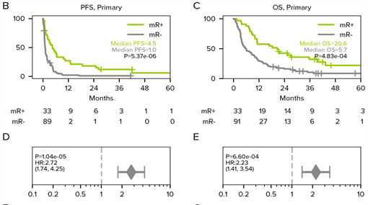
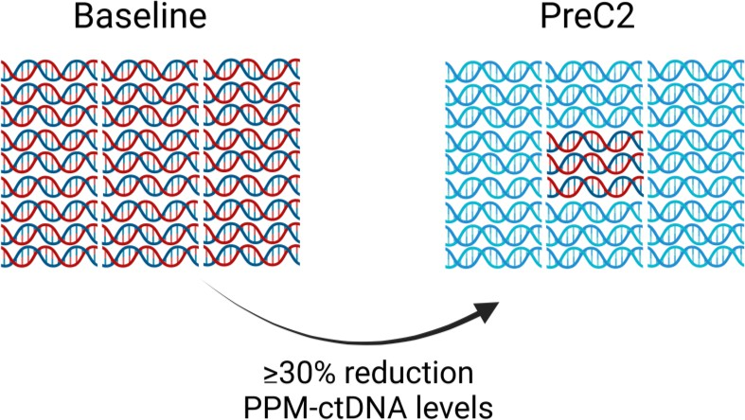


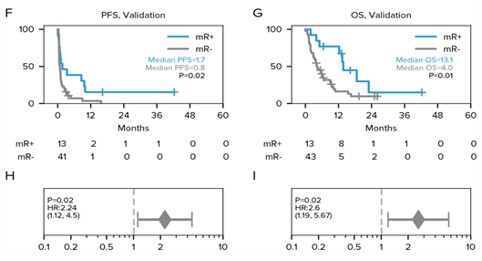




PPM-ctDNA early timepoint dynamics
Molecular Response (mR) criteria
ctDNA molecular Response in early timepoints correlates with better clinical outcomes

Slide 10




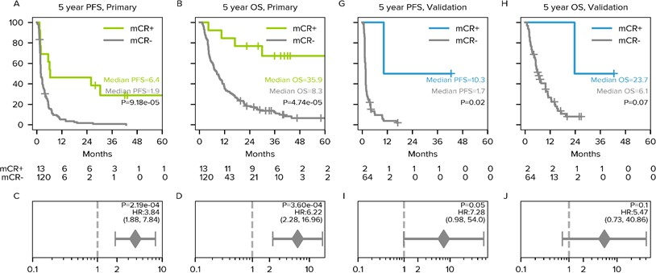





PPM-ctDNA Molecular Clearance during treatment
ctDNA Molecular Clearance (mCR):
At least one timepoint with undetected ctDNA during treatment
ctDNA Molecular Clearance (mCR) correlates with prolonged survival

Slide 11
Pseudoprogressor patient Case Report

Slide 12
Conclusions/Key Takeaways
Using the ultrasensitive analysis we substantially improved the ctDNA signal
detection across our pan-cancer cohort.
Ultrasensitive ctDNA molecular Response (mR) in early timepoints correlates
with better clinical outcomes.
Ultrasensitive ctDNA Molecular Clearance (mCR) correlates with prolonged survival
Ultrasensitive ctDNA is a tool for pseudoprogressor patient detection

Slide 13
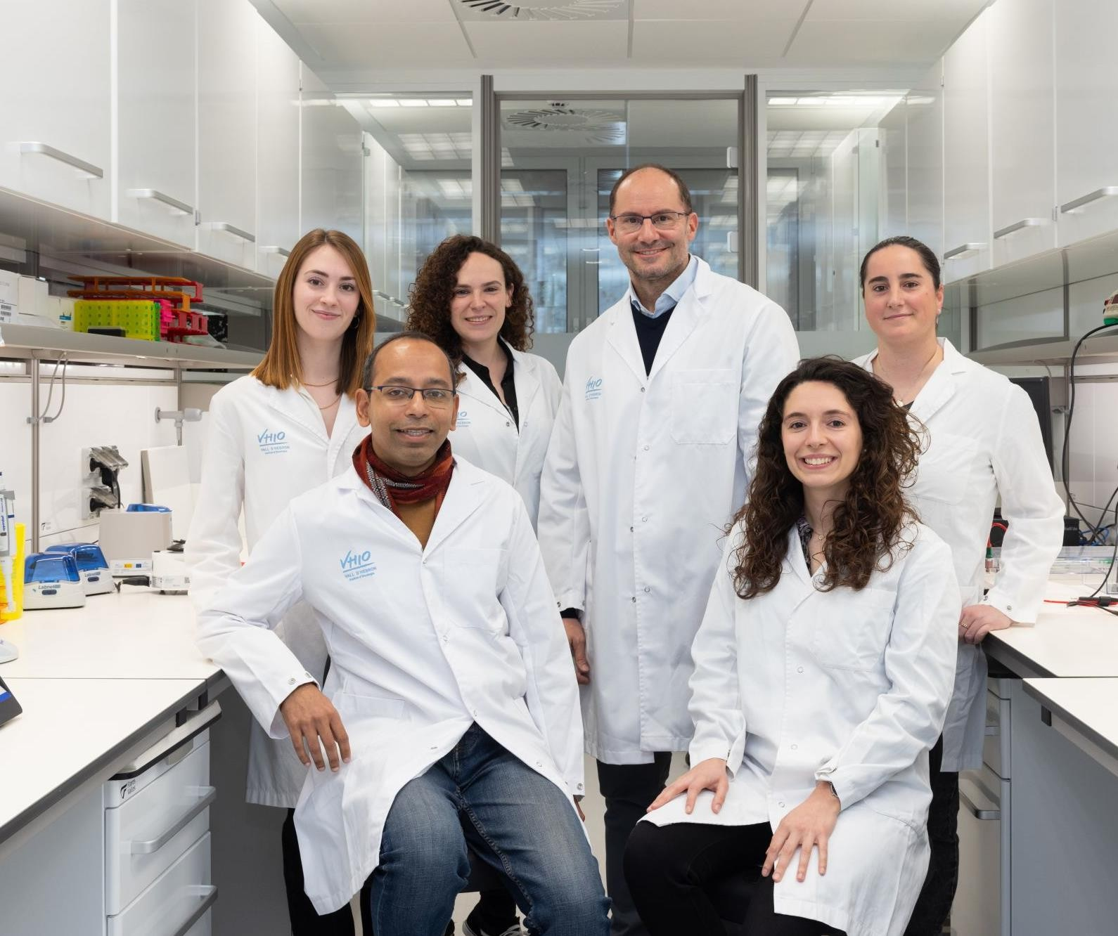
Biomarkers and Clonal dynamics Group
Thank you!
Acknowledgements: Rodrigo Toledo
Elena Garralda Ana Belén Moreno Carlota Arenillas Debayan Datta Aya Louhamane Alessandra Bonilla
Personalis Inc Team

