Slide 1


A novel and sensitive approach for EV surface protein characterization
Molecular Diagnostics
AIT Austrian Institute of Technology
Christa Nöhammer, PhD
christa.noehammer@ait.ac.ac

Slide 2
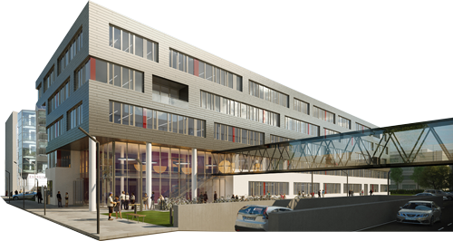
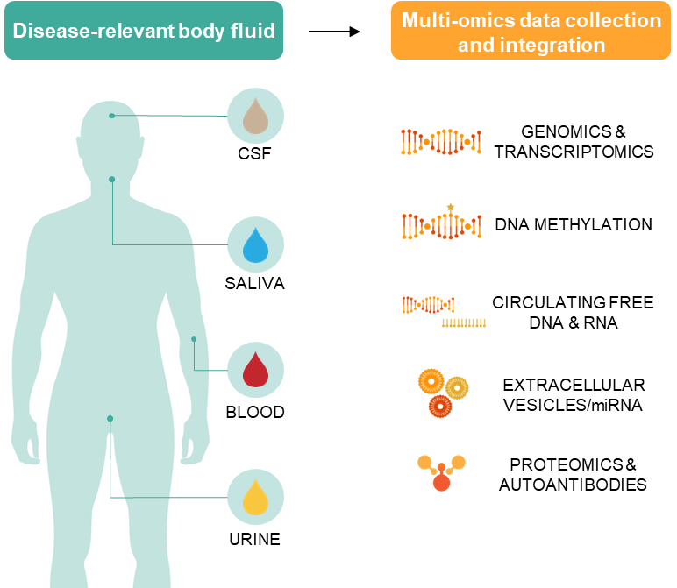


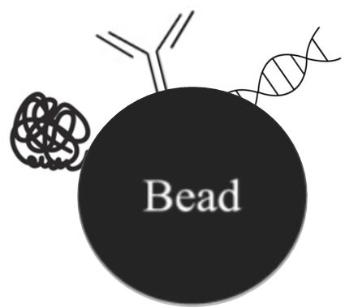




MOLECULAR DIAGNOSTICS UNIT
Austria‘s largest
RTO
MINIMALLY INVASIVE BIOMARKERS
over
employees
1,500
60
www.molecular-diagnostics.ait.ac.at
#employees
& students:
Christa Nöhammer

Slide 3

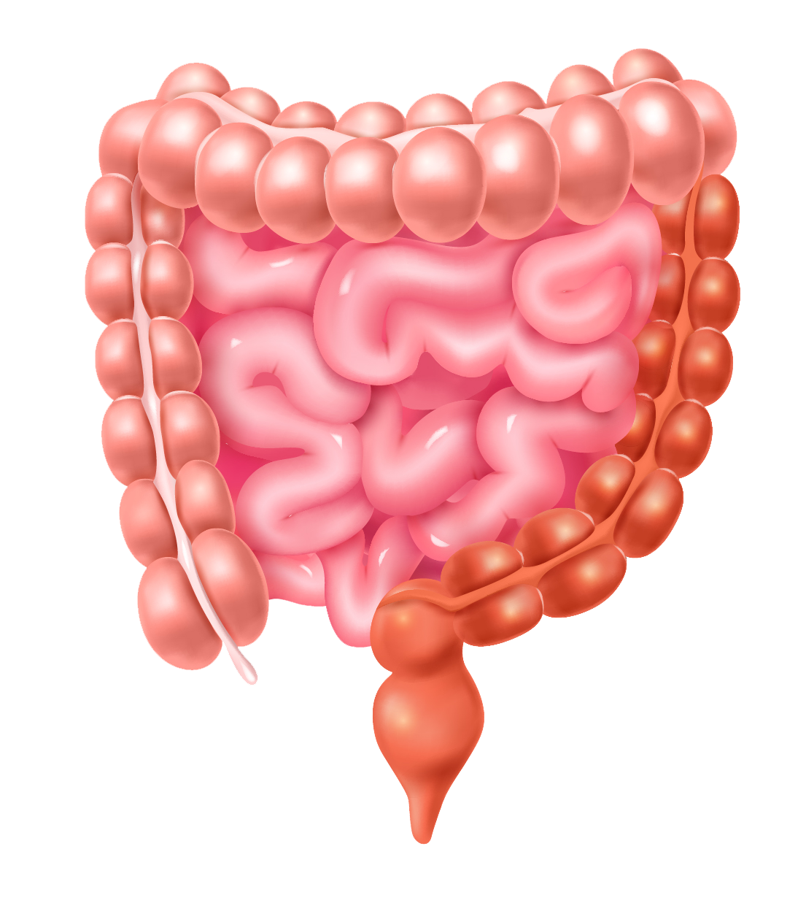
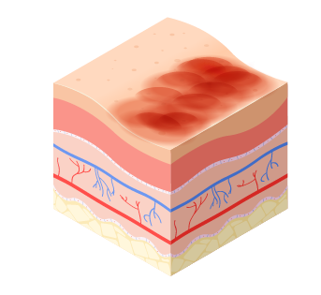
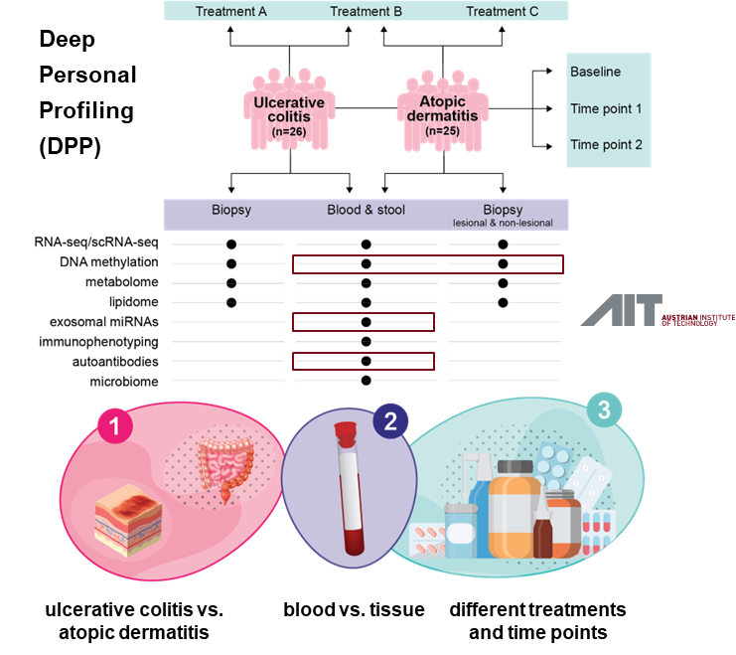
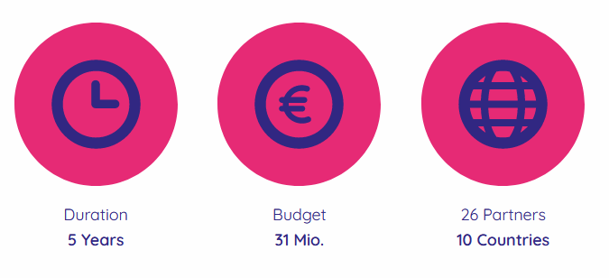

Immuniverse project (IHI)
Identification and validation of circulating biomarkers
for disease progression and treatment response
www.immuniverse.eu
Ulcerative
Colitis
Atopic
Dermatitis
25.11.2024

Slide 4
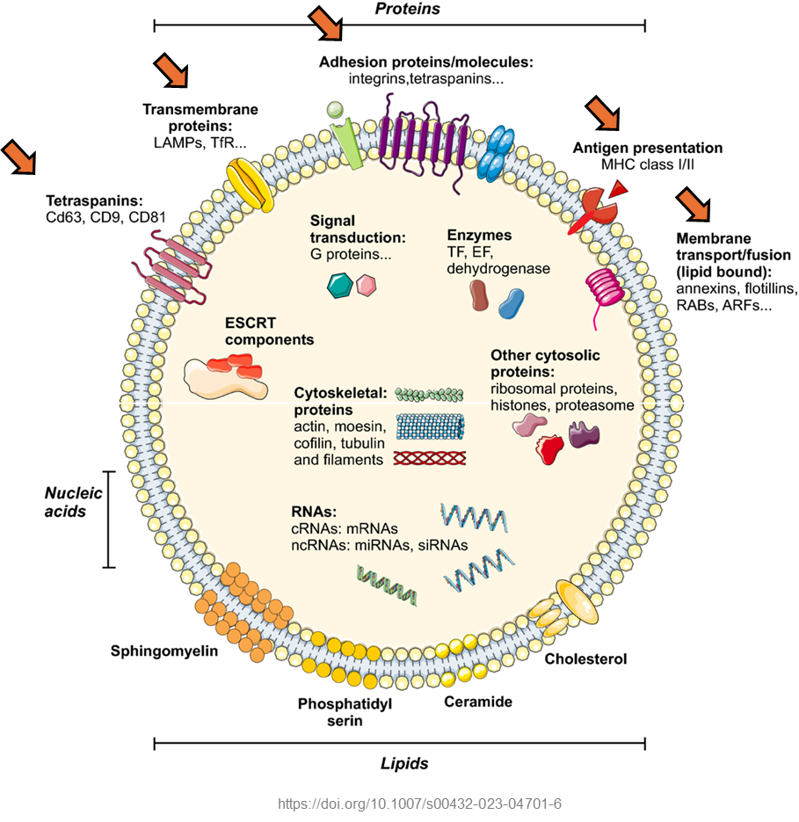
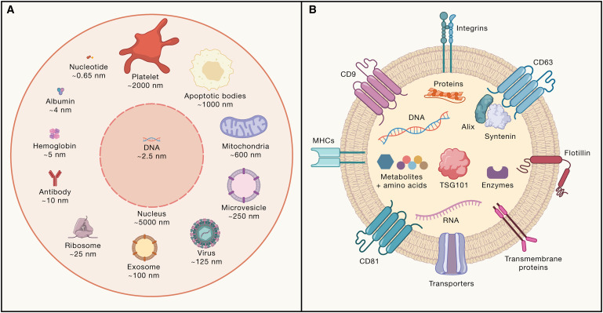
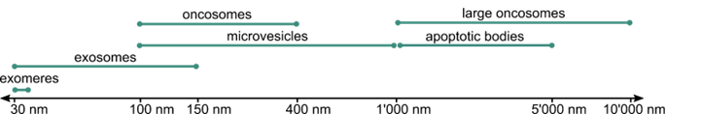
Small Extracellular Vesicles (EVs) = Exosomes
EVs have a large, highly interactive and dynamic surface area
Why are we interested in extracellular vesicles?
Nano-sized, membrane-derived vesicles released by virtually all cells and abundantly present in biological fluids.
Contain diverse bioactive components such as proteins, lipids, nucleic acids, or metabolites.
Small EVs (exosomes, 30-150nm)
Reflect the features of the original cell.
responsible for facilitating EV interactions with the recipient cells
reflects the identity and state of the parent cells
linked to specific diseases, such as particular cancers, neurodegenerative disorders, or inflammatory conditions
Spilak et al., Advanced Drug Delivery Reviews 2021

Slide 5

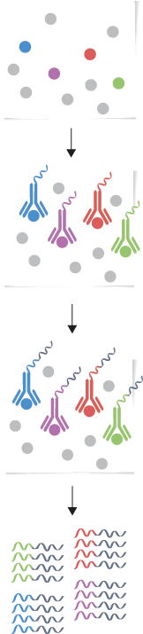
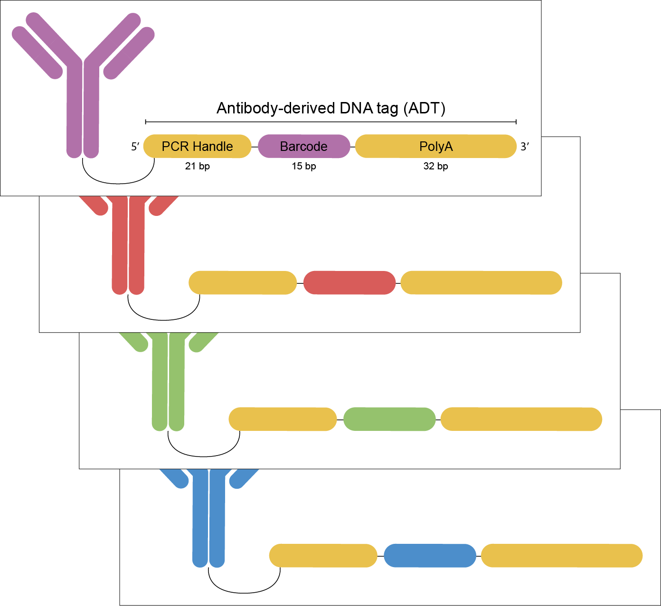

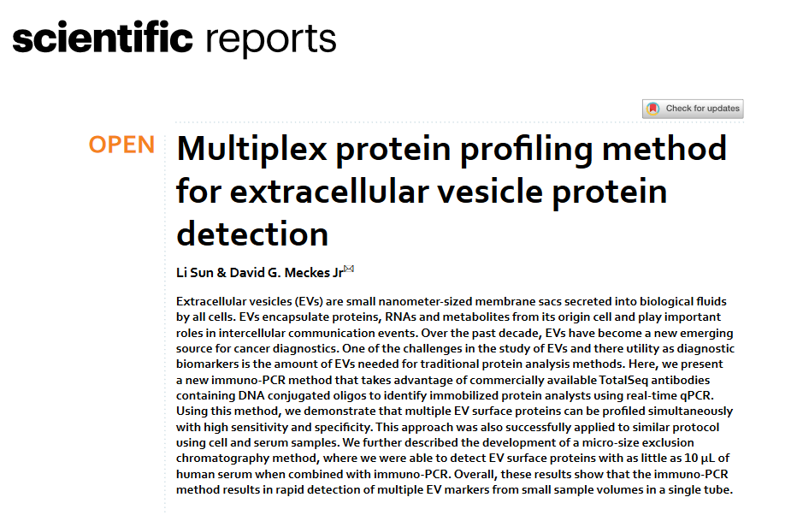


NEW Approach for EV Surface Protein characterisation
Research question
Principle: Total-SeqTM A antibodies (BioLegend)
Workflow
Can we develop a highly sensitive, user-friendly and cost-effective assay for accurately quantifying EV surface proteins in clinical liquid biopsy samples?
Immobilization of EVs on a nitrocellulose membrane.
Method of choice: immuno-qPCR
Formation of immuno-complexes between EV proteins and antibodies.
Extension of ADTs with an adaptor and their release.
600+ antibodies available
qPCR with one antibody-specific and one universal primer.
5

Slide 6
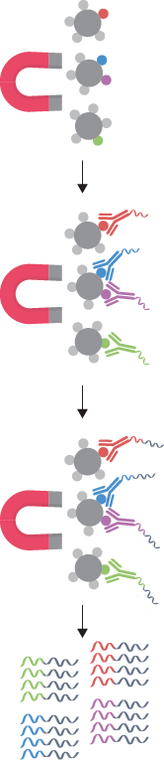
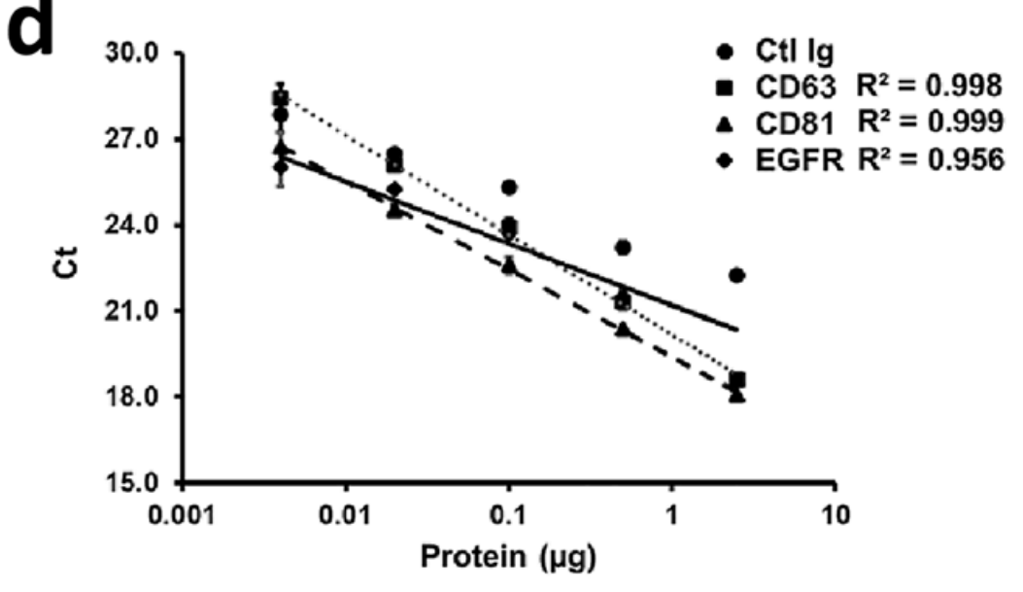

Immuno-qPCR with immobilization on (NHS-activated) magnetic beads
Enhanced workflow
4-plex assay on lysed EVs
Comparison of lysed and intact EVs
Ctrl Ig
4µg protein
PBS
TBS
Immobilization of EVs on NHS-activated magnetic beads.
CD63 R²=0.989
1µg
CD81 R²=0.992
Ctrl
CD9 R²=0.867
CD63
Formation of immuno-complexes between EV proteins and antibodies.
beads
beads
untreated
lysate
untreated
lysate
Extension of ADTs with an adaptor and their release.
qPCR with one antibody-specific and one universal primer.
membrane
membrane
Sun and Meckes, 2021
Sun and Meckes, 2021

Slide 7
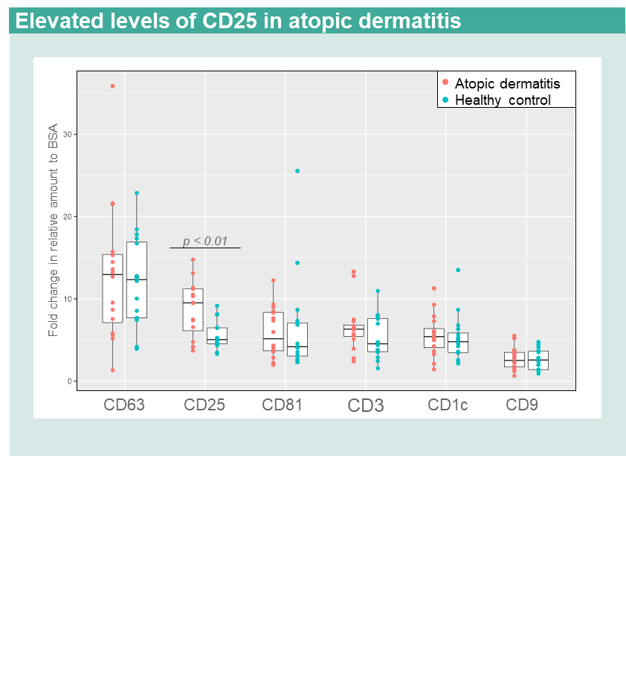
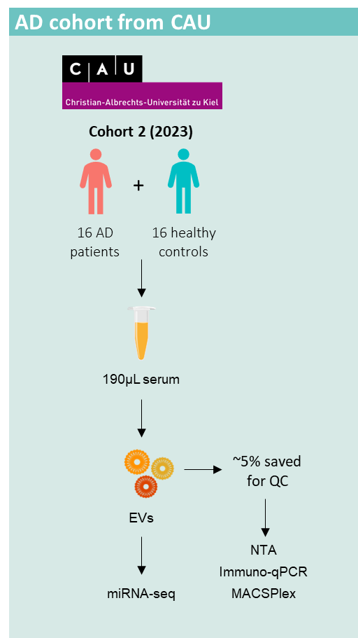
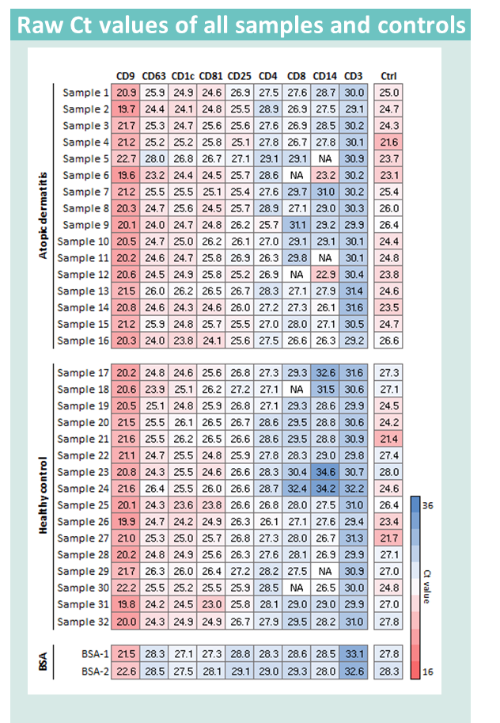
10-plex immuno-qPCR analysis of Atopic Dermatitis samples
CD25, CD1c and CD3 could not be detected by MACSPlex
Input:
Intact (unlysed) EVs precipitated from 190µL serum and resuspended in 310µL TBS
Amount:
8µg protein
~ 0.4 - 1.4µL EVs
~ 10⁷ - 10⁸ particles
~ 0.25 - 0.9µL serum
Filtering criteria:
ΔCt at least 1 between target and BSA
In both AD and HC, at least 9 samples must pass the filter

Slide 8
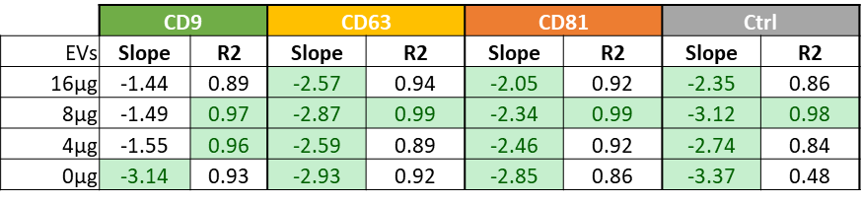
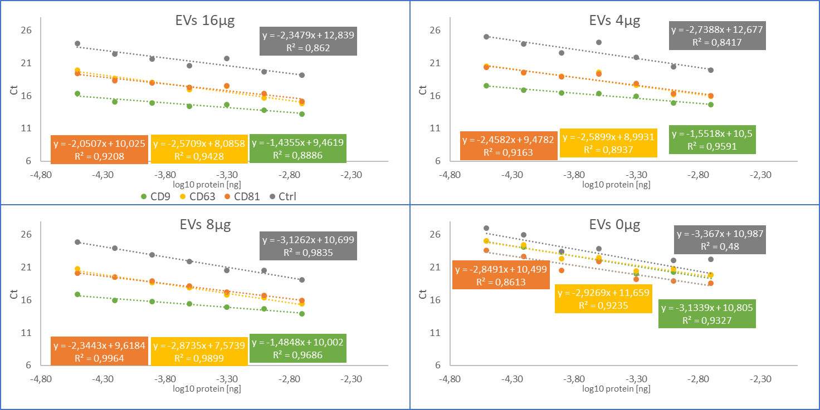
CD9/CD81 Beads &
Antibody titration 4-plex
 | EVs | TBS | Beads | Antibodies
1A | 16 µL | 34 µL | 15 µL | 0
1B | 16 µL | 34 µL | 15 µL | 1:500
1C | 16 µL | 34 µL | 15 µL | 1:1000
1D | 16 µL | 34 µL | 15 µL | 1:2000
1E | 16 µL | 34 µL | 15 µL | 1:4000
1F | 16 µL | 34 µL | 15 µL | 1:8000
1G | 16 µL | 34 µL | 15 µL | 1:16000
1H | 16 µL | 34 µL | 15 µL | 1:32000
2A | 8 µL | 42 µL | 15 µL | 0
2B | 8 µL | 42 µL | 15 µL | 1:500
2C | 8 µL | 42 µL | 15 µL | 1:1000
2D | 8 µL | 42 µL | 15 µL | 1:2000
2E | 8 µL | 42 µL | 15 µL | 1:4000
2F | 8 µL | 42 µL | 15 µL | 1:8000
2G | 8 µL | 42 µL | 15 µL | 1:16000
2H | 8 µL | 42 µL | 15 µL | 1:32000
3A | 4 µL | 46 µL | 15 µL | 0
3B | 4 µL | 46 µL | 15 µL | 1:500
3C | 4 µL | 46 µL | 15 µL | 1:1000
3D | 4 µL | 46 µL | 15 µL | 1:2000
3E | 4 µL | 46 µL | 15 µL | 1:4000
3F | 4 µL | 46 µL | 15 µL | 1:8000
3G | 4 µL | 46 µL | 15 µL | 1:16000
3H | 4 µL | 46 µL | 15 µL | 1:32000
4A | 0 µL | 50 µL | 15 µL | 0
4B | 0 µL | 50 µL | 15 µL | 1:500
4C | 0 µL | 50 µL | 15 µL | 1:1000
4D | 0 µL | 50 µL | 15 µL | 1:2000
4E | 0 µL | 50 µL | 15 µL | 1:4000
4F | 0 µL | 50 µL | 15 µL | 1:8000
4G | 0 µL | 50 µL | 15 µL | 1:16000
4H | 0 µL | 50 µL | 15 µL | 1:32000
7 Ab dilutions (down to 1:32000)

Slide 9
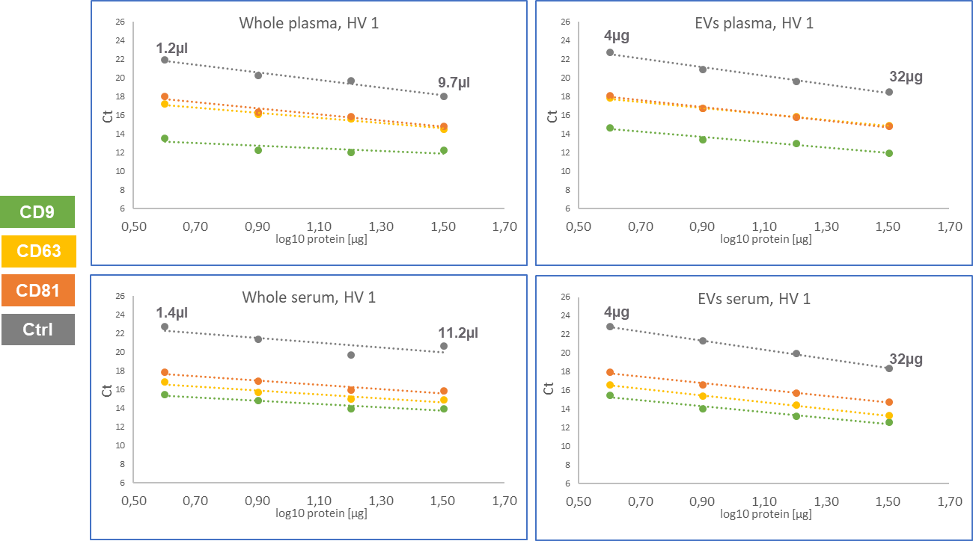
Plasma&Serum vs Plasma-&Serum EVs
CD9/CD81 bead capture, 4-plex Antibody 1:16000

Slide 10
Preliminary results: isolation of miRNA from bead-captured EVs and detection with qPCR
Testing different combinations of beads and incubation times
24 hrs
1 hr

Slide 11
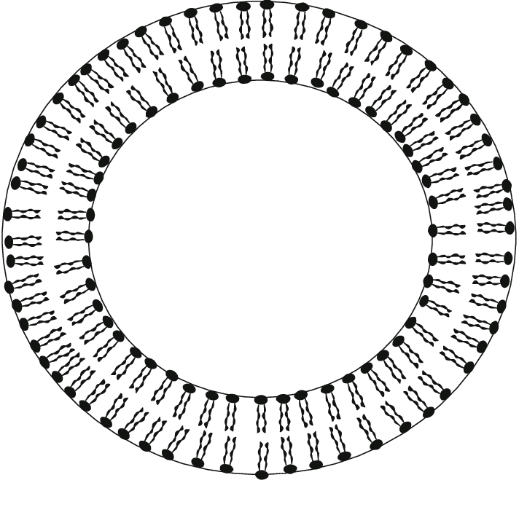
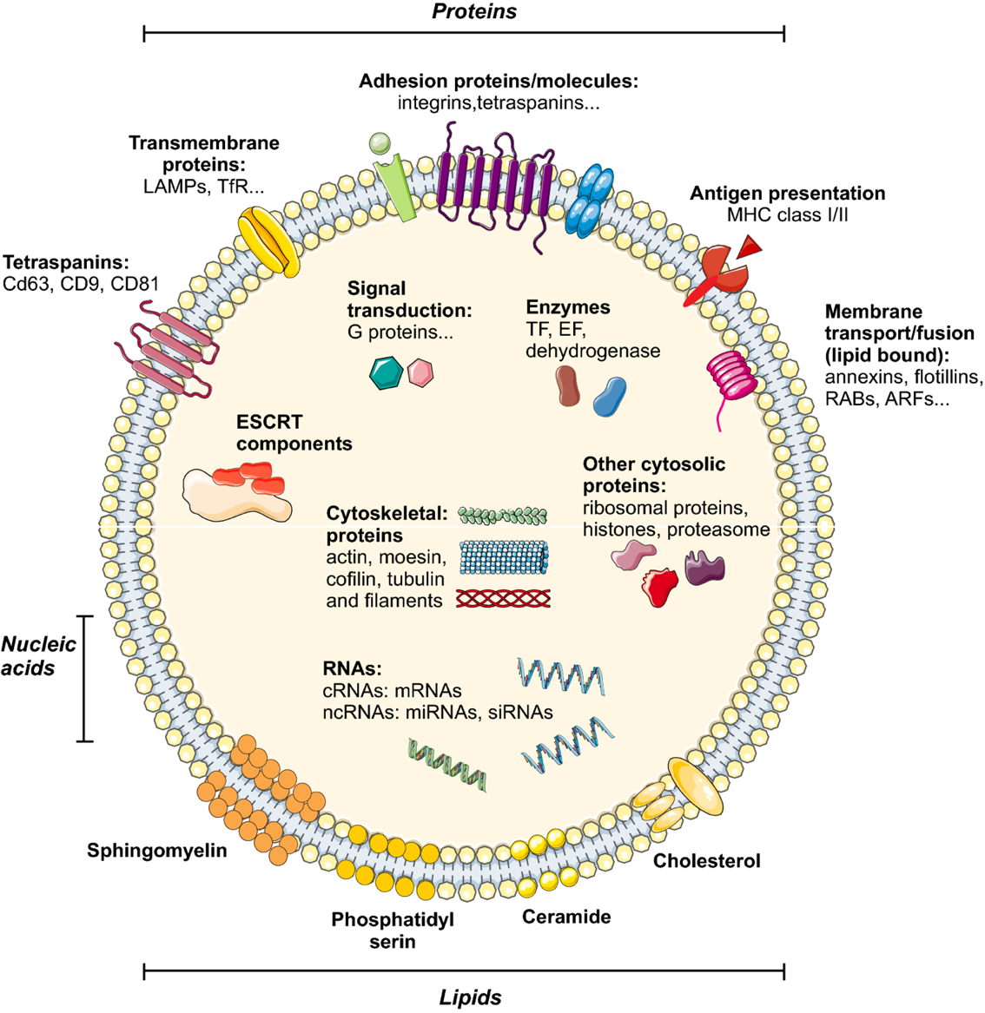
Summary & CONCLUSIONS
Successfully adpated Sun et. al protocol from membranes to magnetic beads
Immuno qPCR approach for EV characterization more sensitive than MagPlex
Analysis of Atopic dermatitis patients revealed differences in CD25 on EVs
Direct analysis of serum and plasma using CD9/CD81 bead EV enrichment works and gives similar results than precipitated EVs enriched by beads.
Distinct differences in EV surface protein expression detected between serum and plasma EVs
Proof of concept for miRNA detection from CD9/CD81 bead captured EVs
CONCLUSION
Surface protein characterization on EVs via immune qPCR is an interesting approach due to its high sensitivity, versatility and simplicity

Slide 12


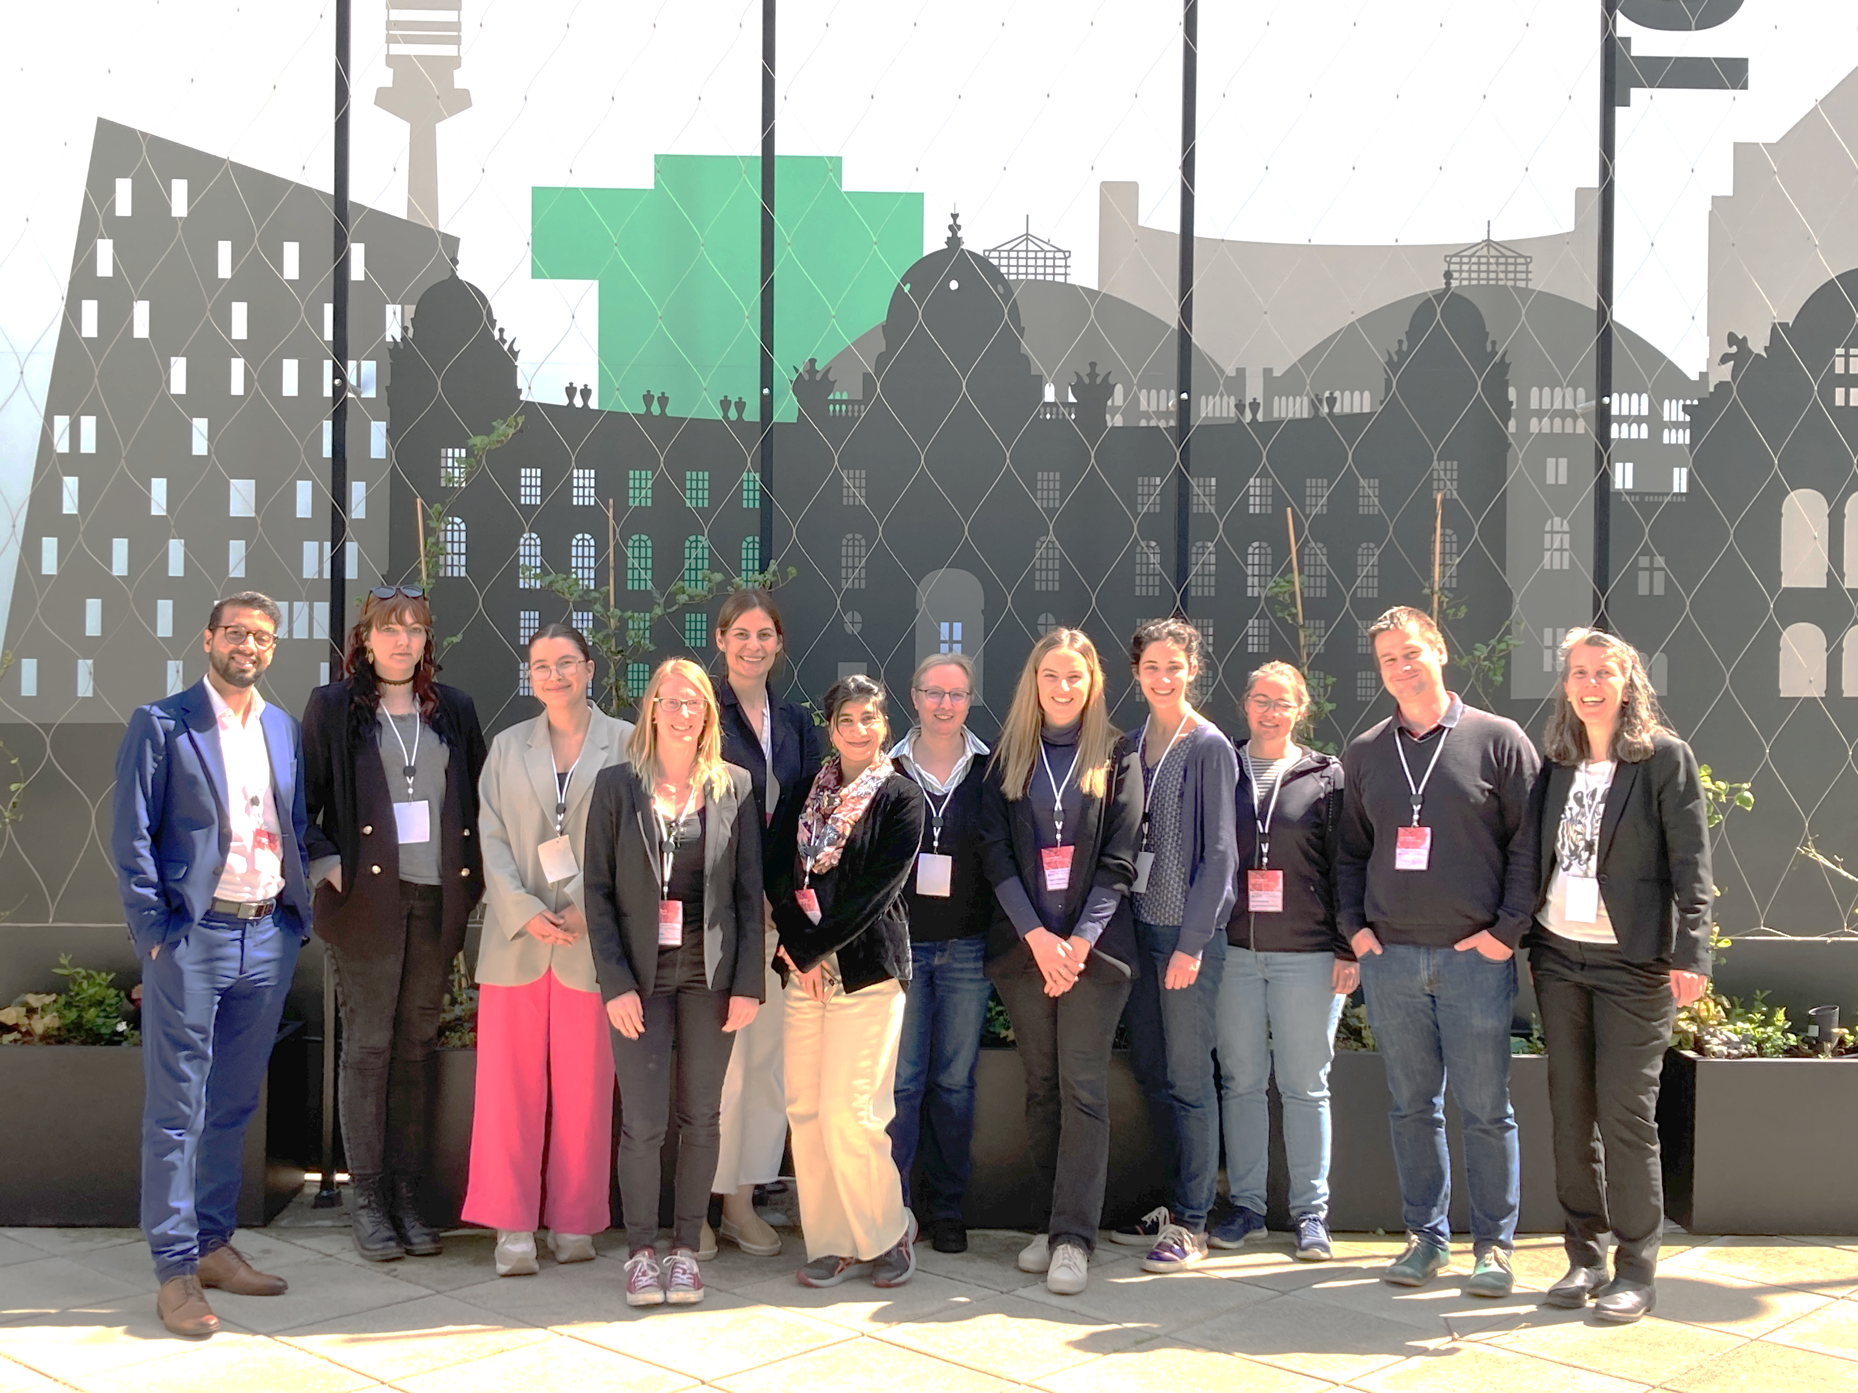







ACKnowledgments
EV-
Ulrike Kegler
Janine Strieder
Lucia Ciglar
Christa Nöhammer
Clinical partners
Inken Harder
Robert Hässler
Stefan Weidinger
CCC TRIO MEETING VIENNA 04/2023

Slide 13
Thank you!
Christa Nöhammer, 26.11.2024
Contact: christa.noehammer@ait.ac.at
www.molecular-diagnostics.ait.ac.at

