Slide 1


The ISEV-ELBS Intersociety Working Group
ELBS General Assembly 2024
Caterina Nardella, PhD

Slide 2
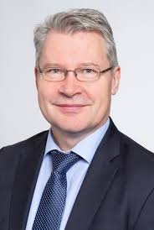
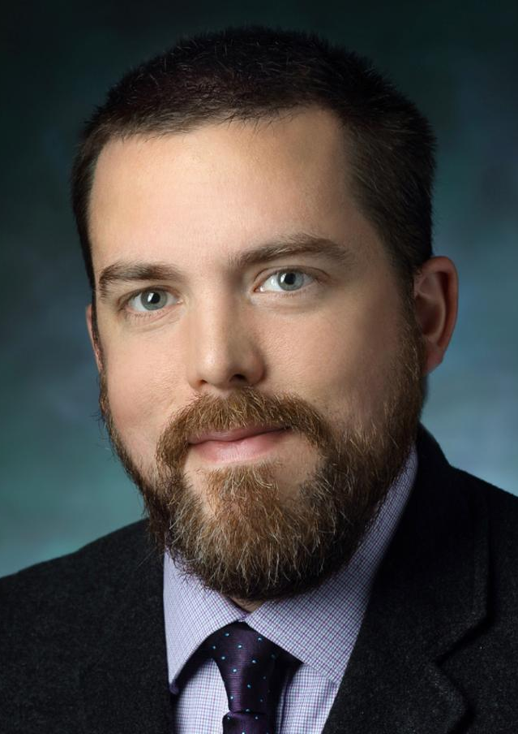
The ISEV-ELBS Intersociety Working Group
History
The ISEV-ELBS Intersociety Working Group (WG) was conceptualized in 2023 as a joint initiative between the International Society for Extracellular Vesicles (ISEV) and ELBS to exploit the potential of Extracellular Vesicles (EVs) as biomarkers for liquid biopsy towards clinical implementation.
The ISEV-ELBS Intersociety WG was formalized in 2024 with an ISEV-led application process and selection of 4 co-chairs.
The ISEV-ELBS WG webpage on both ISEV and ELBS website was launched at the end of July and the ISEV and ELBS social network announcement was done in October.
"The overarching goal of ELBS is the implementation of liquid biopsy into clinical practice. This intersociety working group is of utmost importance to translate the exciting discoveries in the EV research field into clinical studies demonstrating the power of EVs as liquid biopsy biomarkers for personalized cancer medicine. At ELBS, we are very excited to work together with ISEV to reach this important goal." said Klaus Pantel, Founder and current President of ELBS.
Prof. Klaus Pantel
ELBS Founder and President
“As the leading society for more than 2000 EV researchers, ISEV aims in part to uncover how EVs can be used to improve human health. Towards this end, EVs in liquid biopsies hold tremendous potential in many clinical applications. The collaboration between ISEV and ELBS through the formation of this intersociety working group represents an important step, and we are excited to work together in this direction”, said Ken Witwer, President of ISEV.
Prof. Ken Witwer
ISEV President

Slide 3
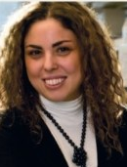
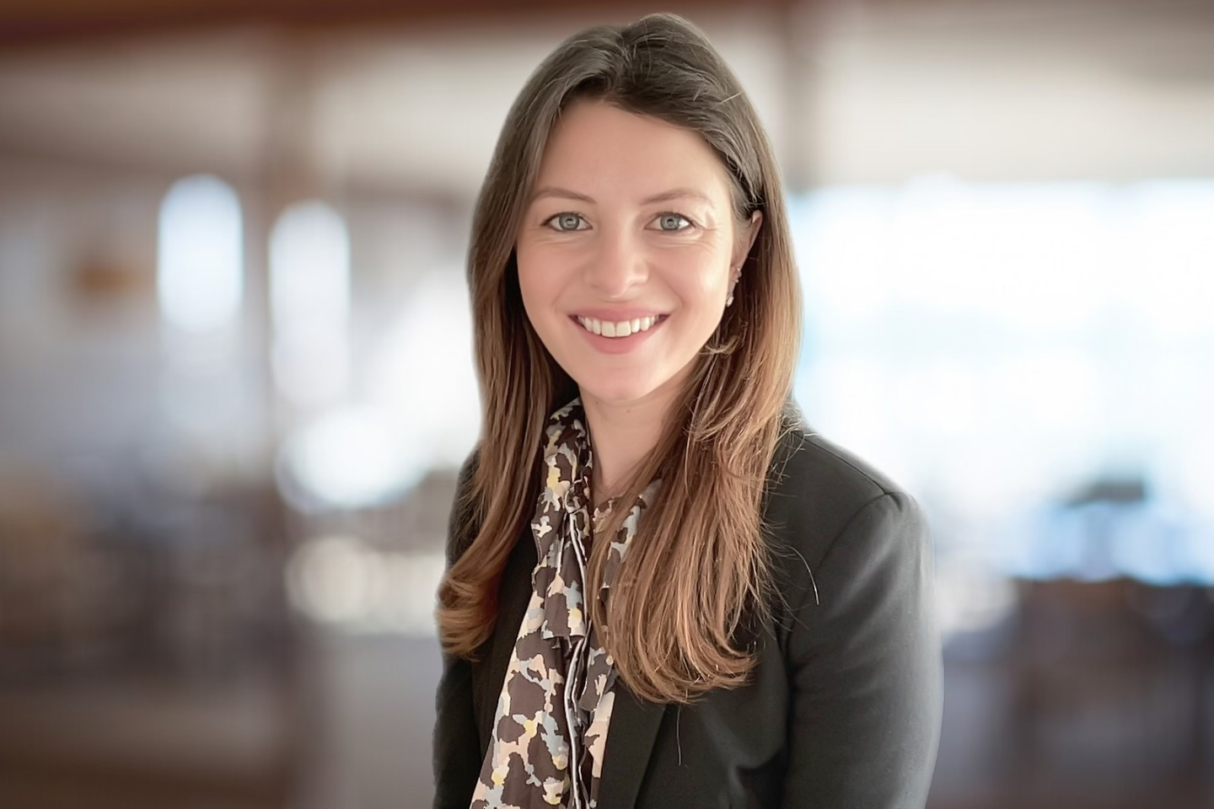
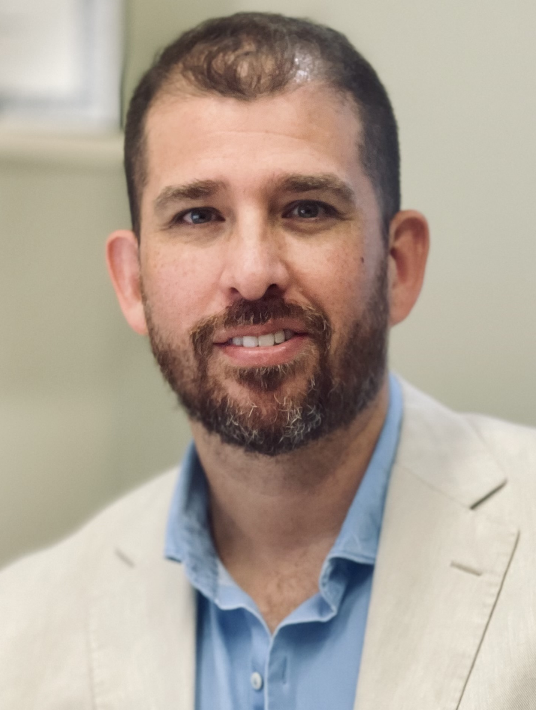
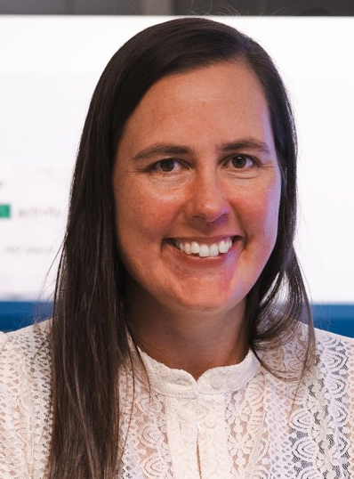
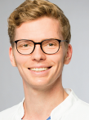
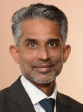
The ISEV-ELBS Intersociety WG
Composition
ISEV – ELBS Intersociety WG
ISEV-nominated Chairs
ELBS EV WG
Chairs
Dr. Caterina Nardella
University of Trento,
Italy
Prof. Julia V. Burnier
McGill University Health Centre, Canada
Prof. Carlos Salomon
The University of Queensland,
Australia
Prof. An Hendrix
Ghent University,
Belgium
Dr. Franz L. Ricklefs
University Medical Centre Hamburg-Eppendorf, Germany
Dr. Basant Kumar Thakur
University Clinic Essen, Germany
Additional Members
Jillian Bracht, Amsterdam UMC (j.w.p.bracht@amsterdamumc.nl)
Bettin Britt, Amsterdam UMC (b.a.bettin@amsterdamumc.nl)
Vera Mugoni, University of Turin, Italy (vera.mugoni@unito.com)
Héctor Peinado, CNIO, Barcelona, Spain (hpeinado@cnio.es)
Natasa Zarovni, The Italian National Research Council (CNR) and RoseBio, Milan, Italy (natasa.zarovni@gmail.com)

Slide 4
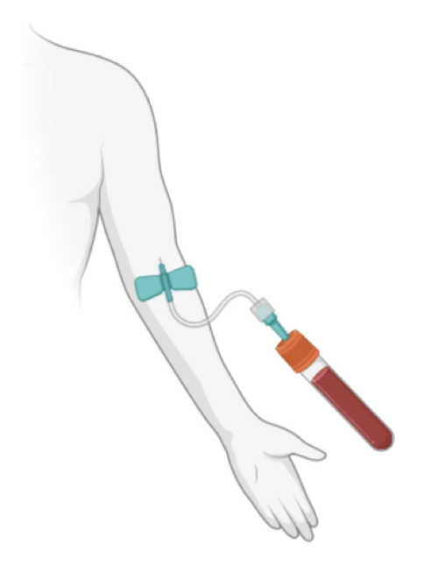
The ISEV-ELBS Intersociety Working Group
Mission
The group aims to foster collaboration between the two societies with the goal of translating extracellular vesicle research (ISEV) in liquid biopsy applications in the clinical practice (ELBS).
Cancer patient
Adapted from Ciani Y et al. Cancer Cell, 2024.

Slide 5


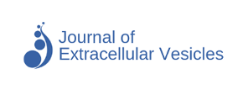

The International Society of Extracellular Vesicles (ISEV)
ISEV is the leading advocate and guide of EV research and aims to advance the understanding of extracellular vesicle biology.
ISEV was funded in 2011 and now include over 1,700 EV researchers worldwide.
The International Society for Extracellular Vesicles publishes two open-source, peer-reviewed journals that are key journals in the EV community: The Journal of Extracellular Vesicles and The Journal of Extracellular Biology.

Slide 6

ISEV – Rigor & Standardization (R&S) Subcommittee
The goal of the ISEV R&S Subcommittee is to improve the reproducibility of research on EVs, and thus help the EV community attain robustness, reliability, credibility and sustainability.
R&S assembles and guides teams of experts who work together as task forces and intersociety working groups on topics ranging from isolation and detection of EVs in a body fluid to regulatory affairs.
Recommendations are disseminated in position papers, guidelines, and other products, and may be incorporated into MISEV (the Minimal Information for Studies of Extracellular Vesicles) guidelines (MISEV2014, MISEV2018 and MISEV2023).

Slide 7




ISEV – Blood Task Force
This task force aims to improve the reproducibility of EV measurement results in plasma and serum.
Collection, handling and storage of blood extracellular vesicles
Quality controls of plasma and serum
Quality controls of extracellular vesicles isolated from plasma or serum
Anticoagulants
Blood stabilization tubes
Reference plasma samples
Publications
MIBlood-EV: Minimal information to enhance the quality and reproducibility of blood extracellular vesicle research, Journal of Extracellular Vesicles 2023, where you can download the checklist: Standardized Reporting Tool for Blood EV Research (Human).
Considerations towards a roadmap for collection, handling and storage of blood extracellular vesicles, Journal of Extracellular Vesicles 2019.

Slide 8
Standardized Reporting Tool for Human Blood EV Research

Slide 9
ISEV – Urine Task Force
This task force aims to put together nephrologists, urologist and biologists with active experience in urinary EV (uEV) research to establish best practice and standardize the field.
Sample collection standardization
Influence of storage
Approaches to normalization
Clinical translation
Publications
The quick reference card "Storage of urinary EVs" – A practical guideline tool for research and clinical laboratories (Journal of Extracellular Vesicles, March 2023).

Slide 10
ISEV – Cerebrospinal Fluid Task Force
This task force aims to to develop recommendations for rigor and standardization of CSF EV studies based on a survey of current practices and procedures, and a comprehensive review of published studies.
CSF Collection, Processing and Storage
CSF EV:
Enrichment
Size & Number
Protein Analysis
RNA Analysis
Glycomic, Lipidomic, and Metabolomic Analysis
Functional Assays
Publications
Recommendations for reproducibility of cerebrospinal fluid extracellular vesicle studies (Journal of Extracellular Vesicles, March 2023).

Slide 11



The ISEV-ELBS Intersociety Working Group
Foreseen Activities
Working in close collaboration with the ELBS EV WG and the ISEV Rigor and Standardization to promote reproducibility of liquid biopsy-EV preparation and analysis towards EV clinical applicability
Developing ISEV-ELBS collaborative initiatives
Organizing co-host workshops and meetings
Producing position papers and publications to guide the field

Slide 12

Next ISEV annual meeting in April 2025
SAVE THE DATE!
The ISEV-ELBS Intersociety WG is planning a 2-hour liquid-biopsy-focused satellite event (work in progress)
ISEV annual meeting is not restricted to ISEV members

