Slide 1

General Assembly of the European Liquid Biopsy Society (ELBS)
26th of November 2024
Barcelona, Spain

Slide 2
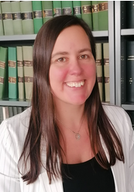
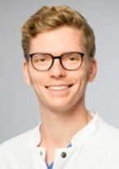
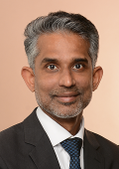
General Assembly of the European Liquid Biopsy Society (ELBS)
26th of November 2024
Barcelona, Spain
EV working group
An Hendrix
Ghent University
Belgium
Franz Ricklefs
University Medical Center Hamburg
Germany
Basant Kumar Thakur
University Clinic Essen
Germany

Slide 3
EV working group: focus topics in 2024
Activity 1: Biobanking and pre-analytics:
How to collect the biofluid?
What is the minimal quality control of the biofluid?
How to process and store the biofluid?
Activity 2: Biomarker potential:
What are the clinical needs and requirements?
Positioning of EVs in the liquid biopsy field?
Activity 3: Stimulate interactions between ISEV and ELBS:
Joined meetings and discussions to steer interactions.
EV working group meeting May 2024
EV working group meeting November 2024
EV working group & ISEV meeting June 2024

Slide 4
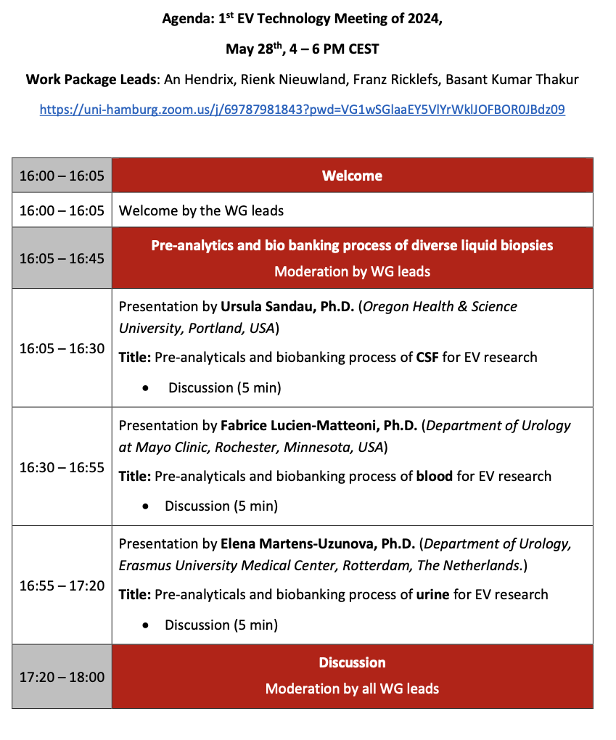
EV working group: activity 1
Biobanking and pre-analytics:
How to collect the biofluid?
What is the minimal quality control of the biofluid?
How to process and store the biofluid?

Slide 5
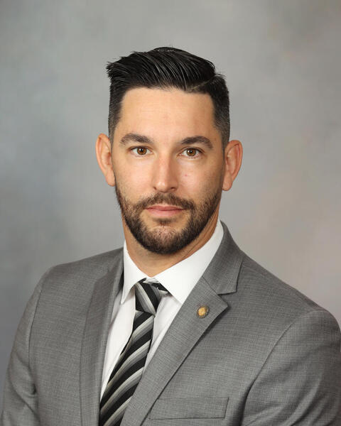
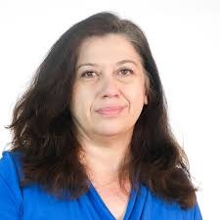
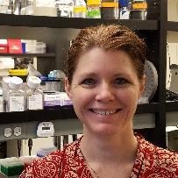

EV working group: activity 1
Fabrice Lucien
Mayo Clinic
USA
Elena Martens
Erasmus University
The Netherlands
Ursula Sandau
Oregon Science & Health University
USA
blood
urine
cerebrospinal fluid

Slide 6
EV working group: activity 1
Biobanking and pre-analytics:
Quality assessment:
What should be evaluated?
Monitor sample stability?
Transparency:
What should be reported?
Collaboration:
Access to annotated samples in centralized biobanks?

Slide 7
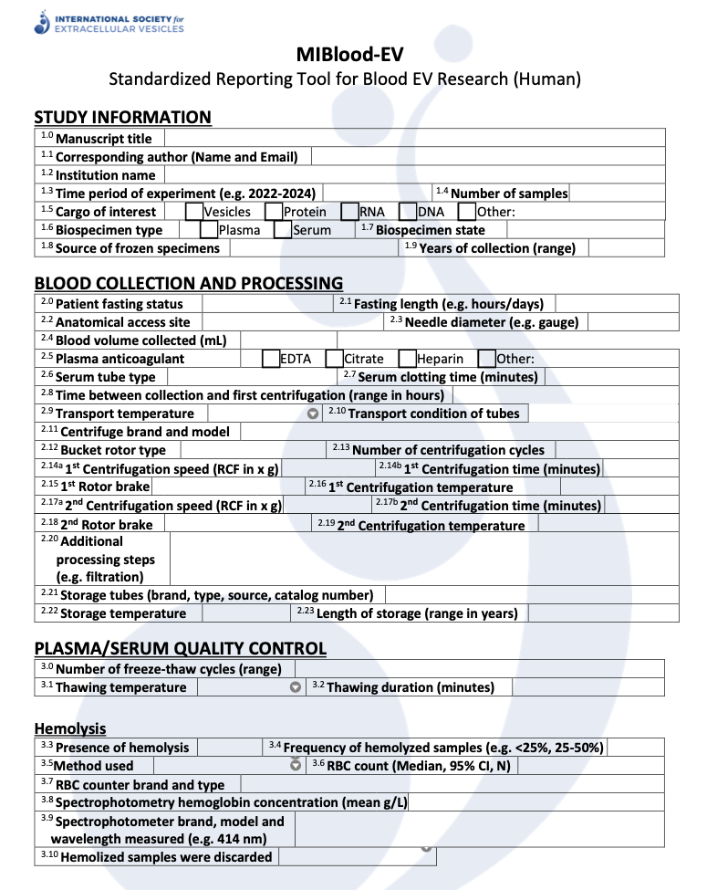
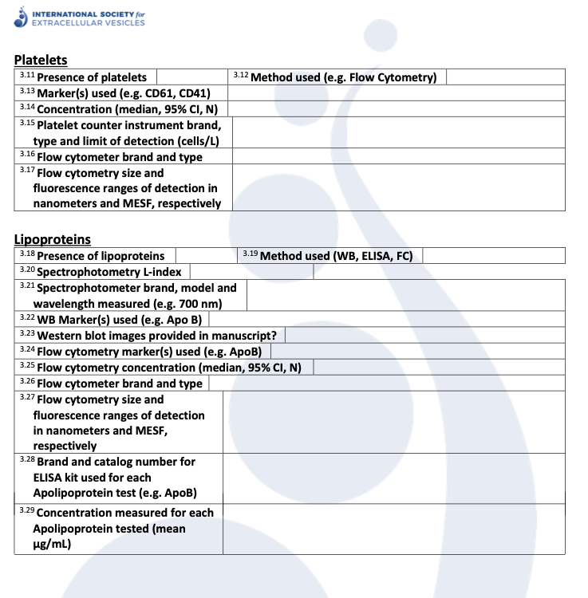
EV working group: activity 1
Biobanking and pre-analytics:
Quality assessment:
What should be evaluated?
Monitor sample stability?
Transparency:
What should be reported?
Collaboration:
Access to annotated samples in centralized biobanks?

Slide 8
EV working group: activity 1
Biobanking and pre-analytics:
Quality assessment:
What should be evaluated?
Monitor sample stability?
Transparency:
What should be reported?
Collaboration:
Access to annotated samples in centralized biobanks?
What’s next? Activities for 2025:
1. Actively reach out to journals (perspective), biobanks & societies (sharing check-lists)
2. Survey & systematic analysis (working group meeting with CTC, DNA and RNA)
3. Design experimental set-up for proof-of-concept and validation study (working group with CTC, DNA and RNA working groups)

Slide 9
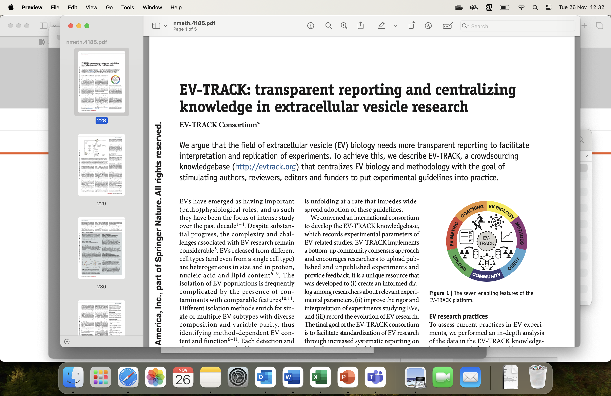
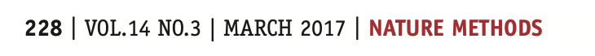
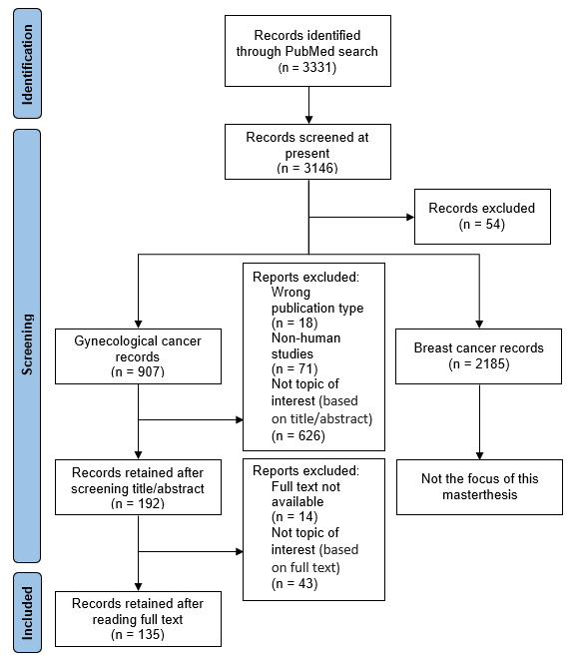

Slide 10
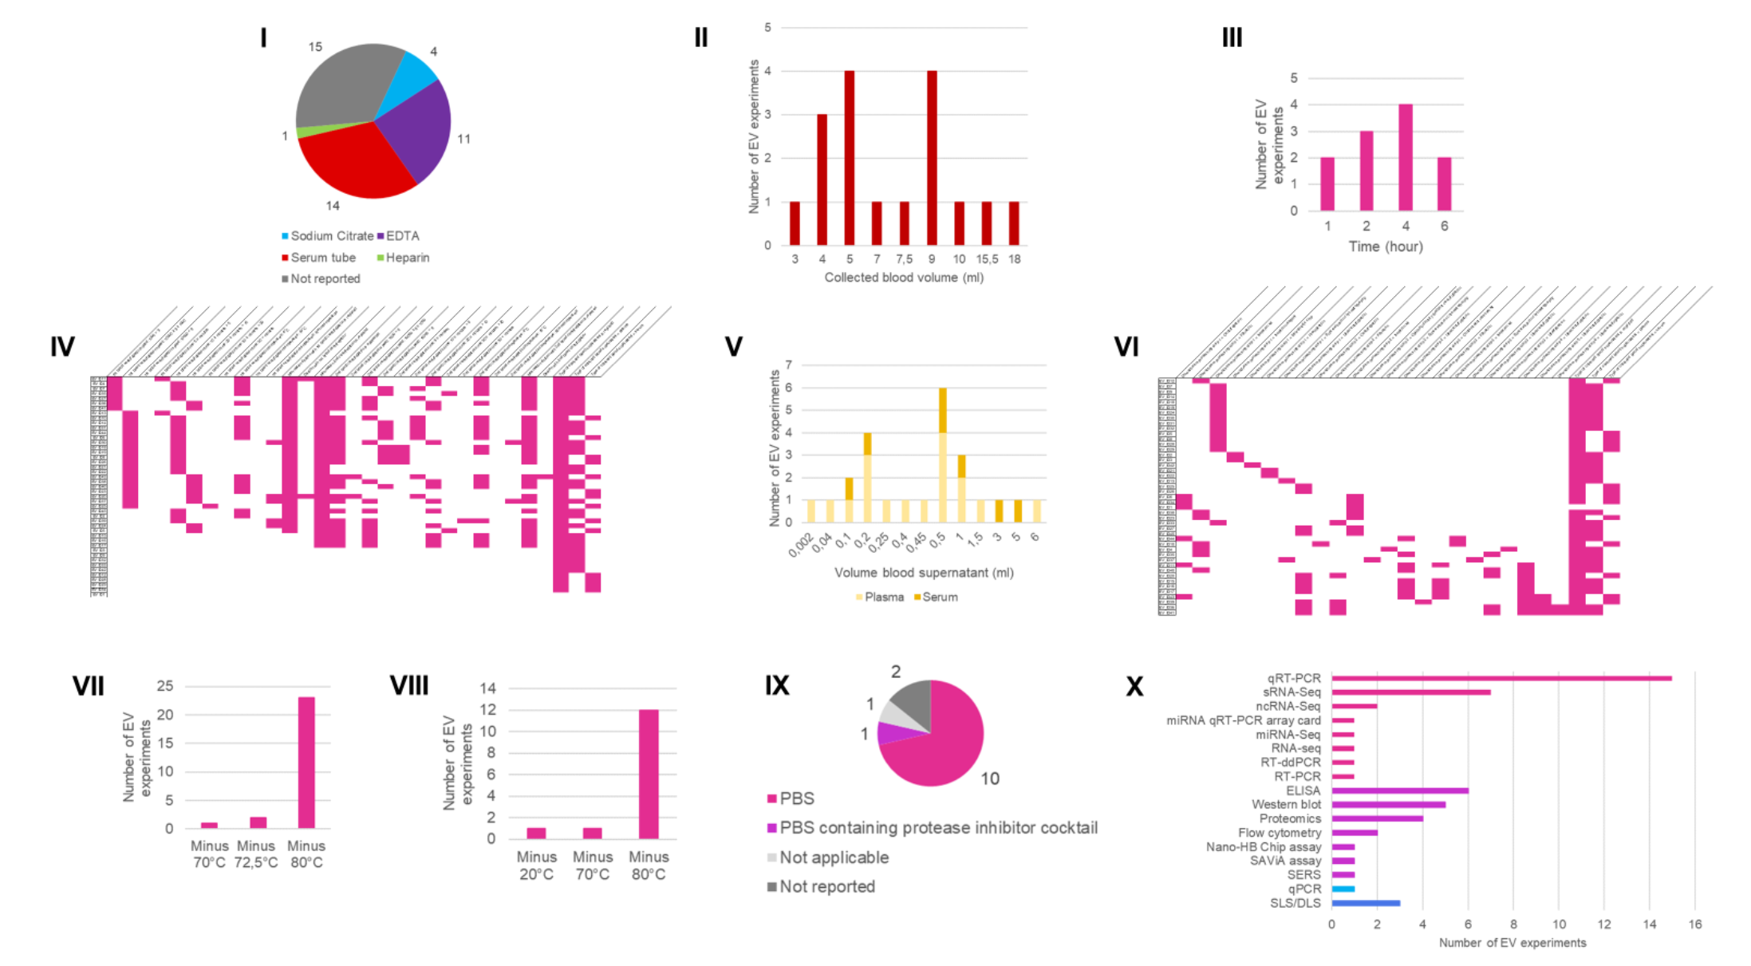
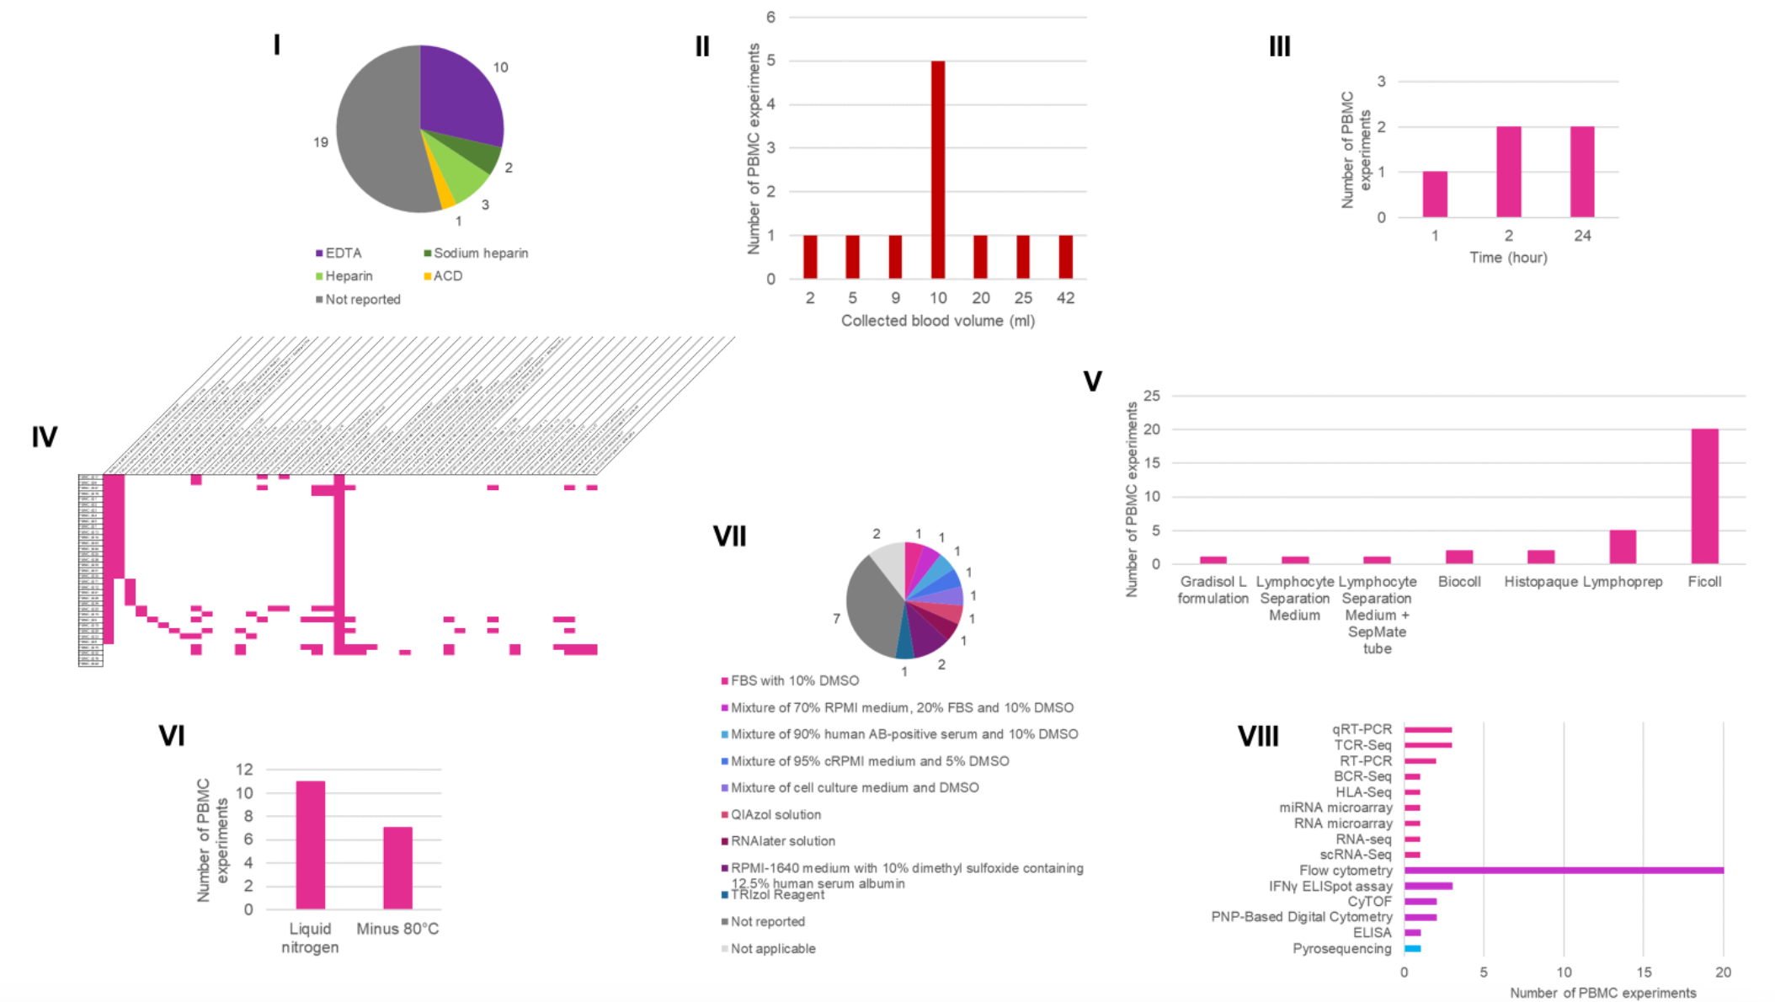
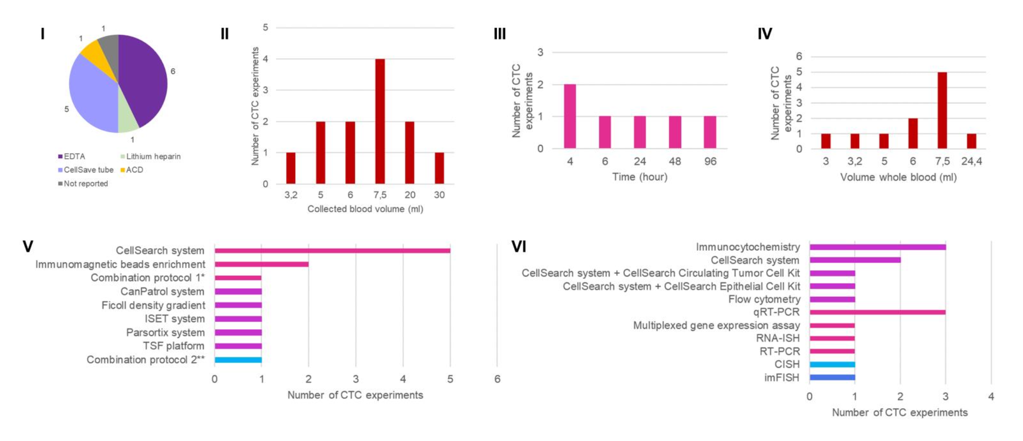
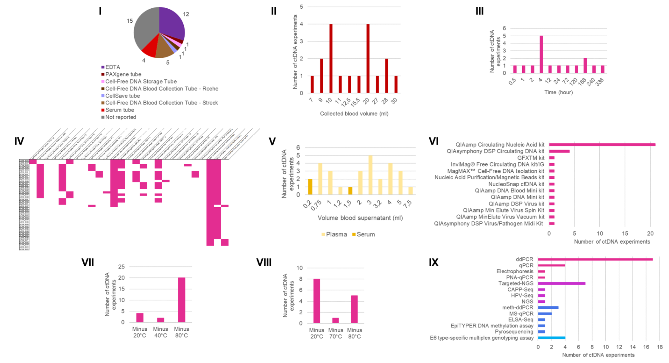
EV working group: activity 1
EV
PBMC
CTC
cfDNA

Slide 11
EV working group: activity 1
Biobanking and pre-analytics:
Quality assessment:
What should be evaluated?
Monitor sample stability?
Transparency:
What should be reported?
Collaboration:
Access to annotated samples in centralized biobanks?
What’s next? Activities for 2025:
1. Actively reach out to journals (perspective), biobanks & societies (sharing check-lists)
2. Survey & systematic analysis (work group meeting with CTC, DNA and RNA)
3. Design experimental set-up for proof-of-concept and validation study (work group with CTC, DNA and RNA working groups)

Slide 12
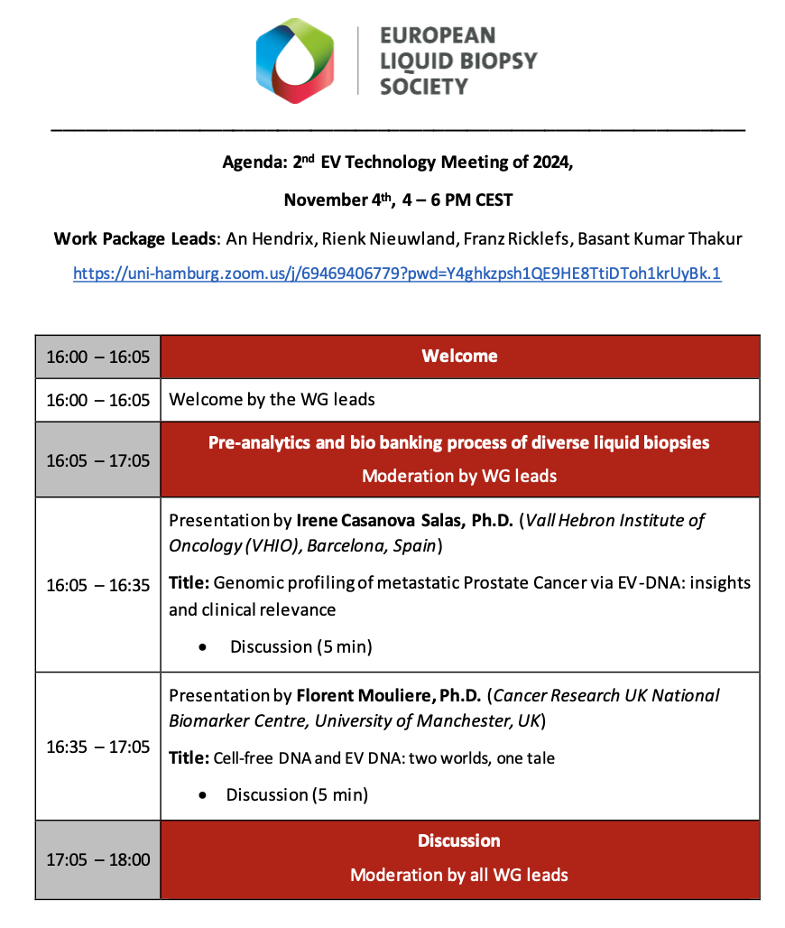
EV working group: focus topics in 2024
Activity 2: Biomarker potential:
What are the clinical needs and requirements?
Positioning of EVs in the liquid biopsy field?

Slide 13
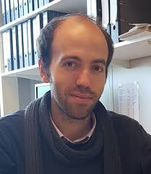
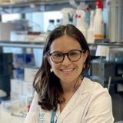
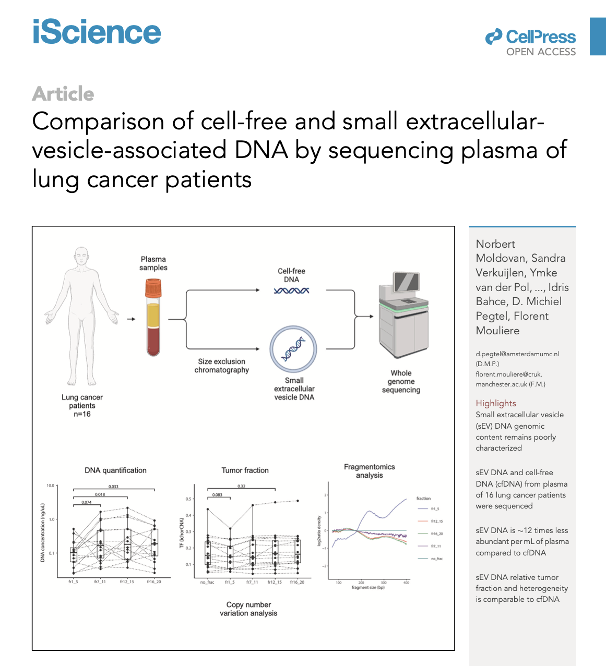
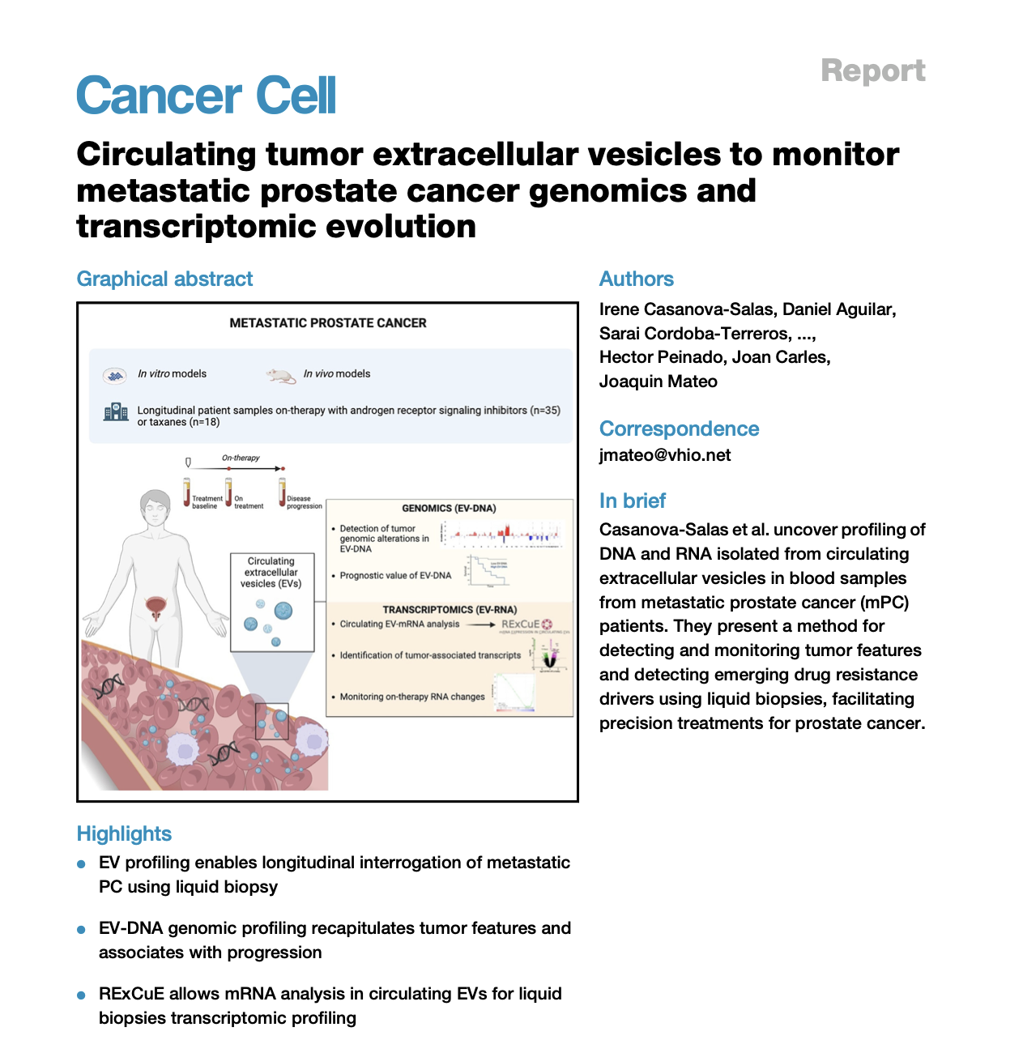
EV working group: activity 2
Florent Mouliere
University of Manchester
UK
Irene Casanova Salas
Vall Hebron Institute of Oncology
Spain

Slide 14
EV working group: activity 2
Biomarker potential:
Positioning of EVs in the liquid biopsy field (ctDNA)?
Therapy
Tumor type
Time point
Diagnostic
Patient
Prognostic
Predictive

Slide 15
EV working group: activity 2
Biomarker potential:
Positioning of EVs in the liquid biopsy field (ctDNA)?
What’s next ? Activities for 2025:
1. Other liquid biopsy targets (EV working group meeting)
2. Review
3. Clinical studies (EV working group meeting)
Therapy
Tumor type
Time point
Diagnostic
Patient
Prognostic
Predictive

Slide 16


EV working group: activity 3
Biobanking and pre-analytics:
How to collect the biofluid?
What is the minimal quality control of the biofluid?
How to process and store the biofluid?
Biomarker potential:
What are the clinical needs and requirements?
Positioning of EVs in the liquid biopsy field?
Stimulate interactions between ISEV and ELBS:
Joined meetings and discussions to steer interactions.

Slide 17
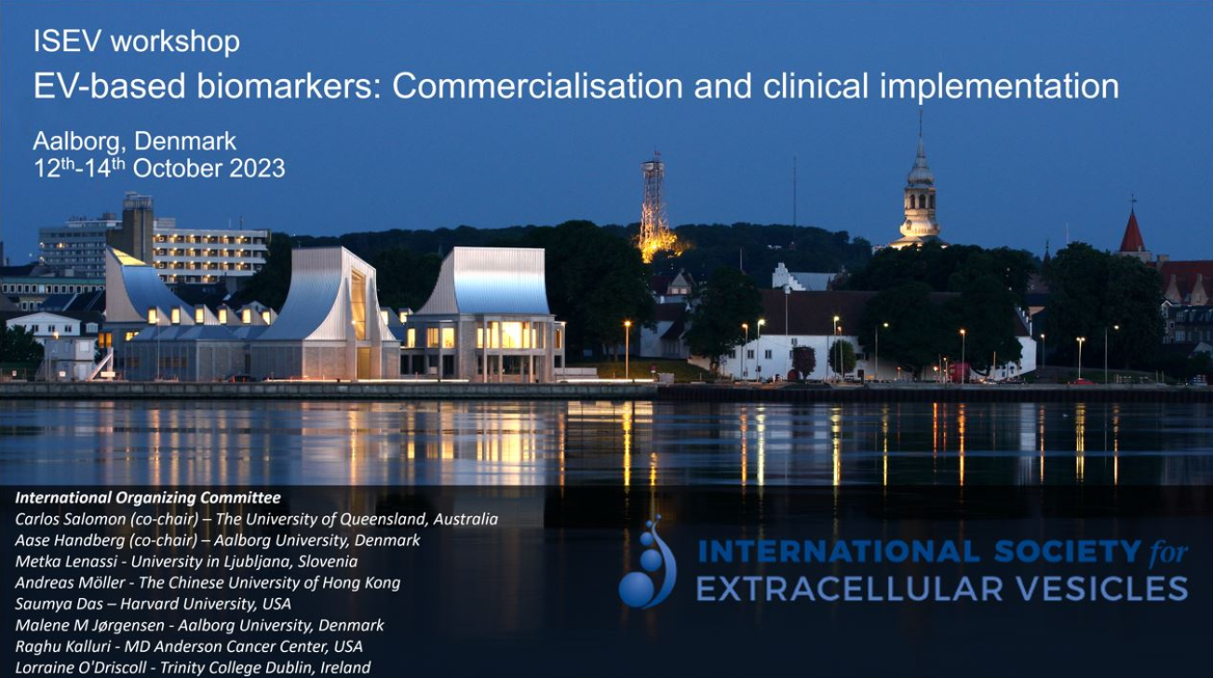
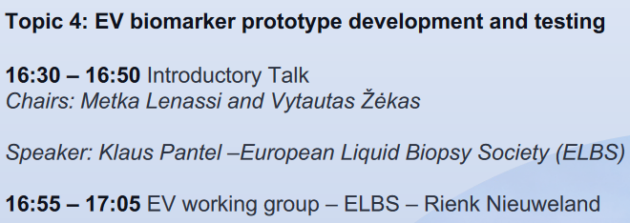
EV working group: activity 3
Establishment of ISEV-ELBS working group October 12th -14th (Aalborg, Denmark).
Discussion topics:
How can we align ISEV and ELBS activities => what are the priorities to consider?

Slide 18
EV working group: Envisioned activities 2025
1 online inter working group meeting to discuss survey, systematic analysis, experimental set-up for protocol validation and reproducibility
Perspective (outreach)
Activity 1: Biobanking and pre-analytics:
How to collect the biofluid?
What is the minimal quality control of the biofluid?
How to process and store the biofluid?
Activity 2: Biomarker potential:
What are the clinical needs and requirements?
Positioning of EVs in the liquid biopsy field?
Activity 3: Stimulate interactions between ISEV and ELBS:
Joined meetings and discussions to steer interactions.
2 online EV working group meetings in 2025 (positioning and clinical)
Review (outreach)
Co-organize an intersociety ISEV-ELBS satellite event and workshop to further stimulate interactions
Dedicated guidelines

Slide 19
Thank you for your attention!
We warmly welcome any suggestions!
EV working group
An Hendrix
Ghent University
Belgium
Franz Ricklefs
University Medical Center Hamburg
Germany
Basant Kumar Thakur
University Clinic Essen
Germany

