Slide 1


Dynamic size and association profiles of tumour-derived DNA (ctDNA) during pancreatic cancer progression
Metoboroghene O. Mowoe, Osama Saher, Maximilian Kordes, Matthew
Eldridge, Johannes Löhr, André Görgens, Samir EL Andaloussi, Matthias Löhr, Nitzan Rosenfeld, Chris G. Smith, and Daniel W. Hagey
Postdoctoral Fellow│BMM, Division of BCM
Department of Laboratory Medicine
Samir El Andaloussi lab

Slide 2
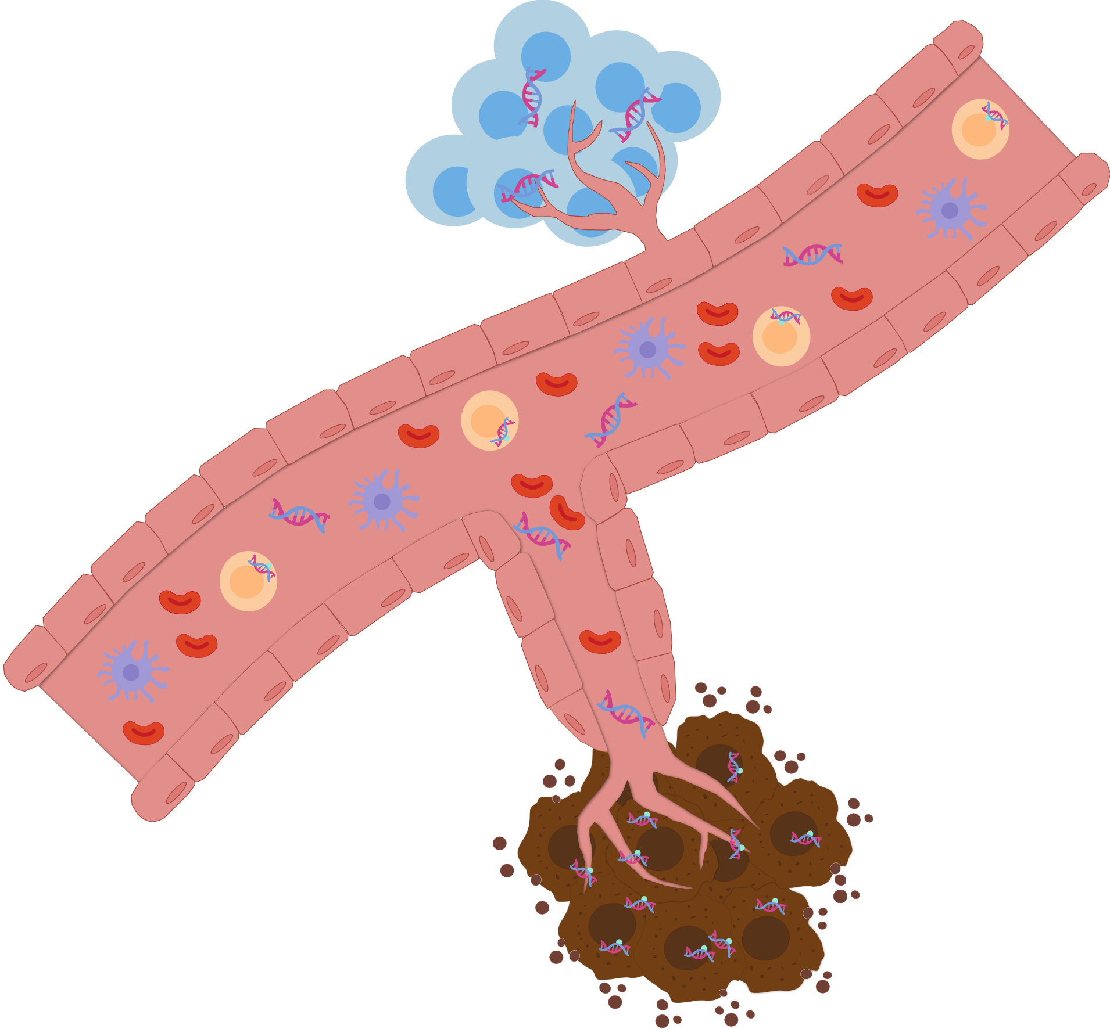
Circulating tumour DNA for treatment monitoring
Global cancer incidence continues to rise
Increased need for continuous treatment monitoring
Accessibility of ctDNA indispensable
What is ctDNA
  Histone-bound fragment <2000bp?
Enriched in specific blood components
Why is this relevant?
BUT minute amount of tumour DNA
in blood. SO?
Notes:
Incidence predicted for 2050- 35 million
Monitoring - help optimize therapy regimes and improve patient outcomes
ctDNA refers to DNA of any length bound to any macromolecule complex
ctDNA is thought to be released from dying cells, which may explain why its prevalence increases as cancer progresses towards terminal illness
Relevance – the most relevant sources of ctDNA may shift during disease progression and is likely often missed using current pre-analytical consitions used for clinical analyses.

Slide 3
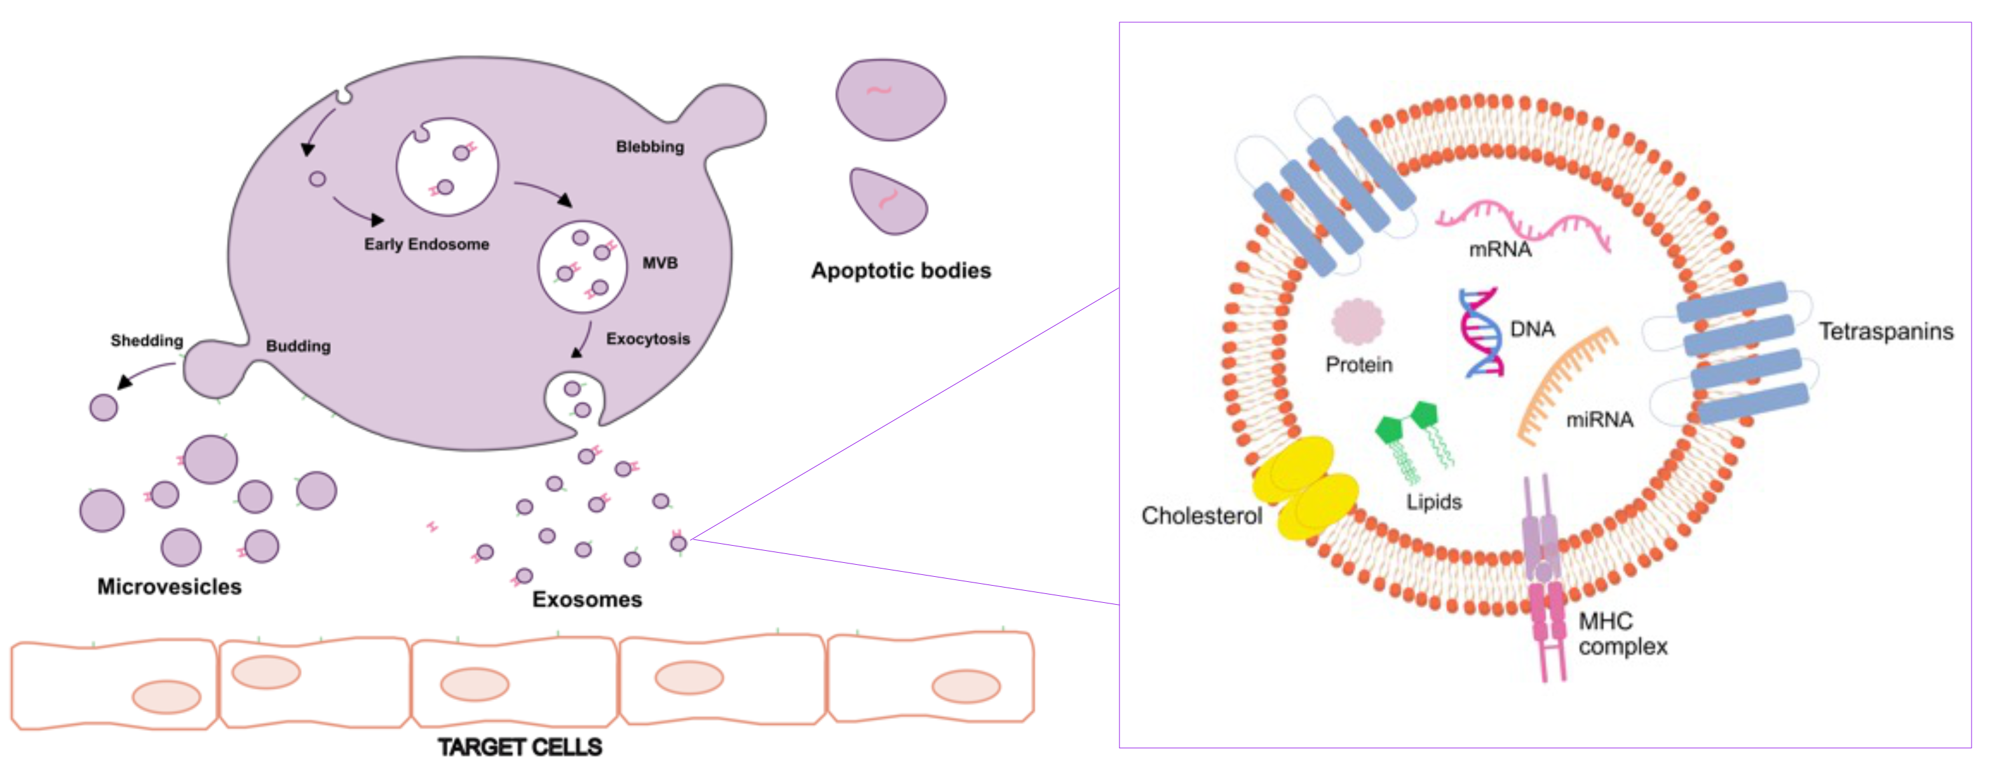
Extracellular vesicles as a ctDNA source
Notes:
Extracellular vesicles (EV) are small lipid bilayer vesicles (<200nm-4um) ubiquitous in almost all LBs, but studies show that they are required to maintain tissue homeostasis and activate a response to pathogenesis in the extracellular environment. Thus, disease Evs may provide info on the pathology and physiology of parent cells.
Moroever, biomarkers from Evs shed directly from tumour cells may provide a more accurate depiction of the tumour environment and are known to a source of ctDNA
However, their diversity blurs their clinical utility
Thus, in a previous study we developed a differential ultracentrifugation method that enabled the acc
urate isolation of EV fractions in blood.

Slide 4
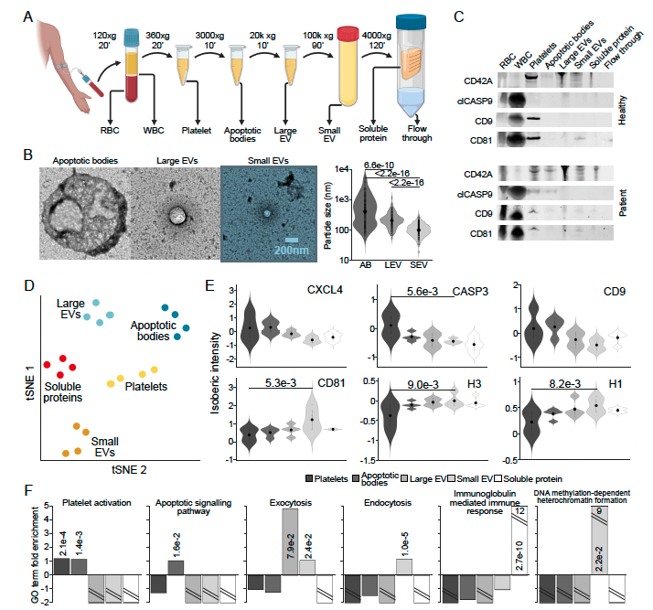
DIFFERENTIAL ULTRACENTRIFUGATION
Hagey et al., JEV 10.12 (2021): e12142
758 nm
239 nm
109 nm
Notes:
First, we performed scanning electron microscopy on the EV components isolated and quantified the size of the particles
Next, WB for markers of platelets (CD24a), AB (cleaved CASP9), and tetraspanins (CD9, 81)
Each marker was enriched in the expected fraction in healthy controls BUT also, there was a more dispersed distribution of all markers in PANC patients

Slide 5
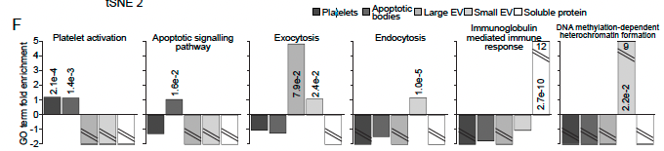
DIFFERENTIAL ULTRACENTRIFUGATION
Notes:
We then expanded to an unbiased approach – proteomics on fractions of 4 healthy controls (IgG and albumin depletion)
Tsne plots show proteins enriched in each fraction separated them from each other
generally DNA-associated protein H3 was similarly associated with
all of the vesicle and SP fractions, while the linker histone H1 was most highly expressed in the SEV fraction (Similarly, genes involved in ‘DNA
methylation-dependent heterochromatin formation’ were specifically enriched in the
SEV fraction)
Together, this analysis confirmed the enrichment of
expected blood components in appropriate differential centrifugation fractions and
suggested a distinct distribution of DNA complexes throughout.

Slide 6
AIM
Each component of blood is generated by distinct biological processes
Thus, we aim to elucidate the associations and nature of ctDNA as diseases progress thereby exploring its potential to improve disease monitoring at various stages of treatment.

Slide 7
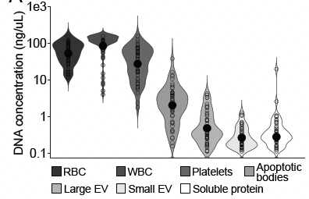
PANCREATIC CANCER COHORT
55 samples from 21 patients
21 samples from 21 controls
Notes:
DNA isolated using a precipitation-based method ()
Most DNA IN WBC and least in SEV (several orders of magnitude difference)
Divided cohort into groups based on time between sample acquisition and patient death
validated by significant differences in CA-19-9 levels and disease progression based on CT scans

Slide 8


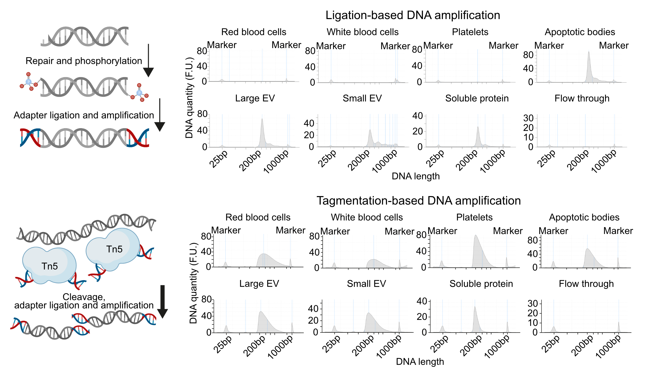
Short versus long DNA
Notes:
Tracking tumour material from long and short DNA needed enrichment from components separately
Short -common ligation method: evs and sp
Ligation lib – SEV DNA consistently derived from dinucleosome and longer DNA species (rare in AB and SP), SEV longer library
Long-tagmentation method: cellular, vesicular, sp only not flow through
WBC = longest library….decreased with vesicle size. SP = shortest

Slide 9
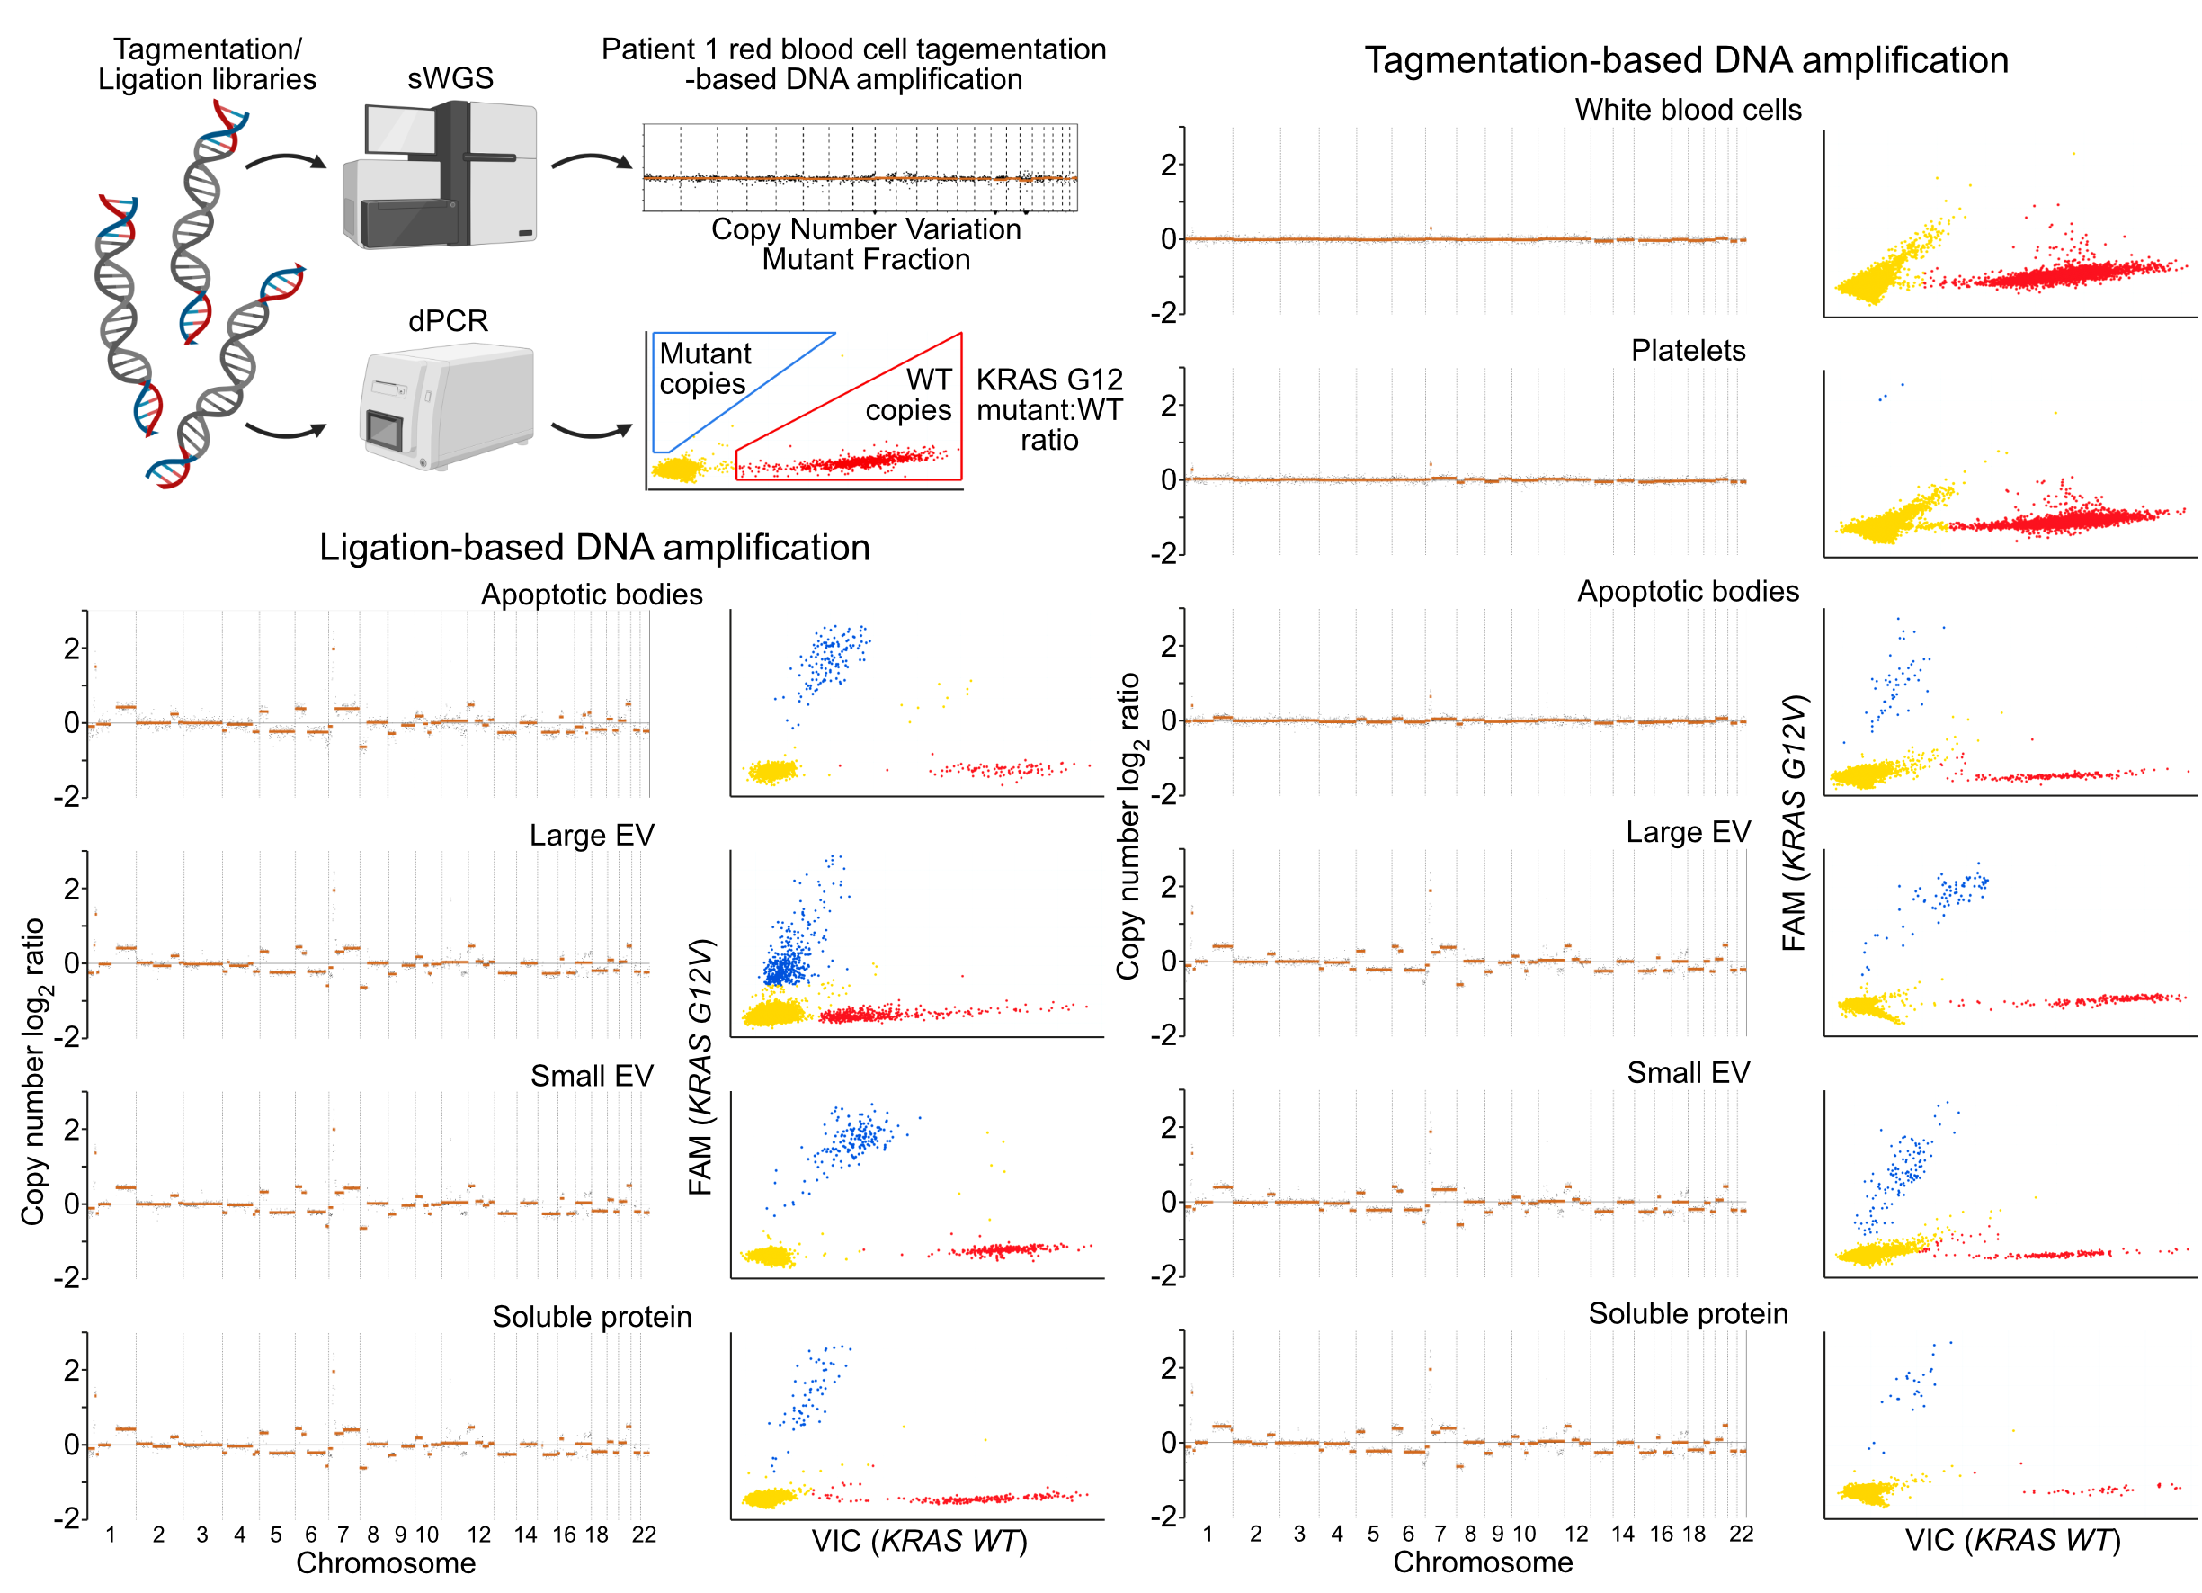
MUTANT FRACTION MEASURES
Notes:
To judge enrichment of tumour DNA in fractions complenetary strategies
Swgs(shallow genome sequencing) – used CNVs revealed to judge tumour fraction
Digital PCR – assess WT:Mutant KRAS DNA copies
Vesicular and SP components had more DNA than cells and platelets (CNV profiles of long and short patient-matched) – leave out?

Slide 10
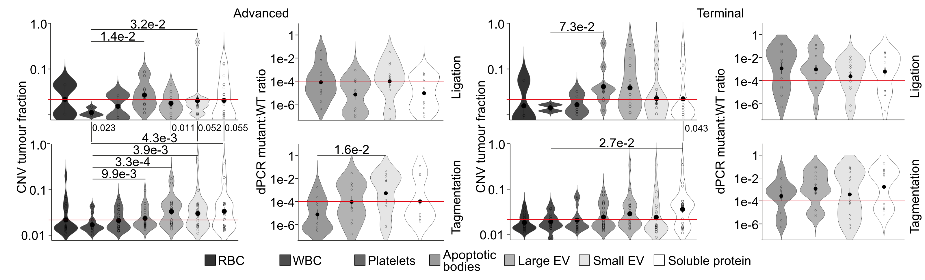
MUTANT FRACTION MEASURES
Notes:
Ligation library – most ctDNA found in Abs regardless of stage
Tagmentation - > ctdna enrichment in SP, LEV, SEV (advanced)
decreased in SEV, increased in SP (terminal)

Slide 11
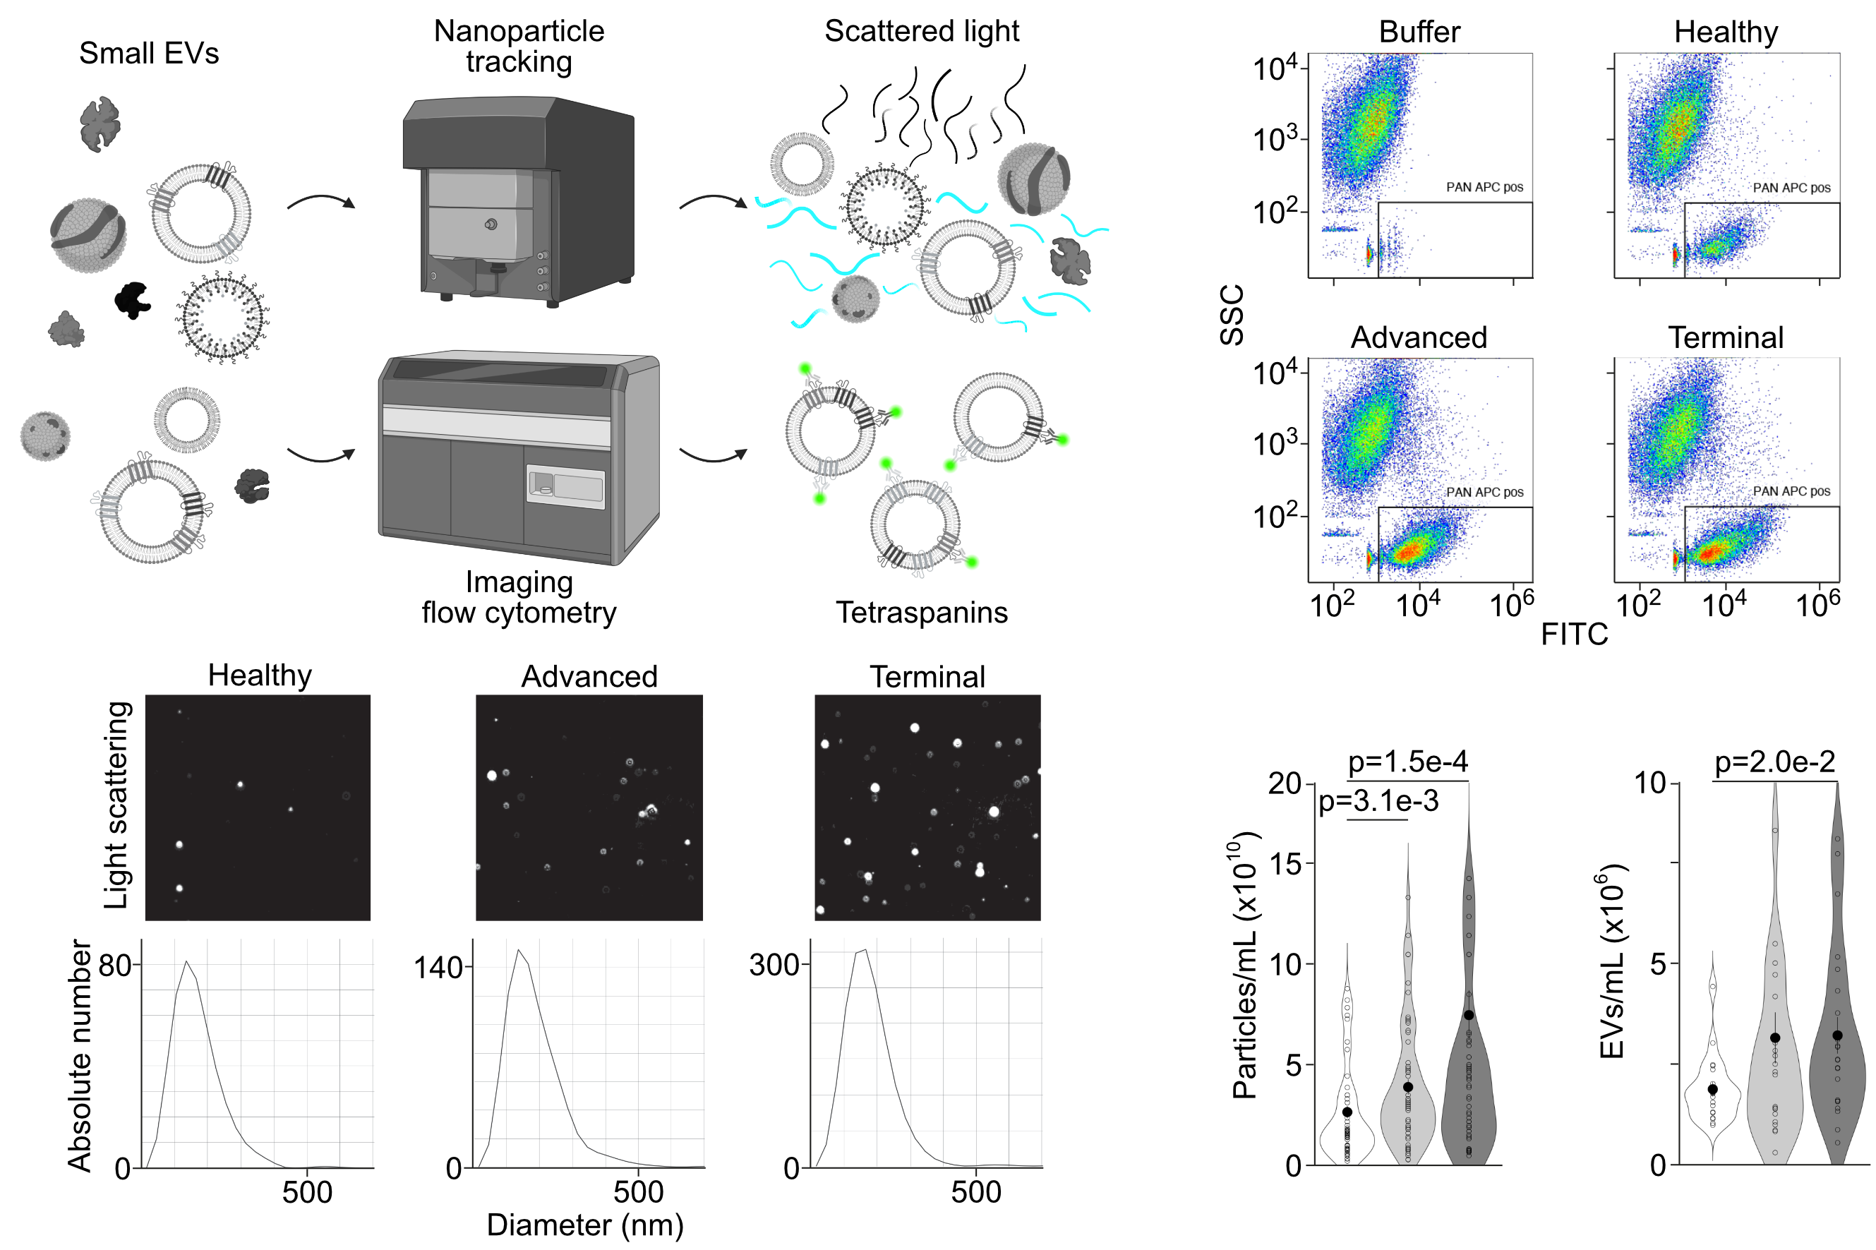
PARTICLE COUNTS
Notes:
To better understand dynamics during progression analyzed particles in SEV fraction
Number of particles increased with disease stage
Similar number of tetraspanins in control and stable disease increased in andvanced and remained stable to terminal.
Discrepancy - ? Nature of DNA complexes within blood

Slide 12
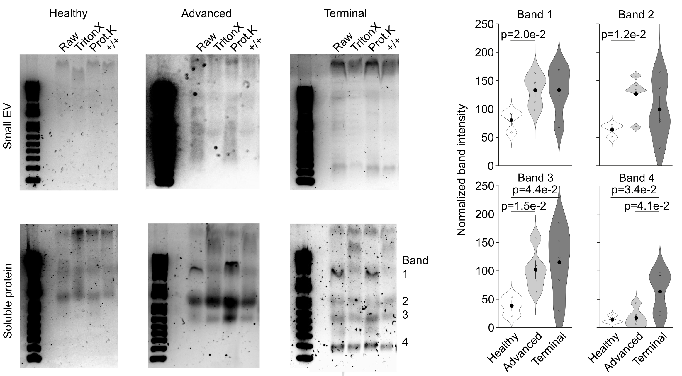
DNA GEL PROFILES
Notes:
Ran SEV fraction at diff stages on native agarose gels labelled DNA with SYBR Gold
Single high mw band in all – sensitive to triton x100 but not protein K
Patients showed additional faint lower mw bands
Bands coprecipitated during uc due to increased abundance?
Repeated for SP fraction – confirmed abundance of low mw complexes – distinct properties in SP (BAND 1-4)
Band 1 – detergent sensitive, band 2-3 –proteinase K sensitive, band 4 – resistant to both
All bands increased in patients but for bands 1-2 already sig in controls, band 3 increased 3-fold, band 4 increased 4-fold in terminal patients

Slide 13
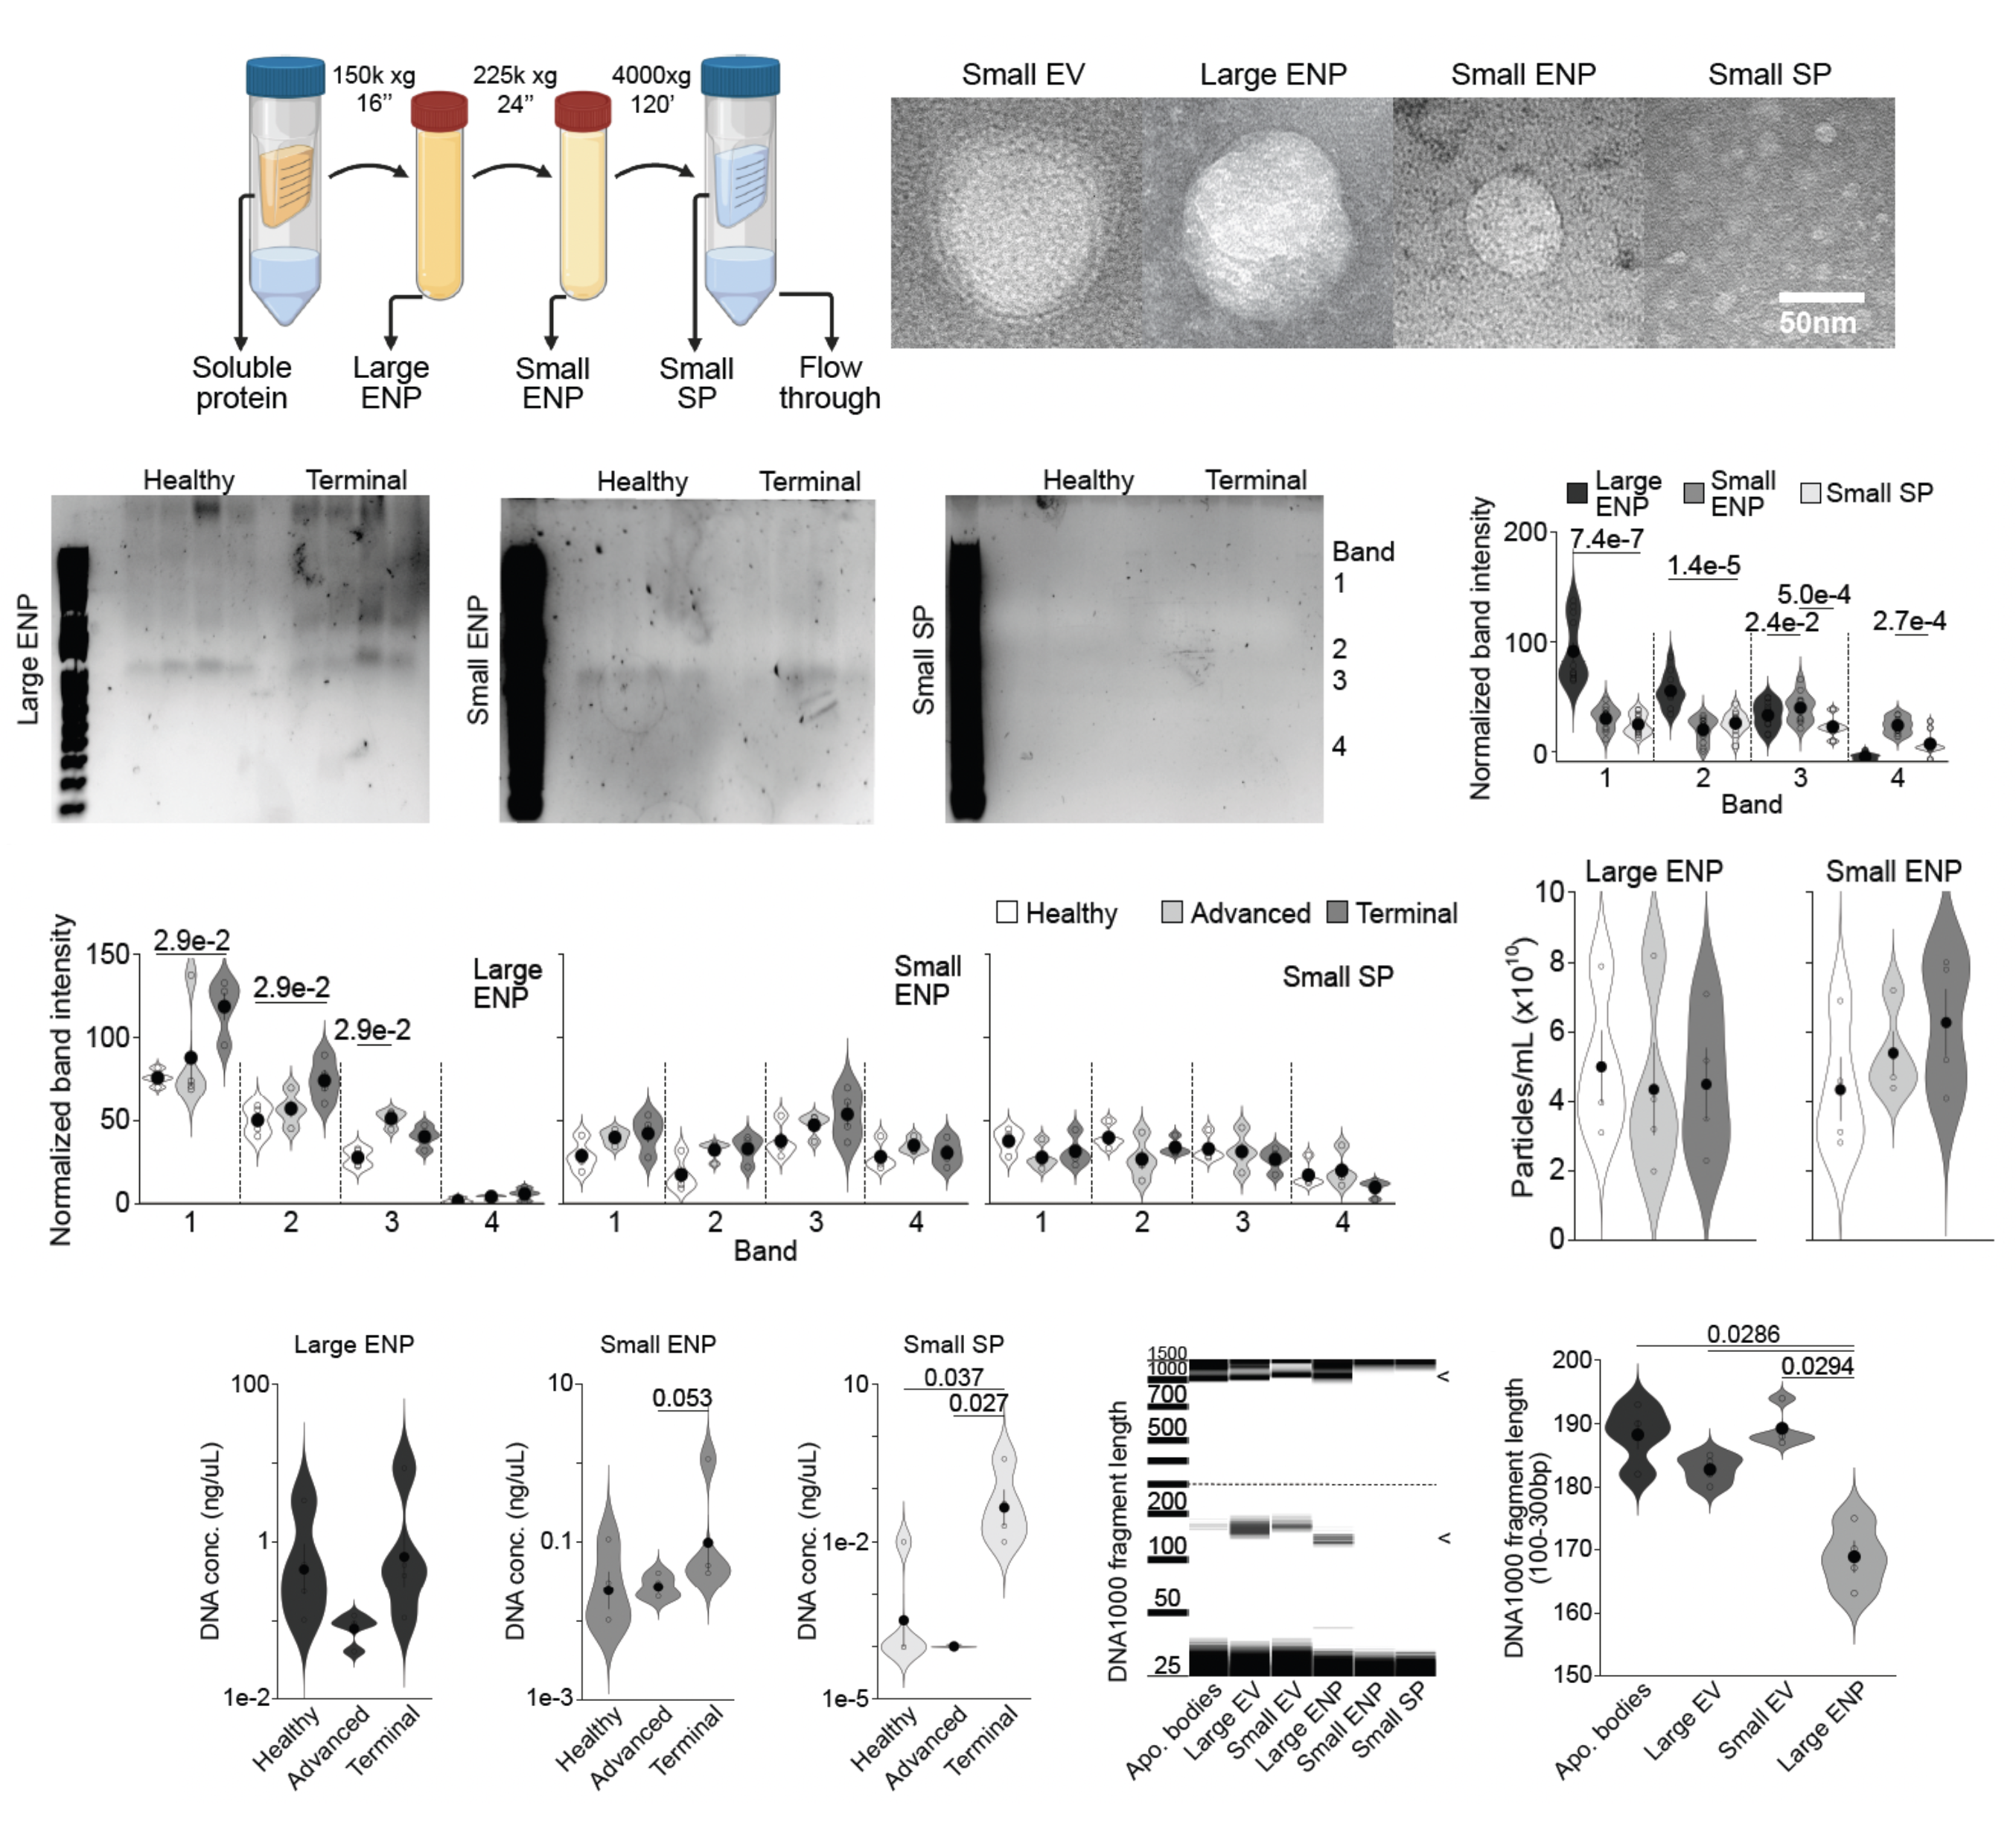
EXTRACELLULAR NANOPARTICLES
Notes:
Further characterize complexes in SP, diluted and further UC to isolate isolate L and S extracellular nanoparticles (ENP)
Electron microscopy show ENPs not in small SPs only
DNA staining showed bands in all (4 controls and terminal)
Bands 1-2 in LENPs , 3-4 in SENPs
Increased DNA in bands 1-3 as disease worsens, little DNA in sSP.
NTA – similar LENP levels, SENP increased with stage – same with DNA quantity (2 low 4 microfluidic electrophoresis)
BUT LENPs associated with longr >1kbp and shorter<200bp frags
Short fragments associated with LENPs 167bp >10bp shorter than those in other fractions

Slide 14
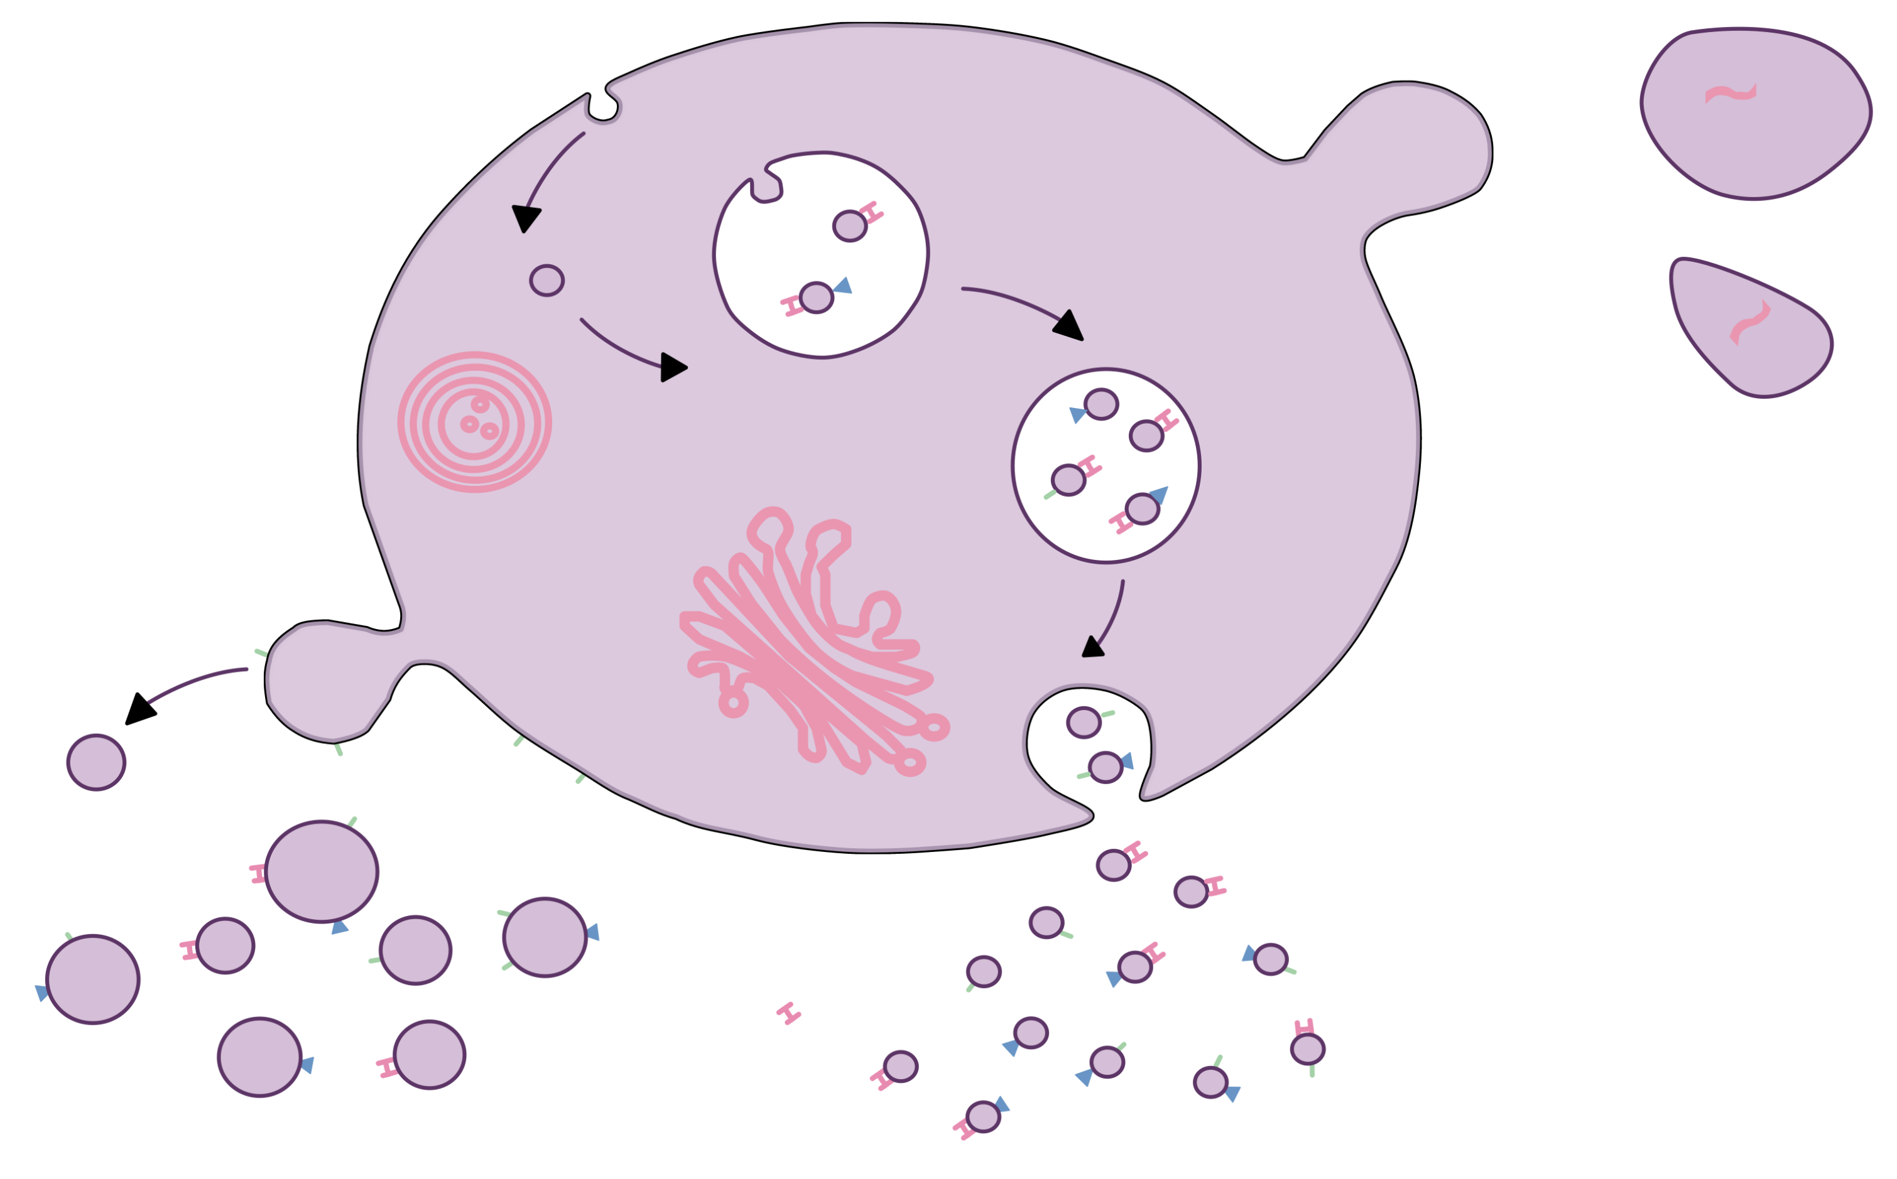

CONCLUSION
Clinical utility of ctDNA for monitoring is validated
Varying protocols result in discrepancies
Here, recommend best pre-analytical conditions
For short DNA – plasma $≤$ 360 g
  20 000 g pellet
Enriching relevant fractions improves sensitivity
Deeper understanding of ctDNA production
Increase research into long EV DNA

Slide 15
metoboroghene.mowoe@ki.se
KAROLINSKA
Max Kordes
Osama Saher
Johannes Löhr
Mathilde Slamani
Samir El Andaloussi
Matthias Löhr
André Görgens
Daniel Hagey
CAMBRIDGE
Nitzan Rosenfeld
Chris Smith
Jessica Videira
Matthew Eldridge
Images were created using Affinity Designer

Slide 16
That’s all folks!
Questions?
We are what we repeatedly do; Excellence then, is not an act, but a habit.
– Williams James Durant

