Slide 1
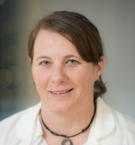
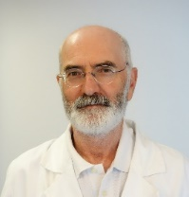
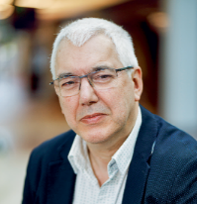

ELBS General Assembly 2024 ctDNA technology working group
November 26th – 27th
Barcelona Biomedical Research Park,
Barcelona, Spain
ctDNA
Prof. Ellen Heitzer
University of Graz
Dr. Patrizio Giacomini
Policlinico Gemelli
Prof. Ed Schuuring
University of Groningen

Slide 2
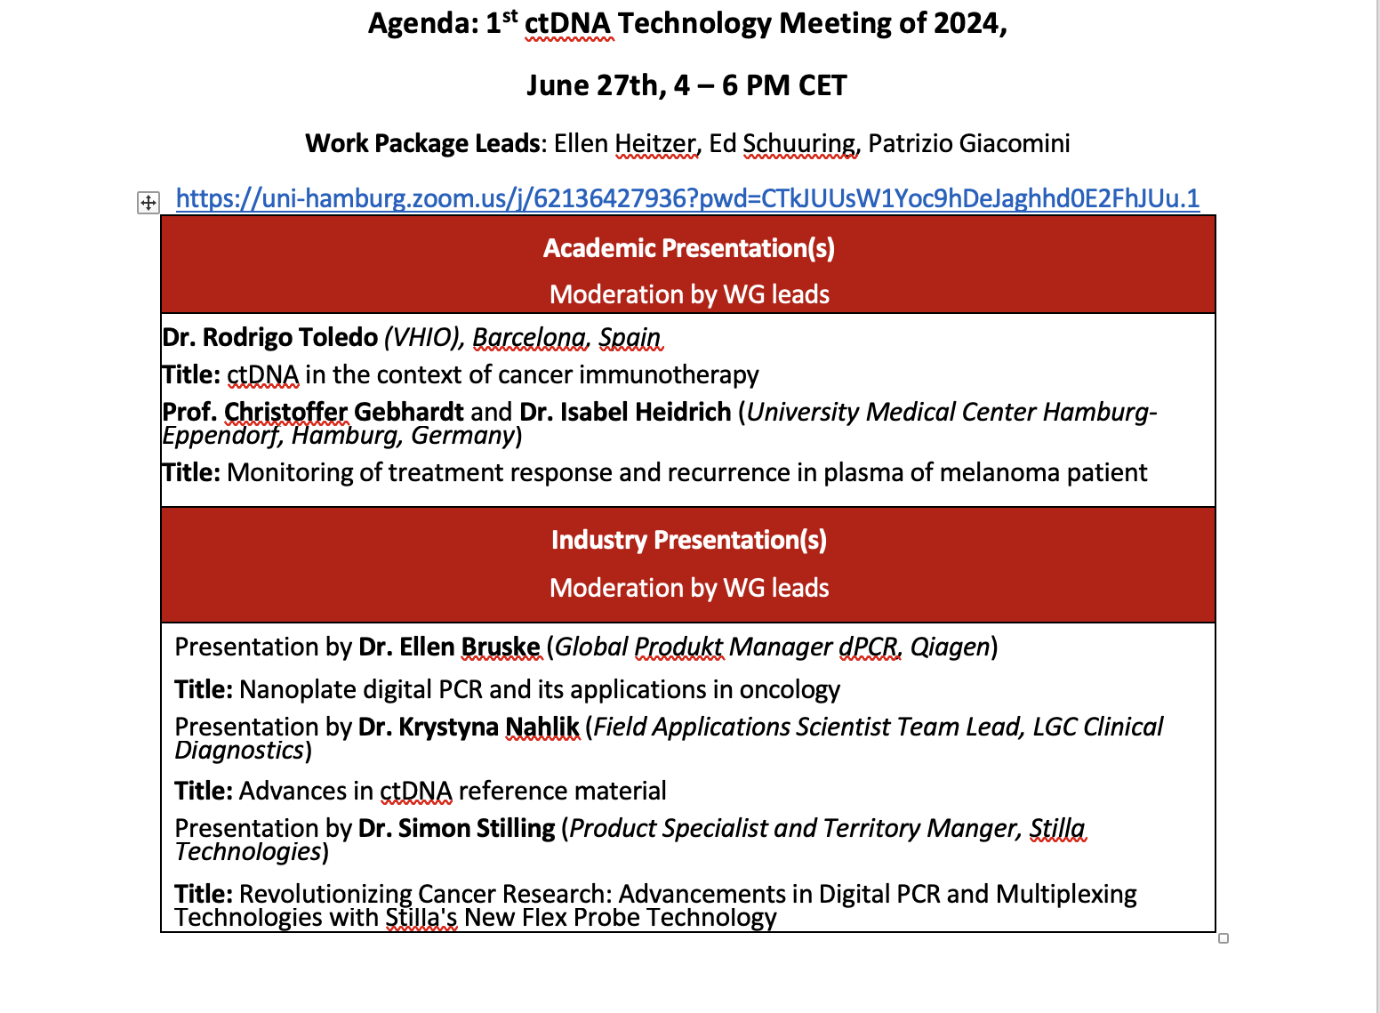

Overview of activities: yrs 2023-2024
Yrs 2023-24
yr2024
Further assessments and completing the recommendation reports
ctDNA Expert workshop on quality assessment and reporting

Slide 3
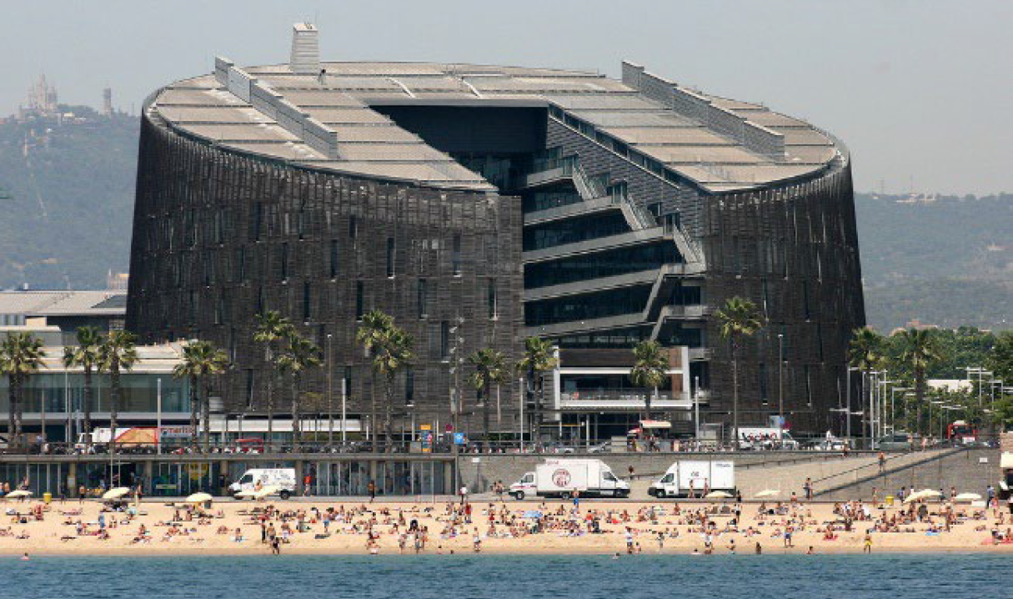
ctDNA Expert workshop on quality assessment and reporting
Barcelona Biomedical Research Park (PRBB)

Slide 4
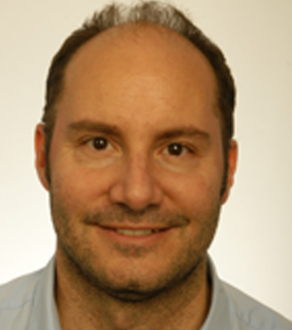
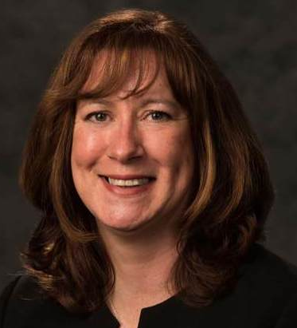
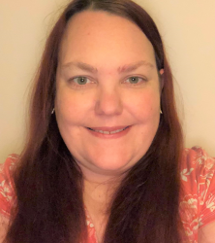
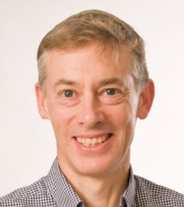
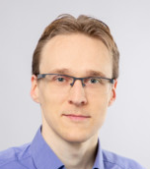
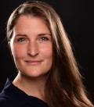
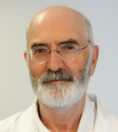
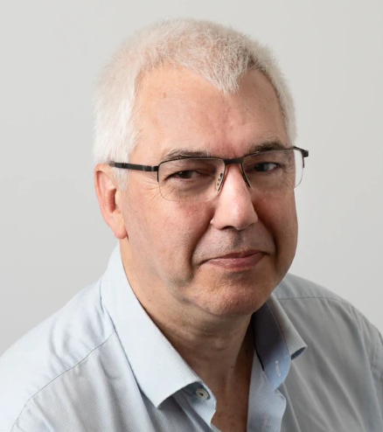

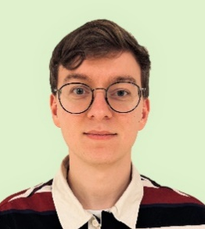
Organisation committee – ELBS-ctDNA workshop
Barcelona – Oct 2023
Rodrigo De Almeida Toledo
VHIO
Zandra Deans
GenQA
Jenni Fairley
GenQA
Simon Patton
EMQN
Simon Joosse
CAN.HEAL
Claudia Koch
ELBS
Patrizio Giacomini
ELBS
Ed Schuuring
ELBS
Ellen Heitzer
ELBS
Vincent de Jager
UMCG

Slide 5


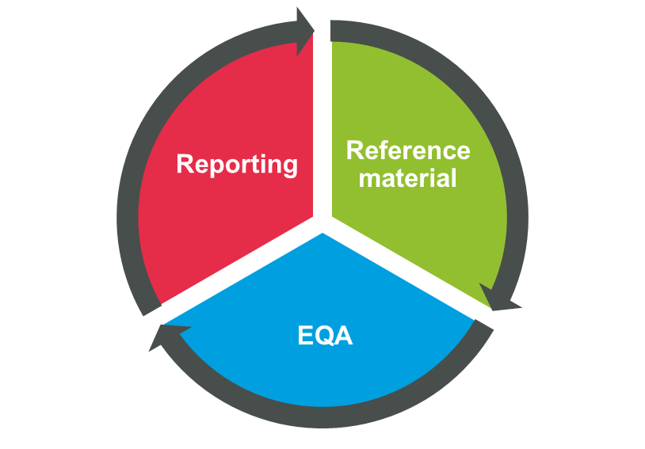


ctDNA EXPERT WORKSHOP ON
QUALITY ASSESSMENT AND REPORTING
What type of refmats do we need for assay validation?
Do we need to cover all types of genetic alterations?
How deep should we go?
What types of EQAs do we need?
What types of alterations should be assessed?
Which use cases should be included?
Should treatment decision be made on low level variant?
Should a confirmatory test be done?
How to deal with CH-related variants?
Which CNA should be reported?
Should VUS be reported?

Slide 6



How to report plasma-derived ctDNA results to the oncologist?
Vincent D. de Jager, MD, PhD-candidate
Department of Pathology and Medical Biology,
University Medical Center Groningen, The Netherlands
On behalf of the ctDNA working group of the European Liquid Biopsy Society (ELBS)

Slide 7
Disclosures
PhD appointment at UMCG was financially supported by a shared grant (‘Landelijke implementatie predictieve analyses bij longkanker op regionaal niveau’) from AstraZeneca, Bayer, Pfizer, Lilly, MSD and Roche (received by prof. dr. S.M. Willems (head of the department of PMB at UMCG)
Speaker’s fee: Roche, Janssen (Johnson&Johnson) (all paid to UMCG account)

Slide 8
Table of contents
‘Why is ctDNA testing important?’
‘What is the problem for reporting ctDNA test results?’
  Reporting of tissue-based versus cfDNA-based test results
‘What did we do’?
  European Liquid Biopsy Society (ELBS) workshop
‘What is next’?
  Practical guidelines/recommendations

Slide 9
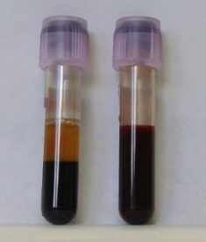
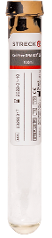
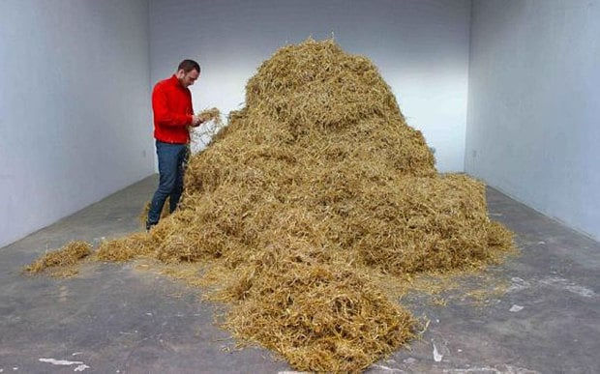
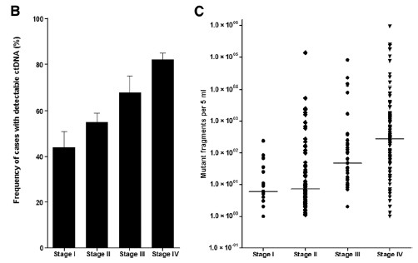
Typical characteristics of circulating tumor DNA
Size of ctDNA/cfDNA in plasma: 166bp
(nucleosome-protected DNA degradation)
ctDNA not detected in all patients with cancer
Heitzer , Clin Chem 2015
Image from www.palaisdetokyo.com
Fraction ctDNA in total circulating
cell-free DNA in plasma: <0.1-1%
Bettegowda, Sci Transl Med 2014

Slide 10
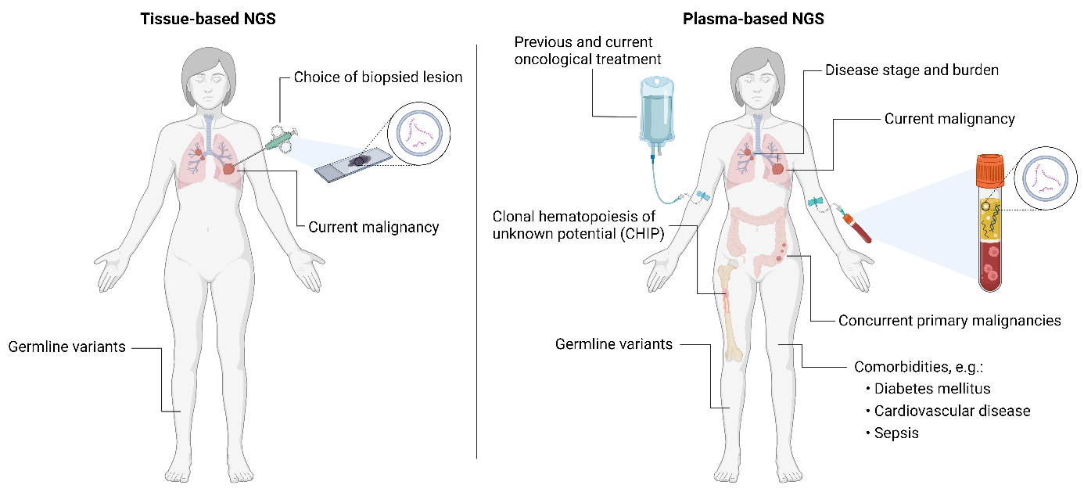

‘What is the problem for reporting ctDNA test results?’
Sensitivity
  Tumor → >20% tumor cells (variants >10% VAF)
  Plasma cfDNA → <1% ctDNA (often <0.5%)
Additional complexities
  CHIP
  Variants from other malignancies
  Comorbidities
Germline mutations
Guidelines for tissue-based molecular test results
  Too limited for reporting of cfDNA-based testing
Created with www.BioRender.com.

Slide 11
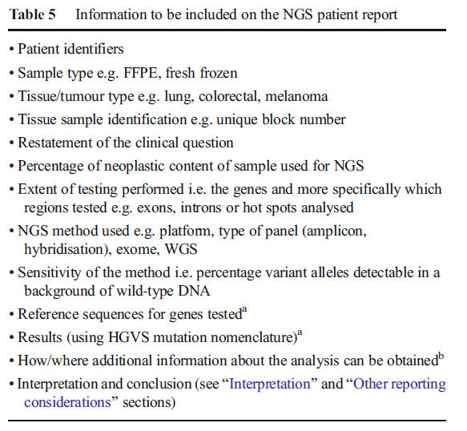
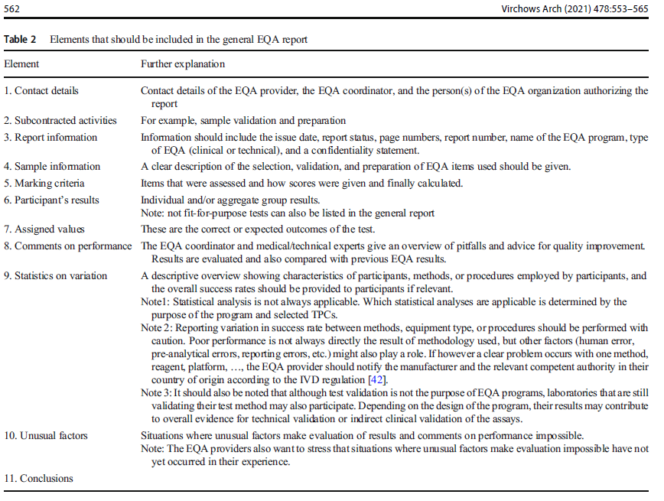
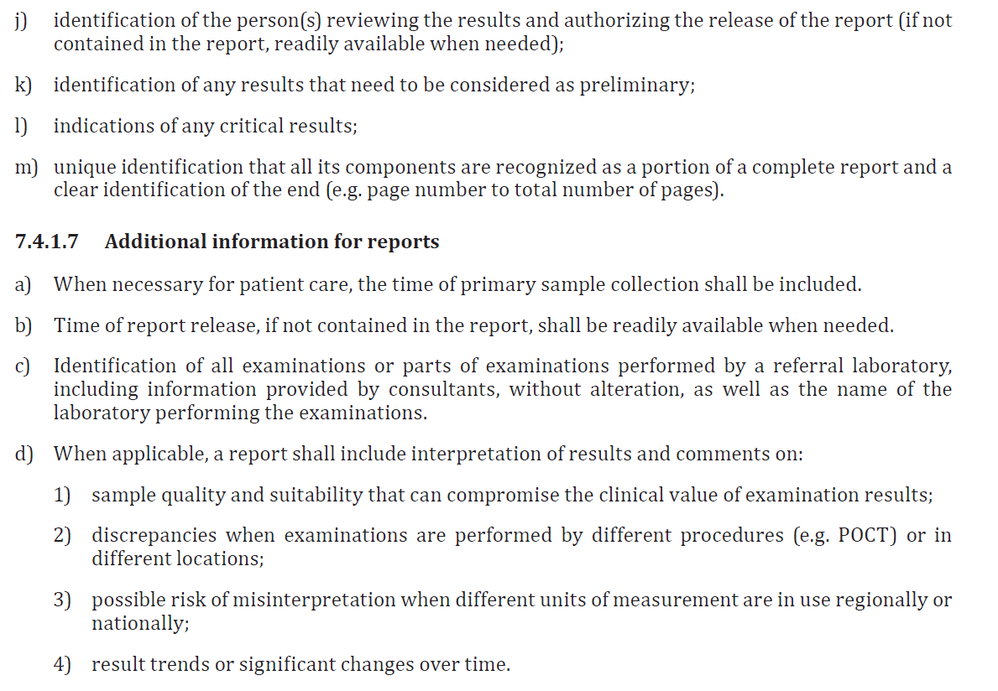
‘What is the problem for reporting ctDNA test results?’
Guidelines for reporting of molecular are available for tissue-based NGS

Slide 12
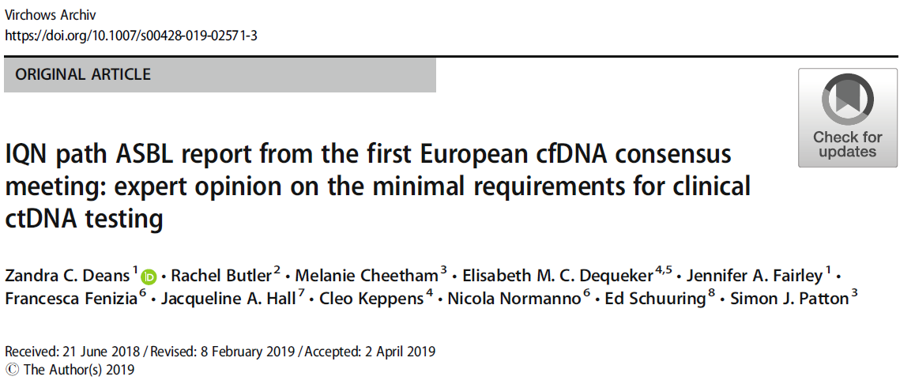
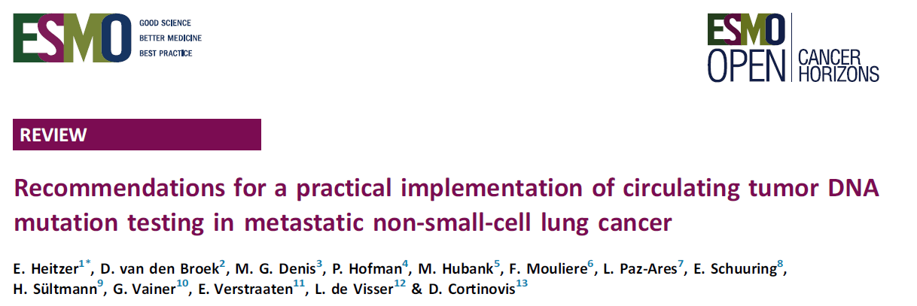
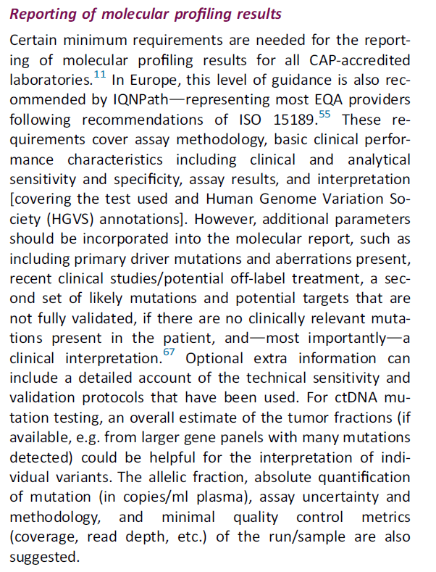
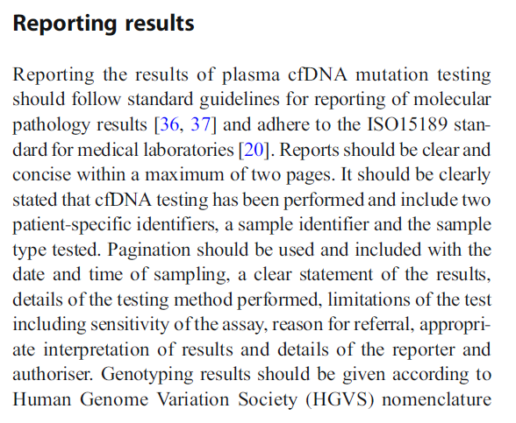
Reporting on molecular findings using plasma-based analysis

Slide 13
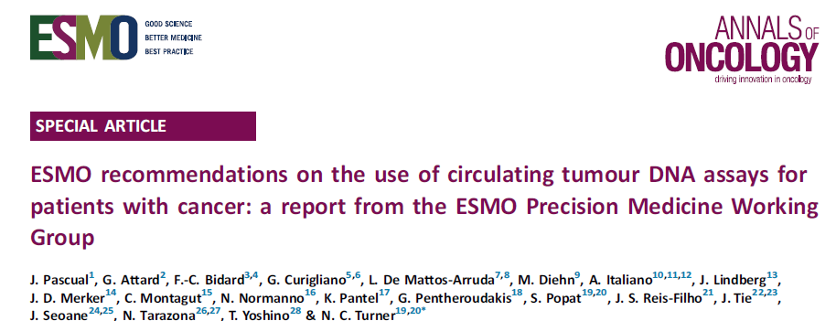
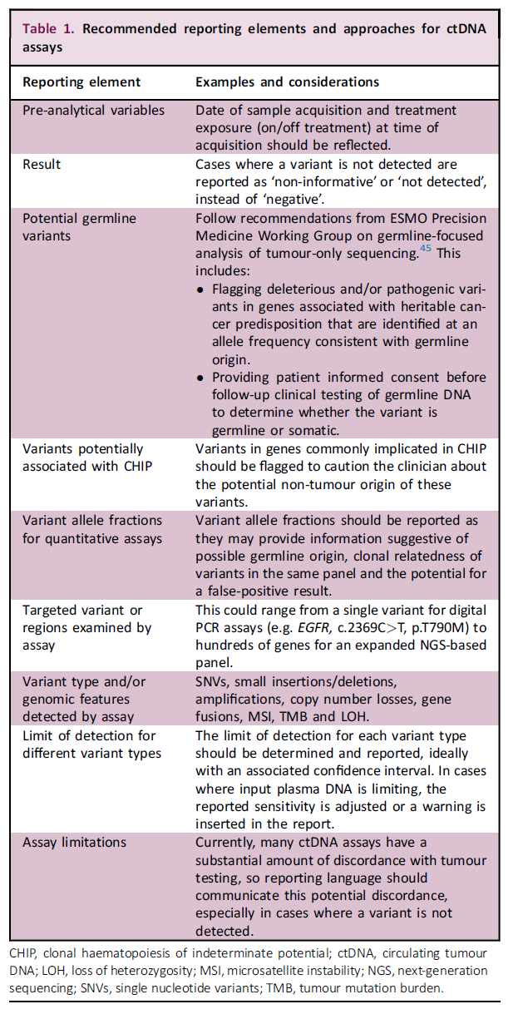
Reporting on ctDNA findings
The liquid biopsy report should be thorough and complete yet easy to interpret. Standards of molecular diagnostics reporting have been published by laboratory accrediting organizations including the CAP and the European Society of Pathology Task Force on Quality Assurance in Molecular Pathology and the Royal College of Pathologists. Certain minimum elements are required in all reports for CAP-accredited laboratories. These elements include (in addition to patient identifiers and specimen type) assay methodology, basic clinical performance characteristics including clinical and analytic sensitivity (limit of detection) and specificity, assay results, and interpretation.

Slide 14
Reporting on ctDNA findings
Today regarding reporting ctDNA results for clinical-decision-making:
Lack of guidance
Lack of consensus
Lack of standardisation
Lack of concrete recommendations
The liquid biopsy report should be thorough and complete yet easy to interpret. Standards of molecular diagnostics reporting have been published by laboratory accrediting organizations including the CAP and the European Society of Pathology Task Force on Quality Assurance in Molecular Pathology and the Royal College of Pathologists. Certain minimum elements are required in all reports for CAP-accredited laboratories. These elements include (in addition to patient identifiers and specimen type) assay methodology, basic clinical performance characteristics including clinical and analytic sensitivity (limit of detection) and specificity, assay results, and interpretation.

Slide 15
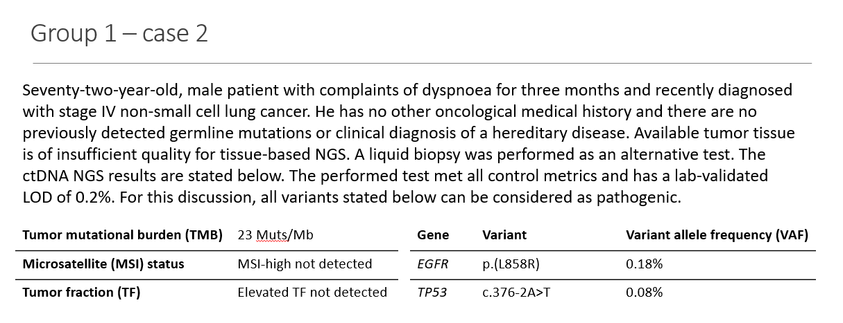
‘How to interpret and report molecular findings from plasma-derived cell-free DNA?’
Defining ELBS-recommendations on reporting of plasma-based ctDNA findings
Example of molecular findings from NGS analysis using cfDNA

Slide 16
ctDNA Expert workshop on reporting of ctDNA/cfDNA data
Discussion Groups
Vincent de Jager, Patrizio Giacomini, Jenni Fairley, Claudia Koch, Ellen Heitzer, Ed Schuuring

Slide 17
Defining ELBS-recommendations on reporting of plasma-based ctDNA findings
Organisation committee – ELBS-ctDNA workshop
Barcelona – Oct 2023
Rodrigo De Almeida Toledo
VHIO
Zandra Deans
GenQA
Jenni Fairley
GenQA
Simon Patton
EMQN
Simon Joosse
CAN.HEAL
Claudia Koch
ELBS
Patrizio Giacomini
ELBS
Ed Schuuring
ELBS
Ellen Heitzer
ELBS
Vincent de Jager
UMCG

Slide 18

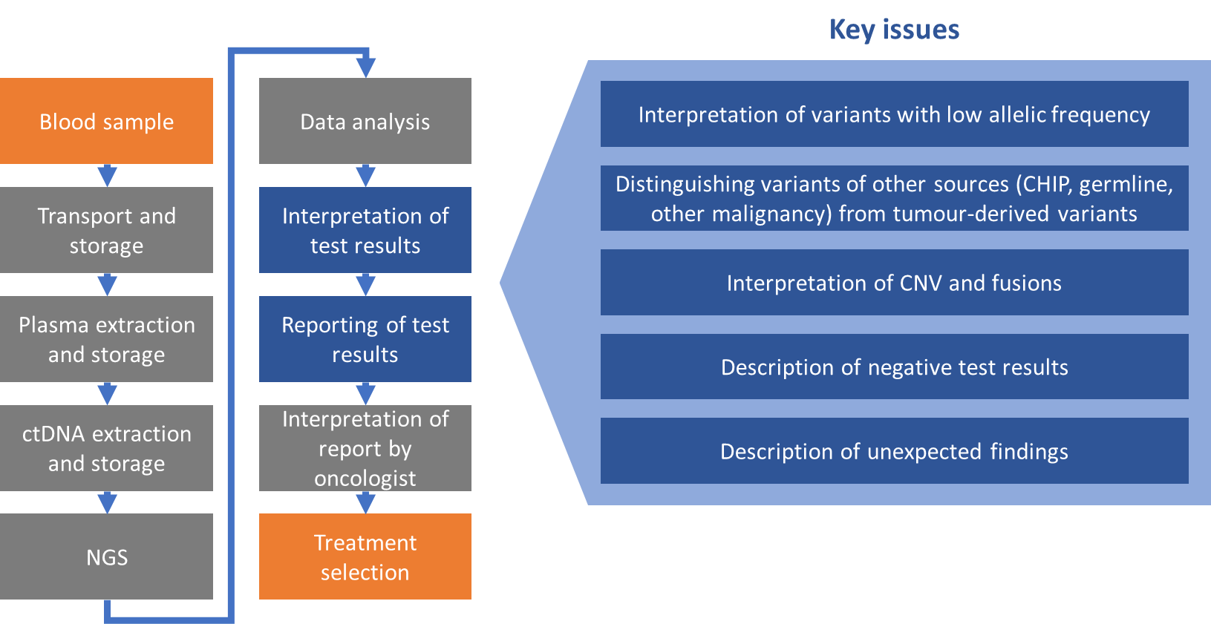
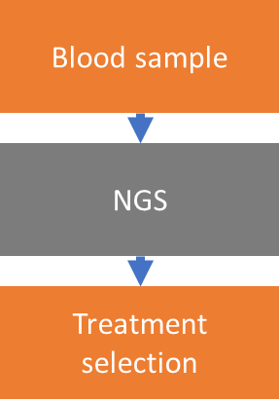
‘What is our aim?’
Aim: to enable clear, effective communication through test reports between pathologists, clinical scientists, and oncologists for optimal treatment selection based on ctDNA-based NGS
Expected outcome: expert opinion consensus recommendations for reporting of plasma ctDNA-based molecular results with focus not only on technical validity but also clinical usefulness and mutual understanding between healthcare professionals

Slide 19
‘What did we do?’
Pre-workshop questionnaire
Workshop
Post-workshop questionnaire
Results
Pre-workshop questionnaire
  Should you report variants below the test’s limit of detection (LOD)?
  Would you indicate actionability for variant with (very) low VAF?
  Challenges/issues encountered in reporting liquid biopsy test results
Aim to prepare participants for workshop

Slide 20

Defining ELBS-recommendations on reporting of plasma-based ctDNA findings
Pre-workshop questionnaire
Workshop
Post-workshop questionnaire
Results
Invited to ensure a mix of representatives, all involved in liquid biopsies
44 experts
Barcelona Biomedical Research Park (PRBB)

Slide 21
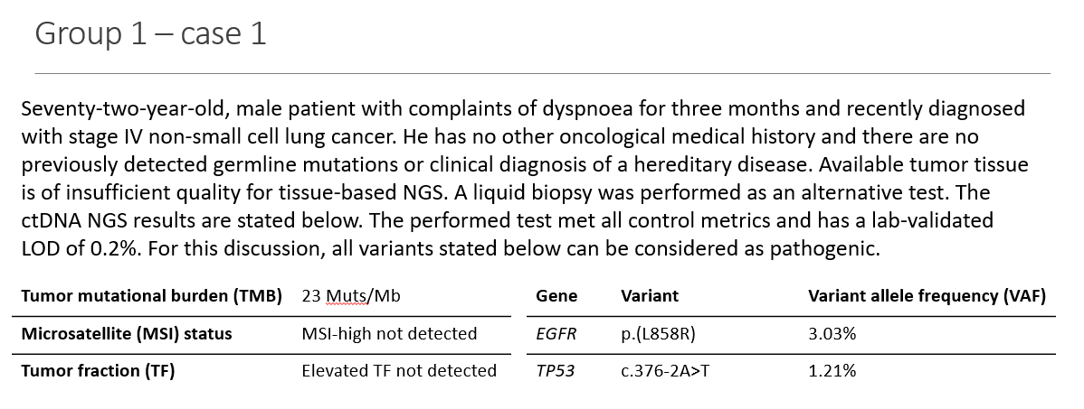
‘What did we do?’
Pre-workshop questionnaire
Workshop
Post-workshop questionnaire
Results
Focus on NGS-based cfDNA testing for predictive biomarkers in patients with histopathological diagnosis of cancer
Discussion groups
  Examples of clinical cases
Plenary discussions

Slide 22
‘What did we do?’
Pre-workshop questionnaire
Workshop
Post-workshop questionnaire
Results
Input from workshop
77 statements
Request for ctDNA testing | Reporting of variants & variants with low VAF
Availability of information prior to ctDNA testing | Distinguishing CH-related variants from tumor-derived variants
Pre-analytical variables and timeframe | Somatic copy number alterations and fusions
Assay specifications and performance assessment | Reporting of negative results
Quality metrics | Unexpected findings

Slide 23
‘What did we do?’
Pre-workshop questionnaire
Workshop
Post-workshop questionnaire
Results
Examples of statements
For each variant, the following parameter(s) should be reported:
Variant allele frequency (%)
Sequencing depth
No. of mutated molecules
Confidence level
Base specific signal-to-noise ratio
If tumor fraction estimation is not included in the test, negative test results should be reported as ‘ctDNA not detected’. Use of terms as ‘wildtype’, ‘negative’, or ‘absence of mutations’ should be avoided.

Slide 24
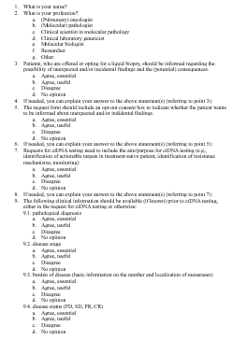
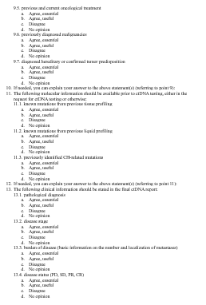
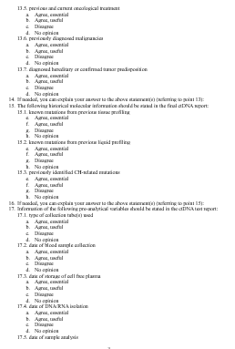
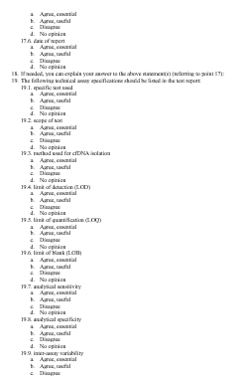
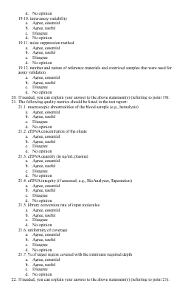
‘What did we do?’
Pre-workshop questionnaire
Workshop
Post-workshop questionnaire
Results
Level of agreement for each statement
  Agree, essential
  Agree, useful
  Disagree
  No opinion
Feedback

Slide 25
‘What did we do?’
Pre-workshop questionnaire
Workshop
Post-workshop questionnaire
Results
Consensus agreement defined as ≥80% agreement (essential or useful)
For 52 out of 77 statements consensus agreement was reached

Slide 26
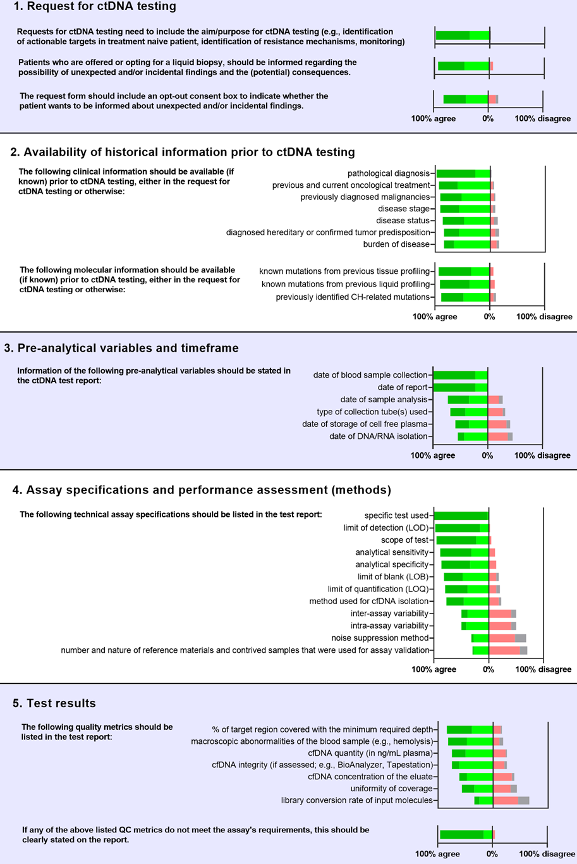
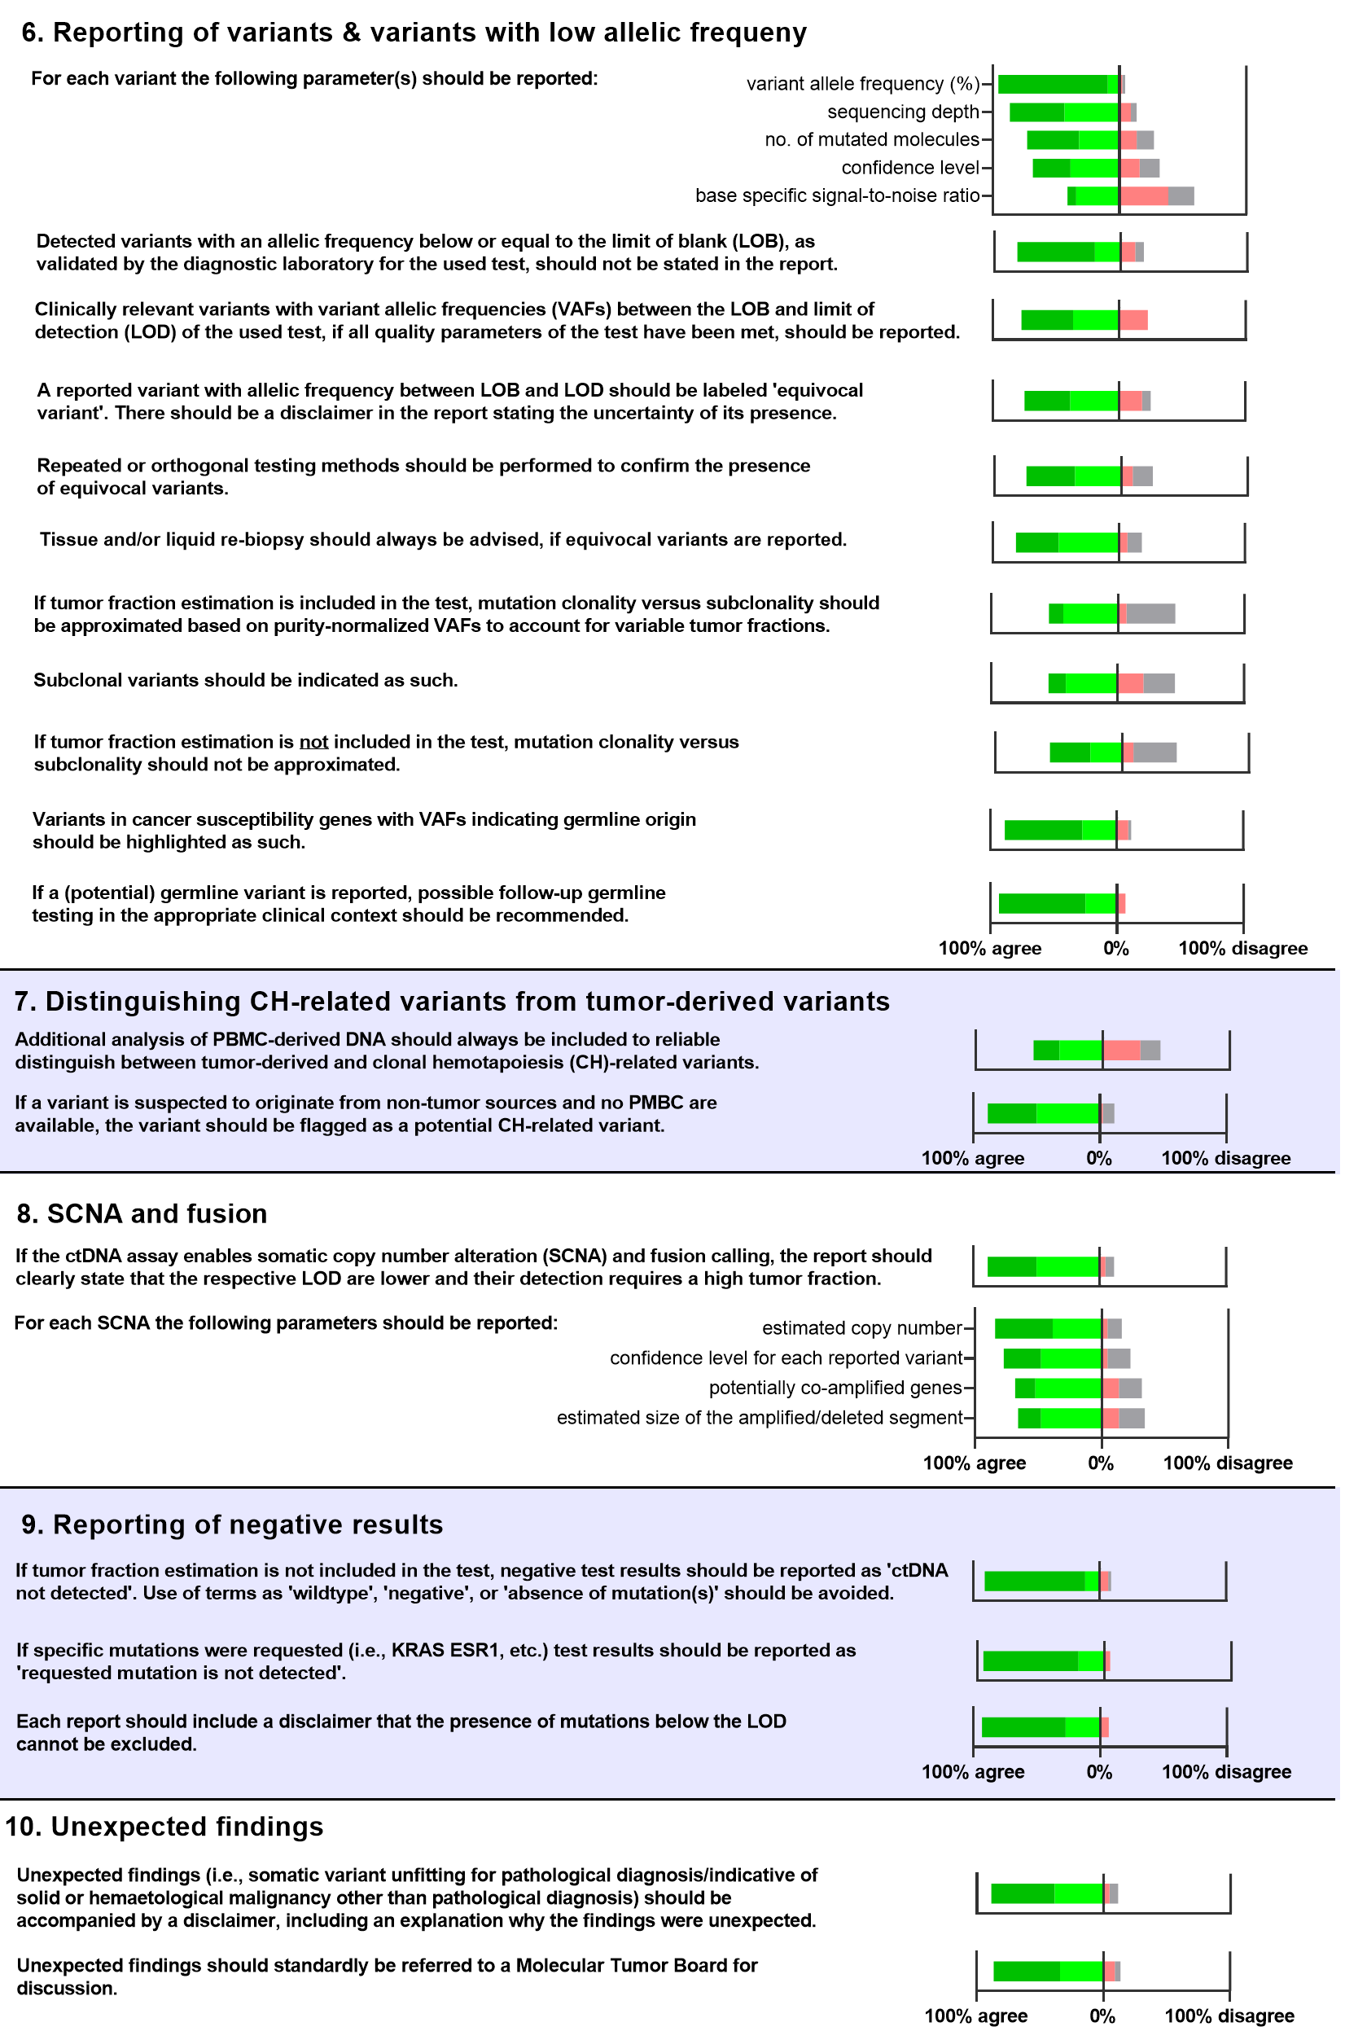
‘What did we do?’
Pre-workshop questionnaire
Workshop
Post-workshop questionnaire
Results
Consensus agreement defined as ≥80% agreement (essential or useful)
For 52 out of 77 statements consensus agreement was reached

Slide 27
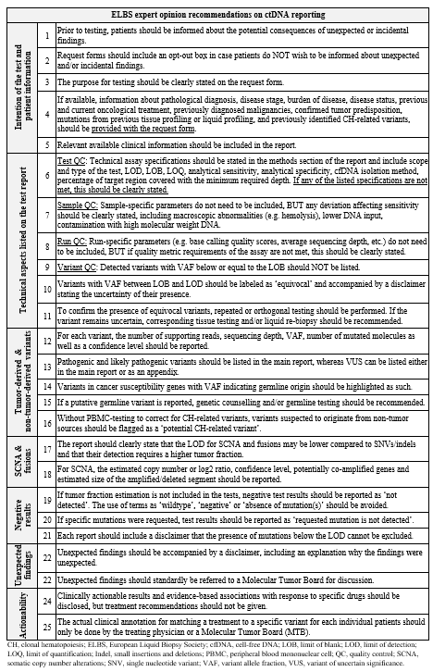
Recommendations for reporting molecular
findings from plasma-based cfDNA
Recommendations paper (under review)
  Expert consensus recommendations
  Underlying rationale

Slide 28
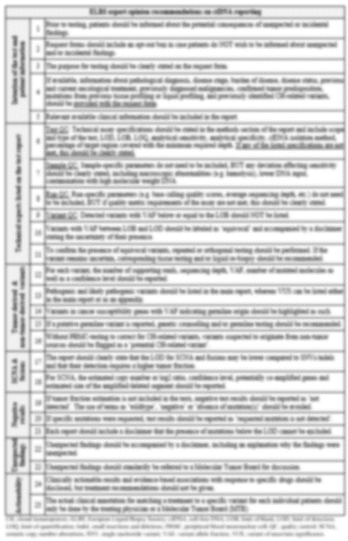
Recommendations for reporting molecular
findings from plasma-based cfDNA
Recommendations paper (under review)
  Expert consensus recommendations
  Underlying rationale

Slide 29
Recommendations for reporting molecular
findings from plasma-based cfDNA
Recommendations paper (under review)
  Expert consensus recommendations
  Underlying rationale

Slide 30
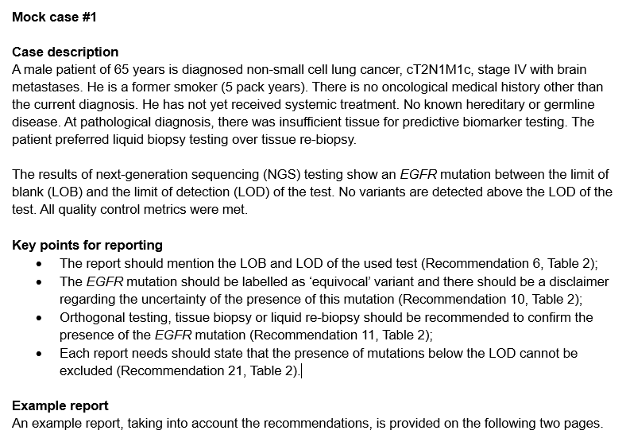
Recommendations for reporting molecular
findings from plasma-based cfDNA
Recommendations paper (under review)
  Expert consensus recommendations
  Underlying rationale
  Example reports of mock cases

Slide 31
Recommendations for reporting molecular
findings from plasma-based cfDNA
Recommendations paper (under review)
  Expert consensus recommendations
  Underlying rationale
  Example reports of mock cases

Slide 32
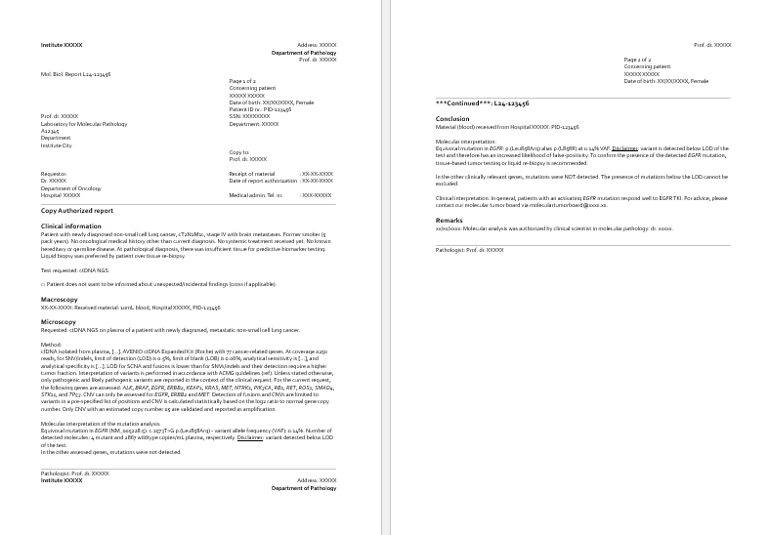
Recommendations for reporting molecular
findings from plasma-based cfDNA
Recommendations paper (under review)
  Expert consensus recommendations
  Underlying rationale
  Example reports of mock cases

Slide 33
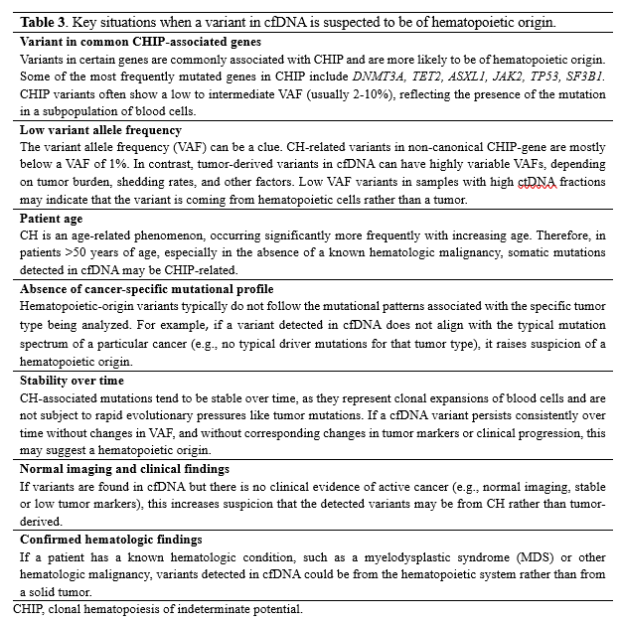
Recommendations for reporting molecular
findings from plasma-based cfDNA
Recommendations paper (under review)
  Expert consensus recommendations
  Underlying rationale
  Example reports of mock cases
  Defining CHIP

Slide 34
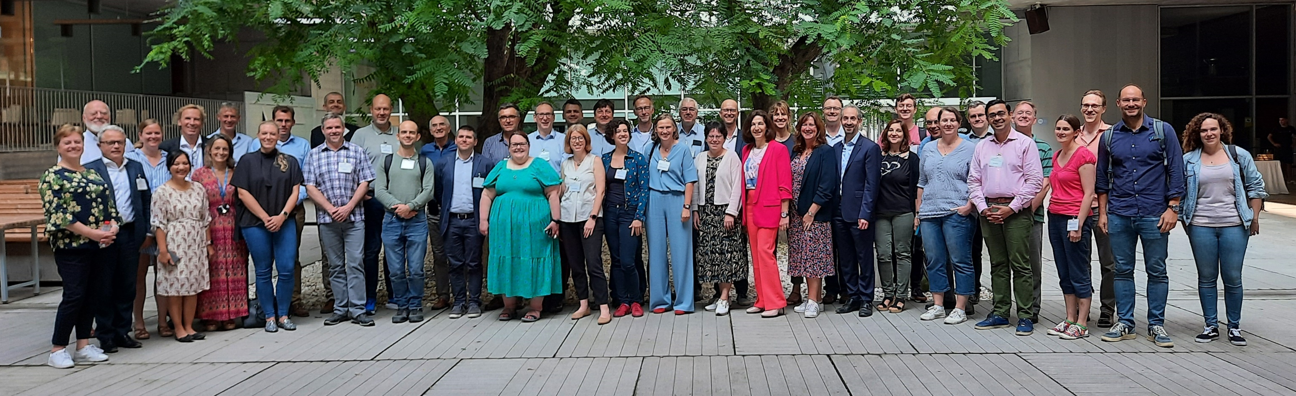
Acknowledgements
Participants of the ELBS workshop
ELBS organization & ctDNA working group
Sofia Agelaki, Claus Lindbjerg Andersen, Daniel Andersson, Beatriz Bellosillo, Inger Riise Bergheim, Daan van den Broek, Sandi Deans, Els Dequeker, Jenni Fairley, Beatriz García Peláez, Patrizio Giacomini, Alastair Greystoke, Ariane Hallermayr, Ellen Heitzer, Jeroen Hiltermann, Michael Hubank, Stefano Indraccolo, Vincent D. de Jager, Simon Joosse, Laura Keller, Matthew Krebs, Marjolijn Ligtenberg, Leandro Lo Cascio, Miguel A. Molina-Vila, Krystyna Nahlik, Michael Neumaier, Björn Nowack, Anca Oniscu, Stephan Ossowski, Andre Oszwald, Niels Pallisgaard, Simon Patton, Mads Heilskov Rasmussen, Etienne Rouleau, Amit Roshan, Mitja Rot, Helene Schlecht, Ed Schuuring, Ulrich Schüller, Laxmi Silwal-Pandit, Holger Sültmann, Philippe Taniere, Rodrigo Toledo, Nora Würdemann
PhD supervisors
  Prof. dr. Ed Schuuring
  Prof. dr. Léon C. van Kempen
  Dr. Anthonie J. van der Wekken
  Prof. dr. Stefan M. Willems

Slide 35
PLANNED ACTIVITIES

Slide 36

‘What is next?’ upcoming publications
ELBS-manuscript in preparation
Reference materials and External Quality Assessment for Liquid Biopsy assays: Expert Opinions from the 2023 European Liquid Biopsy Society ctDNA Workshop.
Reference material
EQA
Reporting
ELBS-manuscript under review
Reporting of molecular test results from cell-free DNA analyses: expert consensus recommendations from the 2023 European Liquid Biopsy Society ctDNA Workshop
Vincent D. de Jager¹, Patrizio Giacomini^{2,3}, Jennifer A. Fairley⁴, Rodrigo A. Toledo⁵, Simon J. Patton⁶, Simon A. Joosse⁷, Claudia Koch^{7,8}, Zandra C. Deans⁴, ELBS ctDNA Workshop Group, Klaus Pantel^{7,8}, *Ellen Heitzer^{3,9}, *Ed Schuuring^{1,3}
ELBS ctDNA Workshop Group (alphabetical order): Sofia Agelaki, Claus Lindbjerg Andersen, Daniel Andersson, Beatriz Bellosillo, Inger Riise Bergheim, Daan van den Broek, Zandra C. Deans, Els Dequeker, Jennifer A. Fairley, Beatriz García Peláez, Patrizio Giacomini, Alastair Greystoke, Ariane Hallermayr, Ellen Heitzer, T. Jeroen N. Hiltermann, Michael Hubank, Stefano Indraccolo, Vincent D. de Jager, Simon A. Joosse, Laura Keller, Matthew Krebs, Marjolijn Ligtenberg, Leandro Lo Cascio, Miguel A. Molina-Vila, Krystyna Nahlik, Michael Neumaier, Björn Nowack, Anca Oniscu, Stephan Ossowski, Andre Oszwald, Niels Pallisgaard, Klaus Pantel, Simon J. Patton, Mads Heilskov Rasmussen, Etienne Rouleau, Amit Roshan, Mitja Rot, Helene Schlecht, Ed Schuuring, Ulrich Schüller, Laxmi Silwal-Pandit, Holger Sültmann, Philippe Taniere, Rodrigo Toledo, Nora Wuerdemann

Slide 37
‘What is next?’
Recommendations for reporting molecular
findings from plasma-based cfDNA
Recommendations paper (under review)
Collaborate with ctDNA test providers to harmonize on reporting
  Optimal standardized test reporting
ELBS-EQA programs (2025) on reporting molecular findings from plasma-based cfDNA
  EQA using mock reports with challenging molecular findings
  EQA using vcf-files of ctDNA findings using ctNGS
ELBS-workshops to promote harmonization and enhance communication between diagnostic labs and oncology teams on cfDNA/ctDNA reporting (2025-2026)
Further development after recommendations
  ‘Filling in the gaps’ (e.g., further defining LOB, confidence level, TMB/MSI, subclones)

Slide 38
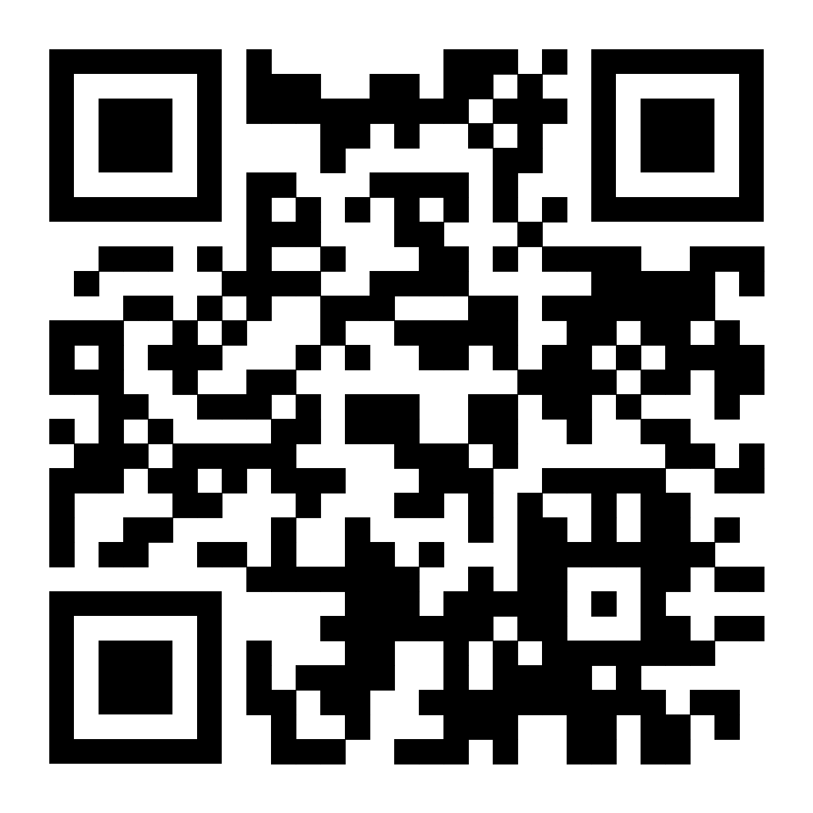





ELBS survey: ctDNA in EU
purpose
state-of-art + outlook
potential responders
ELBS members & non-members, regardless of whether they have active ctDNA programs Participation by non-EU member States is welcome
format
modular, about 130 questions if completing all sections (unlikely)
platform
Built on Research Electronic Data Capture REDCap (Marco Canfora) - embedded form display logic, semi-automated outputs for biostatistics (Irene Terrenato)
3.0 First, please tell us which definition best applies to your Institution/Organization
Academic (teaching and research)
Public Healthcare (public or prevalently public)
Private Healthcare (private or prevalently private)
University spin off
Small-medium size biotech/Enterprise
Private diagnostic lab
Pharmaceutical Company
Biotech Company specifically commercializing ctDNA-related products or services
Other (please specify)
…………………………………………..
1
One representative per institution/group
intro
(a) Technical details, e.g. tumors being ctDNA-profiled, LB facilities, technical tools, preferred metrics … etc
(b) reporting
(c) support/reimbursement
ctDNA (research)
laboratory scale testing and clinical trials
ctDNA (diagnosis)
clinical routine and MTB
ctDNA (companies)
economical operators
2
subroutines
state-of-art
3
regulatory issues
all info confidential:
it will be disclosed in anonymous form
wishes
role of ELBS
outlook

Slide 39
Circulating tumor DNA (ctDNA): a survey by the European Liquid Biopsy Society (ELBS)
Link to the survey:
protection.outlook.com
general questions
specific questions
healthcare implications
research (Q5.0-Q19.0)
all (Q1.0-Q4.0)
diagnostic routine (Q5.0bis -Q26.0bis)
all (Q30-Q36)
Companies (Q27-Q29)
Link to the survey:

Slide 40

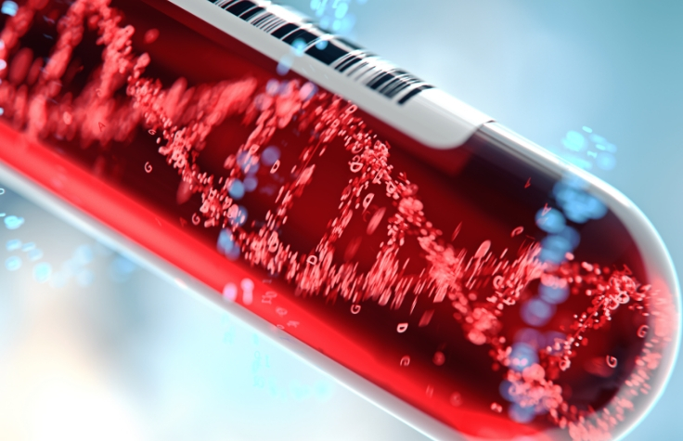
Overview of activities: yr 2025
yr2025
ctDNA EQA on reporting (paper-cases)
ctDNA EQA on reporting (vcf-files)
ctDNA workshops on reporting (harmonisation)
ctDNA Epigenomics Workshop (online)
ctDNA survey
Any other suggestions ?
Please contact the ELBS ctDNA technology working group
Ellen Heitzer (ellen.heitzer@medunigraz.at)
Patrizio Giacomini (patrizio.giacomini@guest.policlinicogemelli.it)
Ed Schuuring (e.schuuring@umcg.nl)
Alina Brüns (a.bruens@uke.de)
Link to the survey:

