Slide 1

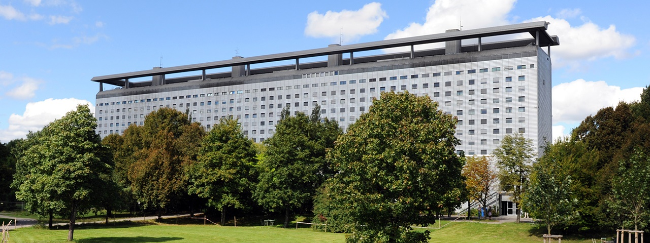
Longitudinal evaluation of CTC to predict recurrence risk in early HCC treated with local ablative therapy - the INTENT study
Marianna Alunni-Fabbroni
ELBS GA, Barcelona 26.11.2024

Slide 2
Disclosures
Menarini Silicon Biosystem
Sirtex Medical
AstraZeneca

Slide 3
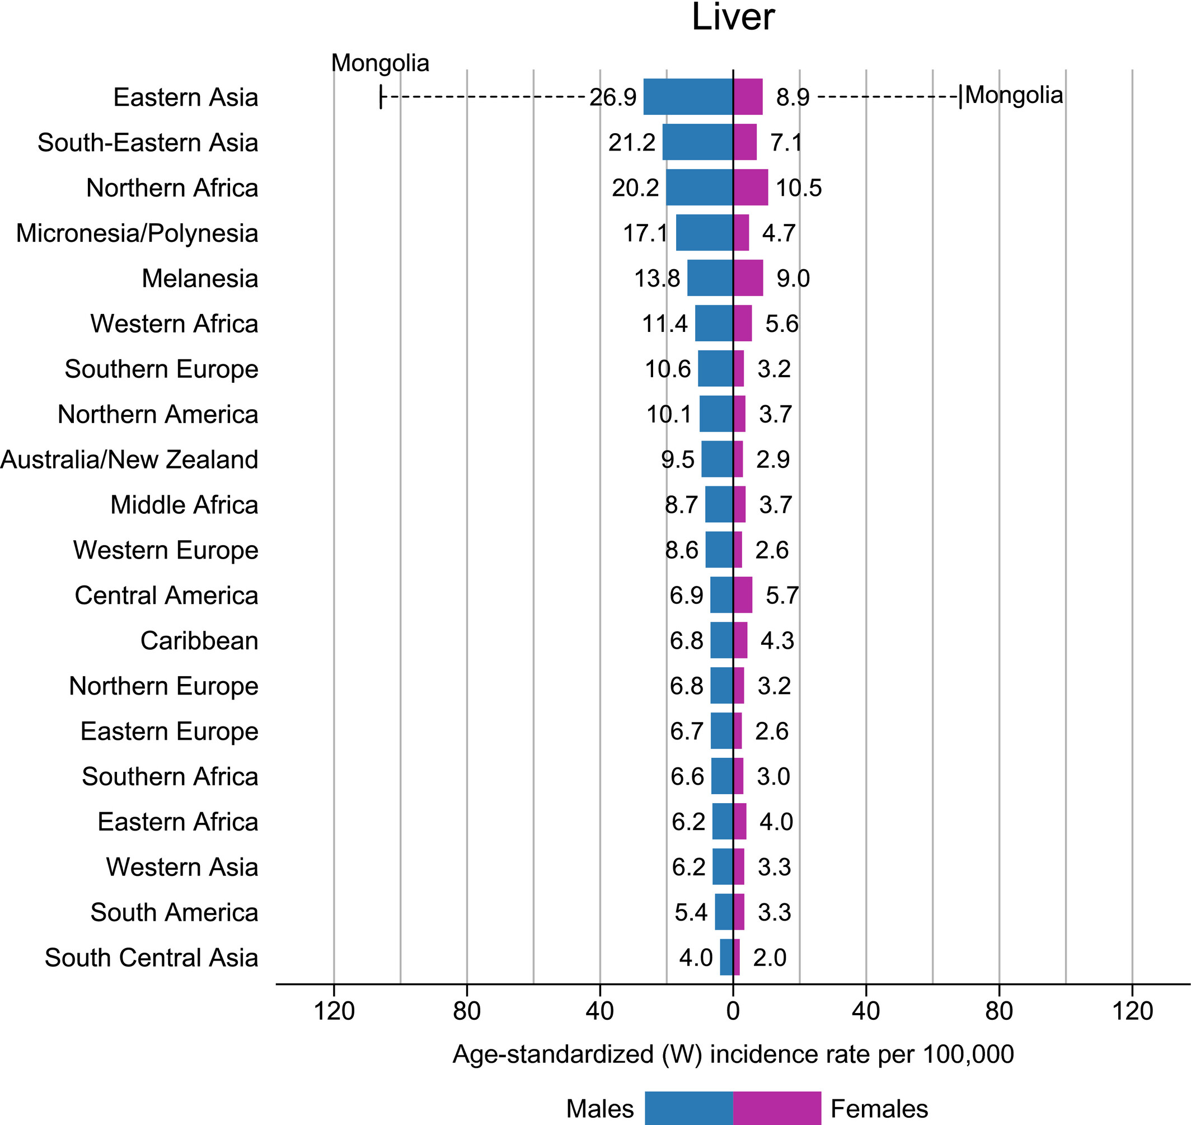
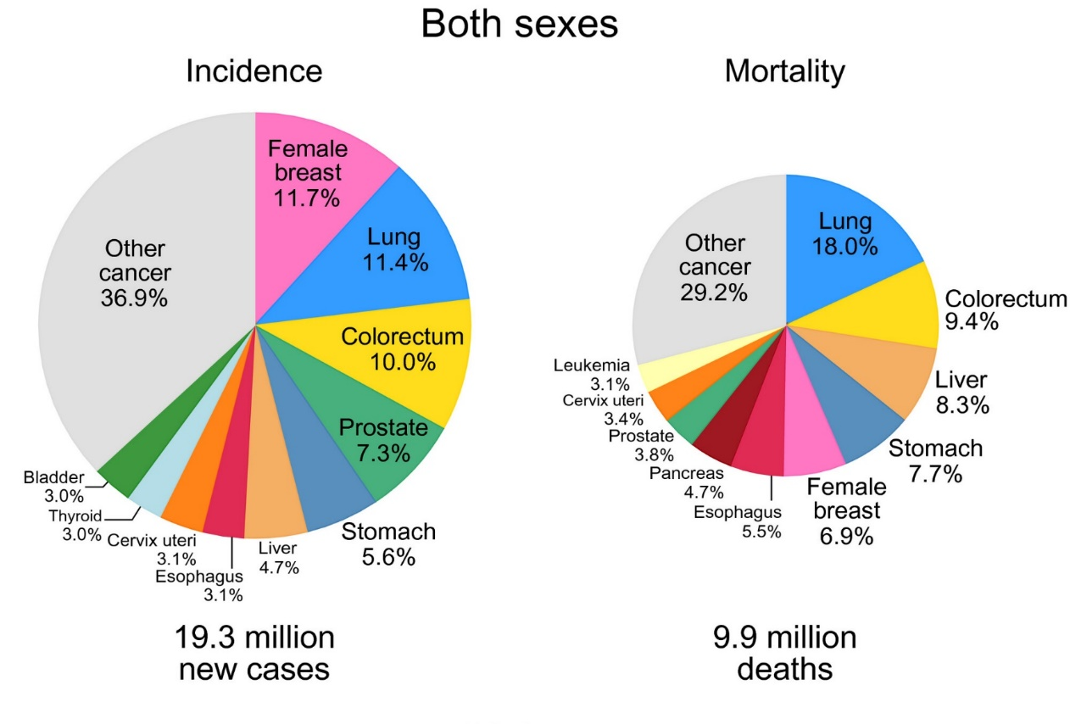

Liver cancer
Global Cancer Statistics 2020
GLOBOCAN
>1million deaths/year by 2030

Slide 4
Why is HCC associated to high mortality?

Slide 5

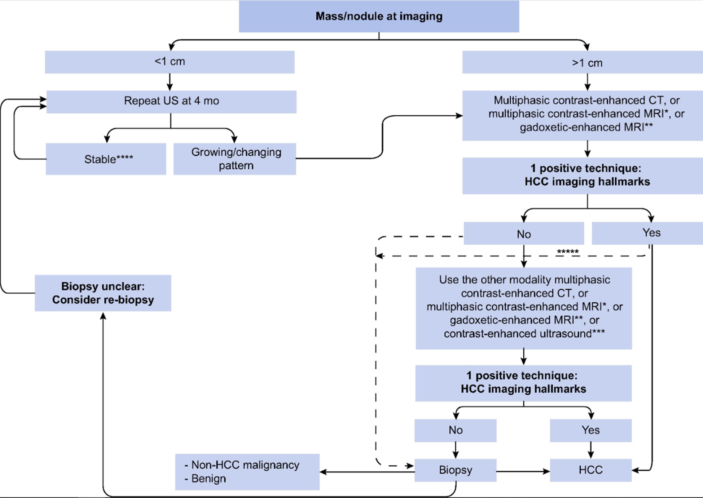
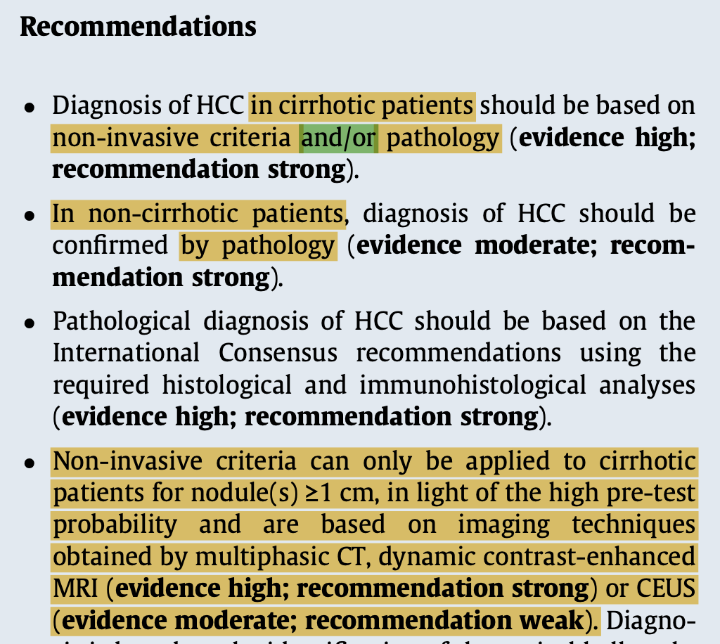
1. Late diagnosis
EASL, JHep 2018

Slide 6
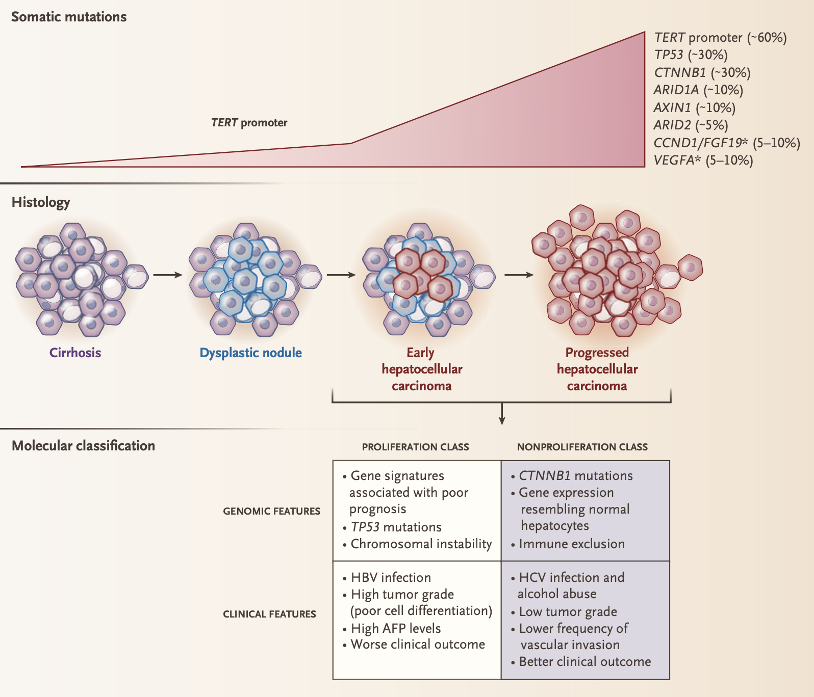
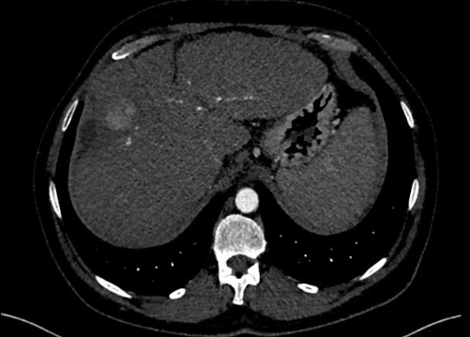
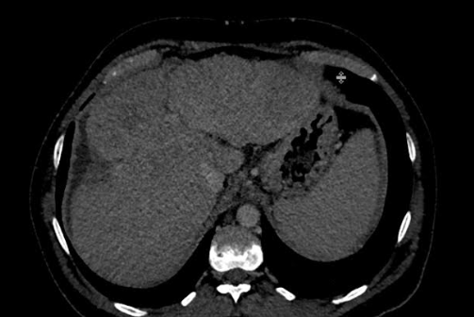
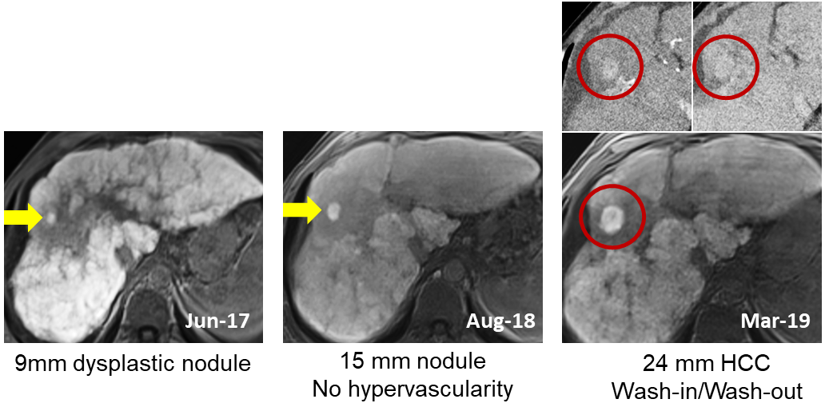
Diagnosis is based on imaging without histology
HOWEVER
Limited to tumor size >1 cm and hemodynamic
Low sensitivity of additional diagnostic biomarkers such as AFP

Slide 7
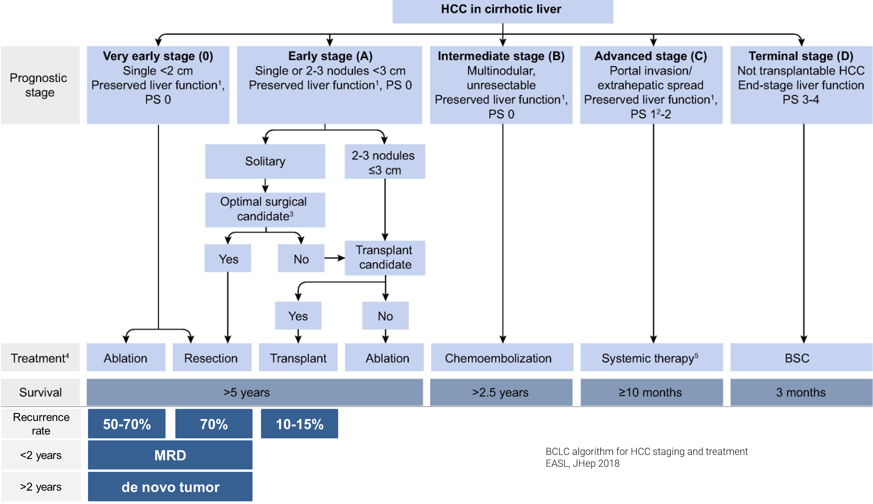
2. High recurrence rate

Slide 8
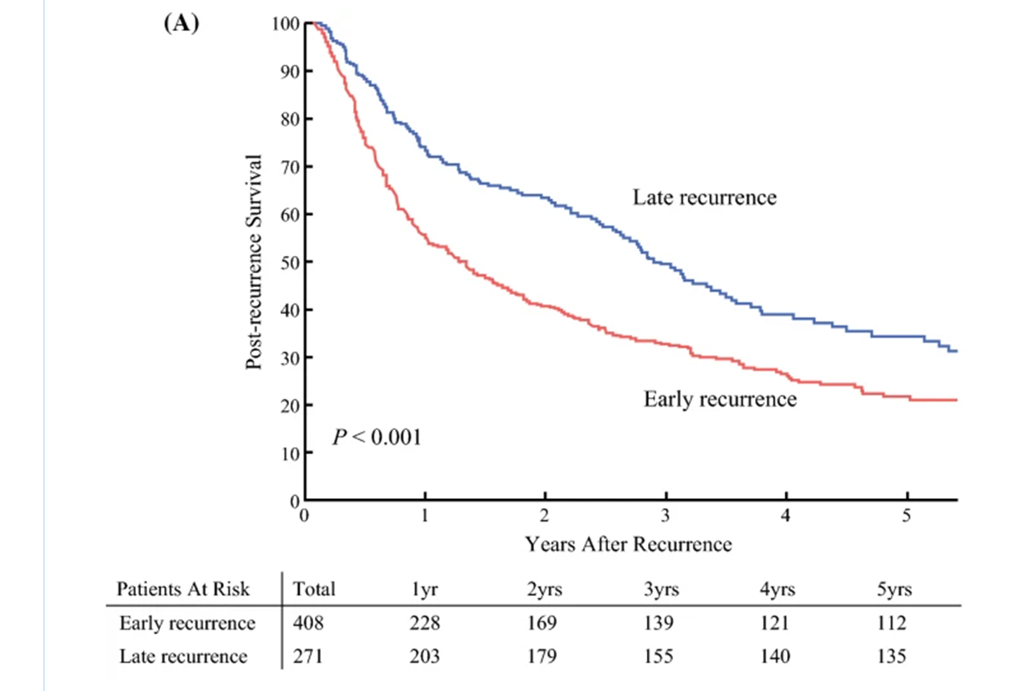
2. High recurrence rate
Yao et al. Ann Surg Onc 2022
Early recurrence has often a more aggressive biology and is associated with poorer long term clinical outcome

Slide 9
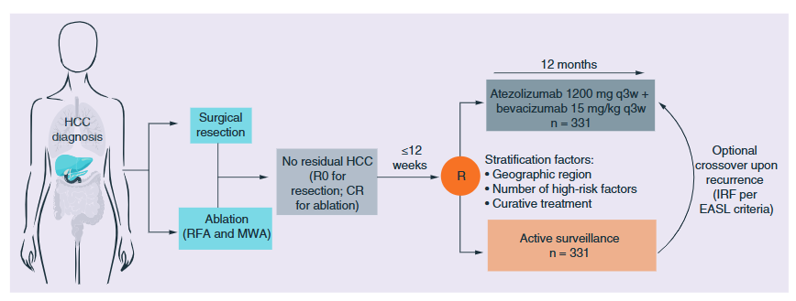
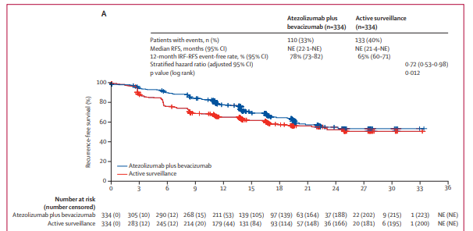
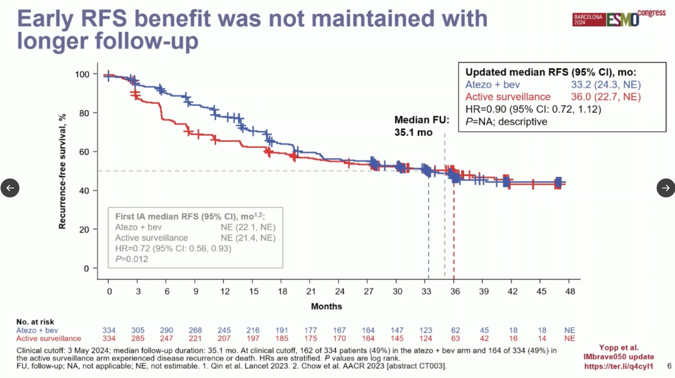
3. Low response rate
Imbrave050: Atezolizumab plus bevacizumab versus active surveillance in patients with resected of ablated high-risk HCC
Initial RFS benefit with atezo + bev vs. active surveillance is not sustained
The benefit-risk profile does not support atezo + bev as adjuvant therapy for all high risk HCC
Qin et al. Lancet 2023
Yopp et al. ESMO 2024

Slide 10
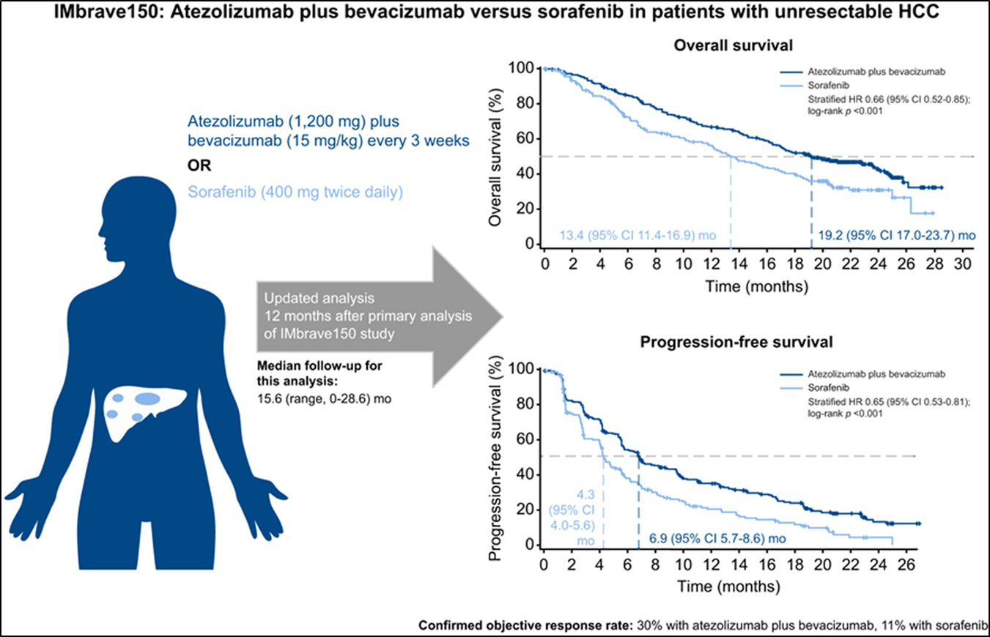
3. Low response rate
Atezo + bev superior in first-line therapy
BUT: ORR only in around 30% of patients
Durable responses and long-term survival only in a small subgroup
No predictive biomarkers for
selection of effective therapy
Chen et al. JHep 2021

Slide 11
In conclusion:
There is a urgent need for additional biomarkers helping to
classify the malignant degree of HCC
predict the chance of postoperative recurrence
allows for therapy monitoring

Slide 12
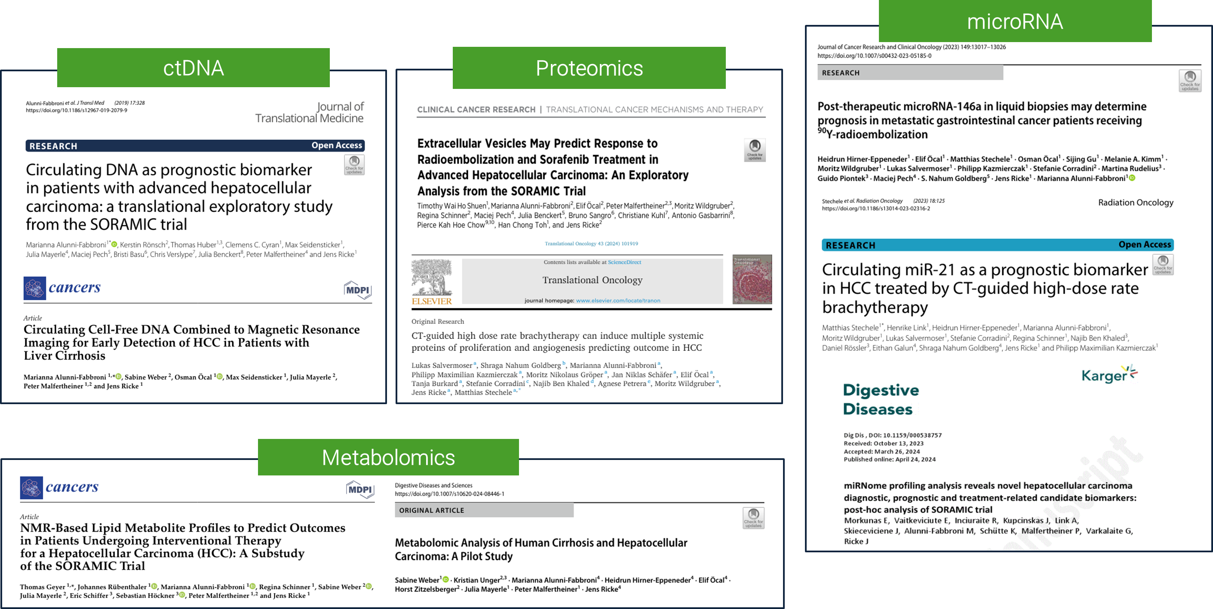
Our previous work in HCC and liquid biopsy

Slide 13
HCC studies focusing on CTC
Entity
Stage
Therapy
Integrated analysis
Aim
Status
INTENT
n=70
HCC
Very early
Early
Local ablation
ctDNA
Early detection
Recruiting
ZUGSPITZE
n=80
HCC
Intermediate
PDL1/CTLA4 + Y90-RE
ctDNA
Early detection
Recruiting
CATCH
n=80
HCC
Advanced
PDL1/VEGF
miRNA
Treatment response
Closed
PRO-MARKER
n=90
CRC
Metastatic
Surgery
Ablation
Systemic
ctDNA
Treatment response
Recruiting
Platform: CellSearch system

Slide 14
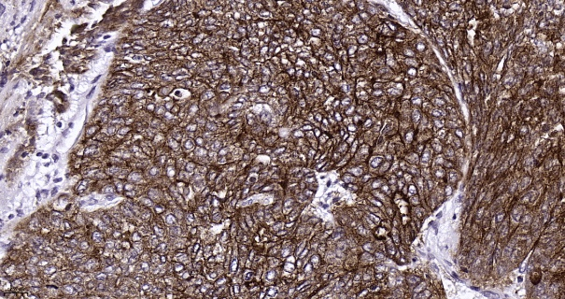
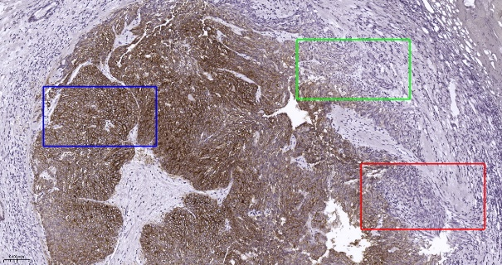
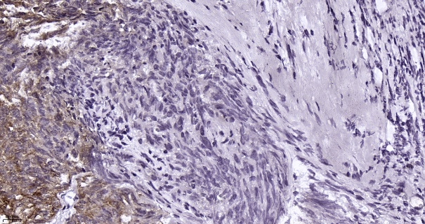
Challenges coming with CellSearch
Number of CTC in blood is usually low
<35% HCC are EpCAM positive
Low and heterogenous EpCAM expression
Lack of specific and established surface markers

Slide 15


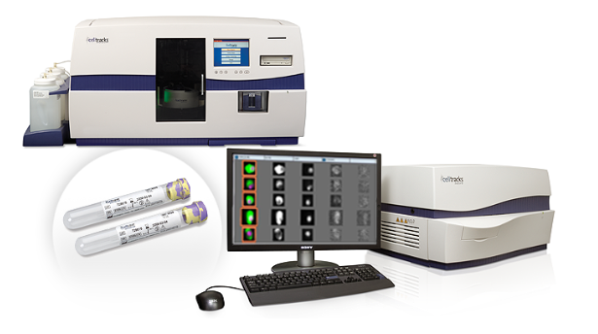
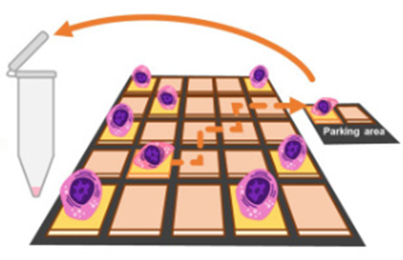

INTENT Study Design
HCC n=70
Objectives
BCLC 0-A-B
MO
Therapy naïve
Local ablation
Proximal and distal blood collection
To evaluate if proximal blood collection increases the amount of detected CTC
To determine if pre- and post-operative CTC can act as biomarker for detection of recurrence
Local ablation
Clinical follow up
Baseline
24 hr post
3-6-12-24M
Quantification
Mutation profiling
Downstream
analysis
DEPArray
Cell Search system

Slide 16
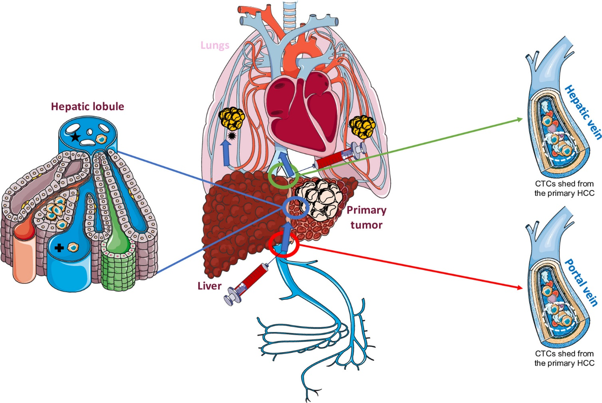
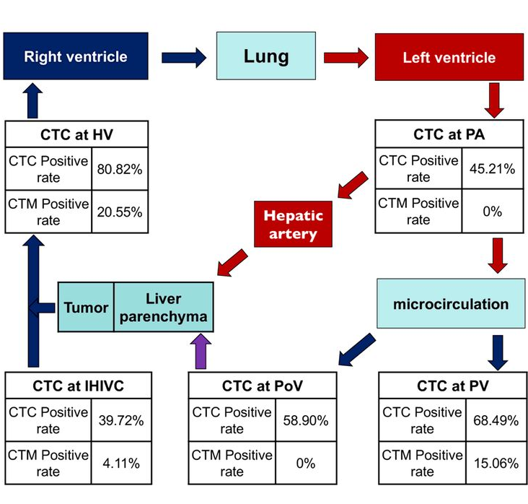
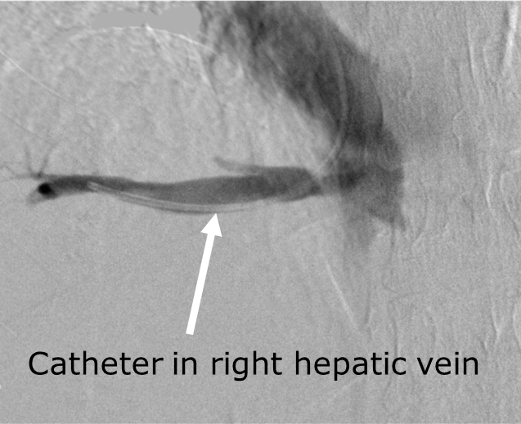
Proximal blood collection
To improve the recovery rate
To overcome the limit of low CTC detection
Buscail et al, Mol Oncology 2019
Sun et al, CCR 2017

Slide 17
Patients characteristics
Variable | Total (n=43)
Age
Median | 69
Range | 48-84
Gender
Male | 35 (83.7%)
Liver cirrhosis
Yes | 40 (93.0%)
Child Pugh
A | 31 (72.0)
B | 12 (28.0)
Etiology
Alcohol | 16 (37.2%)
Viral | 12 (27.9%)
Metabolic | 6 (13.9%)
Other | 6 (13.9%)
BCLC
0 | 7 (16.2%)
A | 28 (65.2%)
B | 8 (18.6%)
Variable | Total (n=43)
Number of lesions
1 | 27 (62%)
2 | 10 (23.2%)
>2 | 6 (14.0%)
Lesion size (mm)
Mean ± SD | 27.7 ± 12
Therapy
iBT | 28 (65.1%)
MWA | 12 (27.9%)
RFA | 3 (7.0%)
Recurrence
Yes | 18 (42.0%)
No | 25 (58.0%)
Deceased
Yes | 3 (6.9%)
No | 40 (93.0%)
Transplanted
Yes | 6 (14.0%)

Slide 18
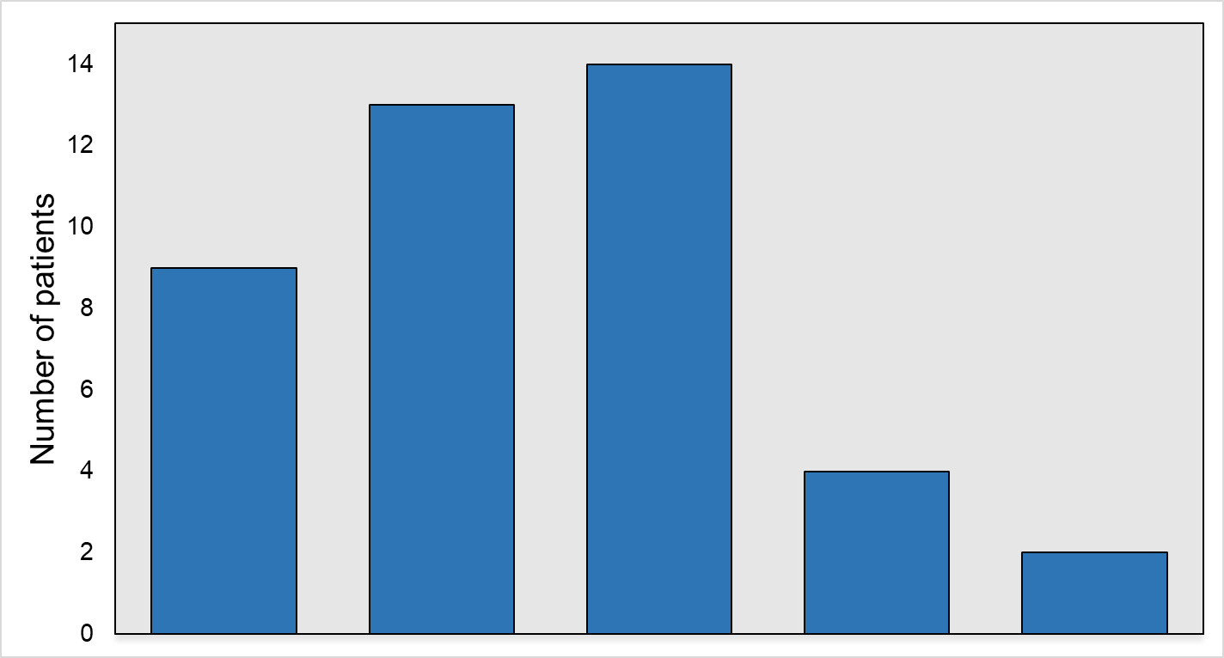
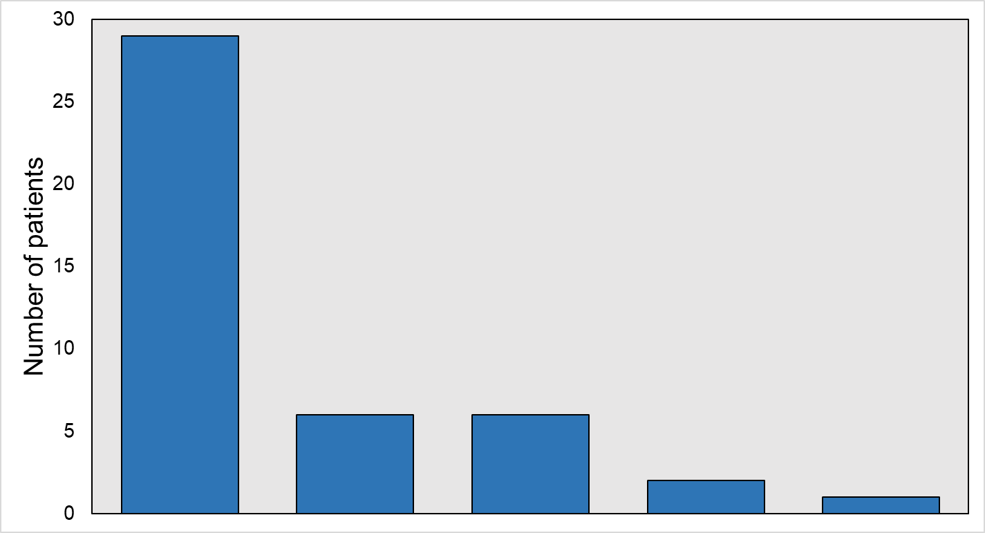
Frequency distribution of the number of CTC
Proximal collection
Distal collection
0
1
2-3
4-5
>6
0
1
2-3
4-5
>6
Number of CTCs
Number of CTCs
71% detection rate
Median: 2 CTC
Range: 1 - 7
32% detection rate
Median: 2 CTC
Range: 1 - 11

Slide 19
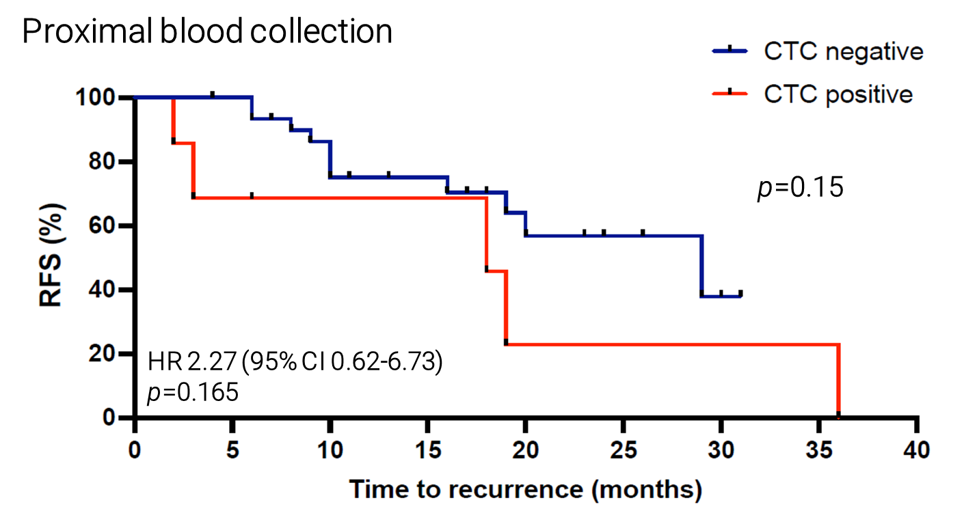
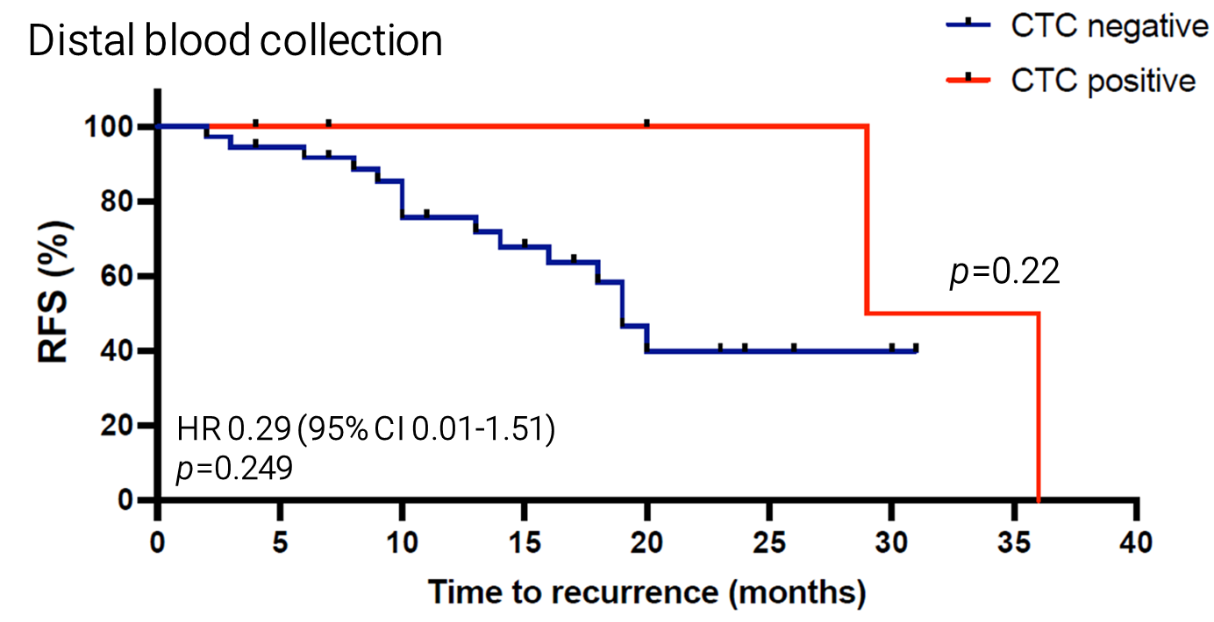
Proximal vs distal blood collection
Recurrence is not associated with CTC in any of the vascular compartments

Slide 20
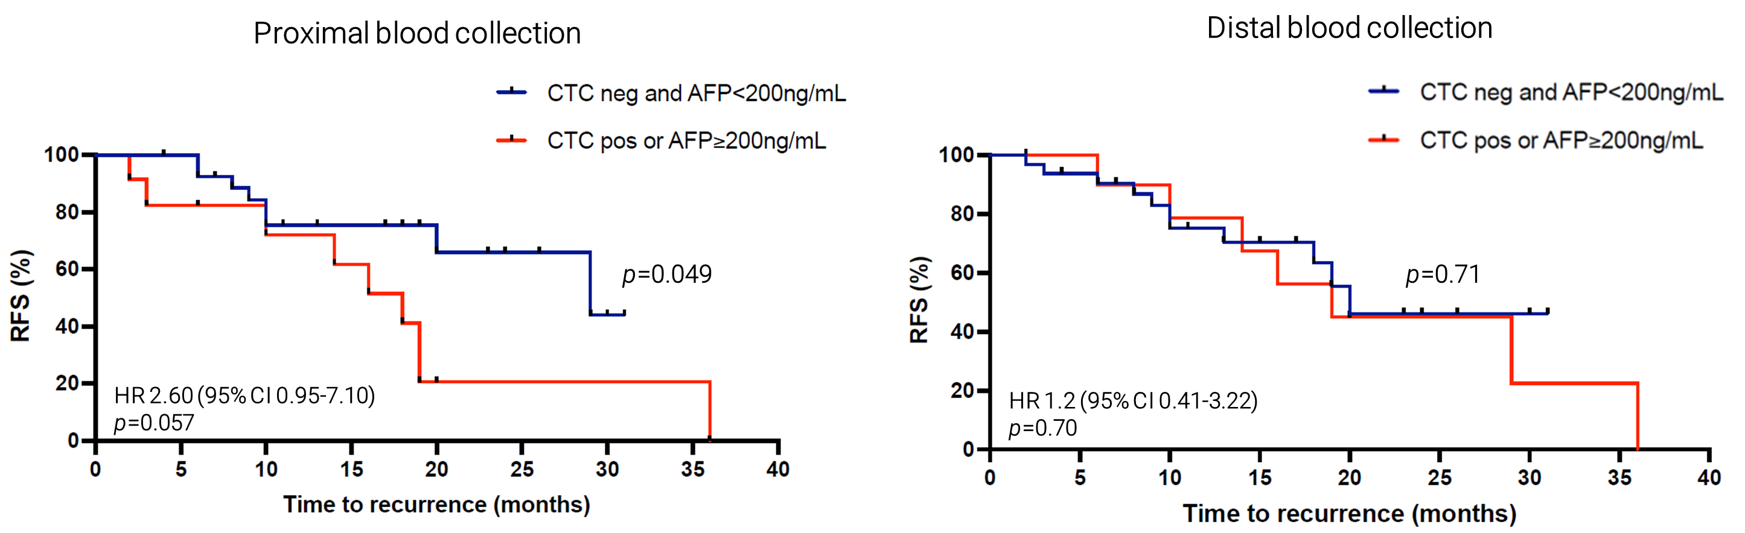
Combination of CTC and AFP
CTC and AFP ≥ 200 ng/mL might be associated with a decreased RFS
Larger cohort to confirm the trend

Slide 21
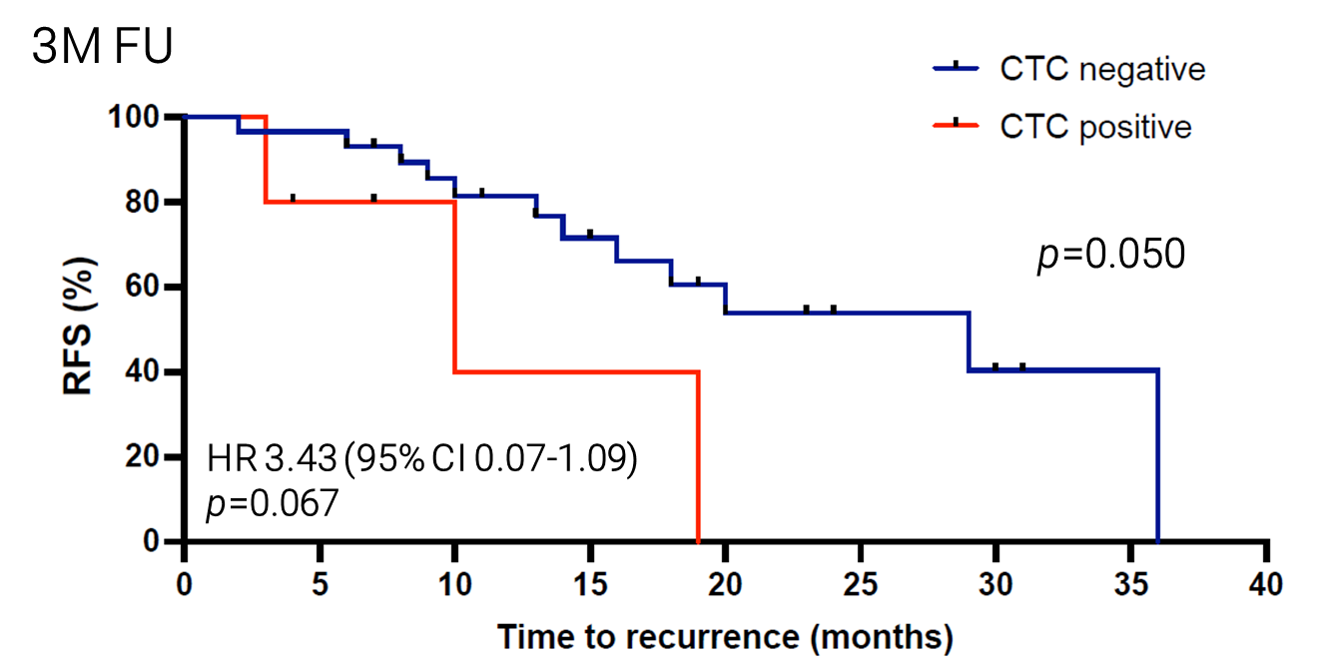
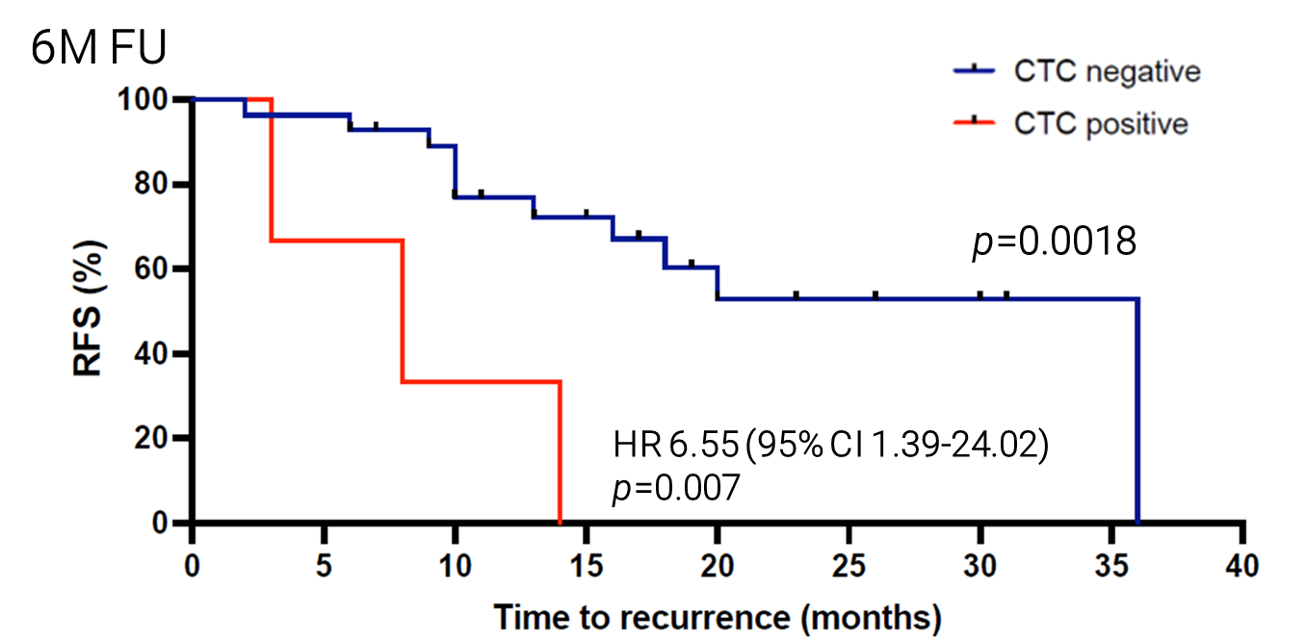
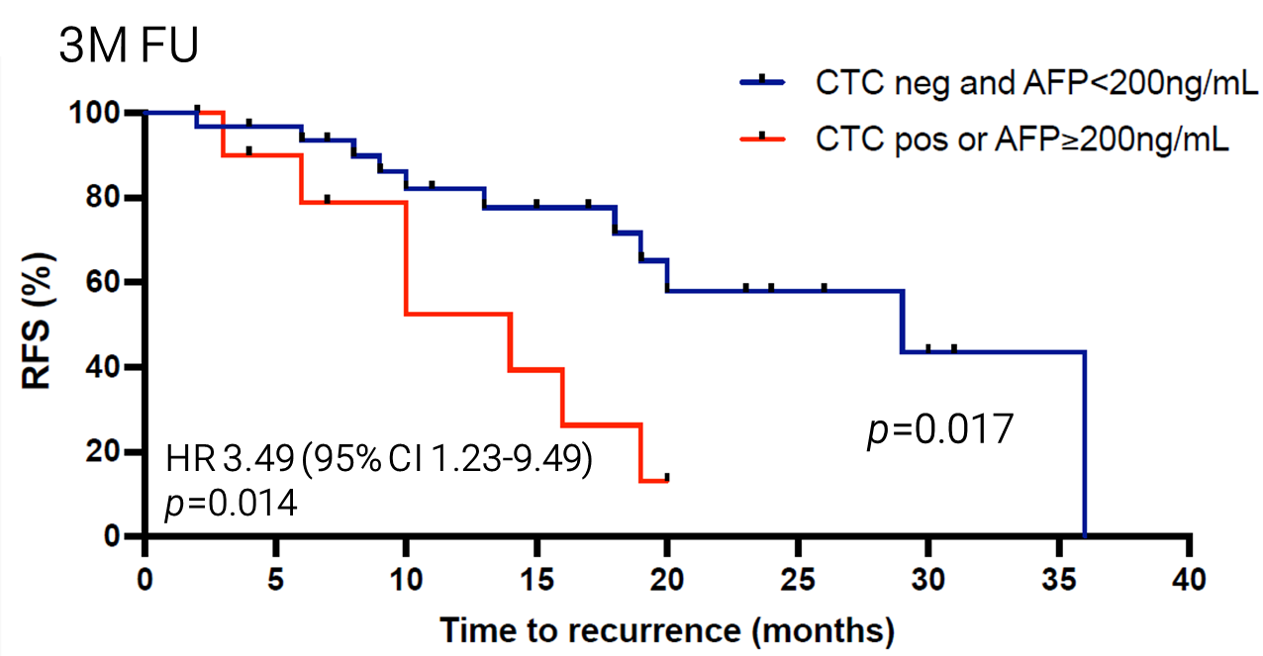
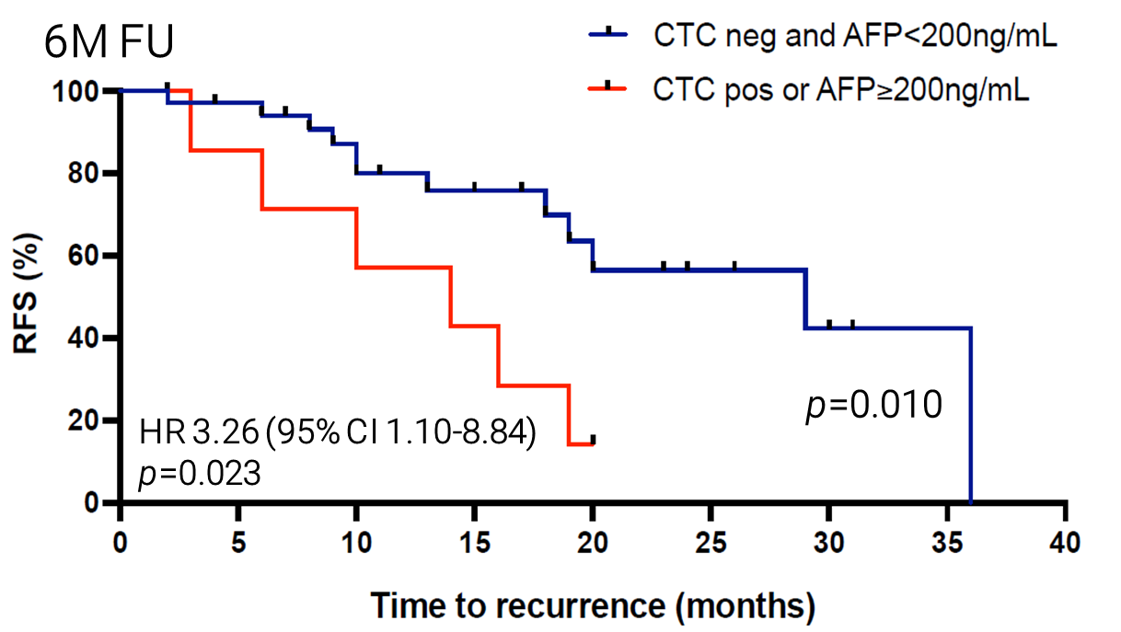
CTC at 3 - 6 months follow-up
Detection of CTC and AFP ≥ 200 ng/mL at FU is associated with decreased RFS

Slide 22
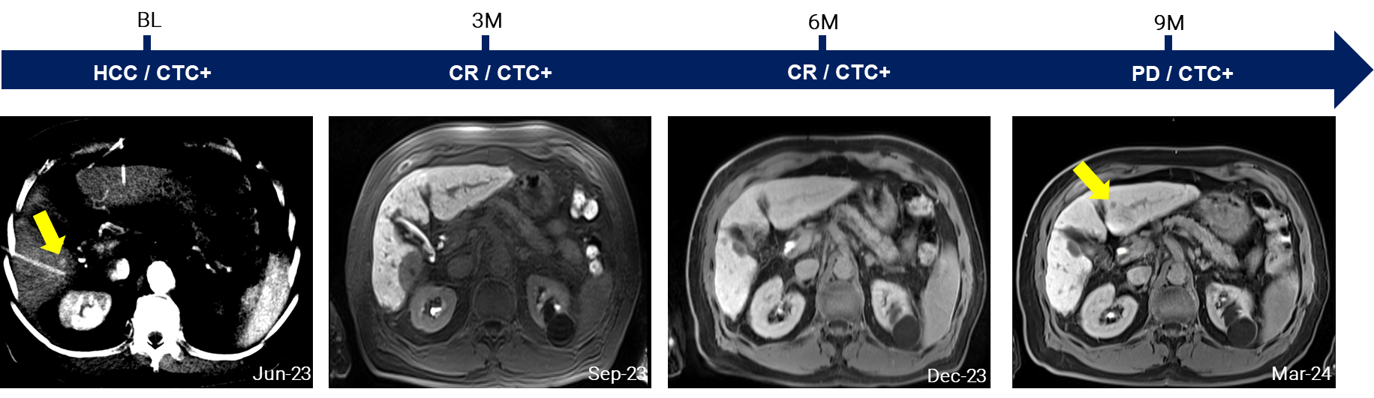
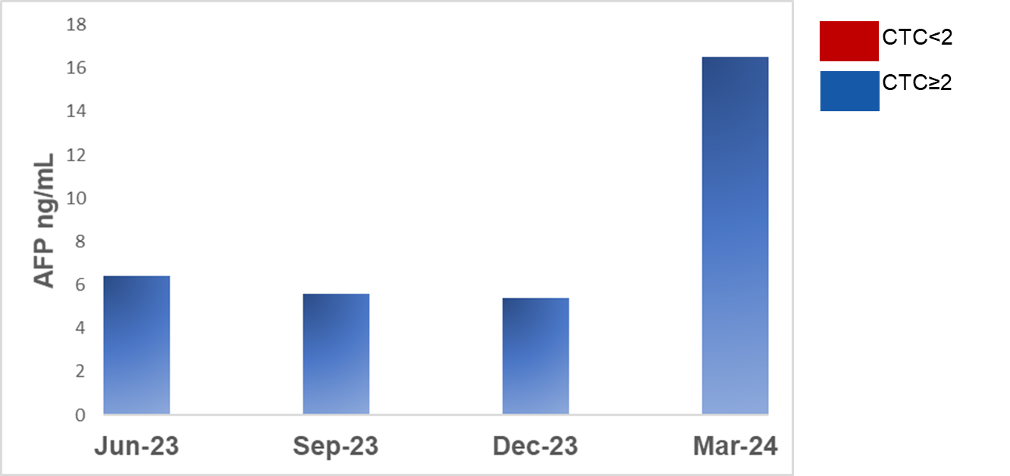
Case study 1
Surveillance
AFP every 3 months post-therapy
MRI/CT every 3 months
Detection of CTC predated MRI by 6 months

Slide 23
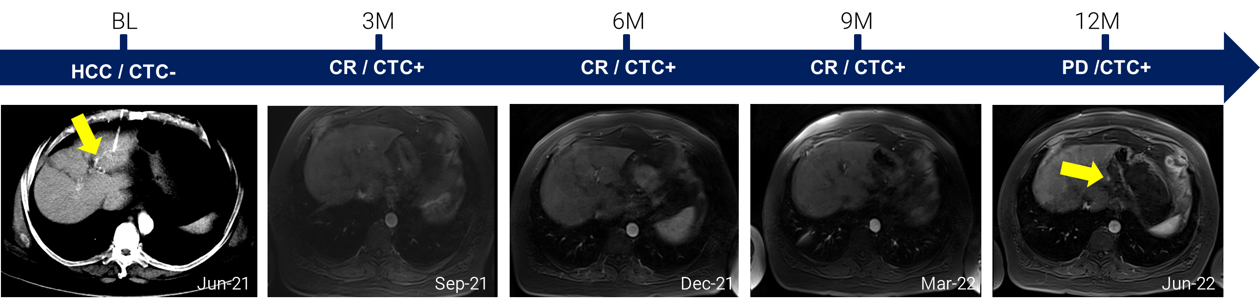
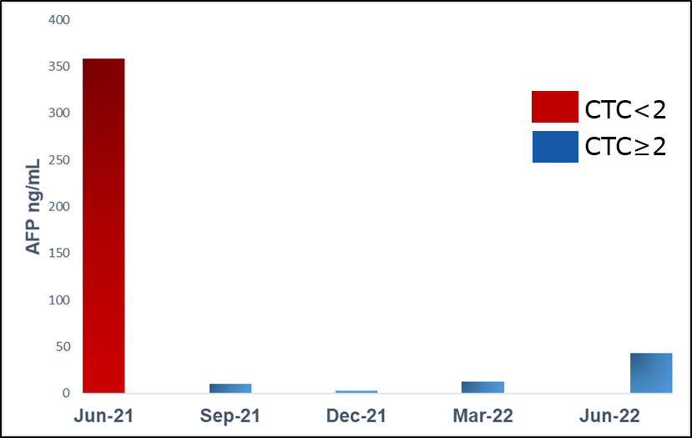
Case study 2
Surveillance
AFP every 3 months post-therapy
MRI/CT every 3 months
Detection of CTC predated MRI by 9 months

Slide 24
Conclusions
In early HCC treated with local ablation:
CTC isolated from the hepatic vein were identified in 71% of patients
Baseline CTC in combination with AFP might be predictive of therapy response
Presence of CTC at 3 and 6 month follow up was significantly associated with
recurrence
CTC detection predated imaging by 9 months

Slide 25
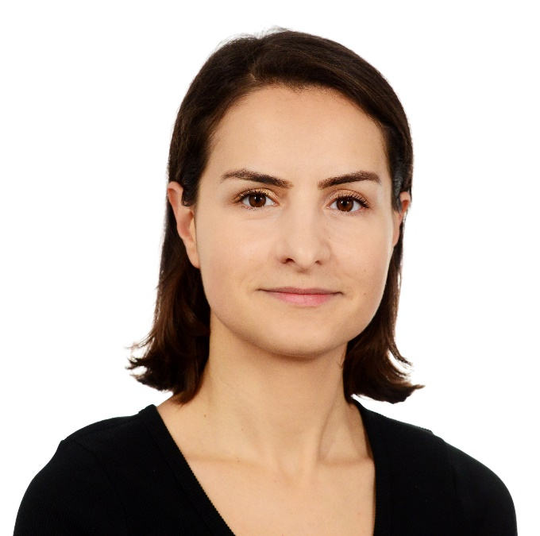


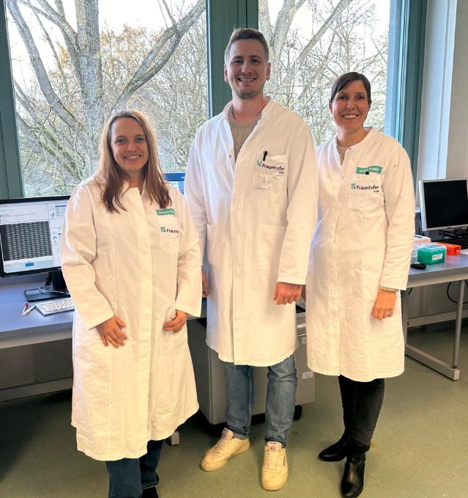


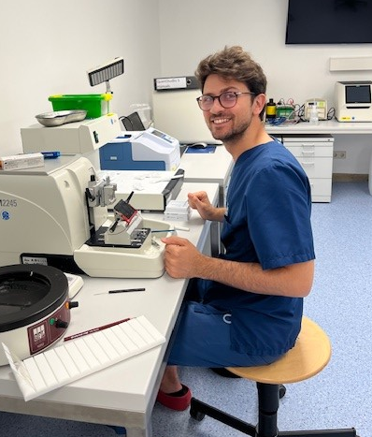
Interventional Radiology
Max Seidensticker
Moritz Wildgruber
Osman Öcal
Luigi Nardone
Jens Ricke
Laboratory for Experimental Radiology
Elif Öcal
Cheryl Gray
Robert Buchner
Tanja Burkard
Elif Öcal
Max Seidensticker
Cheryl Gray
Moritz Wildgruber
Robert Buchner
Barbara Alberter
Judith Proske
Luigi Nardone
Osman Öcal

Slide 26
Thank you
Marianna.Alunni@med.uni-muenchen.de
https://www.lmu-klinikum.de/radiologie/
@LMU_Radiology

Slide 27

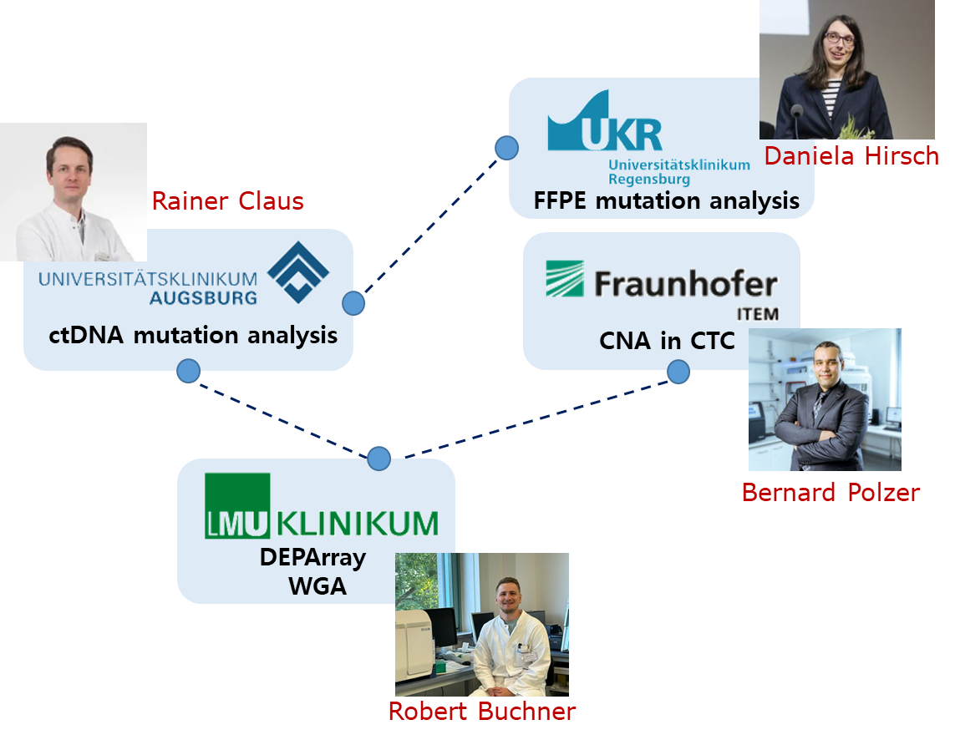
Multimodal liquid biopsy for the detection of minimal residual disease
in early HCC treated with local ablation
Objectives
To identify intra-CTC heterogeneity
To evaluate the potential of ctDNA for early detection of recurrence or prior to confirmed recurrence

Slide 28
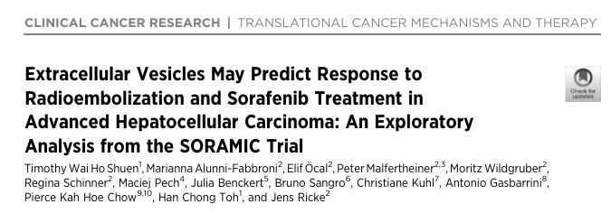

Tim W.H.Shuen
NCC-Singapore
EV-based proteomics predicts response to SIRT+sorafenib and sorafenib-only treatment in patients with advanced HCC

Slide 29
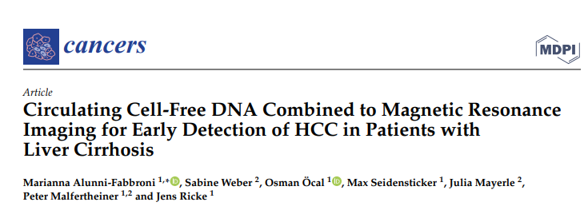
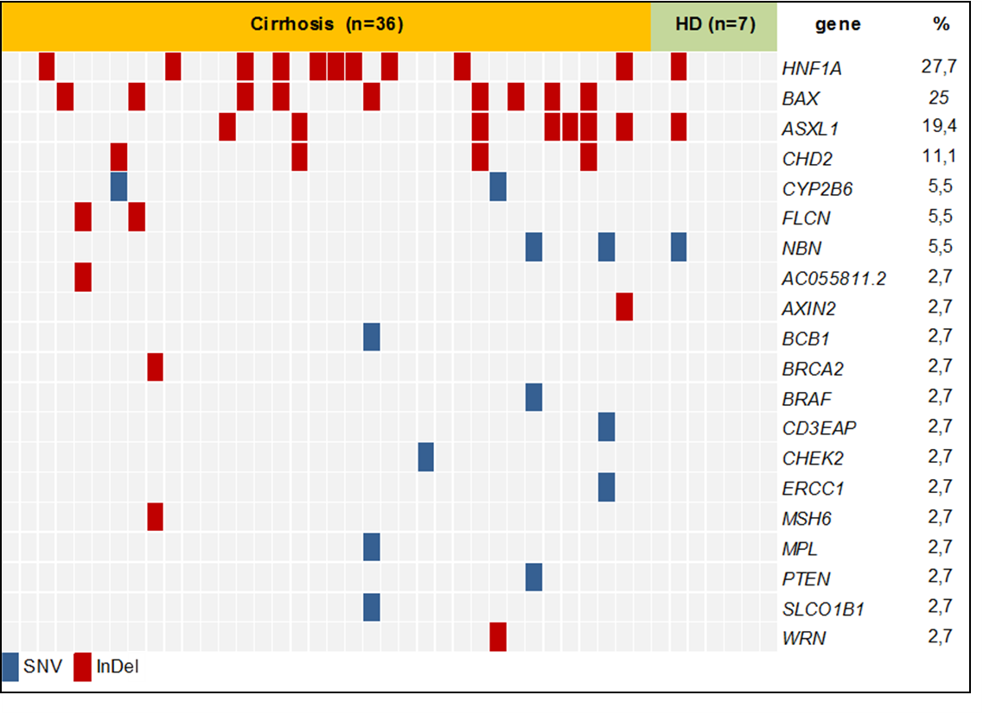
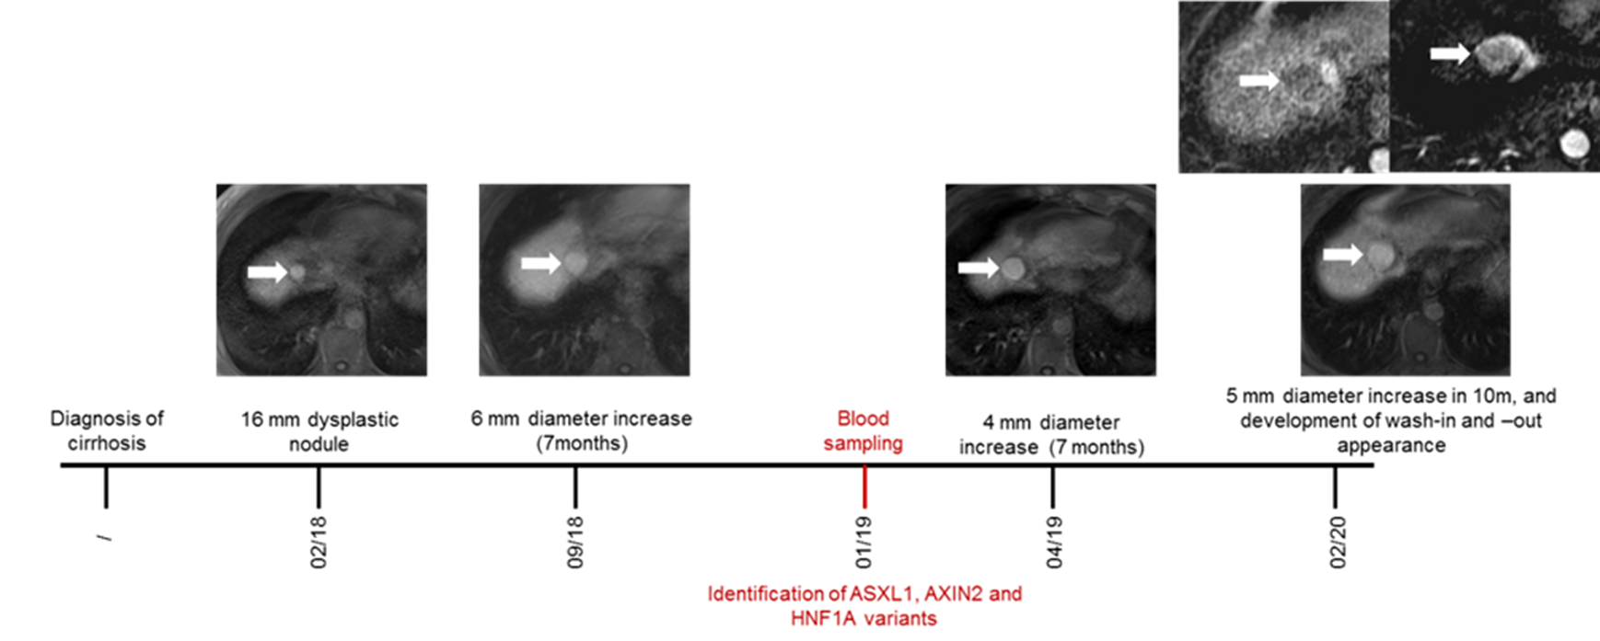
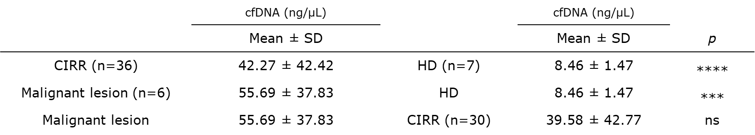
Osman Öcal
Heidelberg
MRI confirmed suspect nodular lesions of early stage HCC in patients carrying cfDNA variants

