Slide 1
ELBS General Assembly 2024
WG: CTC Technology
Evi Lianidou, Yong-Jie Lu & Nick Stoecklein
November 26th- 28th
PRBB,
Barcelona, Spain

Slide 2
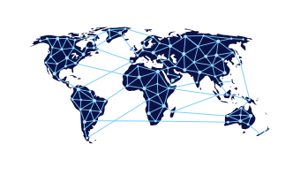



WG CTC Technologies – Long Term Goals
Networking & Scientific Exchange
“open channel” for discussion of technologies and issues
Exchange between users and technology providers
Ring trials and technology assessment
Organization of ring trials
“Pre-competitive arena” for companies
Possibility to technically validate new technologies
Promoting development of assays with clinical utility
“wish-list” from Clinical WG for clinically relevant assays
Developed and/or standardization of “wish-list assays”
Working towards accreditation (and reimbursement)
Markers of immediate interest for ISO15189 certification
Establishment of a validation pipeline
Distribution of protocols and support for certification
mages: Borender

Slide 3
WG CTC Technologies – 2024 activities
Networking & Scientific Exchange: Active online-platform to facilitate long-term goals and enable scientific exchange and communication
- “Working group” pitches
Ring trial & Technology Assessment: Organize method-specific working groups CellSearch → performed ringtrial for External Quality Assessment (EQA)
Parsortix → in process forming a group
Preparing New Survey:
- Use and best practice of CTCs among ELBS members and beyond

Slide 4
WG CTC Technologies – WG Meetings
Regular CTC Technologies Meetings
Presentation of timely paper OR novel methodological development Format: presentation 15-20 min followed by a 10-15 min discussion (academic groups AND industry partners)
Pitch to present institution (5-10 min, no discussion)
Address/raise a discussion point/question concerning CTC-technologies Format: 2-5 min introduction followed by open discussion
→ Four meetings per year (Wednesdays 14:00 CEST) for max 2 hrs

Slide 5
WG CTC Technologies – WG Meetings
Three CTC-Technologies meetings since last annual Meeting
December 6th 2023
May 29th 2024
September 4th 2024
Meetings with
58-67 participants

Slide 6
WG CTC Technologies – WG Meetings
European Liquid Biopsy Society

Slide 7
ELBS Member PITCHES
in chronological order
Evi Lianidou (ACTC Lab, Department of Chemistry, University of Athens, Athens, Greece)
Nikolas Stoecklein (Experimental Surgical Oncology, University Medical Center Düsseldorf, Düsseldorf, Germany)
Hans Neubauer (Department of Translational Gynecology, University Medical Center Düsseldorf, Düsseldorf, Germany)
Klaus Pantel (Institute for Tumor Biology, University Medical Center Hamburg Eppendorf, Hamburg, Germany)
Laura Keller, PhD (Université de Toulouse, Université Toulouse III-Paul Sabatier Centre de Recherches en Cancérologie de Toulouse, Toulouse, France)
Daan van den Broek, PhD (Laboratory Medicine, The Netherlands Cancer Institute, Amsterdam, the Netherlands)
Melanie Janning, MD (University of Mannheim, DGFZ Heidelberg, Germany)
Amin El-Heliebi (Medical University of Graz, Graz, Austria)
Olga Kofanova (Integrated Biobank of Luxembourg (IBBL), Luxembourg
Marianna Alunni-Fabbroni (Radiology Department, Ludwig- Maximilians-University University Hospital, Munich
European Liquid Biopsy Society

Slide 8

WG CTC Technologies – WG Meetings
Upcoming ELBS CTC Technology meetings in 2024
Wednesday 2-4 pm CEST
11.12.2024
Participating groups → Pitches
Academic & Company partners → Talks
https://diginomica.com/us-digital-service-to-nyc-designers-we-need-you

Slide 9
WG CTC Technologies – 2024 activities
Networking & Scientific Exchange: Active online-platform to facilitate long-term goals and enable scientific exchange and communication
- “Working group” pitches
Ring trial & Technology Assessment: Organize method-specific working groups CellSearch → performed
Parsortix → in process forming a group
Preparing New Survey:
- Use and best practice of CTCs among ELBS members and beyond

Slide 10
EQA Scheme – CellSearch
Nine participating ELBS member sites (8 academic)
Oncopole, Toulouse University Cancer Institute, Toulouse, France → Anne Pradines / Laura Keller
Institute of Tumor Biology, UKE, Hamburg, Germany → Sabine Riethdorf
Institut Curie, Paris, France → Jean-Yves Pierga / Renault Shufang
Oslo University Hospital, Oslo, Norway -→ Elin Faye Borgen / Hege Russnes
Translational Medical Oncology Group (Oncomet), Santiago de Compostela, Spain → Laura Muinelo Romay
ACTC Lab, University of Athens, Athens, Greece → Evi Lianidou
University Clinic Düsseldorf, Düsseldorf, Germany → Nikolas Stoecklein / Christiane Driemel / Rui Neves
Erasmus University Medical Center, Rotterdam, Netherlands → Jaco Kraan
Menarini HQ/Bologna lab

Slide 11
CELLSEARCH EQA RESULTS-ELBS
EQA Scheme – CellSearch

Slide 12
EQA Scheme – CellSearch

Slide 13
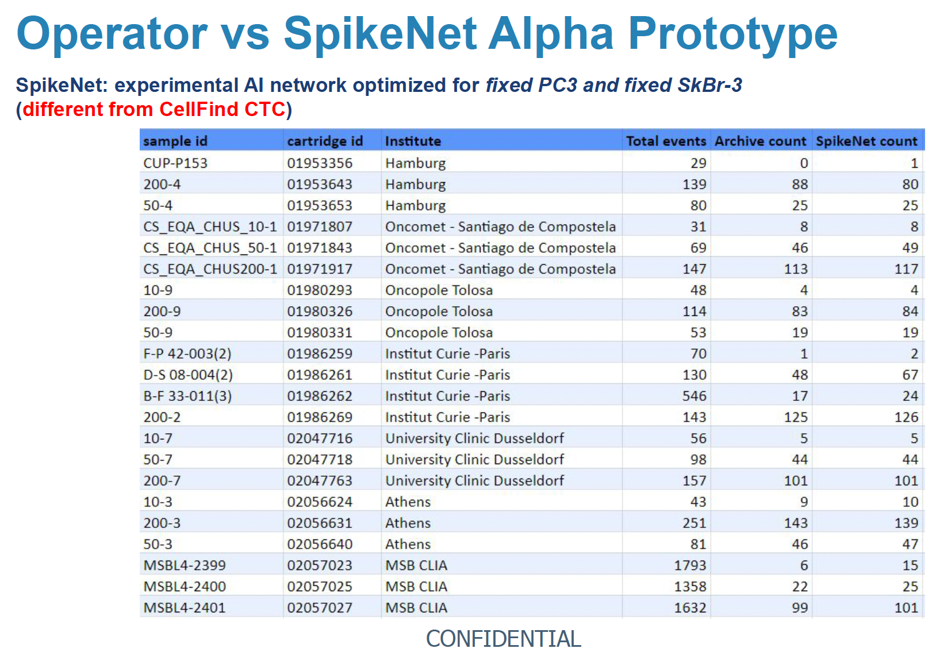
EQA Scheme – CellSearch

Slide 14
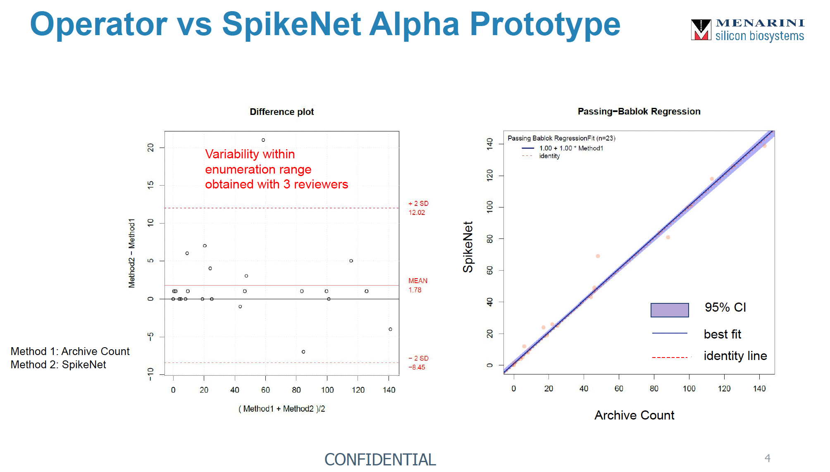
EQA Scheme – CellSearch

Slide 15
EQA Scheme – Other Technologies
Next Project: Ring trial for Parsortix
We would like to welcome other technologies and PIs!

Slide 16
WG CTC Technologies – 2024 activities
Networking & Scientific Exchange: Active online-platform to facilitate long-term goals and enable scientific exchange and communication
- 4 Meetings (3/4 done – the last one in December)
- “Working group” pitches started
Ring trial & Technology Assessment: Organize method-specific working groups and completed CellSearch (Evi) and plan to start the Angle (Yong-Jie)
Preparing New Survey:
- Use and best practice of CTCs among ELBS members and beyond

Slide 17
Upcoming Survey
1. Demographics and Background
2. Current Use of CTC Technology
3. Challenges and Barriers
4. Standardization and Protocols
5. Perception of Value
6. Future Directions
7. Training and Education
8. Feedback and Suggestions

Slide 18
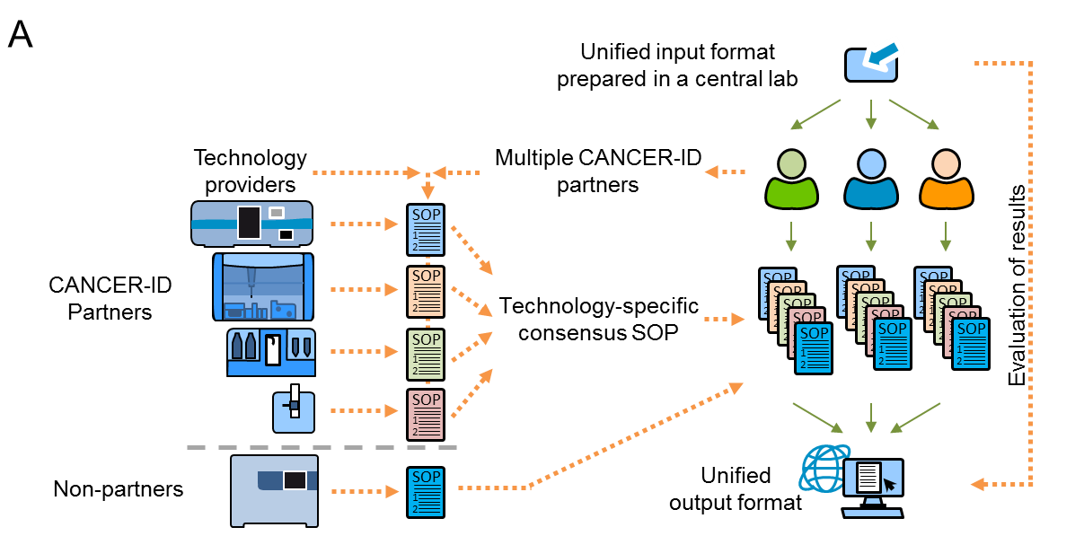
WG CTC Technologies – Proficiency Testing
CANCER-ID
BioRad Genesis System
Integrated Biobank of Luxembourg
IBBL
Athens Düsseldorf Hamburg Montpellier Paris
Central Assessment / ACCEPT / AI
Neves and CANCER-ID et al, Clinical Chemistry 2021

Slide 19
COST Action 2023 -2025
COST → European COoperation in Science and Technology
Meetings
Training Schools
Short Term Scientific Missions (STSM)
Networking Tools

Slide 20
COST Action 2023 → 2025
Best Practice Alliance for Liquid Biopsy in Europe (BPALE)
Liquid biopsy techniques, focusing on the analysis of Circulating Tumor Cells (CTCs), circulating tumor DNA (ctDNA), Extracellular Vesicles (EVs), and other circulating biomarkers, promise to revolutionize cancer patient management. However, their widespread adoption in clinical settings is challenged by method variability, interpretative discrepancies, and a lack of standardization. These challenges are further compounded by Europe's fragmented research landscape.
BPALE addresses these challenges by:
- Establishing a Standardized Framework for Liquid Biopsy
- Promoting Technological Advancements
- Facilitating Interdisciplinary Collaboration
- Prioritizing Patient-Centric Approaches
- Emphasizing Education and Training
- Navigating Regulatory and Ethical Frameworks

Slide 21
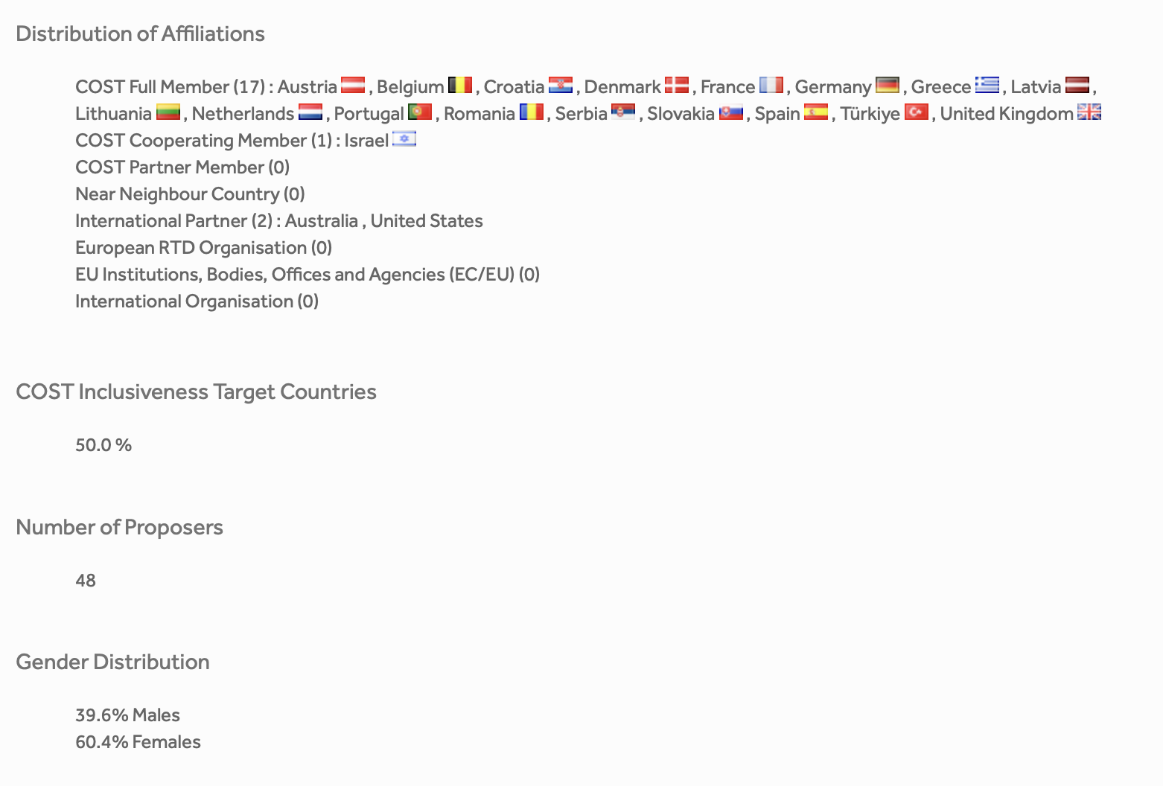
COST Action 2023
Submitted: October 25, 2023
Evaluation Feedback: May 22, 2024
→ 44/50 points: 4x Excellent/6x very good
→ Address critiques and reapply
ICT
17 Young Researcher and Innovators
1 patient advocate group

Slide 22
Plans for 2025
Continue with online WG meeting series (4x)
EQA:Ring trial with Angle
publication/report on EQA schemes for CTC technologies
EQA: Exchange of image files for cross-validation (start with CellSearch) → ISO15189
CTC-Tech Survey
→ finalizing survey (workshop with WG)
COST Re-application
workshop with clinical WG → moving CTC into clinic (e.g. molecular tumor boards)
workshop with ctDNA WG and EV WG for integrated analysis

Slide 23
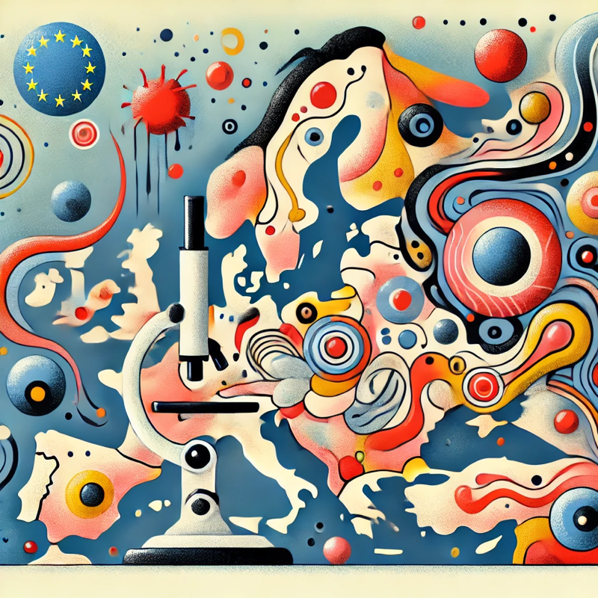
Thank you!
Looking forward seeing you in the next WG meeting!!!
Miró inspred DALLE image of „Circulating Tumor Cells Workgroup and the European Liquid Biopsy Society meeting“

