Slide 1
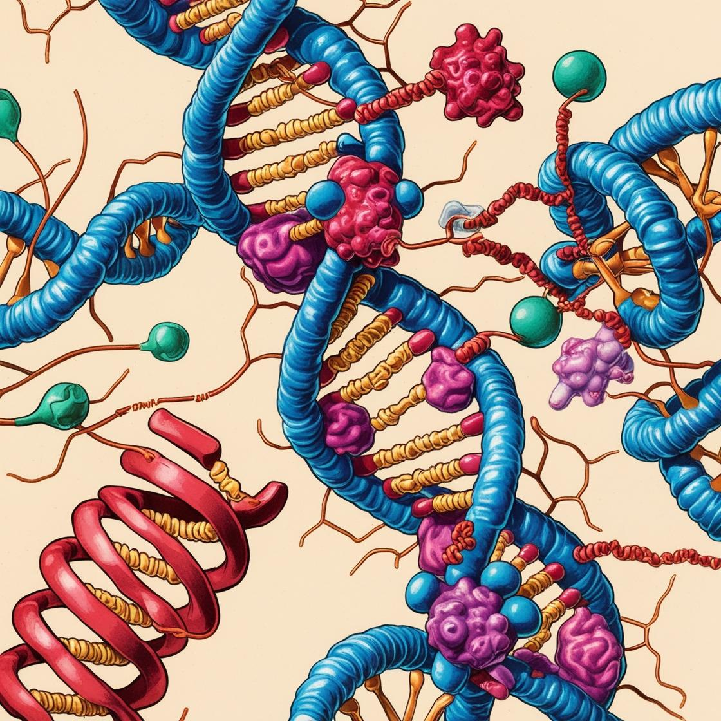


Clonal evolution of mCRC tumors treated with targeted therapy using longitudinal WES-cfDNA analysis
Debayan Datta, Bioinformatician
Biomarkers and Clonal Dynamics Group

Slide 2
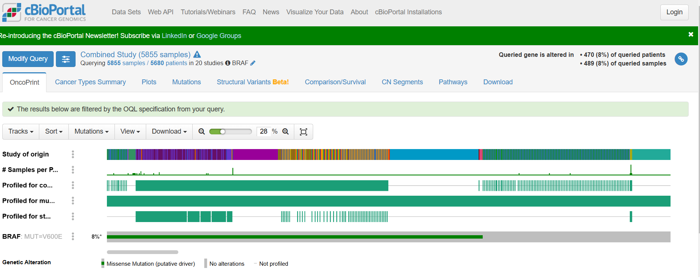

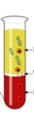
BRAF V600E Colorectal cancer
Colorectal cancer is the third most diagnosed cancer in the world, and is among the leading causes of cancer-related deaths worldwide
Treatment strategies for mCRC depend on molecular marker profiles, and in particular, the BRAF V600E mutation accounts for 5-9% of all mCRC cases. However, such cases are associated with poor prognosis
We present case reports of two mCRC patients with BRAF V600E who received targeted therapy
Using WES of tumor and circulating tumor DNA (ctDNA) samples, we look at the genetic changes in the cancer over time
1L
2L
3L

Slide 3
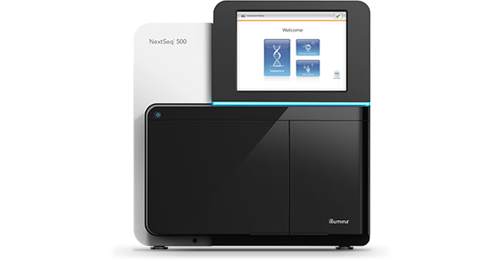
Longitudinal Analysis of Tumor-cfDNA samples workflow
1L
2L
3L
Whole Exome Sequencing
KRAS
BRAF
KMT2C
APC
KRAS
MUC4
TP53
MSH6
PTEN
KRAS
RNF43
BRAF
KMT2C
APC
KRAS
MUC4
TP53
MSH6
PTEN
RNF43
missense
Gain
frameshift
Loss
Somatic Mutations
Copy Number Alterations
Clonal Evolution

Slide 4
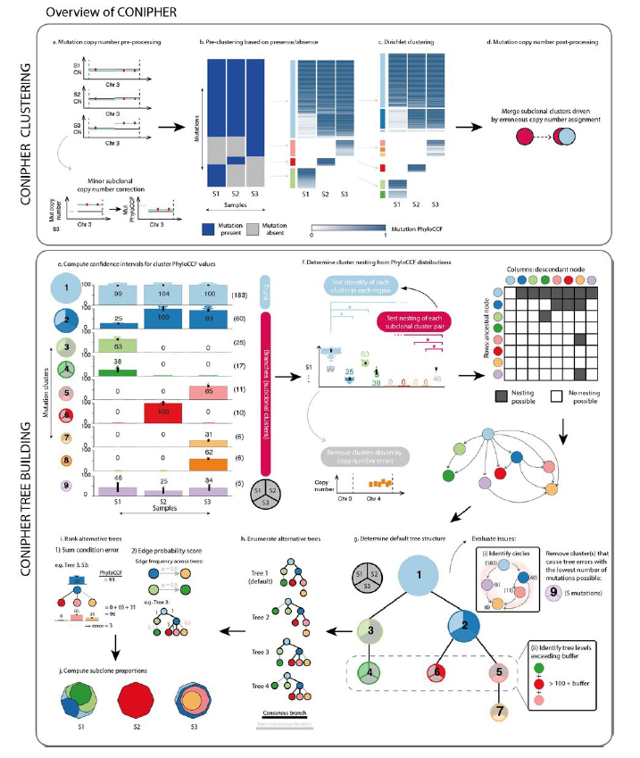
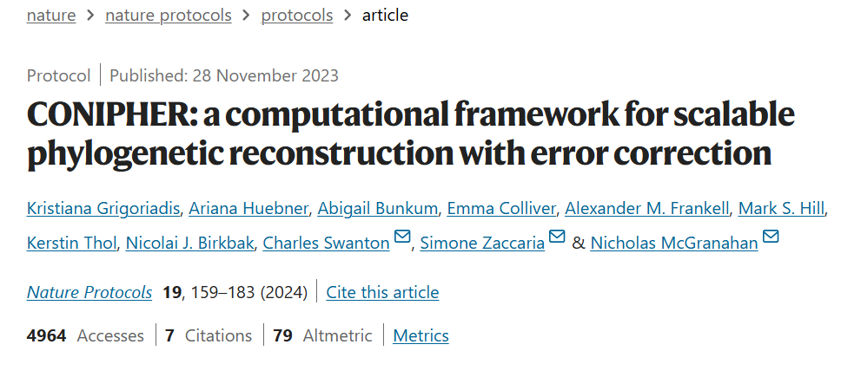
CONIPHER Clonal Evolution
Infers the clonal composition of samples and reconstructs
phylogeny, using mutations and copy numbers, while
correcting for errors.
Calculates an error corrected CCF ( Cancer cell Fraction – the proportion of cancer cells containing a specific mutation ) for each mutation - PhyloCCF
Mutations are clustered based on PhyloCCF, and phylogenetic reconstruction and clonal composition of samples are inferred.
Taken from Grigoriadis et al., 2023

Slide 5



Patient VHIO_40 Timeline
Plasma
D98
Plasma
D124
Plasma
D168
Plasma
D229
Plasma
D263
Plasma
D274
Plasma
D315
Plasma
D392
Plasma
D419
Plasma
D467
Primary
Tumor
D0
PDX/Plasma
D30
First Line
Trametinib + Dabrafenib
+ Panitumumab
Second Line
FOLFOX + BEV
Third Line
FOLFIRI + AFB
Primary Tumor :
Colorectal
Metastasis :
Liver,lung,lymph
MSS
~ 6 months
~ 2 months
~ 6 months
BRAF inhibitor
START_1L | END_1L | PD_1L | BR
D33 | D199 | D224 | PR
START_2L | PD_2L | BR
D237 | D297 | PD
START_3L | PD_3L | BR
D318 | D497 | SD
Whole Exome Sequencing

Slide 6
Mutations across the Timeline
PDX
P2
P3
P4
P5
P6
P7
P8
P9
P10
P11
Tumor
P1
2L
FOLFOX + BEV
3L
FOLFIRI + AFB
1L
Trametinib + Dabrafenib +
Panitumumab
1L
2L
3L
1L
2L
3L
General decrease in the number of mutations and their allele frequencies in cfDNA samples during the treatment

Slide 7
Mutation overlaps across the Timeline
PDX
P2
P3
P4
P5
P6
P7
Tumor
P1
2L
FOLFOX + BEV
1L
Trametinib + Dabrafenib +
Panitumumab
1L
2L
Large number of shared mutations between Tumor, PDX and baseline cfDNA samples
Low overlap with 1L samples and higher overlap with 2L samples

Slide 8
Mutation overlaps across the Timeline
PDX
P2
P3
P4
P5
P6
P7
P8
P9
P10
P11
Tumor
P1
2L
FOLFOX + BEV
3L
FOLFIRI + AFB
1L
Trametinib + Dabrafenib +
Panitumumab
1L
Shared mutations mostly occur between
Tumor, PDX, baseline cfDNA, and 2L samples
2L
3L

Slide 9
Driver Mutations identified in Tumor and plasma cfDNA samples
PDX
P2
P3
P4
P5
P6
P7
P8
P9
P10
P11
Tumor
P1
2L
FOLFOX + BEV
3L
FOLFIRI + AFB
1L
Trametinib + Dabrafenib +
Panitumumab
Driver mutations were obtained using the Cancer Genome Interpreter (https://www.cancergenomeinterpreter.org/home) and
known genes implicated in Colorectal cancer ( Cornish et al. Nature, 2024 )
1L
2L
3L

Slide 10
Driver Mutations and Tumor fractions
PDX
P2
P3
P4
P5
P6
P7
P8
P9
P10
P11
Tumor
P1
2L
FOLFOX + BEV
3L
FOLFIRI + AFB
1L
Trametinib + Dabrafenib +
Panitumumab
1L
2L
3L
1L
2L
3L
Samples with BRAF mutation and non-zero tumor fraction were considered for Clonal evolution analysis

Slide 11
Clonal Evolution of mCRC during targeted therapy
PDX
P6
P7
Tumor
P1
2L
FOLFOX + BEV
3L
FOLFIRI + AFB
1L
Trametinib + Dabrafenib +
Panitumumab
C2
C1 : 75 SNVs
C2 : 68 SNVs
C3 : 31 SNVs
C4 : 13 SNVs
C6 : 7 SNVs
C3
C6
C4
Driver mutations occur in the parent cluster
C1
CONIPHER clonal structure and evolutionary tree

Slide 12
Clonal Evolution of mCRC during targeted therapy
PDX
P6
P7
Tumor
P1
2L
FOLFOX + BEV
3L
FOLFIRI + AFB
1L
Trametinib + Dabrafenib +
Panitumumab
C2
C3
Tumor
PDX
P1
C6
P6
P7
C1
C4
Longitudinal clonal composition in each sample
CONIPHER clonal structure and evolutionary tree

Slide 13
Patient VHIO_14 Timeline
Primary
Tumor
D0
Plasma
D133
Plasma
D45
BRAF inhibitor
First Line
Encorafenib + Binimetinib + Cetuximab
~ 2 months
Primary Tumor :
Colorectal
Metastasis :
Peritoneal
MSS
START_1L | END_1L | BR
D49 | D105 | PR
Whole Exome Sequencing

Slide 14
Mutations across the Timeline
P1
BRAF inhibitor
P2
Tumor
1L
Encorafenib + Binimetinib + Cetuximab
General decrease in the number of mutations in cfDNA samples
Large number of shared mutations between Tumor
and cfDNA samples

Slide 15
Driver Mutations identified in Tumor and plasma cfDNA samples
P1
BRAF inhibitor
P2
Tumor
1L
Encorafenib + Binimetinib + Cetuximab
Driver mutations were obtained using the Cancer Genome Interpreter (https://www.cancergenomeinterpreter.org/home) and
known genes implicated in Colorectal cancer ( Cornish et al. Nature, 2024 )
BRAF allele frequency does not decrease substantially after 1L
Recurring Driver mutations

Slide 16
Clonal Evolution of mCRC during targeted therapy
P1
BRAF inhibitor
P2
Tumor
1L
Encorafenib + Binimetinib + Cetuximab
C1 : 162 SNVs
C2 : 8 SNVs
C3 : 5 SNVs
C4 : 5 SNVs
C1
C3
C2
C4
CONIPHER clonal structure and evolutionary tree
Driver mutations occur in the parent cluster

Slide 17
Clonal Evolution of mCRC during targeted therapy
P1
BRAF inhibitor
P2
Tumor
1L
Encorafenib + Binimetinib + Cetuximab
C1
C3
Tumor
P1
P2
C2
C4
Longitudinal clonal composition in each sample
CONIPHER clonal structure and evolutionary tree

Slide 18
Conclusions
WES of cfDNA provides a non-invasive approach for monitoring targeted therapy response
Longitudinal WES/cfDNA analysis provides a snapshot of mutational and copy number changes occurring through the therapeutic timeline of a patient, as well as the evolution of different clones
Clones emerging or disappearing during or after a line of treatment could provide insights to resistance or sensitivity to drugs administered
Larger cohorts of patients would allow for better insights into tumor heterogeneity and recurrence or remission of cancer following targeted therapy

Slide 19

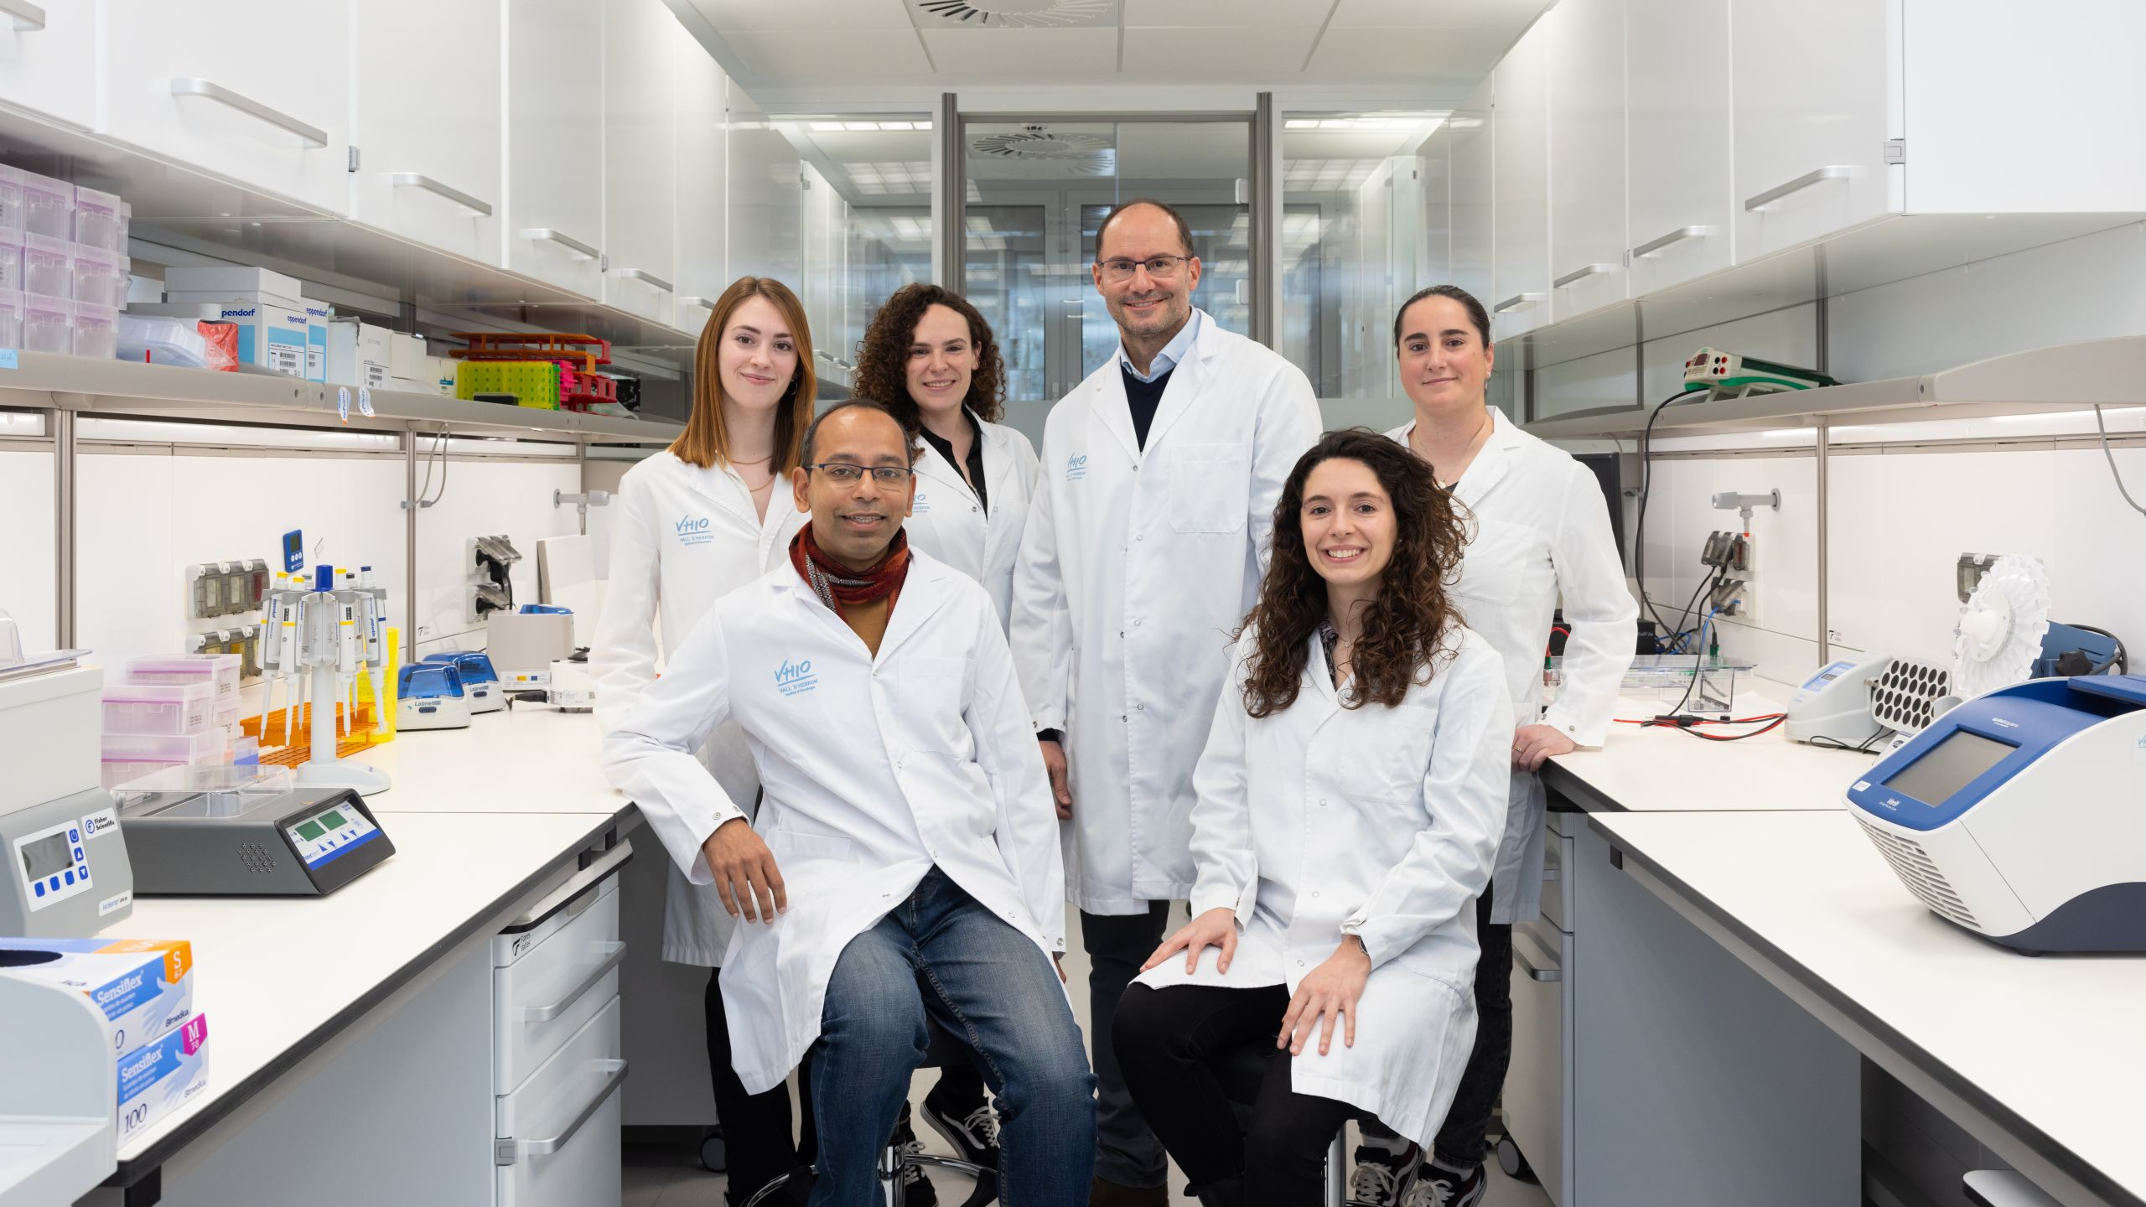
Thank you!
Rodrigo A. Toledo
Ana Belen Moreno-Cardenas
Carlota Arenillas
Alma Calahorro
Aya Louhamane
Alessandra Bonilla
Armando Mel

