Slide 1
Welcome to the
ELBS General Assembly Meeting 2024
26th of November (9 am – 6 pm)
Auditorium, PRBB, Barcelona, Spain

Slide 2
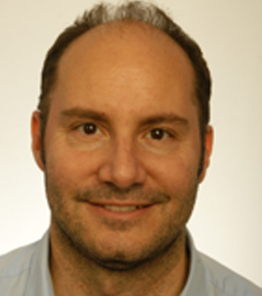
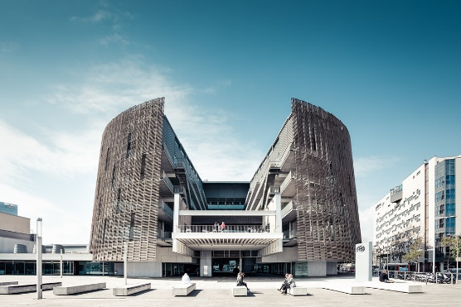

ELBS GA in Barcelona – 26./27.11.2024
THANK YOU!
To our co-organizers Rodrigo Toledo (VHIO) and the CIBERonc team for helping us with organizing this event,
finding this great location and having us here in Barcelona!
Rodrigo De Almeida Toledo
VHIO

Slide 3
Guidelines for a fruitful event:
Registrations: 131 participants across 78 institutions
To ensure a productive and enjoyable experience for everyone, please observe the following guidelines:
⌚
📱
🎤
☀
Punctuality:
Please be on time for all sessions.
Arriving promptly ensures that we stay on schedule and respect the time of our speakers and fellow attendees.
Mobile Phones:
Keep your mobile phones on silent mode during sessions to avoid disruptions.
If you need to take a call, please step outside the meeting room.
Speakers:
Please meet with the technicians 5 minutes before your talk so they can attach your microphones.
As we have a tight schedule, please keep an eye on your time. The clock at the edge of the stage will help you with this.
Last, but not least:
Enjoy the meeting!
Take this opportunity to actively contribute to discussions, connect to members, and identify future initiatives you would like to become involved in.☺

Slide 4

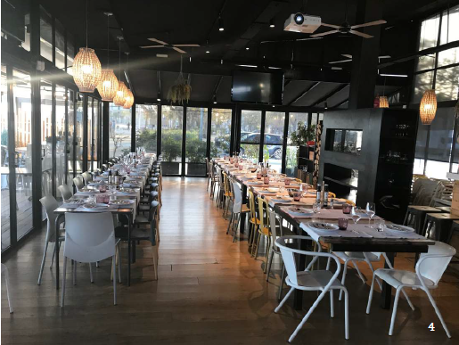
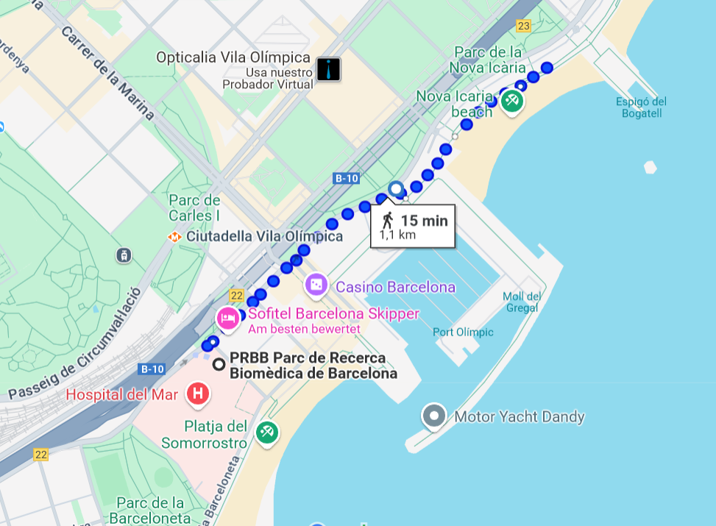
Joint Dinner – Restaurant Xiroi
Dinner: Tuesday, 26th of November
Address: Xiroi, Passeig Marítim de la Nova Icària, 38, Sant Martí, 08005 Barcelona
Menu Choice: Small card behind your name tag to remind you of your menu choiuce (meat, fish, vegetarian, vegan)
Restaurant opens at 6.30 p.m.
&
dinner starts at 7 p.m.
Offer: Walk together starting from 6.15 p.m. in front of the PRBB

